Slide 1
Polarized target status
05/06/2018
Norihiro DOSHITA

Slide 2
outline
Target material loading
TE calibration
Magnet commissioning
-- New field rotation procedure
Polarization test
Physics data taking
-- comparing to 2015
polarization and relaxation time
Issues to be followed
-- cooling water
-- EIO tubes
Man power

Slide 3
Target material loading (17/4)
17/4 : loading material
Preparation
- loading platform
- nitrogen bath (forgot cleaning)
- leak detector
- LN2 dewar
- warming DR and magnet
Material
- upstream material in 2015 → downstream in 2018
- downstream material in 2015 → upstream in 2018
- added about 50 cc (20 -25 g ) of SMC material
- downstream socks in 2015 was cleaned in 2017

Slide 4
TE calibration (20/4 -24/4)
Test of the communication between NMR and Magnet control system with Sylvain on Friday morning
( - dipole test was done from Thursday night to Friday morning)
Setting Trim coils → same as in 2015
Installed of He3 vapour pressure system
Filling liquid helium of 10 m^3 gas in the mixing chamber (from Thursday afternoon )
Started at 18:00 on Friday (1.44K)
Started 2nd temperature point on Saturday 16:30 (1.27K)
Started 3rd point on Sunday 16:10 (0.98 K)
Started 4th point on Monday 11:00 (2nd 0.98 K)
Target shift for TE calibration
Thanks to Vincent, counted in the normal shifts
Auto system stopped twice, otherwise working well

Slide 5
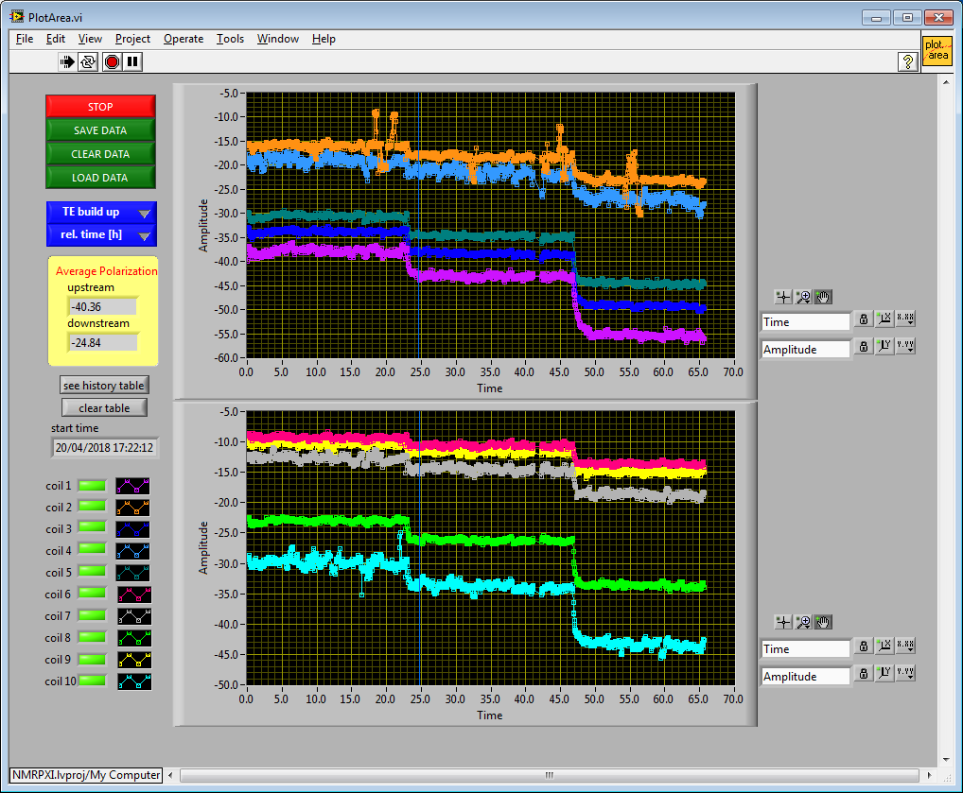
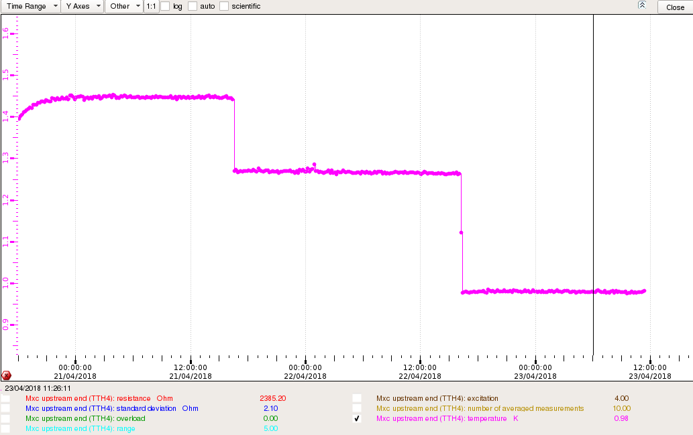
TE calibration in Apr. 2018
21/04/2018 16:30
Start pump#4
22/04/2018 16:10
Start pump#1
1.45 K
1.27 K
0.98 K

Slide 6
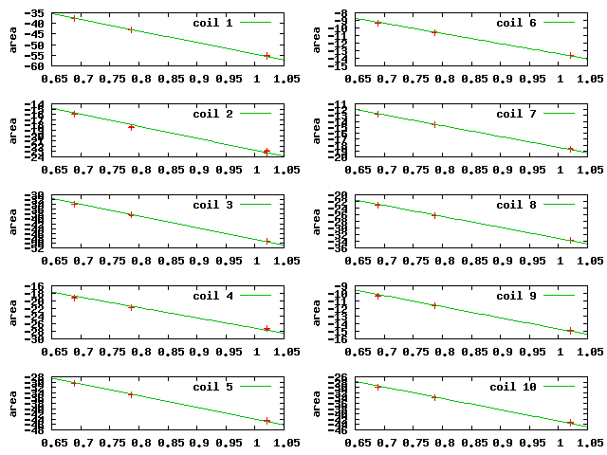
4 temperature points

Slide 7
July in 2015

Slide 8
Temperature at TE calibration
He3 vapor system did not work well.
TTH4 and TTH5 available
Correction of resistance @ 2.5T
- data taken Tuesday morning

Slide 9
Calibration constants (NMR signal area @ TE 1K)
coil1 = -54.4342 +/- 0.1816 (0.3335%)
coil2 = -22.7626 +/- 0.1136 (0.4988%)
coil3 = -48.4761 +/- 0.1896 (0.3911%)
coil4 = -27.1523 +/- 0.2678 (0.9863%)
coil5 = -43.8718 +/- 0.1447 (0.3298%)
coil6 = -13.3982 +/- 0.03178 (0.2372%)
coil7 = -18.3778 +/- 0.05888 (0.3204%)
coil8 = -33.131 +/- 0.105 (0.317%)
coil9 = -14.6842 +/- 0.07668 (0.5222%)
coil10 = -42.6571 +/- 0.2014 (0.4721%)

Slide 10
 |  | Magnet Commissioning in 2018
20/3 | MSS Trim | Quench back heater for trim coils, control currents
20/3 | Solenoid | Power ON (10 A)
21/3 | MSS Sol | Slow discharge of solenoid
21/3 | MSS Dip | Slow discharge of dipole
22/3 | MSS Sol | Quench back heater for solenoid, fast discharge at 70 A (6 times)
22/3 | MSS | Resistance of current leads without helium flow
28/3 | Sol | Full current of 646 A
28/3 | Dip | Full current of 590A
28/3 | Sol | Stability test
29/3 | Dip | Stability test
29/3 | MSS | Safety for filed rotation (Logics of “Tiroir de Securité” )
 | Sol Dip | Present field rotation procedure (longitudinal ←→transverse)
 | Sol Dip | New field rotation procedure (longitudinal ←→transverse)
20/4 | Sol | TE mode procedure
 | Sol | Field homogeneity with material

Slide 11
Issues on the magnet commissioning
Successfully done : Fabrice supported a lot.
Modification
- magnet coil voltage monitoring cards for current detection (23/3)
- new MSS program
- new power convertor control system (4/4)
Magnetic filed warning sign
Magnet field direction
- sol : + current → point to downstream
(opposite from 2015)
- dip : + current → point to up
( another intervention foreseen during LMD)

Slide 12
New procedure test result
0.50 % loss in 2015 from sol. to dip. (from dip. to sol.) with trim coils OFF
< 0.10 % loss with trim coils ON oppositely in 2018 (new procedure)

Slide 13
Trim coils operation in 2015 (Transverse mode)
Dipole current
+650 A
Solenoid current
0 A
Time
Trim coils setting
+
0
-

Slide 14
Trim coils operation in 2018 (Transverse mode)
Dipole current
+650 A
Solenoid current
0 A
Time
Trim coils setting
+
0
-

Slide 15
Polarization test
28/4 : polarization first in this year
8/5 -82.7 % (up), +81.3 % (dwn) for 40h
After several tests before data taking started.
Upgrade target parameter monitoring at DCS
done by Jaakko and Christophe
→ see Christophe’s talk
-- still improving now

Slide 16
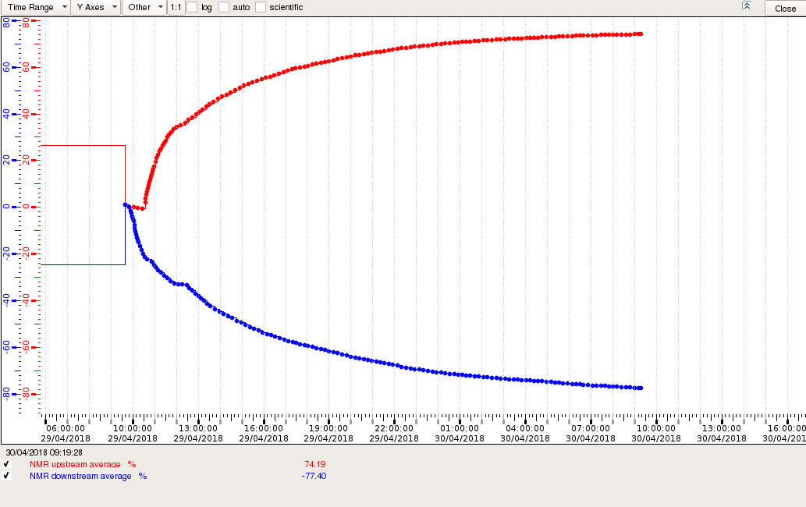
First polarization build up in 2018
+74 % in 24h
-78 % in 24h

Slide 17
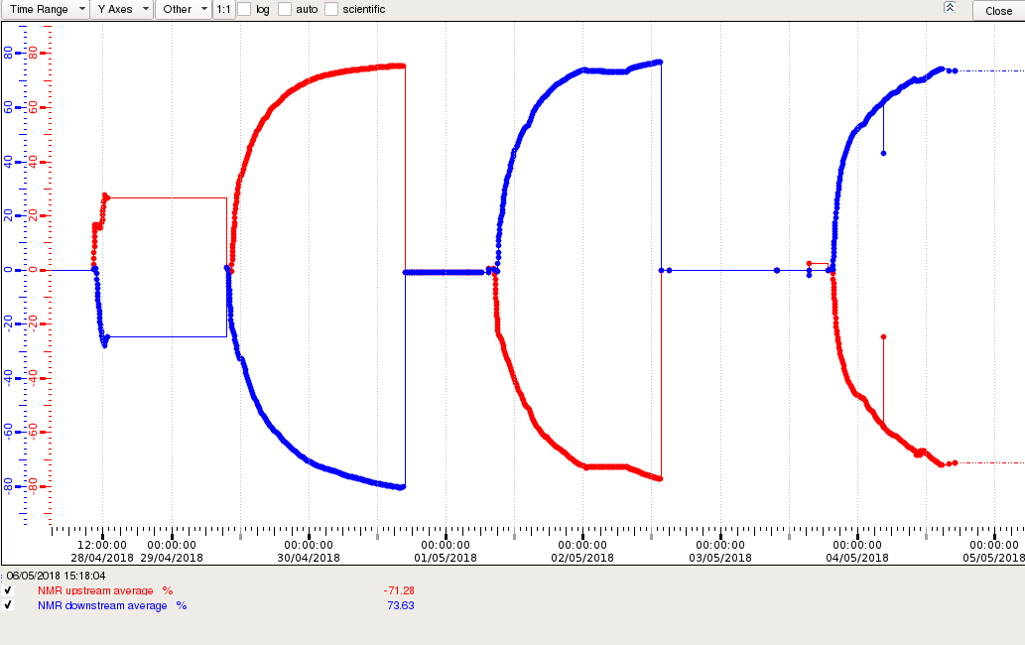
Polarizations

Slide 18
Polarization after 26h in 2015 and 2018
 | Upstream Cell | Downstream Cell
Positive Polarization | + 75.3 % + 75.0 % | +73.2 % + 78.2 %
Negative Polarization | - 73.5 % - 80.3 % | -72.2 % -79.4 %

Slide 19
Relaxation time with beam in 2015 and 2018
 | Upstream Cell | Downstream Cell
Positive Polarization | ~ 1200 h ~ 1500 h | ~ 1000 h ~ 1500 h
Negative Polarization | ~ 900 h ~ 1300 h | ~ 700 h ~ 1100 h

Slide 20
Relaxation time without beam in 2015 and 2018
 | Upstream Cell | Downstream Cell
Positive Polarization | 2070 h (3/9) 2890 h (4/6) | 1400 h (19/8)
Negative Polarization | 1250 h (19/8) | 1100 h (3/9) 2180 h (4/6)

Slide 21
Cooling water
Tap water (microwave EIO tube, back up for pumps)
→ temperature behavior known
Chilled water (Pump room air conditioner)
→ pump room temperature during summer
→ see Caroline’s talk
Raw water in pump room (Pumps )
Raw water inside hall (diffusion pump, NMR rack)

Slide 22
EIO tube problem
23/5 Wed. night : Kaori realized frequency jumped more than 100 MHz.
- power also lost control
24/5 Thur. : Investigated by Yuri
- too much reflection : isolator problem
- blocked cavity control :
Cannot generate the freq. for positive pol.
Spare isolator : arrived from Yamagata (4/6)
Cathode voltage change??
Spare EIO tube ??

Slide 23
Circulator
Circulator

Slide 24
Cathode voltage vs Frequency
5.7 kV

Slide 25
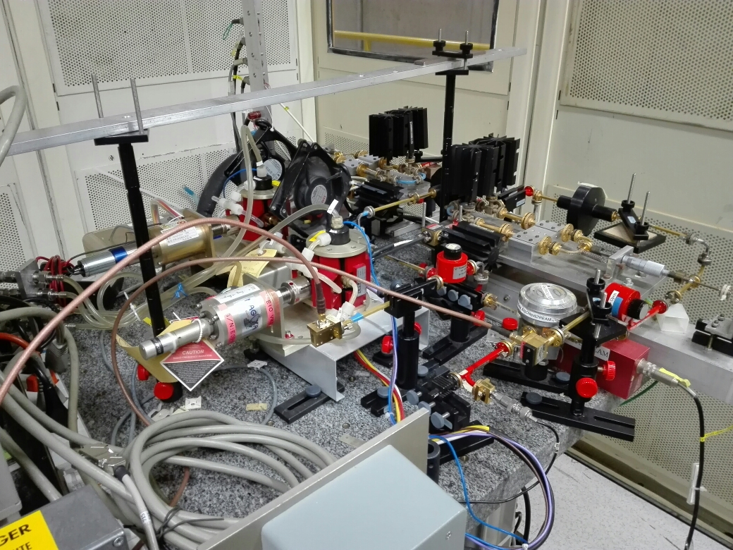
Microwave Preparation
EIO -
oscill.
Calibration of
Trombone microm.
attenuators

Slide 26
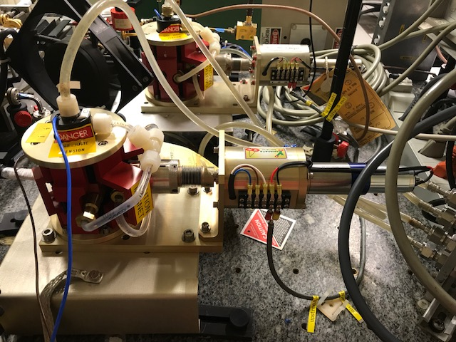
Motor
Wave guide
Cavity

Slide 27
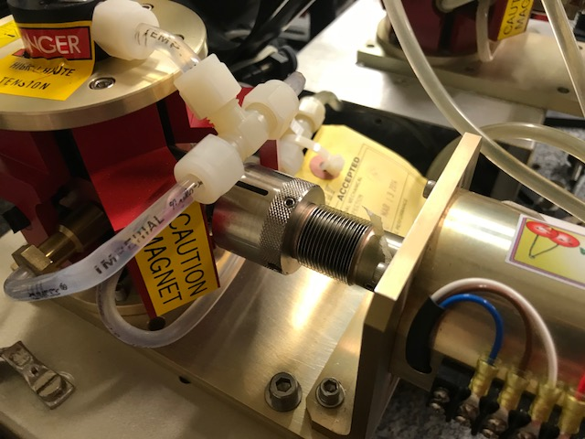

Slide 28
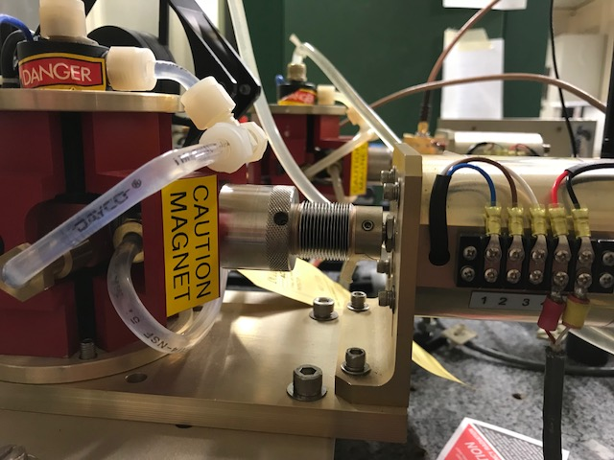
Potential meter
readout

Slide 29
EIO tubes in stocks

Slide 30
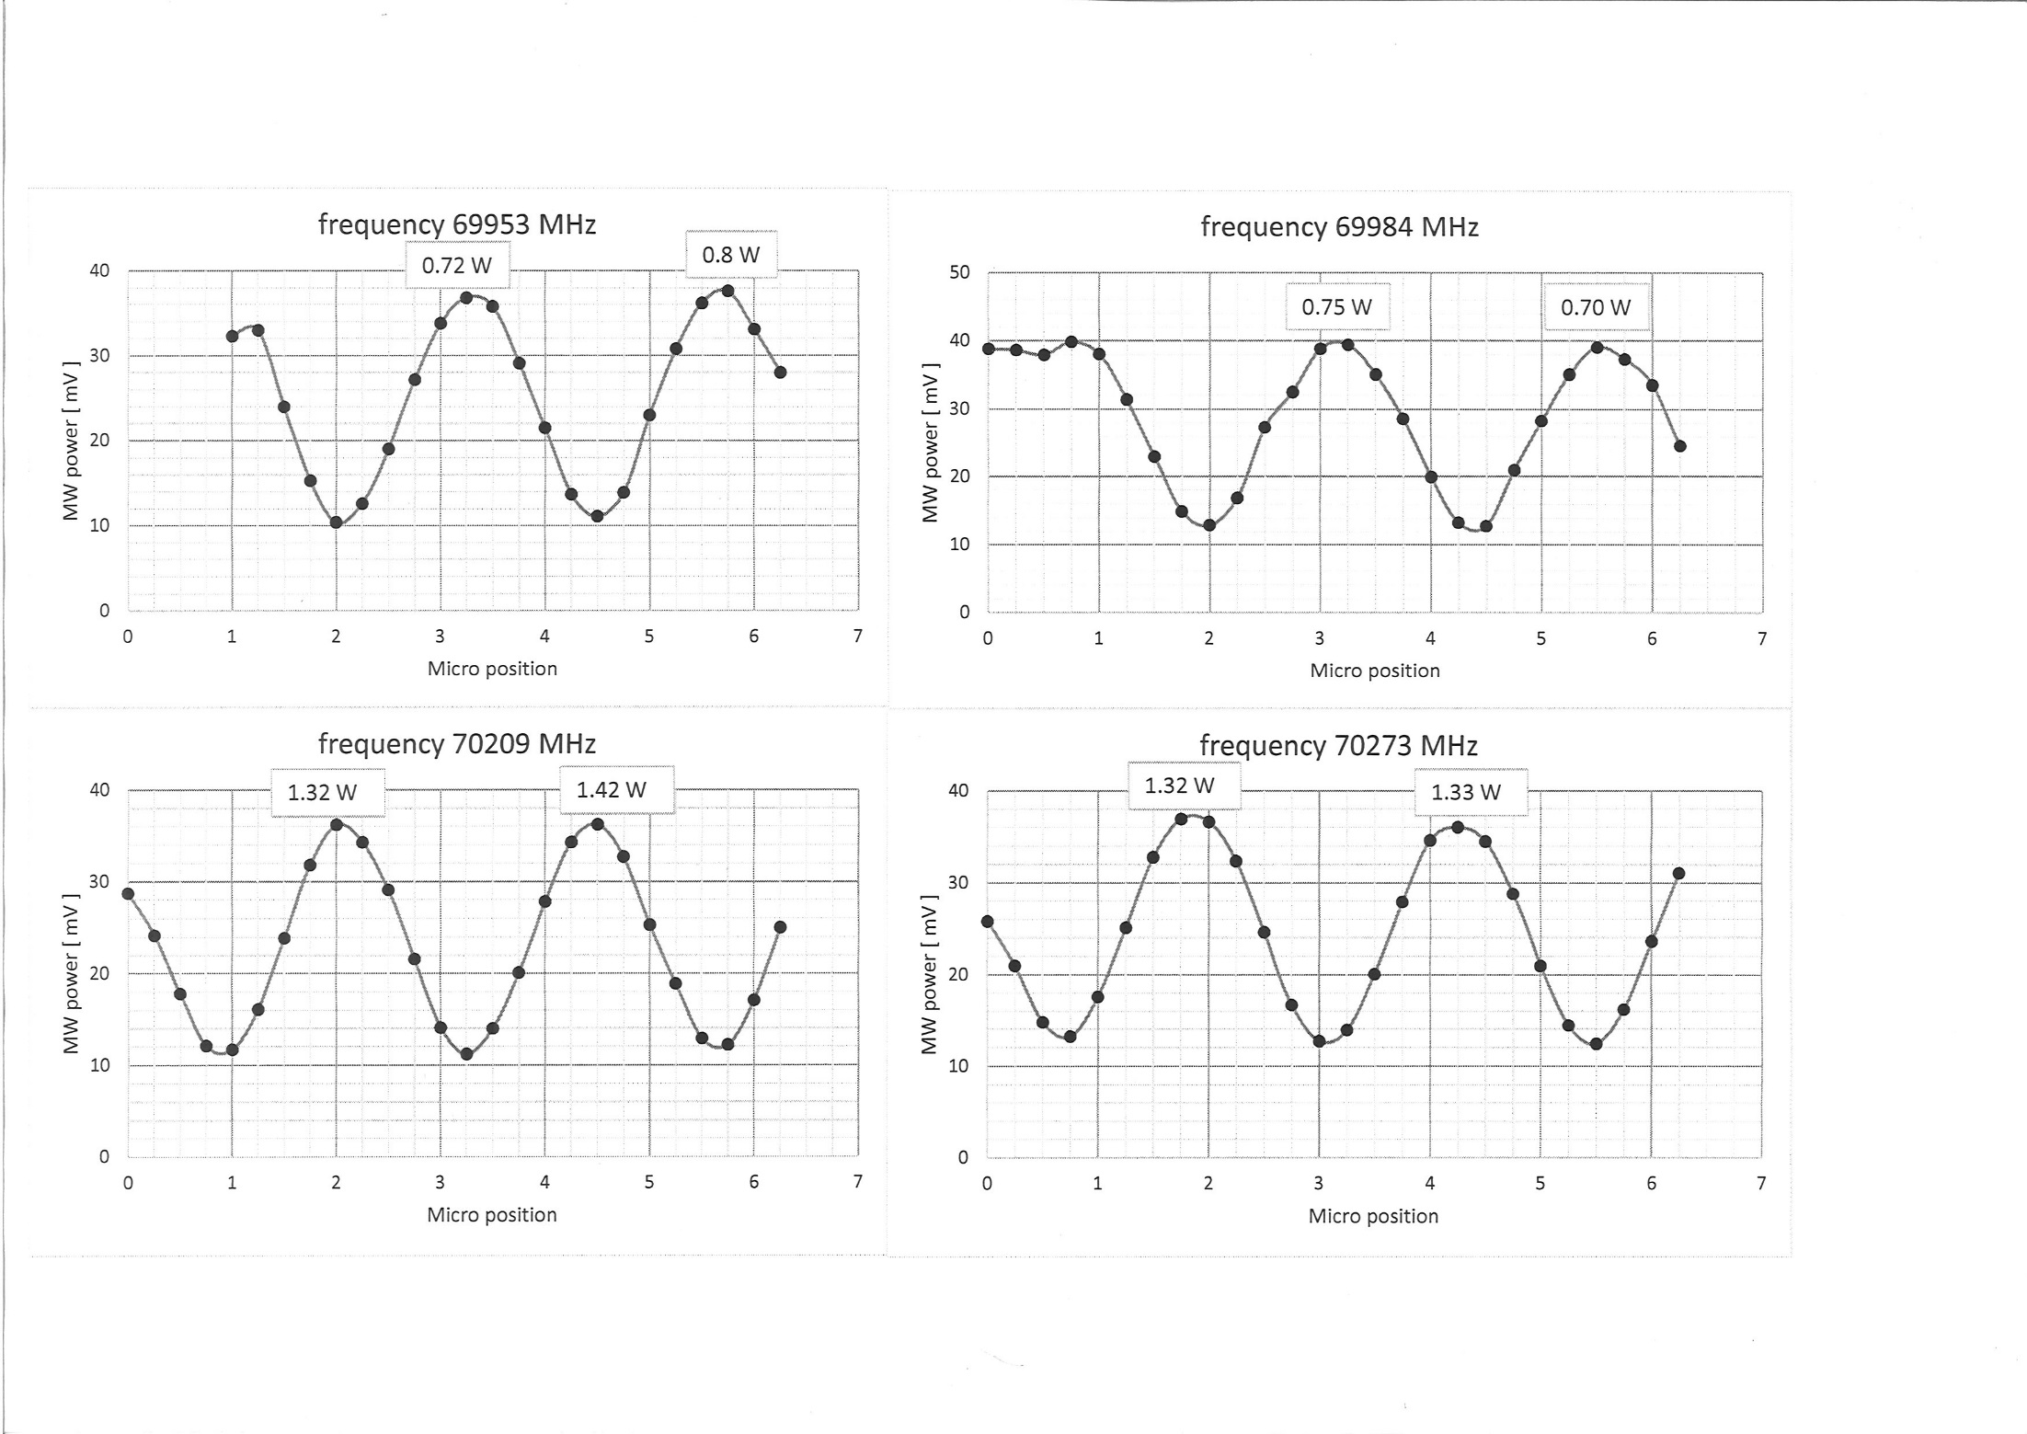
Upstream waveguide
Measured by Yuri
Power
69.953 GHz
69.984 GHz
Power
0.7 W
0.7 W
Power
70.209 GHz
70.273 GHz
Power
1.3 W
1.3 W
Trombone attenuator position

Slide 31
Man power availability
 | April | May | June | July | August | Sep | Oct | Nov | Dec
Jaakko
Michael
Genki
Kaori
Yuri
Nori
Stefan Runkel
26/5
16/5
??
28/6 – 5/7
??

Slide 32
Back up

Slide 33
After loading
Cleaned up He3 line by evacuation pumps
Restarted cooling dilution refrigerator (Tuesday evening)
- He4 pump system started on Thursday.
- He3 pump system : problem of relay
Leak check of o-ring on the flange
Leak check of the access tube (indium joint)
Leak check of isolation vacuum of the holder
Removed loading platform on Thursday

Slide 34
NMR system preparation
Installed cooling water line
Installed NMR cables after loading
Connected NMR cables after loading
- one cable was cut but fixed it
Tuning Q-curves
Installed radiation shield

Slide 35
Integrated area @ 1.27K
(very preliminary)
coil1 = -43.1713 +/- 0.02362 (0.05471%)
coil2 = -18.4606 +/- 0.09139 (0.495%)
coil3 = -38.439 +/- 0.01839 (0.04783%)
coil4 = -21.8121 +/- 0.06017 (0.2759%)
coil5 = -34.7328 +/- 0.02014 (0.05798%)
coil6 = -10.5719 +/- 0.0169 (0.1598%)
coil7 = -14.5848 +/- 0.02518 (0.1726%)
coil8 = -26.272 +/- 0.01477 (0.05624%)
coil9 = -11.6647 +/- 0.02001 (0.1716%)
coil10 = -33.9287 +/- 0.02973 (0.08763%)

Slide 36
Relaxation time of proton (NH3) at COMPASS
Year | Material | Program | Relaxation time
1998? SMC | OLD | Transverse | ~500 hours at 0.5T
2007 | OLD | Longitudinal /Transverse | ~4000 hours at 0.6T ~ 9000 hours at 1.0 T
2010 | OLD | Transverse | ~ 9000 hours at 0.6 T
2011 | NEW | Longitudinal | ~ 9000 hours at 2.5 T
2015 | NEW | Transverse | ~ 1200 hours at 0.6 T With hadron beam

Slide 38
MSS for field rotation
Dip
+465 A
Sol Dip
+80 A
-236 A
-
+236 A
-135 A
+135 A
Sol
-80 A
Done
-465 A
To be checked
Allowed region by MSS

