Slide 2
Cloud Storage for Data Intensive Sciences in Science and Industry
Hugo González Labrador – Storage Group
CHEP Sofia 2018
Notes:
Hello, my name is Hugo Gonzalez Labrador, I work at CERN in IT-ST group as the Service Manager of CERNBox and I would like to make a report on the CERNBox Service.

Slide 3
Outline
Challenges
Collaborations
Cloud Storage
Overview and summary
Notes:
This is the oultline of my talk, first I will start with the description of the service, the architecture, after I will show you some numbers abou the service and I will finish with the latest achievement and on-going work on the service.

Slide 5
What do we see coming
Interesting projects with new challenges
  High-Lumi LHC, Dune, ...
Just bigger?
  e.g. HL-LHC x10 more luminosity/storage x50 more compute (more complex events)
  New experiments: e.g. Dune
New technologies!
  Rethink the way HEP does data analysis
  Bigger batch capabilities?
    Natural sharing capabilities and seamless integration of large facilities with private resources

Slide 6
New technologies (1)
Role "industrial" solutions
  Marketed with different names
    Cloud, Big-data, ...
  Areas to get elements for our solutions
  Areas for collaborations
Second-level effect
  User-base expectations
    Why this is not as easy as {Dropbox, Facebook, } ?
    Attracting brilliant students
  More batch?
    We definitely know how to build a larger computer centres
    We should optimise the human part of the process (to make it more efficient):
      Private copies vs sharing
      Reinvent vs improve via reuse

Slide 7
New technologies (2)
Other sciences?
  Relatively straightforward
    We speak the "same" language
  They are going through similar (re)volutions in the computing models
    Data explosion
    Compute explosion
    Large distributed communities
Examples
  Earth Observations (e.g. EU JRC)
  Astronomy (SKA -Square Kilometer Array- Australia and South Africa)
  Support scientists proving infrastructure(CLoudstor - AARNET)
  Reach out future scientists (UP2U)

Slide 8
1 or 2 slides on
1 slide (just pictures and references to other CHEP talks)
  EOS
  CERNBox
  SWAN (including the BE)
1 Slide
  boxed on AWS
  boxed on Helix
  TOTEM

Slide 9
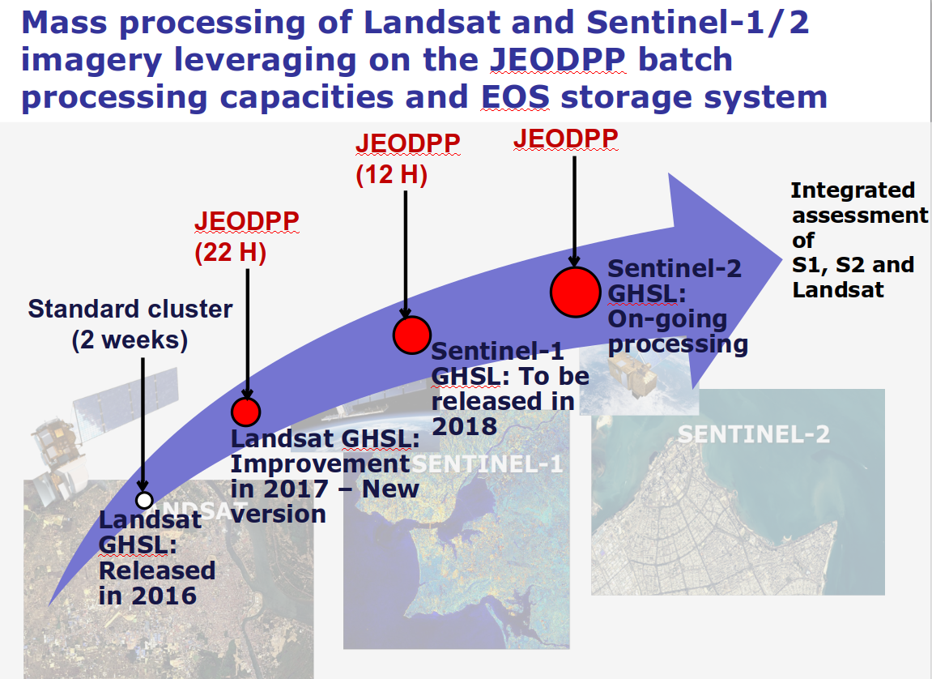
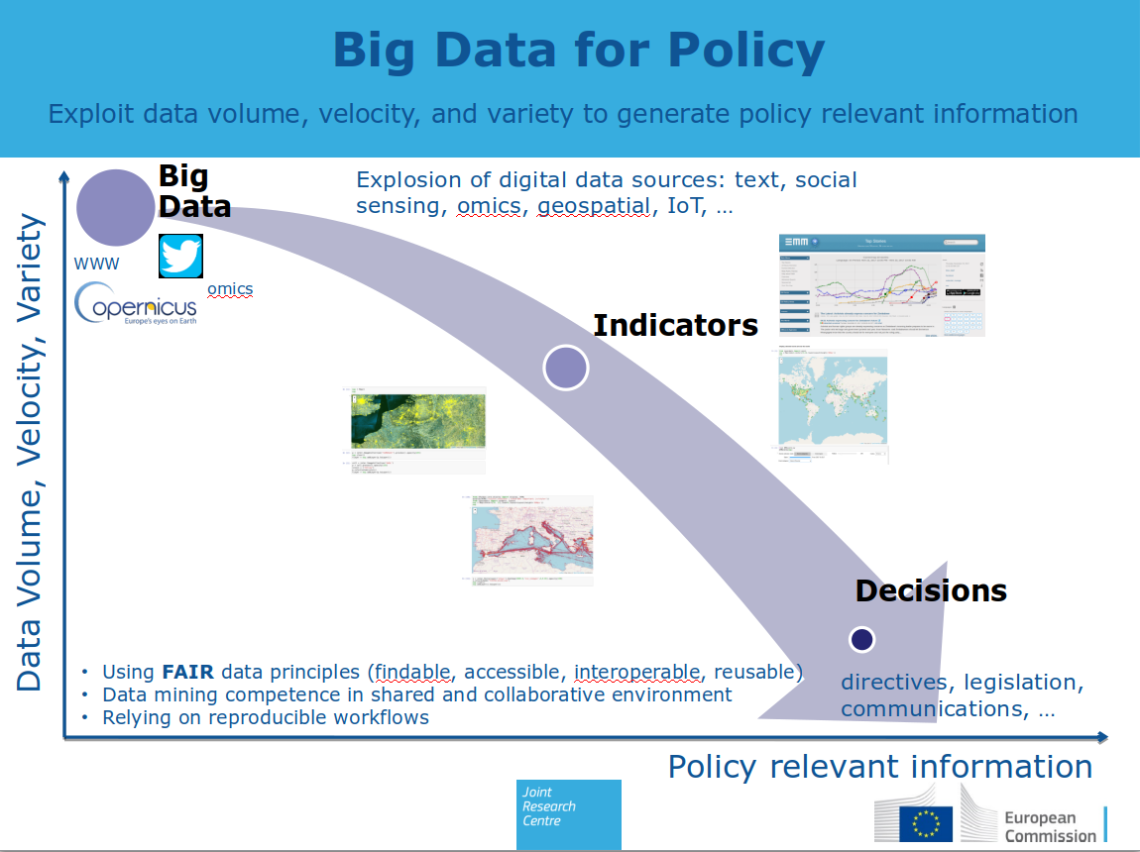
Earth observation (JRC)
More data
  More/better satellites
Turnaround time
  Importance of satellite data for everyday life
  Data --> Actionable information
    Agriculture
    Pollution
    Flood
    Climate changes
    ...
Slides from C. Macmillan (JRC):
  opening session at "Big data in Space",
  Oct 2017, Toulouse

Slide 10
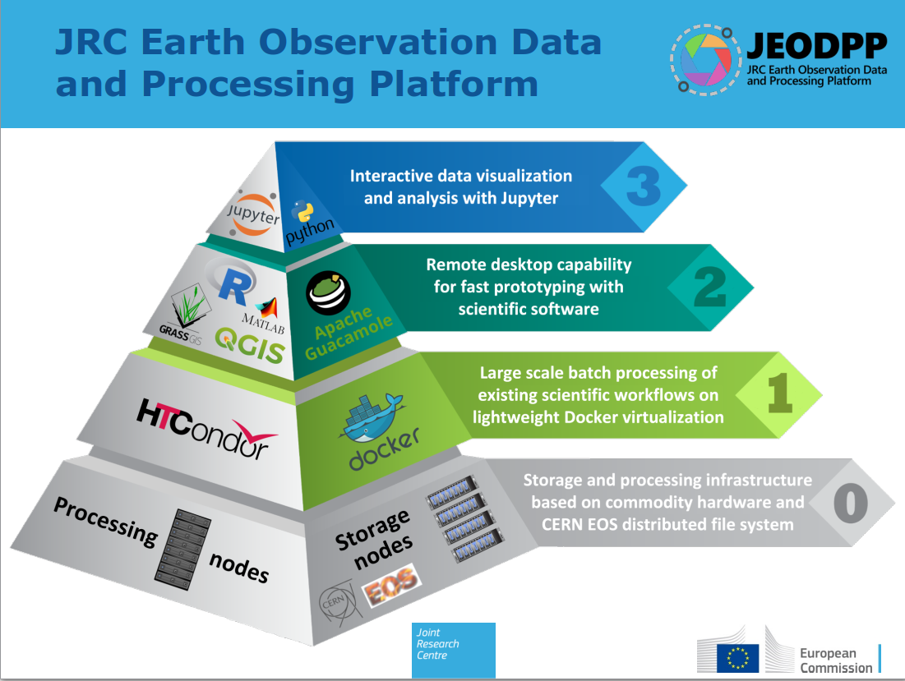
Similar tools as SWAN
P. Hasenohr and A. BurgerJRC presentation at CS3 2018 (Krakow)
P. Soille et al., FGCS, 2017, DOI: 10.1016/j.future.2017.11.007
Application specific
Commonalities with WLCG sites (Docker,HTCondor)
Commonalities with WLCG sites (EOS, OpenStack)

Slide 11
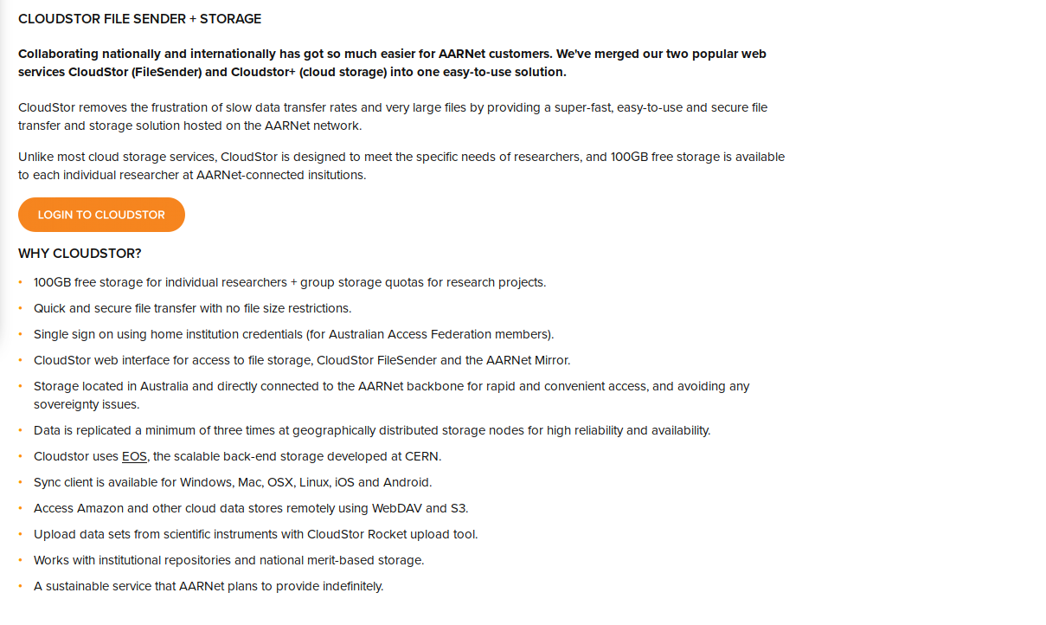
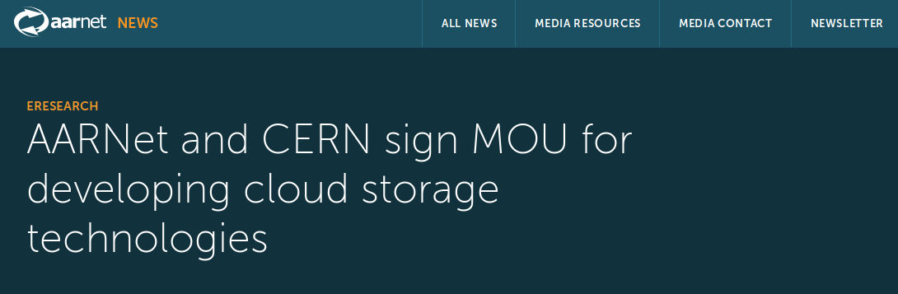
Similarities with some projects in HEP
Cloudstor (AARNET) is:
- Ditributed from the start
- Multi-science from the start
- Multi-platform from the start

Slide 12
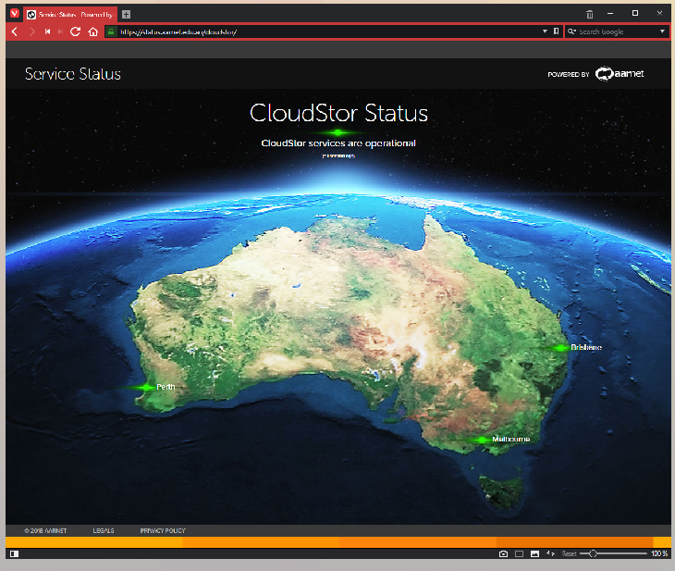
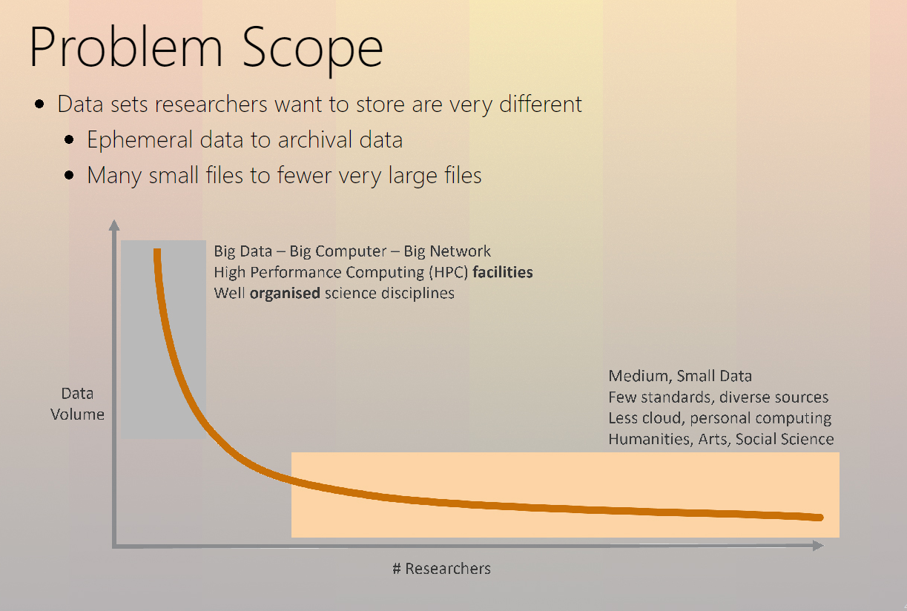
Cloudstor
Rocket to the Cloud – A Faster Way to Upload M. D'Silva (AARNET)
Presented at CS3 2018 (Krakow)

Slide 13
Steal slide to Luca (Comtrade)
Mention OpenLab collaboration

Slide 14
Steal slide to Kuba (UP2U)

Slide 15
Steal slides to Kuba (CS3 publicity)
History of companies at CS3
Why CS3 is important (see next ones with some of my ideas, to be completed by you, notably by Kuba)
"See you in Rome" slide

Slide 16
CS3
Started as a workshop to learn (from each other, including academia and companies) how to provide cloud storage for scientific communities
Right participant base
  HEP and non-HEP
  WLCG sites, HPC sites, University sites
  Academics, start-ups, established companies
We believe the drive of our community is an important factor of progress
  Which is needed (cfr HL LHC)
  Which can achieved by taking on board interesting technologies developed outside (cfr OwnCLoud, Jupyter, Docker)
  Need to join forces (cfr collbration on EOS with non-HEP initiative as JRC and AARNET
  University (UP2U) important as outreach but also as source of input (expectation of usage of our tools)

Slide 17
Overview and Summary
Notes:
Just to finish

Slide 18
Conclusions
HEP-developed software (CERNBox, EOS, SWAN) can boost the use cases of other sciences (JRC, AARNet) and constitute the backend for a new generation of services.
The challenge is to adopt cloud storage solutions into the main data analysis workflow.
Focus on human efficiency rather than only on machine performance, changes in the way people perform their analysis.

