Slide 1
WP3 – Gun and Injector
Massimo.Ferrario@LNF.INFN.IT
WP3 Meeting 2 – June 1, 2018

Slide 2
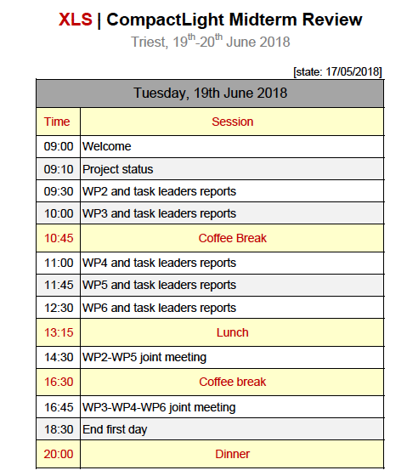

Slide 3
Previuous Discussion Summary
A self-consistent FEL parameter list is needed from WP2 as soon as possible. ➔ Swiss FEL as a reference?
Beam dynamics simulation support is needed from WP6.
We all agreed on the new description of WP3 Tasks, Deliverables are unchanged.
Sub-Task leaders have been nominated. Sub-Task leaders are supposed to lead the assigned work in collaboration with the other participating institutes and to provide to the WP leader their specific contribution for the Deliverables.

Slide 4
Deliverables
D3.1 - Preliminary assessments and evaluations of the optimum e-gun and injector solution for the CompactLight design, (=>M18).
D3.2 – A review report on the bunch compression techniques and phase space linearization, (=>M18).
D3.3 – Design of the injector diagnostics/beam manipulations based on a X-band cavities, (=>M36).
D3.4 - Design of the CompactLight e-gun and injector, with phase space linearizer (=>M36).

Slide 5
New Description of Tasks
(task leaders institutes in bold)
Task 3.1 - Gun Design (RF, Solenoid, Cathode, Laser, Diagnostics) => D3.1 M18 => D3.3 M36
  S-Band Gun RF Design (CNRS + IASA+UAIAT-INFN+ALBA )
  C-Band Gun RF Design (INFN +IASA+Sapienza)
  X-Band Gun RF Design (CSIC-IFIC + UAIAT+ Sapienza)
  DC Gun Design (TU/e )
  Laser/Photocathode (IASA+CNRS+INFN )
Task 3.2 - Compressor Design (Velocity Bunching, Magnetic Chicane) ) => D3.2 M18 => D3.3 M36
  S-Band Velocity Bunching (TU/e + IASA+ALBA)
  C-Band Velocity Bunching (INFN +IASA+TU/e )
  X-Band Velocity Bunching ( Sapienza+CERN+IASA+INFN )
  Magnetic Compressor (ST + CERN+INFN+CNRS)
  Task 3.3 – X-Band Transverse RF Deflector (Sapienza+ IASA+ ) => D3.3 M36
Task 3.4 - : RF Linearizer Design => D3.2 M18 => D3.3 M36
  X-Band RF Linearizer Design (Sapienza )
  K-Band RF Linearizer Design (ULANC +Sapienza )
  Passive linearizer (CNRS )

Slide 6
Thanks for your attention

Slide 7
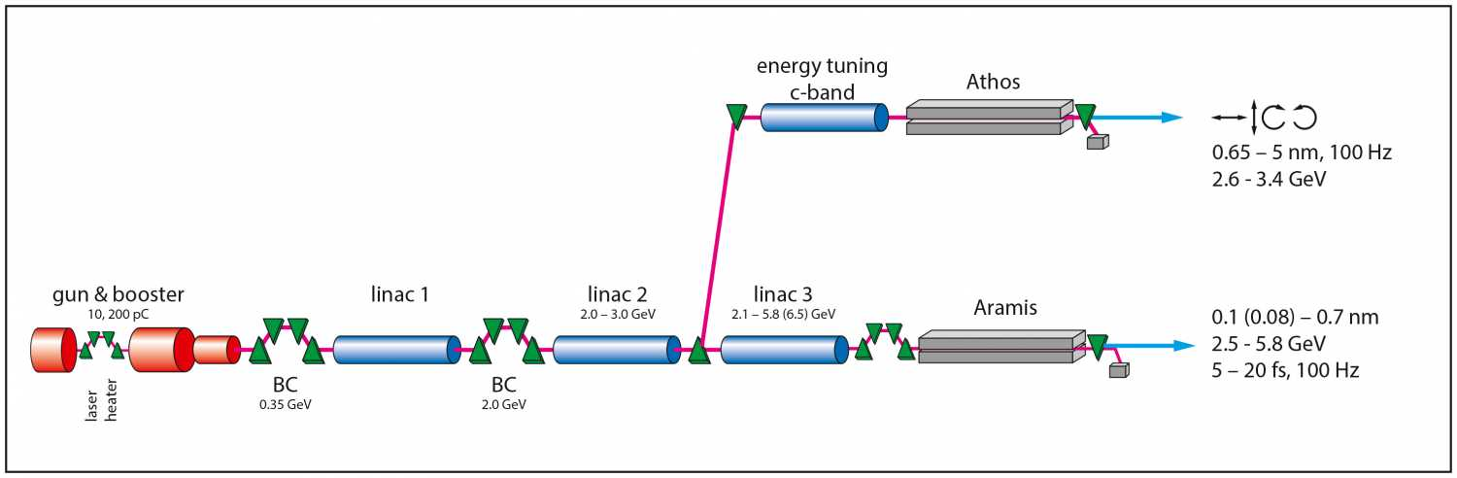
Relationship to other WPs: Jim View
WP6 – Beam Dynamics and Start to End Simulations
WP3 – Gun and Injector
WP5 – Undulators and Light Production
WP4 – RF Systems
Using SwissFEL as an example. https://www.psi.ch/swissfel/

Slide 8
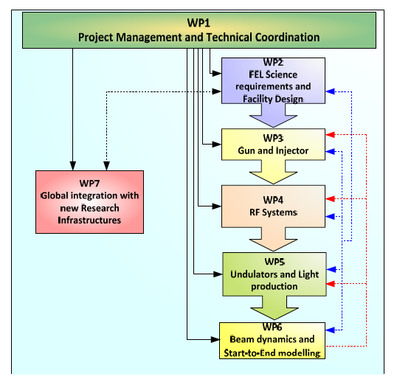

Slide 9
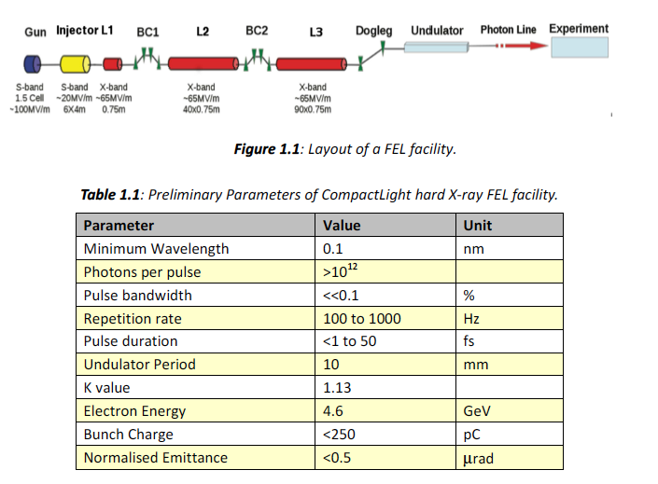
Tentative parameter list

Slide 11
Description of tasks
The work will be divided in four tasks:
Task 3.1 - Evaluation of an innovative full-X-band injector, inclusive of a higher-harmonic linearization in the K band. This ambitious goal aims to advance the recent achievements in the design of X-band guns and to explore the feasibility of RF components at unprecedented frequencies such as the K band. INFN will lead this task with the support of ST, CERN, UA-IAT, ULANC, TU/e, USTR.
Task 3.2 - Evaluation of a high-gradient C-band injector and S-band in jector inclusive of X-band linearizer and a magnetic chicane. INFN will lead this task with the support of all the partners working on this WP.
Task 3.3 - Design of CompactLight e-gun and injector inclusive of linearizer and a magnetic chicane. INFN will lead this task with the support of all the partners working on this WP.
Task 3.4 - Phase-space linearisers, and options for compact magnetic chicanes to achieve longitudinal bunch compression). Diagnostics tool based on X-band deflecting transverse cavity will also be considered. INFN will lead this task with the support of ST, CERN, UA-IAT, ULANC, URM, ALBA.

Slide 12
