Slide 1
WP3: C-BAND INJECTOR
D. Alesini
on behalf of the WP3 C-band injector working team*
* F. Cardelli, M. Diomede, G. Castorina, B. Spataro, M. Croia, M. Ferrario, A. Mostacci, C. Kourkoutis, N. Gazis

Slide 2
ORGANIZATION OF THE ACTIVITY ON C-BAND INJECTOR
1) C-Band gun design to reach the 240 MV/m peak field level
      1a) Optimum 2D profile to minimize mod. Poy. Vector, peak field etc… and to increase the gun mode separation for short RF pulses (F. Cardelli, D. Alesini, G. Castorina)
      1b) Powering schemes with RF pulse compressors and optimum coupling coefficient (D. Alesini, F. Cardelli)
      1c) Coupler design options:
      magnetic (F. Cardelli, D. Alesini)
      mode launcher (G. Castorina, B. Spataro)
      alternative schemes (F. Cardelli, D. Alesini)
2) C-Band TW accelerating structures design for the velocity bunching and acceleration: optimum irises tapering, structure length,… (M. Diomede, D. Alesini)
3) Beam dynamics simulations of the injector to reach the XLS requirements: gun gradient, TW structures accelerating field, solenoids strength, half cell length optimization…(M. Croia, M. Ferrario,…)
4) Solenoids design (C. Kourkoutis, N. Gazis)
5) Mechanical drawings of the injector module (N. Gazis)

Slide 3
ORGANIZATION OF THE ACTIVITY ON C-BAND INJECTOR
1) C-Band gun design to reach the 240 MV/m peak field level
      1a) Optimum 2D profile to minimize mod. Poy. Vector, peak field etc… and to increase the gun mode separation for short RF pulses (F. Cardelli, D. Alesini, G. Castorina)
      1b) Powering schemes with RF pulse compressors and optimum coupling coefficient (D. Alesini, F. Cardelli)
      1c) Coupler design options:
      magnetic (F. Cardelli, D. Alesini)
      mode launcher (G. Castorina, B. Spataro)
      alternative schemes (F. Cardelli, D. Alesini)
2) C-Band TW accelerating structures design for the velocity bunching and acceleration: optimum irises tapering, structure length,… (M. Diomede, D. Alesini)
3) Beam dynamics simulations of the injector to reach the XLS requirements: gun gradient, TW structures accelerating field, solenoids strength, half cell length optimization…(M. Croia, M. Ferrario,…)
4) Solenoids design (C. Kourkoutis, N. Gazis)
5) Mechanical drawings of the injector module (N. Gazis)

Slide 4
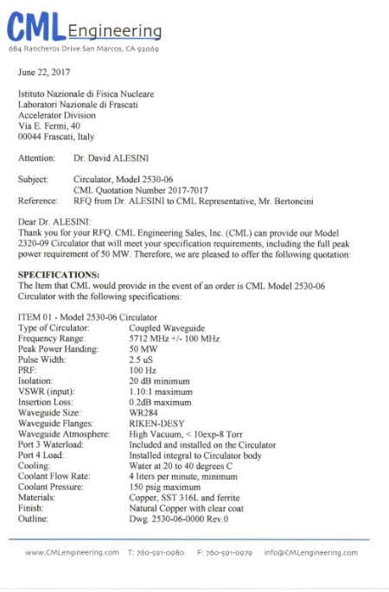
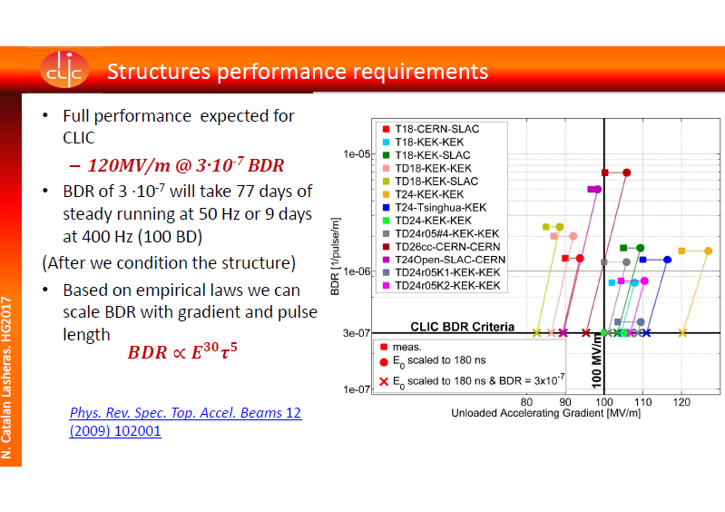
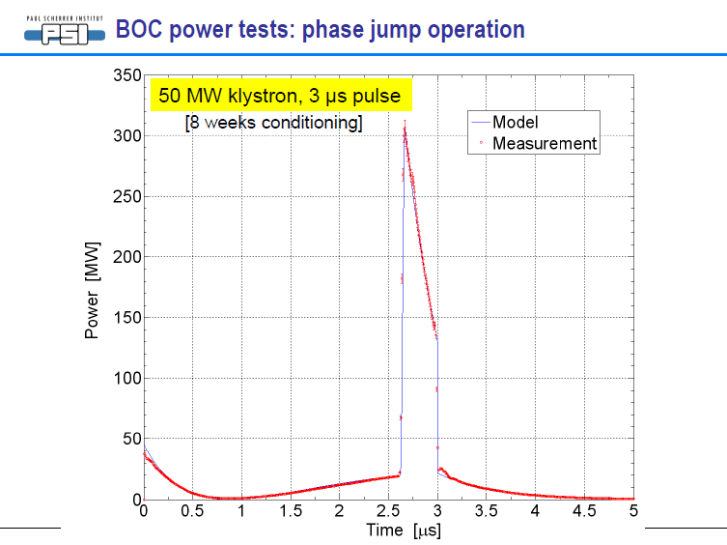
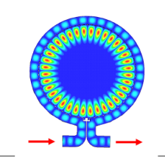
C-band gun design: general considerations
State of the art:
in X band (CERN/SLAC) with 180ns input pulse E_{surf}@irises≅240 MV/m BDR∼10⁻⁶
C Band klystrons with solid state modulators (Toshiba+Scandinova) are working up to 100 Hz with 3μs, 50 MW peak power available
Circulator (CML) available: 50 MW, 2.5 μs, 100 Hz
SLED/BOC C-band compressors available (PSI) with amplification factors >4 @ 200 ns flat top pulses
Consequences:
A C-Band gun filled in 180ns and working at 240 MV/m with BDR∼10⁻⁶ can work if properly designed;
Circulator can be used up to the 50 MW peak power level
SLED/BOC C-band compressors can be used (if necessary)
ULTRA FAST GUN

Slide 5
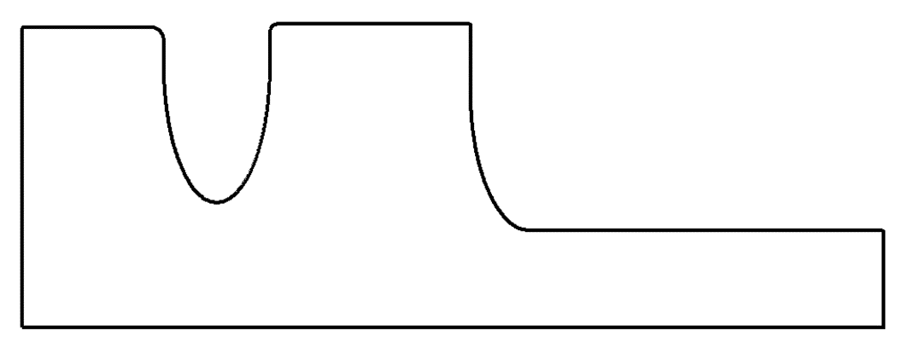
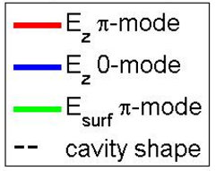
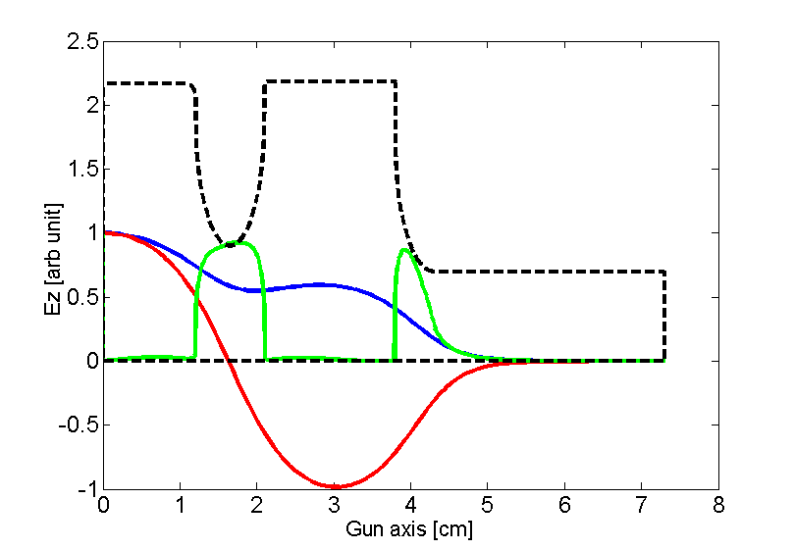
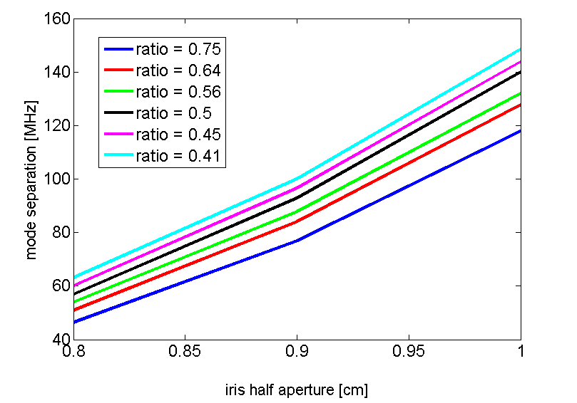
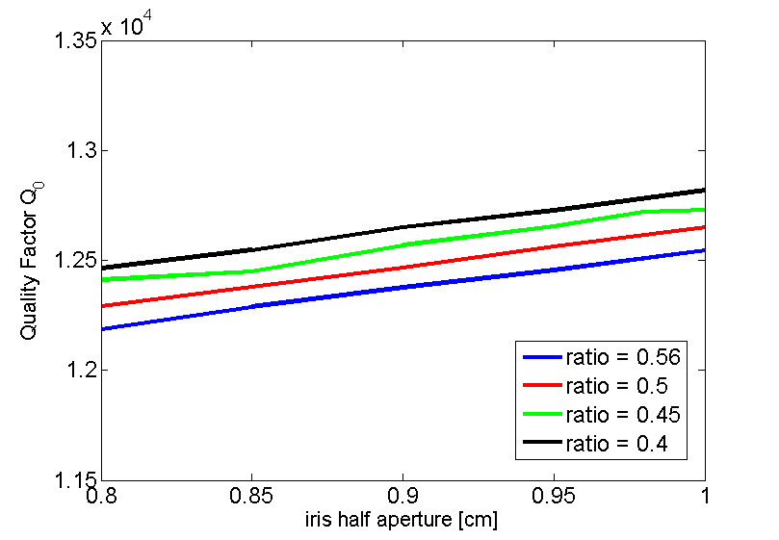
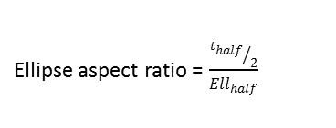
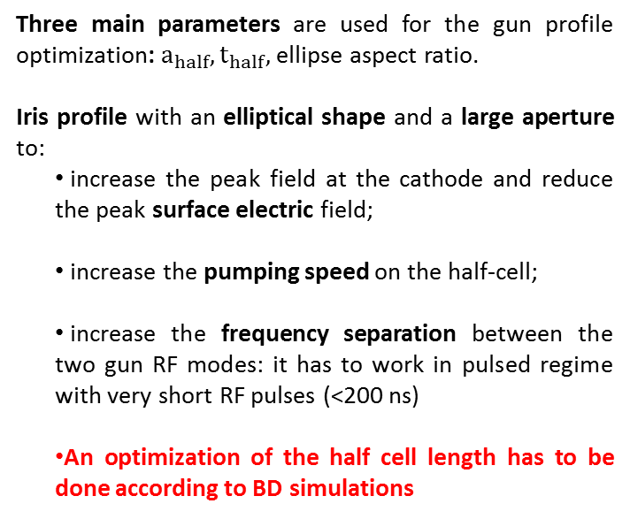
C-Band gun 2D DESIGN: mode separation, QUALITY FACTOR
Three main parameters are used for the gun profile optimization: $a_{half}, t_{half},$ ellipse aspect ratio.
Iris profile with an elliptical shape and a large aperture to:
      increase the peak field at the cathode and reduce the peak surface electric field;
      increase the pumping speed on the half-cell;
      increase the frequency separation between the two gun RF modes: it has to work in pulsed regime with very short RF pulses (<200 ns)
      An optimization of the half cell length has to be done according to BD simulations
t_{full}
t_{half}
Ell_{half}
Ell_{full}
b_{half}
b_{full}
a_{half}
a_{full}
d_{half}
d_{full}
Ellipse aspect ratio = $\frac{{t_{half}}/2}{Ell_{half}}$

Slide 6
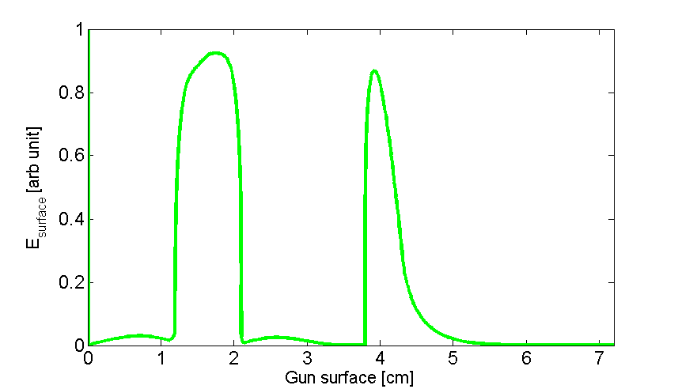
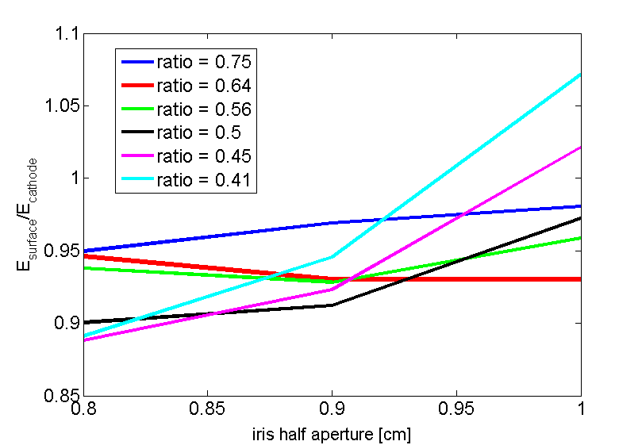
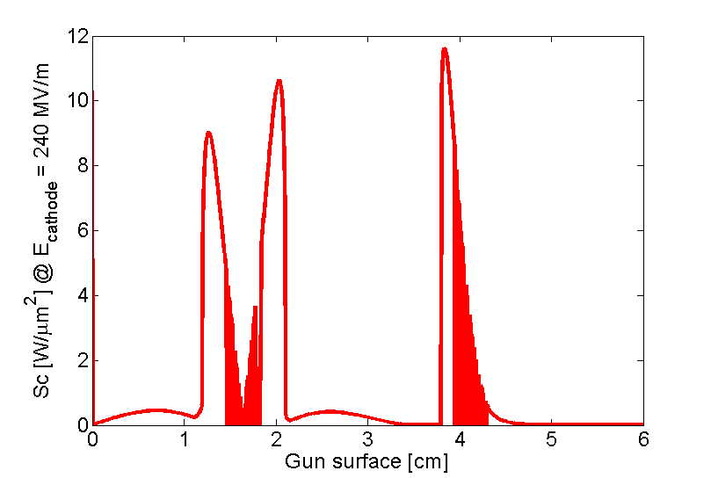
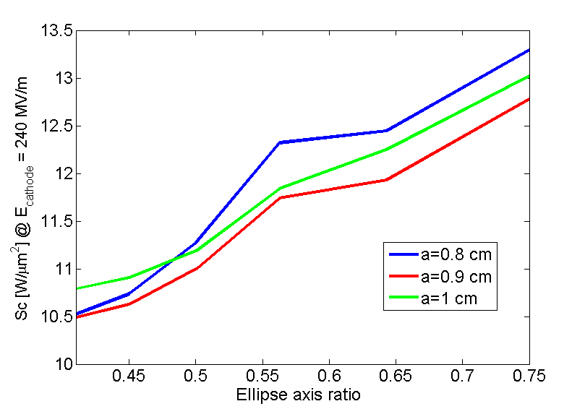
C-Band gun 2D DESIGN: MODIFIED POYNTING VECTOR
[Grudiev et al. PRST-AB 12, 102001 (2009)]
Cahode
first iris
second iris
Sc<4 W/µm² is the specified value for 10⁻⁶ BDR/m @ 200 ns RF pulse length. Expected BDR @ Sc=12 W/µm² 100-150 ns SW structures have to be evaluated/tested.

Slide 7
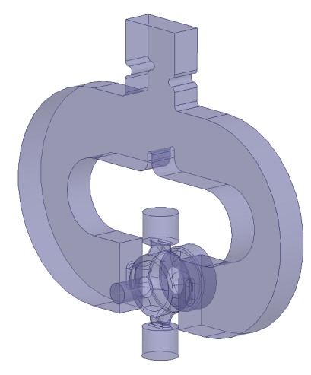
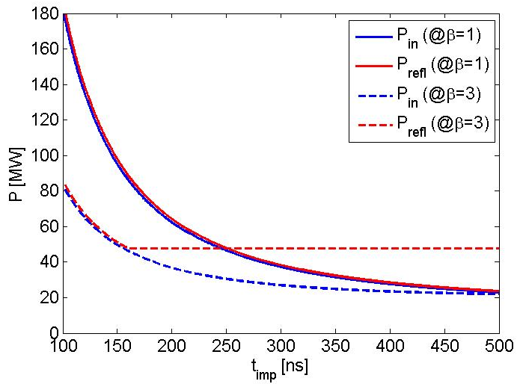
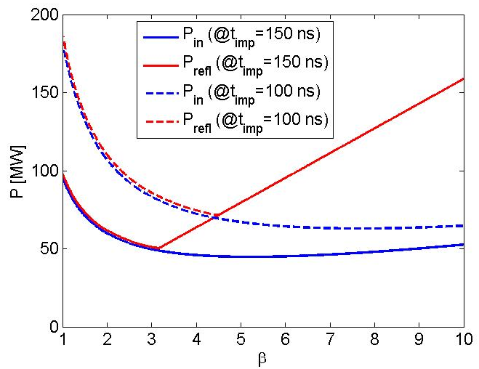
C-Band gun design: optimum coupling coefficient CALCULATION
We calculated the required input power (and reflected power) to reach 240 MV/m cathode peak field
P_{refl}
P_{in}
Considered C-Band gun parameters (2D and preliminary 3D calculations)
f_{π} | 5.712 GHz
Q₀ | 10450
τ_{F} | 140 ns
E_{cath} | 240 MV/m
P_{diss} @E_{cath}=240MV/m | 15.5 MW
Av. P_{diss} @100Hz, 200ns | <300 W
⇒A coupling coefficient equal to 3 allows keeping under control the required input power necessary to reach the 240MV/m on the cathode.
⇒With β=3 we can also keep at a reasonable value the reflected power
P_{diss}

Slide 8
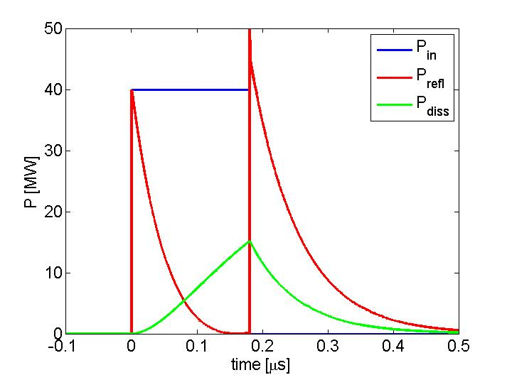
C-Band gun design: POWERING SCHEME CASE 1
-Klystron connected to the cavity through one circulator
-RF pulse length 180 ns
0.180 μs 40 MW
β=3
KLY
circ
GUN
240 MV/m cathode peak field

Slide 9
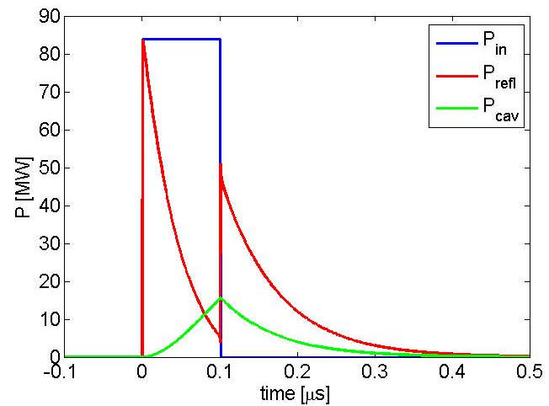
C-Band gun design: POWERING SCHEME CASE 2
-Klystron connected to the cavity through one RF compressor (P.C.) and two circulators
-RF pulse length 100 ns
100 ns, 85 MW
P.C.
X2.1
circ
β=3
KLY
circ
GUN
1-1.5 μs, 40 MW
Incident, reflected dissipated power from the gun
Short kly pulses
Small amplification factor
This scheme is flexible (we can detune the P.C. and go to the case 1) and allows exploring RF pulses even shorter than 100 ns

Slide 10
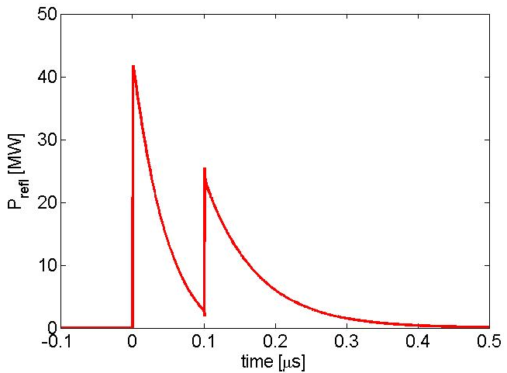
C-Band gun design: POWERING SCHEME CASE 3
-Klystron connected to the cavity through one circulator, one RF compressor and a power divider
-RF pulse length 100 ns
0.1 μs, 170 MW
BOC
X4.2
1/2
KLY
circ
LOAD
POWER
DIVIDER
β=3
2.5 μs, 40 MW
1/2
GUN
Reflected power to the circulator
Incident, reflected dissipated power from the gun

Slide 11
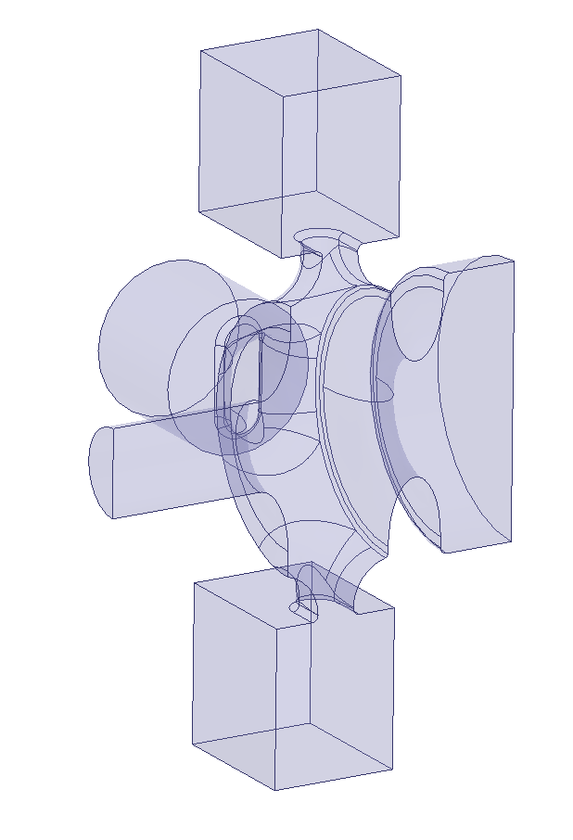
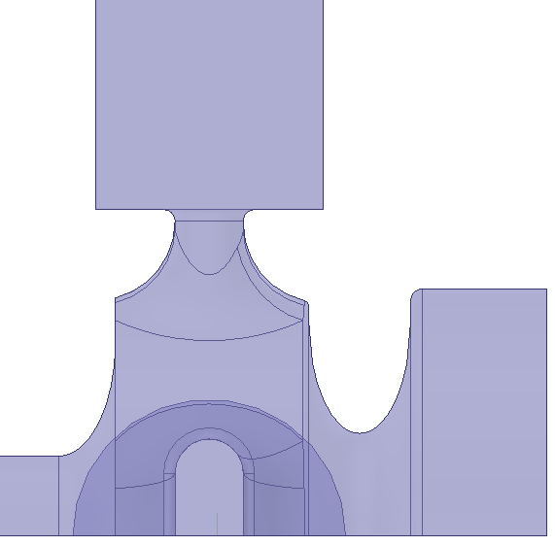
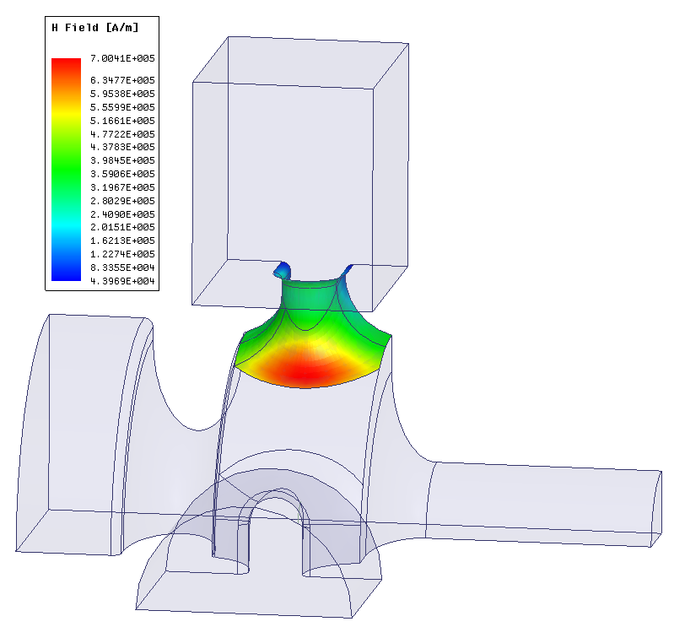
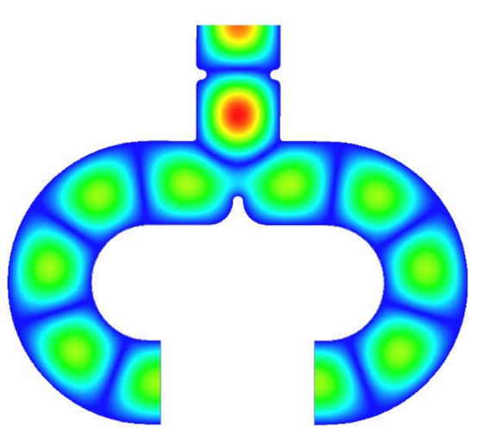


C-Band gun design: MAGNETIC COUPLING (1/2)
Magnetic Field Distorsion compensation:
Symmetric feeding with two input waveguides and two symmetric holes for quadrupole field compensation
Quadrupole field compensating hole and pumping port
Input waveguide
cathode
$$l$$
Pulsed heating:
The coupling window strongly rounded to reduce the peak surface magnetic field and, as a consequence, the pulsed heating.
$$t_{c}$$
Coupling apertures
Pumping ports:
The holes for quadrupole compensation can be used for pumping
Input waveguide
Laser injection:
On axis
Solenoid:
Can be put immediately after the gun and installed separately. Bore of the solenoid relatively small (no cathode compensation solenoids required, in principle)
Power splitter

Slide 12
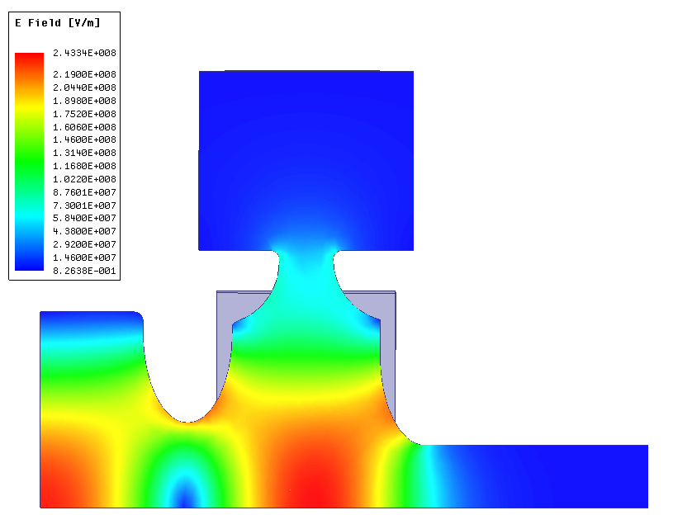
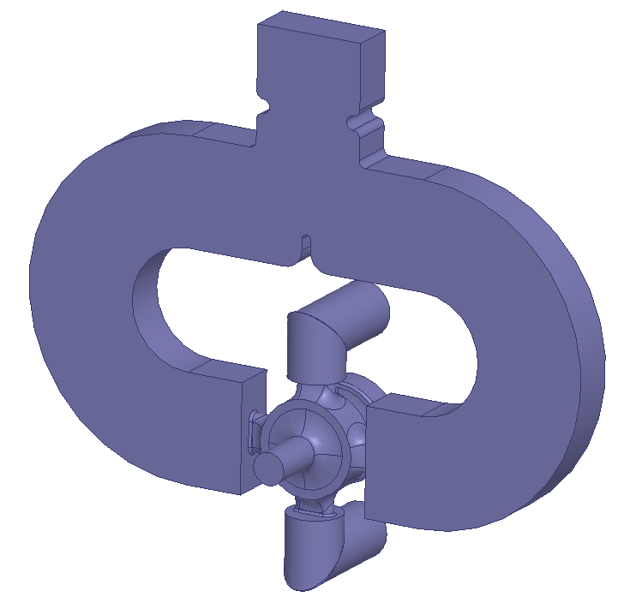
C-Band gun design: MAGNETIC COUPLING (2/2)
Electric field amplitude
Parameters
1
f_{π} | 5.712 GHz
Δf_{0-π} | ≈ 100 MHz
Q₀ | 10450
β | 3.08
τ_{F} | 143 ns
E_{cath} | 240 MV/m
P_{in} @240MV/m | 20.8 MW
Average P_{diss} @100Hz, 100ns | 150 W
S₁₁ @res | -5.86 dB
E_{surf}/E_{cathode} | 0.92
Sc max on surface @ 240MV/m | 10.63 W/µm²
Field flatness | <1%
T_{pulsed} @ 100 ns (square pulse) @ 200 ns (square pulse) | 47°C 66°C
Power
Splitter
d
a
2
3
Pin ≈ 21 MW
Power splitter
cathode
Beam tube
Vacuum pumping port

Slide 13
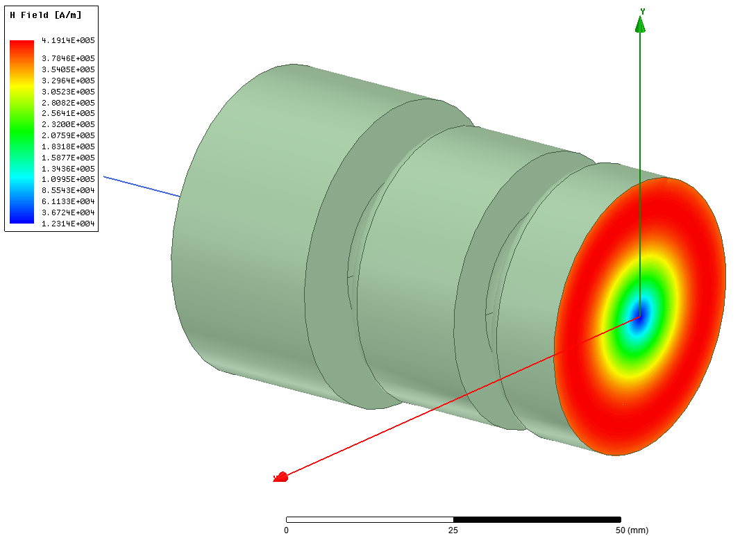
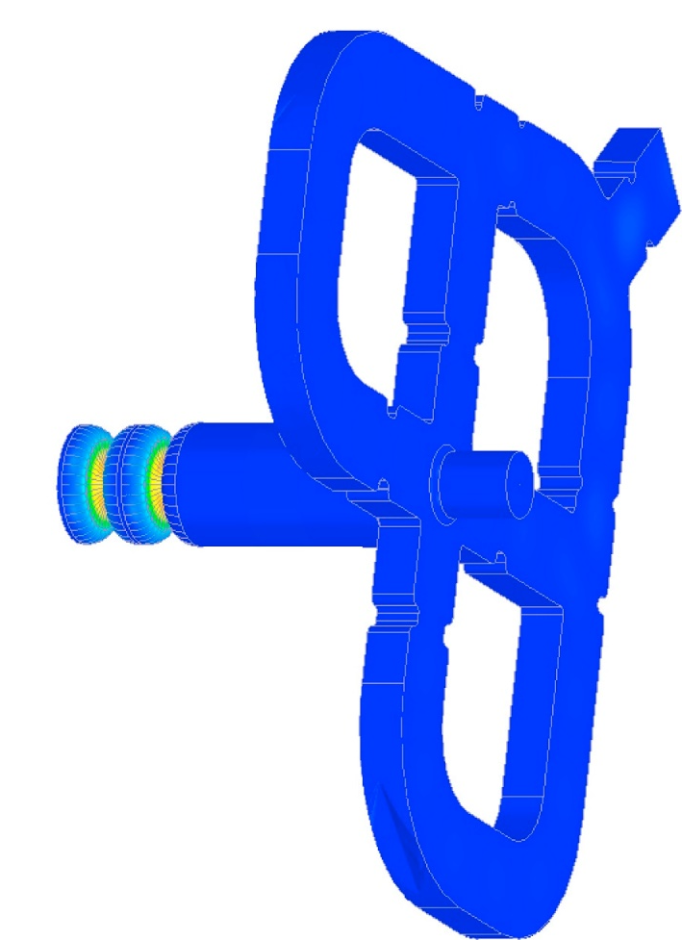
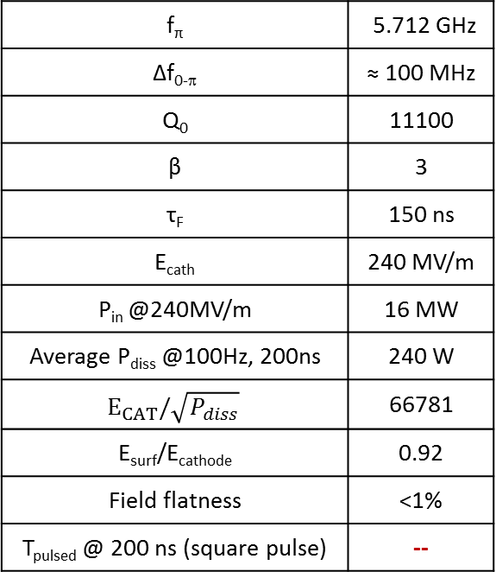
C-Band gun design: MODE LAUNCHER
Magnetic Field Distorsion compensation:
Perfect 2D profile: no multipole components
Input waveguide
Pulsed heating:
No pulsed heating on the input coupler
f_{π} | 5.712 GHz
Δf_{0-π} | ≈ 100 MHz
Q₀ | 11100
β | 3
τ_{F} | 150 ns
E_{cath} | 240 MV/m
P_{in} @240MV/m | 16 MW
Average P_{diss} @100Hz, 200ns | 240 W
$$E_{CAT}/\sqrt{P_{diss}}$$ | 66781
E_{surf}/E_{cathode} | 0.92
Field flatness | <1%
T_{pulsed} @ 200 ns (square pulse) | --
Pumping ports:
To be studied. Pumping from waveguides could be too far form the accelerating cells
Gun
Mode launcher
Laser injection:
To be studied. On axis injection after the mode launcher is probably too far from the cathode
Solenoid:
To be studied. The solenoid bore has to be increased with respect to the other cases and a compensating solenoid for the reduction of the magnetic field on the cathode has to be designed

Slide 14
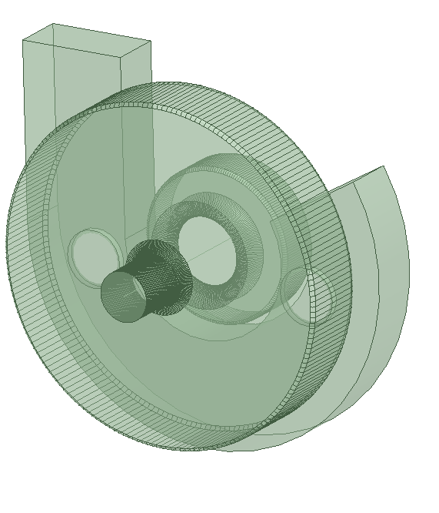
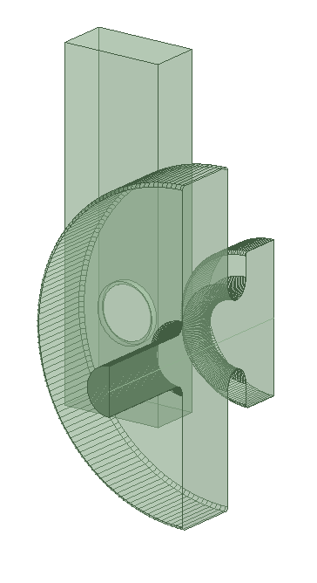
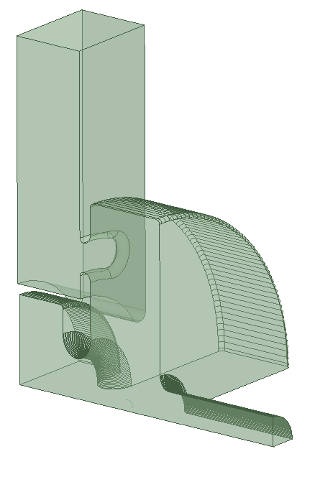
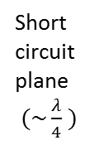
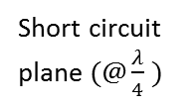
C-Band gun design: ELECTRIC COUPLING ON FULL CELL WORKING ON TM₀₂₀ MODE (1/2)
Need to have a compact coupler with low pulsed heating
Electric coupling on TM₀₂₀ mode on the full cell
Coupling hole
Input port
Short circuit plane$(\sim \frac{λ}{4} )$
Short circuit plane$(@\frac{λ}{4} )$
J-type feeding
TM010 like
Half cell
TM010 like
Half cell
TM020 like
Full cell
TM020 like
Full cell

Slide 15
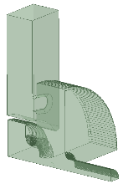
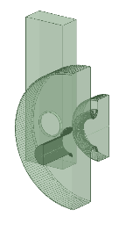
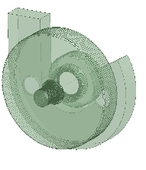
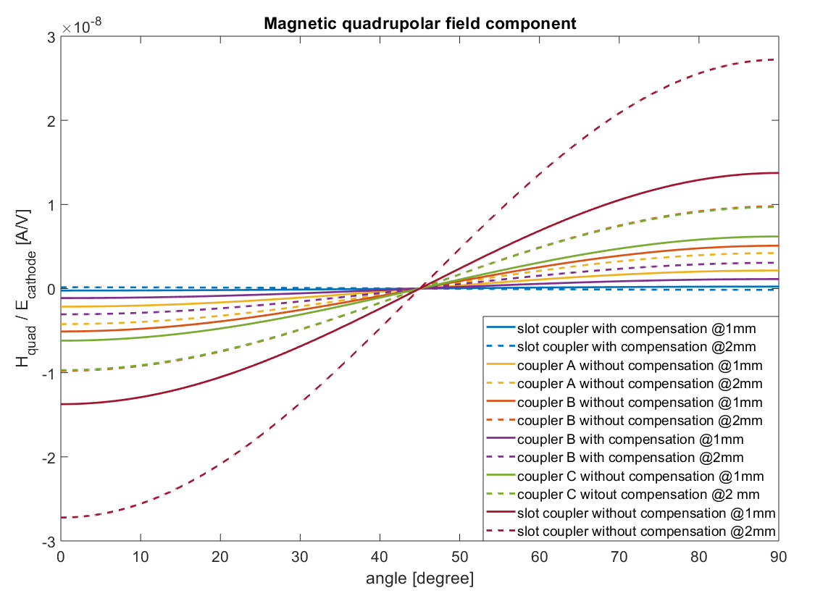
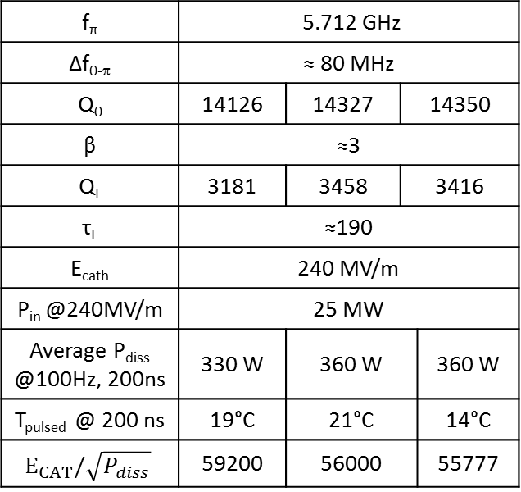
C-Band gun design: ELECTRIC COUPLING ON FULL CELL WORKING ON TM₀₂₀ MODE (2/2)
Magnetic Field Distorsion compensation:
Symmetric feeding with two input waveguides and two symmetric holes for quadrupole field compensation
Pumping ports:
From waveguides
Pulsed heating:
Reduced because of the electric coupling
A
B
C
Solenoid:
After the gun OK
Laser injection:
On axis
f_{π} | 5.712 GHz
Δf_{0-π} | ≈ 80 MHz
Q₀ | 14126 | 14327 | 14350
β | ≈3
Q_{L} | 3181 | 3458 | 3416
τ_{F} | ≈190
E_{cath} | 240 MV/m
P_{in} @240MV/m | 25 MW
Average P_{diss} @100Hz, 200ns | 330 W | 360 W |  | 360 W
T_{pulsed} @ 200 ns | 19°C | 21°C |  | 14°C
$$E_{CAT}/\sqrt{P_{diss}}$$ | 59200 | 56000 |  | 55777

Slide 16
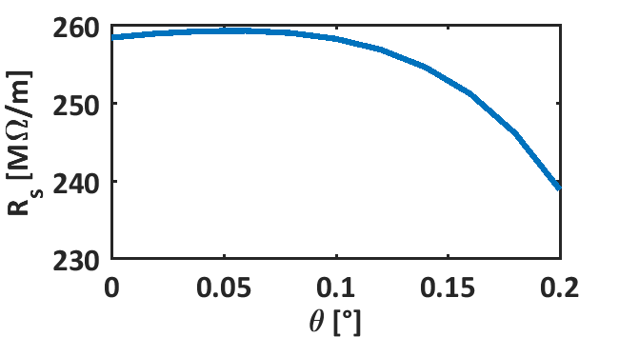
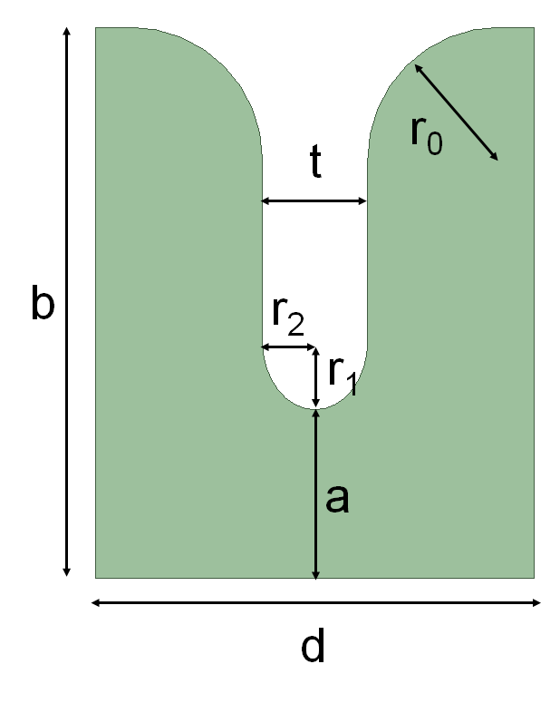
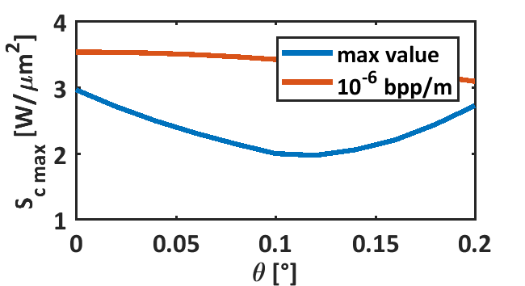
TW STRUCTURES FOR VELOCITY BUNCHING
BD simulations have to be done
In the meanwhile a scan of possible C-band structures geometries (irises apertures, tapering, powering schemes…) is under investigation
f | 5.712 GHz
d cell | 17.496 mm
t_k | 3 us
Q_0 of BOC | 216000
Referred to 65 MV/m
<a>=6.3 mm, Ls=1.2 m,

