Slide 1


Photocathodes for Electron Accelerators
Evangelos Gazis
Katerina Tzanetou
Pirsi Prepibaj
Rafaella Kotitsa
Nick Gazis (ESS ERIC)
Institute of Accelerating Systems & Applications
National Technical University of Athens

Slide 2
Outline
Photocathodes in the past
Photocathodes today
Photocathodes in the future
Electron Guns
X-FEL
Conclusions
Notes:
This is a presentation after a search in the literature about the photocathodes, electron guns and X-FEL examples of other labs, in the past, current time and future. Having this results we can effectively have a reasonable proposal for our collaboration.

Slide 3
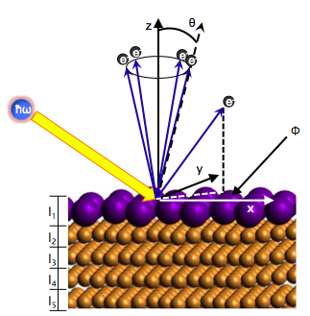
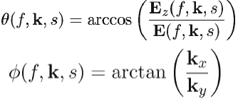
Theoretical Modelling
Progress
QE determination for clean Cu surfaces and other metals
Effect of adsorbates
Next Steps
Stepped surfaces, partial coverages of adsorbates
Extension of code to model transverse and longitudinal energy spread
Thin films, alloys, semiconducting overlayers
Notes:
We know that the photon irradiation of specific energy to a metal extracts electrons from the surface
There is progress of the Quantum Efficiency (QE) determination for Copper (Cu) and other metals
We should be focused for the next steps to codes for simulation of the transverse and longitudinal energy spreads to thin films, other materials, etc.

Slide 4
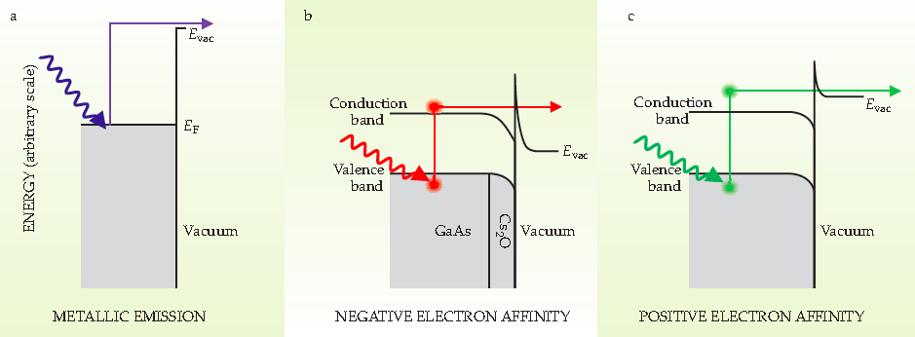
Photo Emission from Metals
METALS: The electron absorbs enough photon energy (UV) to overcome the material’s work function
SEMICONDUCTORS: IR or visible light excite electrons across the material’s band-gap
SURFACES with POSITIVE ELECTRON AFFINITY: have vacuum level above the conduction band; so excitation energies to overcome the band-gap are needed
Notes:
Read the a), b) and c)

Slide 5
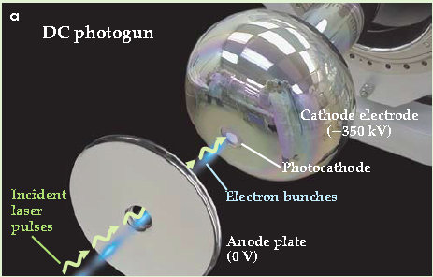
DC Photo Gun
2
3
1
Notes:
A principle schematic of a DC photocathode in operation: 1) laser beam irradiates the photocathode, 2)electron extraction from photocathode, 3) Electron bunches via the DC HV = -350V

Slide 6
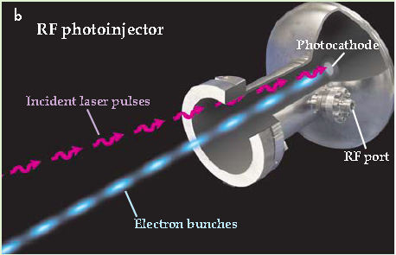
RF Photo Gun
Notes:
A principle schematic of an RF photocathode in operation: similar steps with RF photo-injector

Slide 7
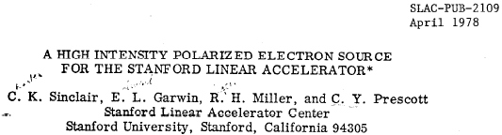
Photocathodes in the past
  DC photocathode guns
  RF photocathode guns
SLAC DC photocathode gun
Photocathode used: GaAs
Maximum polarization: 40%
Notes:
Let’s have a look of the photocathodes of various labs, i.e. SLAC DC photocathode

Slide 8
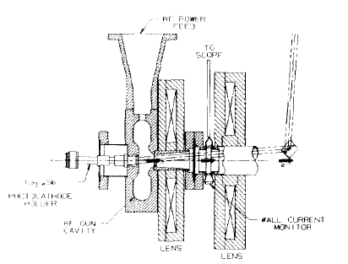
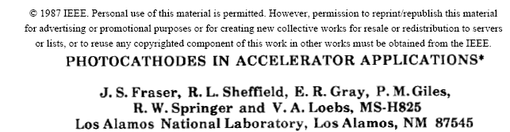
Photocathodes in the past
Los Alamos RF photocathode gun
Operation Frequency 1.3 GHz
Photocathode used Cs₃Sb
Peak surface field 60 MV/m
Bunch charge 12 nC
Peak beam current 100-150 A
Beam emittance 32 mm·mrad
Notes:
In addition, at Los Alamos the RF photocathode with with its parameters in operation

Slide 9
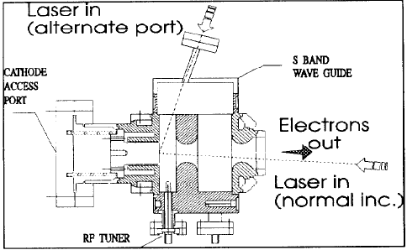
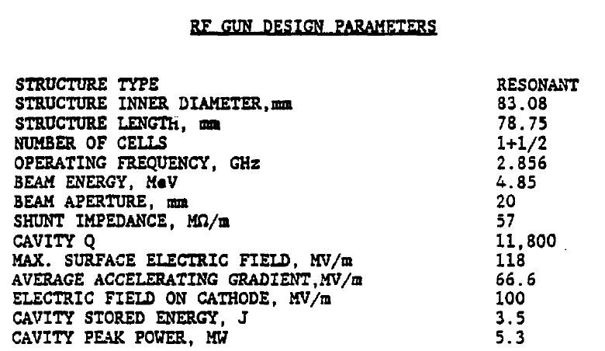
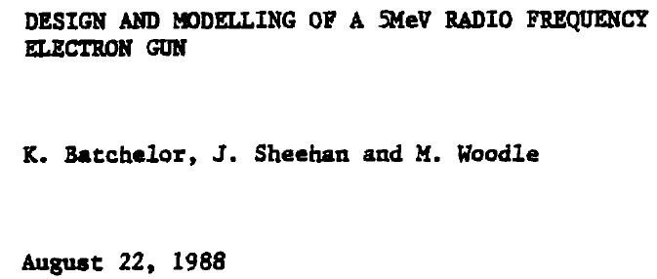
Photocathodes in the past
BNL RF photocathode gun
Photocathode used Cu
Beam emittance 3 mm·mrad
Notes:
In addition, at BNL the RF photocathode with with its parameters in operation

Slide 10
Classification of the current Photocathodes
Out of the gun photocathode preparation and exchange with a Load-Lock system
Electron emission
  Photocathodes
        Metal
        Amorphous semiconductor
        Crystalline semiconductors
Electron acceleration
  DC high voltage
  Radiofrequency acceleration
        Normal conductive acceleration
        Superconductive acceleration
  VHF field acceleration
        Normal conductive acceleration
        Superconductive acceleration
Notes:
A proposed classification of the photocathodes & electron gun is based on 1) Electron emission (various materials) and 2) Electron Acceleration (various modes of acceleration)

Slide 11
Current DC Photocathode for ERL
Maximum voltage achieved – 500 kV
Maximum design current – 10 mA
Photocathode – GaAs/Sb
Photocathode preparation system (not shown) integrated with the gun
For protection of the ceramic insulator from field emission and scattered electrons it is made segmented
Notes:
The current DC photocathode for ERL is presented with with its parameters in materials and the next slides the photocathodes in operation

Slide 12
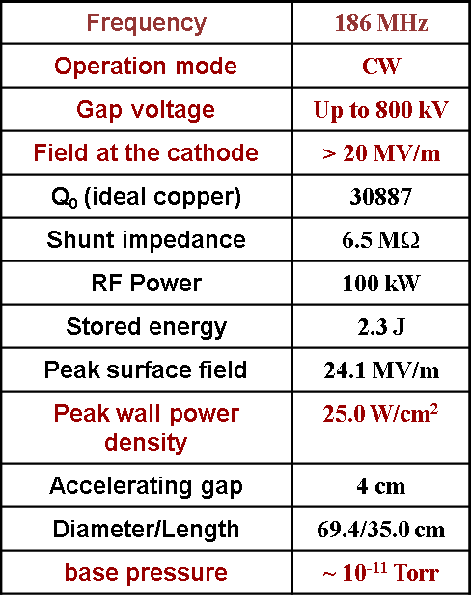
The LBNL VHF photocathode gun
Photocathode used Metal/Te/Sb
Notes:
The current LBNL VHF photocathode is presented with its parameters

Slide 13
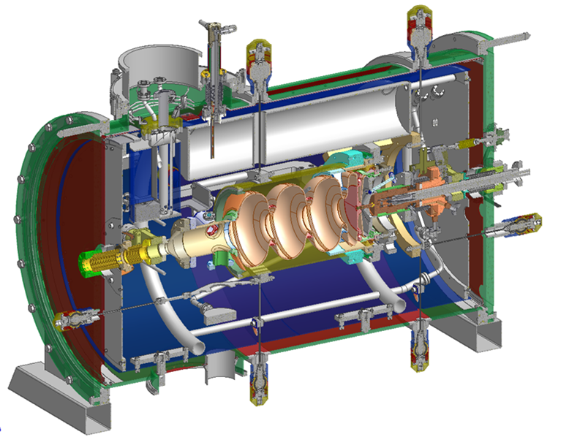
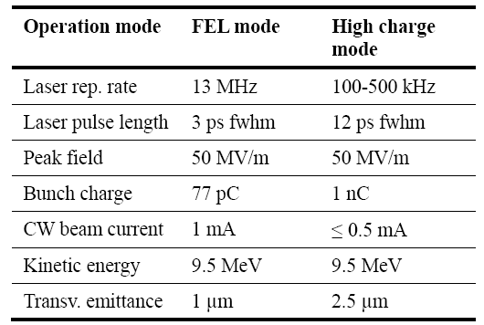

The ELBE SRF photocathode gun
RF frequency 1.3 GHz
RF scheme 3.5 cells
Operation mode CW
Photocathode used Cs₂Te/Metal
Notes:
The current ELBE SRF photocathode is presented with its parameters

Slide 14
Current photocathode materials
Class | Material | QE | Response time | Intrinsic Energy | Wave Length | Gun | Application
Normally conducting metals | Cu, Mg | 10⁻⁵-10⁻⁴ | 10’s fs | 100’s mV – 1’s V | UV | NC-RF, VHF | Low rep rate FELs
Super conducting metals | Nb, Pb | 10⁻⁵-10⁻⁴ | 10’s fs | 100’s mV – 1’s V | UV | SC-RF | High rep rate FELs
Positive e⁻ affinity Te-based | Cs₂Te | 0.1-0.2 | ps’s | 100’s mV | UV | NC-RF, SC-RF VHF DC | High rep rate FELs
Positive e⁻ affinity Sb-based | Cs₃Sb etc | 0.1-0.2 | ps’s | 100’s mV | Visible | DC VHF, SCRF(?) NCRF(???) | ERLs, High rep rate FELs
Negative e⁻ affinity semiconductor | GaAs, etc | 0.1-0.35 | 1’s ps – 100’s ps | 10’s mV – 100’s mV | IR- Visible | DC (XHV) | Polarized sources, ERLs
Notes:
This table presents the various materials with the various materials, QE, Response time, Intrinsic Energy, Wave length, ands applicaitions

Slide 15
Future requirements for electron accelerators
Beam energy : 100’s keV – GeV’s
Bunch peak current : Amps – kA’s
      Bunch charge : fC’s – nC’s
      Bunch duration : fs’s – ns’s
Beam average current : nA’s –A’s
      Bunch charge : fC’s – nC’s
      Bunch repetition rate : Hz – 100’s MHz
Beam energy spread : 0.1 %’s
Beam emittance : sub µm’s
Beam synchronisation : less than10’s of fs
Notes:
Under the progress of new generation of electron accelerators, there are proposed parameters for future accelerators

Slide 16
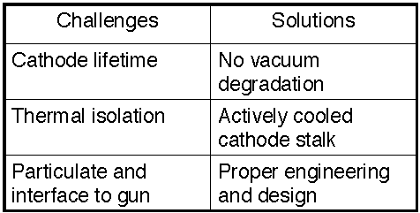
Photocathods choice & challenges
a possible proposal
• CsK₂Sb is cathode of
choice, with a diamond
amplified photocathode
as the next generation
Cathode
• Lots of experience with
CsK₂Sb photocathode
deposition, extensive
R&D on diamond
amplified photocathode
Notes:
The Cesium Potassium Antimony alloy can be one candidate for our photocathode

Slide 17
Future requirements to the photocathodes for the accelerators
a possible proposal
High Quantum efficiency
High Robustness
Low intrinsic emittance
Fast response time
New ideas are welcomed!
Notes:
This study may be focused on the following photocathode properties for the XLS

Slide 18
Electron Gun
Notes:
Let’s turn to the electron gun

Slide 19
Useful properties for Electron Gun design
• Average current
• Peak current
• Pulse length
• Emittance (beam quality)
• Reliability (lifetime)
• Physical size
• Cost
• Larger duty factor
  – lower gradient
  – higher QE
  – lower bunch charge
• Lower emittance
  – higher gradient
  – lower QE
  – faster cathode
  – lower bunch charge
  – smaller emission radius
• Higher charge per bunch
  – higher gradient
  – higher QE
  – larger emission radius
Notes:
Read the title and the upper part of the properties must be studied for the electron gun. Then read only the sub-titles in blue color

Slide 20
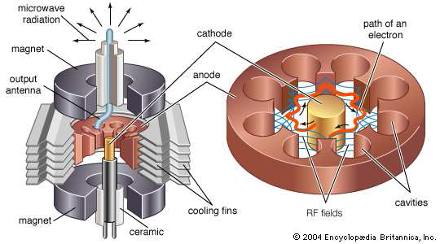
Electron Gun Example
Microwave Oven Power Source
Notes:
A schematic of the electron gun is presented with the main object providing the RF field for the electrons

Slide 21
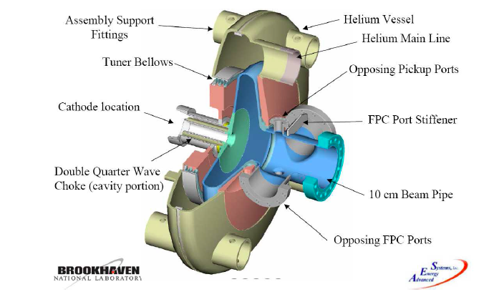
BNL SRF Gun
Photo-injector designed to deliver 2 MeV beam, 5 nC/bunch at 9.38 MHz
Notes:
Photo-injector at BNL (USA) designed to deliver 2 MeV beam, 5 nC/bunch at 9.38 MHz

Slide 22
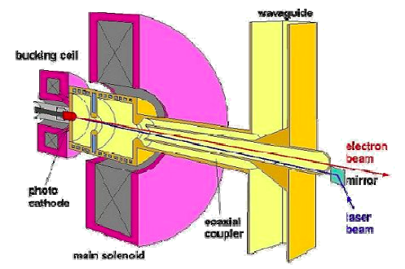
Normal Contacting RF gun
PITZ NC RF gun, 1 nC, 10 kHz
Notes:
General principle of operation of normal contacting gun

Slide 23
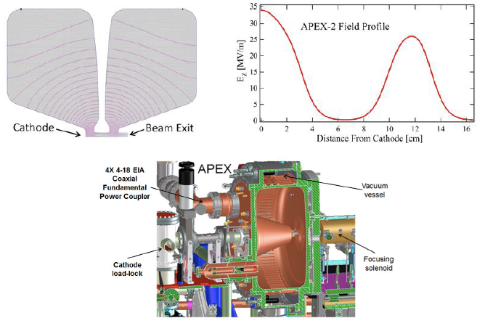
APEX VHF Gun
Electric field distribution inside APEX
Notes:
Details of the electric field shape for the electron acceleration

Slide 24
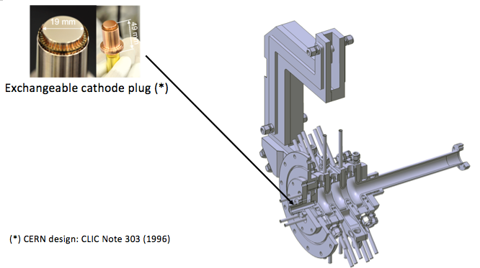
SWISS FEL RF Photoinjector
SwissFEL RF Photoinjector:
S band, 2.5 Cell; 7 MeV; 100 MV/m; 100 Hz; 10 - 200 pC
Notes:
The SWISS FEL photoinjector

Slide 25
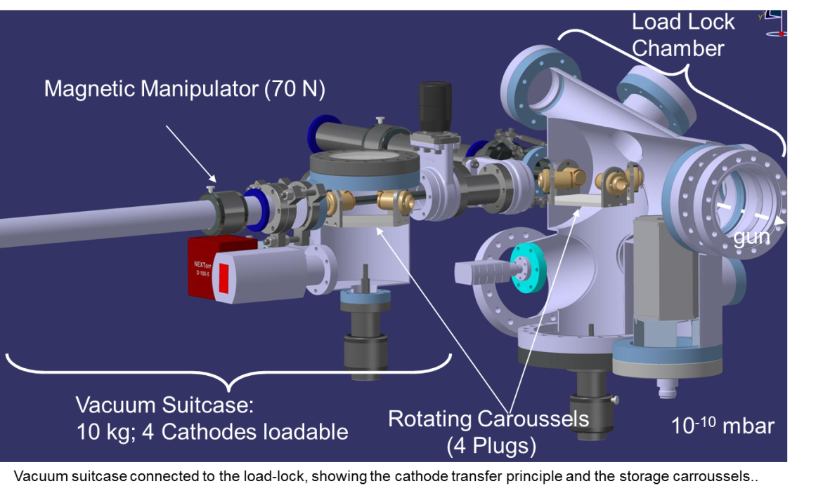
SWISS FEL RF Photoinjector
Load Lock Chamber for SwissFEL
Notes:
Some more pictures

Slide 26
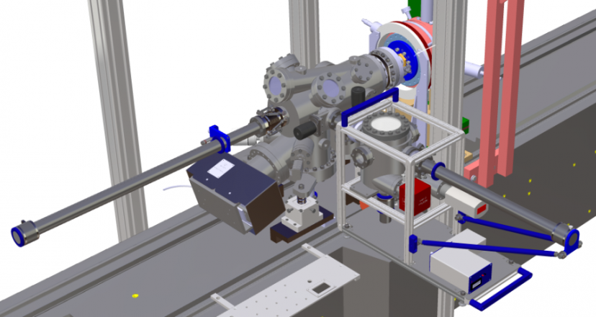
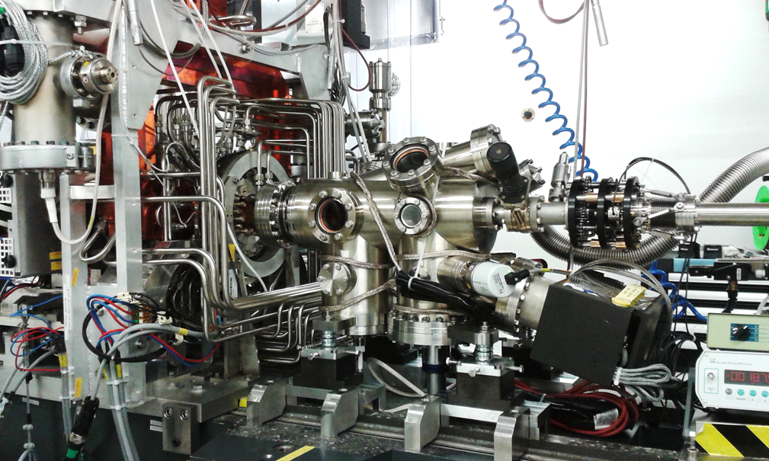
SWISS FEL RF Photoinjector
Load Lock Chamber behind RF Gun
Load lock chamber
Vacuum suitcase
Cathode is pushed against
RF gun with ~500 N
mechanical force
~ 500 N
RF Photoinjector:
2.5 Cell; 7 MeV;
100 MV/m peak field
e⁻

Slide 27
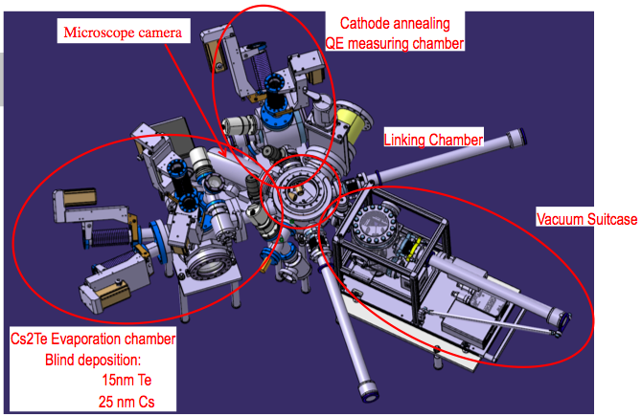
SWISS FEL Cathode Preparation
Notes:
A total view of the cathode

Slide 28
Conclusions
The various modes and types of the photocathodes has been investigated
An intensive simulation study will follow to arrive to the perspectives of our proposal
The running of some codes has been achieved in our team, for defining the parameters of the photocathode

