Slide 1
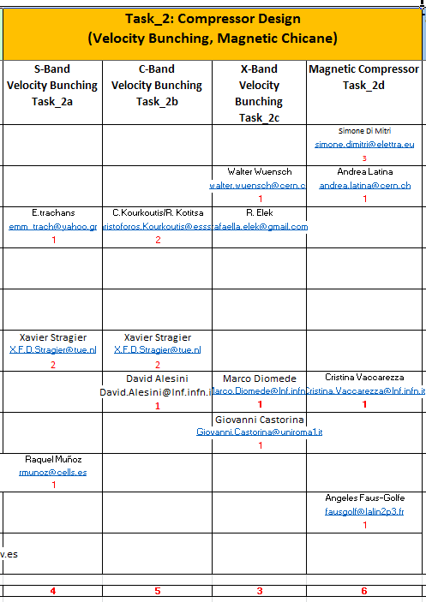

Status
WP3 Sub-Task & Participants:
Deliverable 3.2:
“A review report on the bunch compression techniques and phase space linearization”
=> M18, i.e., by June 2019
Working Plan:
Identify Report contents – DONE
Define individual actions – DONE
Provide a tentative document by Dec.’18
Receive feedbacks from other WPs
Produce a final Report, focused on CL target FEL performance.

Slide 2
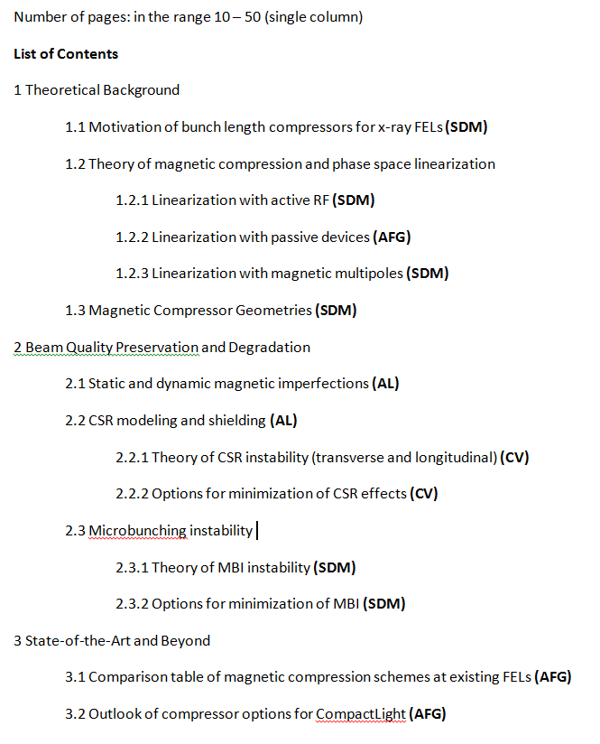
Report Contents
Essential theoretical background, state-of-the-art linearized magnetic compression schemes and R&Ds.
Single-particle dynamics and collective effects
Microbunching instability and suppression schemes
Overview & Comparison tables.
Indications for CL.

