Slide 1
A K band TW accelerating structure for the Compact light XLS project
B. Spataro - M. Behtouei (PhD student)
on behalf of the SPARC - LAB collaboration

Slide 2
Summary
Analytical estimations of the group velocity
HFSS numerical estimations
Cavity dimensions calculations
Comparison between analytical and numerical of the group velocity
Accelerating electric field estimation

Slide 3
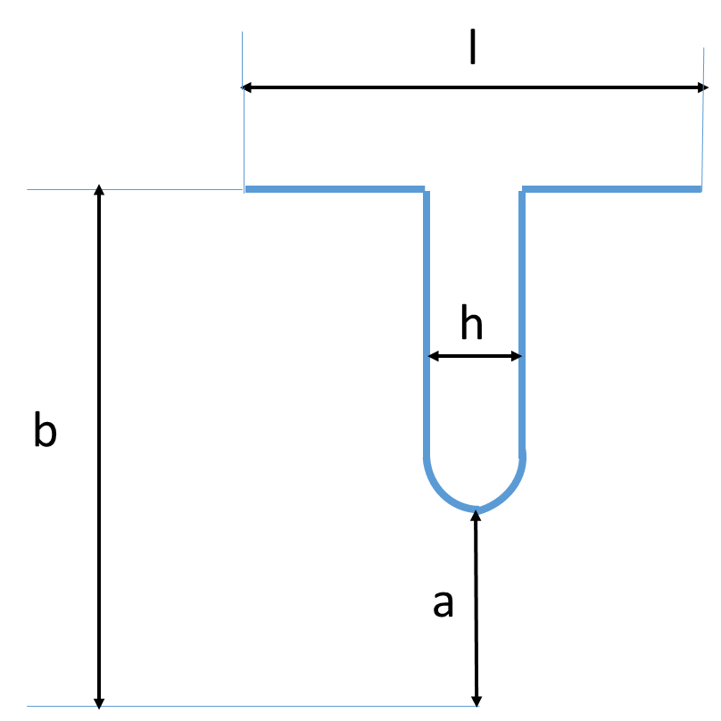
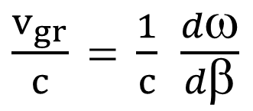
TW cavity shape for the 2π/3 mode
b = cavity radius
a = iris aperture radius
h = iris thickness
l = cell lenght
λ
/3
$\frac{v_{gr}}{c} = \frac{1}{c}$ $\frac{dω}{dβ}$

Slide 4


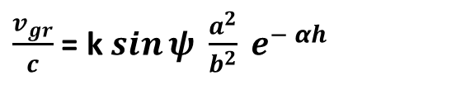


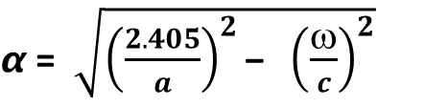
Group velocity analytical estimation
From Thomas P. Wangler , after some manipulations the group velocity is given by :
$\frac{v_{gr}}{c}$ = k $\sin{ψ \frac{a^{2}}{b^{2}} e^{− αh} }$
$α$ = $\sqrt{{\left(\frac{2.405}{a}\right)}^{2}\text{− }{\left(\frac{ω}{c}\right)}^{2}}$
≈ $\frac{2.405}{a}$
Ψ
= phase advance per cell of the traveling wave structure
$$α$$
= attenuation per unit lenght of the field for theTM₀₁ waveguide
mode through a hole in a wall of thickness h
K = constant
h = iris thickness
a = iris radius
b = cavity radius
By using the Taylor expansion of the term
$$e^{−αh}$$
and assuming h = 0.08 $λ$
we get the analytical equations
$\frac{v_{gr}}{c}$ = k $\sin{ψ}$ $\left[ \frac{a^{3}}{λ^{3}}− 0.19 \frac{a^{2}}{λ^{2}}+0.185 \frac{a}{λ}+.\frac{λ}{a}−0.0012 \right]$
$\frac{v_{gr}}{c}$ = k $\sin{ψ}$ $\left[ \frac{a^{3} }{b^{3}}\text{−} 0.496\frac{a^{2}}{b^{2}} + 0.126 \frac{a}{b}+. \frac{b}{a}\text{−} 0.0213 \right]$

Slide 5
HFSS numerical simulations
As an example by assuming a/𝞴 = 0.16 :
V_{gr}/c = 0.0365
a/b = 0.388

Slide 6
Cavity radius fit as function of the iris radius at F = 23.988 GHz and F = 35.982 GHz

Slide 7
23.988 GHz and 35.982 GHz cavity dimensions
As an example, by assuming 𝞴 = 8.3375 mm
v_{gr}/c = 0.0365
iris radius = 1.333 mm
cavity radius = 3.43 mm
thickness iris h = 0.667 mm
with 𝞴 = 12.506 mm
v_{gr}/c = 0.0365
iris radius = 2 mm
cavity radius = 5.65 mm
thickness iris h = 1 mm
These dimensions are perfectly consistent with the 110 Ghz structure by scaling law with frequency tested at SLAC

Slide 8
Dispersion relation
a = 1.333 mm, h = 0.667 mm, K = 4 %

Slide 9

Comparison beteween HFSS and Analytical estimations
Max error
11.2 %
5.6%
$\frac{v_{gr}}{c}$ = k $\sin{ψ}$ $\left[ \frac{a^{3}}{λ^{3}}− 0.19 \frac{a^{2}}{λ^{2}}+0.185 \frac{a}{λ}+.\frac{λ}{a}−0.0012 \right]$
$\frac{v_{gr}}{c}$ = k $\sin{ψ}$ $\left[ \frac{a^{3} }{b^{3}}\text{−} 0.496\frac{a^{2}}{b^{2}} + 0.126 \frac{a}{b}+. \frac{b}{a}\text{−} 0.0213 \right]$

Slide 10
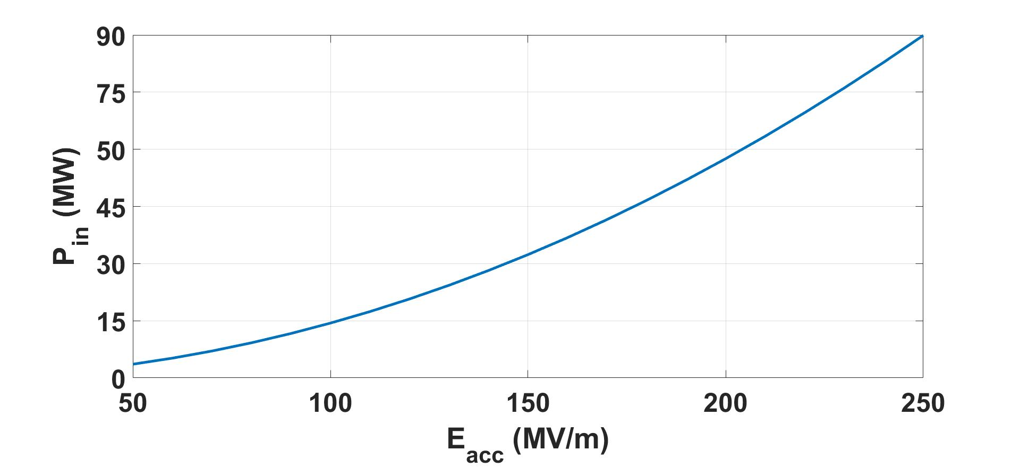
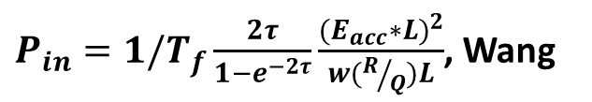
Input RF power for different gradients
Assuming a structure length L = 21 cm ,T_{f} = 20 ns (filling time) and τ = 0.65 (attenuation)
${P_{in}=1/T}_{f}\frac{2τ}{1−e^{−2τ}}\frac{{{(E}_{acc}∗L)}^{2}}{w(R/Q)L}$, Wang
Parameter | Value
Filling Time, Tf | 20 ns
L, length | 21 cm
w, frequency | 2pi*35.982 GHz
R/Q | 57.7 kΩ/m
τ | 0.65
For a CG structure: input group velocity v_{gr_in}/c =6.2%, output group velocity v_{gr_out}/c=1.7%,
For a CI structure : v_{gr} = 0.035 c
Luigi Faillace checked these estimations by using a different approach (normalized electric field method )

Slide 11
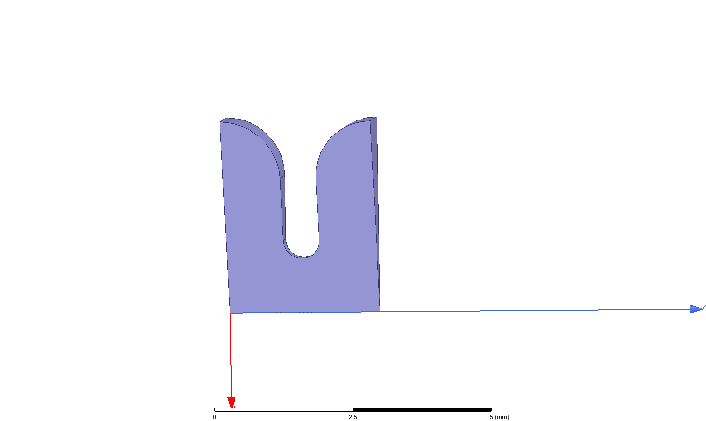
Rounded cavity : final RF estimations have been processed and will be discussed in a next talk
As an example at F = 35.982 GHz with a = 1 mm, h = 0.667 mm, b = 3.538 mm:
R_{sh}/m = 195 MΩ/m
Q = 4065

