Slide 1
LINAC4 Actions Follow up
LINAC4 core supervisors : Giulia Bellodi, Jean-Baptiste Lallement, Silvia Schuh, and Alessandra Lombardi
ABP linkperson to OP : Silvia Schuh

Slide 2
Source in the tunnel during the run2017-18
Performance achieved (at 160mA) :
  Current : 20mA
  Emittance : 0.3 mm mrad rms / smaller with laser system (0.2 mm mrad rms)
  Useful Pulse length (5%flatness) : 600 µsec
  Pulse-to-pulse : 2%

Slide 3
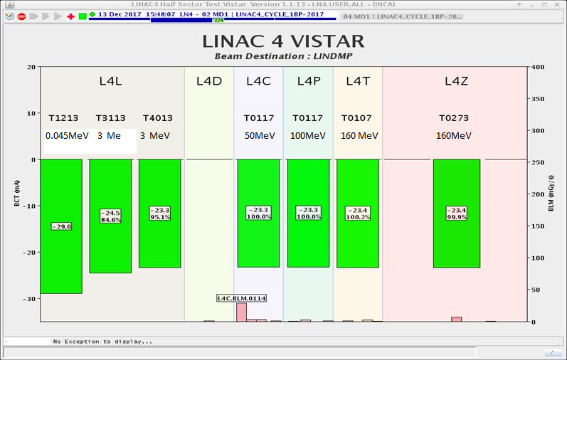
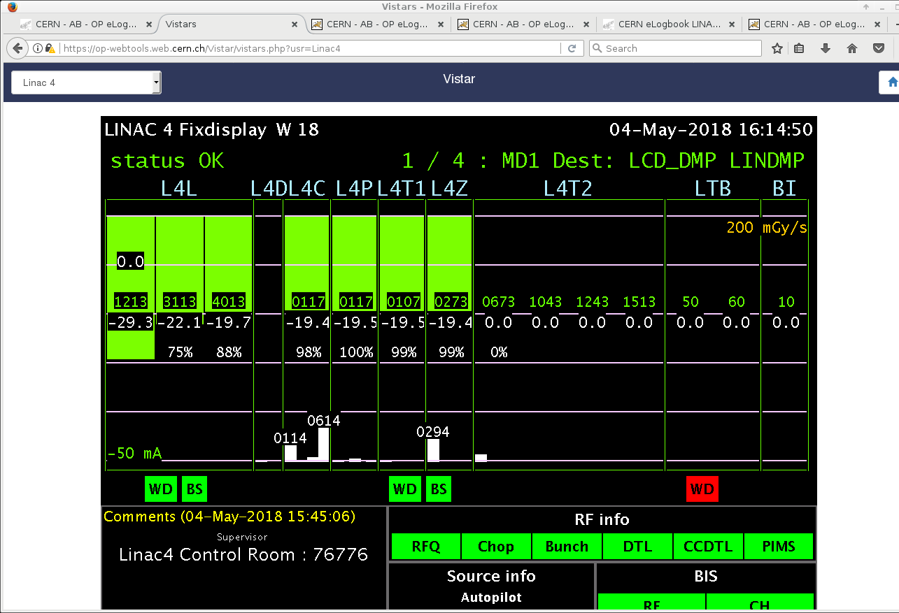
current
Run 2017 – December
Run 2018 – May – after cesiation
The source has had issues during the 2018 run. These issues are due to a problem in the gas valve. This should be sorted out by the next run. We count on 20mA at the end of the linac

Slide 4
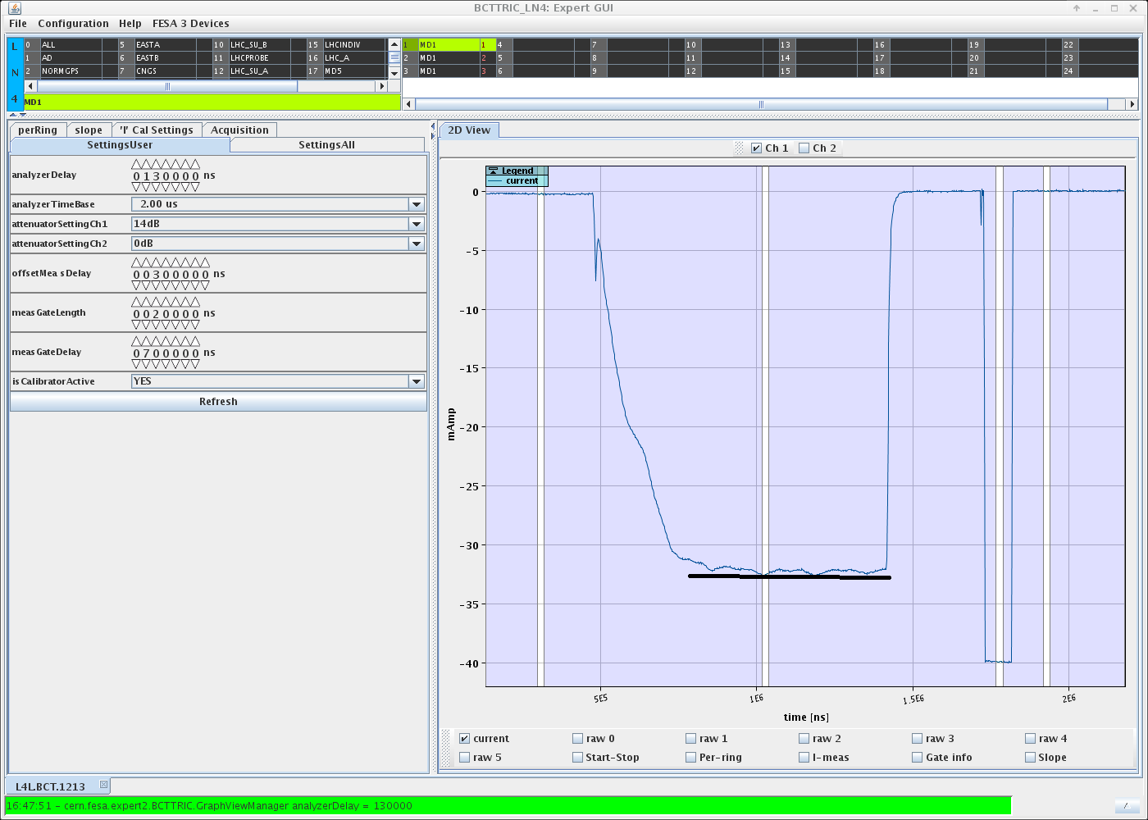
600µsec good pulse length
Measured 18 may 2018 –variation over 600 µsec is 6% but when going through the RFQ the difference are flattened to few %.
From the linac4 side we can inject 150turns per ring.
We need to get rid of the head of the pulse :
Part with the pre-chopper (tests in septembre)
Part with the chopper (1 ms operation is demonstrated with additional cooling, Anthony Jones and Mauro Paoluzzi )
600µsec

Slide 5
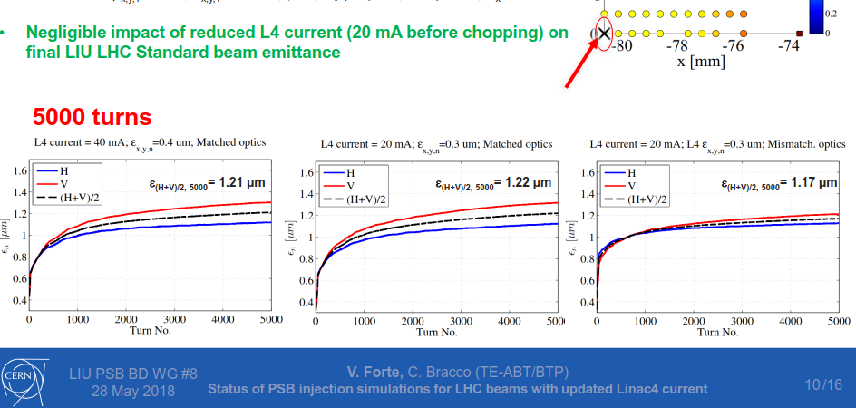
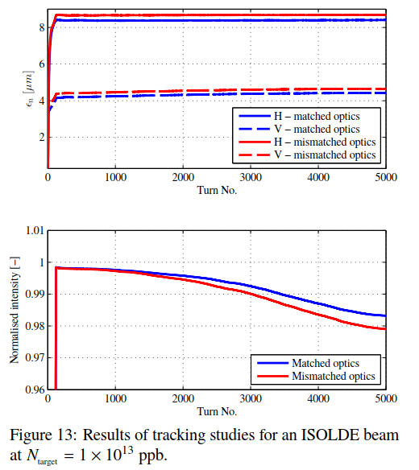
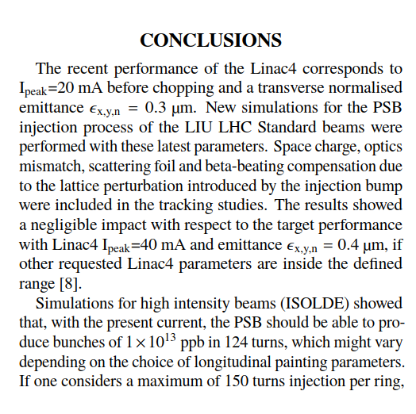
With this source we can do all the beams that are produced today
Vincenzo Forte HB2018

Slide 6
The RF phases setting –completely solved
To set the phases use the beam characteristics
Scan the phase of each cavity, measure the beam average energy and find the match with pre-calculated curves
To find the beam energy : either beam loading or ToF (more precise at the higher energy)
Script based on beam loading written by ABP, setting of the whole linac in 1 hour. - available since xx
Procedure being written by ABP to set the phases of each cavity (total is 25 phases to be set)

Slide 7
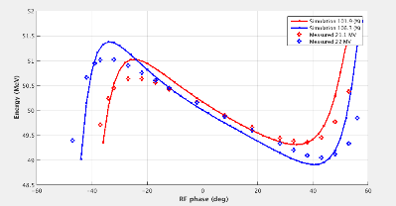
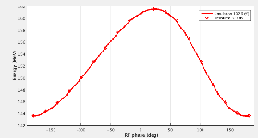
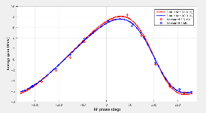
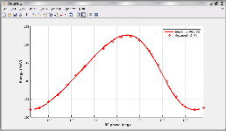
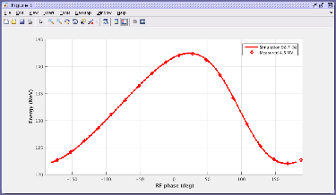
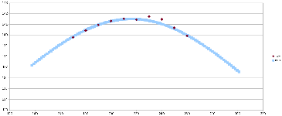
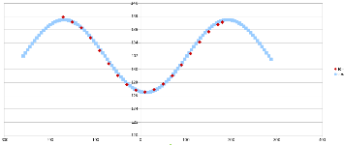
Characteristics curve
Characteristic curves : energy out of an RF cavity as function of amplitude and phase.
Solid line : simulations,
Dotted : measurements

Slide 8
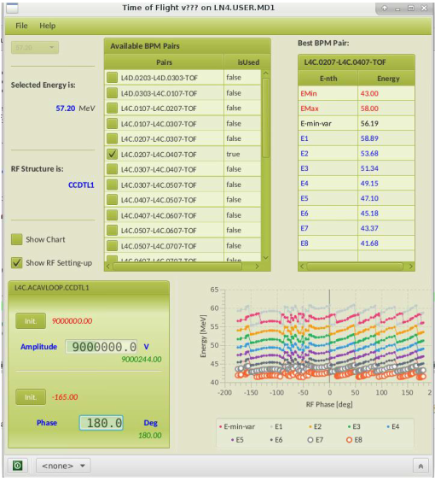
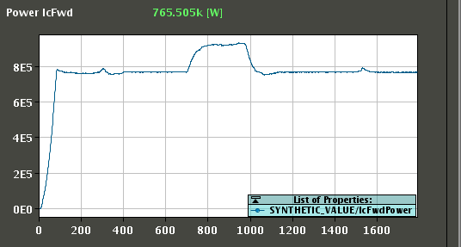
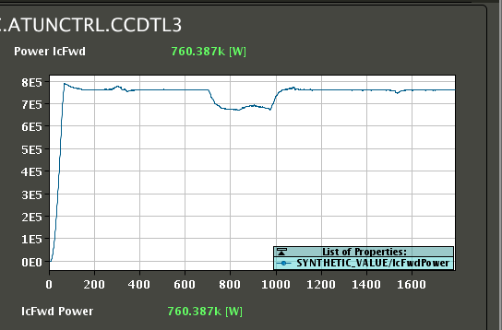
Measure the energy : ToF vs beam loading

Slide 9
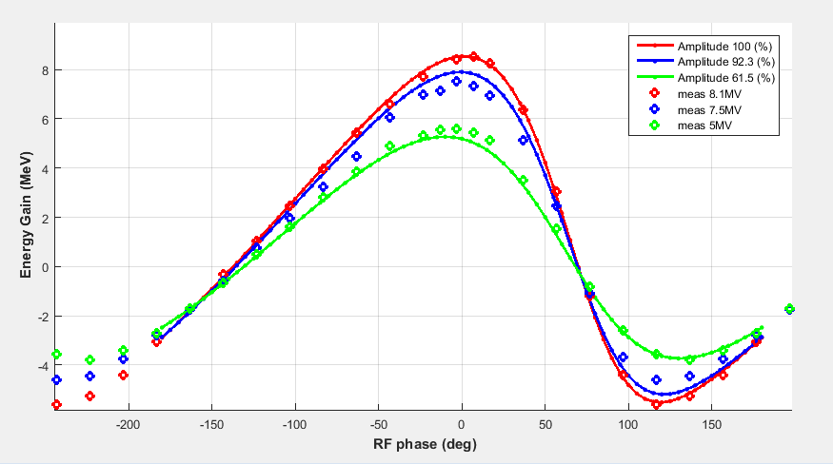
Energy gain from beam loading vs phase

Slide 10
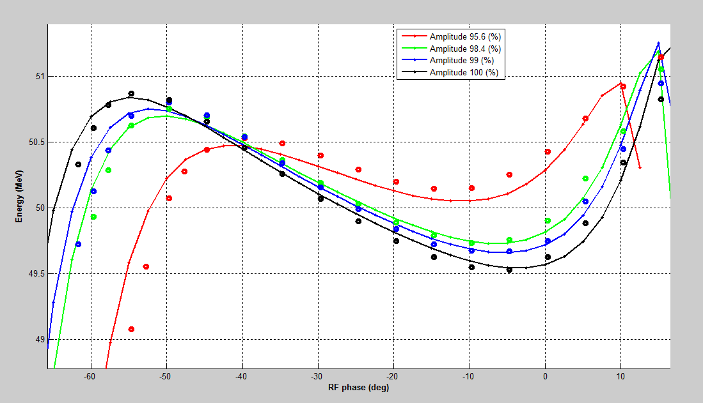
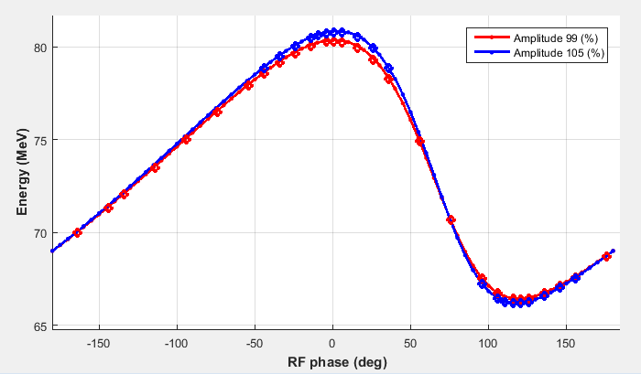
Time-of-flight
Solid : expected from simulations
Dots: ToF measurements
50 MeV : Energy measurement vs DTL tank3 Phase for different amplitudes
80MeV : Energy measurement vs CCDTLmodule4 Phase for different amplitudes

Slide 11
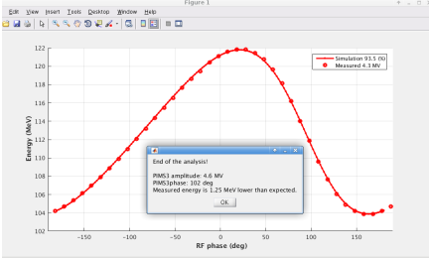
Automated procedure based on beam loading
Script (python) to scan the phase and calculate the energy from beam loading written by ABP
Off line analysis to fit data and find phase
Proposal : OP picks this up and makes into a suitable application

Slide 12
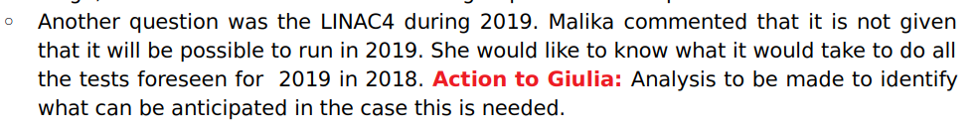
Min. peak current (before chopping) | 40 mA | comments
Intensity flatness along the pulse for pulse lengths up to 160 μs Intensity flatness along the pulse for pulse lengths >160 μs Beam energy Current stability shot-by-shot Nominal chopper operation/extinguish factor | ±2% ±5% 160 MeV ±2% | Measured during the 2017-18 run . No special need to remeasure. Certainly no need to arrive to the PSB lines
Horizontal/vertical position variations along the pulse | ±1 mm | Measured during the 2017-18 , can be projected at the PSB entrance, would be better to measure at the LBE.
Horizontal/vertical injection angle error | ±<0.4 mrad
Normalized transverse emittances | ≤0.4 mm mrad | Measured during the 2017-18 at the end of the linac , to be measured in 2019 at the PSB. Not that important for the emittance value but crucial for alphas and betas.
Ppm energy spread | ~80-450 (600) keV | Can be measured only in 2019 because we need debuncher
Energy painting |  | Can be measured only in 2019

Slide 13
Planning up to 2020
So far the 2019 run during LS2 is on, Julie has a meeting on July 2nd to finalise details, no show stoppers identified. Coordination needed especially during the critical period of LS2.
  2018
  2019 running to the LBE
  Get planning or delete

Slide 14
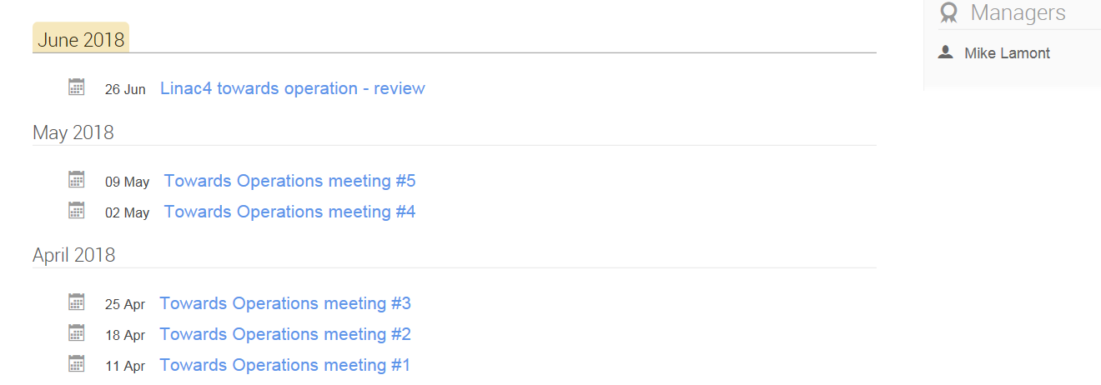
https://indico.cern.ch/category/10274/

