Slide 1
Towards HL-LHCV1.4
R. De Maria
WP2 meeting 12/6/2018

Slide 2
Changes HLLHC1.3 → 1.4
Layout:
2+2 crab cavities → 2 crab cavities only
Q4: 4xMCBY+MQY 1.9K → 3xMCBY+MQY 4.5 K
Q5: 3xMCBY+MQY 1.9K → 1xMCBC+MQML 4.5
Remote alignment system (i.e. machine can be realigned during beam commissioning)
Extended D1 beam-screen
New specification for TCTPV-TCTPH-TCLX stroke and apertures
Increased distance D2-CRAB
Changes in the triplet corrector package
Optics:
Crossing bumps re-optimized thanks to remote alignment system
Decision on crossing plane for Point 1/5
New aperture estimates thanks to remote alignment system
IR4 optimized for instrumentation and e-lens
IR6 reviewed and re-optimized for TCDQ gaps, Q5 strengths
Dedicated optics for 7TeV (using 7.5TeV equivalent currents where needed)

Slide 3
Table of content
TCTPH-TCLX
Aperture outlook and iteration with vacuum
Next steps

Slide 4
Layout changes
MCBXFB
MCBXFB
MCBXFA
HLLHCV1.3
IP
Q1
HV
Q2a
Q2b
HV
Q3
HV
CP
D1
1.9K
B1(E)
D2
H
V
C
C
H
V
H
V
Q4
H
V
H
Q5
MBRD
V
H
C
C
V
H
V
H
MQY
V
H
V
MQY
B2(I)
MCBRD
1.9 K
MCBY
1.9 K
MCBY
1.9 K
MCBXFB
MCBXFB
MCBXFA
HLLHCV1.4
IP
Q1
HV
Q2a
Q2b
HV
Q3
HV
CP
D1
1.9K
B1(E)
D2
H
V
C
C
H
V
H
Q4
H
Q5
MBRD
V
H
C
C
V
H
V
MQY
V
MQML
B2(I)
MCBRD
1.9 K
MCBY
4.5 K
MCBC
4.5 K
Changes with respect to the baseline:
Q4: reusing existing cold mass (3 correctors instead of 4), no need of 1.9 K.
Q5: reusing existing Q5 cold mass (1 corrector instead of 3), no need of 1.9 K.
Full deployment of remote alignment system to be used with safe beam.

Slide 5
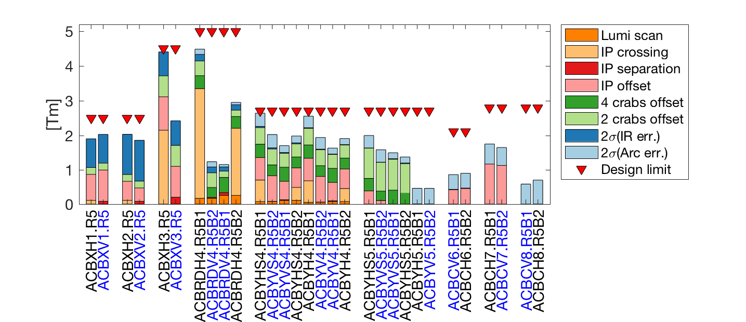
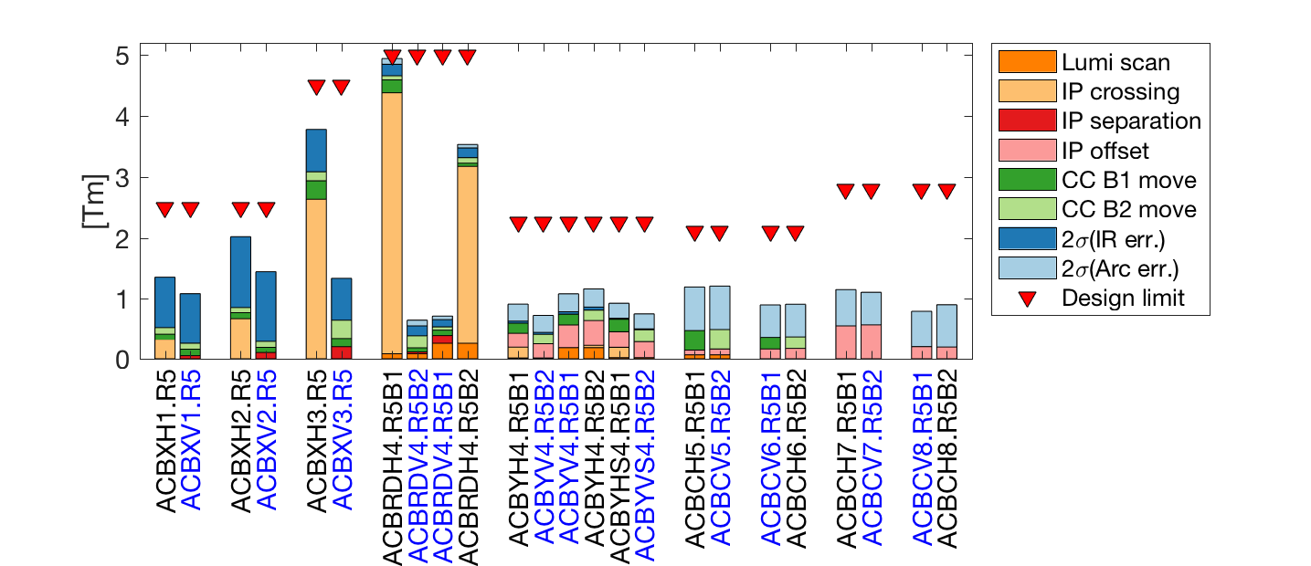
Orbit corrector strength budget
HLLHCV1.3
Right Point 5, H crossing.
The following symmetries apply:
Left B1 -> Right B2,
Left B2 -> Right B1
H Point 5 -> V Point 1
HLLHCV1.4:
orbit bumps reduced at the crab cavities
IP offset performed by remote alignment
Limited crab beam adjustment still possible
Crossing: ±295 μrad
Separation: ±0.75 mm
IP Offset: ±2.0 mm with re-alignment
Luminosity scan: ±100 μm
Crab knobs: ± 0.5 mm (baseline only)
Imperfection (2σ): from uniform distribution of mainly ±0.5 mm quad. alignment and 0.5 mrad / 20 units dipole errors.
IP
Q1 Q2 Q3 D2
Triplets
Q4 Q5 Q6-8
Matching section
HLLHCV1.4
IP
Q1 Q2 Q3 D2
Triplets
Q4 Q5 Q6-8
Matching section

Slide 6

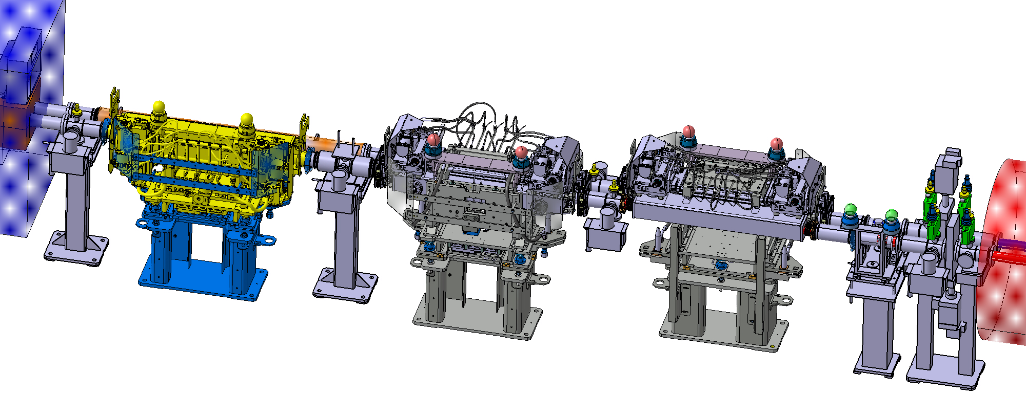
TCLX – TCPH issues in HLLHC
Beam size in between TAXN – D2 is much larger than LHC due to lower β* and D2 closer to the triplet, beam separation smaller than LHC because D1 – D2 distance is shorter.
TCLX needs thicker internal jaw to provide dose protection to D2
-> Larger stroke in less space.
  TAXN
  D2
  TCTPV
  TCTPH
  TCLX

Slide 7
TCLX – TCPH issues in HLLHC
TCLX and TCPH required maximum gap >80 mm: https://edms.cern.ch/file/1561432/1.0/CERN-ACC-2015-0129.pdf
ColUSM #67, 5/2/2016 https://indico.cern.ch/event/493012/
 | TCTPV | TCTPH | TCLX
Orientation | Vertical | Horizontal | Horizontal
Absorber Cross-section | 34 x 20 mm² | 34 x 20 mm² | 70 x 40 mm²
Jaw Stroke | 40 (+5) mm | 30 (+5) mm | 30 (+5) mm
Half Beam Separation | 80.4-81.9 mm | 83.4-84.9 mm | 86-87.5 mm
Interference* with present layout | 11.3 mm | 43 mm | 58.1 mm
* Interference calculated assuming a standard collimator tank and including baking equipment thicknesses (tank jacket thickness 25 mm and/or vacuum chamber wrapping 5 mm) and a new ID/OD 91/95 mm vacuum chamber.
Further discussed at ColUSM #93 (22/9/2017) and integration meeting 12/1/2017:
Interference solved but still with stroke limited to 30 mm.

Slide 8
TCL-TCT Aperture specifications
Offset (X,Y) | Baseline | Remote alignment
Ground Motion + Fiduc. | ~2 mm | ~0.5 mm
Orbit Error + crab adj. | 2.5 mm | 2.5 mm
Collimator stroke | 15 σ + 10 % (β-beat) | 15 σ + 10 % (β-beat)
Protected aperture | 12 σ + 10 % (β-beat) | 12 σ + 10 % (β-beat)
2 mm IP shift | With orbit correctors | With re-alignment
A_{y}
A_{x}
Sep.
Round 15 cm | A_{x} [mm] | A_{y} [mm] | A_{x} [mm] | A_{y} [mm] | Sep. [mm]
TCLX | 36.4 | 27.9 | 31.9 | 26.1 | 86.0-87.5
VTCLX | 28.0 | 36.4 | 26.1 | 31.9 | 86.0-87.5
TCTPH | 28.5 | 37.1 | 26.5 | 32.7 | 83.4-84.9
VTCTPH | 37.0 | 28.1 | 32.5 | 26.4 | 83.4-84.9
TCTPV | 28.9 | 38.0 | 26.9 | 33.7 | 80.4-81.9
VTCTPV | 38.1 | 28.7 | 33.7 | 26.9 | 80.4-81.9
Flat 7.5/18 cm | A_{x} [mm] | A_{y} [mm] | A_{x} [mm] | A_{y} [mm] | Sep. [mm]
TCLX | 42.8 | 33.8 | 38.3 | 32.0 | 86.0-87.5
VTCLX | 33.9 | 42.9 | 32.1 | 38.4 | 86.0-87.5
TCTPH | 34.2 | 43.5 | 32.3 | 39.1 | 83.4-84.9
VTCPTH | 43.3 | 34.0 | 38.8 | 32.2 | 83.4-84.9
TCTPV | 34.5 | 44.3 | 32.6 | 39.9 | 80.4-81.9
VTCTPV | 44.2 | 34.5 | 39.8 | 32.5 | 80.4-81.9
ColUSM, 23/2/2018

Slide 9
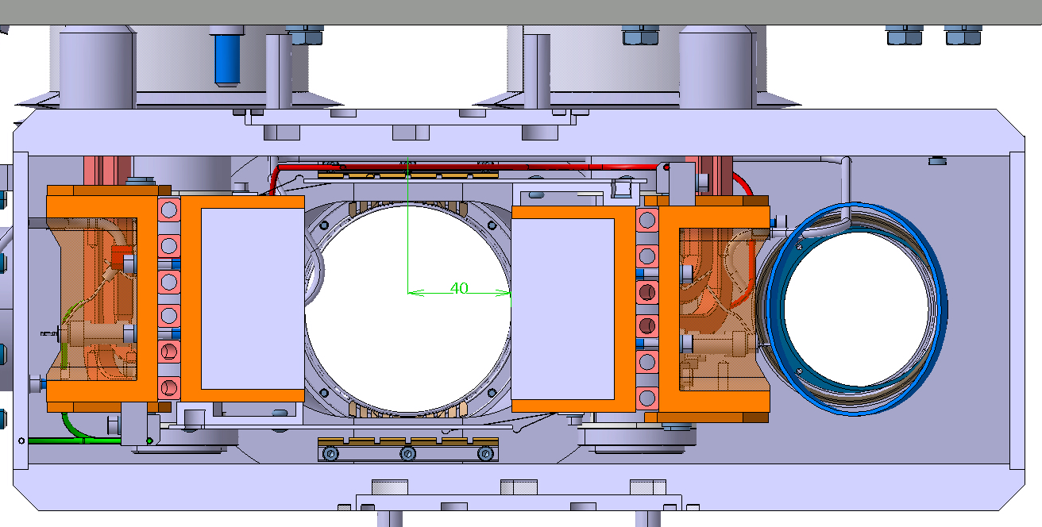
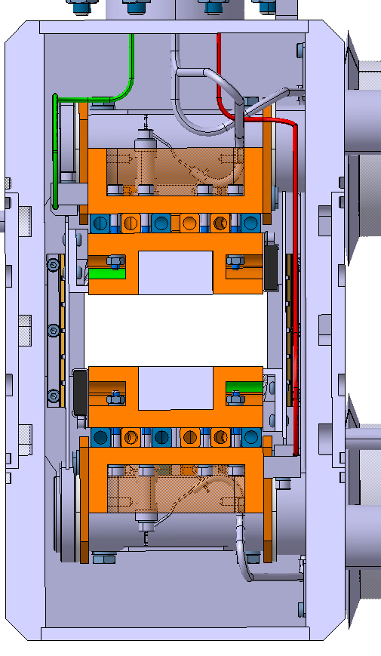
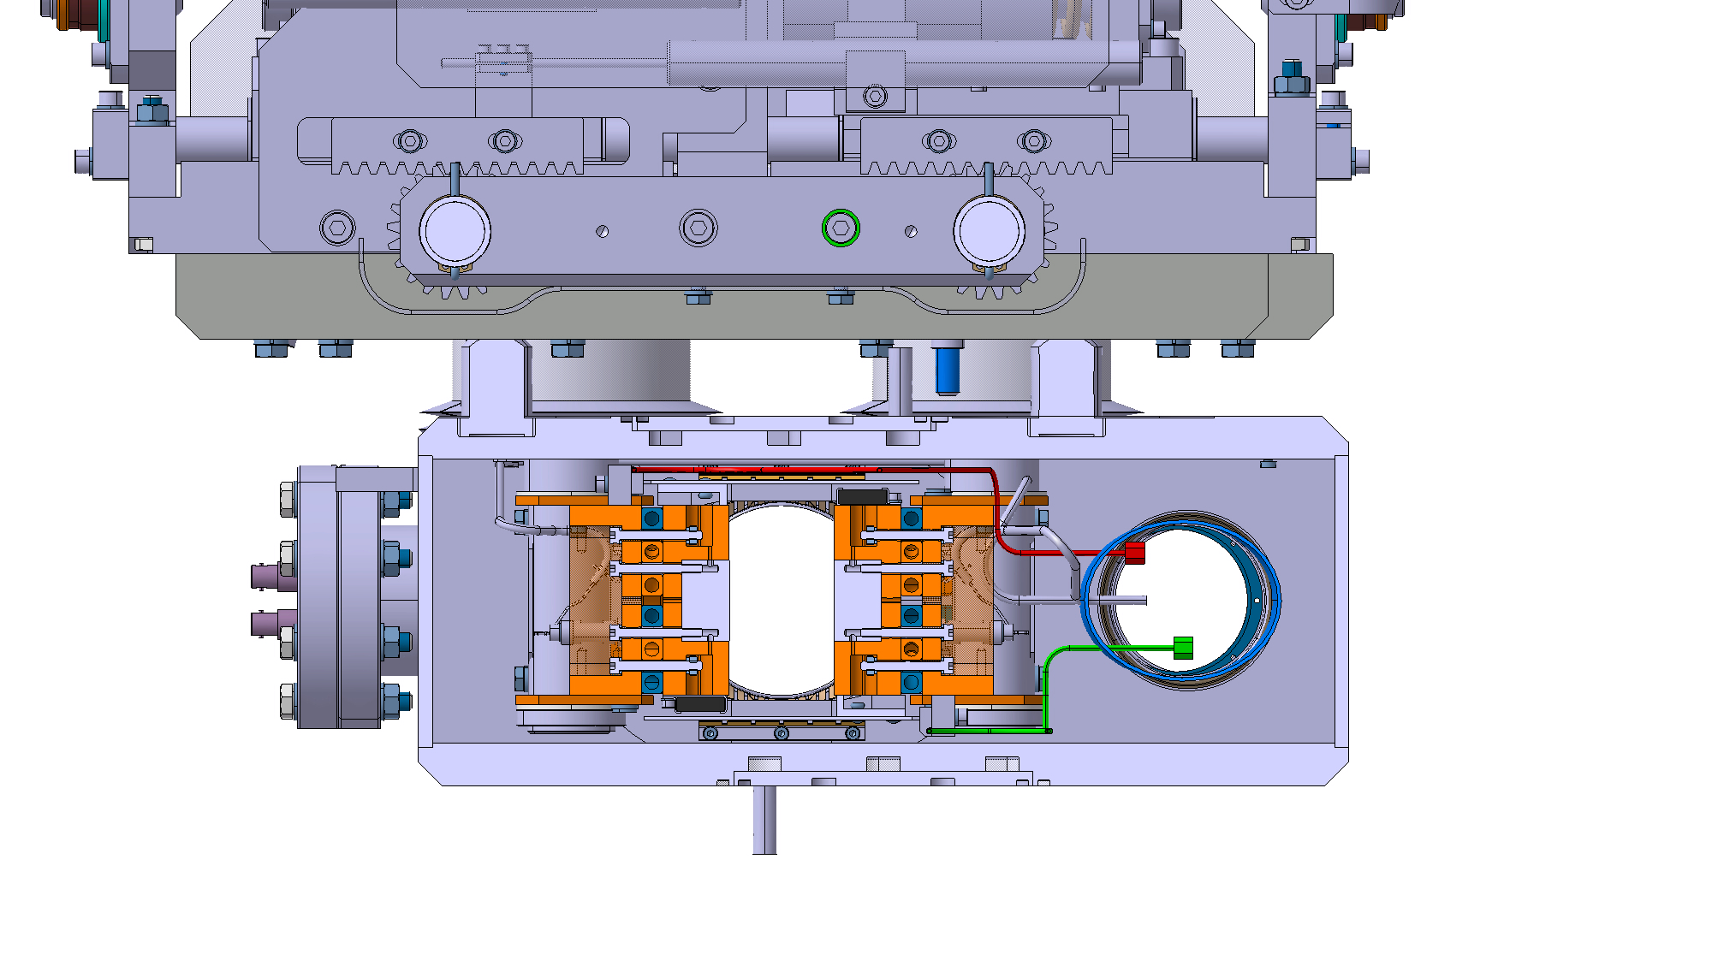
New design proposal
TCTPV
TCLX - 4 mm gap
 | Stroke | Chamber
TCLX | 40 mm | 65/80 mm
TCTPH | 32.5 mm | 80/65 mm
TCTPV | 40 mm | n/a
TCTPH
Remote alignment meeting, L. Gentini, 31/5/2018

Slide 10
Aperture update
Intermediate results: HLLHCV1.3 Optics without IP shift.
HL1.3 | 15 cm 500 μrad | 7.5/18 480 μrad
TAXS | 18.5 | 15.9
Triplet best case | 16.5 | 15.5
Triplet with tolerances¹ | 13.2 | 12.7
TAXN | 17.5 | 14.0
D2 | 19.0 | 15.0
Q4 | 18.8 | 13.4
Q5 | 28.3 | 20.0
Q6 | 29.9 | 19.9
Round optics
Triplets aperture bottleneck for all scenarios
Flat optics
Q4, TAXN, D2 may become aperture bottleneck, but not limiting.
Possible improvements:
Shorter crossing angle bump will improve TAXN, D2 apertures (and slightly Q4).
Remote alignment expected to reduce ground motion and fiducialization tolerances (2 mm -> 0.5 mm).
Detailed orbit error model from D. Gamba (expected 2 mm -> 1 mm).
¹ R. Bruce et al. CERN-ACC-2017-0051 + J. Jeanneret, LHC rep 1007

Slide 11
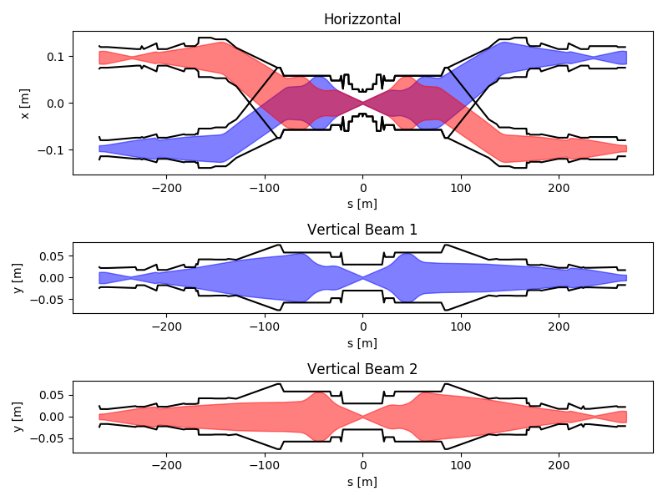
Aperture for vacuum layout
WP12 asked beam envelope without mechanical, alignment and fiducialization tolerances to specify vacuum apertures.
The request inverts the typical work flow because mechanical, alignment and fiducialization are not finalized.
Recipe given:
Beam stay clear =
1.1 n_{σ} σ_{nominal} + 2 mm
where:
n_{σ} = 13.25 up to D1
n_{σ} = 15 TAXN-Q5
n_{σ} = 20 sigma Q6 to Q7.
In addition, new vacuum aperture should always have larger margins than those found in the triplet.
Table available here.
Consistent with present hardware and avoid additional aperture bottleneck.

Slide 12
Next steps
To release version 1.4:
Decision or study new position for Q4/Q5 for cryogenic integration.
Decision on how to gain 30 cm in between D2/crab cavities.
Consistency check between drawings and optics model.
Optimization crossing schemes and other orbit bumps.
Finalization IR6 optics and IR4 optics.
Freeze mechanical, ground motion, fiduc. tolerences.
Computation aperture margins and phase advance tunability.
Evaluation/choice of crossing planes.
Studies in parallel:
Study optics at 7 TeV with ultimate currents in Q7 (more urgent if we want to ask for an hardware test at the end of the run).
Update MS10 branch and follow-up of the DA studies.
Optics optimization for forward physics.

