Slide 1

Synchrotron radiation and photoemission
from the 11T-dipoles
G. Iadarola
with input from P. Andreu Munoz, P. Dijkstal,
L. Mether, G. Rumolo, D. Shoerling

Slide 2
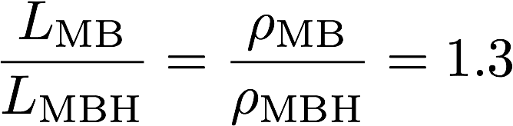
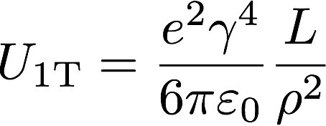
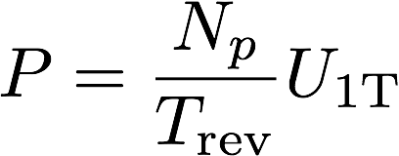

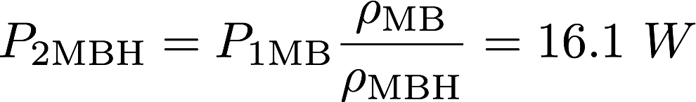
Synchrotron radiation power
  Old configuration: 1 MB bending magnet L_{MB} = 14.3 m ρ_{MB} = 2.8 km
  New configuration: 2 MBH high field magnets L_{MBH} = 2 x 5.3 m ρ_{MBH} = 2.1 km
The total bending angle is kept constant, therefore:
The energy radiated by a proton in a single turn, in a dipole of length L and bending radius ρ, is given by:
(1)
The average power radiated by a beam of N_{p} protons in the considered bend is given by:
(2)
For a single MB magnet and the two HL-LHC beams at 7TeV:
We can use (1) and (2) to to scale to the MBH:
The increase of about 4 W is completely negligible w.r.t. the cooling capacity of 8 kW/arc
For details: A. Hofman, “The physics of synchrotron radiation”
Notes:
Formulas:
\frac{L_\mathrm{MB}}{L_\mathrm{MBH}} = \frac{\rho_\mathrm{MBH}}{\rho_\mathrm{MB}} = 1.3
U_{\mathrm{1T}} = \frac{e^2 \gamma^4}{6\pi\varepsilon_0}\frac{L}{\rho^2}
P = \frac{N_p}{T_\textrm{rev}}U_{\mathrm{1T}}

Slide 3
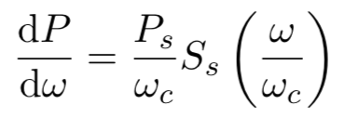
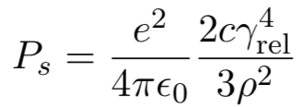
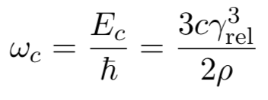
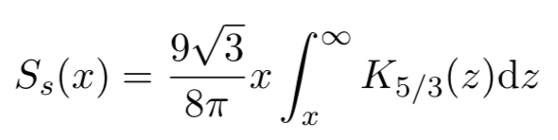
Photoemission
The photon energy (frequency) spectrum is given by:
Where:
Instantaneous power
Critical frequency
Special function
Calculation described in detail in P. Dijkstal et al., “Simulation studies on the electron cloud build-up in the elements of the LHC Arcs at 6.5 TeV” and implemented in python tool at https://github.com/PyCOMPLETE/CellStudyInputPyECLOUD

Slide 4
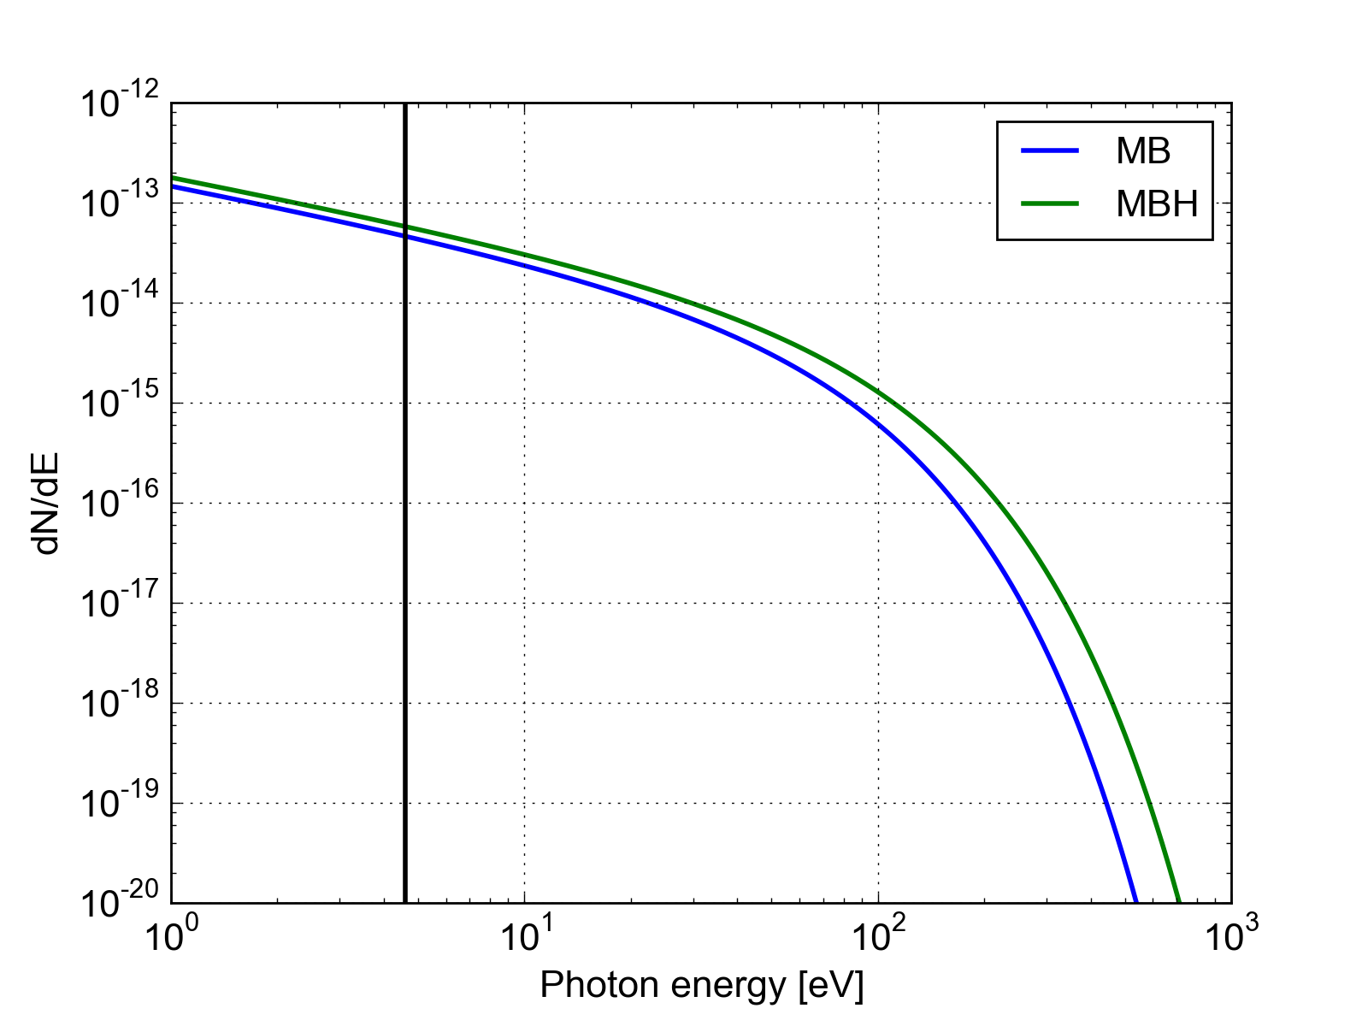
Photoemission
The photon spectrum changes as a function of the bending radius:
Proton at 7 TeV
photons per proton and per unit path length
Copper work function
The number of photoelectrons is proportional to the number of photons above the work function, it can be obtained integrating the spectrum…

Slide 5
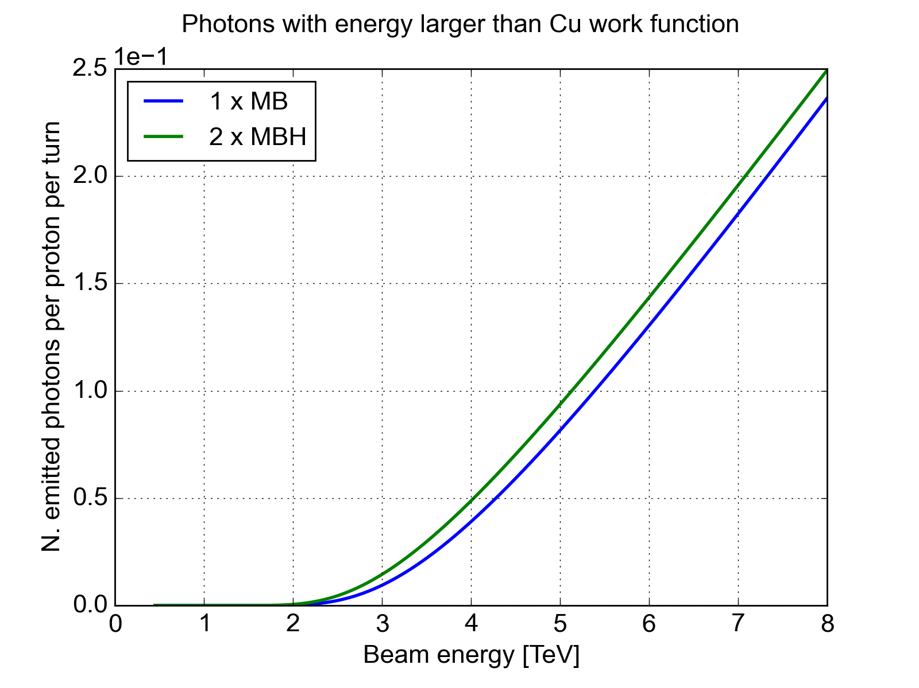
Photoemission
The increase in the number of photoelectrons is marginal

Slide 6
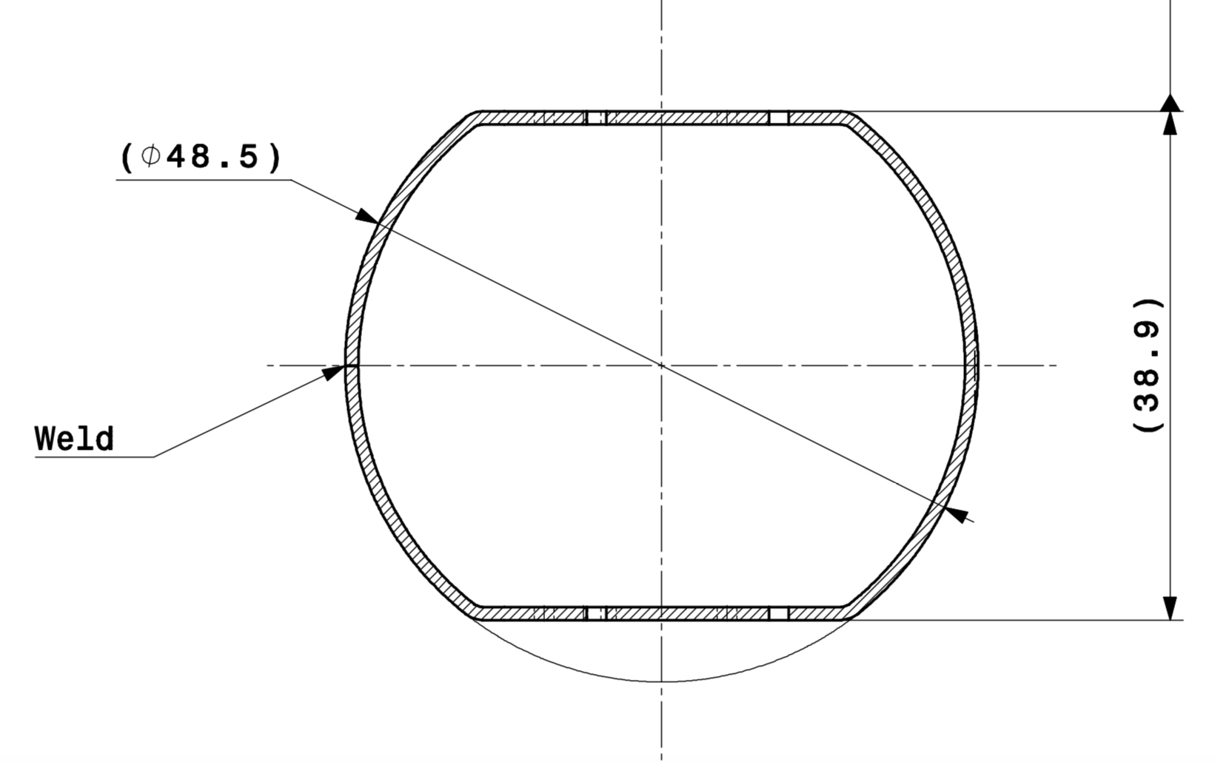
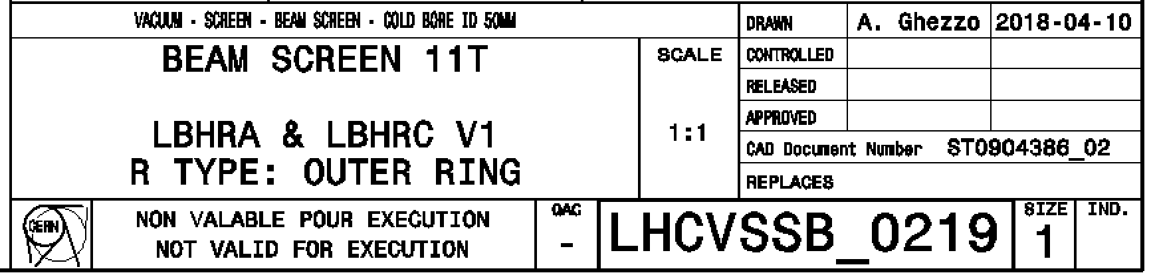
Geometry
The geometry is very similar to the one of the LHC MB beam screens
  no significant changes expected on the e-cloud buildup
46.5
36.9
Drawing provided by P. Andreu Munoz and D. Shoerling

Slide 7
Summary
The increase of the magnetic field from 8.33T to 11T results in an increase of the synchrotron radiation power and number of generated photoelectrons
  Both effects have been evaluated and are expected to be very small (hardly detectable)
As the beam screen geometry is extremely similar to the one installed in the standard MBs, no change is expected on the e-cloud buildup w.r.t. the LHC standard bending magnets
Thanks for your attention

