Slide 1

Civil Engineering, Infrastructure & Siting (CEIS) Working Group Introduction
John Osborne – Matthew Stuart SMB-SE-FAS

Slide 2
PiP Status Update
Figures for the CLIC PiP
  Civil Engineering

Slide 3
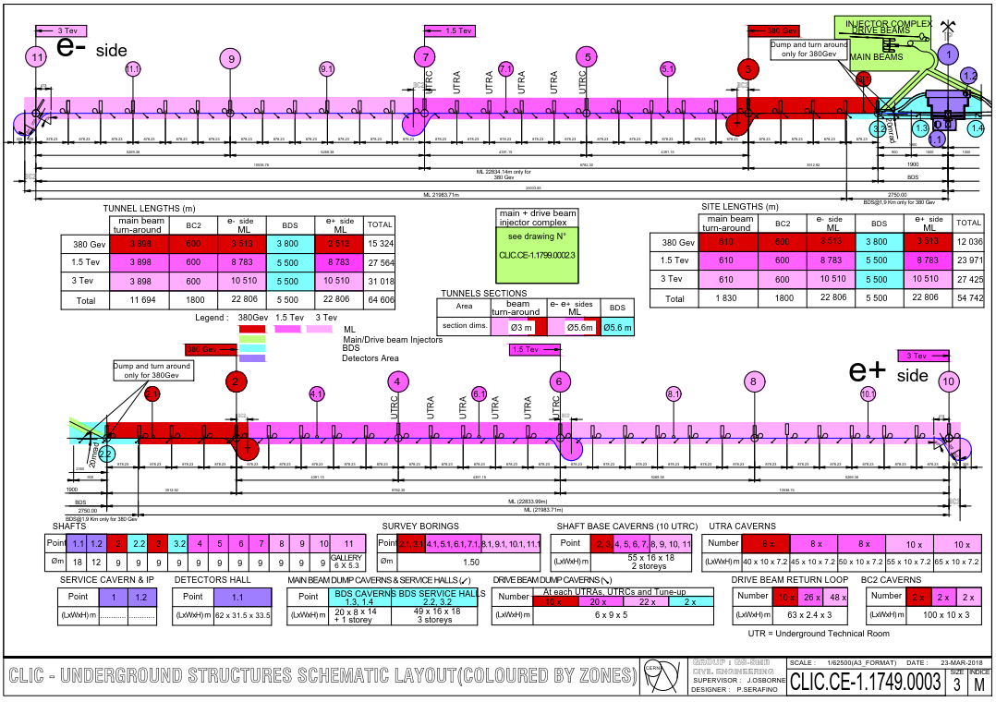
Civil Engineering figures
Figure 6.1
Lengths of all tunnels correct?
Cross-checked with beam lines as the lengths have changed multiple times.
Difficult to read everything in the PiP, potential to reference EDMS document for a full scale Drawing

Slide 4
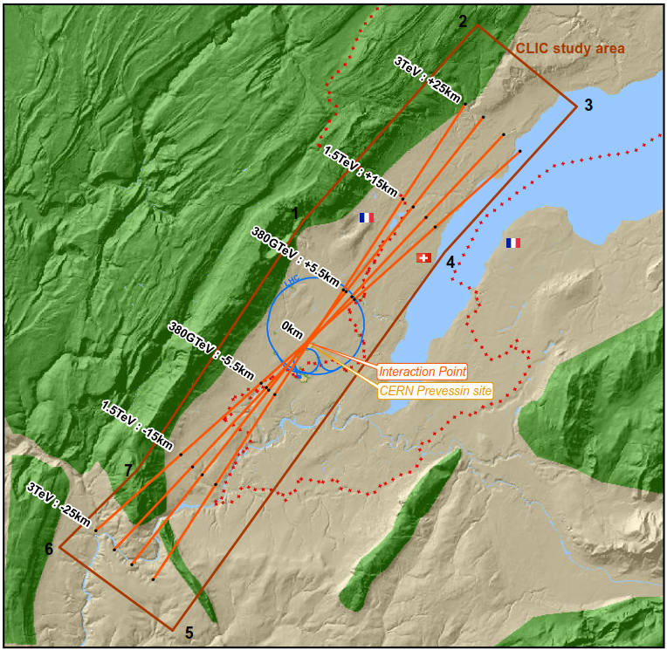
Civil Engineering figures
Figure 6.2
Boundary Conditions: any comments?
No changes needed.

Slide 5
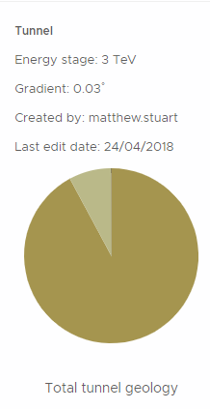
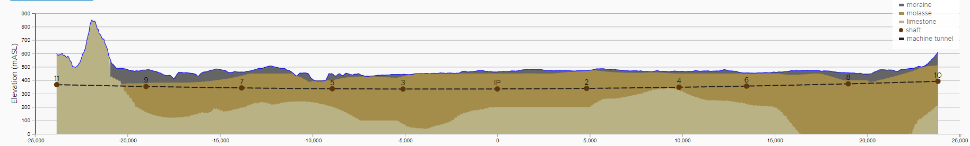
Civil Engineering figures
Figure 6.3
Geological profile
Important profile for the PiP – very difficult to see in the PiP due to length of the figure. Could potentially use a table to show the percentage of the different geology’s?

Slide 6
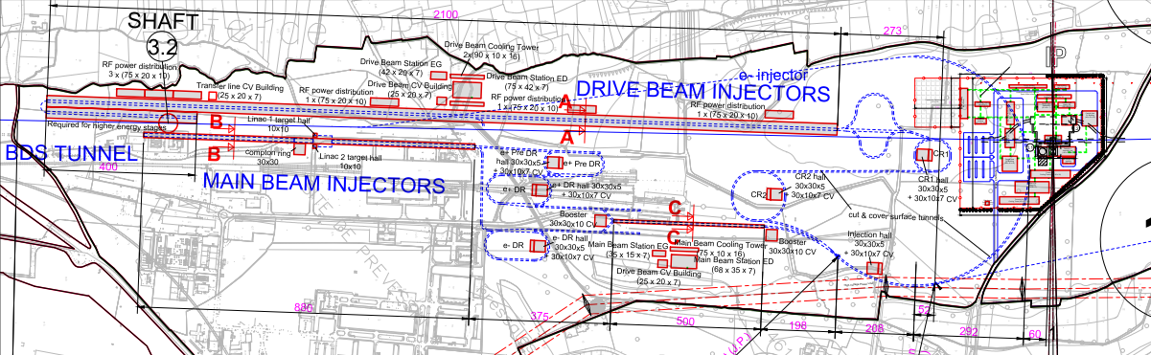
Civil Engineering figures
Figure 6.4
Injection complex (DB injector length to be reduced.
Suggested changes: decrease the visibility of the background to make the injection complex more obvious
Check lengths of the tunnels to ensure they match up with other chapters: Andrea?

Slide 7
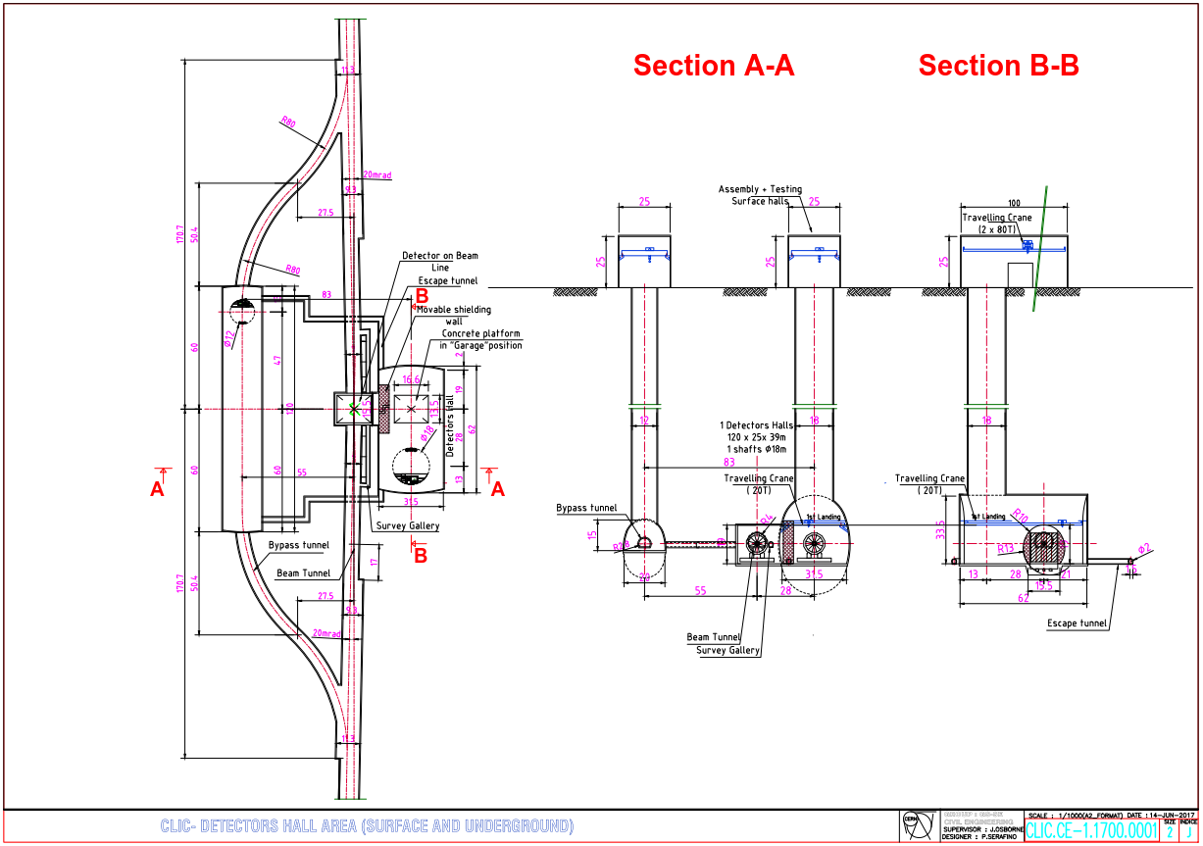
Civil Engineering figures
Figure 6.5
Interaction region: No changes needed to the actual drawing.
Make the text larger to improve the figure.
Any other changes foreseen to the interaction region?

Slide 8
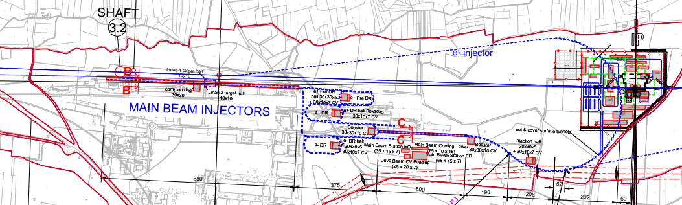
Civil Engineering figures
Figure 6.6
Klystron Injection complex
Again make the injection complex clearer by reducing the visibility of the background

Slide 9
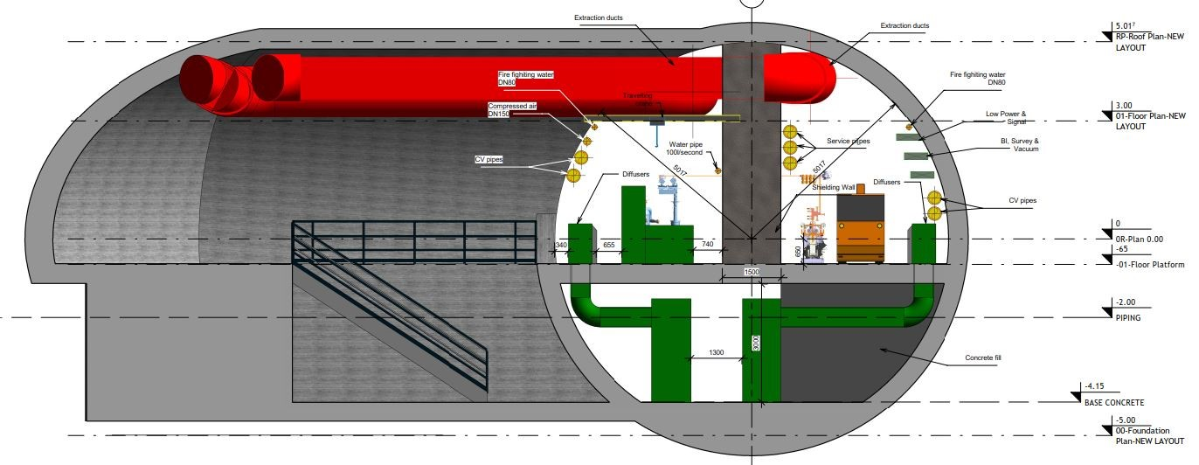
Civil Engineering figures
Figure 6.7
Klystron Tunnel cross-section
Integration of the smoke extraction required.
Any other changes – increase text size to ensure it is legible in the document.

Slide 10
Project Implementation Plan Summary
Chapter | Discipline | Pages | Comments | Responsible person | PiP Status |  | Cost Status
CEIS
 | Civ. Eng | 5/5 | Pages increased to 5 for CE | John Osborne/Matt Stuart | First draft completed | ☺☺ | First Estimate | ☺
 | Electicity supply | 5/3 |  | Davide Bozzini | First draft completed | ☺☺ | First Estimate | ☺
 | CV | 4/3 |  | Mauro Nonis | First draft completed | ☺☺ | Not Received | ☹
 | Transport and Installation | 4/3 |  | Ingo Ruehl/Michael Czech | First draft completed | ☺☺ | First Estimate | ☺
 | Safety systems | 4/3 | incl. enviroment and access | Simon Marsh | First draft completed | ☺☺ | First Estimate | ☺
 | Radiation studies | 3/3 |  | Markus Widorski | First draft completed | ☺☺ | N/A
 | Cryo | 0/3 | in case of SC solenoid, check | Dimitri Delikaris | NA |  | N/A
Project Implementation Plan (PiP) Produced for ESU.
25 page document compiled and reviewed.
Final edit of the document text completed by the end of September.
Final figures need to be added into the PiP as soon as possible
Cost Estimates for most disciplines completed.
  Still waiting for CV.
First draft of PBS completed

Slide 11
Project Implementation Plan Summary
Summary:
PiP First draft completed, reviewed and changes made.
Final PiP to be completed with all figures up to date by the 1st of November
Next PBS review will be in October (exact date TBC) – Official reviewers to be present
Still require costs from some disciplines.
Next CEIS Meeting on the 16th of November 2018
Future Study:
Still some Work on integration of the CV ducts required.
Smoke extraction Integration started – still needs completing.
Figures and tables for the PiP to be completed
References required for the PiP – please send through

