Slide 1

Civil Engineering, Infrastructure & Siting (CEIS) Working Group Introduction
John Osborne – Matthew Stuart SMB-SE-FAS

Slide 2
PiP Status Update
Formally Launching Drawings for PiP Approval
  Civil Engineering

Slide 3
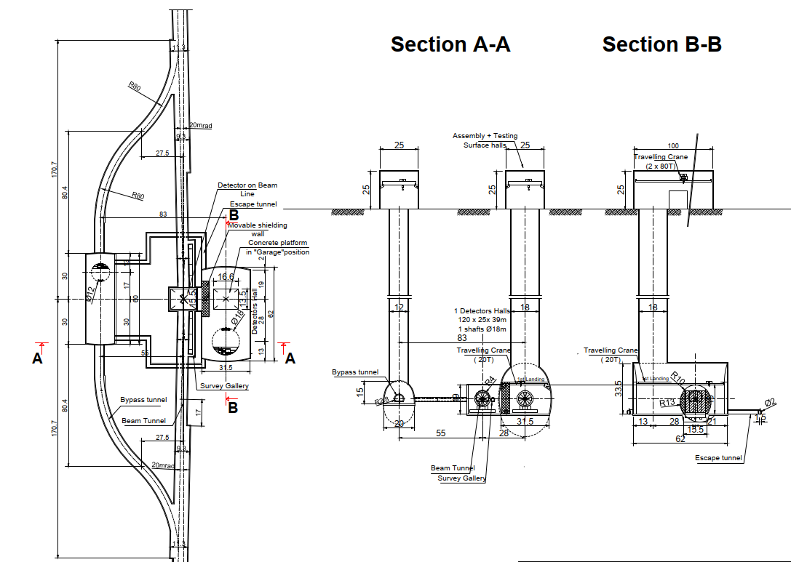
Civil Engineering figures
Detector Hall Area
Same for both the Klystron and Drive Beam options.
Service Cavern size reduced to 60m
No changes foreseen, ready to issue.

Slide 4
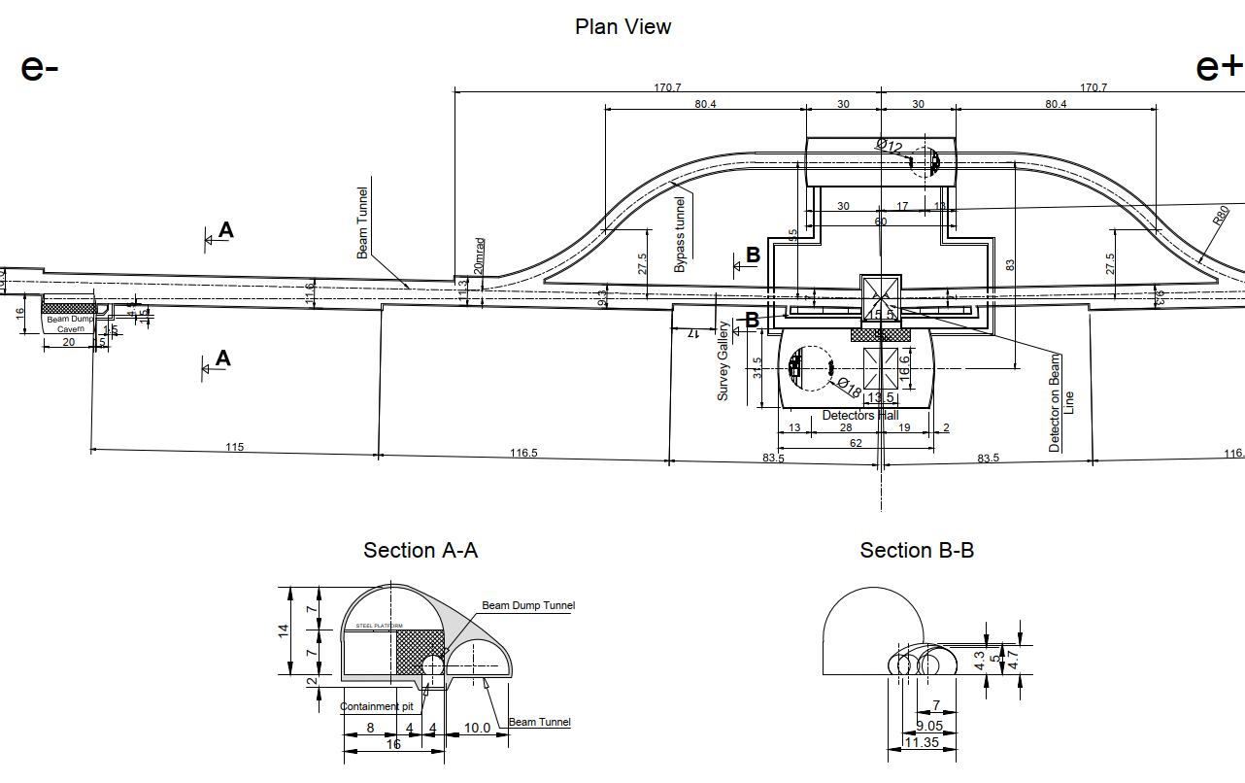
Civil Engineering figures
Main Beam Dumps
No changes foreseen, ready to issue

Slide 5
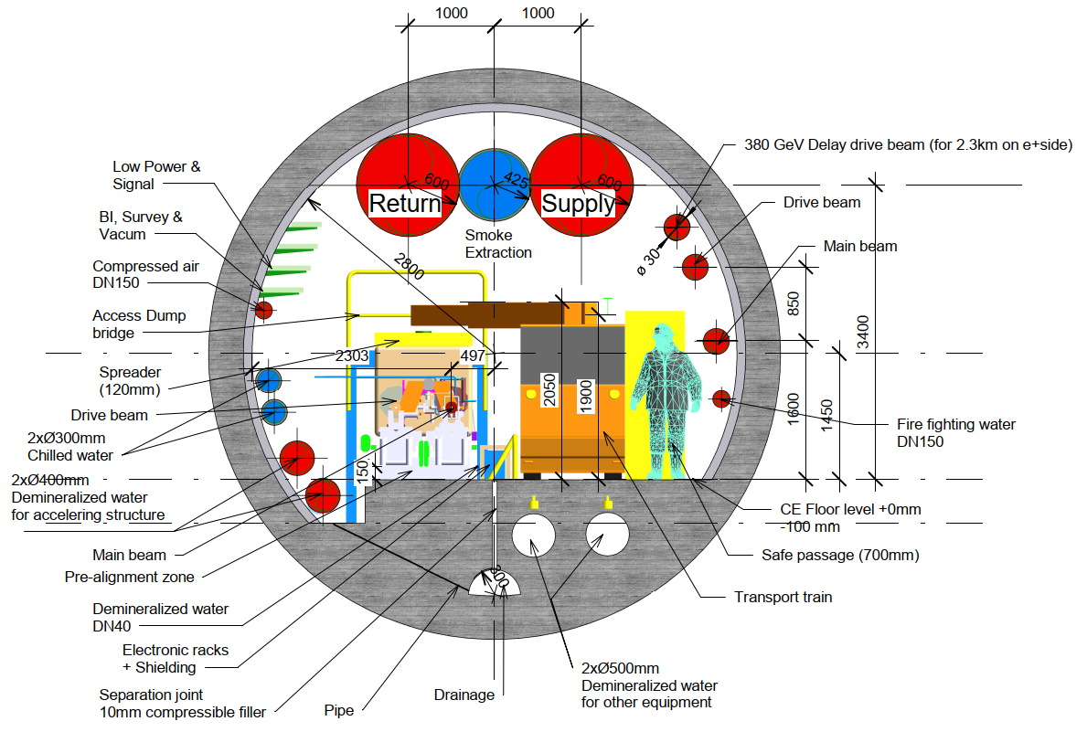
Civil Engineering figures
Drive Beam Cross-section
Smoke extraction duct to be raised
Cable trays removed and water pipes raised.
Beam lines lowered slightly
Any other changes required?

Slide 6
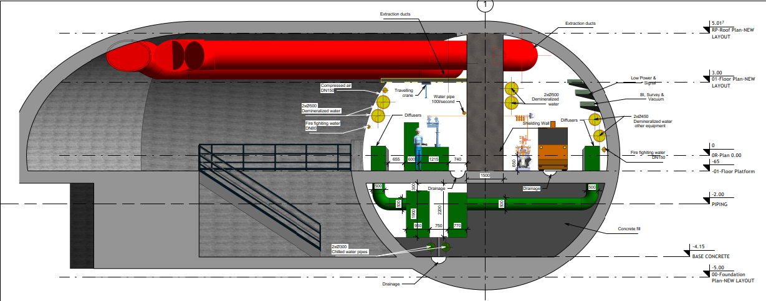
Civil Engineering figures
Klystron Cross-section
All services now in place?
Water pipe: 100l/s – is this necessary?
Smoke extraction to be described in CV chapter of PiP – utilises extraction ducts
Text size to be increased further.

Slide 7
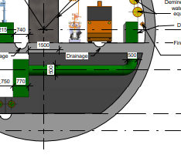
Civil Engineering figures
Klystron Cross-section
Proposed layout for ladder access to allow movement between the two tunnel sides at every UTRA for works access only – 878m.
Not an emergency escape route

Slide 8
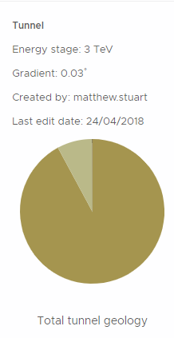
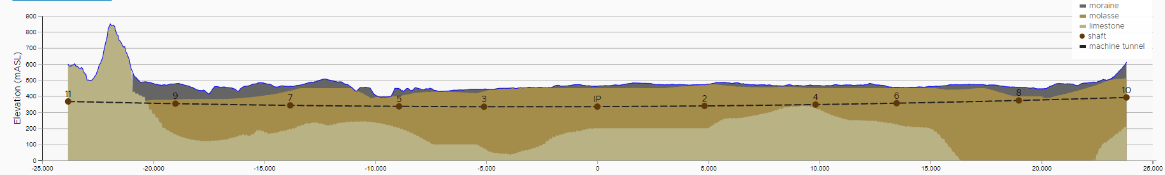
Civil Engineering figures
Figure 6.3
Geological profile
Important profile for the PiP – very difficult to see in the PiP due to length of the figure. Could potentially use a table to show the percentage of the different geology’s?

Slide 9
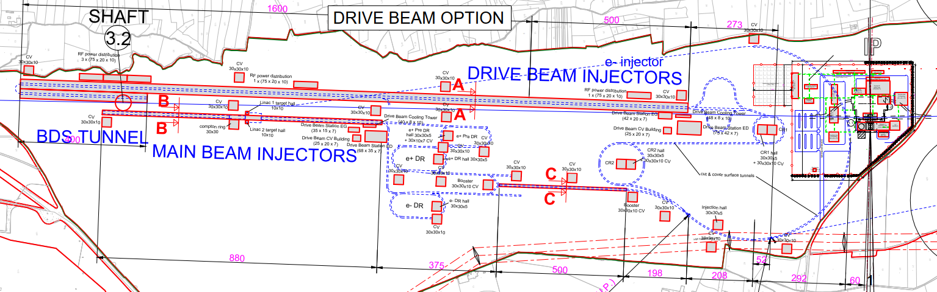
Civil Engineering figures
Drive Beam Injection Complex
Injection complex – 500m of DB surface building only needed at higher energies
Suggested changes: Background visibility has been removed to make the Injection complex clearer
New CV buildings added to ensure compatibility with CV design.
Future changes required for the e⁺ and e⁻ beam lines.

Slide 10
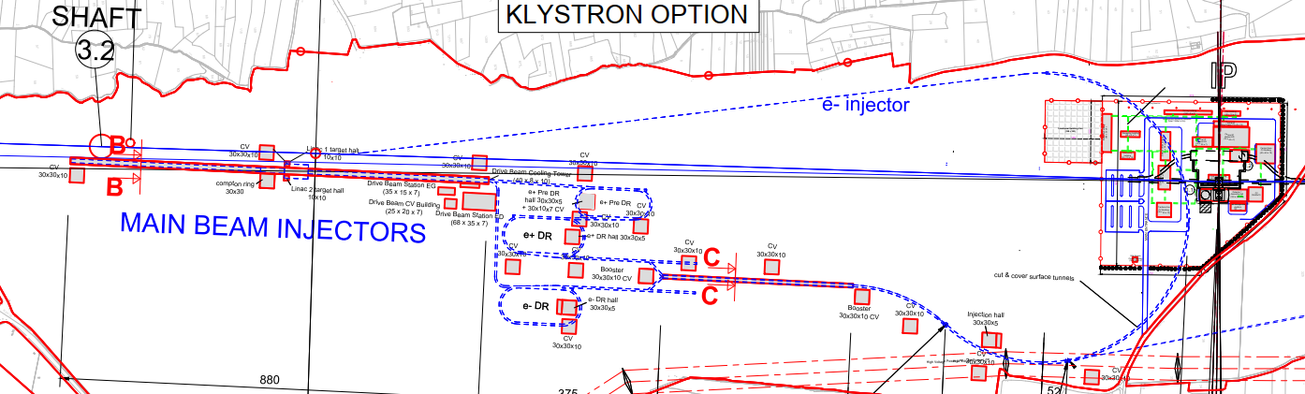
Civil Engineering figures
Klystron Option Injection Complex
Suggested changes: Background visibility has been removed to make the Injection complex clearer
New CV buildings added to ensure compatibility with CV design.
Future changes required for the e⁺ and e⁻ beam lines?

Slide 11
Project Implementation Plan Summary
Chapter | Discipline | Pages | Comments | Responsible person | PiP Status |  | Cost Status
CEIS
 | Civ. Eng | 5/5 | Pages increased to 5 for CE | John Osborne/Matt Stuart | Final Draft Completed | ☺☺ | First Estimate | ☺
 | Electicity supply | 5/3 |  | Davide Bozzini | Final Draft Completed | ☺☺ | First Estimate | ☺
 | CV | 4/3 |  | Mauro Nonis | Final Draft Completed | ☺☺ | First Estimate | ☺
 | Transport and Installation | 4/3 |  | Ingo Ruehl/Michael Czech | Final Draft Completed | ☺☺ | First Estimate | ☺
 | Safety systems | 4/3 | incl. enviroment and access | Simon Marsh | Final Draft Completed | ☺☺ | First Estimate | ☺
 | Radiation studies | 3/3 |  | Markus Widorski | Final Draft Completed | ☺☺ | N/A
 | Cryo | 0/3 | in case of SC solenoid, check | Dimitri Delikaris | NA |  | N/A
Project Implementation Plan (PiP) Produced for ESU.
Document compiled and reviewed and edited.
Final edit of the document text completed.
Final figures placeholders in text.
  The above figures will all be used in the text (where necessary) if no changes are required from this working Group
Cost Estimates completed – Any cost updates/changes to be submitted before the end of next week.
First draft of PBS completed.

Slide 12
Project Implementation Plan Summary
Future Study:
Smoke extraction Integration started – still needs completing.
References required for the PiP – none received so far last chance to send through
Summary:
PiP First draft completed, reviewed and changes made.
Final PiP figures to be included.

