Slide 2
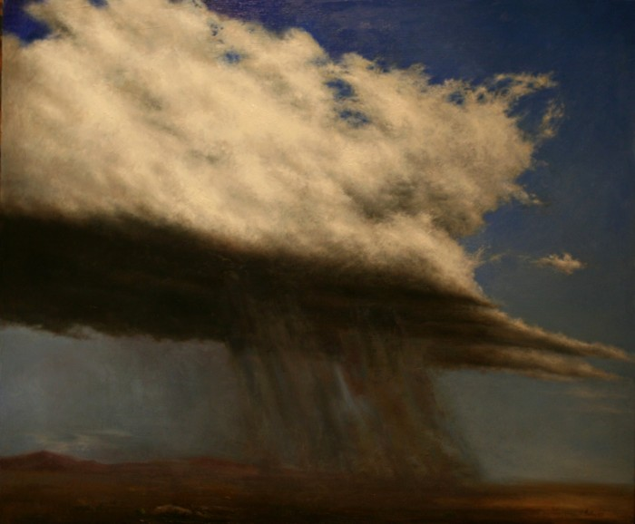
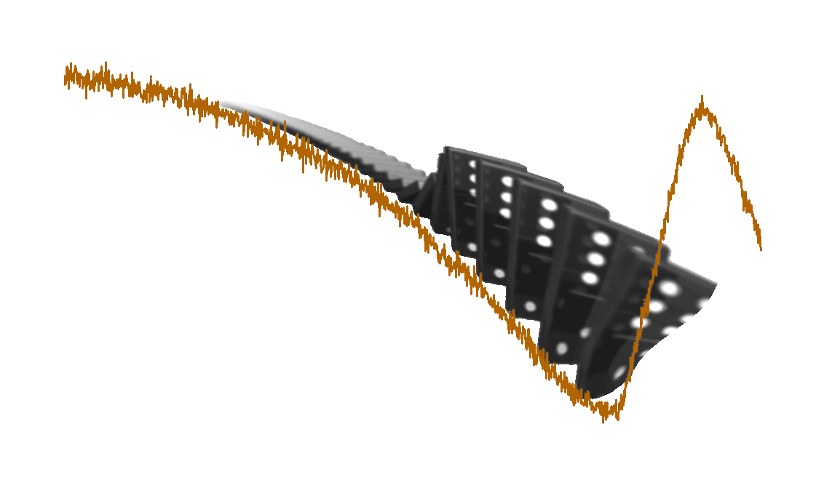
Fifty years without free will.
Aaron Schurger
INSERM Cognitive Neuroimaging Unit
NeuroSpin Research Center
CEA-Saclay, FRANCE

Slide 3
"...She raised one hand and flexed its fingers and wondered, as she had sometimes before, how this thing, this machine for gripping, this fleshy spider on the end of her arm, came to be hers, entirely at her command. Or did it have some little life of its own? She bent her finger and straightened it. The mystery was in the instant before it moved, the deciding moment between not moving and moving, when her intention took effect. It was like a wave breaking. If she could only find herself at the crest, she thought, she might find the secret of herself, that part of her that was really in charge. She brought her forefinger closer to her face and stared at it, urging it to move. It remained still because she was pretending, she was not entirely serious, and because willing it to move, or being about to move it, was not the same as actually moving it. And when she did crook it finally, the action seemed to start in the finger itself, not in some part of her mind. When did it know to move, when did she know to move it? There was no catching herself out..."
McEwan, I. Atonement. New York: Random House; 2001. pp. 33-34
Notes:
Noticed that I did not say “conscious decision” to move.

Slide 4
"...She raised one hand and flexed its fingers and wondered, as she had sometimes before, how this thing, this machine for gripping, this fleshy spider on the end of her arm, came to be hers, entirely at her command. Or did it have some little life of its own? She bent her finger and straightened it. The mystery was in the instant before it moved, the deciding moment between not moving and moving, when her intention took effect. It was like a wave breaking. If she could only find herself at the crest, she thought, she might find the secret of herself, that part of her that was really in charge. She brought her forefinger closer to her face and stared at it, urging it to move. It remained still because she was pretending, she was not entirely serious, and because willing it to move, or being about to move it, was not the same as actually moving it. And when she did crook it finally, the action seemed to start in the finger itself, not in some part of her mind. When did it know to move, when did she know to move it? There was no catching herself out..."
McEwan, I. Atonement. New York: Random House; 2001. pp. 33-34
Notes:
Noticed that I did not say “conscious decision” to move.

Slide 5

"...She raised one hand and flexed its fingers and wondered, as she had sometimes before, how this thing, this machine for gripping, this fleshy spider on the end of her arm, came to be hers, entirely at her command. Or did it have some little life of its own? She bent her finger and straightened it. The mystery was in the instant before it moved, the deciding moment between not moving and moving, when her intention took effect. It was like a wave breaking. If she could only find herself at the crest, she thought, she might find the secret of herself, that part of her that was really in charge. She brought her forefinger closer to her face and stared at it, urging it to move. It remained still because she was pretending, she was not entirely serious, and because willing it to move, or being about to move it, was not the same as actually moving it. And when she did crook it finally, the action seemed to start in the finger itself, not in some part of her mind. When did it know to move, when did she know to move it? There was no catching herself out..."
“the neural decision to move”
The hypothetical neural event that commits some part of the body to an imminent movement.
McEwan, I. Atonement. New York: Random House; 2001. pp. 33-34
Notes:
Noticed that I did not say “conscious decision” to move.

Slide 6
When is the neural decision to act, relative to the onset of the action itself?
How is it related to the conscious decision or urge to move?
Notes:
We’re not just interested in when we feel the conscious urge to move, but rather when we feel that urge relative to when the brain commits to producing the movement.

Slide 7
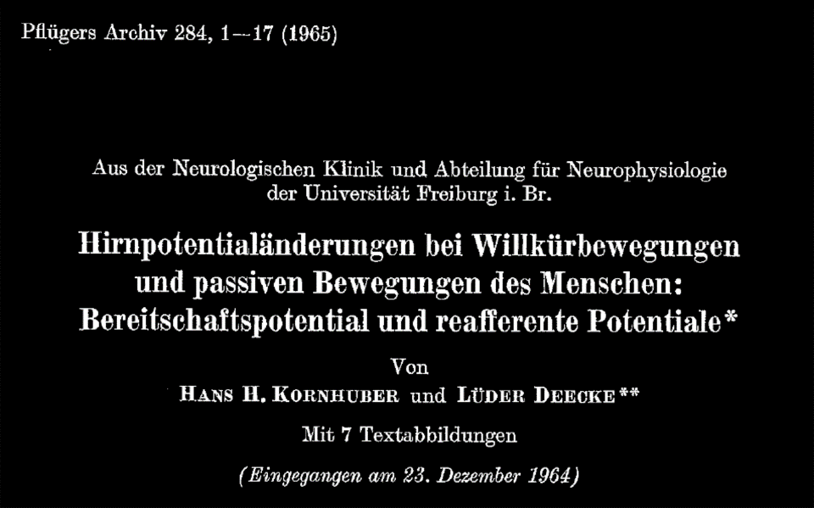
Notes:
Changes in brain potentials with willful and passive movements in humans: the readiness potential and reafferent potentials.
Currently celebrating its 50th anniversary.
They did something that, at the time was quite radical… they asked subjects to [next slide]
----- Meeting Notes (10/16/15 12:45) -----
Maybe translate the title on the slide.

Slide 8
Changes in brain potentials with willful and passive movement in humans: the readiness potential and reafferent potentials.
Notes:
Changes in brain potentials with willful and passive movements in humans: the readiness potential and reafferent potentials.
Currently celebrating its 50th anniversary.
They did something that, at the time was quite radical… they asked subjects to [next slide]
----- Meeting Notes (10/16/15 12:45) -----
Maybe translate the title on the slide.

Slide 9
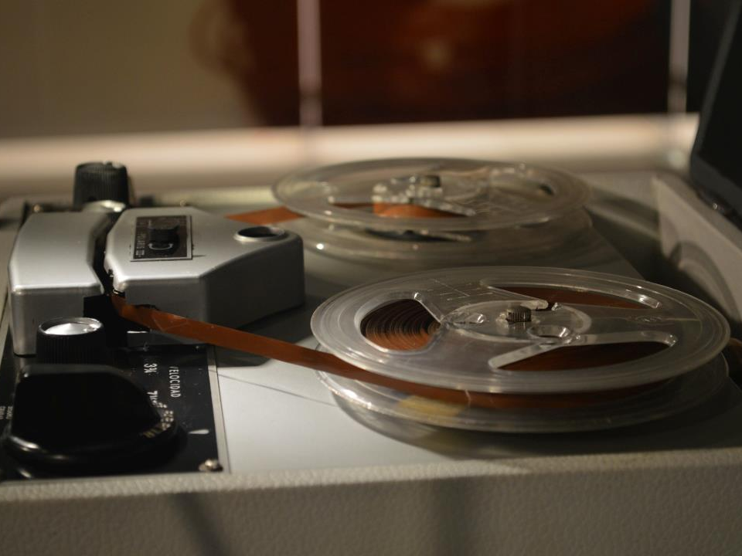
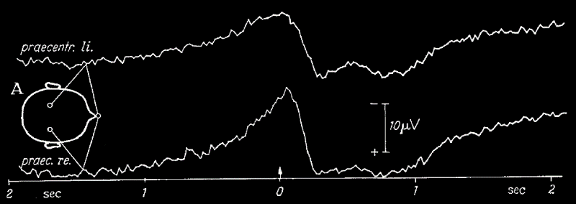
Bereitschaftspotential or readiness potential
Kornhüber and Deecke (1965) Pflügers Archiv 284, 1-17
Subjects asked to:
Perform self-paced (uncued) movements.
“…not rhythmic, but rather at irregular intervals.”
“Pause at least 15 sec between movements, but not more than about 25 sec.”
Notes:
One of the most likely candidates for “neural decision to move” was the RP, discovered by K&D in 1965…

Slide 10
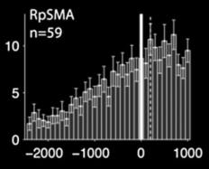
Bereitschaftspotential or readiness potential
“…the electrophysiological sign of planning, preparation, and initiation of volitional acts.”
primates (Romo and Schultz 1986, 1992; Lee and Assad, 2003; Maimon and Assad 2006)
rodents (Hyland 1998; Chapin et al 1999; Seki et al, 2005; Isomura et al 2009)
firing rate (spks/ s)
crayfish (Kagaya & Takahata 2011)
time (ms)
Fried et al 2011 (human premotor)
Notes:
One of the most likely candidates for “neural decision to move” was the RP, discovered by K&D in 1965…
----- Meeting Notes (10/16/15 12:45) -----
What layer were they in, when recording from single neurons. Maybe focus more on this being a mechanistic explanation rather than on the crayfish posing a special mystery. First mechanistic explanation offered.

Slide 11
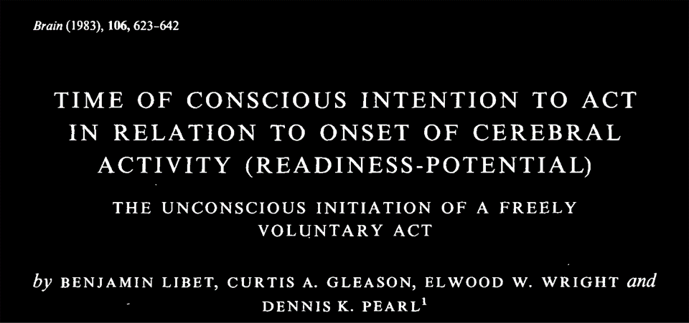
Notes:
About 20 years later…

Slide 12
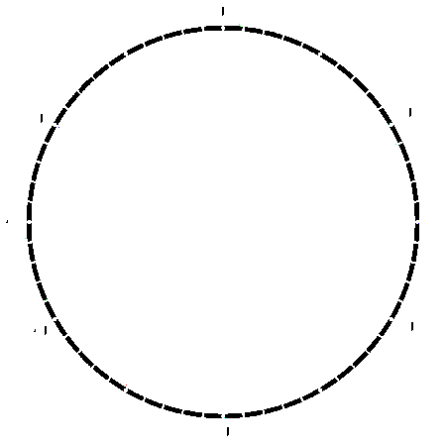
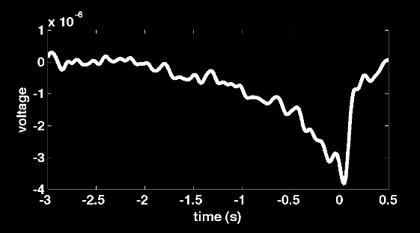
-1.5
-1
-0.5
0
Libet et al (1983) Brain 106, 623-642
Subjects asked to:
“At any time … when he felt like doing so, to perform the quick, abrupt flexion …”
“let the urge to act appear on its own at any time without any preplanning or concentration on when to act”
“that is, try to ‘be spontaneous’” [emphasis added]
Notes:
Libet knew about the RP, but he was more interested in consciousness and in particular the conscious sensation of an urge or an intention to move. Now we had this temporal marker of “planning and preparation for movement” in EEG data, and so Libet then wanted to use that marker [as a point of reference] to look at the time of the conscious intention to act with respect to the sequence of neural activity leading up to movement.
Libet was concerned with the decision time (W). I am now concerned with the time of the RP itself (in red).
Note that same has been replicated at single-neuron level (Fried et al 2011)

Slide 13
-1.5
-1
-0.5
0
Libet et al (1983) Brain 106, 623-642
RP
Conscious decision
Movement
Subjects asked to:
“At any time … when he felt like doing so, to perform the quick, abrupt flexion …”
“let the urge to act appear on its own at any time without any preplanning or concentration on when to act”
“that is, try to ‘be spontaneous’” [emphasis added]
(W time)
Notes:
Libet knew about the RP, but he was more interested in consciousness and in particular the conscious sensation of an urge or an intention to move. Now we had this temporal marker of “planning and preparation for movement” in EEG data, and so Libet then wanted to use that marker [as a point of reference] to look at the time of the conscious intention to act with respect to the sequence of neural activity leading up to movement.
Libet was concerned with the decision time (W). I am now concerned with the time of the RP itself (in red).
Note that same has been replicated at single-neuron level (Fried et al 2011)

Slide 14

The prevailing view…
DECISION
(neuronal)
OUTCOME
“planning and preparation for movement”
MOVEMENT
time
When self becomes conscious of the decision to move
Notes:
The prevailing view
----- Meeting Notes (10/16/15 12:45) -----
Copy just picture of domino RP back to definition slide (neural decision to move).

Slide 15
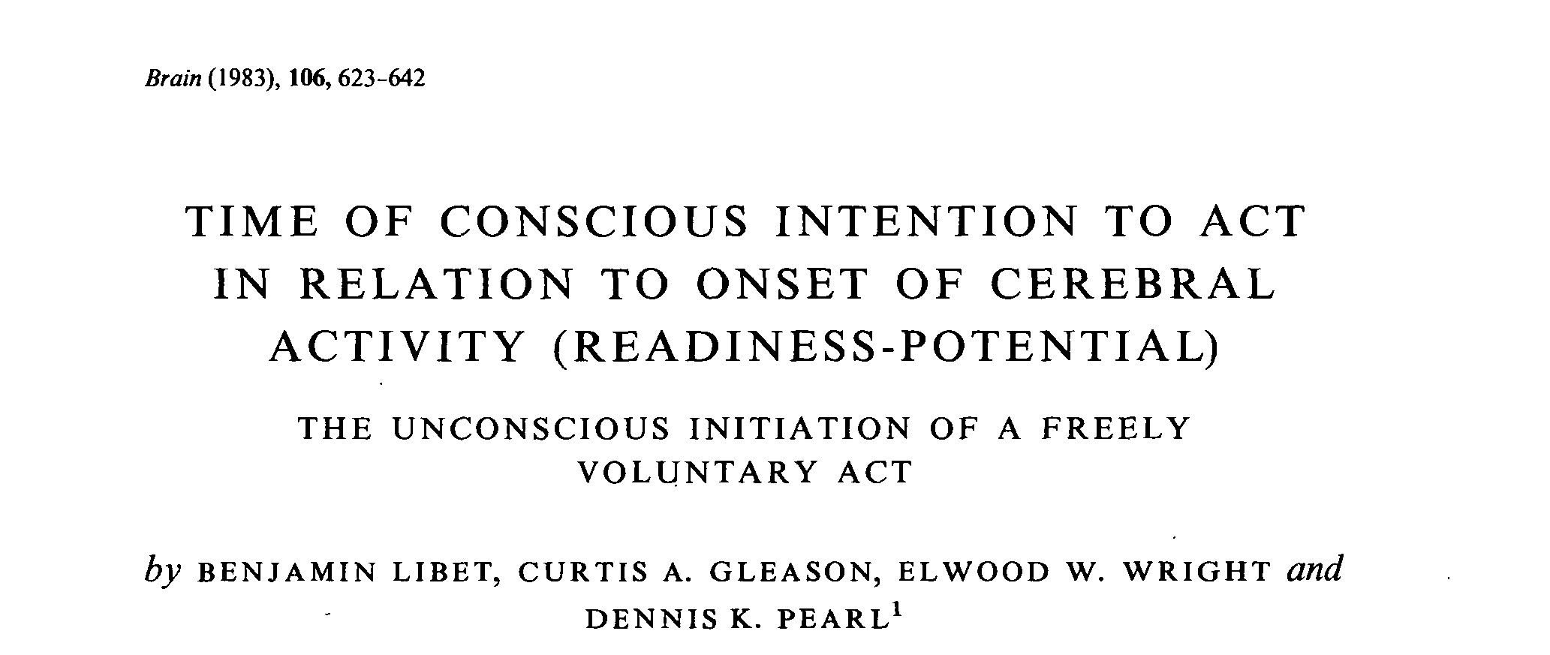
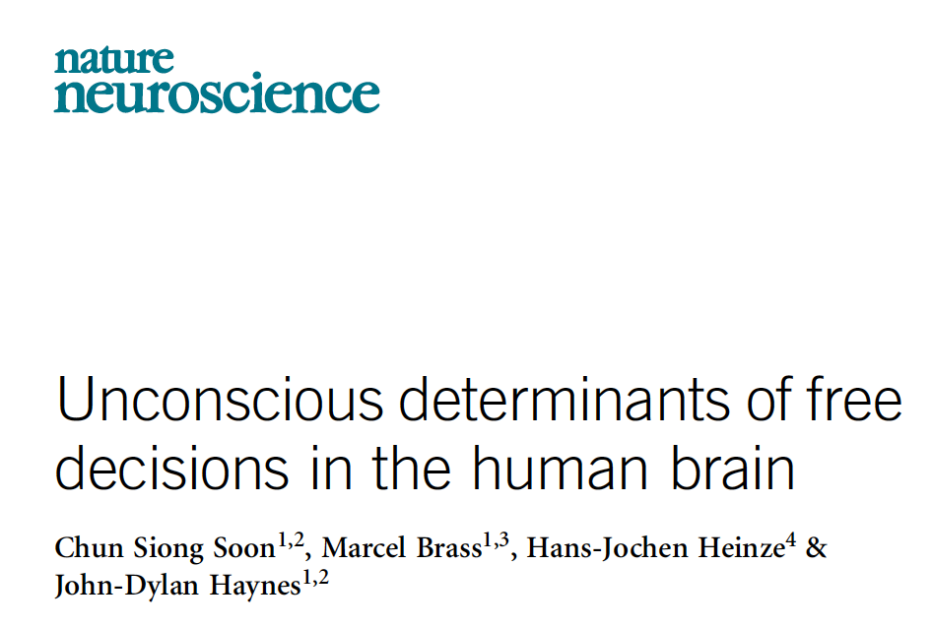
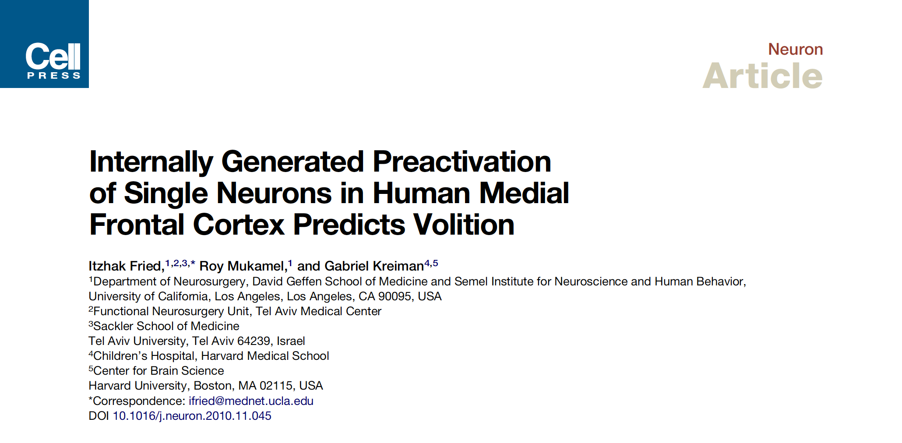

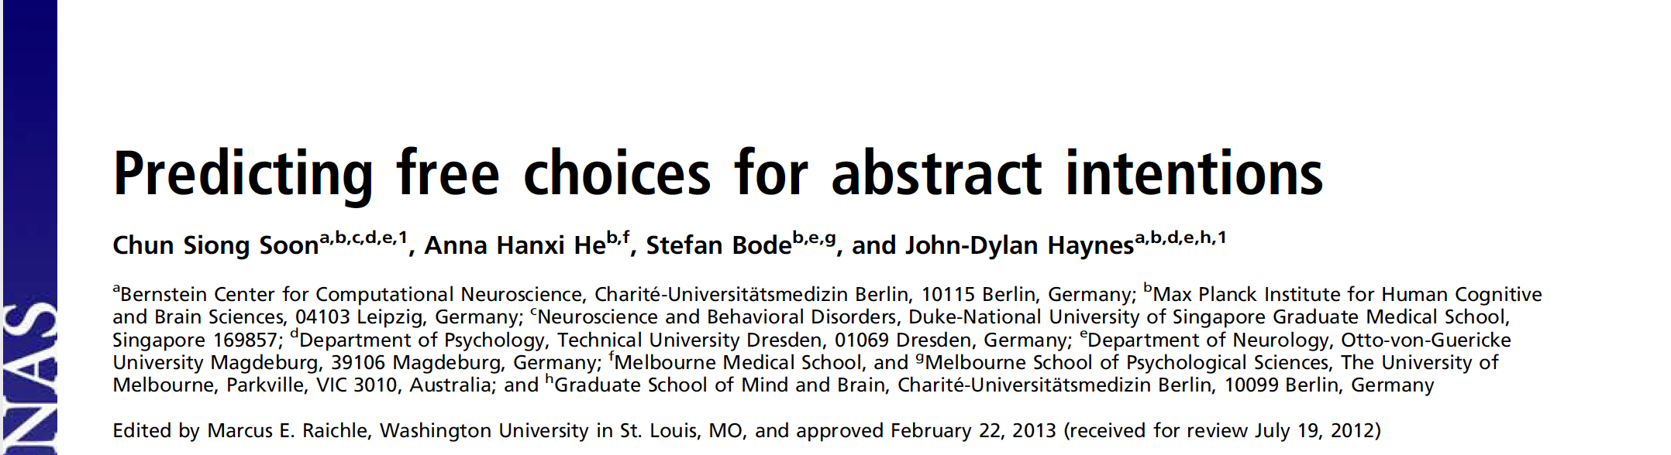
Notes:
These will not be the last!
And don’t forget Grey-Walter.

Slide 16
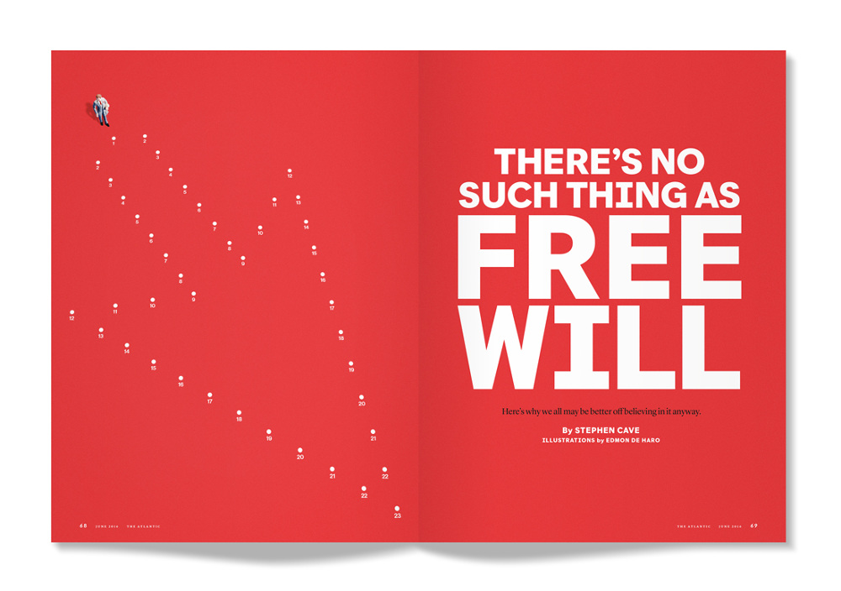
Notes:
The Atlantic
June 2016

Slide 17
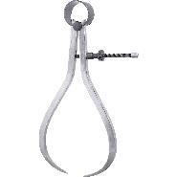
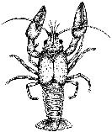
Puzzling questions
Subjects are quite accurate in estimating the time of sensory perceptual decisions [+/- 50 ms] (Libet 1983)
  Why not motor decisions as well?
The RP has not proven to be a highly informative signal feature for brain-computer interfaces.
  c.f. Bai et al, Clin Neurophysiol (2010), Mason & Birch, IEEE (2000), Lew et al, Front Neuro Eng (2012)
The crayfish has a readiness potential.
  But has no motor cortex (no cortex at all, in fact)
Kagaya & Takahata, j Neurosci, 2010
Procambarus clarkii
Notes:
In spite of fifty years of research, we still lack a coherent mechanistic account of the RP beyond descriptive phrases like “planning and preparation for movement”.

Slide 18
An new perspective on the RP …
(by way of metaphor)
Flu season
Each participant wears a portable health monitor at all times throughout the season
Minute-by-minute “life points” are recorded
If volunteer gets sick with the flu, the date/time of onset is noted.
THOUGHT
EXPERIMENT
Large population
Scientific question: ætiology of the flu
Notes:
Zero life points = death.

Slide 19
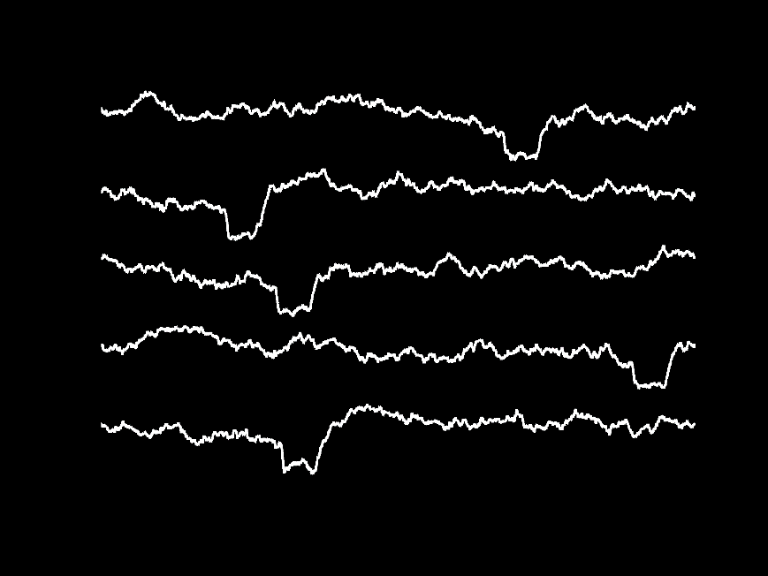
•
•
•
= onset of flu symptoms
time →

Slide 20
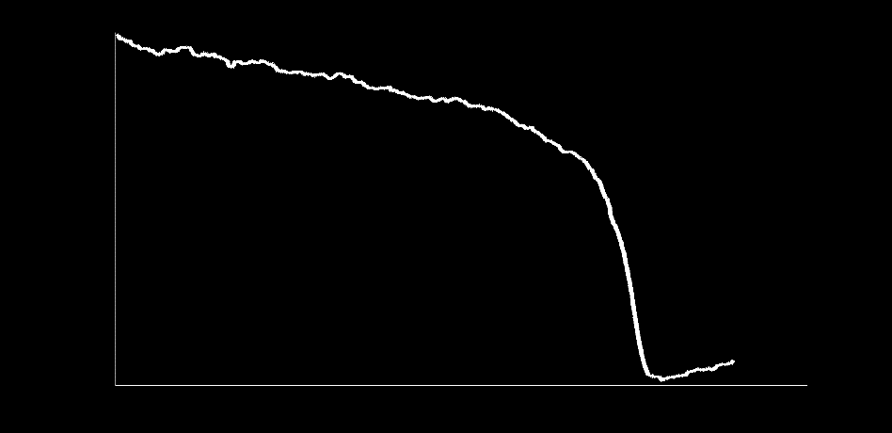
The road to the flu
onset of
symptoms
-3d
-2d
-1d
t₀

Slide 21
The road to the flu
onset of
symptoms
-3d
-2d
-1d
t₀
contact with virus
Notes:
If we didn’t know when the contact with the virus happened, and we wanted to find out – that would be tough to do, but it would be somewhere around where the health points take an abrupt transition.

Slide 22
time →

Slide 23
Intrinsic fluctuations caught in the flash photo of event-locked averaging?
-3d
-2d
-1d
t₀

Slide 24
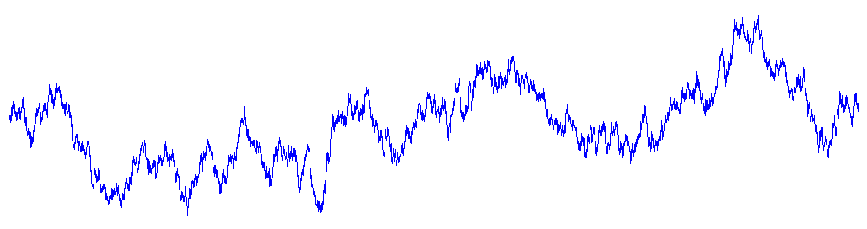
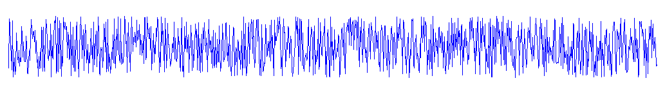
Spontaneous fluctuations in neural activity?
YES
autocorrelated noise
white noise
Notes:
Explain what is autocorrelation.

Slide 25
Q: How might a machine comply with Libet's intructions?
threshold
One possible solution:
Move closer to the threshold
Wait…
Notes:
This is where the cloud idea comes in. An explanation like “well, I just wait a while and then just move” just doesn’t cut, does it.

Slide 26
Schurger, Sitt, & Dehaene PNAS (2012)
Premise #1
Brain uses the same mechanism for decision making in Libet’s (1983) task as it would in any decision-making task:
  Accumulation of evidence to a threshold.
  Except, in this case, there is no “evidence” per se.
    Mostly internal “noise”
    Plus a weak imperative to move

Slide 27
Schurger, Sitt, & Dehaene PNAS (2012)
Premise #2
When the imperative to produce a movement is weak or absent, the precise moment at which the decision threshold is crossed is largely determined by spontaneous sub-threshold fluctuations in neuronal activity.

Slide 28
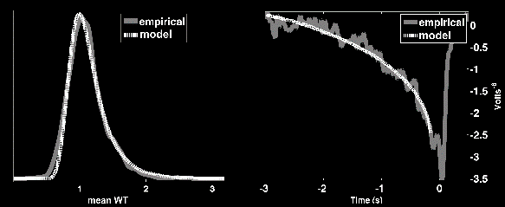

“stochastic decision model”
(1) “imperative”
(2) leak
(noise)
dx = (I – kx) + ξ
(3) threshold on x
BEHAVIORAL
EEG
electro-
encephalography
Schurger, Sitt, & Dehaene, PNAS, 2012
Notes:
In my own recent research, I’ve shown that the pre-movement buildup might reflect ongoing random fluctuations in neural activity, rather than a specific intentional process.
We used the same kind of computational model that is commonly used with cued decision-making tasks: accumulation to a decision threshold.
Except that we paid special attention to the role of noise in determining the threshold crossing.
According to the model, when the imperative to move is weak, then the precise threshold crossing time is largely determined by random autocorrelated fluctuations in neural activity, which appear in the time-locked average as a slow non-linear buildup.
Using this model we were able to account for both behavioral and EEG data from subjects performing a self-initiated movement task, and confirm a novel prediction.
Thus, what appears to be a sign of planning and preparation for movement might simply be there because self-initiated movements tend to coincide with crests in autocorrelated neural noise – which happens, by the way, to be similar in both vertebrates and invertebrates.

Slide 29

Another test of the model
INTERRUPTION
EXPERIMENT
After doing the classic Libet task for 20 minutes…
Repeat the same task again, but this time an occasional “click” is heard at a random time during the trial.
Subject makes spontaneous button presses as usual, but if the click is heard before the movement is made, then subject is to press the button immediately (i.e. speeded response to click).
Notes:
SAY THAT “TRIAL ENDS WHEN EITHER SUBJECT MAKES SPONTANEOUS MOVEMENT -OR- CLICK IS HEARD.

Slide 30
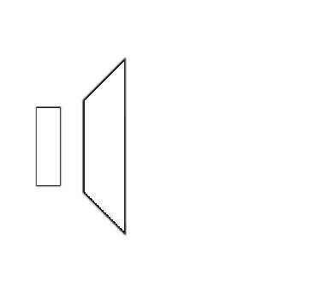
PREDICTION
INTERRUPTION EXPERIMENT
Fast RT's to interruptions should be preceded by a buildup in (-) signal amplitude beginning well before the interruption itself, even when the subject was not preparing to move at that particular moment.

Slide 31
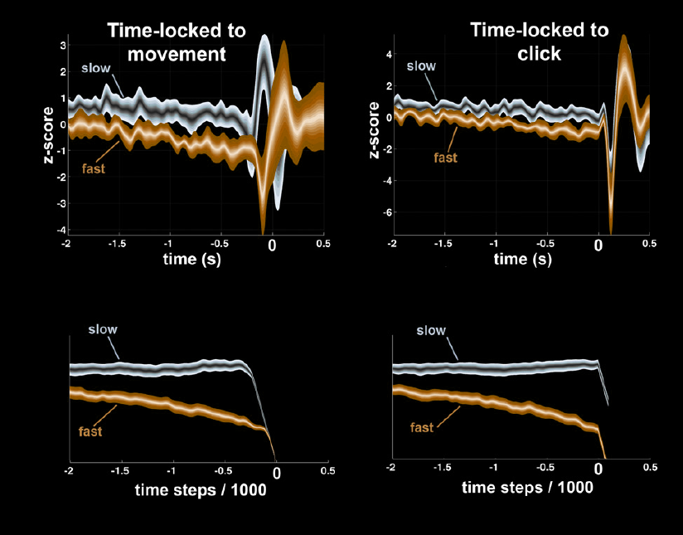
Empirical test of the model
E M P I R I C A L
M O D E L
Notes:
How can you “prepare” for a movement that you don’t even know you are going to make?
Mention that we controlled for various
----- Meeting Notes (10/16/15 12:45) -----
** I never said whether this was EEG or MEG or intracranial. Need to show for each study, what kind of data it is. **

Slide 32
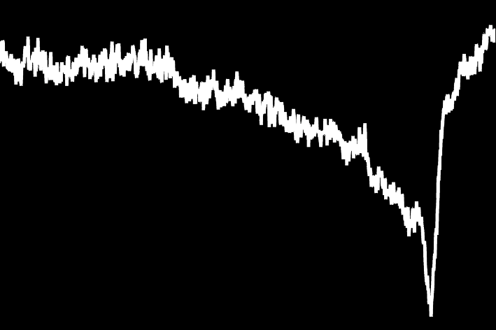
Our not-yet-prevailing view…
Jo et al., Exp Brain Res, 2013
Bengson et al., JoCN, 2014
Yellin et al., NIMG, 2014
Murakami et al., Nat Neuro, 2014
Schultz-Kraft, et al., PNAS, 2016
> 500 ms
Spontaneous fluctuations
The neural decision to move
A threshold crossing event (?)
~ 200 ms pre-movement (?)
Schurger et al, TICS, 2015
Notes:
Our not-so-prevailing view, which is supported by these subsequent studies…
Cortico-spinal excitability, lateralization, subjective estimates.

Slide 33
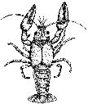
Answers to puzzling questions…
The crayfish (Procambarus clarkii) also exhibits a readiness potential, with roughly the same time constant as the human RP (~ 3 sec).
  But has no motor cortex (no cortex at all, in fact)
Kagaya & Takahata, j Neurosci, 2011
Kagaya & Takahata, Science, 2011
???
Notes:
----- Meeting Notes (10/16/15 12:45) -----
Don't harp too much on the crayfish thing. Harp on the fact that we have a mechanistic explanation that offers an account.

Slide 34

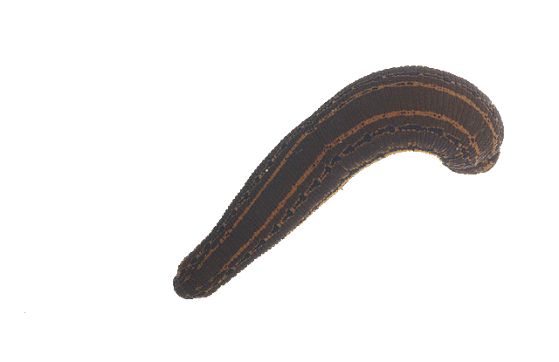
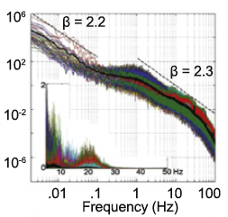
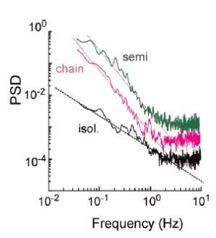
Answers to puzzling questions…
β = 2.0
The crayfish (Procambarus clarkii) also exhibits a readiness potential, with roughly the same time constant as the human RP (~ 3 sec).
  But has no motor cortex (no cortex at all, in fact)
Garcia-Perez et al 2007
He at al 2010
???
Notes:
When this little guy transitions from a resting state to a foraging state, the precise time also rides on spontaneous ongoing fluctuations in his neural activity.
----- Meeting Notes (10/16/15 12:45) -----
Forgot to mention that the little creature is a leech!

Slide 35
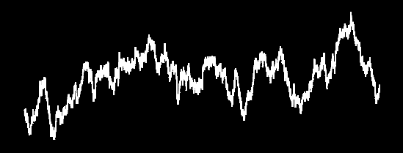
Answers to puzzling questions…
The RP has not proven to be a highly informative signal feature for asynchronous BCIs.
  c.f. Bai et al, Clin Neurophysiol (2010), Mason & Birch, IEEE (2000), Lew et al, Front Neuro Eng (2012)
The crayfish (Procambarus clarkii) also exhibits a readiness potential, with roughly the same time constant as the human RP (~3 sec).
  But has no motor cortex (no cortex at all, in fact)
Notes:
False alarms is the limiting factor.

Slide 36
Answers to puzzling questions…
Subjects are accurate in estimating the time of sensory perceptual decisions (+/- 50 ms)
  Why not for motor decisions as well?
The RP has not proven to be a highly informative signal feature for asynchronous BCIs.
  c.f. Bai et al, Clin Neurophysiol (2010), Mason & Birch, IEEE (2000), Lew et al, Front Neuro Eng (2012)
The crayfish (Procambarus clarkii) also exhibits a readiness potential, with roughly the same time constant as the human RP (~3 sec).
  But has no motor cortex (no cortex at all, in fact)
Yes, why not!
Notes:
Try to reach this point within 30 minutes.
----- Meeting Notes (10/16/15 12:45) -----
Maybe explain this a bit better. Don't go too fast.

Slide 37
In summary:
The stochastic decision model…
accounts for the electrophysiological and behavioral variables in Libet’s (1983) task
argues for a late commitment (~ -200ms) in spontaneous voluntary movements
argues that the conscious intention has a meaningful and reasonably accurate relationship with the decision to move.
suggests that a pre-event buildup may be a general phenomenon rather than a specific mechanism.

Slide 38
Epochs with movement
Epochs without movement
Notes:
So we’re suggesting that the neural decision to move is relatively late, consistent with subjective estimates, but how can we try to determine empirically when it happens.

Slide 39
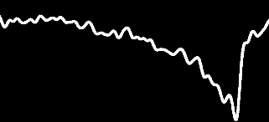
test epochs
Epochs with movement
“baseline”
Epochs without movement
?

Slide 40

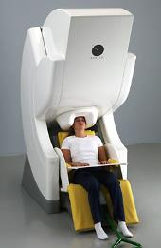
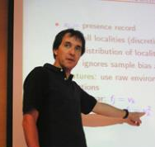
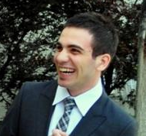

Mapping the time course of neural activity predictive of impending movement using adaBoost
magneto-encephalography
Prof. Rob Schapire
Mehmet Basbug
Department of Computer Science
Princeton University
+
electro-
encephalography
Notes:
----- Meeting Notes (10/16/15 12:45) -----
State what adaBoost is! Say that it is a machine learning technique. Focusing using few subjects and a lot of data per subject - this is what classifiers like.

Slide 41



•
Timed viewing…
•
•
Random shuffling of “manual” and “automatic” trials
auto
Free viewing…
X
manu
Viewing time drawn from subject’s own viewing-time distribution (on manual trials).
•
•
•

Slide 42
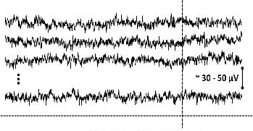
“Movement” condition
Epochs with movement
slide transition only
movement + slide transition
Epochs without movement
“Matched”
control condition
Notes:
Now it’s a fair fight!

Slide 43
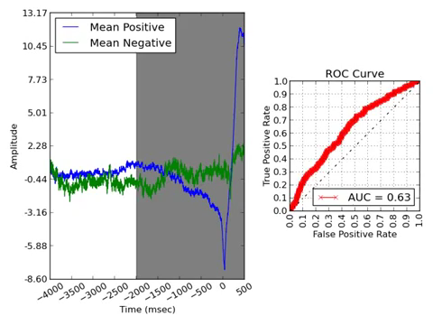
Results : sliding window classification
manual
automatic
Basbug, Schapire, & Schurger (in review)
Notes:
----- Meeting Notes (10/16/15 12:59) -----
Explain what mean positive and mean negative means and explain what ROC curve is a function of ability to tell them apart. This is just showing you a single feature, but classifier is using many features.

Slide 44
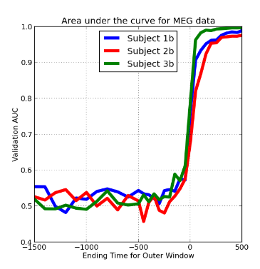
Results : sliding window classification
Validation AUC
Leading edge of window
Basbug, Schapire, & Schurger (in review)
cf. Schultze-Kraft et al, PNAS, 2016
Point of no return ~ -200 ms
~1400 trials per subject
Notes:
----- Meeting Notes (10/16/15 12:59) -----
Maybe skip the Yelisyeyev thing. Or explain it better.

Slide 45
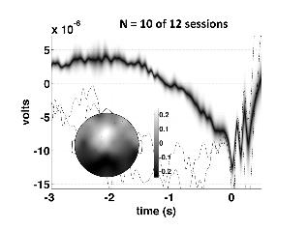
Results : sliding window classification
Readiness potential
Validation AUC
Leading edge of window
Basbug, Schapire, & Schurger (in review)
cf. Schultze-Kraft et al, PNAS, 2016
Point of no return ~ -200 ms
~1400 trials per subject
Notes:
----- Meeting Notes (10/16/15 12:59) -----
Maybe skip the Yelisyeyev thing. Or explain it better.

Slide 46
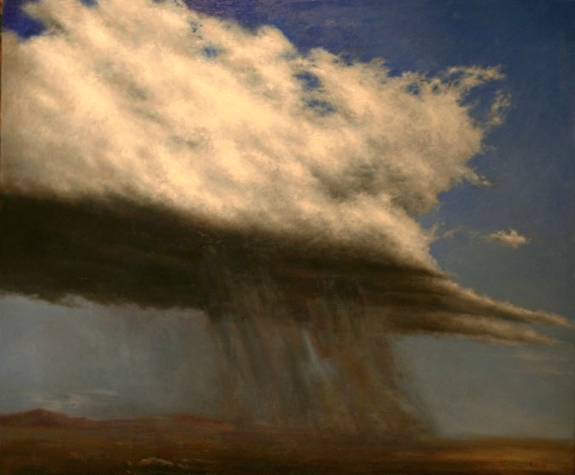

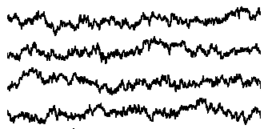
Sampling the conditions that are active when a movement is not about to happen, is integral to being able to reliably predict when movement is going to happen.
Notes:
Our model also exposes an important limitation of using movement-locked data epochs in the study of self-initiated movement, which is the main approach used in this area of research. The problem with movement-locked analyses is that they discount the prior probability of whatever you find in the average. Consider trying to learn to predict the onset of rainfall based only on a sample of rainy days. It will be difficult to generalize to an arbitrary set of conditions, because very often it does not rain. Likewise, in the study of self-initiated movement, sampling the conditions that are active when a movement is not about to happen, is integral to being able to reliably predict when movement is going to happen.

Slide 47
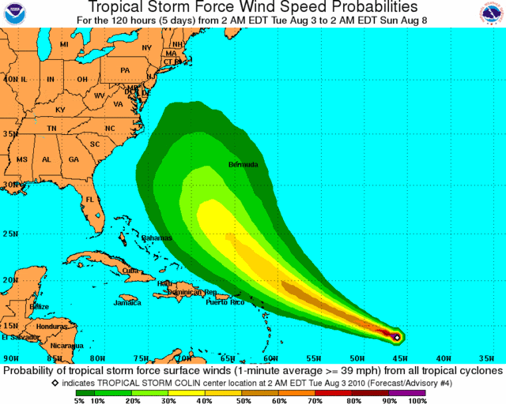

Future directions
Time-unlocked forecasting

Slide 48
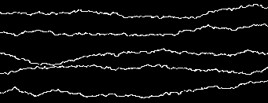


Brain-Behavior Forecasting
stochastic
deterministic
“trigger”
VS
P (S_{t-τ} | M_{t0})
P (M_{t+τ} | S)
time (past)
time (future)
Notes:
The distribution at each point in time in the movement-locked average reflects P(S|T). BBF treats the data as a single continuous time series, looks forward in time, and tries to map the probability of behavior at future times given the present state of the system and its recent past.
Requires a lot of data.
Will use information foraging to get a large amount of data form each subject.

Slide 49


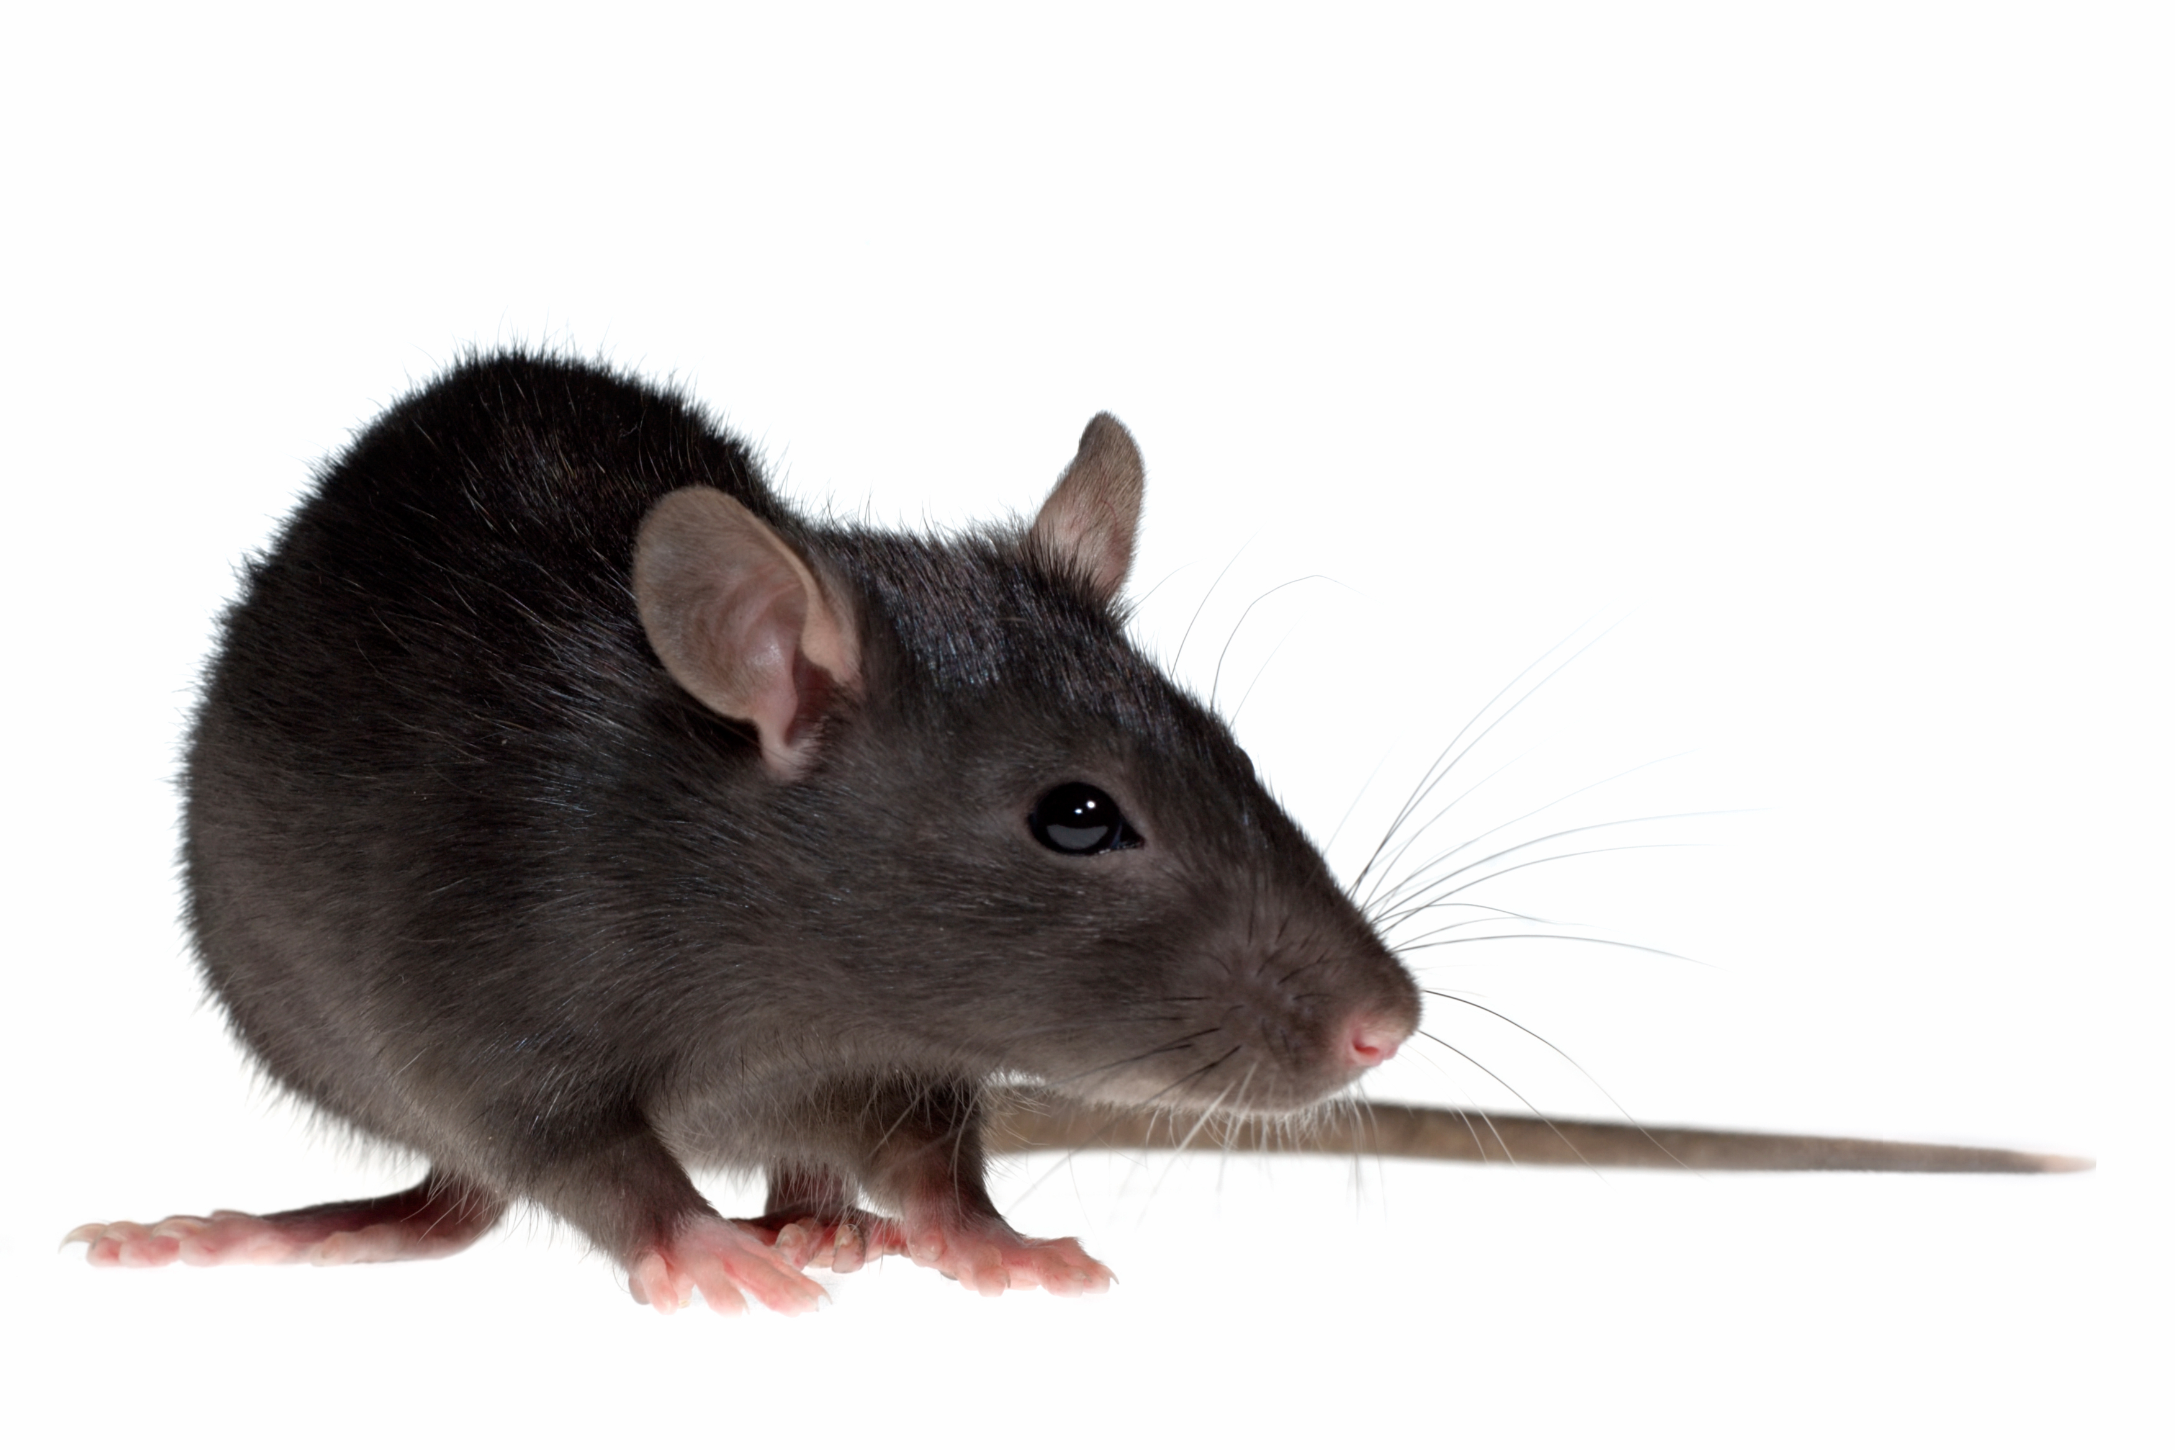
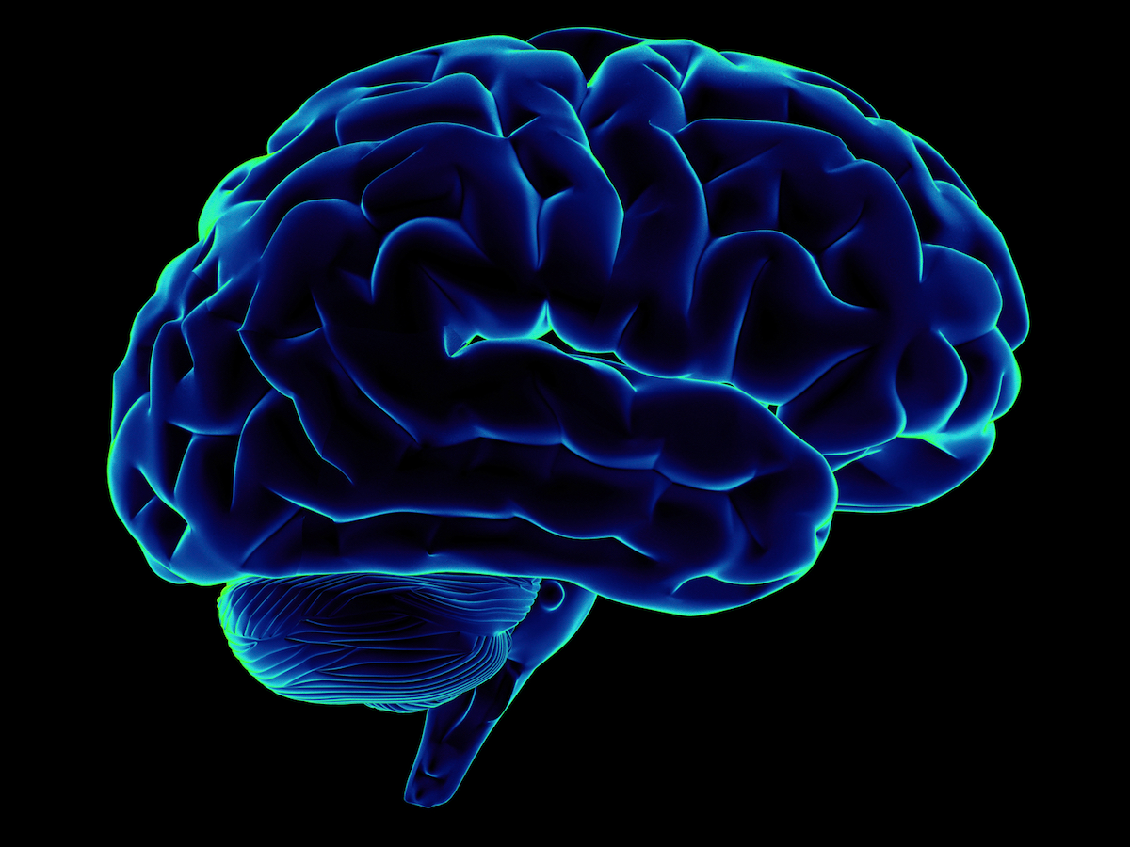
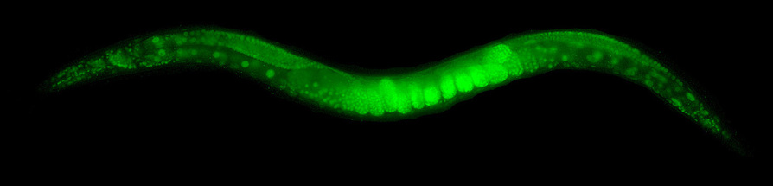
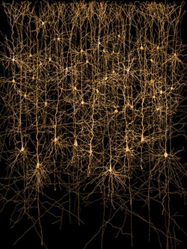
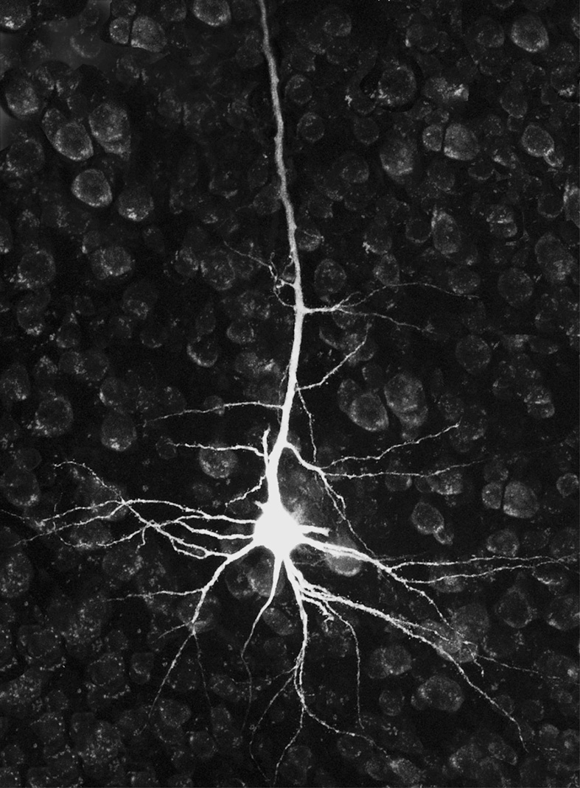
Notes:
A single human brain is arguably more complex than the entirety of the Earth’s atmosphere, and even the local weather can be challenging to predict. Yet some have begun to conclude that when it comes to the brain, the game is essentially won – we just put brain data together with machine learning, and we’re able to predict behavior. I would submit to you that the game has barely just begun – the self-initiation of action remains a profound mystery. For those who prefer to believe in free will, there is as yet no hard empirical evidence to stand in your way.

Slide 50
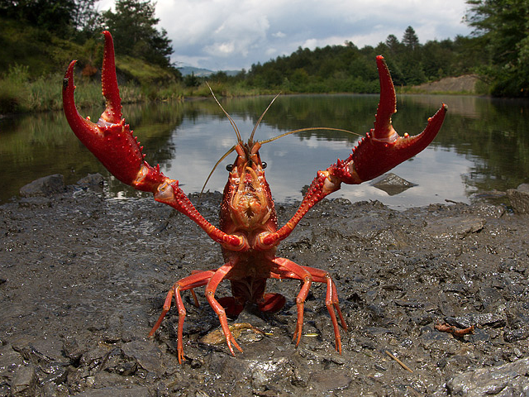
fin
THANK YOU!
Notes:
www.sites.google.com/site/aaronschurger/

Slide 51










Stanislas Dehaene
Jacobo Sitt
Code? | Data? | Questions?
aaron.schurger@gmail.com
www.sites.google.com/site/aaronschurger
Notes:
More clarity on 1/f and leech etc, and also on boosting.

Slide 52
Post script
Have we proven that free will exists?
  No.
We’ve reinterpreted the evidence against, such that it no longer counts as evidence against.
We’ve also introduced a role for neural noise in fixing the precise moment at which spontaneous voluntary actions are initiated.

Slide 53
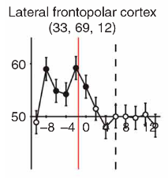
% correct classification
"If you believe that the brain is governed by the laws of nature and that our decisions are realized by our brain, our decisions should not be completely unrelated to brain activity ongoing in the recent past.”
"Above chance prediction alone is far from disproving free will (free in the sense of it not being determined by prior brain activity). And even if you were to decode with 99% accuracy you would still need to demonstrate that the prior brain activity necessarily leads the subsequent choice.”
-JDH

Slide 56
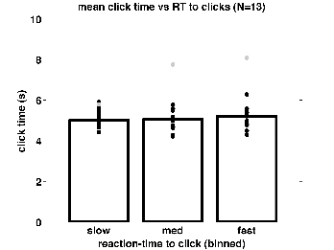
Empirical test of the model
Coincidental preparation?
Exclusion of coincidence trials.
Maybe fast responses tend to occur late in the trial, allowing more time for anticipation to build up.
Nope.

Slide 57




Internally- vs externally-driven movement: a continuum
EXTERNAL
INTERNAL
role of spontaneous fluctuations…
predictions

Slide 58
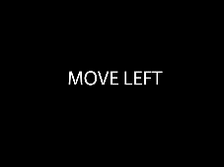





The metaphysics of spontaneity
OR
. . .

Slide 59
The metaphysics of spontaneity
Can the brain voluntarily “roll its own inner dice”?
  w/ Shlomi Sher (Pomona College), Mehmet Basbug (Princeton)
0.8
instructed
decide
0.7
spontaneous
0.6
0.5
0.4
0.3
-3.0
-2.0
-1.0
0
1.0
Notes:
----- Meeting Notes (10/16/15 12:59) -----
Either give each one 30 seconds, or not at all. Looks too much like a laundry list.

Slide 60



C
?
cause
?
effect
time
Notes:
In the debate about the role that conscious decisions might play in the initiation of overt action, there is an implicit timeline with “causes” and “effects”. Agency is information (hopefully valid information) about the causal relationship between events on that timeline.
Agency ~ ownership (feeling of).

Slide 61
BCI
C
?
cause
?
effect
time
Notes:
In the debate over whether or not consciousness plays any role in the initiation of action, there is an implicit timeline with causes and effects.
Notice that consciousness and the cause of movement are treated separately. They might be one and the same, but we allow for the possibility that they are distinct phenomena.

Slide 62
Libet’s Paradox
How can purposeful movement-causing brain activity begin before the conscious decision to initiate the movement has even emerged?
Notes:
In spite of fifty years of research, we still lack a coherent mechanistic account of the RP beyond descriptive phrases like “planning and preparation for movement”.
And now we are left with a new question, which I call “Libet’s paradox”.

Slide 63
Libet’s Paradox
How can purposeful movement-causing brain activity begin before the conscious decision to initiate the movement has even emerged?
One possible answer: the RP is not purposeful and does not reflect the primary cause of movement.

Slide 64


Notes:
This question is relevant in many contexts,

Slide 65

Notes:
This question is relevant in many contexts,

Slide 66


Notes:
This question is relevant in many contexts,

Slide 67


Notes:
This question is relevant in many contexts

Slide 68

Notes:
And the question is especially relevant to the development of self-paced brain-computer interfaces, where the interface not only has to interpret what the user wants to do, but also must be detect when the user intends to act, and most importantly, not respond otherwise.

Slide 69
A SINGLE SPIKE
FROM
A SINGLE NEURON
London, M., A. Roth, et al. (2010), Nature 466(7302): 123-127.
Notes:
London, M., A. Roth, et al. (2010). "Sensitivity to perturbations in vivo implies high noise and suggests rate coding in cortex." Nature 466(7302): 123-127.

Slide 70
C
?
cause
?
effect
time
Notes:
In the debate over whether or not consciousness plays any role in the initiation of action, there is an implicit timeline with causes and effects.
Do they manifest at different times, or the same time, or are they perhaps one and the same? In any case, if we are going to take on the bigger question of conscious volition we need first to understand the cause-effect relationship between the brain and the body for spontaneous voluntary actions. Consider this simple example
Notice that consciousness and the cause of movement are treated separately. They might be one and the same, but we allow for the possibility that they are distinct phenomena.

Slide 71

H₀ in forecasting:
  autocorrelation + event-locking = Nostradamus!
on random time series
Schurger et al (2012) fig. S5
Notes:
It’s not about predicting movement in general – it’s about predicting *that* movement.
Redo plot with single line on plot and black background.

Slide 73
Notes:
On any given day at least some of our actions can be considered responses to stimuli: the traffic light ahead turns red, so you press on the brake pedal; the phone rings and you answer it; someone calls out to you and you respond. But many, if not most, of our voluntary actions are spontaneous, meaning that they are not provoked by a stimulus cue in the immediate environment. [COFFEE EXAMPLE] How does the brain decide precisely when to act (or whether to act in the first place), when there is no stimulus cue? For example …

Slide 74
This idea is not entirely new…
[According to Eccles] “… there is a tendency for the initiation of the movements to occur during the excitatory phases of the random spontaneous activity" (Eccles, 1985, p. 542). The earlier phase of the RP (up to about 200 ms before the movement) would then reflect this spontaneous activity, …
This hypothesis implies that spontaneous fluctuations … such as those reflected in the earlier part of the RP, should regularly occur, independently of any intention or movement, so as to allow the production of voluntary acts.
Gomes JOCS 1999
Notes:
Are there any dualists in the room? Don’t be shy…

Slide 75
This idea is not entirely new…
[According to Eccles] ”… there is a tendency for the initiation of movements to occur during the excitatory phases of random spontaneous activity" (Eccles, 1985, p. 542). The earlier phase of the RP (up to about 200 ms before the movement) would then reflect this spontaneous activity, …
This hypothesis implies that spontaneous fluctuations … such as those reflected in the earlier part of the RP, should regularly occur, independently of any intention or movement, so as to allow the production of voluntary acts.
Gomes JOCS 1999

Slide 76
Support for the stochastic decision model
Murakami et al Nat Neuro 2014

Slide 77
Support for the stochastic decision model
Murakami et al Nat Neuro 2014

Slide 78
Support for the stochastic decision model
Murakami et al Nat Neuro 2014
Bounded integration models “identify the initial intention to act as the moment of threshold crossing while explaining how antecedent subthreshold neural activity can influence an action without implying a decision.”
Notes:
----- Meeting Notes (10/16/15 12:45) -----
Maybe a see also with other studies.

Slide 79


daily max temp
autocorrelation function
degrees F
r_{k}
day of month
lag k days
Notes:
I’ve pointed out that brain data is autocorrelated and that this leads to some problems when doing event-locked averaging (at least when looking backwards in time from the event). Learning what tends to happen before it rains is not the same as learning how to predict the onset of rain.
The same can be true of behavior. Trying to predict can be one of the best tools for studying spontaneous voluntary behavior, but there are some specific caveats to keep in mind, well-known in weather forecasting, less well-known in neuroscience. Here you see the daily max temp in Ithaca NY for jan 1987, and its autocorrelation function on the right (meteorological phenomena tend also to be autocorrelated).

Slide 80
H₀ in forecasting:
  autocorrelation + event-locking = Nostradamus!
on random time series
Schurger et al (2012) fig. S5
Notes:
It’s not about predicting movement in general – it’s about predicting *that* movement.
Redo plot with single line on plot and black background.

Slide 81
Spontaneous fluctuations in neural activity?
~
YES
log(power)
autocorrelated noise
log(freq)
log(power)
white noise
log(freq)
Notes:
Explain what is autocorrelation.

Slide 82
Stochastic decision model
Schurger, Sitt, & Dehaene PNAS (2012)
dx = (I – kx) + ξ
(1) drift
(”imperative")
noise
(3) threshold on x
(2) leak
Notes:
That’s evident here when you look at the behavior of the model (with a weak imperative).

Slide 83
Stochastic decision model
Sign reversed
Schurger, Sitt, & Dehaene PNAS (2012)
crossing
dx = (I – kx) + ξ
(1) drift
(”imperative")
noise
(3) threshold on x
(2) leak
Notes:
Don’t forget to mention distribution of crossing times.

Slide 84


Fitting the WT distribution and RP
Find parameters of best fit here:
Test the fit here (same parameters):
waiting-time (WT) distribution
readiness potential
electro-
encephalography
Task = Libet (1983)
Schurger, Sitt, & Dehaene PNAS (2012)

Slide 85
P (S_{t+τ} | M_{t0})
P (M_{t+τ} | S_{t0})
Notes:
Takes a lot of data to build, but that is our approach: to collect a large amount of data from a relatively modest number of subjects.
----- Meeting Notes (10/16/15 12:59) -----
State that this is the readiness potential in reverse.

Slide 86
deterministic
“trigger”
Notes:
A single human brain is arguably more complex than the entirety of the Earth’s atmosphere, and even the local weather can be challenging to predict. Yet some have begun to conclude that when it comes to the brain, the game is essentially won – we just put brain data together with machine learning, and we’re able to predict behavior. I would submit to you that the game has barely just begun – the self-initiation of action remains a profound mystery. For those who prefer to believe in free will, there is as yet no hard empirical evidence to stand in your way.

Slide 87
Fifty years without free will.
Aaron Schurger
INSERM Cognitive Neuroimaging Unit
NeuroSpin Research Center
CEA-Saclay, FRANCE

