Slide 1
Updates on emittance blowup studies from injection missteering.
E. Senes, M. Fraser, A. Huschauer, F. Tecker, V. Forte
Acknowledgement: S. Levasseur, J. Storey

Slide 2
Outline
Beam setup and measurement method
Emittance evolution after injection
  Nominal steering
  Vertically mis-steered
Measurements at C171
Conclusions (?)

Slide 3
BCMS 12b modified beam
A new beam has been tested, modifying a 12 bunches BCMS beam (used in single bunch)
Same requirements as for the low brightness beam
  Far from resonances, working point below coupling
  Coupling compensated
  Lower brightness
Working point
I = 35x10¹⁰ ppb
ε_{x_norm} = 1.619 +/- 0.069
ε_{y_norm} = 0.838 +/- 0.014
dp/p_{rms} = 8.3x10⁻⁴
ƛ_{max}=0.6 A
B = I/0.5*(ε_{x} + ε_{y}) = 28
PSB in PS optics

Slide 4
How to kick
Vertical plane
  No vertical kicker installed
  Beam can be misinjected using DVT40 or DVT50
  PRO: There should be nothing else going on if the coupling is compensated (neglecting space charge)
Horizontal plane
  First injection error (via KFA45 strength modulation)
  Fire a kicker at low strength at the second injection instance
  BUT: There is also the transfer line missmatch going on
Other (failing) ideas
  Use the transverse feedback kicker to kick the beam (too weak)
  Use the postpulse of KFA45 (next presentation)
  Use the raising/falling edge of a kicker (uneven kick along the bunch)

Slide 5
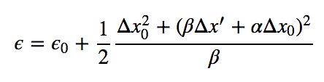
Analysis
EMITTANCE BLOWUP
ANALITICAL EXPECTATION
AFTER FILAMENTATION
Notes:
Beta at the kicker or at DVT50

Slide 6


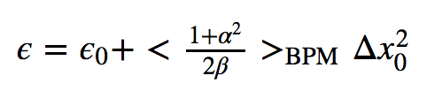
Analysis
EMITTANCE BLOWUP
ANALITICAL EXPECTATION
AFTER FILAMENTATION
SINGLE BPM
Δx from BPM
position
- β_{BPM} from model
ALL BPMs
KICK FROM
PARAMETER
SET
- Average parameters
from α and β at the
BPM location
Δx from RMS 1st-2nd
turn difference
Notes:
Beta at the kicker or at DVT50

Slide 7
Emittance evolution C171-C190
A number of measurements show that measured emittance gets smaller during the first 15 ms of the cycle (e.g. eLogbook at 11:35)
This is true also for nominal steering !
RF ON
RF OFF

Slide 8
Emittance evolution
Missteering of 200 urad kick in the vertical plane
RF OFF
RF ON

Slide 9
Emittance evolution
Scraping some data, this is in agreement with the horizontal BGI measurements made in December with a low emittance beam (MD2586_INDIV_VdM modified)
Nominal steering
KFA45 0.25 mrad error
Wirescan effect
Notes:
Not so easy to spot when missteered with the BGI … but in the horizontal plane there is a lot going on

Slide 10
Measurements at C171
Missteering in both planes (separately) has been measured. Emittance measured at C171.
The typical situation (e.g. third method used):
X plane kick
Y plane kick
a = 5.59
Expected 11.26
a = 4.32
Expected 7.06
Y missteering (last night data)
still object of investigation

Slide 11
Conclusions
Horizontal and vertical missteering at the injection were measured
  The blowup is in general smaller than the analytical expectation
Firing a additional kicker at flatbottom is not technically possible
The measured emittance decreases during the first 15 ms
  In the horizontal plane in agreement with the BGI measurements for the low brightness beam of December
Given these results, the emittance evolution has to be understood before performing further steering measurements
  The effect of the Disperision+Energy missmatch in combination with the radial loop action is the subject of investigation.

Slide 12
Notes:
Any input ???

Slide 13
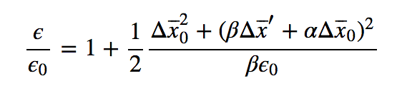
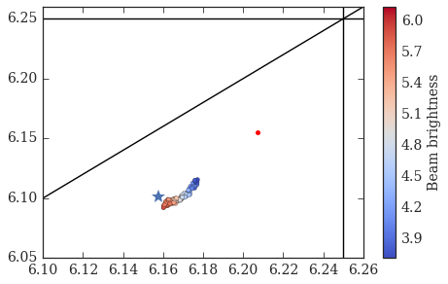
MD2586_INDIV_VdM
I = 13x10¹⁰ ppb
ε_{x_norm} = 2.509 +/- 0.119
ε_{y_norm} = 2.013 +/- 0.034
dp/p_rms = 5e-4
ƛ_max=0.39 A
B = I/0.5*(ε_{x} + ε_{y})
Blowup expectation from steering:
Goal: understand the emittance blowup from injection steering, need to
Stay away from resonances
Decoupled motion in the two transverse planes
Low brightness to limit space charge effects
Working point
PBS in PS optics

Slide 14
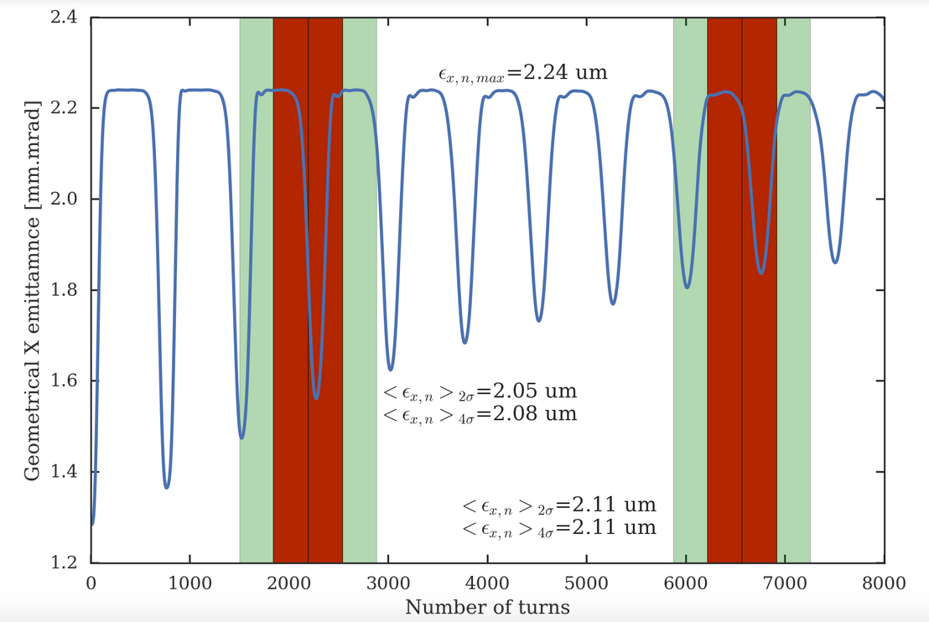
Measure recoherence (if any) with wirescanner
Amplitude | Time | Turns
2σ | 0.8 ms | 349
4σ | 1.6 ms | 690
Scan time | Turn number
175 ms | 2188
185 ms | 6564
Simulation parameters:
I = 15x10¹⁰ ppb
ε_{x_norm} = 2.9 um
ε_{y_norm} = 2.0 um
Kick = 0.35 mrad less than nominal
Recoherence would give us a measurement error of max ~10%
!
… and further simulations with space charge showed that the dips are basically invisible
Notes:
Rev time used = 2.29 us

Slide 15
In general

