Slide 2
First results of PSB-to-PS transfer dedicated MDs
V. Forte, M. A. Fraser (TE-ABT/BTP)
Acknowledgements: G.P. Di Giovanni, A. Huschauer, A. Oeftiger, E. Senes, F. Roncarolo, A. Guerrero Ollacarizqueta
LIU PSB Beam Dynamics WG #8 – 28th May 2018

Slide 3
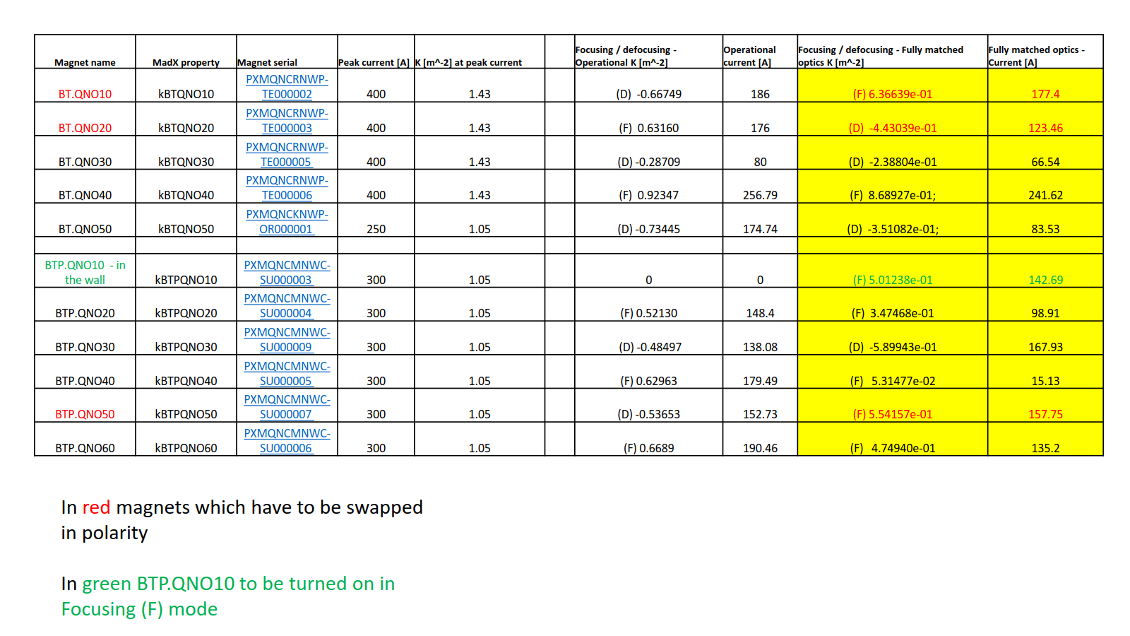
Initial (fully matched) non-PPM Optics
Swap of 2 BT quads
  Parallel operations to PSB dump and/or ISOLDE not allowed
  ‘Local’ mode needed on swapped quad currents ➔ no flexibility

Slide 4
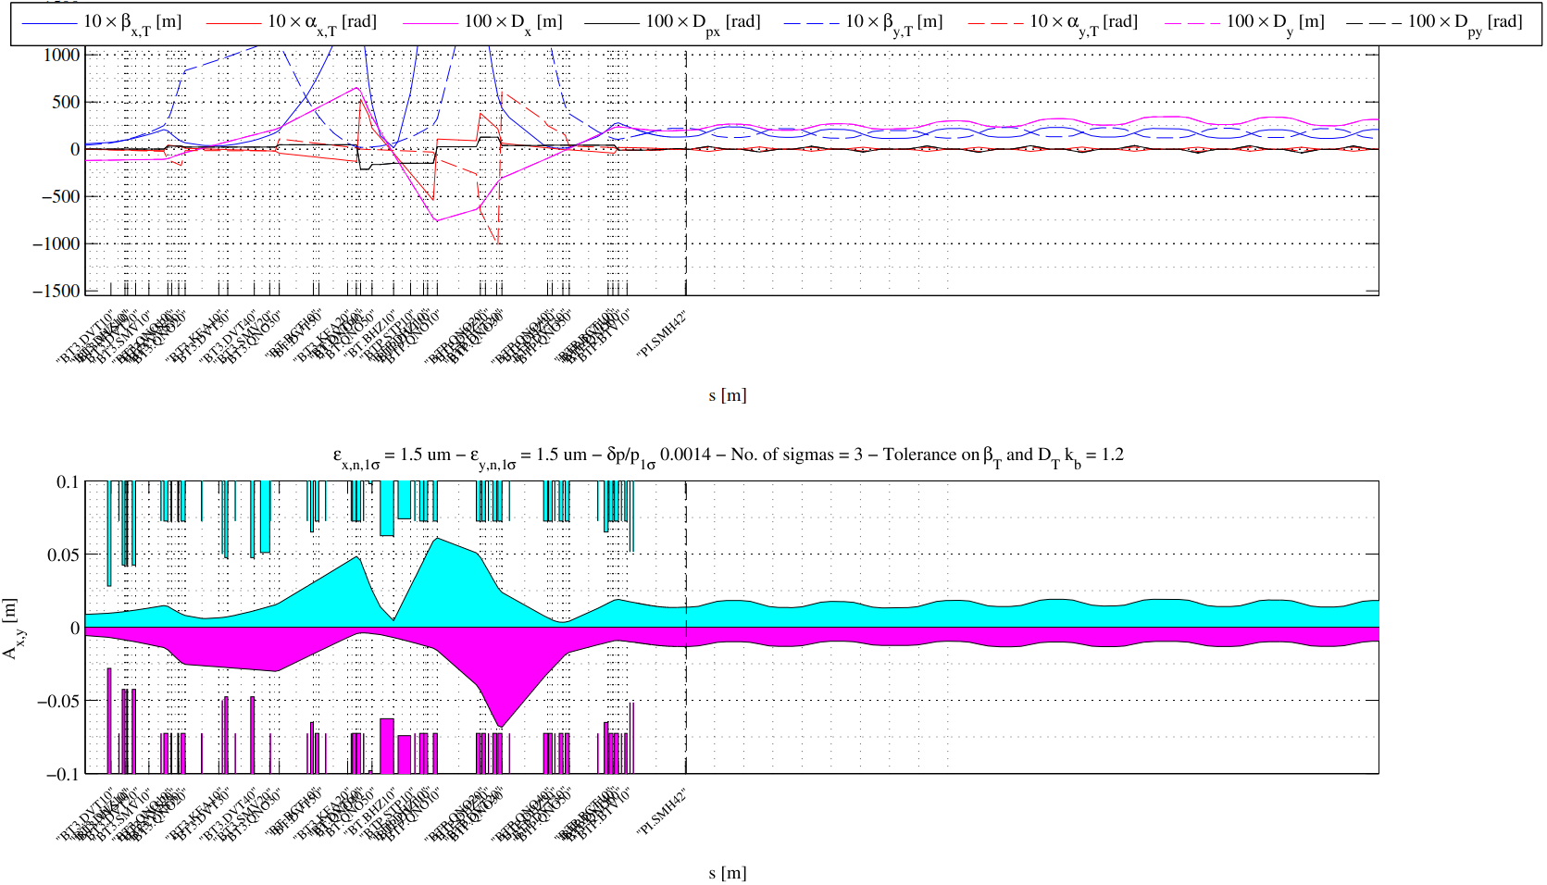
Initial (fully matched) non-PPM Optics
Large aperture for small emittance beams

Slide 5
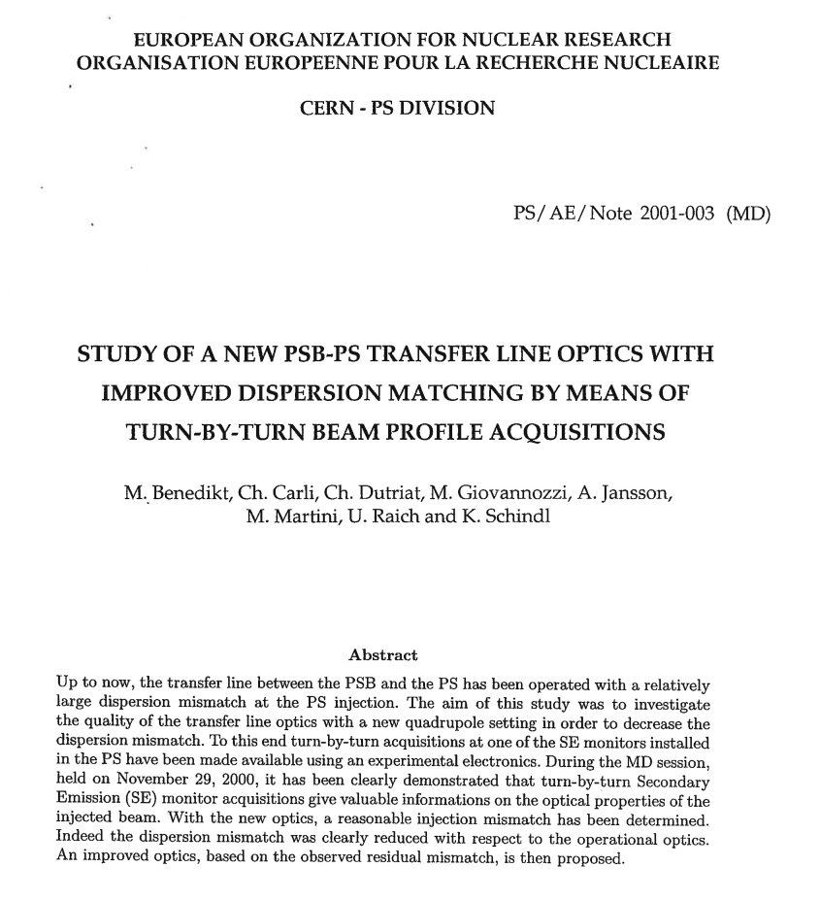
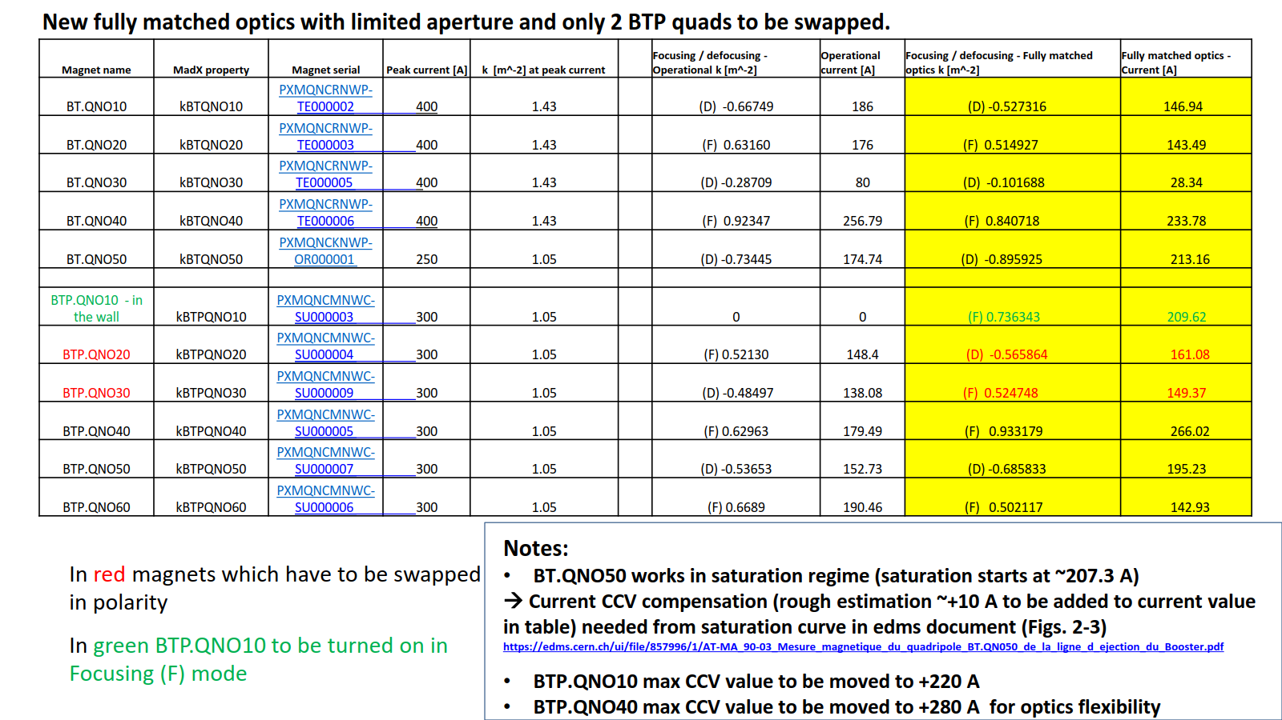
Final (fully matched) non-PPM Optics
New matching developed
  Starting from paper by M. Benedikt et al. (different PSB tunes in 2001)
No BT quads swap needed
  Parallel operations to PSB dump and/or ISOLDE allowed
2 BTP quads to be swapped ➔ in local mode for practical reasons

Slide 6
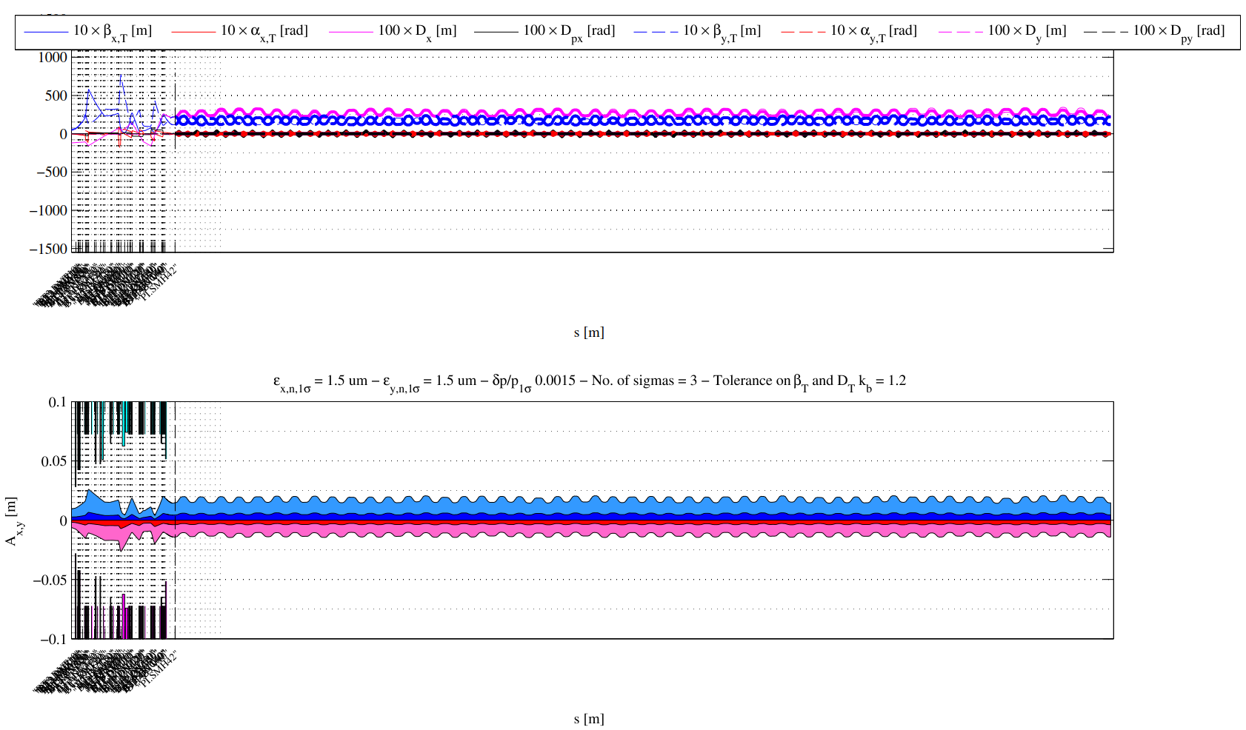
Final (fully matched) non-PPM Optics
Reduced aperture
BT-BTP
PS
Horizontal
BT-BTP
PS
Vertical

Slide 7
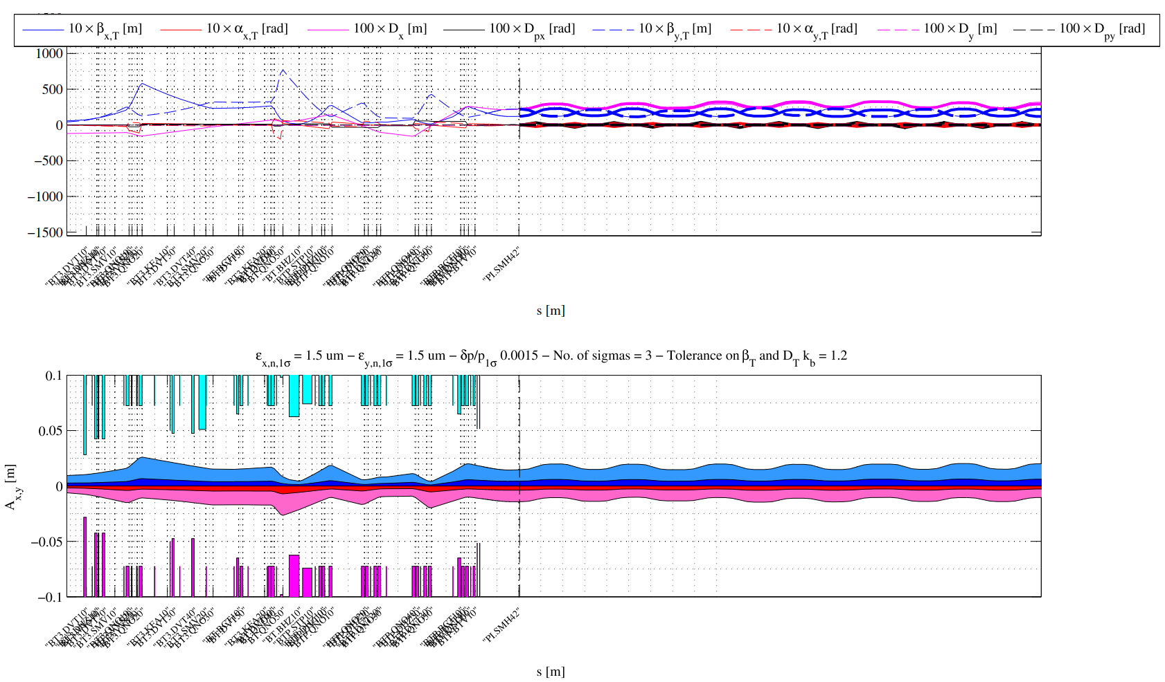
Final (fully matched) non-PPM Optics
BT-BTP
PS
Horizontal
BT-BTP
Vertical
PS

Slide 8
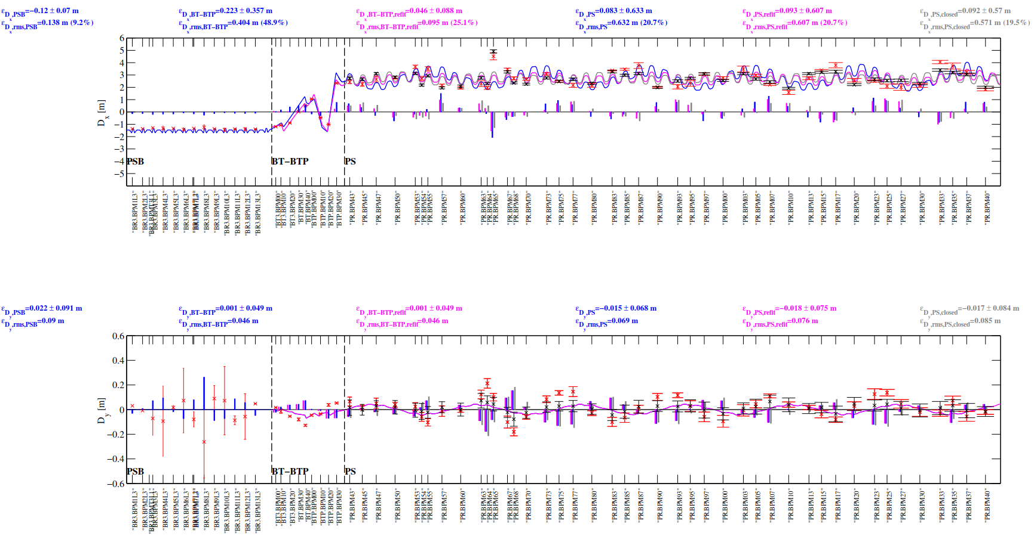
Final (fully matched) non-PPM Optics - dispersion measurements
Measured dispersion follows well the model (PSB and BT-BTP) and is fairly on close solution of PS (06-06-2018)

Slide 9
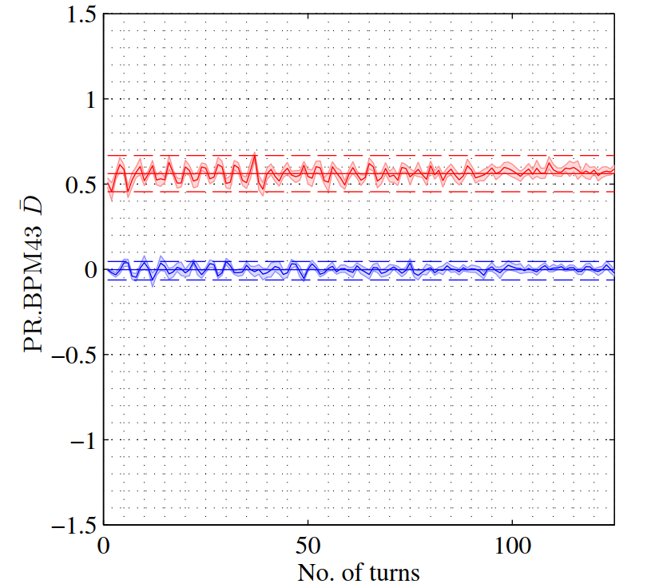
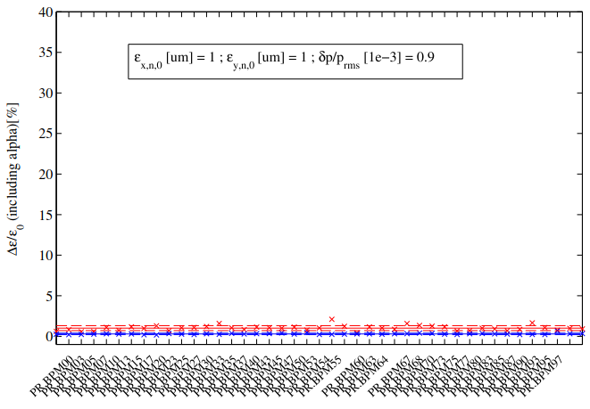
Final (fully matched) non-PPM Optics - dispersion measurements
Measured dispersion follows well the model
  Δε/ε₀ ~ 1 %
  RF OFF and RF ON give similar results

Slide 10
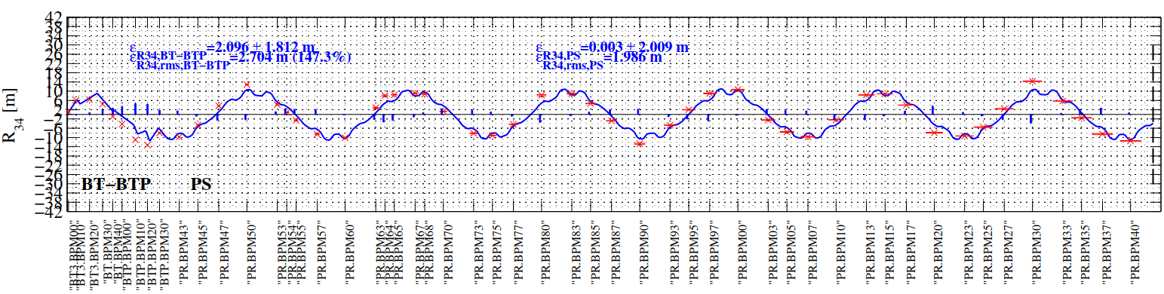
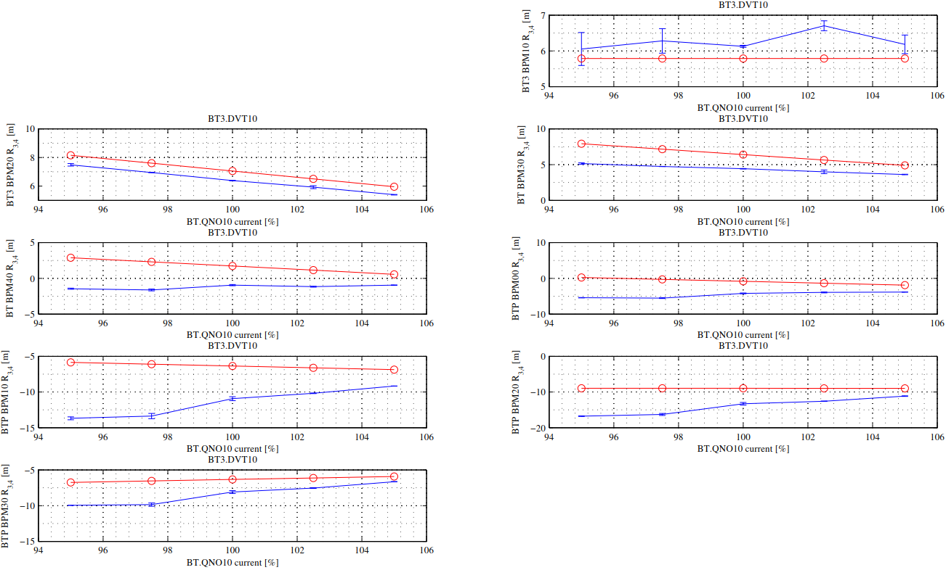
Operational optics – quad gradient errors
Kick response analysis on-going to understand quad gradient errors in BT-BTP line
  Operational optics example:
    BT.QNO10

Slide 11
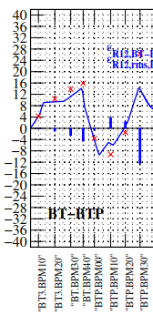
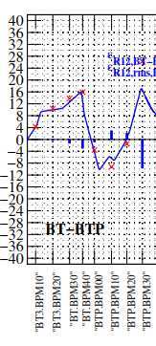
Final (fully matched) non-PPM Optics – kick response measurements
Analysis on-going for the final (fully matched) optics
Nominal
MadX BT.QNO10 x 1.10

Slide 12
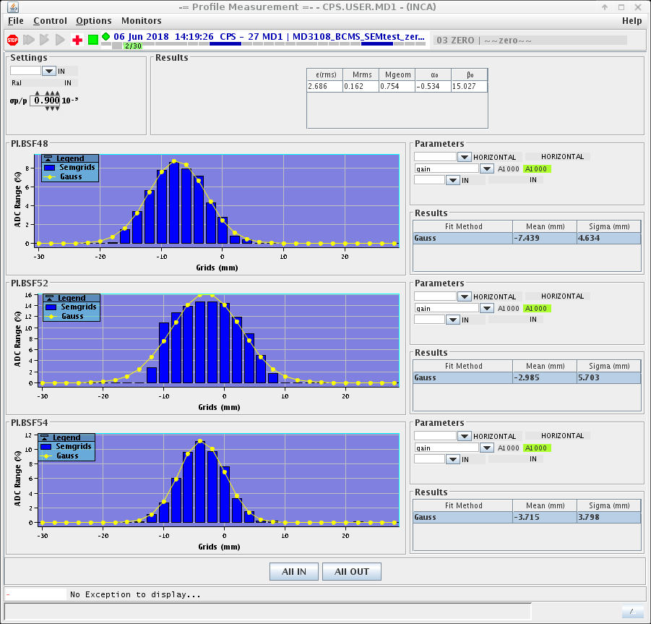
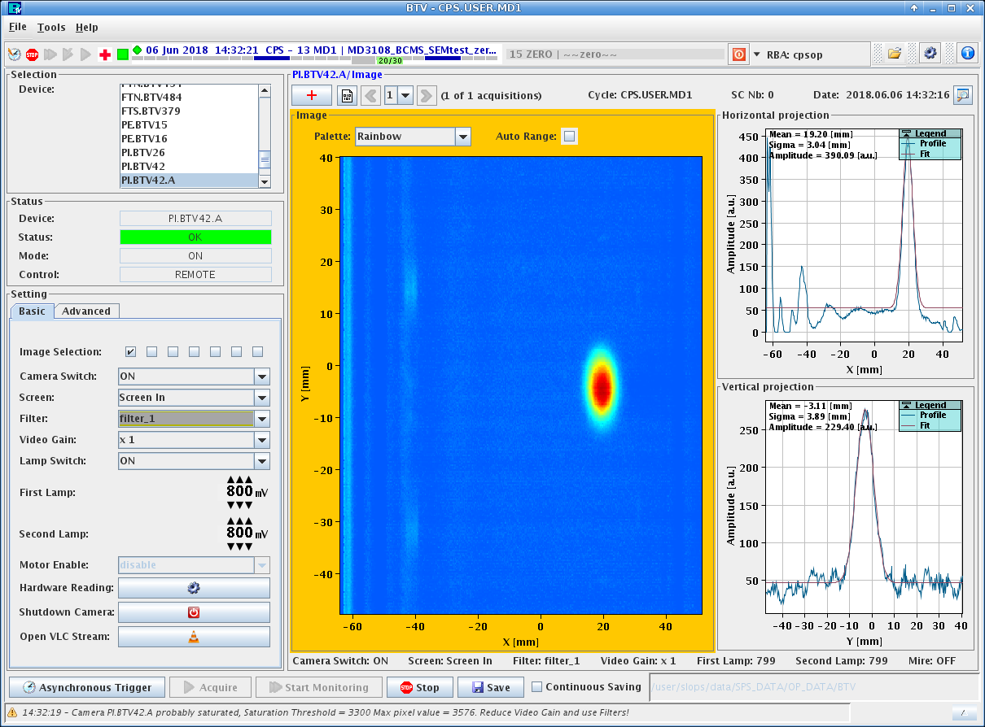
Final (fully matched) non-PPM Optics – SEM-grid measurements
Rare opportunities to use the SEM-grids, as beam is needed downstream
  HORIZONTAL SEM-GRIDS
  We see beam scraped on horizontal SEMgrids
    BLM in BT-BTP very low (max 2 units /256)
    Maybe touching at PI.SMH42 septum location ➔ to be followed up with more SEMgrids time
      Usage of new BTV (PI.BTVA42) at septum PI.SMH42➔ measured dispersion ~1.7 um (consistent with BPM measurements)

Slide 13
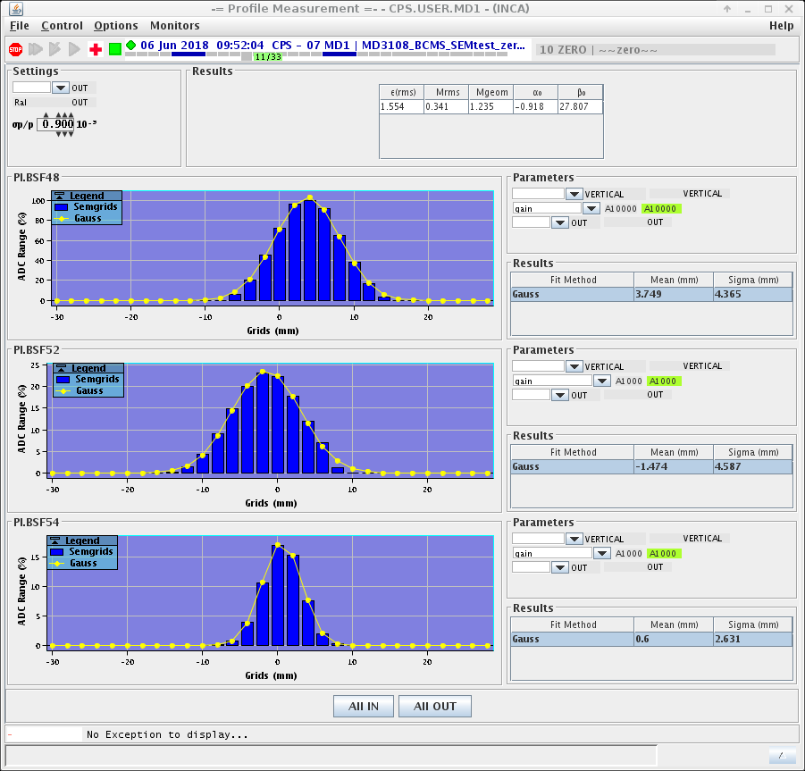
Final (fully matched) non-PPM Optics – SEM-grid measurements
Rare opportunities to use the SEM-grids, as beam is needed downstream
  VERTICAL SEM-GRIDS
  Analysis to be performed off-line on acquired data

Slide 14
Next steps
Finalise analysis on acquired data:
  Kick response
    sensitivity to quad strength for quads linear error recognition)
    JMAD lattice for ALOHA under preparation (thanks Ilias, Kajetan, Francesco) to help for analysis
    YASP for the stitched and matched line has been implemented for the 4 rings:
      Kick response in good agreement with independently measured ones (few inconsistencies)
  SEM-grids profiles
  Emittance measurements
For next dedicated MDs:
  Improve steering for clearer SEM-grids acquisition
    Reconstruct Twiss parameters at PS injection septum 42
    Reconstruct tr. line initial condition (@ BT3.START)
    Develop a tuning knob to compensate for residual Twiss/dispersive errors
  Profit of turn-by-turn SEMgrids after TS in June as matching monitors

