Slide 1
Beam based measurement of the KFA45 post-pulse ripple
E. Senes, M. Fraser, A. Huschauer, F. Tecker, V. Forte
Acknowledgment: Jan Schipper, CPS operation team

Slide 2
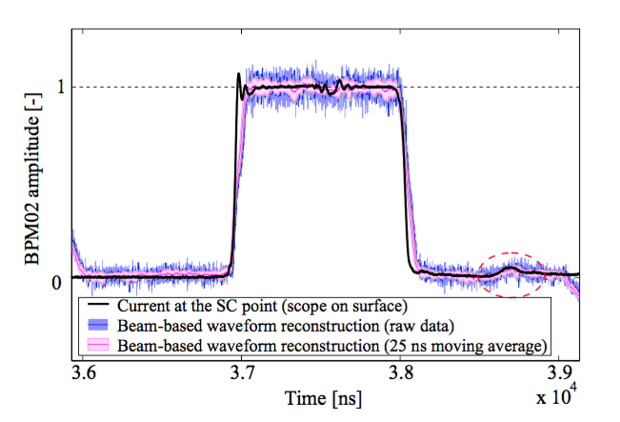
Motivation
A postpulse is present after the main pulse of KFA45 (see LIU-PS Beam Dynamics WG meeting #13)
It has been used already for optics measurements, not strong enough for steering measurements
Understanding the effect on the beam is important to give inputs for the design of KFA45 upgrade (e.g. does the post-pulse scale with voltage, what is the minimum voltage needed for optics measurements)
CERN-ACC-NOTE-2018-0031

Slide 3
Method
KFA45 was fired at the second injection of the beam
1us-long pulse, KFA trigger fine delay moved gradually away recording orbit and losses (both start and end triggers moved, to preserve pulse length)
Pulse trigger step: 25 ns, 5 shots per step
Test beam:
LHC_INDIV_VdM modified
I = 13x10¹⁰ ppb
ε_{x_norm} = 2.509 +/- 0.119
ε_{y_norm} = 2.013 +/- 0.034
dp/p_rms = 5e-4
ƛ_max=0.39 A
B = I/0.5*(ε_{x} + ε_{y})

Slide 4
Results
Maximum and minimum kick settings compared
RMS orbit of the first 80 turns after second injection
MAX VOLTAGE SETTINGS
MIN VOLTAGE SETTINGS
4 modules
295 kV
1 module
45 kV

Slide 5
Results
Maximum and minimum kick settings compared
RMS orbit of the first 80 turns after second injection
MAX VOLTAGE SETTINGS
MIN VOLTAGE SETTINGS
4 modules
295 kV
1 module
45 kV
NON PERFECT
SYNCRONISATION
BETWEEN MODULES

Slide 6
Conclusions
OASIS is not the right tool to measure the postpulse amplitude, the current probe on the surface is.
Beam-based measurements show that
  Pulsing a single module:
    The proper kick is too strong and induces losses, even though not kicking out completely the beam
    The postpulse induces small oscillations and hard to measure
  Pulsing all the modules:
    The pulse is obviously kicking out the beam
    The postpulse induces RMS orbit oscillations up to 6 mm
    The module post-pulse synchronisation is not perfect
Further measurements to be performed to deduce the orbit variation per kV of pulse voltage
For future designs: being able to pulse a single module at low voltage is fundamental. Currently 14x2 kV is technically possible, but not done yet because of the need to reprogram the G64.

