Slide 2
Update on intensity reach with LHC-type beams
LIU-PS Beam Performance Meeting
LIU-PS Beam Dynamics Working Group
7 June 2018
H. Damerau, A. Lasheen

Slide 3
Overview
Observations at high intensity
  Standard 72-bunch beam
  BCMS beam
Beam-based cavity impedances
Changes during YETS2017/18
  RF
  Vacuum interventions
Summary and outlook

Slide 4
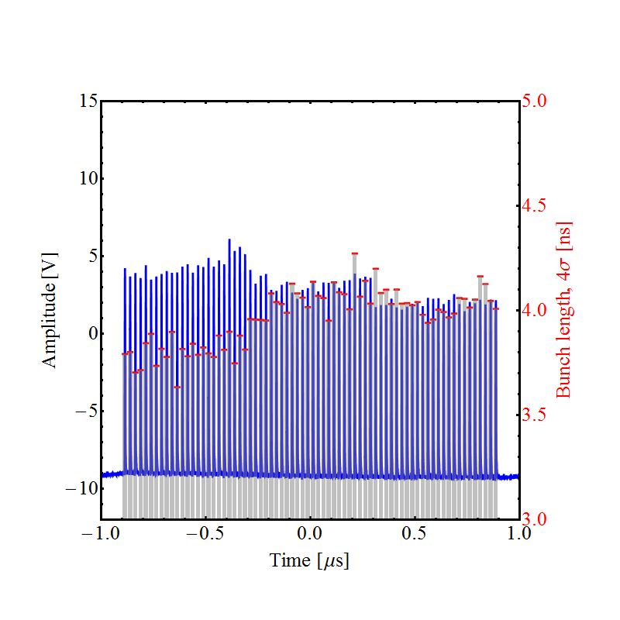
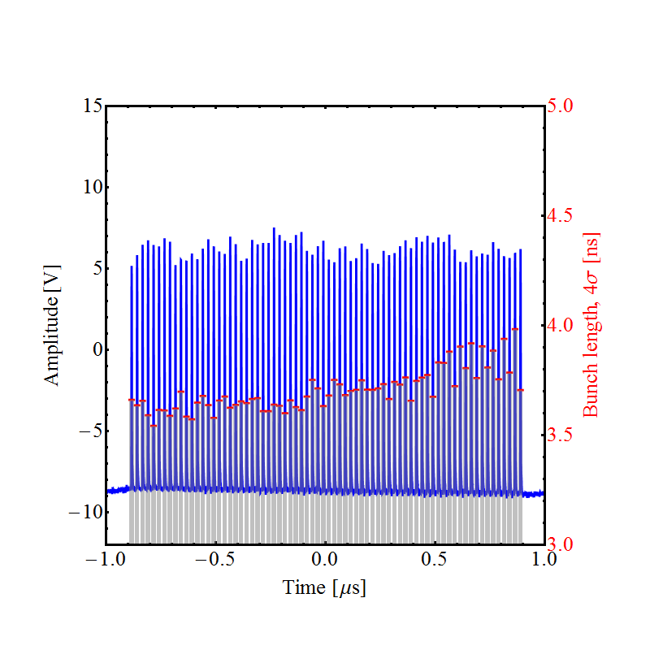
LHC25ns (standard), 72 bunches
Beam seems longitudinally in better shape than in 2016/2017
  Standard beam stable beyond 2∙10¹¹ ppb, more for BCMS
  Change with respect to 2016 and 2017 not fully understood
Clearly shorter bunches at extraction compared to 2017
Bunch profile/length last turn
Bunch profile/length last turn
N_{b} = 2.1 ∙ 10¹¹ ppb (2017)
N_{b} = 2.4 ∙ 10¹¹ ppb (2018)

Slide 5
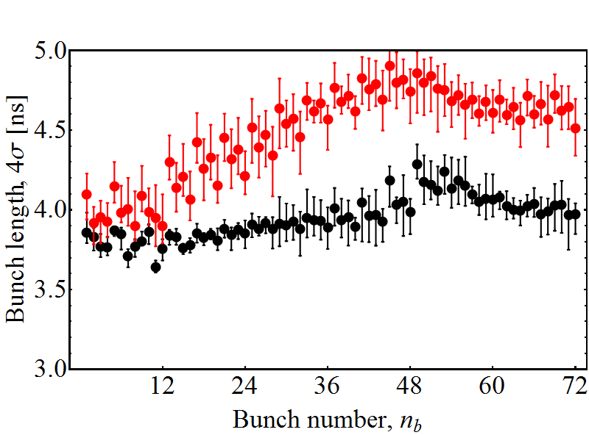
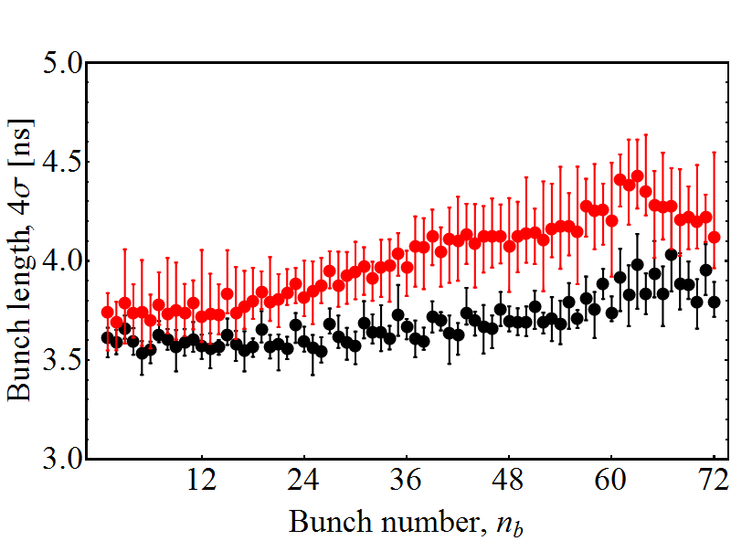
LHC25ns (72 bunches), final bunch length
Bunch length along the batch, 4σ Gaussian fit
Compare two and three 80 MHz cavities with gaps open
Bunch length dominated by rotation or longitudinal emittance?
Bunch length at ejection
N_{b} = 2.1 ∙ 10¹¹ ppb (2017)
Bunch length at ejection
N_{b} = 2.4 ∙ 10¹¹ ppb (2018)
⎯ C80-08/88/89
⎯ C80-08/88
⎯ C80-08/88/89
⎯ C80-08/88

Slide 6
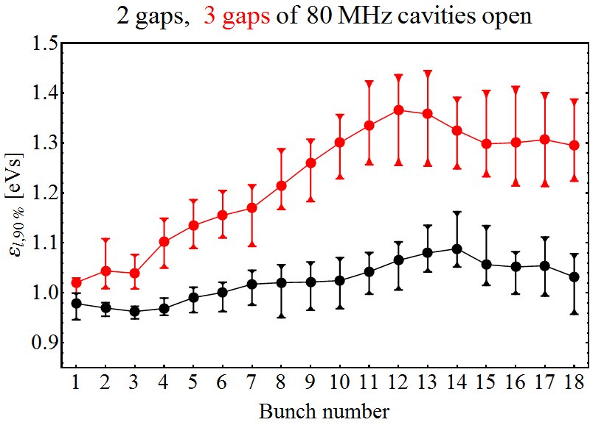
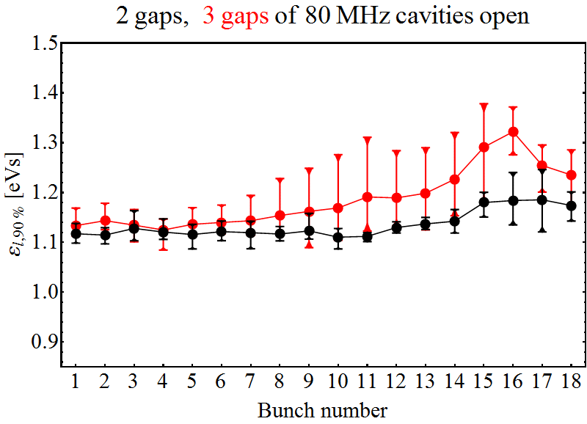
LHC25ns (72 bunches), emittance at flat-top
Multi-bunch tomography at arrival on flat-top (before 4-split)
Longitudinal emittance at flat-top ~10% larger compared to 2017
  Shorter bunches with larger emittance → rotation parameters
Intensity during 2018 measurements ~15% above 2017 values
Effect of 3rd 80 MHz cavity gap seems less strong
Emittance, ε_{l} at flat-top arrival
N_{b} = 2.1 ∙ 10¹¹ ppb (2017)
Emittance, ε_{l} at flat-top arrival
N_{b} = 2.4 ∙ 10¹¹ ppb (2018)
⎯ C80-08/88/89
⎯ C80-08/88
⎯ C80-08/88/89
⎯ C80-08/88

Slide 7
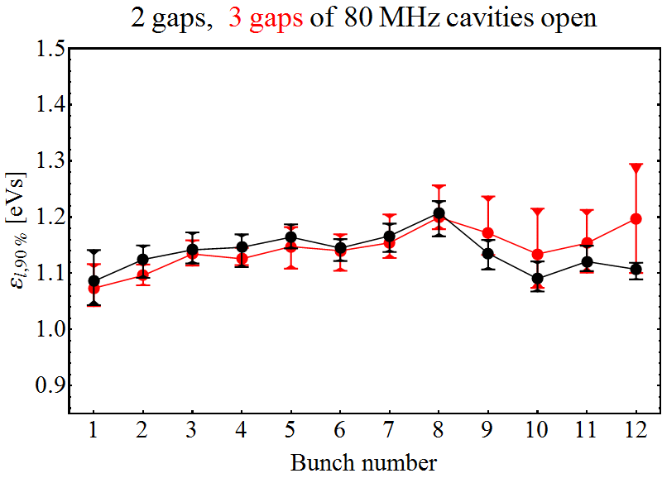
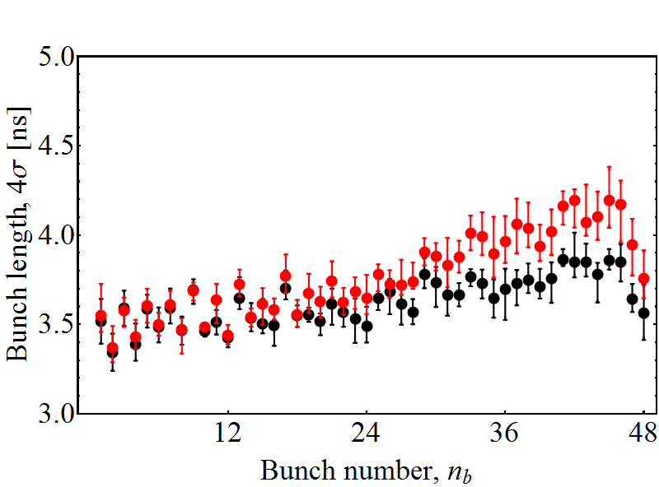
LHC25ns (BCMS, 48 bunches), emittance
Intensity increased up to ~3 ∙ 10¹¹ ppb (1.5 ∙ 10¹³ ppp in total)
Little data from 2017 high-intensity BCMS beam for comparison
Again, potential issue with ~10% too large emittance
Redo measurements at N_{b} = 2.6 10¹¹ ppb and nominal ε_{l}
Emittance, ε_{l} at flat-top arrival
N_{b} = 3 ∙ 10¹¹ ppb (2018)
Bunch length at ejection
N_{b} = 3 ∙ 10¹¹ ppb (2018)
⎯ C80-08/88/89
⎯ C80-08/88
⎯ C80-08/88/89
⎯ C80-08/88

Slide 8
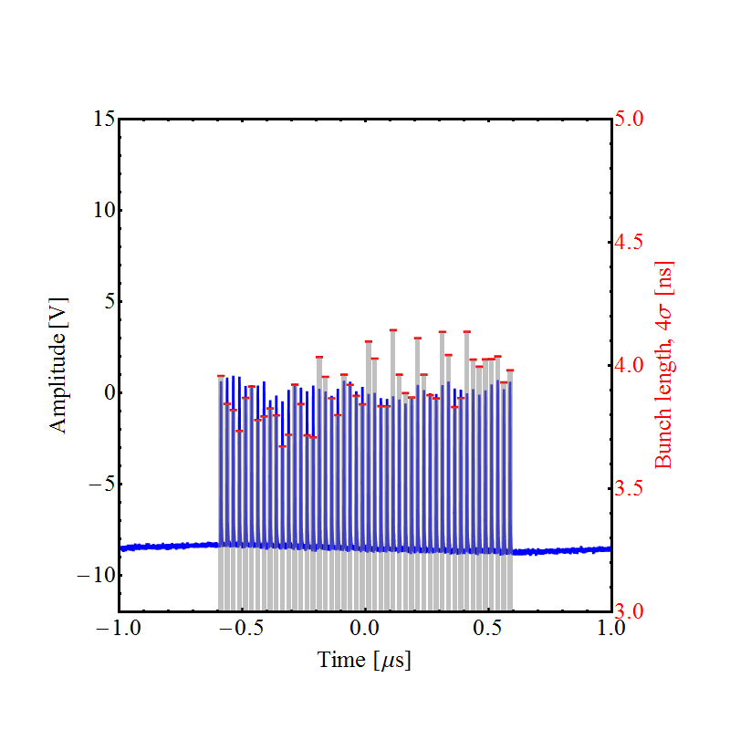
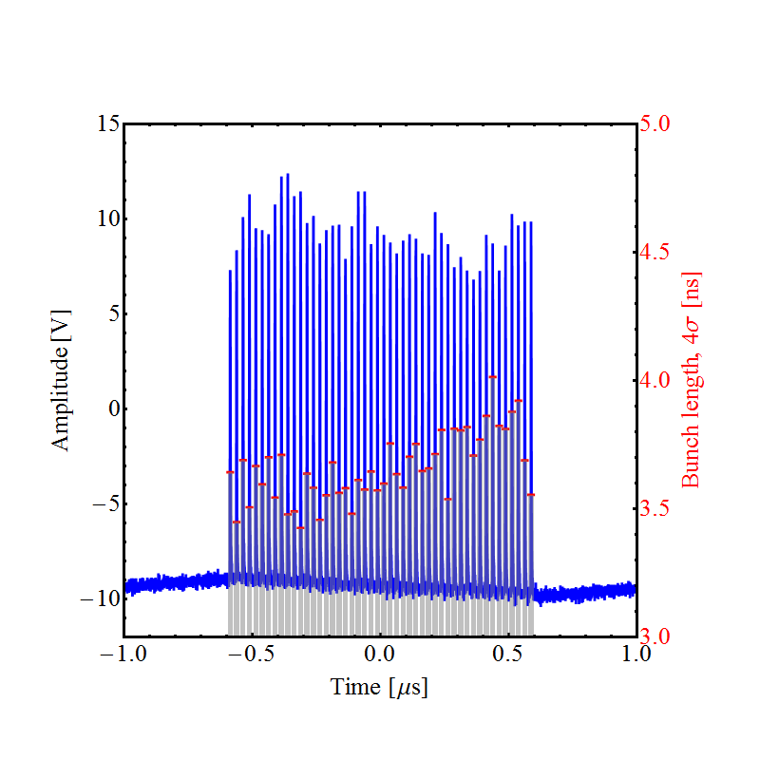
LHC25ns (BCMS), 48 bunches, bunch length
Bunch length along the batch, 4σ Gaussian fit
Examples for 2017 operational and 2018 high-intensity beams
Bunch length at ejection
N_{b} = ~1.5 ∙ 10¹¹ ppb (2017)
Bunch length at ejection
N_{b} = 3 ∙ 10¹¹ ppb (2018)

Slide 9
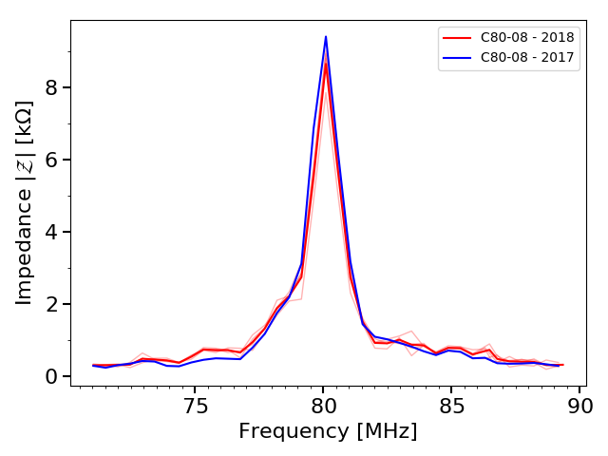
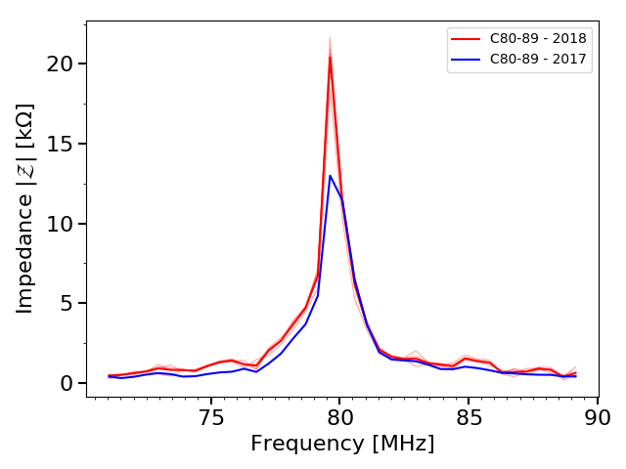
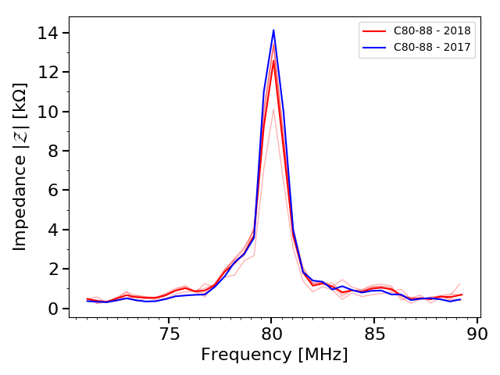
Impedance of 80 MHz cavities
Cavity C80-08
Same procedure as in 2017
Preliminary results from beam-based impedance for 80 MHz cavities
No significant change in impedance
⎯ 2018 data
⎯ 2017 data
Cavity C80-89 (tuned for Pb⁵⁴⁺)
Cavity C80-88
⎯ 2018 data
⎯ 2017 data
⎯ 2018 data
⎯ 2017 data
To be completed with measurements of 40 MHz cavities

Slide 10
Changes during YETS2017/18
  RF upgrades
  New anode power converters 40 MHz and 80 MHz cavities
    No significant impedance change
    Expected reduction (~20%) with new amplifier in direct feedback loop of cavity C80-88 not visible with beam
  New power supplies for Finemet cavity amplifiers
    Coupled-bunch feedback not tripping anymore
    Saturation of drive power with previous supplies?
    Re-check feedback with six gaps after ITS1
  New pre-driver amplifiers for 10 MHz cavities
    No effect on direct wide-band feedback
    Improved 1-turn delay feedback operation?
  200 MHz amplifier upgrade
    Same coupling of cavities with amplifiers (final stage unchanged)
  RF bypass measurement campaign
    Small number of non-conformities, as every year
  No change of feedback setting-up technique in 2018

Slide 11
Changes during YETS2017/18
  Vacuum interventions
  Septa SMH16, SEH23 and SMH42
    No additional RF shielding in swapped devices
    Regular preventive maintenance
  Wire scanner in SS54
    Prototype wire scanner of new design
    Minor contribution to longitudinal impedance expected
  Wire scanner SS85
    One-to-one exchange by identical unit
  New BTV screen in magnet unit 41
    Minor contribution to longitudinal impedance expected
  Insignificant effect on longitudinal impedance expected

Slide 12
Summary and outlook
  Bunches at PS extraction shorter than in 2017
    Bunch rotation settings to be adjusted
    Longitudinal emittances actually larger
    Longitudinal beam quality looks better that it really is
  May partially explain seemingly better stability
  Significant improvement for BCMS to be understood
  Future beam studies
  Re-measure at 2.1 ∙ 10¹¹ ppb with parameters as close as possible to the ones for 2017 measurements
  Set-up BCMS beam at 2.1 and 2.6 ∙ 10¹¹ ppb with smallest possible longitudinal emittance
    Experience in SPS at ~2.1 ∙ 10¹¹ ppb with 2018 BCMS
  Complete cavity impedance studies (40 MHz and 80 MHz)
  Check influence of longitudinal blow-up on distribution

Slide 13

THANK YOU FOR YOUR ATTENTION!

