Slide 1
General News and Introduction
Conventional Beams WG Meeting
L.Gatignon
11 June 2018

Slide 2
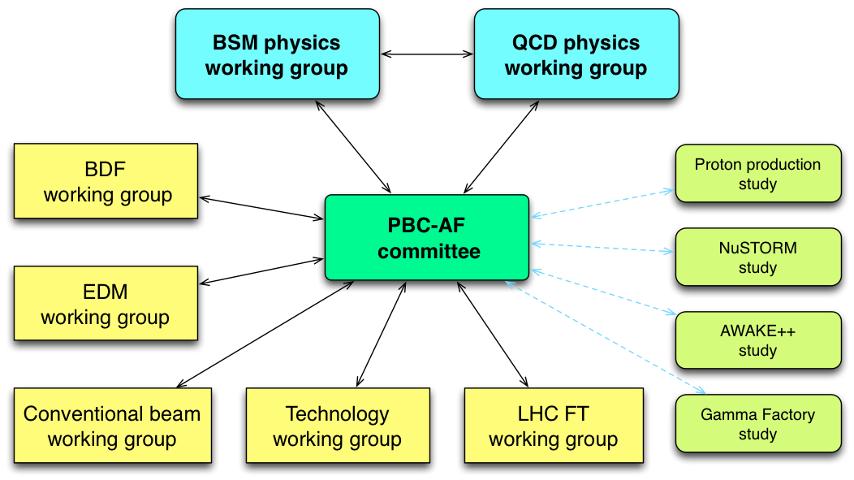
Introduction
During the PBC kickoff workshop a large number of fixed target proposals were presented. It is thought important to perform pre-proposal studies in order to allow the working groups to make progress with their evaluation.
Given the relatively long list of studies, we will focus first on those leading to a possible short and medium time-scale implementation and with limited resources, as well as on those
which seem to be the most
advanced and competitive
(based on the available input
after the initial kickoff event
and on a first feasibility
analysis regarding the
FT implementation).

Slide 3
List of experiments to be covered
What? | Activities, Status
K12 beam dump | Benchmarking ‘ok’, optimizing layout for dedicated run
KLEVER | Targeting studies completed, optimizing neutral beam
T10 flux increase | Ongoing discussions with RP, EN-STI, EN-CV
NA60 | First ideas worked out
DIRAC | First ideas worked out
MuonE | Several tests in H8 and M2 under way. Working on options for final locations.
NA64-mu | Improved understanding of requirements. Tests underway. Two options for full experiment
COMPASS | SPSC recommendation for 2021.
RF separated beam | Studies just launched. First discussion with RF.
NA61 | High intensity tests, machine protection issues progressing. VLE beam design under way.
REDTOP | First evaluation of possibilities made. Now on hold

Slide 4
General News
Since the previous CBWG Meeting on November, two new members joined the team in EN-EA: Dipanwita Banerjee in December last year and Eva Montbarbon in March this year.
The studies and discussions with the experiments and project are performed within 3 subgroups for EHN1, EHN2 and ECN3. The EHN2 group has had many meetings with all proposals for EHN2. The projects for EHN1 and ECN3 are more weakly coupled and many interactions have taken place with the individual project representations.
In parallel we have had weekly meetings among the EN-EA members, sometimes with technical or outside experts.

Slide 5
PBC and CBWG Deliverables
The proposed experiments report to the BSM and QCD physics groups.
The general Accelerator and Facilities WG prepares additional input to PBC concerning feasibility, technical aspects, proton availability, costs, etcetera. The Conventional Beams WG is part of PBC-AF and will submit a final report and separate documents (reports, notes, etc) in reference to PBC via the PBC-AF working group.
The PBC-CBWG report shall include an executive summary of no more than 10 pages, that will also be made available separately
The PBC will submit an overall document to ESPP with references to the executive summaries and full reports of the CBWG and other working groups inside PBC-AF.
The projects are expected to submit their own short documents to ESPP.
The ultimate deadline is 18 December 2018.

Slide 6
Important remark
PBC collects proposals and complements these with additional information concerning global interest, competition, feasibility, cost, etc and prepares an overall picture. This is driven by the physics working groups.
PBC-CBWG will provide technical information concerning feasibility, possible solutions (or lack thereof), cost, safety aspects (e.g. RP), etcetera.
PBC-CBWG will remain independent and will not make choices between or support particular projects.

Slide 7
REDTOP
CBWG got a request from the PBC chair to study the feasibility of REDTOP at CERN. REDTOP is a search for very rare eta decays, originally proposed for Fermilab.
REDTOP requires a 2 GeV kinetic energy beam with duty cycle of 80% or more. This is not trivial to reconcile with the rest of the program, but with reduced requirements further studies might be useful in some more machine oriented working groups.
We organised meetings with several machine experts and gave first conclusions to the PBC chair and the PBC-AF group.
The conclusion was to not go further at this stage and make our conclusions available to REDTOP and PBC.

Slide 8
REDTOP conclusions (in short)
REDTOP is an experiment for very rare eta decays, originally proposed for FERMILAB. Discussions with several machine experts have taken place concerning implementation at CERN. They request 10¹⁸ pot per year and hence a duty cycle of 80% or more..
In LEIR the beam energy is too low and many machine aspects would need serious studies and investment. In particular LEIR is not a shielded machine
The upgraded PSB energy after LS2 would match perfectly, but here the implementation would also be difficult and penalising for the other users.
At the PS slow extraction into a heavily shielded facility (like the IRRAD+CHARM bunker in the East Hall) has been looked at. No showstopper has been identified. Again many studies would be required and the impact on the rest of the PS physics program would be very significant. Reduced flux requirements could ease the situation.
For the moment this study is put on hold and any further study should be in a more machine oriented working group.

Slide 9
On the longer term
The amount of work is such that no final conclusions can be reached by the end of this year.
In the CERN Medium Term Plan a (modest) budget line is foreseen to continue the efforts for many years, however a budget increase for this activity is for the moment only foreseen after 2026.
It is clear that we must also converge on plans for studies and activities beyond ESPP.
Once the projects become mature, they must be submitted to the SPSC and will be evaluated there along the normal procedures. Requests for running time in 2022 and beyond will be evaluated only when the ESPP recommendations become available.

Slide 10
PBC General Meetings
The PBC General Workshop will take place on Wednesday and Thursday this week. The final PBC general workshop will be held in the beginning of 2019.

Slide 11
Questions?

Slide 12
Global document structure
Executive summary
Introduction (including list of proposals)
Organisation in subgroups (according to experimental halls)
EHN1 related projects
EHN2 related projects
ECN3 related projects
Interfaces to other PBC working groups
Future studies and outlook
Summary and conclusions
Notes:
EHN1 projects(

Slide 13
1. Introduction
Section | Editor
Short description of on-going beams, infrastructure and experiments | LG
List of new proposals | LG
Separation into studies, with justification and deliverables | LG
I imagine about 5 pages for the description of what we have now
1 page for the list of experiments
2 pages for the separation into separate studies and globally the deliverables
Total about 8 pages

Slide 14
2. Organisation in subgroups
Section | Editor
Rationale (why are some coupled) | LG
Attribution of projects to a particular hall | LG
Summary table | LG
Rationale 1-2 pages (description of particularities of each hall)
Attribution to subgroups about 2 pages
Summary table 1 page
Total ~4 pages

Slide 15
3. EHN1 related projects
Section | Editor
NA61 studies (~6 pages) | NC
Higher intensities, shielding
Machine protection for beam position
Beam stability issues
NA64-e studies (~3 pages) | NC
Intensity aspects and collimation
Permanent installation advantages and description of PPE144
NA64-h studies (~1 page) | NC
Remarks on hadron beams (intensity, PID, etc)
Total ~10 pages

Slide 16
4. EHN2 related projects
Section | Editor
COMPASS proposal | JB
Deuterons proposal (1 page)
R_{p} proposal (1 page)
Low-E beam, vacuum improvements (3 pages)
RF separated beam (to be defined) | JB, EM
NA64-mu | JB, DB
Implementation inside SM2 (4 pages)
MuonE | JB
Test location and plans (4 p)
Permanent location options (or in place of COMPASS, 5 pages)
Muon beam characteristics and implications (5 pages)
Electron beam (refer to vacuum improvements above, 3 pages)
Cost indications (summary of each section)
Total about 30 pages + RF
Notes:
(5 apges)

Slide 17
5. ECN3 related projects
Section | Editor
NA62-Beamdump (“SHADOWS”?) | MR, LG
Benchmarking and optimisation with present layout (8 p)
Proposal for 1-year run (8 pages) including approximate cost
KLEVER | MvD, LG
Benchmarking of simulations and conclusion on targeting (8 pages)
P42 modifications (1 page)
K12 beam line design (10 pages)
Intensity limitations and mitigation measures | AG, LG
RP aspects, impact on ventilation, costs (8 pages)
Equipment resistance and mitigation, costs (8 pages)
Possibilities or not for NA60++ and DIRAC++ | AG, LG
Total: ~51 pages

Slide 18
6. Interfaces to other working groups
Section | Editor
Machine performance study group (1 page) | LG
For overall proton flux
BDF WG (3 pages) | LG
For super-cycle composition and duty cycle
AWAKE WG | LG
Small impact on supercycle and duty-cycle
Total about 5 pages
Notes:
Small impact on

Slide 19
7. Future studies and outlook
Obviously depending on how far we get. E.g. describe future needs or plans for:
Section | Editor
RF separated beam design | JB
KLEVER implementation | LG
Intensity increase in ECN3 | AG
Detailed design of ‘H10 beam’ (if not excluded already) | LG
Safety aspects in more detail | all
More detailed costing in general | all
Not more than about 5 pages in total?
Notes:
SafDeat

Slide 20
8. Summary and conclusions
Section | Editor
Summary of the above
What is possible and what is impossible
Overview of costs
Put it context with respect to physics WG recommendations
Total about 3 pages?

Slide 21
Final remarks on report
This would add up to a total of about 110-120 pages
Individual sections shall refer to ATS notes (?) wherever appropriate;
e.g. KLEVER targeting studies or detailed K12 beamdump simulations,
HALO studies in M2, software development for PBC studies,
at a later stage details about RF separated beam?, etc

