Slide 1


Elinks for the IT phase-2 Upgrade
Alice Bean, Robert Young, Sadia Khalil, James Ballard, Sam Glaser, Tanner Lankford, Devdatta Majumder
EPIX/FPIX Workshop at Zurich
June 13th, 2018

Slide 2
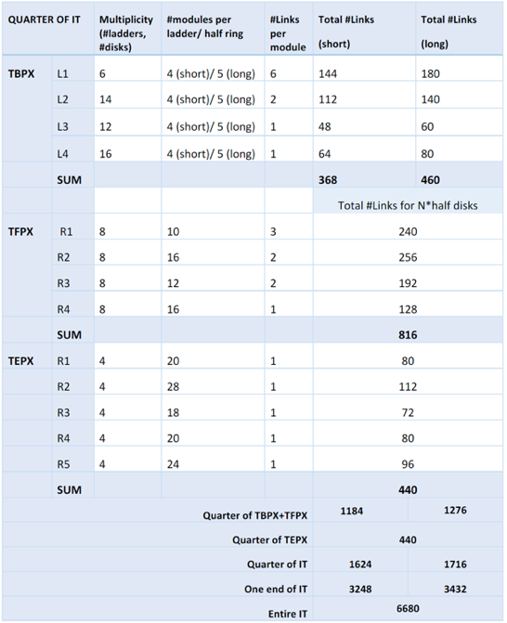

E-links: Introduction
Each LpGBT can support 7 upstream and 7 downstream signals.
Each module has 1 control downstream link at 160 Mb/s that receives the data via a 2.5 Gb/s downstream optical link
Upstream readout links at 1.28 Gb/s
TBPX Port Cards can fit between disks in some locations
IP
TFPX & TEPX needs short eLinks

Slide 3
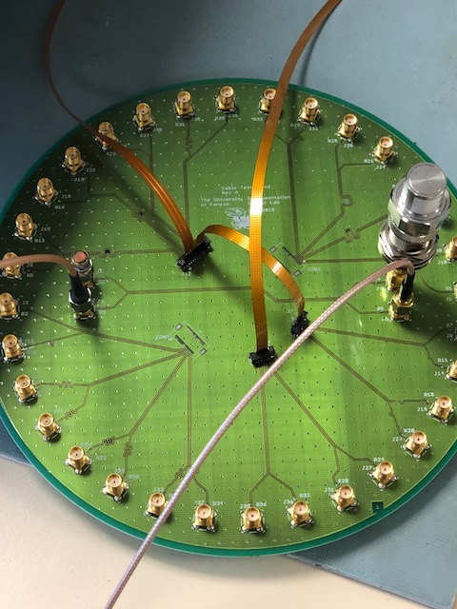
E-links Status
1/1.5 m
Cables under test
  FFC-bifurcated with 10cm/1.5m leg
    Ordered 20 from ColtTech in Kansas City. Will be delivered on June 18
  FFC-bifurcated with 10cm/1.m leg
    Received 20 from a Chinese company on June 13
  Manufactured 1m and 2m long micro-twisted pair cables
10cm
Activities
  BERT to test bit errors up to 1.28 Gbps at KU (FPGA board: VC707) and setting it up at CERN (FPGA board: KC705)
  S-parameter tests and eye diagrams using Vector Network Analyzer (CERN) or FPGA board (KU)
  Setting up a test stand to connect with RD53A board using small PCB cable adapter from Display Port to SMK or AMP connectors (Details in coming slides)
  Prepare for Radiation campaigns (first in July): Delivered the TP cables, and will be sending more as they will become available

Slide 4
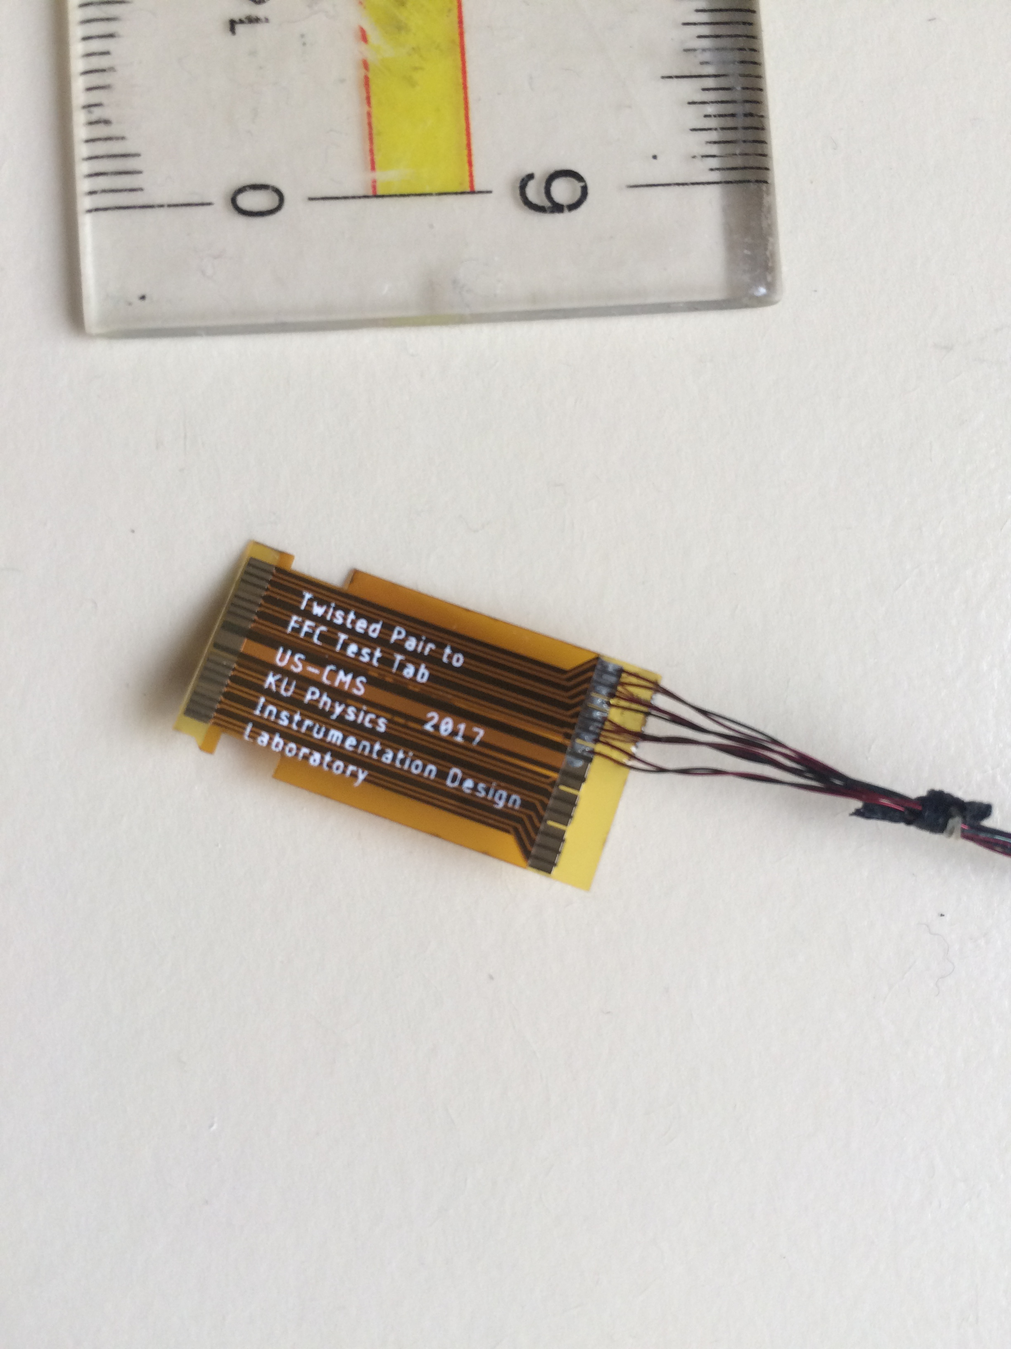
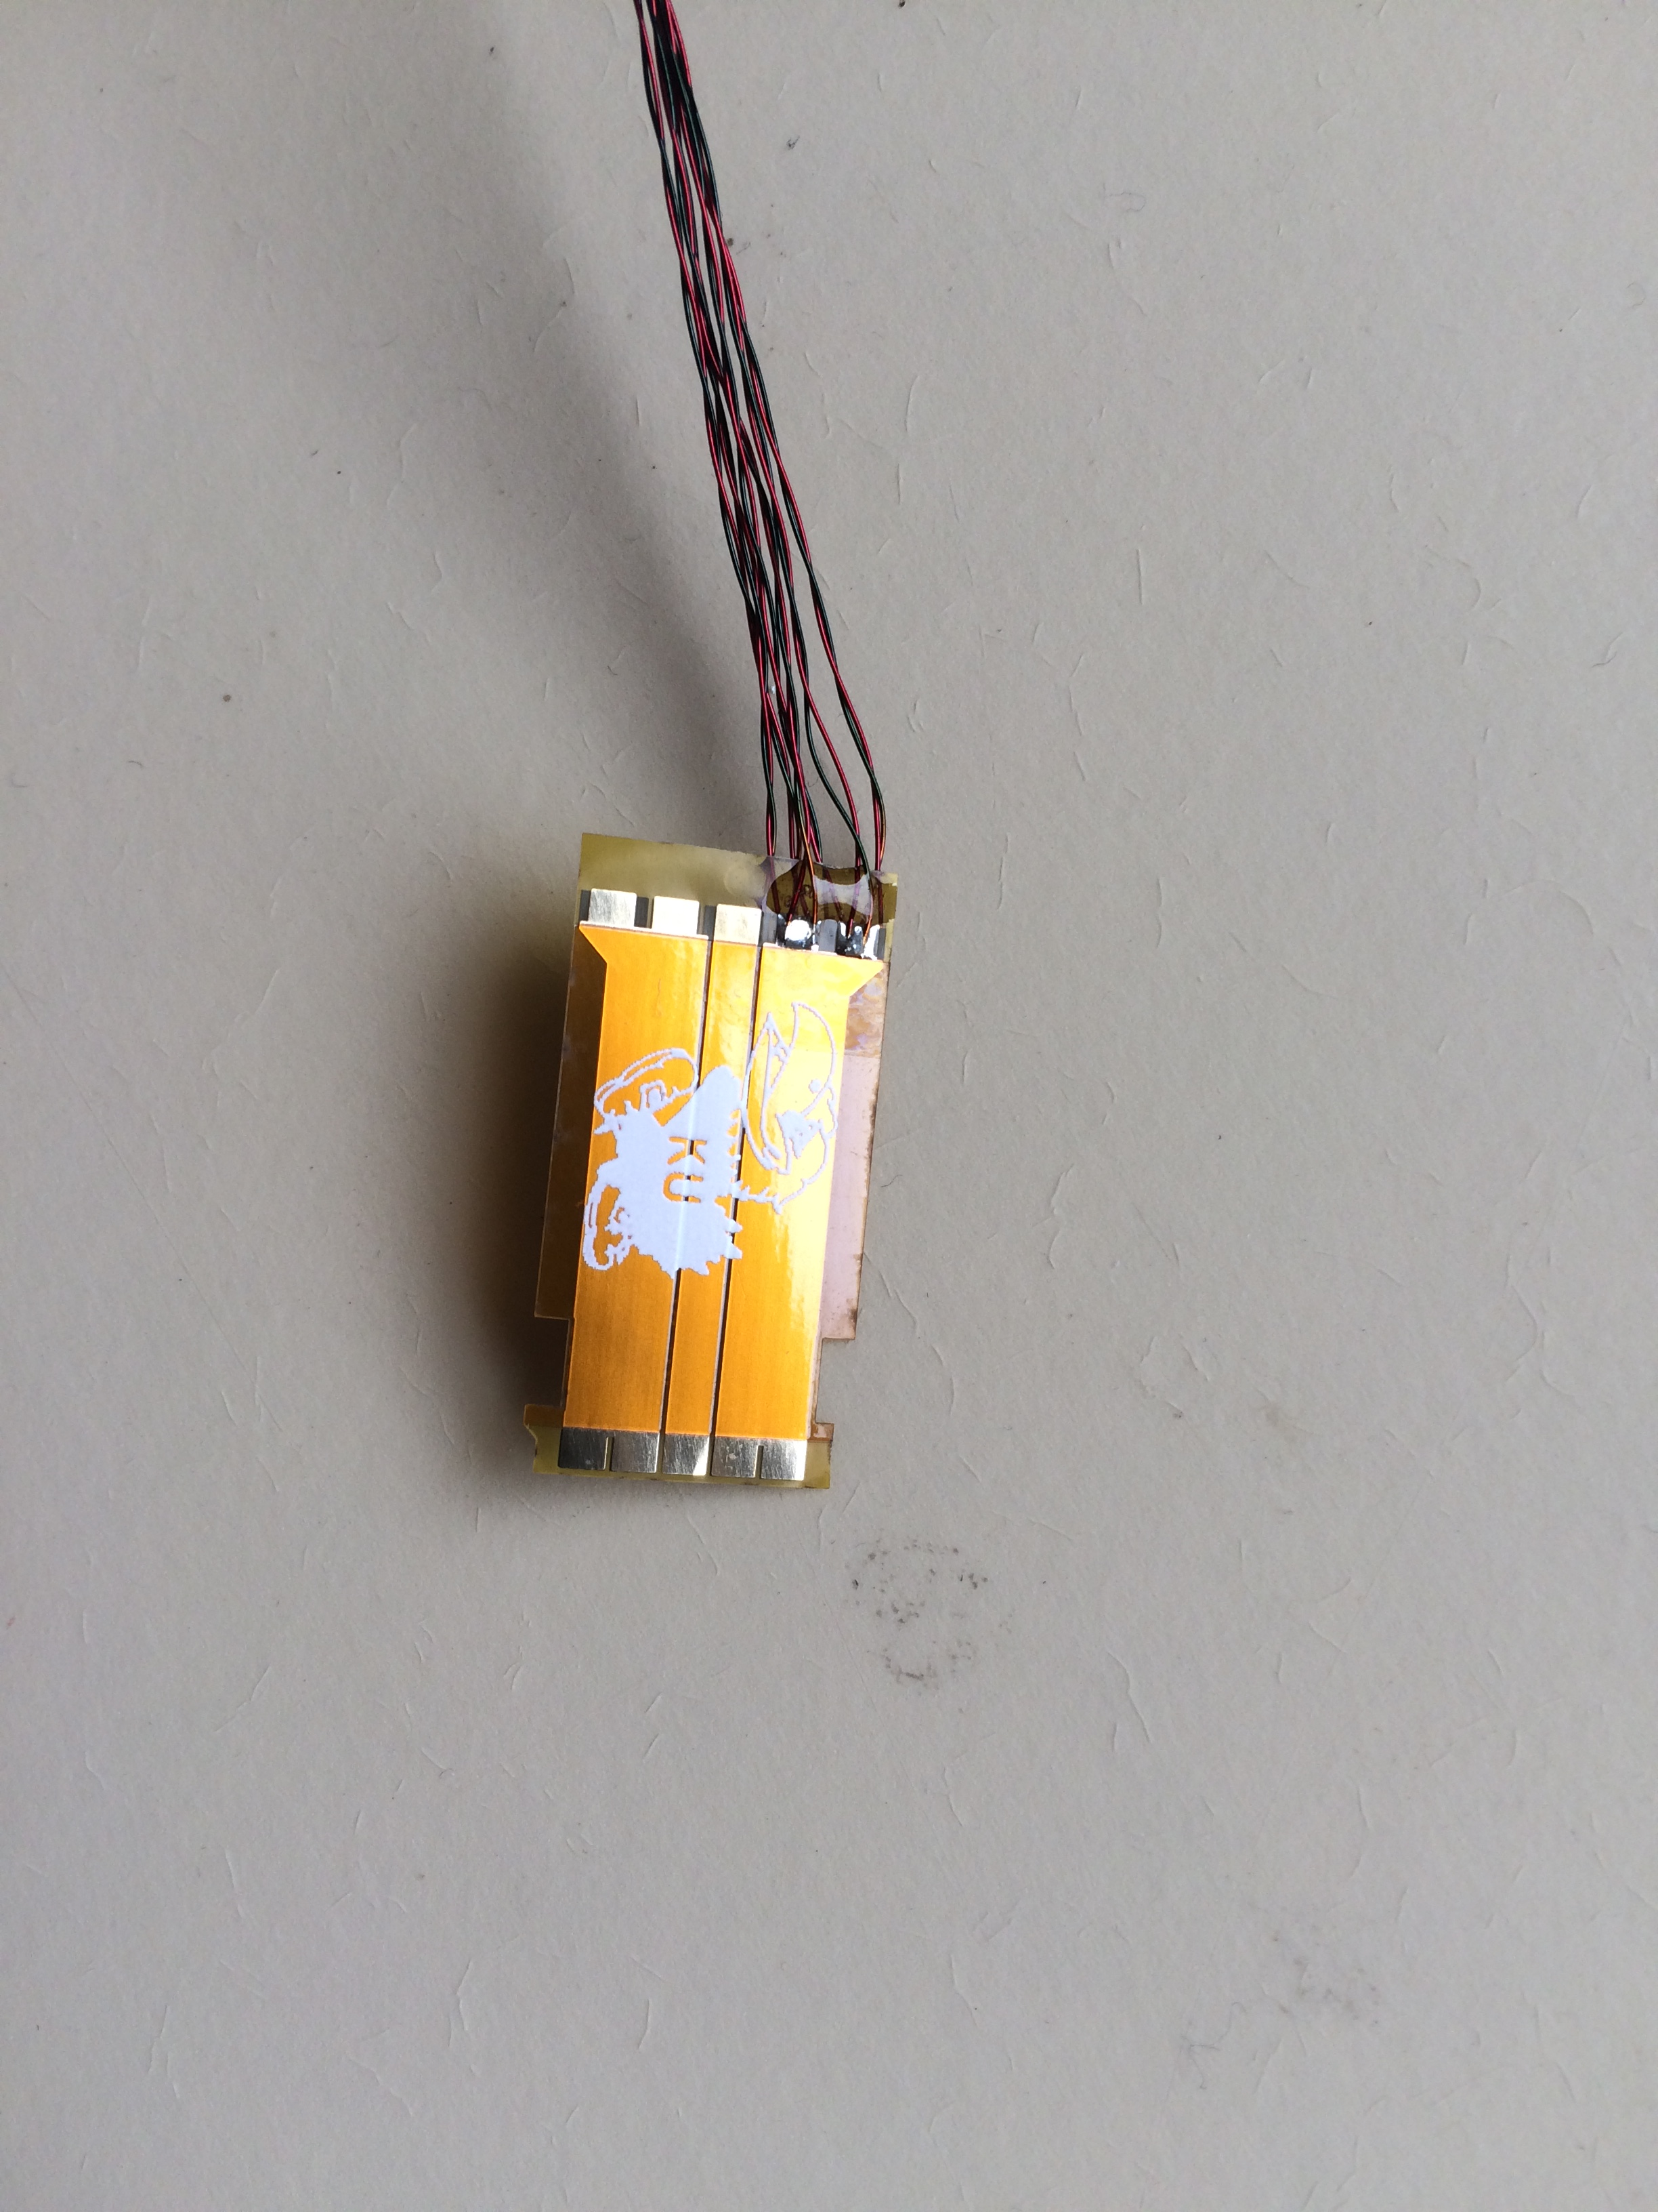
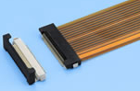
Reminder: Twisted Pair Cable
The material used is Cu with double QML Kapton insulation with 4 twist/inch and thickness of 36 AWG that were used for ATLAS nSQP cables
The FFC tabs are connected to 4 differential pairs per cable. The front side has signal differential pairs and one heavy trace to simulate the high-voltage bias. The bottom face split up into three heavy traces to be used as grounds or to power the electronics
Cables uses SMK connectors used in phase-1 TFPix
  Initially, we have a shortage of these connects but now have recently recovered some from CERN (Thanks to Will Johns!)
    EF-5D Series 0.5mm Pitch used for Phase-1 FPX flex cables, 20 contacts per size, 100 Mrad tested
Notes:
This is what we could do.

Slide 5
Flat Flex Cable Prototype
Material and connectors
  The cables are made up of two 0.13 mm thick polyamide layers, with additional 0.2 mm stiffener added to meet the connector requirement.
  The ends have gold fingers, with left side being connected to the 20 pin AMP connector and the two right hand sides being connected to two 8 pin AMP connectors (See next slide).
  The weight of Cu traces is 1oz assuming thickness is 35 μm.
1/1.5 m
10cm
Front
Back

Slide 6
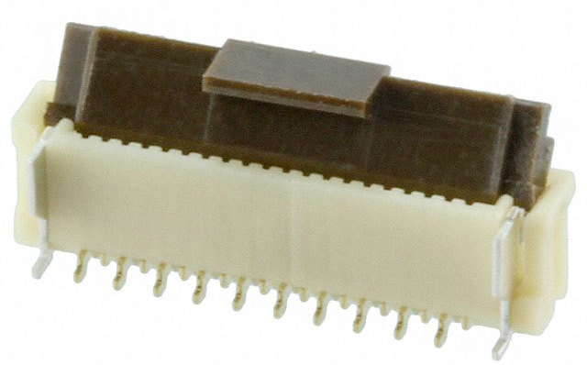
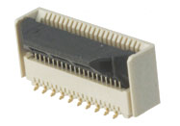
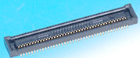
Alternate FFC Connectors (In stock)
AMP 2-1734742-0 (20 and 8 pins) and is default for bifurcated FFC
  Has sliding bale: no locking mechanism and the connection is hard to make
  Right now we have the 0.5mm spacing but the HDIs are looking at 0.3mm spacing
Hirose: FH12-20S-0.5SVA(54), FH40-20S-0.5SV, DF40HC(3.5)-40DS-0.4V(51)
Default for now for the port cards
Notes:
SMK hard to buy, AMPs hard to plugin, rest we have not tested.

Slide 7
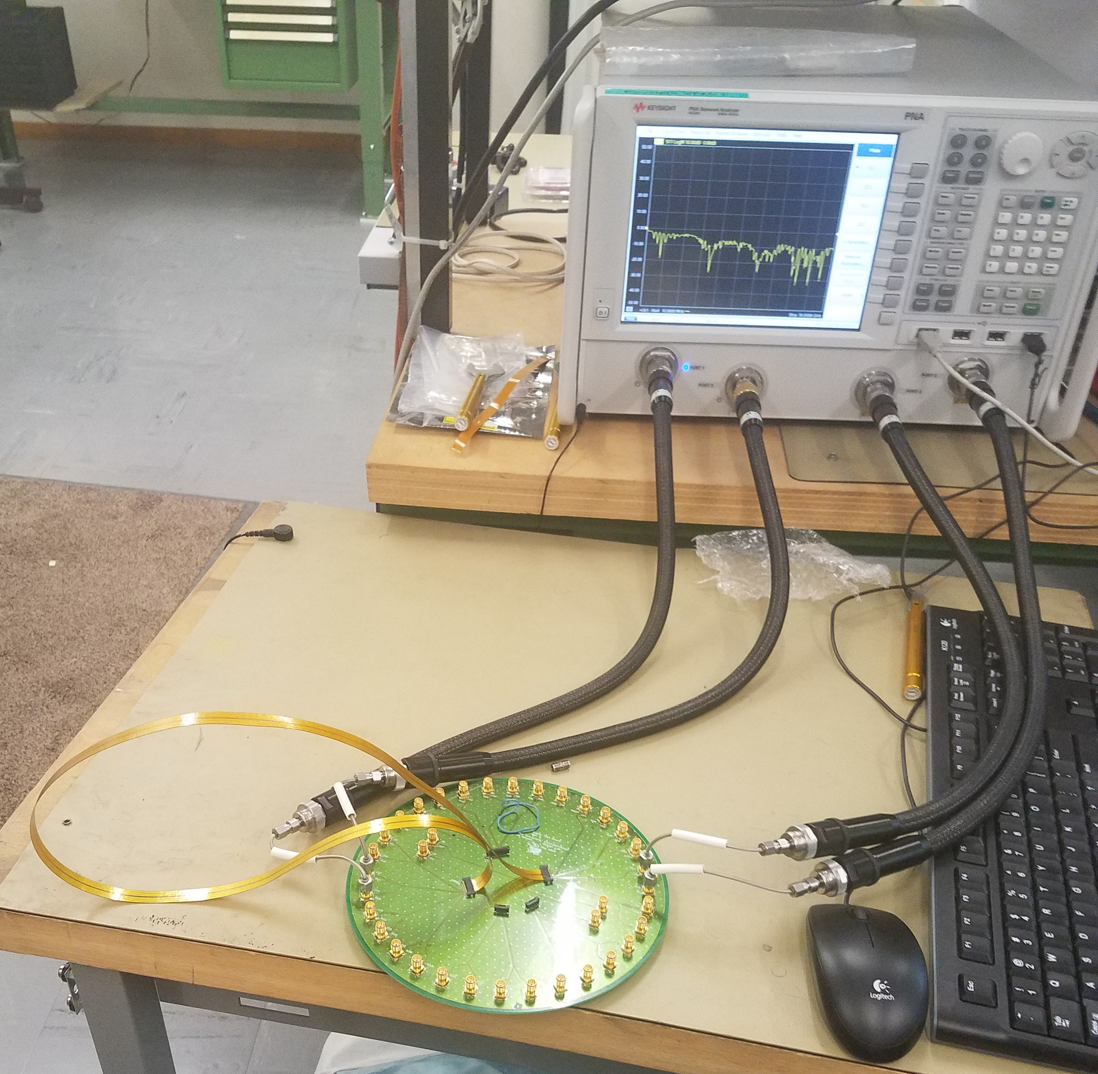
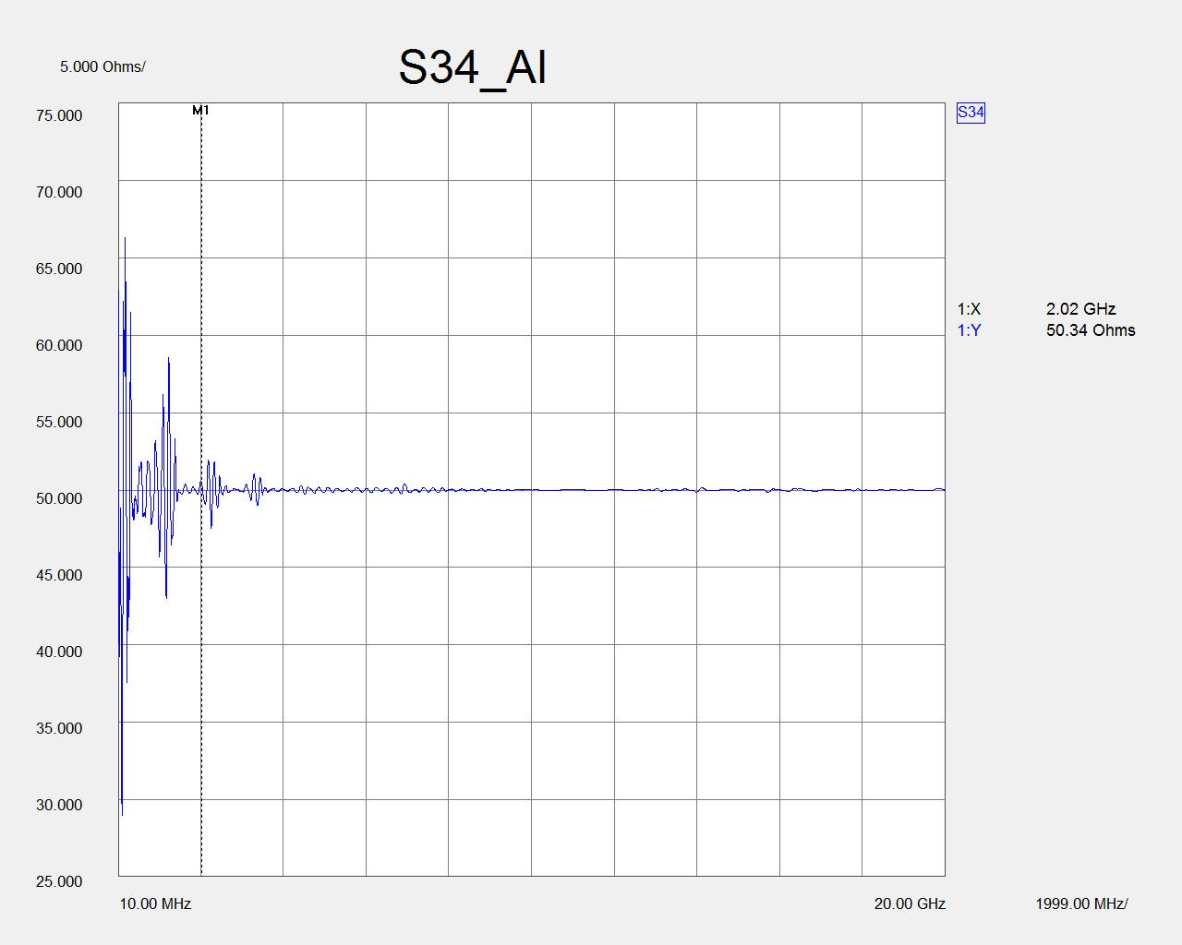
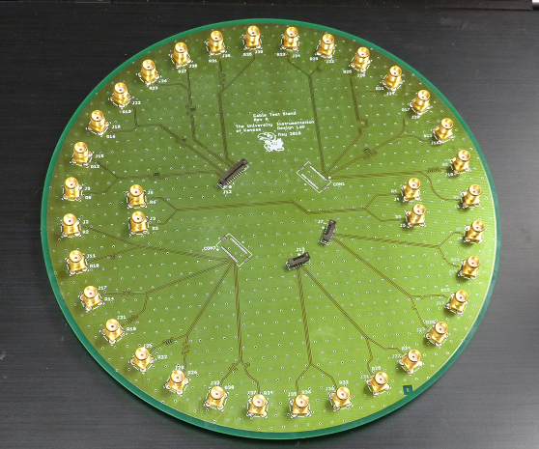
Cable test Round Board
VNA at CERN
It’s an 8 inch round board, that can connect either SMK or AMP connector for each differential pair to two SMA connectors
Used with Vector Network Analyzer and test stand to connect with RD53A board
Al FPix Phase-1 FFC

Slide 8
BERT at KU & CERN
VC707 board
Tests run at 400, 640 and 1280 Mbps
0.8 m Al FFC
Cables | 400 Mbps | 640 Mbps | 1.28 Gbps
0.762m Al FFC (phase1) | 0 err/10¹⁰ bits | 0 err/10¹³ bits (CERN)
0.51m long TP | 0 err /10¹⁰ bits | 0 err/10¹² bits
2m long TP | 0 err /10¹⁰ bits
Test TP cable |  | 0 err /10¹⁰ bits | 0 err/10¹² bits
Adapter board
test TP
0.5m TP
test TP

Slide 9
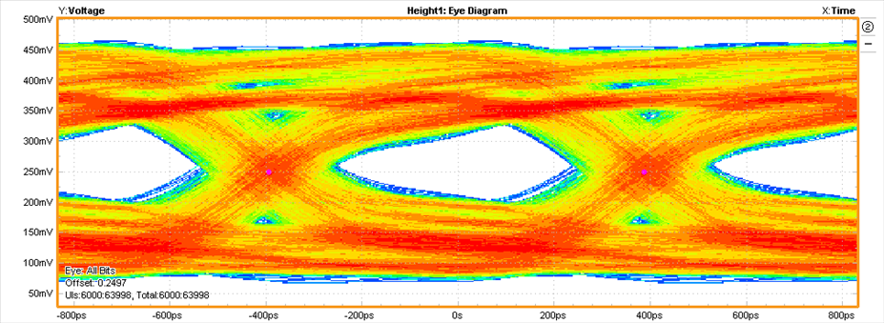
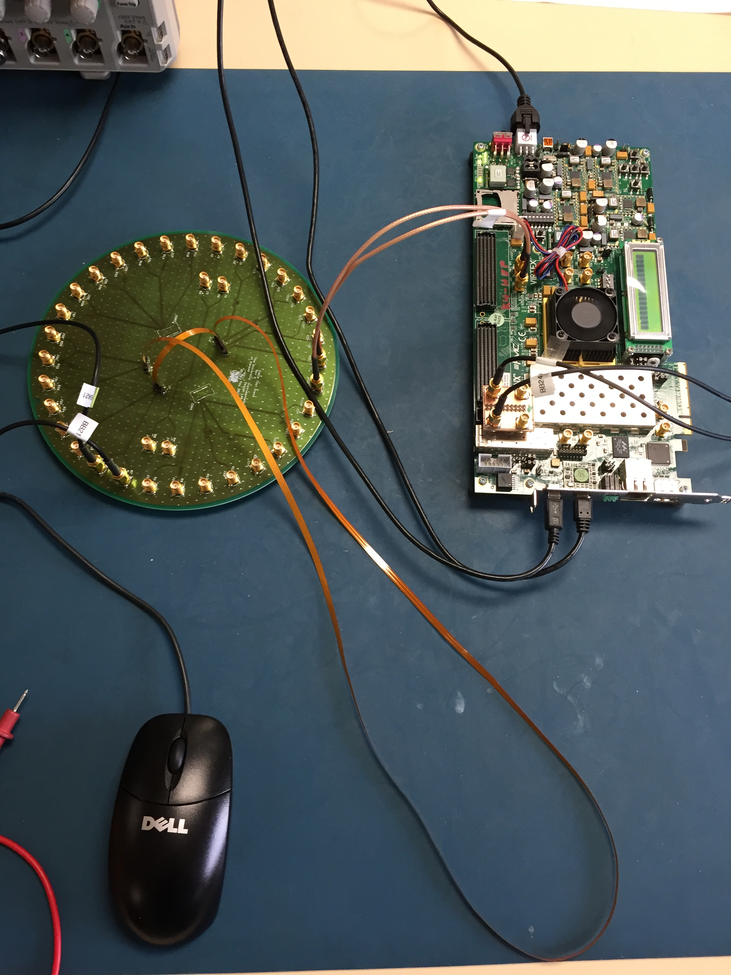
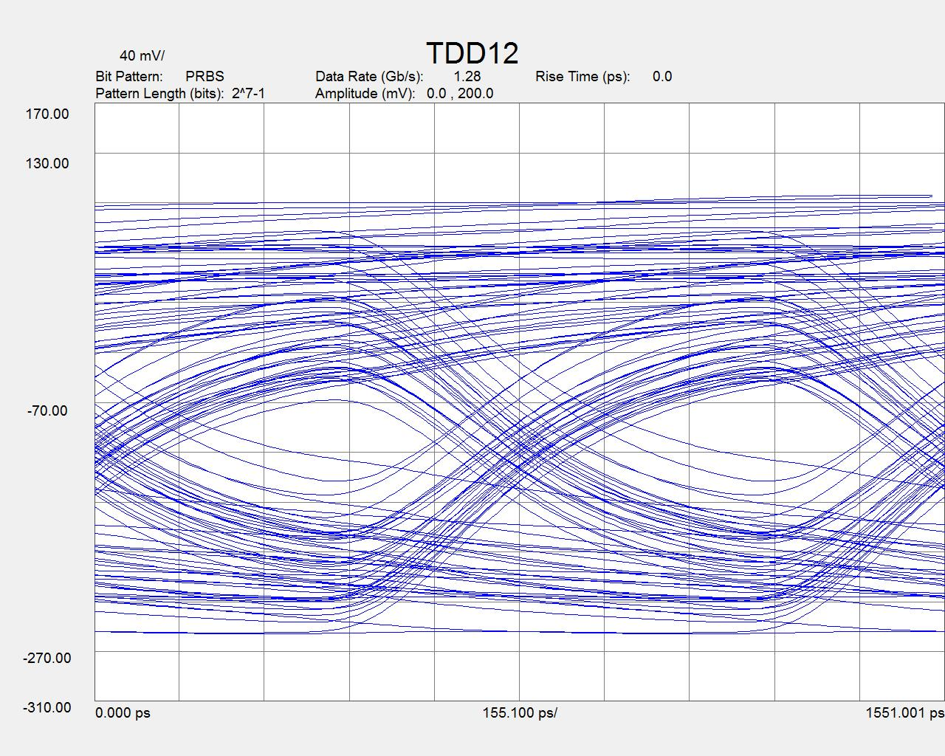
Eye Diagram
Chinese FFC (10 cm)
VC707 board
Preliminary first look,
needs work
Al FFC (Phase-1) through VNA
Test setup for the Chinese manufactured FFC

Slide 10
Current Test setup with round board for RD53A
1.28Gbps data path for test
SMA to FFC
FPGA
GTX for 1.28Gbps
(only 1 pair SMA on FPGA board)
SMA cables, 1 pair
SMK
SMA cables, 1 pair
RD53 SSC
AMP
Bonn adapter board
SMA
“slow” I/O for control
(1.5m FFC prototype contains 2 differential pair per leg)
FFC under test
Round PCB is intended to allow testing of FFC on a Vector Network Analyzer (VNA) or any other device using SMA connection(s). It can be used to adapt one or both ends to the RD53 SSC and FPGA test boards.
Slow 160Mbps control data path
Notes:
Represents initial setup allowing for test of multiple data channels on RD53
Uses first article FFC test cable
First article test cable intent is to
find manufacturer that can make cables up to 1.5m length
Test for drive and signal integrity issues with RD53 high-speed I/O drivers
Test cable design(s) for impedance etc. using VNA
Only one pair of GTX high speed I/O available on FPGA board using SMA connectors
Not shown, but necessary for development is driving SMA directly to “Bonn adapter board” for GTX signals to get baseline characteristics
Slow control path (160Mbps) on SMA cables, not critical to test of FFC
Circular board can also be used for testing cable with VNA
Circular board contains sample differential traces to also test design equations for FR4 rigid board designs to be implemented

Slide 11
Proposed test setup eliminating round board for RD53A
Create PCB that connects to FMC on FPGA board to pick up multiple GTX I/O pairs & slower I/O for control path
Create a PCB that connects to FFC cable and terminates in Display Port for use with RD53A test board
FPGA
FMC
1st or 2nd article FFC test cable
RD53 SSC
“slow” I/O for control
Display Port cable (present in all 3 setups, but not shown on previous slides for clarity.)
Notes:
Represents final test setup
Uses first or second article FFC test cable
First article test cable intent is to
find manufacturer that can make cables up to 1.5m length
Test for drive and signal integrity issues with RD53 high-speed I/O drivers
Test cable design(s) for impedance etc. using VNA
Second article test cable will be designed based on
Information learned from test setup 1 & 2 previous slides
Any updates to RD53 driver I/O abilities
Final maximum and minimum lengths as determined by mechanical design
Slow speed control path (160Mbps) moved onto FFC cable for integrated testing

Slide 12
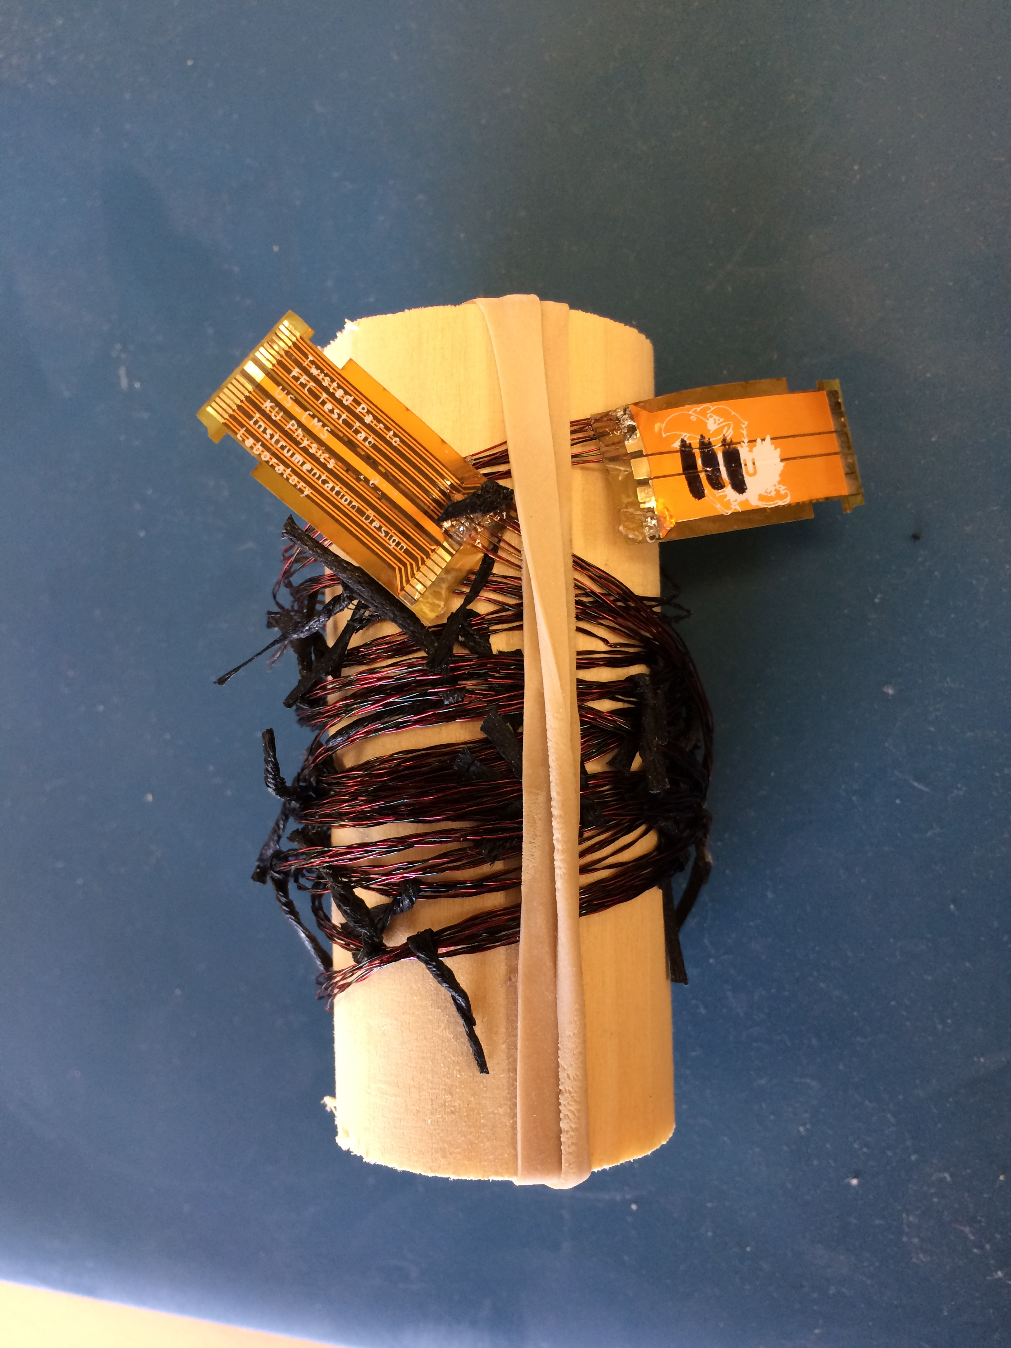
July Egamma Radiation Campaign
We are in contact with Malte and has filled the document EDMS 1807333 from our side
Dosage provided in this campaign will be 500Mrad (5MGy), where we require a cumulative dosage of 1.5Grad (15MGy)
Logistic of irradiation (Working with CERN Rad Camp contact)
List of samples and quantities
Materials | Quantity
Coupon board that houses 4 connectors | 2
Hirose connectors of three families (in a bag) | 3+3+3=9
Micro twisted pair cable of 1m length | 2
Micro twisted pair cable of 2m length | 2
FFC of 1.0m (long end) and 10cm(short end) | 3
FFC of 1.5m (long end) and 10cm(short end) | 3
Wrapped around 3’’ long and 1.5’’ diameter block

Slide 13
Backup

Slide 14
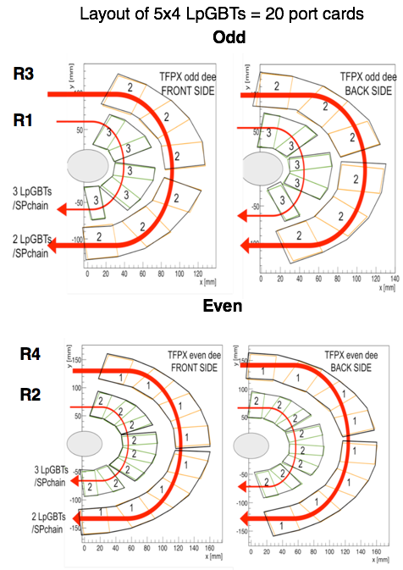
E-links: Flavor
TFPX
Elinks flavors are driven by the TEPX/TFPX power routing
A port card needs to max 6 uplinks and max 4 downlinks

Slide 15
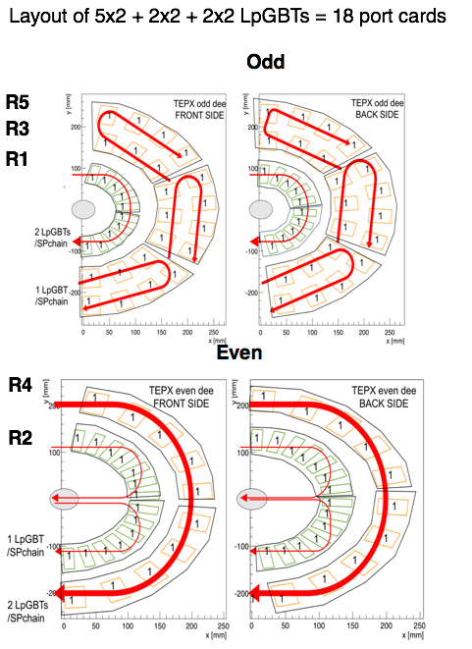
E-links: Flavor
TFPX
Elinks flavors are driven by the TEPX/TFPX power routing
A port card needs to max 7 uplinks and max 5 downlinks

