Slide 1
Phase 2 Pixel
Where do we stand with our present understanding of the services for the Inner Tracker ?
Some other consideration on beam and alignment to be kept in mind
Obviously nothing is final, all just at the conceptual level, mainly to try to understand if it all fits

Slide 2
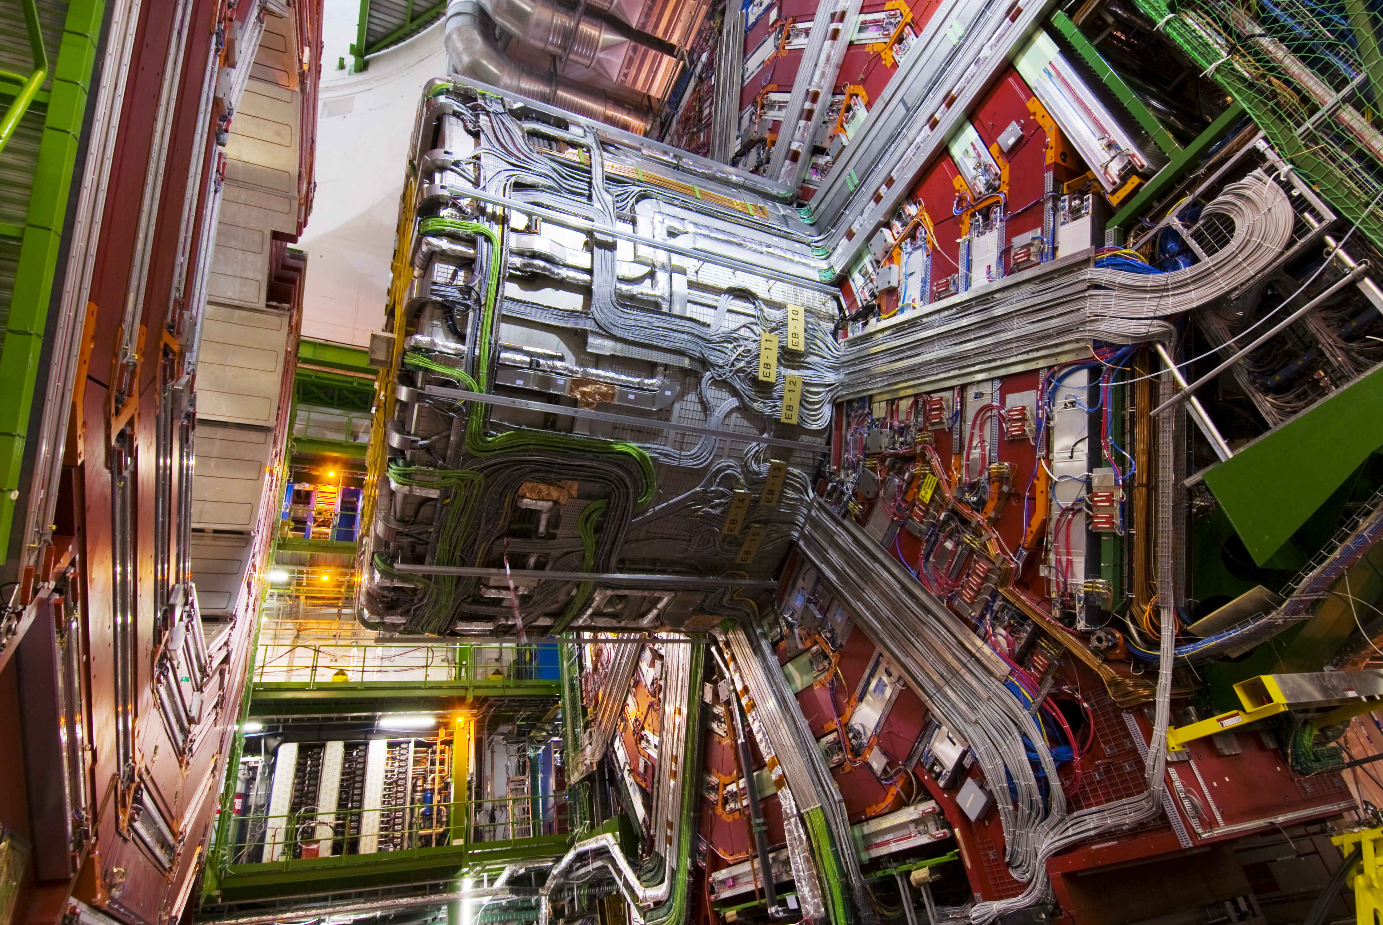
Phase 2 Pixel: YB0
YB0 will be stripped naked of services on the inside and outside of the solenoid

Slide 3
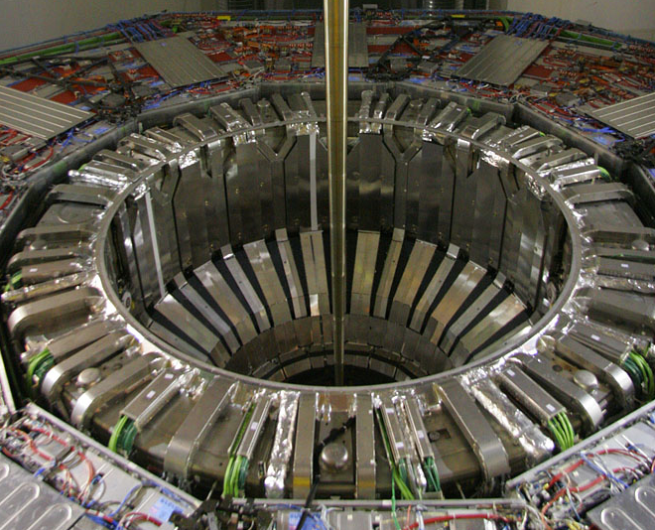
Phase 2 Pixel: YB0
Services on the inside will be very similar to what we have today, but not quite (wider PP1, toller EB/HB channels)

Slide 4
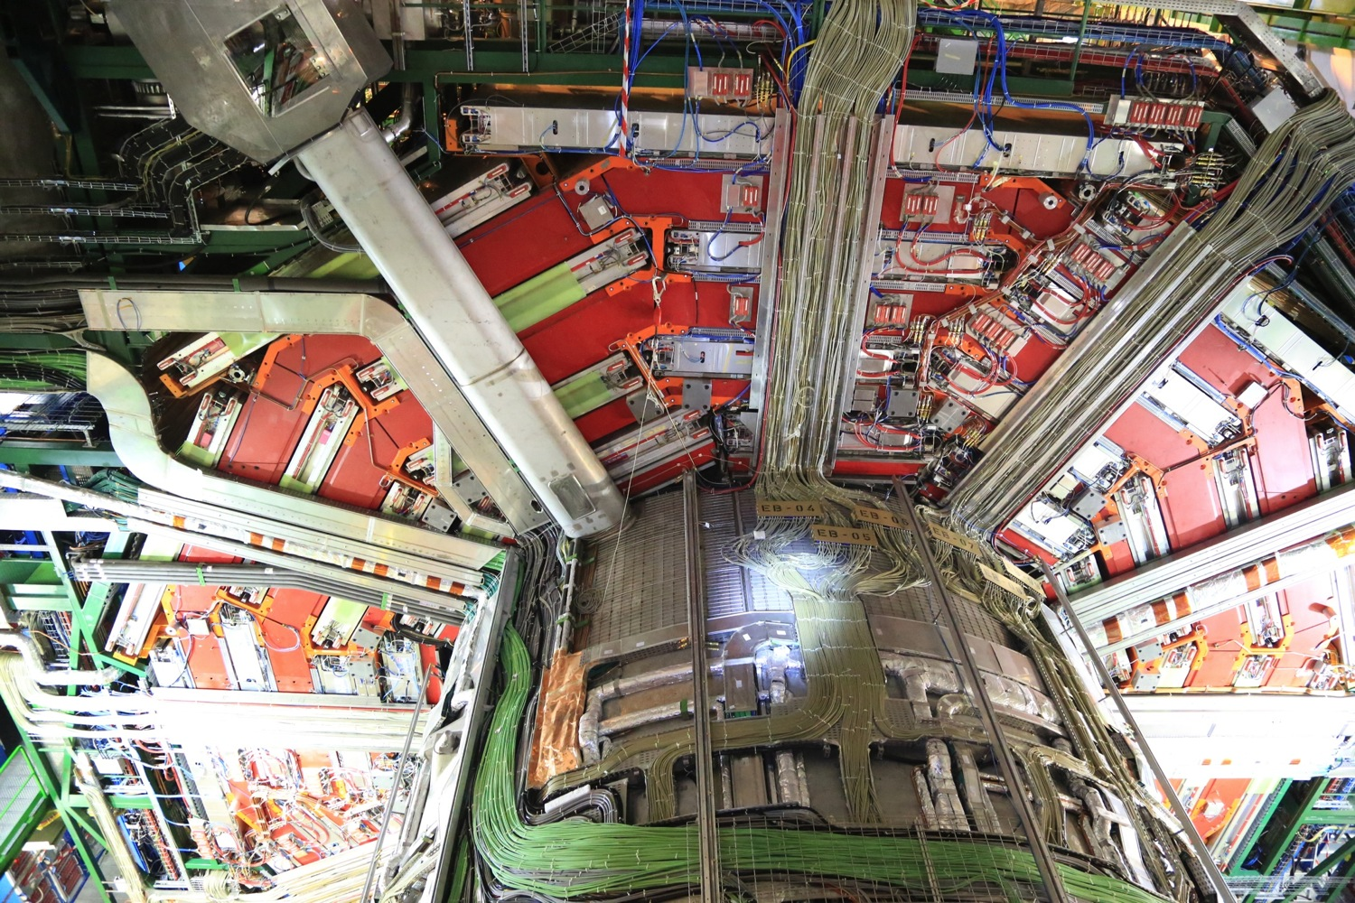
Phase 2 Pixel: YB0
Need to evaluate the cross-section available for getting out of YB0

Slide 5
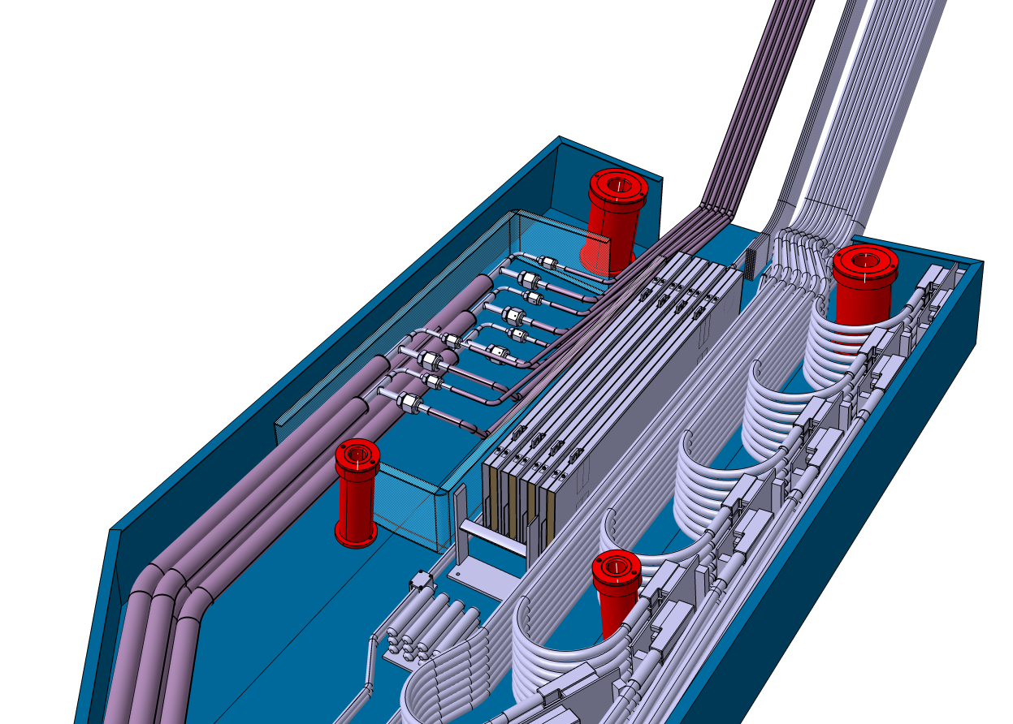
Phase 2 Pixel: PP1 (Same for IT and OT)
Same general concept as for the present Tracker/Pixel
16 full PP1 per end
Each PP1 is divided into 3 parts:
  A: either 48 cables or 6 cooling connections
  B: up to 18X5 = 90 (24X) MFB (going to 15 Trunk Opt. Cables)
  C: either 48 cables or 6 cooling connections
4 full PP1 dedicated to IT on the horizontal plane (i.e. +2, +9, +11, +18)
Single pipes, regular insulation
Concentric inlet/outlet and vacuum jacketed
5 cassettes of 18 connectors each for the optical fibers
6 stacks of 8 connectors each would fit IF D-SUB size 5

Slide 6
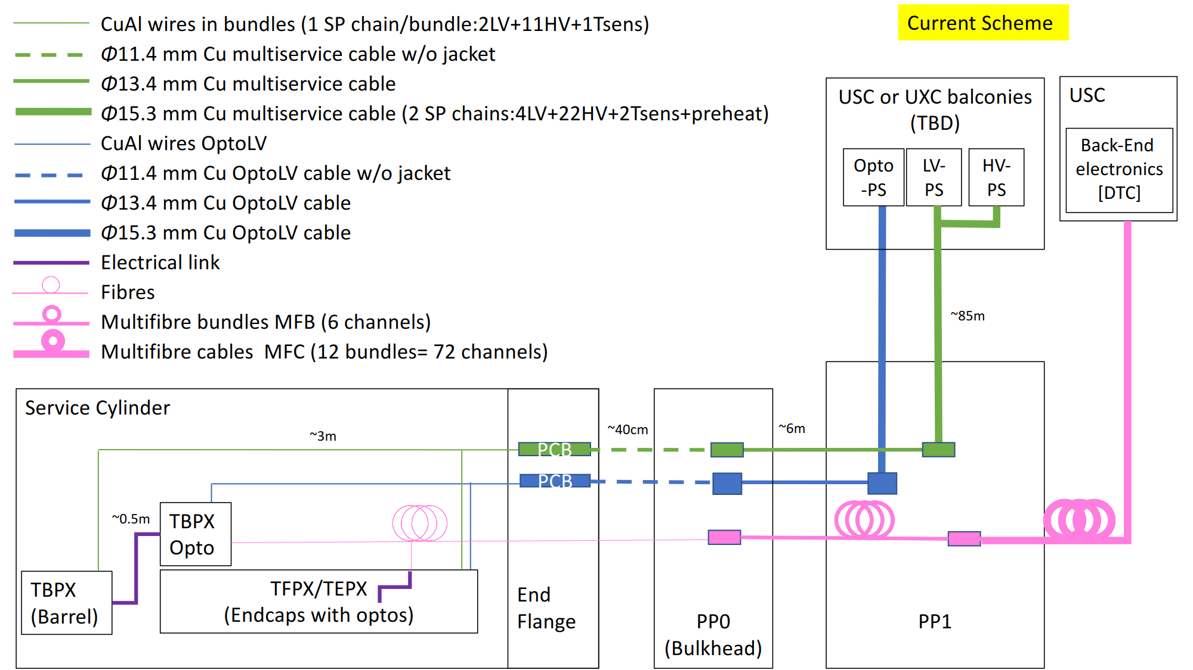
Phase 2 Pixel: Cables
Provided by: Stella Orfanelli

Slide 7
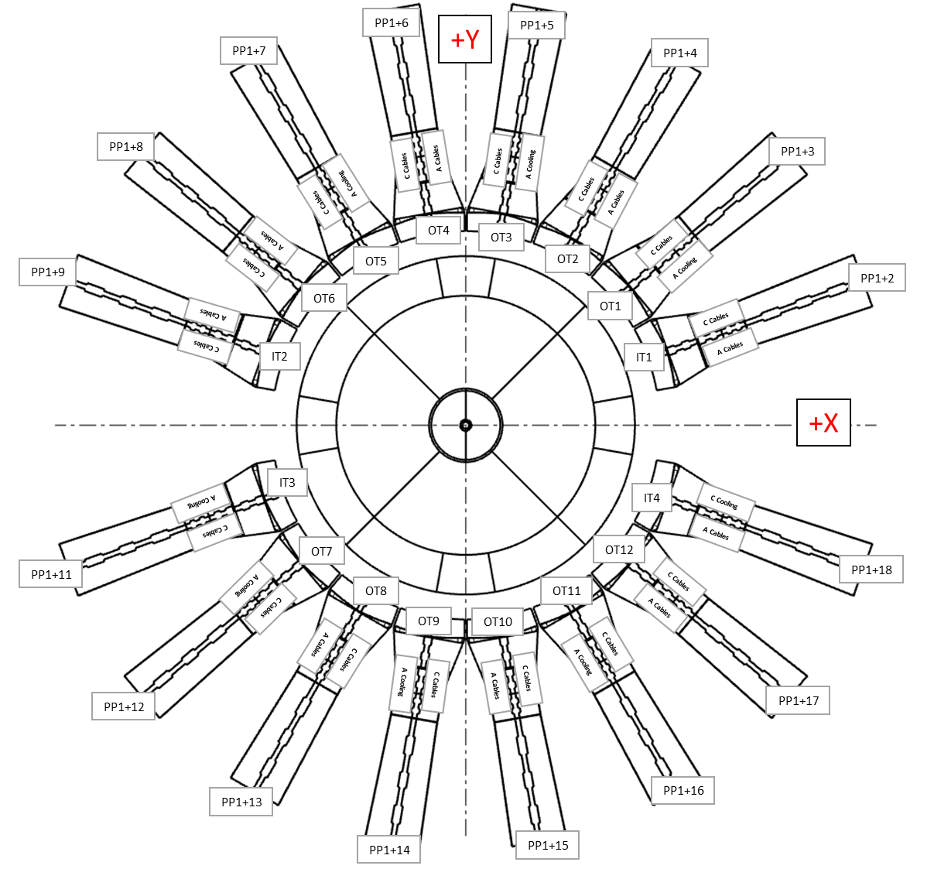
Phase 2 Pixel: Services at Bulk-Head (+Z-end)
PP1+9 A | Transfer loops | Cables
TBPX | 0 | 6
TFPX | 0 | 16
TEPX1 | 0 | 7
TEPX2 | 0 | 7
LpGBT |  | 6
Total | 0 | 42
PP1+9 B | MFB
TBPX | 4
TFPX | 7
TEPX1 | 3
TEPX2 | 3
Total | 17
PP1+9 C | Transfer loops | Cables
TBPX | 1 | 0
TFPX | 1 | 0
TEPX1 | 1 | 0
TEPX2 | 0 | 0
LpGBT |  | 0
Total | 3 | 0
PP1+2 C | Transfer loops | Cables
TBPX | 0 | 6
TFPX | 0 | 16
TEPX1 | 0 | 7
TEPX2 | 0 | 7
LpGBT |  | 6
Total | 0 | 42
PP1+2 B | MFB
TBPX | 4
TFPX | 7
TEPX1 | 3
TEPX2 | 3
Total | 17
PP1+2 A | Transfer loops | Cables
TBPX | 1 | 0
TFPX | 1 | 0
TEPX1 | 1 | 0
TEPX2 | 0 | 0
LpGBT |  | 0
Total | 3 | 0
Preliminary
PP1+11 A | Transfer loops | Cables
TBPX | 1 | 0
TFPX | 1 | 0
TEPX1 | 0 | 0
TEPX2 | 1 | 0
LpGBT |  | 0
Total | 3 | 0
PP1+11 B | MFB
TBPX | 4
TFPX | 7
TEPX1 | 3
TEPX2 | 3
Total | 17
PP1+11 C | Transfer loops | Cables
TBPX | 0 | 6
TFPX | 0 | 16
TEPX1 | 0 | 7
TEPX2 | 0 | 7
LpGBT |  | 6
Total | 0 | 42
PP1+18 C | Transfer loops | Cables
TBPX | 1 | 0
TFPX | 1 | 0
TEPX1 | 0 | 0
TEPX2 | 1 | 0
LpGBT |  | 0
Total | 3 | 0
PP1+18 B | MFB
TBPX | 4
TFPX | 7
TEPX1 | 3
TEPX2 | 3
Total | 17
PP1+18 A | Transfer loops | Cables
TBPX | 0 | 6
TFPX | 0 | 16
TEPX1 | 0 | 7
TEPX2 | 0 | 7
LpGBT |  | 6
Total | 0 | 42

Slide 8
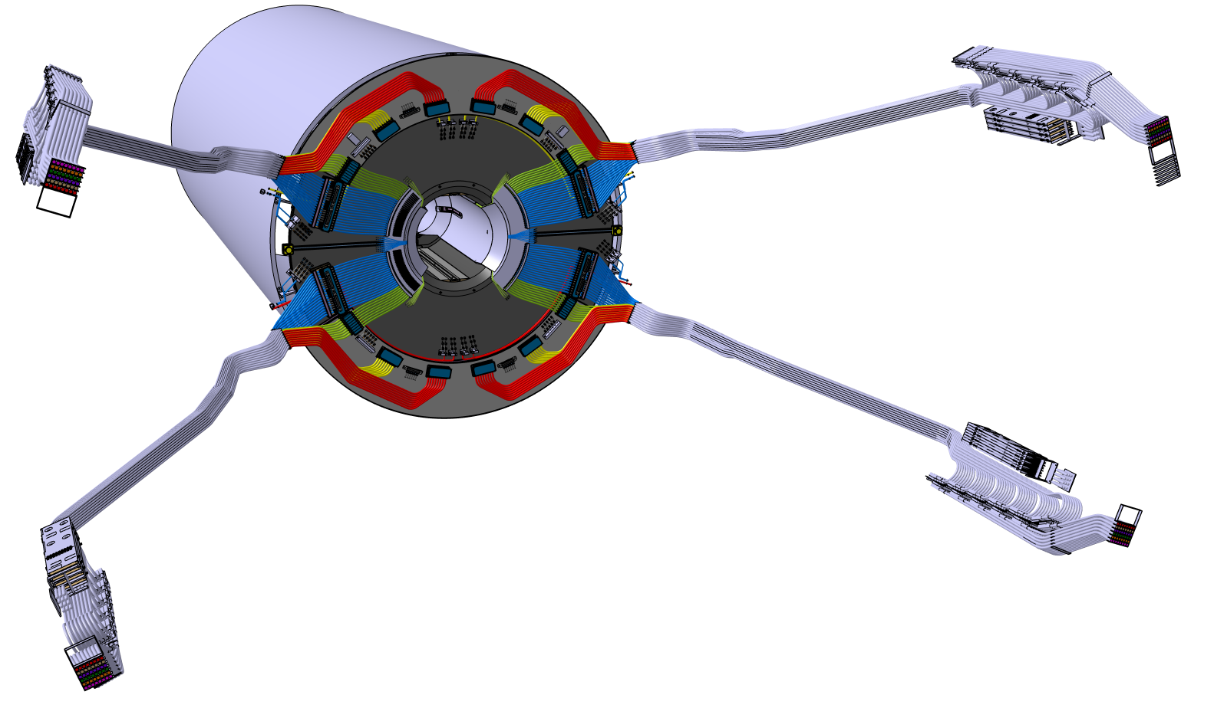
Phase 2 Pixel: Services at Bulk-Head
42/48
42/48
cables
Cooling:
TBPX
TFPX
TEPX1
Cooling
TBPX
TFPX
TEPX1
Cooling
TBPX
TFPX
TEPX2
Cooling
TBPX
TFPX
TEPX2
cables
Cables for TBPX, TFPX, TEPX1, TEPX2 are all separated in Phi
42/48
42/48
Preliminary 3D model (A. Filenius)

Slide 9
Phase 2 Pixel: Services at Bulk-Head
Power cable connections in scheme 1
In Scheme 1 the cable coming from the PP1 would be split into two before the PP0 connection.
After the split two DSUB –type connectors would be soldered and molded onto the ends, and would be stacked as shown below to ensure minimum height consumption.
PP0
MTP-MTP
adapter
Z-axis
<- IT
DSUB con.
DSUB con.
PP1 ->
BULKHEAD

Slide 10
Phase 2 Pixel: Services at Bulk-Head
Power cable connections in Scheme 2
In Scheme 2 the cable would be split into two after the PP0 connection, splitting could be done with or without a PCB.
The purpose of the PCB is to provide a sturdy platform to solder onto and to split the cable into two with the possibility to have more desirable wires (diameters) after the PCB.
Without PCB you would simply separate the wires from the cable to their individual bundles. If different wires are desired, PCB could be replaced with simply soldering the desired wires into the wires of the cable.
PP0
Z-axis
Cable tension reliever
<- IT
MTP-MTP
adapter
~0.5m
PCB
DSUB Size 5
IT Service Cylinder endflange
PP1 ->
BULKHEAD

Slide 11
Phase 2 Pixel: Services at Bulk-Head
Outlet manifold
Vacuum Jacketed Transfer Line
Inlet manifold
Outlet Pipe, OD12mm ID10mm
½-inch VCR con.
Inlet Pipe, OD8mm ID6mm
Outlet Pipe, OD2.2mm ID2mm
¼-inch VCR con.
⅛-inch VCR con.
Inlet Pipe, OD2.2mm ID2mm
Mini-VCR con.
Pipe dimensions still to be confirmed.
~0.3m-0.5m
Service Channels
~0.5m-3m
~4m-5m
Barrel/
Dee
Capillaries
PP0
(Bulkhead)
IT
PP1
Connection needed for testing?

Slide 12
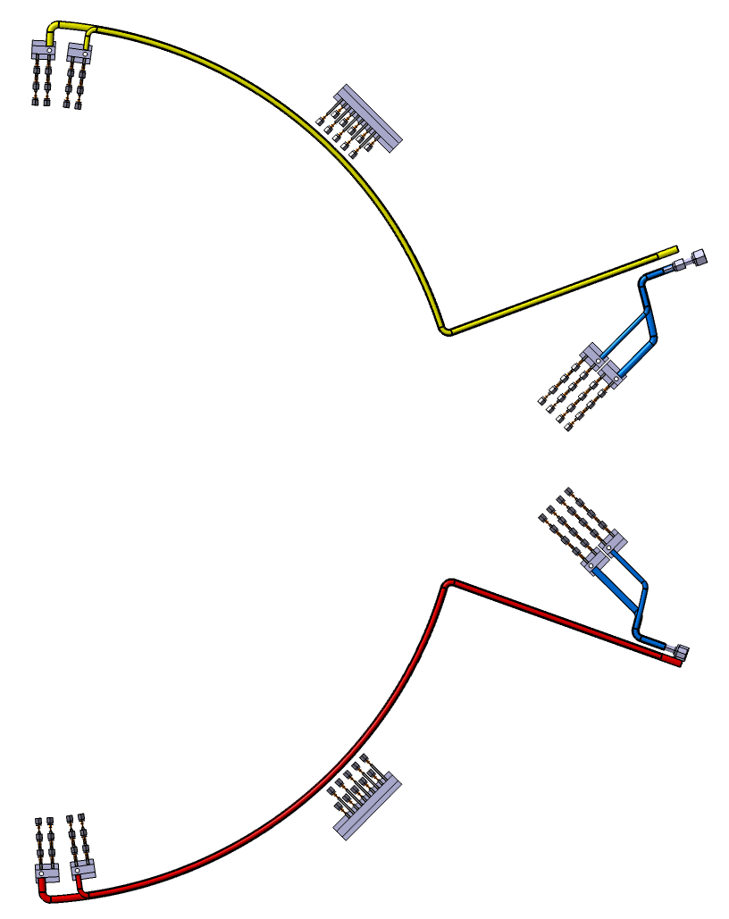
Phase 2 Pixel: Services at Bulk-Head
Manifolding and transfer loops of one IT quarter
Added one transfer loop for TBPX to be able to have inlets and outlets at top and bottom
 | Inlets | Outlets
TEPX1 | 6 | 6
 | Inlets | Outlets
TBPX | 5 | 5
 | Inlets | Outlets
TFPX | 8 | 8
One ¼ | Transfer loops
TBPX | 2
TFPX | 2
TEPX1 | 1
TEPX2 | 1
Total | 6
 | Inlets | Outlets
TFPX | 8 | 8
 | Inlets | Outlets
TBPX | 5 | 5
 | Inlets | Outlets
TEPX2 | 6 | 6
Not finished model,
TBPX Transfer loop pipes (green) missing

Slide 13
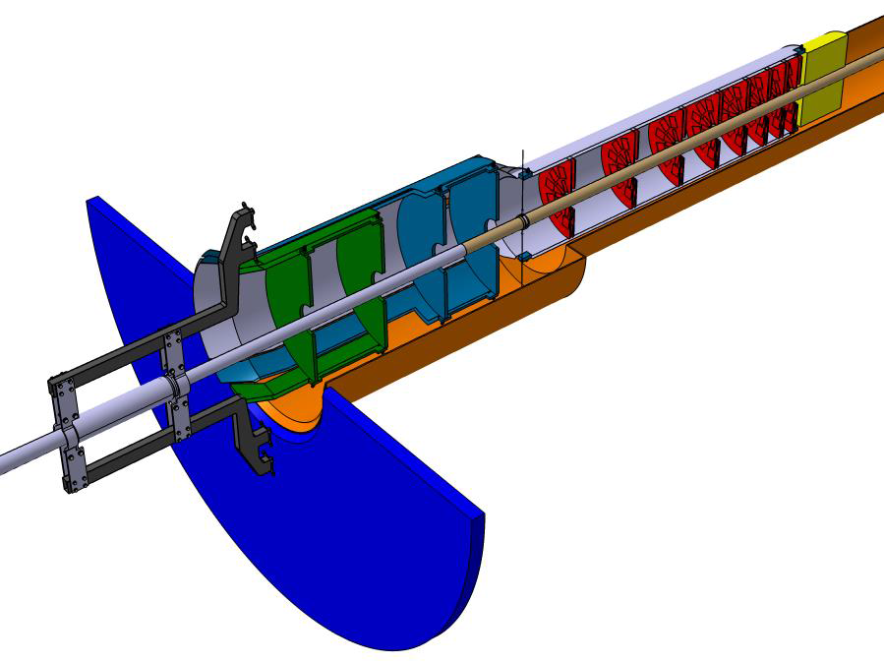
Phase 2 Pixel: Services at Bulk-Head
TEPX1
TEPX2

Slide 14
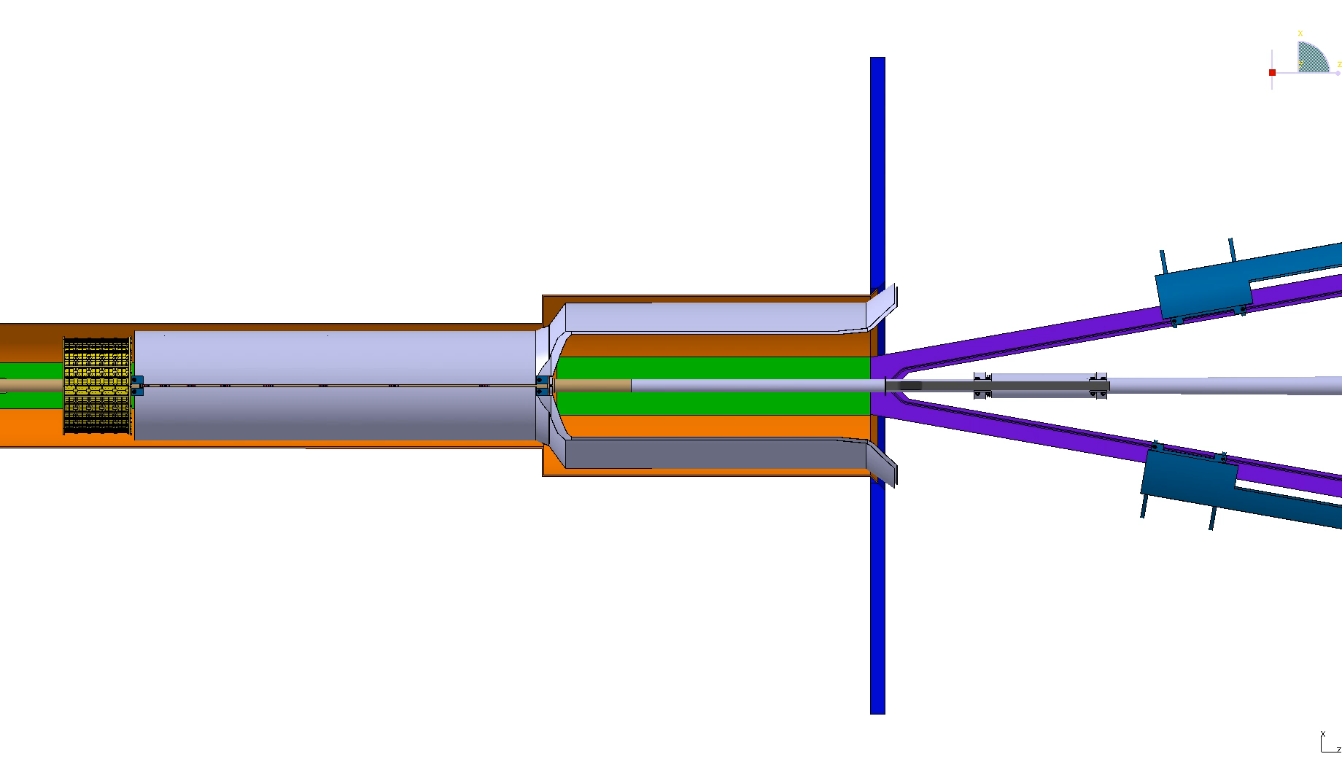
TEPX1 Installation
Wheels positioned at
the middle of the
TEPX Double Dees
Wheels follow the same rail

Slide 15
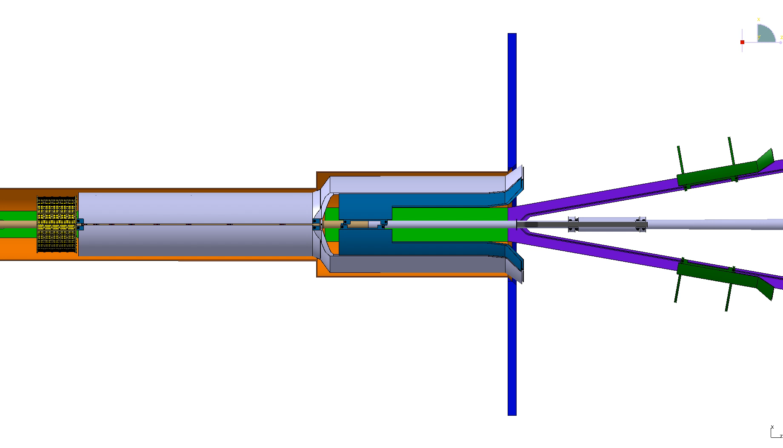
TEPX2 Installation

Slide 16
Phase 2 Pixel: Cooling concept
Similar to Phase1 Pixel detector
Cooling plant in USC, manifold distribution in UXC
Cooling plant vs Detector grouping still not settled
Cooling plant systems will have automatic back-up plant upon failure of a single plant
Vacuum jacketed inlet-in-outlet transfer line from Cooling plants to manifolds and from manifolds up to PP1
Single pipes and regular insulation from PP1 to PP0

Slide 17
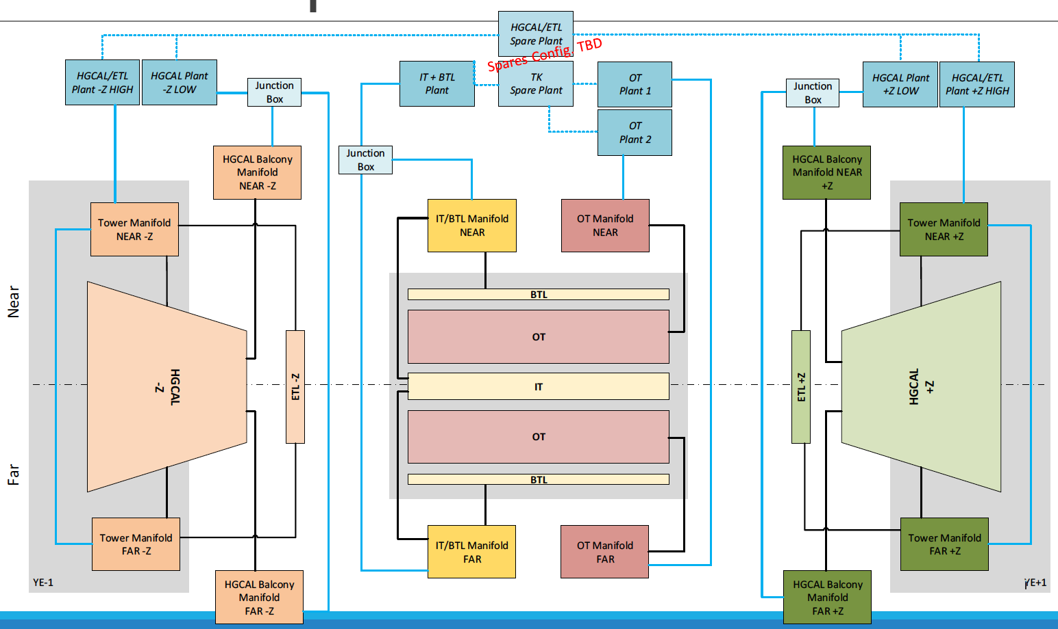
Phase 2 Pixel: Cooling concept
T.Pakulski

Slide 18
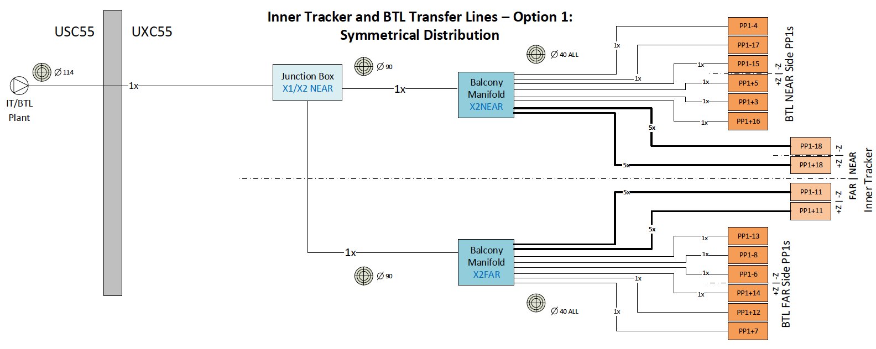
Phase 2 Pixel: Cooling concept
Working also on the alternative of having the manifolds in X0 in order to minimize the length of the lines to PP1.

Slide 19
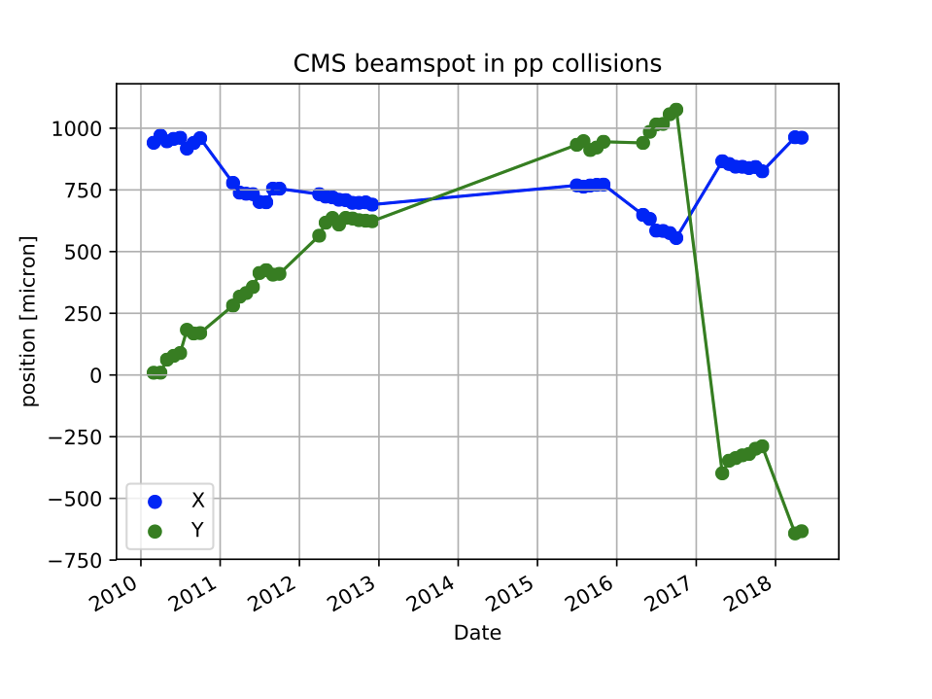
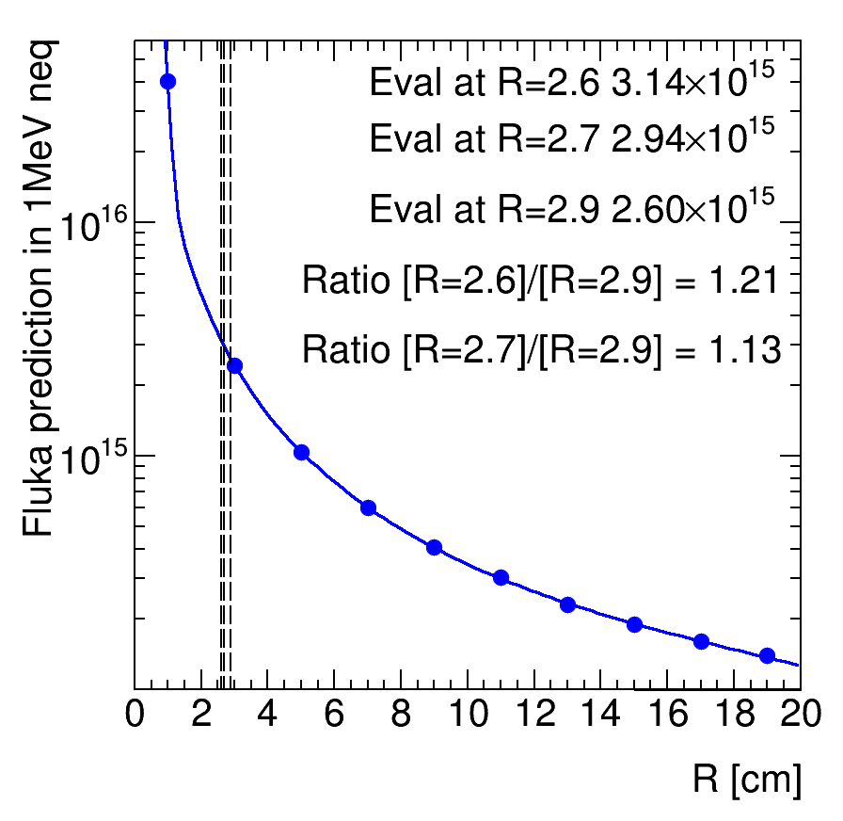
Phase 2 Pixel: Beam and alignment
Dose vs radius
2017 - Optics bump Y = -1.5mm
CMS coordinate system
BPIX Center (2018): X = +860 ; Y = -1019
Beam moved up by ~1.3mm in 8 years
With beam non centered
  Increase in radiation damage
  Unbalanced hit rate
2018 - Optics bump Y = -1.8mm
 | 2010 | 2012 | 2015 | 2017 | 2018
Distance between beam and BPIX center (mm) | 4.5 | 4.6 | 2 | 0.9 | 0.4
Beam lowered by further 0.3mm
It has been a struggle to keep the beam centered over the years
BPIX shimmed up by 3mm
New BPIX shimmed up by 3mm, beam lowered by 1.5mm

Slide 20
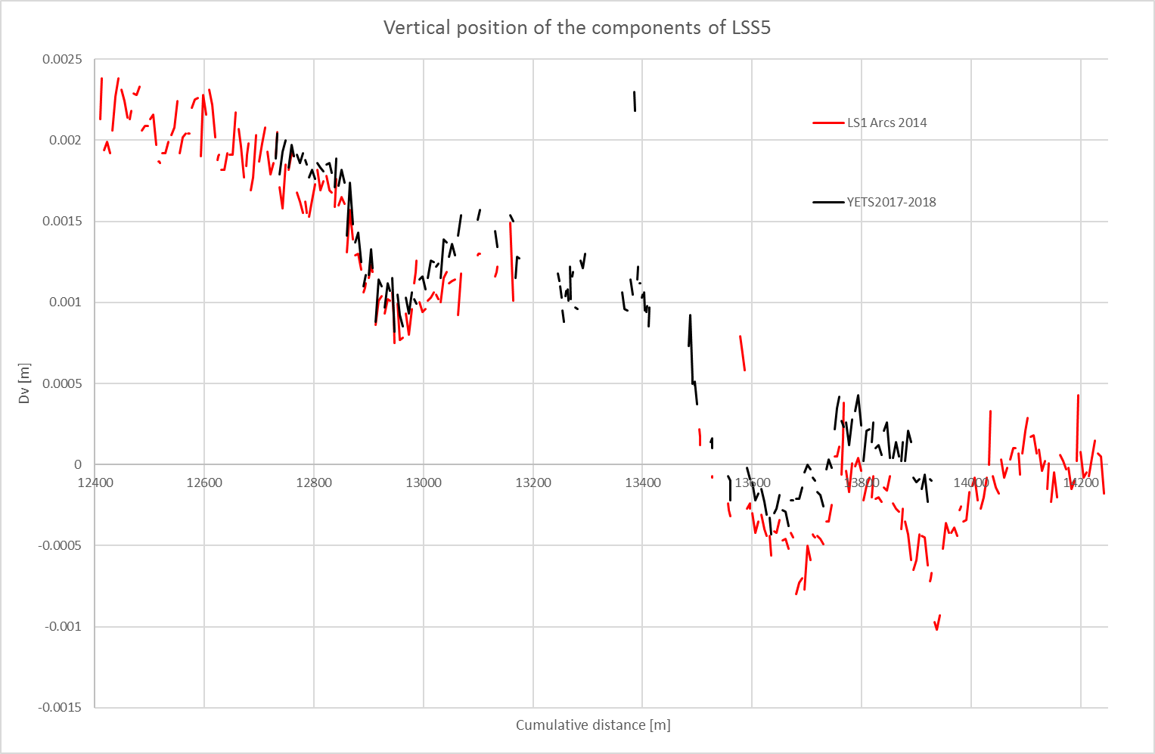
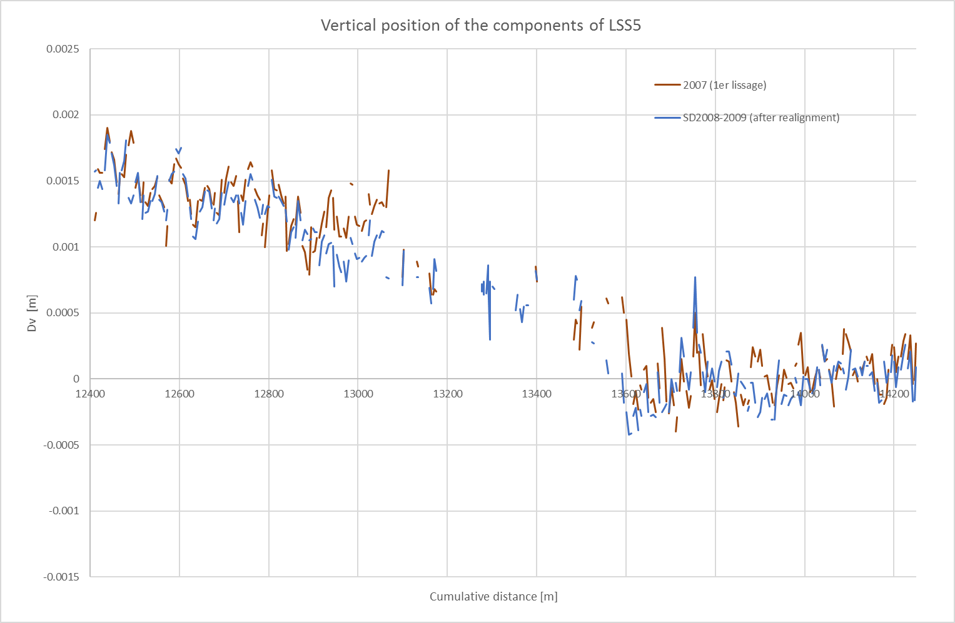
Phase 2 Pixel: Beam and alignment
Magnetic elements around IP5 are surveyed every year
They are found on the rise every year
Over the years a clear
“bump” developed around IP5
2014
2018
1 mm
IP5
Data from 2007-2008

Slide 21
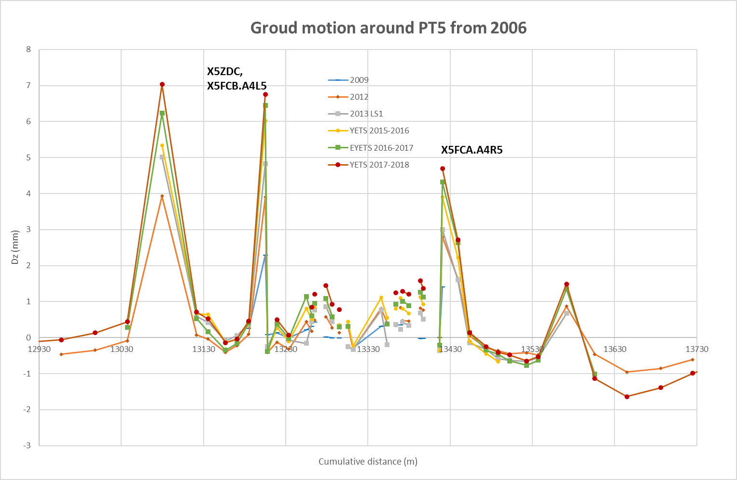
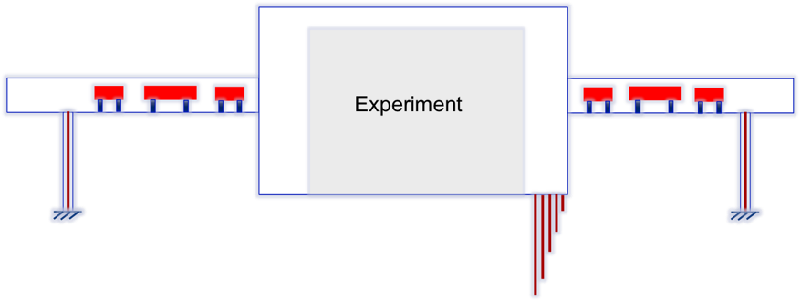
Phase 2 Pixel: Beam and alignment
Ground around IP5 is indeed moving up
Will realign during LS2 (from LQ10 to RQ10) with the goal of lowering IP5 by 3mm
Trend will continue into the HL-LHC era
Motorized adjustment will be introduced with HL-LHC from LQ5 to RQ5, but will it be enough?
We are considering shimming up YB0 during LS3 (but difficult and risky)
Change of strategy (w.r.t. 2007) and align the Tracker in order to have the center of the ITST in YB0 centered (or higher) than the nominal beam line.
CMS
YB0 centered and stable with respect to deep reference probes both in UXC55 and LHC tunnel

Slide 22
Phase 2 Pixel: Beam pipe

Slide 23
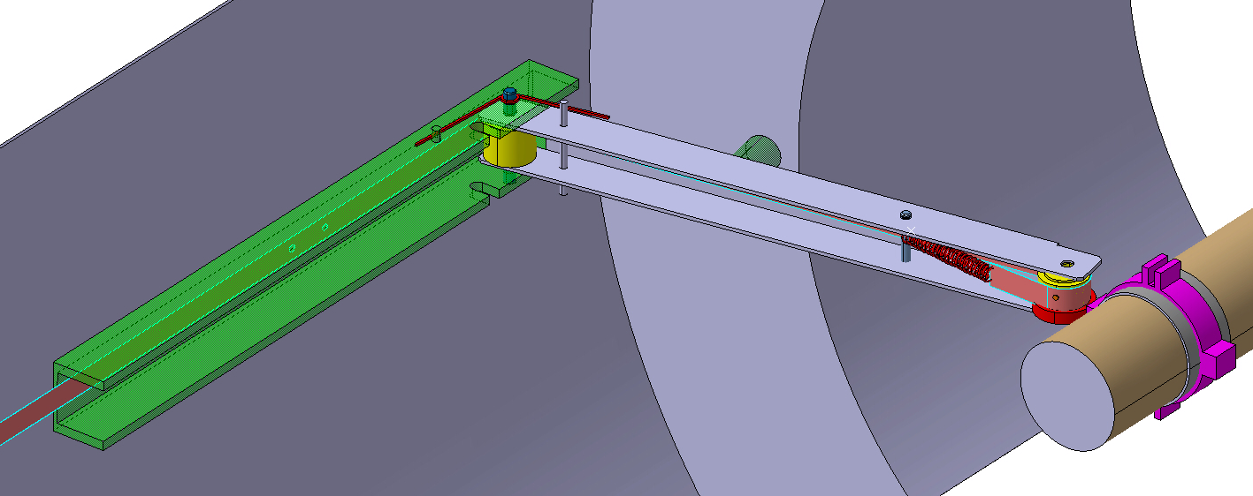
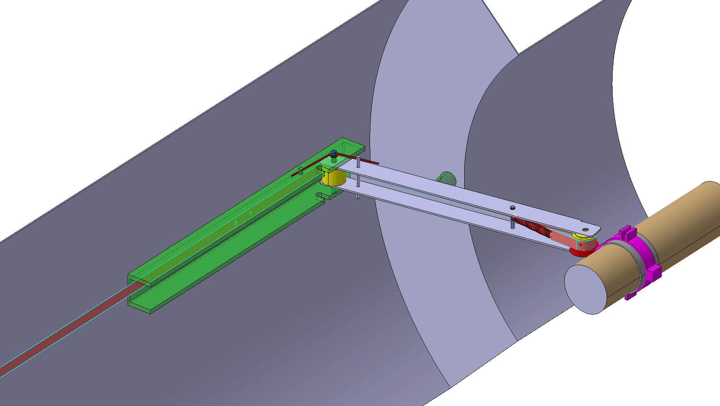
Phase 2 Pixel: Beam pipe/Supports
New beampipe design is finished and construction should start soon.
Installation during LS2
No change in beam pipe supports (1.6m, 3.1m, 3.5m) between LS2 and LS3. We will just add an adapter flange at 3.1m
Start looking at some ideas for LS3:
Metal ribbon push/pull from BulkHead
Sketch of the 1.6m support with rigid arm (horizontal support wire no longer possible as detectors extend beyond 1.6m)

Slide 24
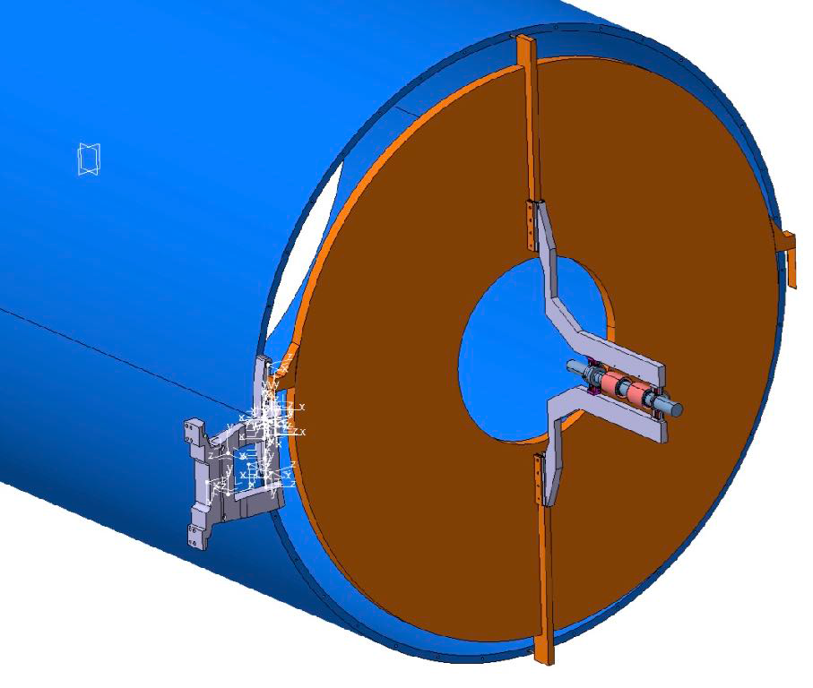
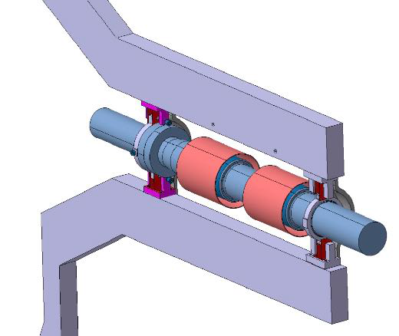
Phase 2 Pixel: Beam pipe/Supports
Fishing rods now supported from Bulk-Head
New ideas (R.Loos) for supporting the beam pipe at 3.1m
Goal would be to make it more compact and easy to adjust at 3.1m
New 3.1m support

Slide 25
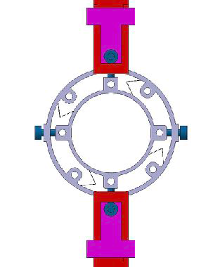
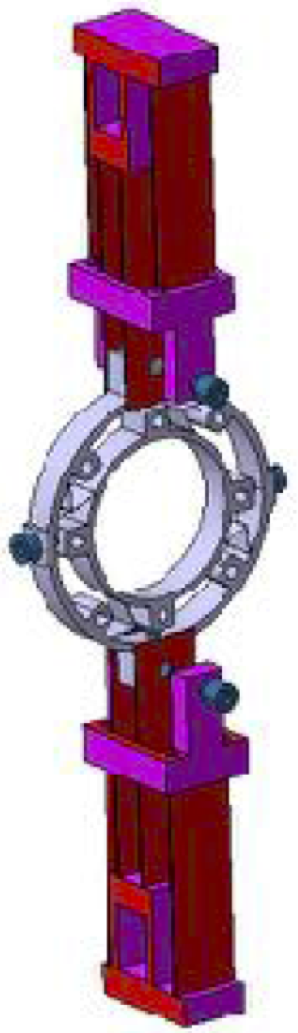
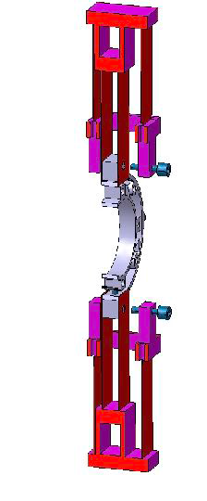
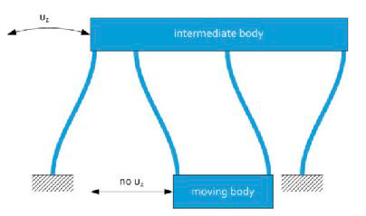
Phase 2 Pixel: Beam pipe/Supports
3.1m support
R. Loos

Slide 26
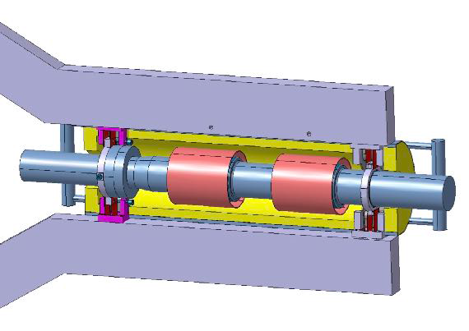
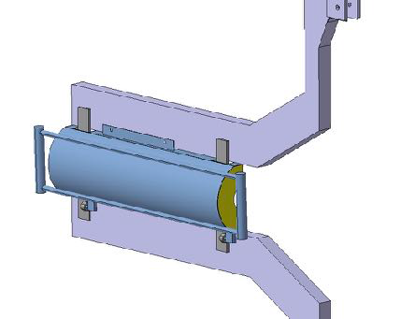
Phase 2 Pixel: Beam pipe/Supports
We need to consider the presence of an RP shield as the flange (although now in Al) is still the dominating source od radiation near the beam pipe.

