Slide 2
3rd ALICE & VSC LS2 preparation meeting
Update on production and preparation works
Josef Sestak, Giuseppe Bregliozzi, Chiara di Paolo, Jerome Gilles Chaure
on behalf of TE – VSC – BVO

Slide 3
Content
ECR circulation and comments
Update on production of the central chamber
Update on production of the RB24&26 layout
Annular ion pump in RB24
Procedures for removal and installation
AOB

Slide 4
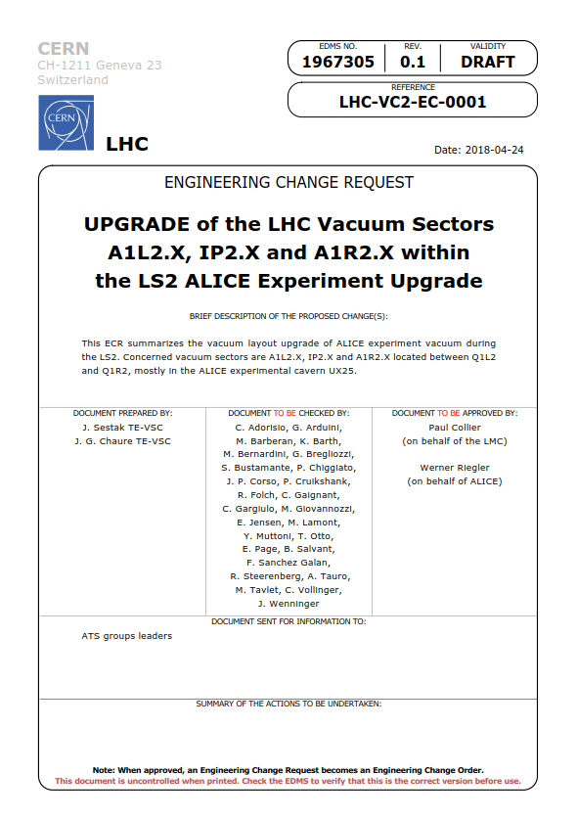
ECR LHC-VC2-EC-0001
LHC-VC2-EC-0001 v.0.1
Upgrade of the LHC vacuum sectors A1L2.X; IP2.X and A1R2.X within the LS2 ALICE experiment upgrade
  https://edms.cern.ch/document/1967305/0.1

Slide 5
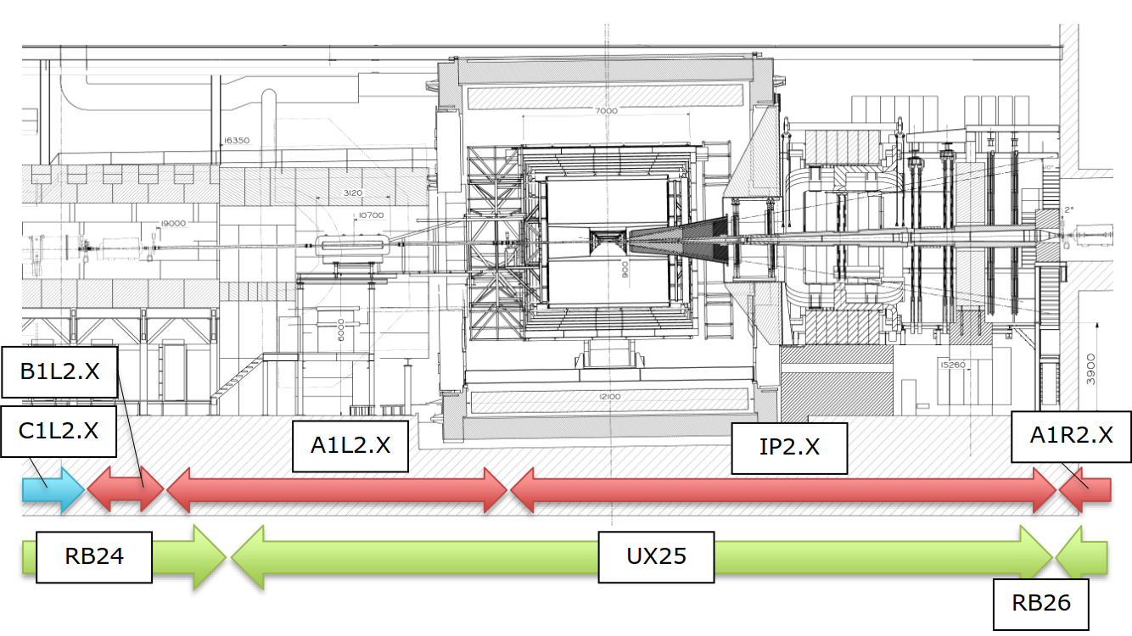
ECR LHC-VC2-EC-0001
ALICE IP2 and connected vacuum sectors A1L(R)2.X

Slide 6
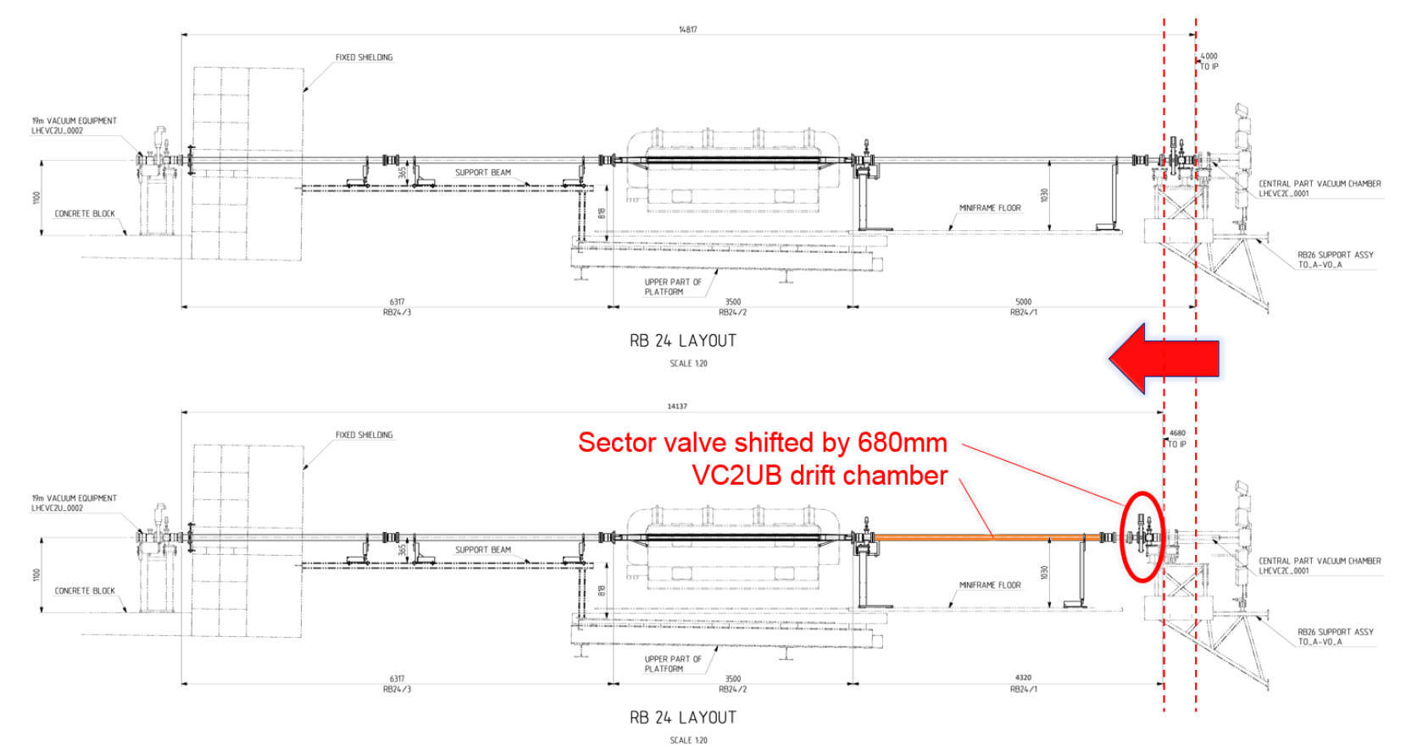
ECR LHC-VC2-EC-0001

Slide 7
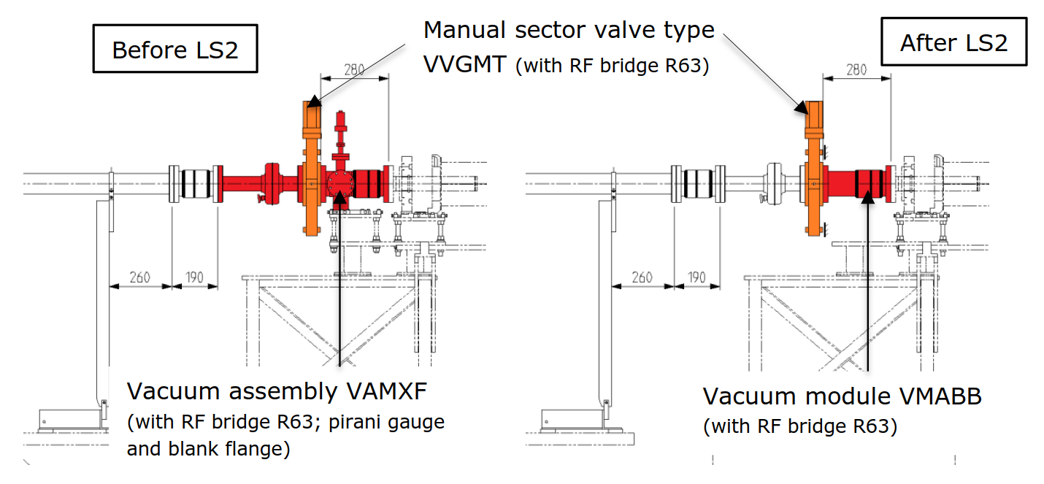
ECR LHC-VC2-EC-0001
No aperture/material changes

Slide 8
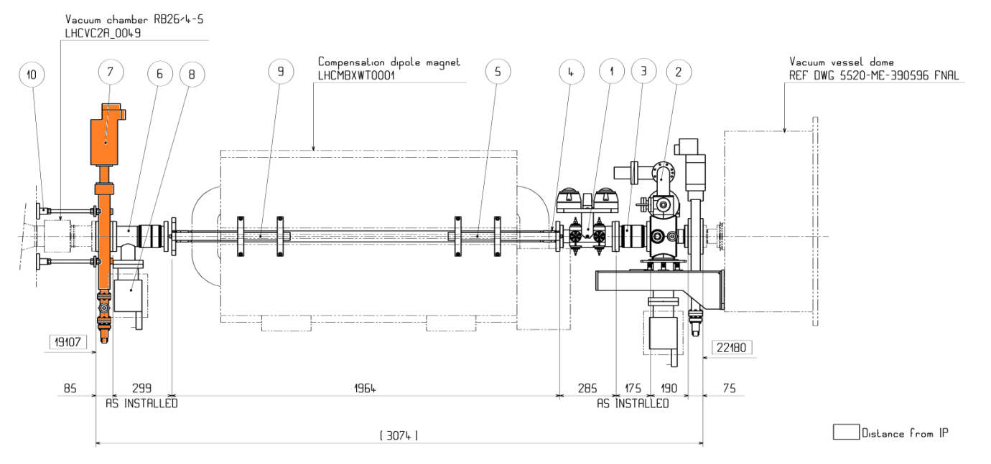
LHC ECR LHC-VC2-EC-0001
No aperture/material changes

Slide 9
Comments from Aperture and Impedance
There is no clear statement in the ECR about any layout changes (for aperture) apart from those concerning the experimental beam pipe.
The reference to TREX and LMC should be rephrased in several places of the document, as in those committees (at least for beam aperture) only the experiments beam pipe was analysed and approved.
The two tables 1 and 2 should contain a legend to describe the meaning of the colour coding and also the information concerning the aperture should be added. This information is essential to analyse in terms of aperture the layout beyond the experimental beam pipe.

Slide 10
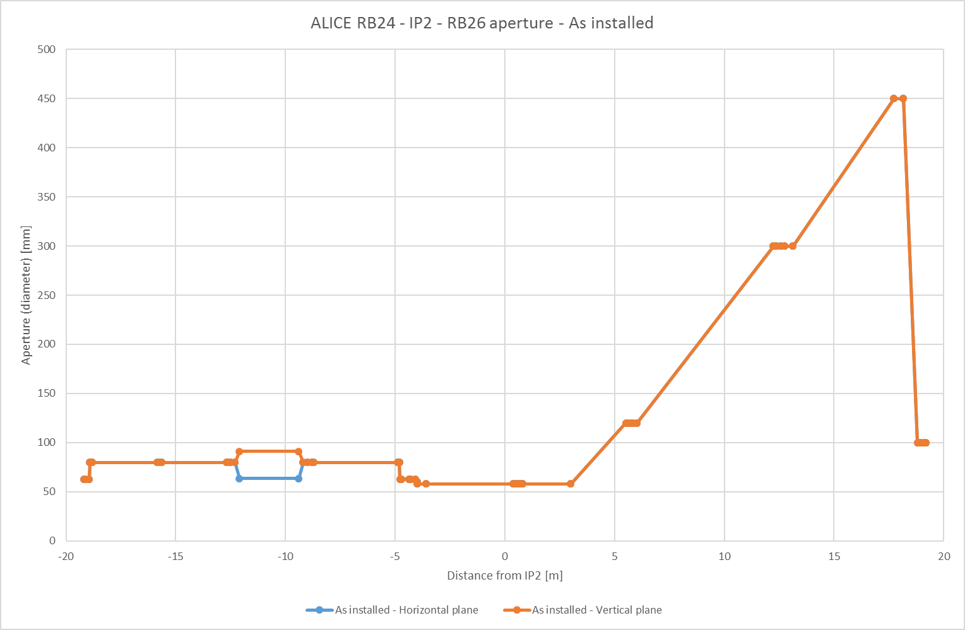
ECR LHC-VC2-EC-0001

Slide 11
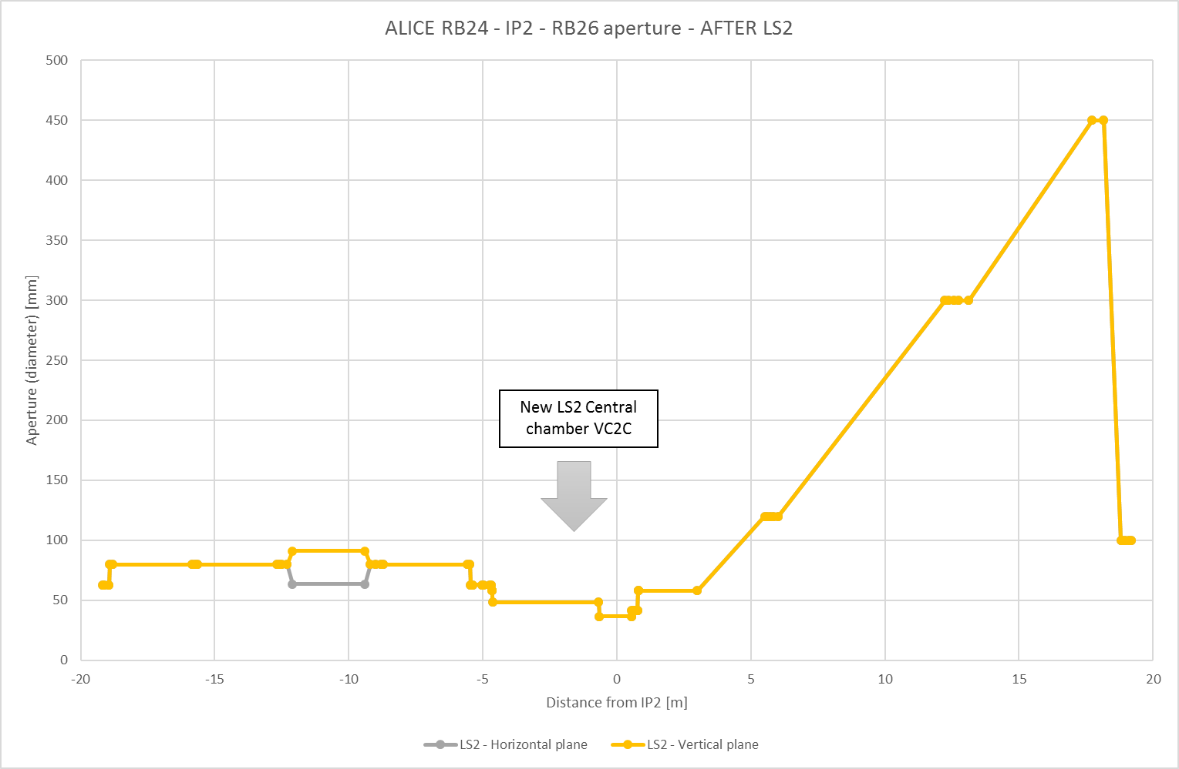
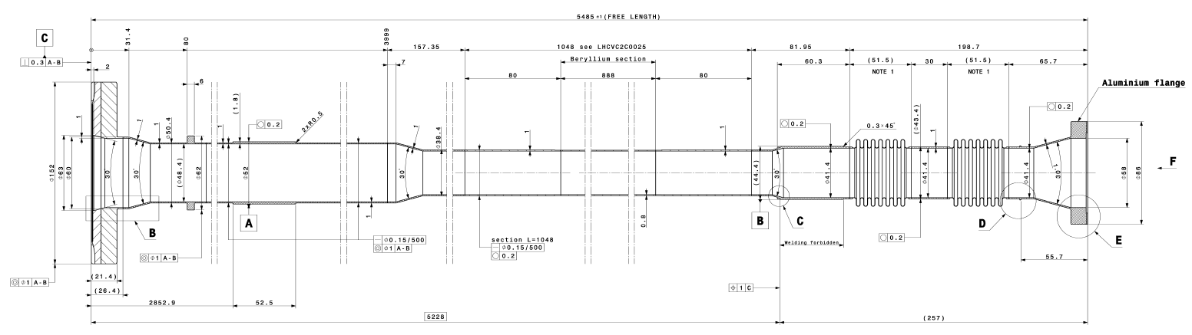
ECR LHC-VC2-EC-0001

Slide 12
Comments from Coordination and RP
Planning must be validated in agreement with the LHC LS2 general schedule.
Please add the planning proposed by ALICE in the ECR.
Specification of the activities to be performed on the side of the LHC machine.
Also if the LS2 start date is the 3rd December, this activity can start only on 17th December, but to be validated with RP.

Slide 13
Planning and RP constraints
Intervention for RB24 and RB26 were discussed with RP.
  Access to the A1L2.X by beginning of LS2 should be fine from RP point of view.
Cavern interventions as ALARA level 1.

Slide 14
Version - 01/06/2018
Josef Sestak
Experimental vacuum upgrade project – LS2 preparation & planning
ALICE EXPERIMENTAL VACUUM UPGRADE
Main VSC deliverables:
Removal of (RB24) A1L2.X vacuum chambers
Removal of existing central vacuum chamber
Installation of a new central vacuum chamber
Installation and upgrade of (RB24&RB26) A1L2.X and A1R2.X
New Central chamber installed and IP2.X closed
Feb 21
Final neon pump-down
Aug 17
Venting of the IP2.X; A1L2.X and A1R2.X
Central chamber ready for installation
Recommissioning with beam
Dec 5
Aug 12
Mar 5
Start of LS2
Neon injection for IP2.X and A1R2.X (intermediate)
End of LS2
Dec 3, 2018
Feb 24
Feb 20, 2021
2018
2018
2019
2020
2021
Q1
Q3
Q1
Q3
Q1
Q3
Q1
2021
Today
10 days
Feb 20 - Mar 5
Machine check-out
2 days
Dec 6 - Dec 7
Removal of (RB24) A1L2.X vacuum chambers (phase 1)
1 day
Dec 17 - Dec 18
Removal of (RB24) A1L2.X vacuum chambers (phase 2)
30 days
Jan 14 - Feb 22
Removal of the existing central chamber
5 days
Nov 25 - Dec 2
Upgrade of (RB26) A1R2.X vacuum sector
21 days
Jan 6 - Feb 3
Installation of the new central chamber
15 days
Feb 3 - Feb 21
Bake-out of the IP2.X and A1R2.X
3 days
Jul 1 - Jul 3
Installation of the (RB24) A1L2.X vacuum chambers
9 days
Jul 6 - Jul 17
Bake-out of the (RB24) A1L2.X
291 days
Jan 1 - Feb 11
Central chamber production (MATERION)
131 days
Feb 11 - Aug 12
Central chamber post-production actions, coating and acceptance
245 days
Jan 1 - Dec 10
Production of the components for RB24 & RB26 upgrade

