Slide 2
3rd ALICE & VSC LS2 preparation meeting
Update on production and preparation works
Josef Sestak, Giuseppe Bregliozzi, Chiara di Paolo, Jerome Gilles Chaure
on behalf of TE – VSC – BVO

Slide 3
Update on production of VC2C
Qualification phase ongoing
Coating qualification samples
  Vacuum acceptance – Completed
  NEG coating – Completed
  NEG activation – Ongoing
We hope to give approval on final production by today or beginning of the next week.

Slide 4
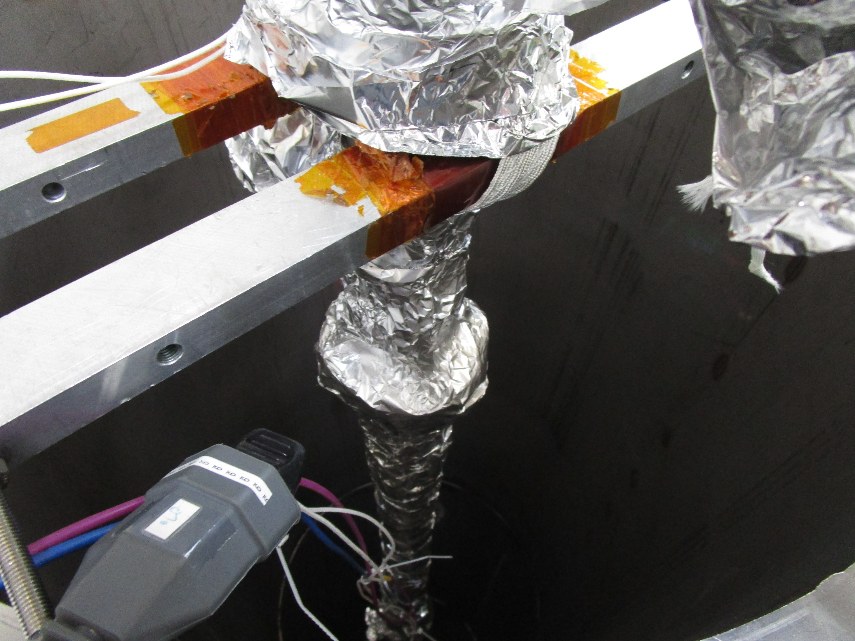
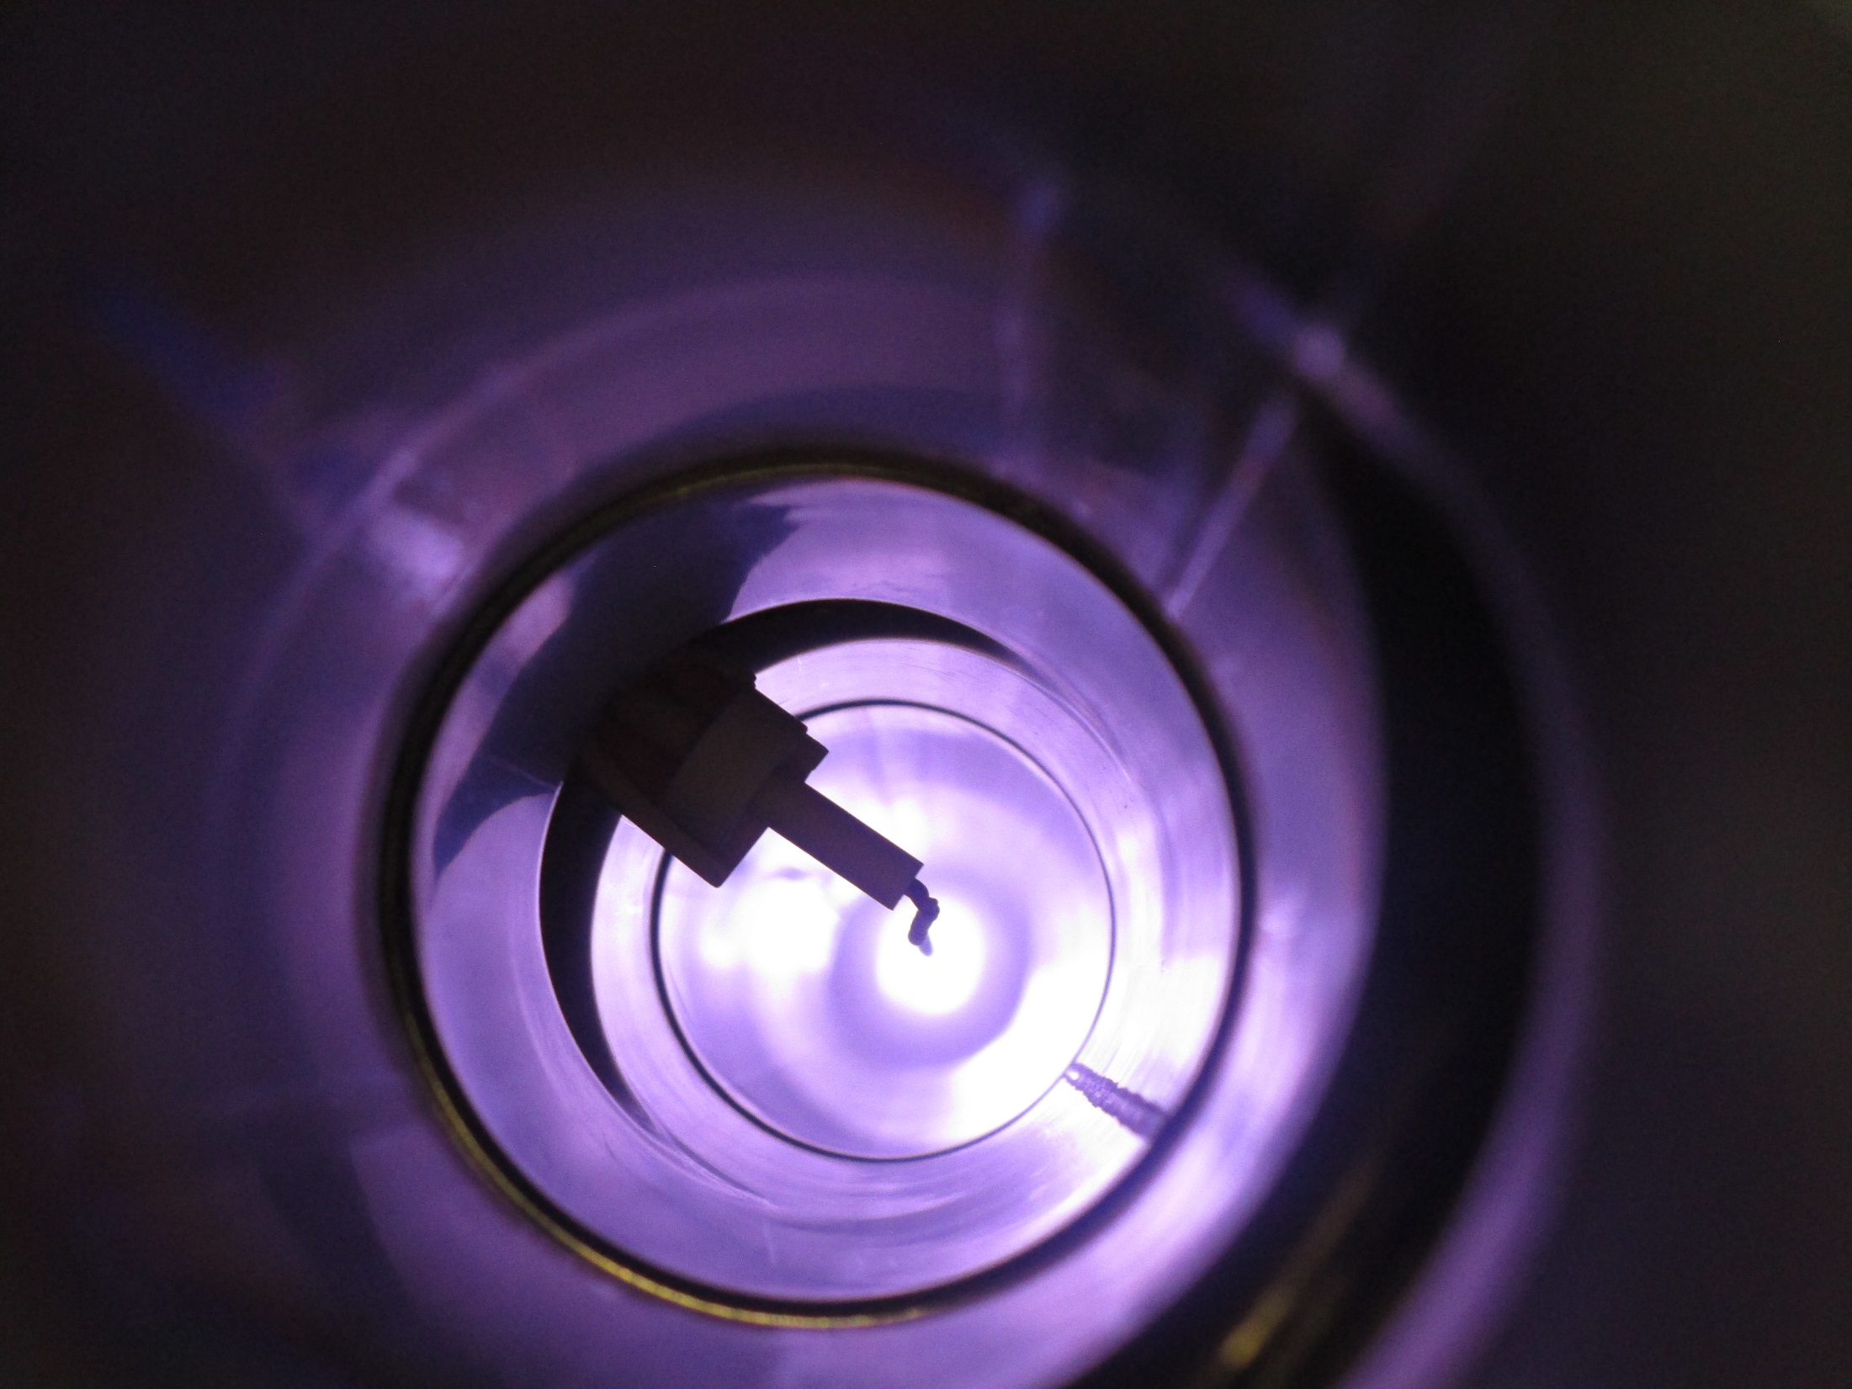
Update on production of VC2C
NEG coating process

Slide 5
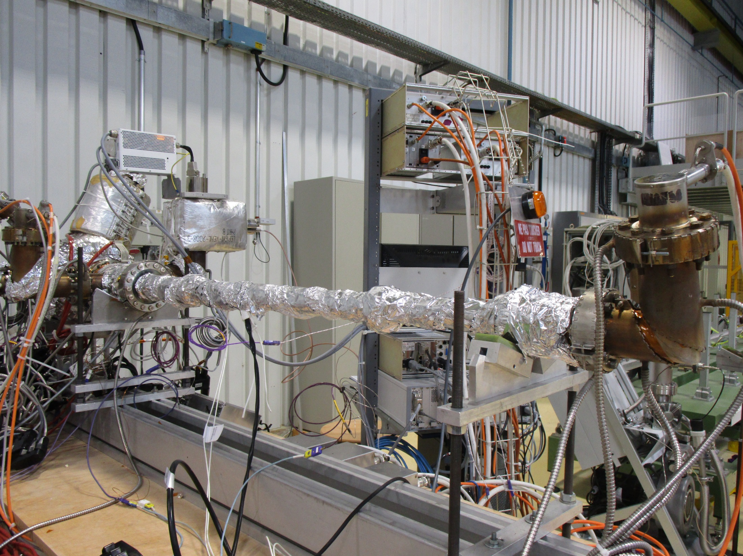
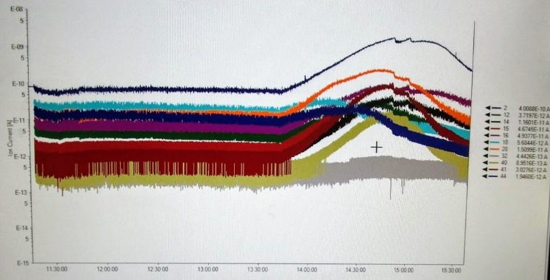
Update on production of VC2C
Vacuum acceptance and NEG activation
Activation for 24 hours at 200 °C
Cool-down by Friday 1st of June

Slide 6
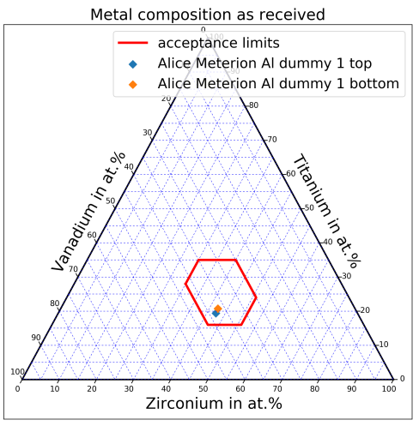
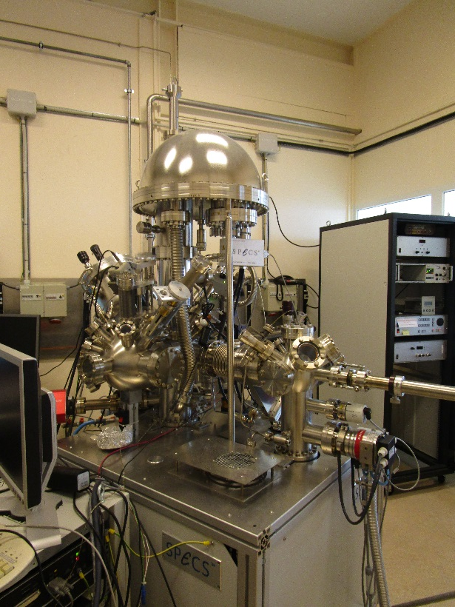
X-ray photoelectron spectroscopy (XPS) on the NEG coated samples
EDMS 1978615 v.1 by Holger NEUPERT
According to EDMS 630214 (standard control procedure for the assessment of the quality of TiZrV NEG coatings by XPS) the ALICE NEG coated samples are activated correctly.

Slide 7
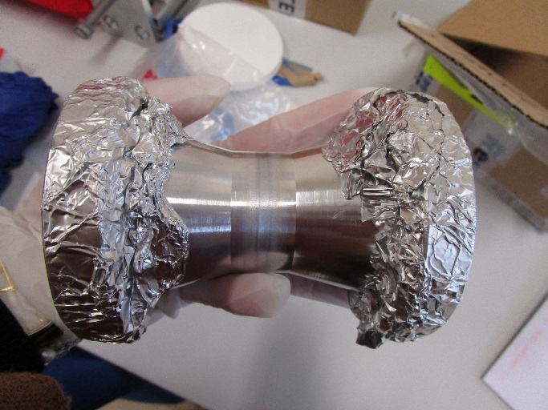
Peel-off tests on the minimized flanges
Validation of the NEG coating of the test minimized aluminium flanges (EN AW-2219).
CLEANING:
Degreasing with NGL17/40 (US 5’+5’) during 1h of the two flanges.
Etching with a mix of phosphoric acid and nitric acid during 15min of one flange plus the welding.
ACTIVATION:
10 thermal cycles in vacuum performed (to simulate the life cycle of the chamber)
No visual sign of peel-off has been detected on the cone treated by etching
A very small mark detected on the end of the degreased cone, checked with SEM

Slide 8
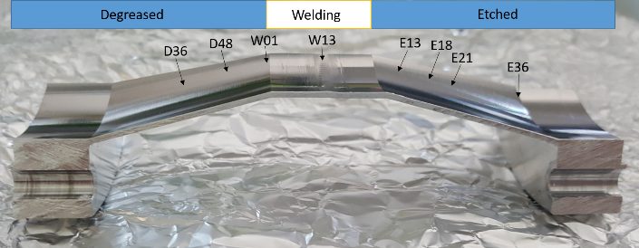
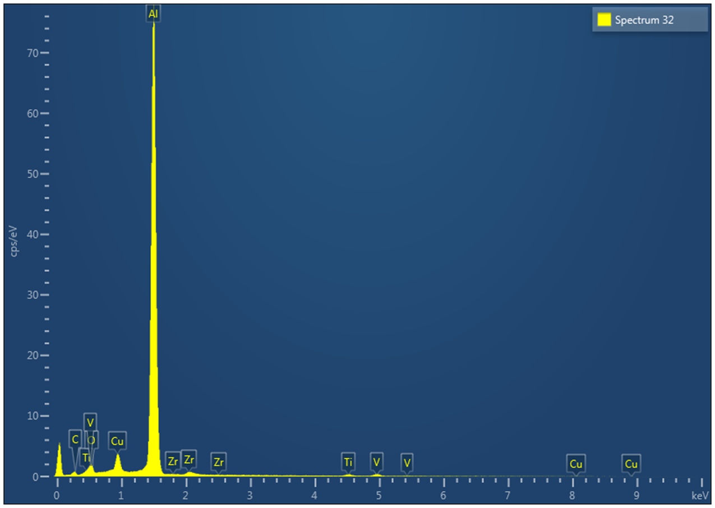
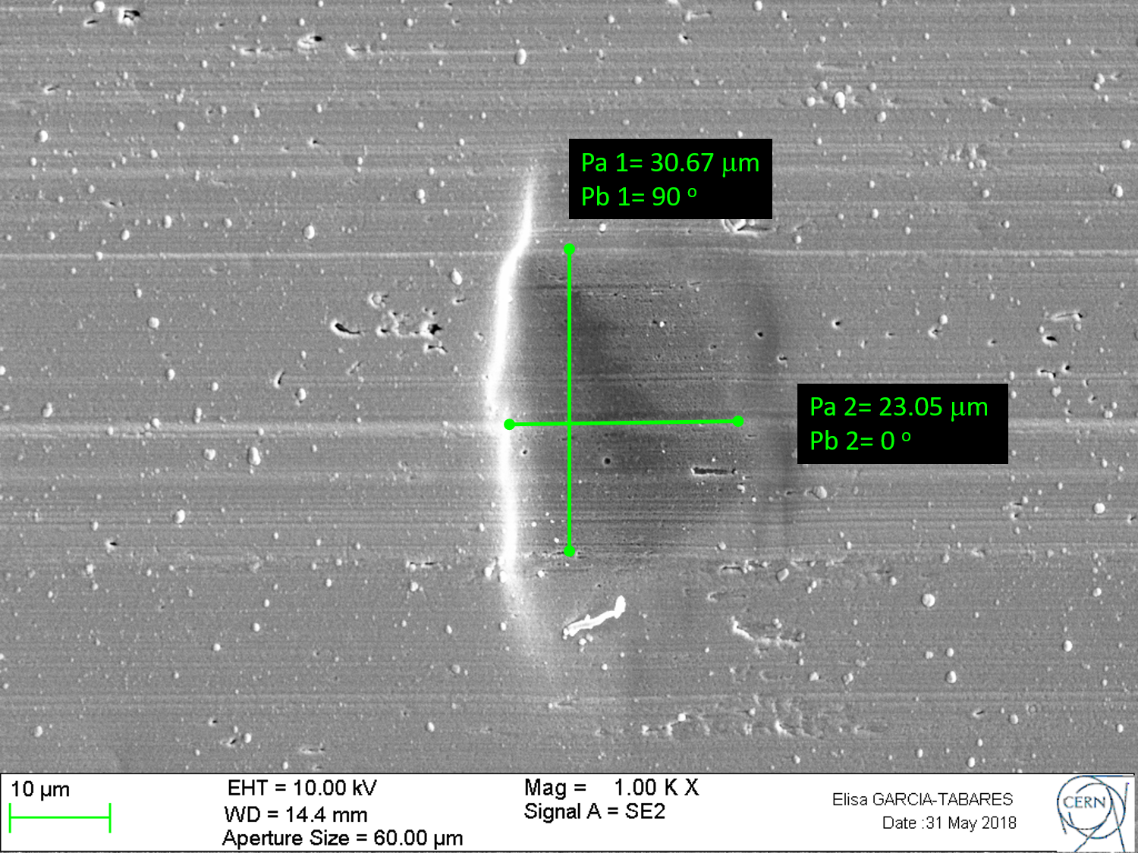
SEM & EDS inspections
Etched cone
ENERGY-DISPERSIVE X-RAY SPECTROSCOPY (COMPOSITION quantitative)
SECONDARY ELECTRON (MORPHOLOGY)
Spectrum 32
BACKSCATTERED ELECTRONS (COMPOSITION qualitative)

Slide 9
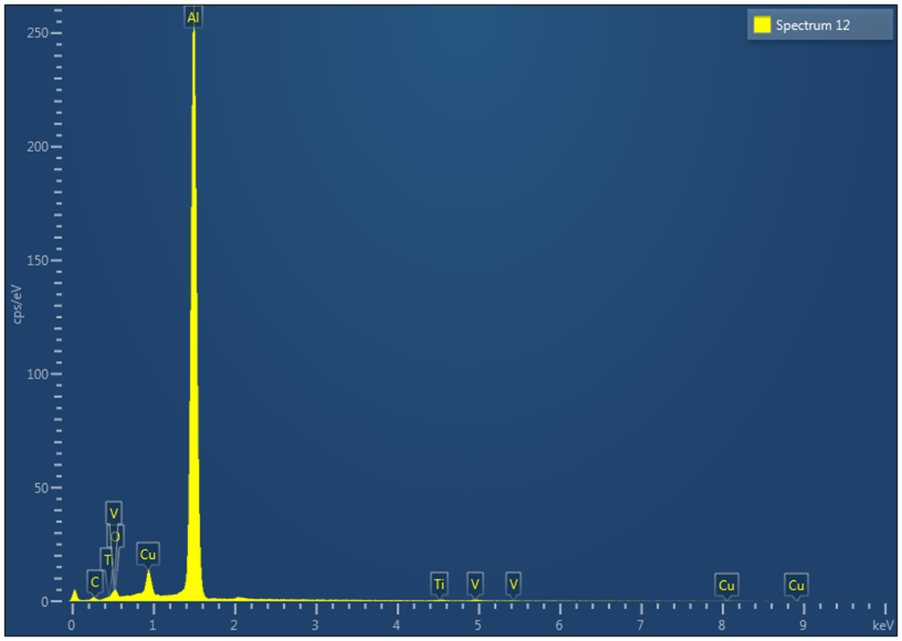
SEM & EDS inspections
Degreased cone
Spectrum 12

Slide 10
ALICE chambers from Materion
About 10m of EN AW-2219 aluminium tubes and two bimetallic CF100 flanges (316L to EN AW-5083) are being shipped to CERN for production of ALICE LS2 central chambers.
The material will be cleaned and etched with the procedures for experimental chambers (EDMS 1674505) by beginning of the next week.
Presence of witness samples for XPS analysis during the treatments.

Slide 11
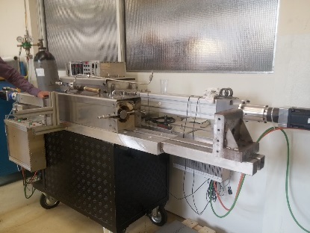
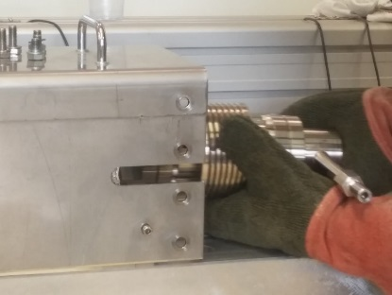
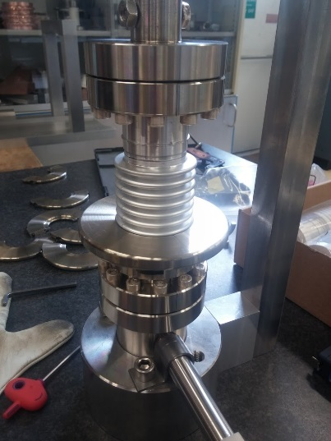
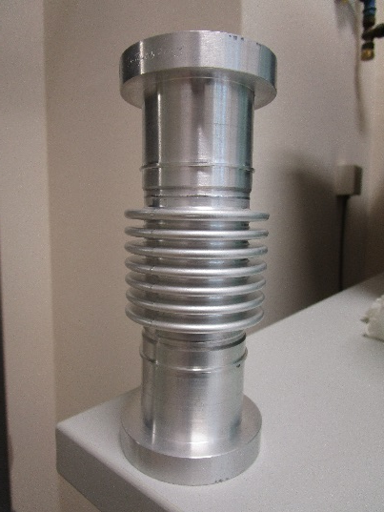
Spare double bellows assembly
Bellows forming process
Production of bellows – completed
Welding – completed
Leak detection – completed
Final machining – next week
2 conform spare assemblies
Available quantity for production at Materion
3 + 2

