Slide 2
3rd ALICE & VSC LS2 preparation meeting Update on production and preparation works
Josef Sestak, Giuseppe Bregliozzi, Chiara di Paolo, Jerome Gilles Chaure
on behalf of TE – VSC – BVO

Slide 3
Baked or Unbaked IP beryllium part
Model Scenario
There was an issue due to which the vacuum sector of IP2.X must be opened and re-activated.
The machine is in standard access regime (YETS – EYETS).
Central chamber stays in place as well as TPC.
ITS is extracted (if necessary).
RB26 chambers are equipped by permanent bake-out system
Aluminium part of VC2C is equipped by permanent bake-out system.
Beryllium part of VC2C stays without any bake-out (saturated NEG coating).

Slide 4
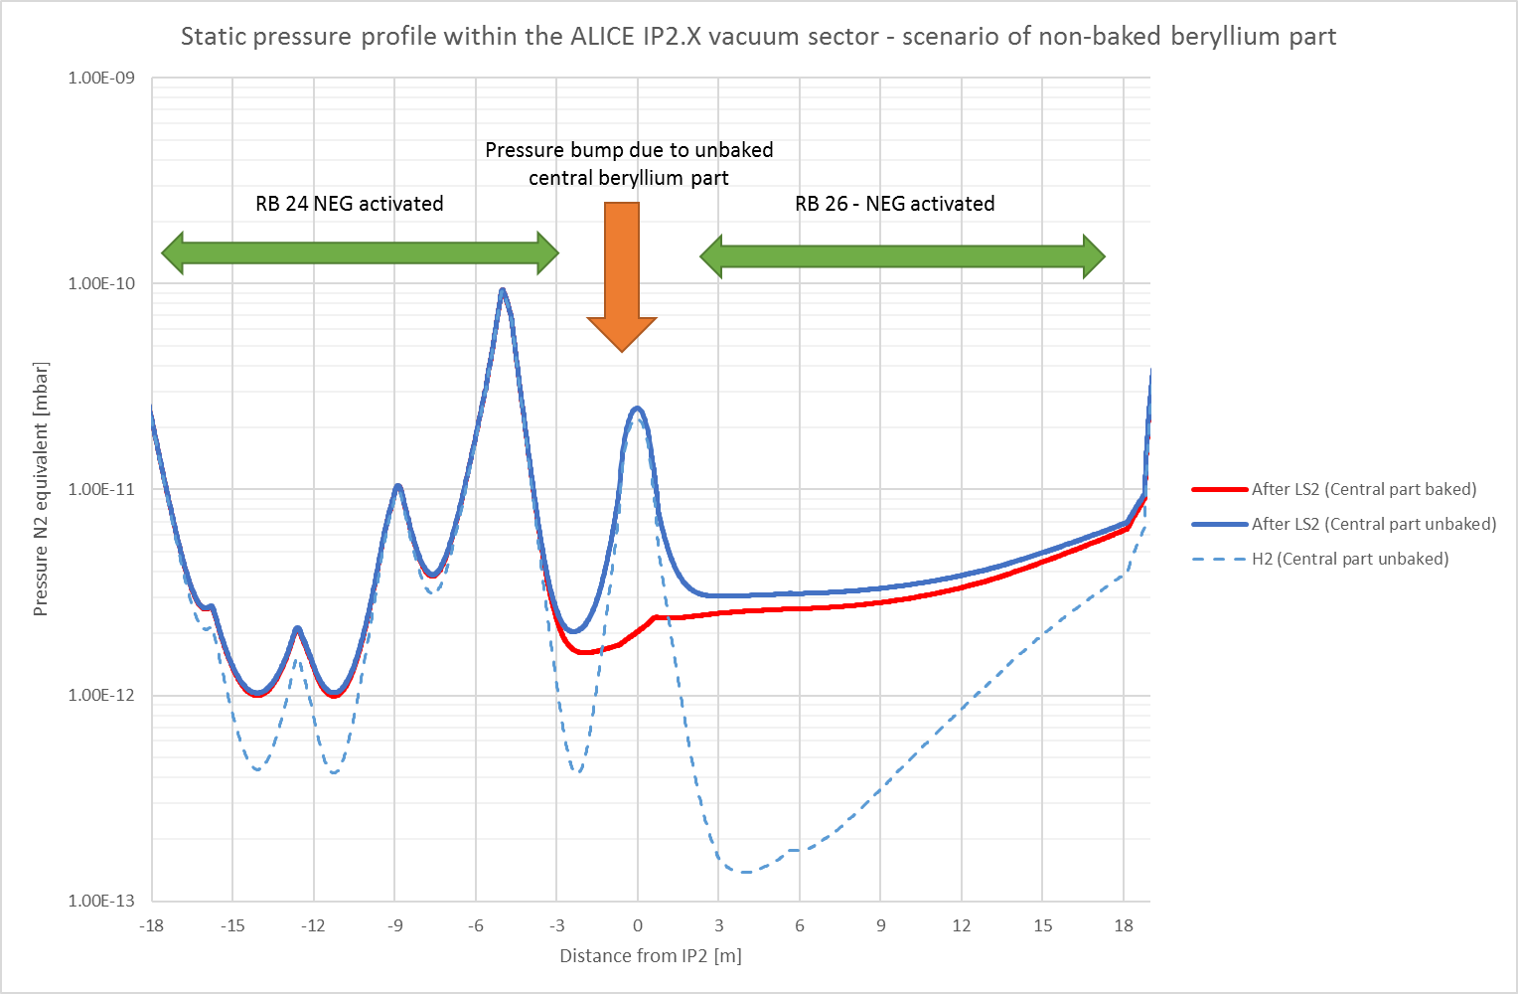
Baked or Unbaked IP beryllium part
Conservative estimation
Outgassing rate for IP part assumed as baked stainless steel.
Saturated NEG has lower outgassing + lower SEY.

