Slide 1
Spokesman’s introduction

Slide 2
Work in the Hall
Spokesman's introduction
Whyte

Slide 3
Hall schedule
Work is on-going; bullets from previous presentations:
  Repatriation of equipment:
    CW has prepared a list of equipment to be repatriated.
    It has been circulated a number of times and will now be presented to the MICE EB tomorrow.
    The list then will be stamped ‘final’ and posted as a document on the wiki.
  Srappage and salvage works:
    Will be organised by CW and JG
    Management and safety arrangements will remain in force as before, i.e.:
      John Govans is the Hall Manager responsible for all works in the MICE Hall;
      Work will be carried out under the supervision of the Duty Coordinator who has responsibility for safe working delegated from the Director of PPD
        CW is making the necessary arrangements for the DC rota
John Govans presently off sick; work has slowed down:
  If this materially affects equipment owners, please contact Colin Whyte

Slide 4
MLCR & S/w&C Decomissioning
Spokesman's introduction

Slide 5
S/w&C decommissioning and maintenance of analysis capability
Durga Rajaram is developing necessary plan:
  DR/P.Kyberd:
    Personnel/support requirements identified:
      Need to complete transition by end of Jun18
  DR/P.Franchini with C.Brew (PPD) and others:
    Migration plans for MLCR-hosted computing defined
  IIT are working to ensure long-term support for MICE WWW presence:
    Still need to consider a forward-facing presense on ‘STFC-corporate’ pages

Slide 6
Papers & next steps in analysis
Spokesman's introduction

Slide 7
Emittance paper
endorsed to proceed
by Editorial Board
Final draft of
Liquid-hydrogen
paper being
prepared

Slide 8
Papers

Slide 9
Fixed points in analysis work
CM51:
  Analysis w/s: 25 and 26 June 2018; RAL
  Plenary: 27Jun18 – 28Jun18: RAL:
    WWW page

Slide 10
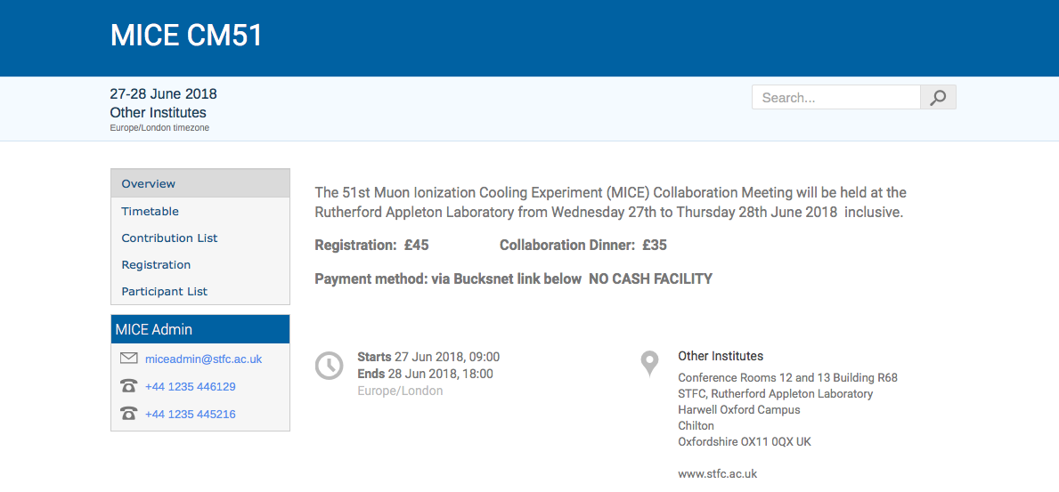
https://indico.cern.ch/event/727201/

