Slide 1
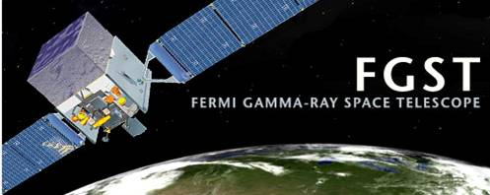
Recent Results from the Fermi Gamma-ray Space Telescope
Robert P. Johnson
U.C. Santa Cruz
Department of Physics and
Santa Cruz Institute for Particle Physics
on behalf of the Fermi-LAT Collaboration

Slide 2
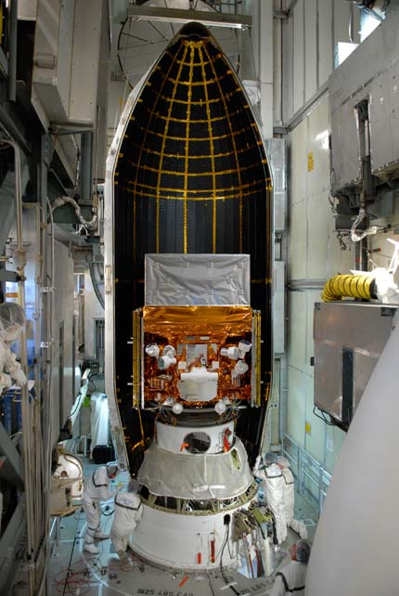
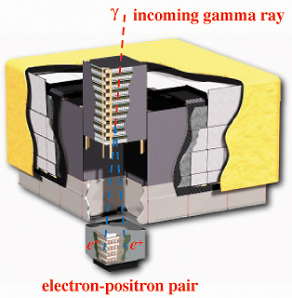




Fermi
Observatory
ApJ 697, 1071, 2009
Large Area Telescope (LAT)
D.o.E.
4×4 modular design
Mass: 3 tons
~million amplifiers; 5 computers
<650 Watts power!
GBM
γ-ray Burst Monitor

Slide 3
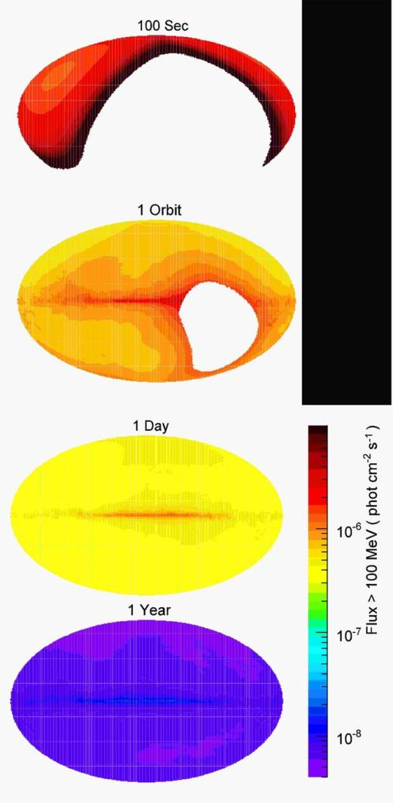
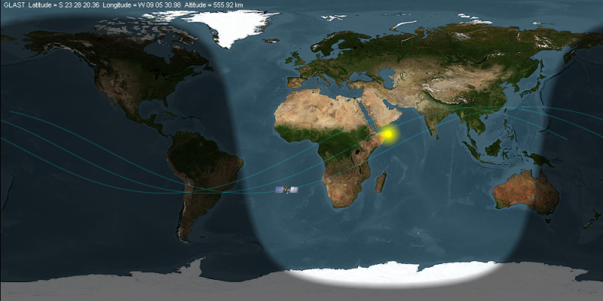
All Sky Monitor
The normal operating mode of Fermi is more-or-less zenith pointed.
Avoids looking at the Earth.
Scans the sky each orbit.
Rock +50° (toward the north orbital pole) one orbit.
Rock −50° (toward the south orbital pole) the next orbit.
In a single day quite uniform coverage of the entire sky is obtained.
2.4 sr field of view

Slide 4
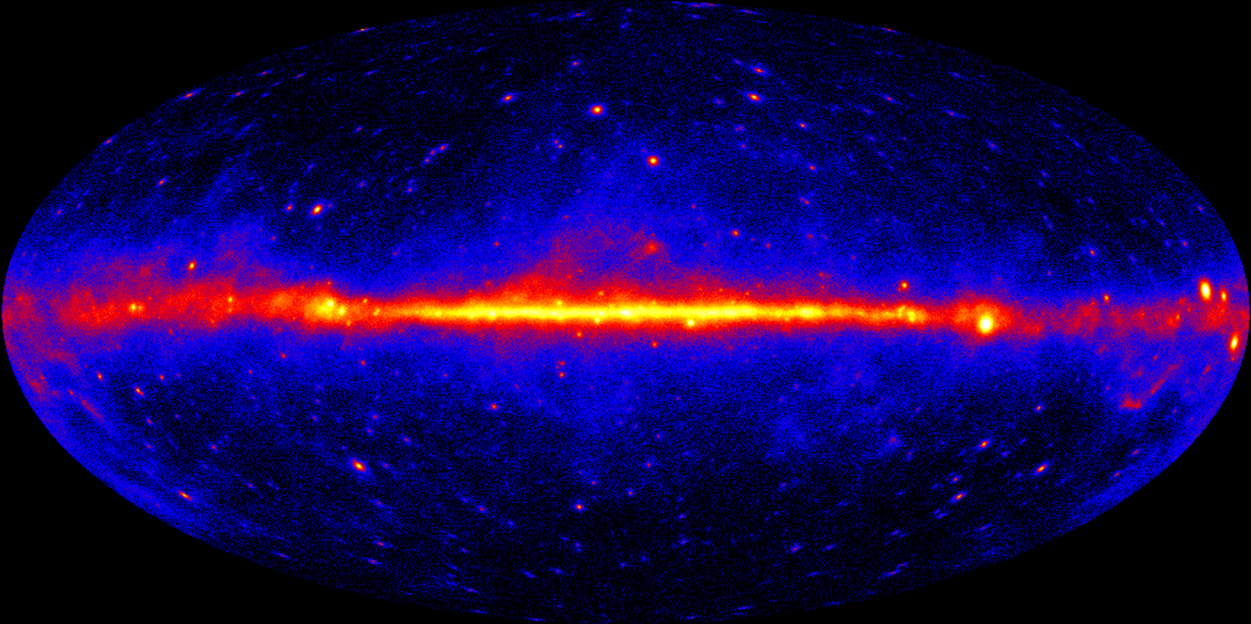
1-Year All-Sky Map, E>200 MeV
Rate map, exposure corrected, log scale.

Slide 5
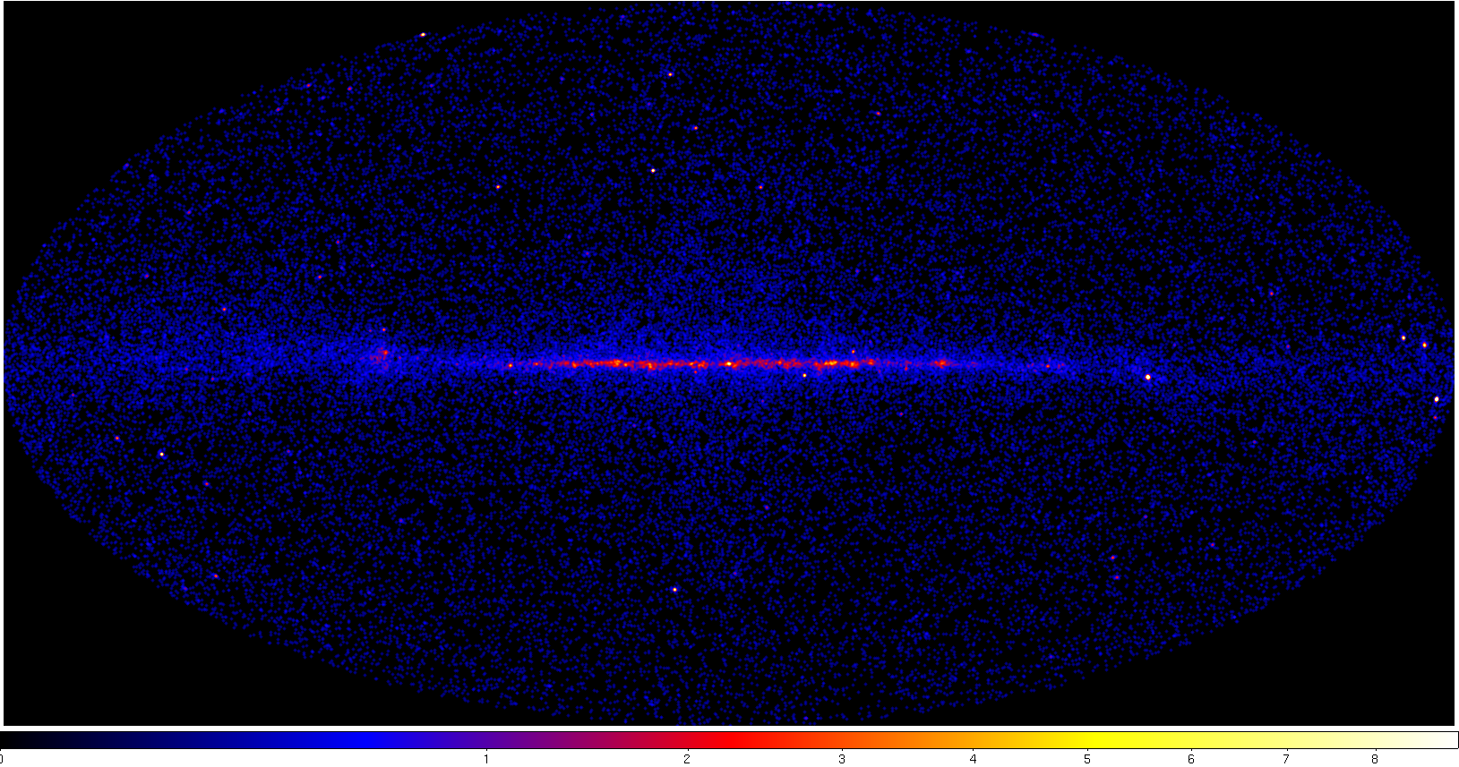
1-Year All-Sky Map, E>10 GeV
Counts map.

Slide 6
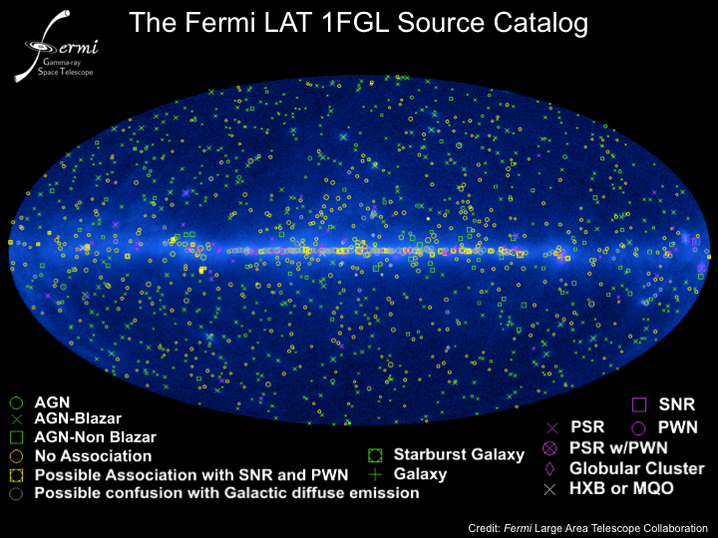
First 11 months of data
1451 Sources (>4σ significance)
630
arXiv:1002.2280
New classes not associated (confidently) with γ-ray sources in 3rd EGRET catalog.

Slide 7
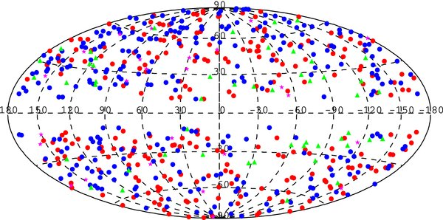
AGN Catalog
Type | Number
FSRQ | 296
BL Lac | 300
Other AGN | 41
Undetermined | 72
First 11 months of data.
709 sources identified as AGN.
ApJ 715, 429, May 2010

Slide 8
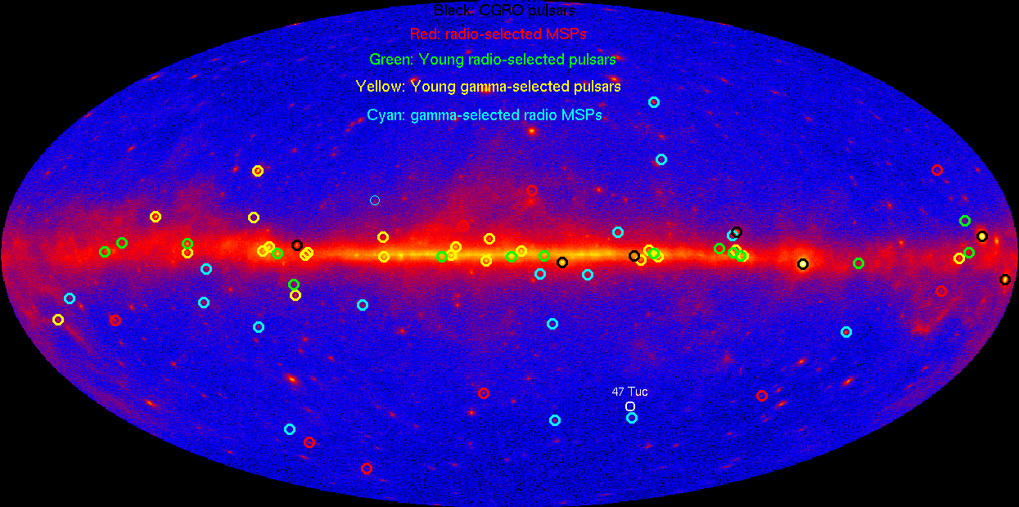
Gamma-Ray Pulsars
More than 56 gamma-ray pulsars in the first year
Plus gamma-selected MSPs
ApJS, 187, 460 (2010)
arXiv:1006.2134v1

Slide 9
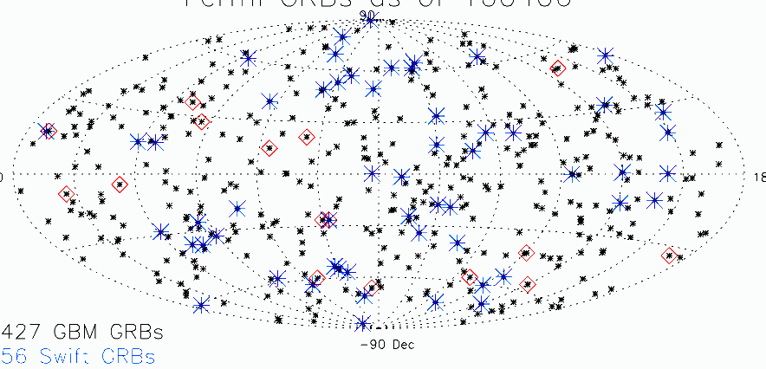
Gamma-Ray Bursts (GRB)
Equatorial coordinates
As of April, 2010:
427 GBM GRB.
56 also observed by the Swift BAT.
16 LAT GRB (~½ of GBM bursts are in the LAT field of view).
First 12 LAT-detected bursts (high-energy photons):
GRB 080825C
GRB 080916C z = 4.35 +/-0.15 (GROND/photometric) 13 GeV photon!
GRB 081024B short-duration burst
GRB 081215A
GRB 090217
GRB 090323 z = 3.6 (Gemini/spectroscopic)
GRB 090328 z = 0.736 (Gemini/spectroscopic)
GRB 090510 z = 0.903 (VLT/spectroscopic); short duration; 31 GeV photon!
GRB 090626
GRB 090902B z = 1.822 (Gemini/spectroscopic) 33 GeV photon!
GRB 090926A z=2.1 (VLT/spectroscopic) 19.6 GeV photon!
GRB 091003

Slide 10
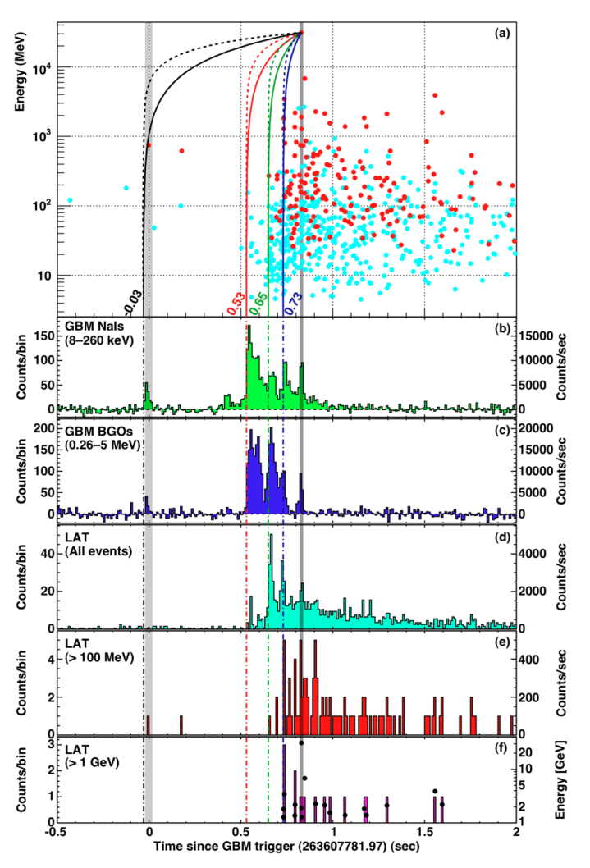
GRB 090510
Interesting constraint on Quantum Gravity ideas:
Some quantum gravity “theories” predict that high energy photons should travel slightly more slowly than low-energy photons.
In this GRB we see a 31 GeV photon less than 1 second after the first X-ray photons, after traveling >7 billion light years.
This requires the quantum-gravity mass scale to be at least 1.2 times the Planck mass.
Nature 462, pp 291, 331.

Slide 11

Limits on Lorentz Invariance Violation
Assume dispersion: v=δE/δP ~ c (1− (E/E_{QG} )^{n})‏ with n=1
  Cosmological distance:
  In GRB 080916C (z=4.2) the highest energy photon, 13.2 GeV, was detected 16.5 s after the GBM trigger.
  In GRB 090510 (z=0.90) the 31 GeV photon was detected only 0.83 s after the GBM trigger.
  The time delay due to quantum gravity cannot be more than this, assuming that the GeV photons are not emitted before the X-ray burst.
GRB090510
1.5×10¹⁹
Pulsar
(Kaaret 99)‏
GRB
(Ellis 06)‏
AGN
(Biller 98)‏
GRB
(Boggs 04)‏
AGN
(Albert 08)‏
GRB080916C
Planck mass
min M_{QG}
(GeV)‏
1.8x10¹⁵
0.9x10¹⁶
4x10¹⁶
10¹⁷
1.8x10¹⁷
0.2x10¹⁸
1.5x10¹⁸
10¹⁹
1.2x10¹⁹
10¹⁵
10¹⁶
10¹⁸

Slide 12
First 11 months of data
1451 Sources (>4σ significance)
Yet another new (transient) source class:
Gamma-ray Nova!
V407 Cygni (ATEL #2487)
March 10, 2010
Publication to appear in Science.
630
arXiv:1002.2280

Slide 13
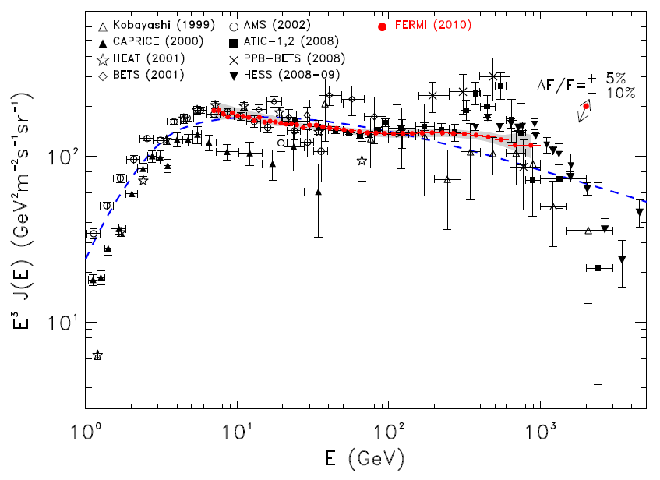
Cosmic-Ray Electrons (7 GeV to 1 TeV)
Preliminary
Low-E analysis
Strong, Moskalenko, & Reimer, ApJ 613, 962 (2004) GALPROP
High-E analysis
Two independent Fermi analyses (using very different triggers) match well across the 20 GeV boundary.
Submitted to Phys. Rev. D

Slide 14
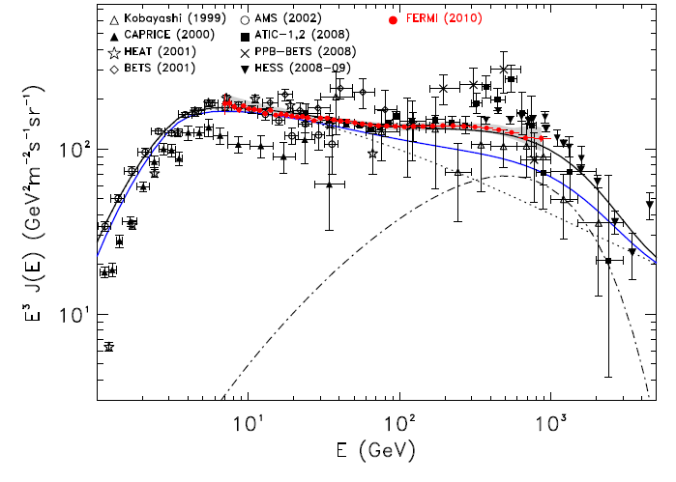
Cosmic-Ray Electrons (7 GeV to 1 TeV)
Preliminary
e⁻ only
GALPROP, but with injection index Γ=1.6/2.7 below/above 4 GeV.
Additional (pulsar-like) component with Γ=1.5 and exponential cutoff.
Submitted to Phys. Rev. D

Slide 15
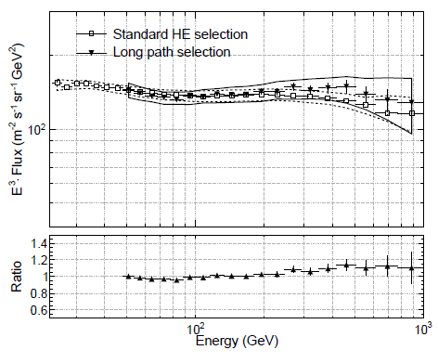
Cosmic-Ray Electrons
To counter claims that our calorimeter is too thin at normal incidence to measure up to 1 TeV, we repeated the analysis using only electrons passing through at least 12 X₀ of material (average of 16 X₀).
The results are consistent and still rule out any sharp peak around 800 GeV.
Submitted to Phys. Rev. D

Slide 16
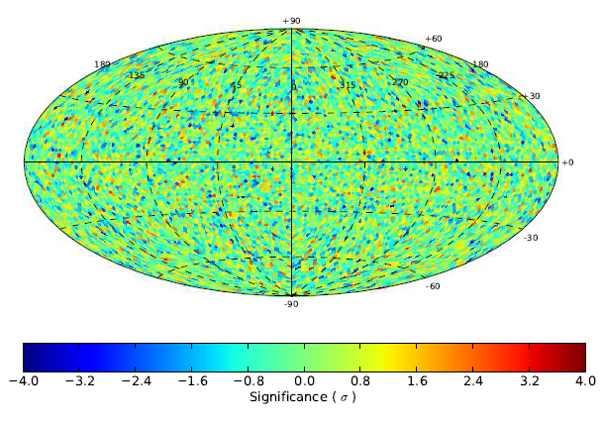
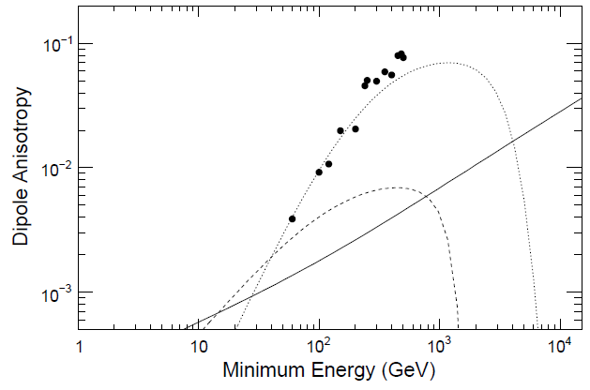
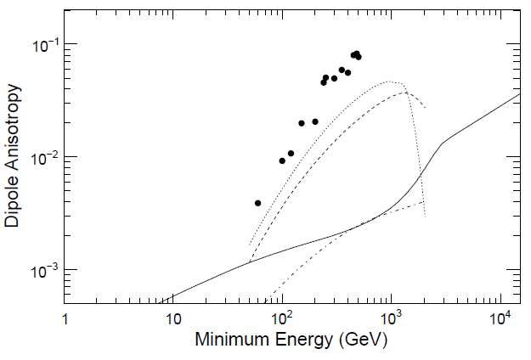
Cosmic-Ray Electron Anisotropy
Submitted to Phys. Rev. D
Significance of deviations from the mean rate.
No significant anisotropy is observed in the CR electron flux.
The results can rule out dominance of a very bright nearby source.
3σ upper limits from data
Vela
3σ upper limits from data
Regis and Ullio, arXiv:0907.5093
Preliminary
Preliminary
Monogem
Galprop
MW Halo DM
MW DM substructure

Slide 17
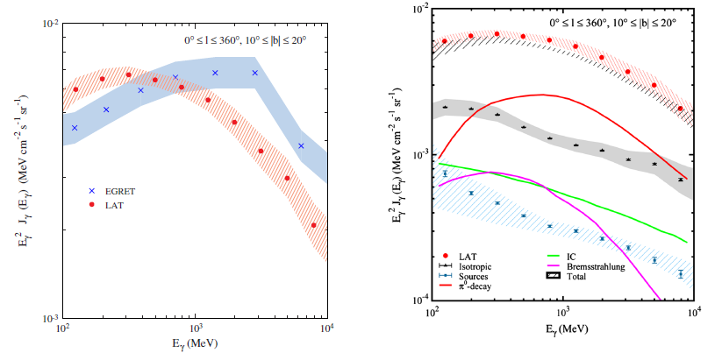
Galactic Diffuse Emission
The first Fermi-LAT publication on the galactic diffuse spectrum is in disagreement with the EGRET spectrum.
In particular, there is no obvious “GeV excess” with respect to standard models of the diffuse production from cosmic rays.
PRL 103, 251101 (Dec 2009)

Slide 18
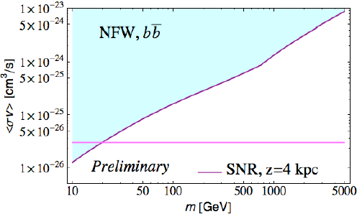
Halo Dark Matter Limits (|b|>10°)
unpublished
The diffuse flux from the Galactic halo can be used to set limits on dark-matter annihilation.
  Relies on differences in the angular and spectral distributions of the diffuse production from cosmic rays versus dark matter.
  Still very preliminary. Investigations are still in progress of the dependence of the result on our astrophysical models of the Galaxy (e.g the CR source distribution, halo height, diffusion coef. etc.).

Slide 19
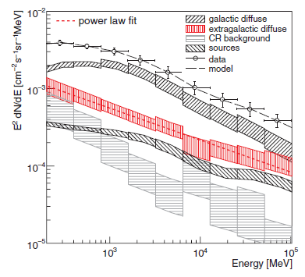
Isotropic (Extragalactic) Diffuse Emission
|b|>10°
Spectral Index γ=2.41 ± 0.05
Intensity (E>100 MeV)=
(1.03 ± 0.17)×10⁻⁵ cm⁻² s⁻¹ sr⁻¹
PRL 104, 101101 (March 2010)
A recently published analysis has extracted the isotropic flux of gamma rays (believed to be primarily extragalactic) by reducing and understanding the residual CR background.
  Based on Fermi measurements of the blazar luminosity function (arxiv:1003.0895), unresolved AGN can account for up to 30% of this diffuse.
  Star forming galaxies may be able to account for most of the rest (Fields et al., arxiv:1003.3647).

Slide 20
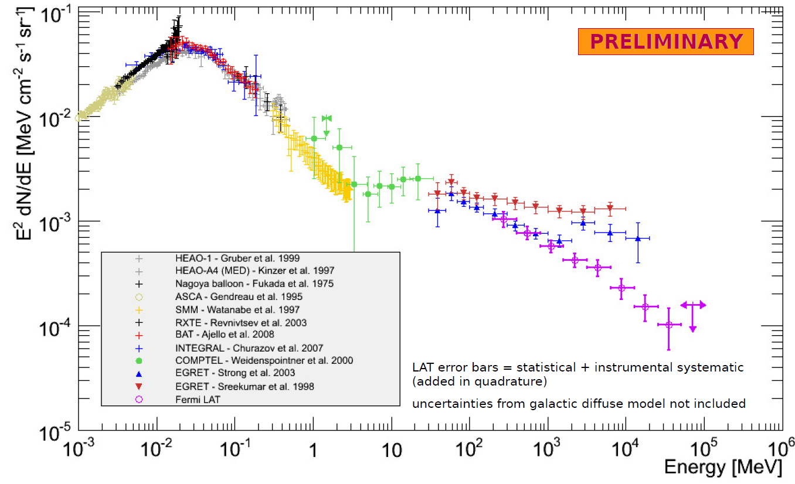
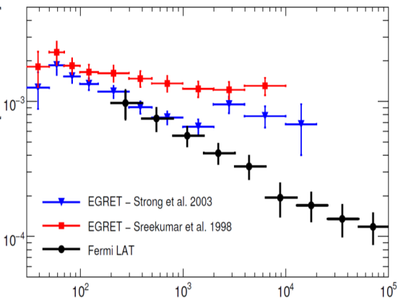
Isotropic SED from 1 keV to 100 GeV
Some inconsistency with previous measurements by EGRET.
Higher energy reach.
PRL 104, 101101 (March 2010)

Slide 21
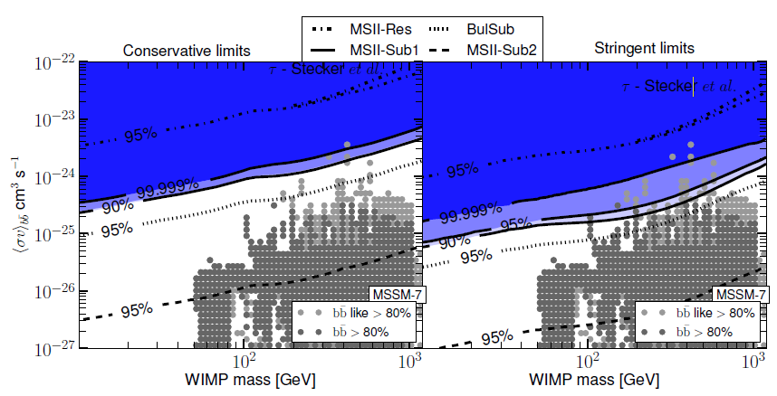
Cosmological Dark Matter
The isotropic extragalactic contribution have be interpreted in terms of limits on cosmological dark matter annihilation:
JCAP04 (2010) 014
DM structure evolution scenarios
Models of absorption by EBL
DM could supply all the photons in a given bin
Assuming a power-law model for astrophysical background

Slide 22
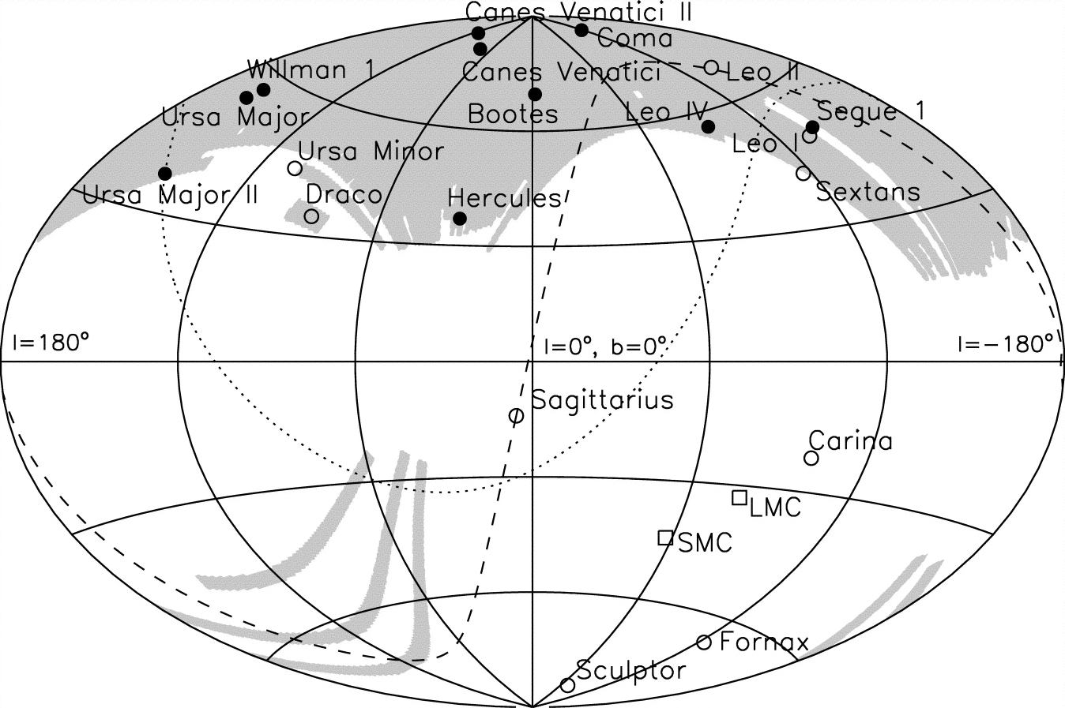
Dwarf Spheroidal Galaxies
Large satellite galaxies
Well-known dSphs
dSphs discovered by SDSS
Belokurov, V., et al. 2007, ApJ, 654, 897

Slide 23
Dwarf Spheroidal Galaxies, DM Search
1 & 2
Select 14 dSphs away from the galactic plane and not too distant.
Require good stellar kinematic data and high mass/light of 10 to over 1000.
Segue 2
Belokurov, V., et al. 2007, ApJ, 654, 897

Slide 24
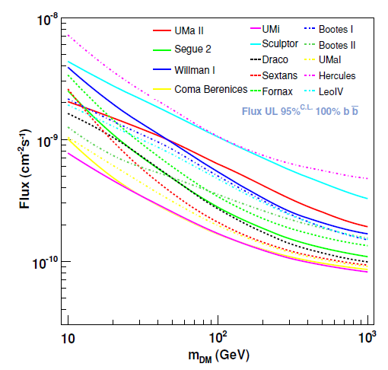
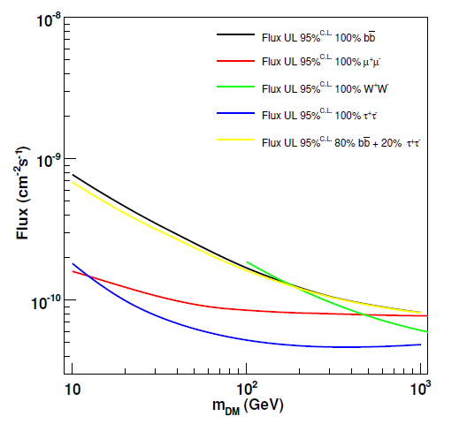
Dwarf Spheroidal Galaxies
Flux limits for DM annihilation spectra
The limit depends on the WIMP mass and the decay mode
For the Ursa Minor dSph
ApJ 712 (2010) 147.

Slide 25
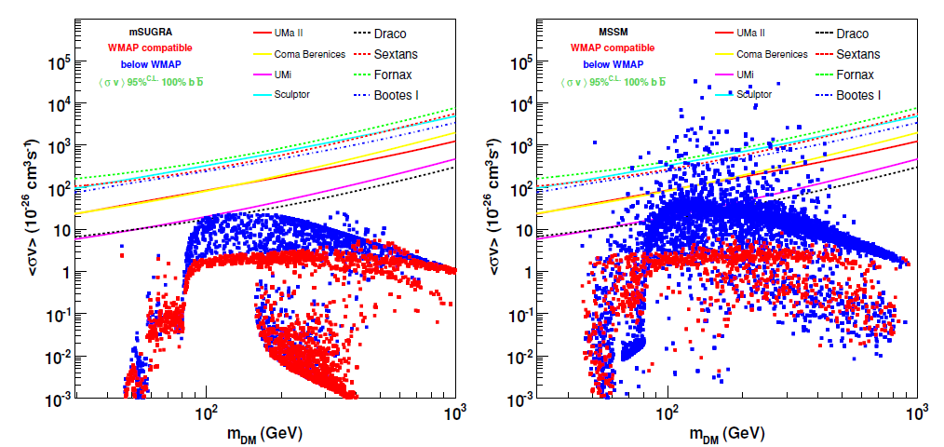
Dwarf Spheroidal Galaxies
Stellar data from Keck (Bullock, Kaplinghat, Martinez) were used to evaluate the DM content of each of 8 dwarfs, to translate the flux limits into annihilation cross section limits. No substructure boost assumed.
Red points are models with a cosmological WIMP thermal relic density compatible with WMAP data.
Work is in progress to combine all dwarfs into a single limit, giving about a 40% improvement over the best of these published results.
ApJ 712 (2010) 147.

Slide 26
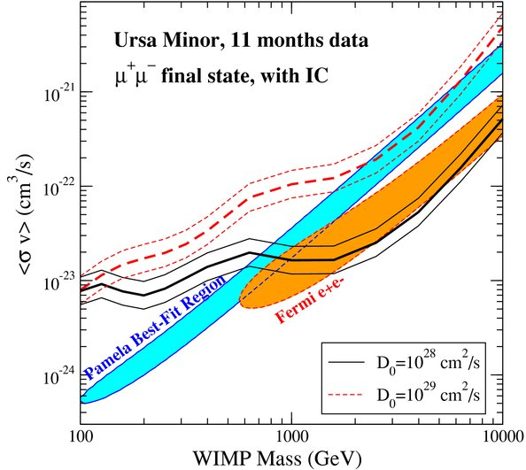
Dwarf Spheroidal Galaxies
Lepto-phylic models, such as those proposed to explain the Pamela positron excess and Fermi electron spectrum, are nearly ruled out by these (and other) FERMI dark-matter limits.
ApJ 712 (2010) 147.

Slide 27
Conclusions
Fermi is now two years into its (at least) five year mission, with a large, high-quality all-sky data set of gamma rays and electrons.
  The photon data are available to the public as well as to the LAT and GBM collaborations.
The first catalog of nearly 1500 sources includes several new classes of gamma-ray sources.
  Bonanza for particle astrophysics of high-energy sources and studies of cosmic particle acceleration.
High quality, high statistics measurements of the galactic and extragalactic diffuse emission have also been made.
  Crucial for studying cosmic ray acceleration and propagation.
No evidence of dark-matter annihilation has been seen.
  The limits are close to but do not yet cut very much into the most interesting theoretical parameter space.
  But, there is still much work to do here with 5 to 10 times more data as well as analysis refinements and new search avenues.

Slide 28
Additional slides

Slide 29
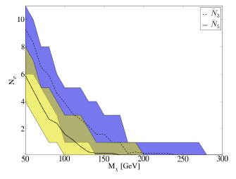
Dark Satellites
Via Lactea-2 simulation of the DM galaxy (Nature 454, 735)
  Including a boost for unresolved substructure
  Sample 10 viewing points 8 kpc from the Galactic center
WIMP annihilation to b,b-bar using Dark-SUSY (JCAP 0407, 008)
  Nominal expected cross section: 3×10⁻²⁶ cm³/s
MC simulation of the Fermi-LAT instrument response
10 year observation time
Number of DM halo objects visible at 3 std. dev. significance.
Number of DM halo objects visible at 5 std. dev. significance.
B. Anderson et al., arXiv:1006.1628v1.

Slide 30
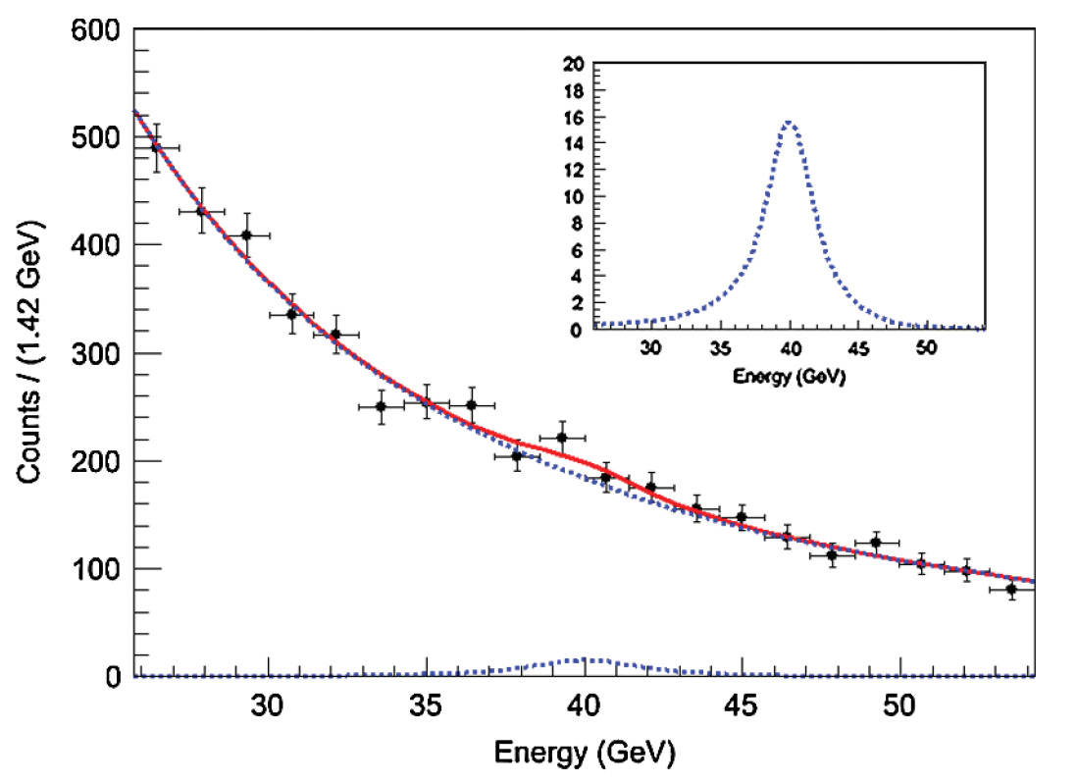
Gamma-Ray Line Search
Example fit, at 40 GeV (the fit with the largest line “signal”)
Fit to a power-law background plus a line at 40 GeV.
11 Months
Almost all sky:
Galactic plane removed, except for Galactic center.
Sources removed by 0.2° cut.
The signal fraction and the power-law index float freely in the fit.
PRL 104, 091302 (2010)

Slide 31
Gamma-Ray Line Search
Cross Section Upper Limits, for annihilation to γγ
(i.e. annihilation cross section times B.R. to γγ)
PRL 104, 091302 (2010)

