Slide 1
Underlying Event Studies and Forward Physics at CMS
ICHEP 2010 – July 22-28, 2010 – Paris
(3 – Perturbative QCD Jets and Diffractive Physics)
Paolo Bartalini (National Taiwan University)
on behalf of the CMS collaboration
PAS QCD-10-001 & CERN-PH-EP/2010-014, submitted to EPJC: “First Measurement of the Underlying Event Activity at the LHC with √s = 0.9 TeV”.
PAS QCD-10-010: “Measurement of the Underlying Event Activity at the LHC with √s = 7 TeV and Comparison with √s = 0.9 TeV”.
PAS QCD-10-005: “Measurement of the Underlying Event Activity with the Jet Area/Median Approach at 0.9 TeV”.
PAS FWD-10-002: “Measurement of the energy flow at large pseudorapidity at the LHC at √s = 900, 2360 and 7000 GeV”.
PAS FWD-10-001: “Observation of diffraction in proton-proton collisions at 900 and 2360 GeV centre-of-mass energies at the LHC”.
See also the poster contribution by A.Lucaroni
“Study of the underlying event with the CMS detector at the LHC”

Slide 2
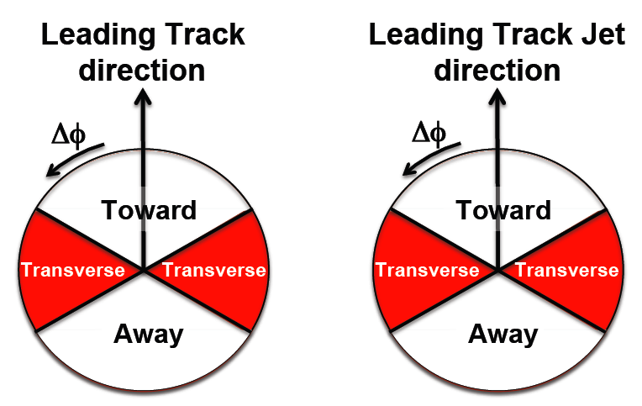
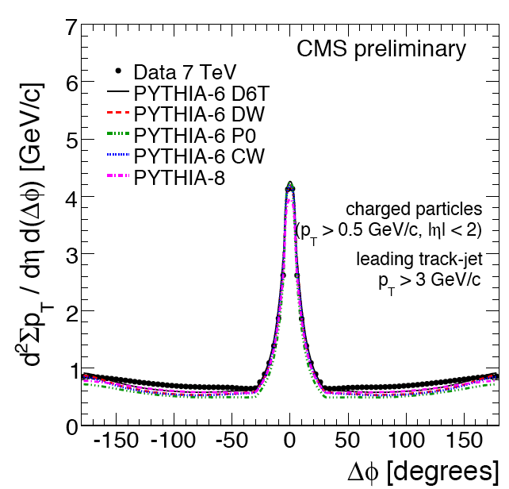
Measuring the UE in pp at √s = 900 GeV and 7 TeV
UE Measurements among the foundation of the
LHC Physics program: Isolation, vertices, etc.
Also very interesting per se → MPIs, BBR.
[PAS QCD-10-001 and QCD-10-010]
The leading track or leading track-jet provide
a scale and define a direction in the φ plane.
Observables built from charged tracks:
+ d²N_{ch}/dηdφ multiplicity density
+ d²ΣpT/dηdφ , pT density.
toward
The transverse region is expected to be
particularly sensitive to the UE.
Unavoidable road to CMS MC Tuning.
Part of a much more ambitious program to study Multiple Parton Interactions at the LHC.
transverse
TRADITIONAL UE DISTRIBUTIONS & BRAND NEW ONES!
However UNCORRECTED for detector effects
SUMMARY PAPER WITH CORRECTIONS VERY SOON!
away
7/23/10
P.Bartalini - ICHEP 2010
2

Slide 3
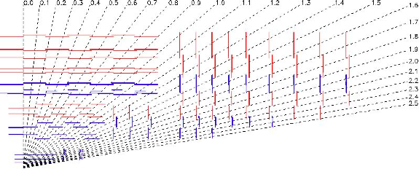
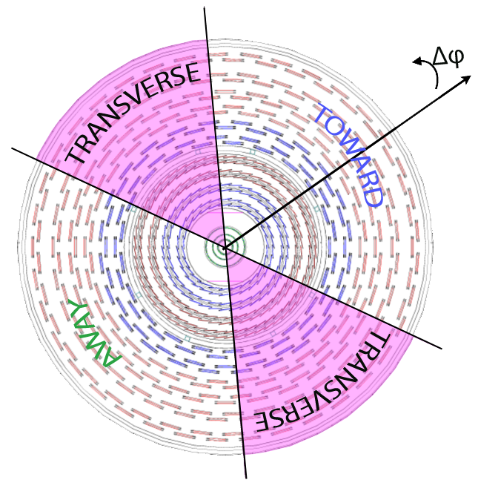
Measuring the UE in pp at √s = 900 GeV and 7 TeV
3.8 T
CMS Tracker
p_{T} resolution
@ 1 GeV/c is:
0.7% at η = 0 and
2% at |η| = 2.5
PAS TRK-10-001
96.3% efficiency for MIPs and time resolution of 3 ns
time resolution better than 0.2 ns
7/23/10
P.Bartalini - ICHEP 2010
3
Notes:
The central feature of the CMS apparatus is a superconducting solenoid, of 6 m
internal diameter. Within the field volume are the silicon pixel and strip tracker, the crystal
electromagnetic calorimeter (ECAL) and the brass-scintillator hadronic calorimeter (HCAL).
Muons are measured in gaseous detectors embedded in the iron return yoke.
The forward calorimeters provide almost hermetic coverage. They include
ZDC (>8.5), CASTOR (-6.6<eta<-5.3), and HF (2.9<eta<5.2). HF we use in the study
to see rap.gap.
HF, consists of steel absorbers and embedded radiation-hard quartz fibers, which provide a fast collection of Cherenkov light.
----------------------------------------------------------------------------------------------------
CMS uses a right-handed coordinate system, with the origin at the collision point,
the x-axis pointing to the centre of the LHC, the y-axis pointing up (perpendicular to the LHC
plane), and the z-axis along the anticlockwise-beam direction. The polar angle is measured from the positive z-axis and the azimuthal angle is measured in the x-y plane.
--------------------------------------
Two elements of the CMS detector monitoring system, the Beam Scintillator Counters (BSCs) and the Beam Pick-up Timing for the eXperiments (BPTX) devices , were used to trigger
the detector readout. The two BSCs are located at a distance of 10.86 m from the nominal
interaction point (IP) and are sensitive in the eta range from 3.23 to 4.65. Each BSC is a set of 16 scintillator tiles. The BSC elements have a time resolution of 3 ns and an average minimum ionizing-particle detection efficiency of 96.3%, and are designed to provide hit and coincidence rates. The two BPTX devices, located around the beam pipe at a distance of 175m from the IP on either side, are designed to provide precise information on the bunch structure and timing of the incoming beam, with better than 0.2 ns time resolution.

Slide 4
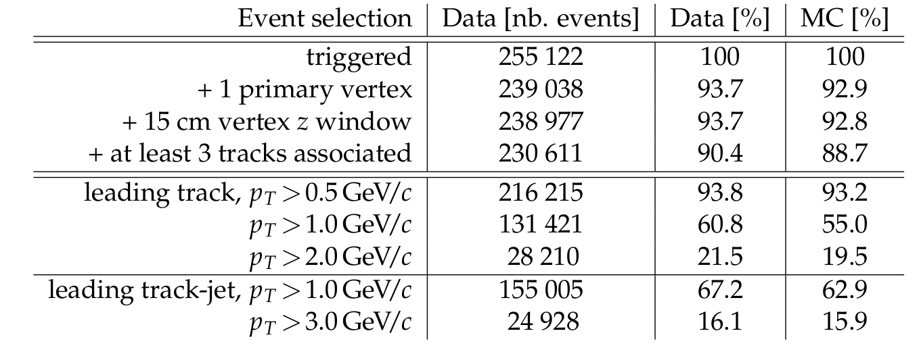
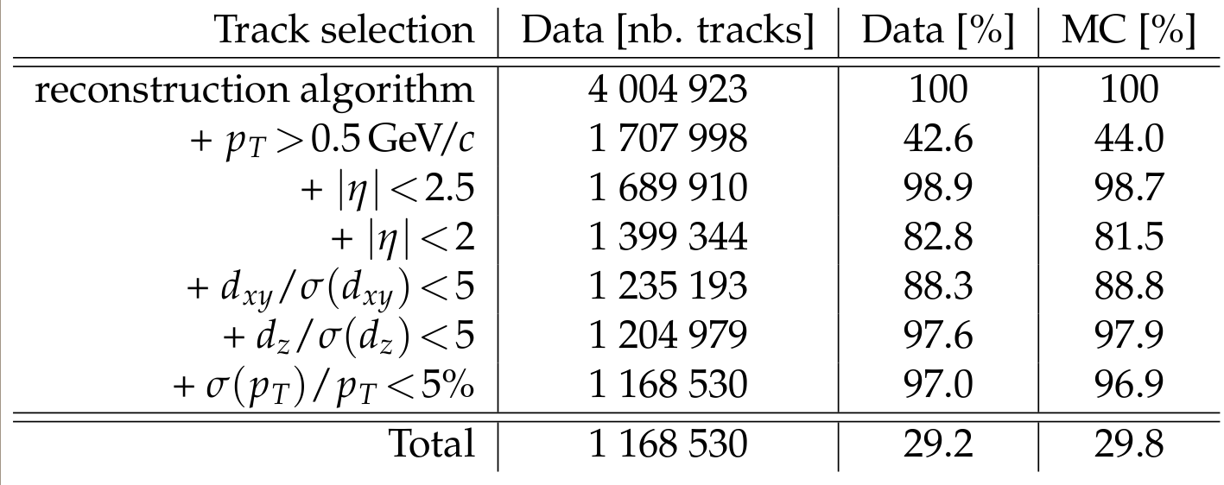
Event and Track Selections (900 GeV)
Trigger: coincidence of both Beam Pick-up Timing for eXperiments (BPTX) and
Beam Scintillator Counters (BSC)
Good primary vertex
Presence of leading object
ZeroBias events used for cross-checking efficiencies in data and MC
Good agreement in DATA VS MC comparison
Kinematic region for tracker acceptance and good tracking performances
Association of tracks to
primary vertex
Additional quality cut
Final efficiency ~ 90%, fake rates ~ 2% at central rapidity (from Simulation)
7/23/10
P.Bartalini - ICHEP 2010
4

Slide 5
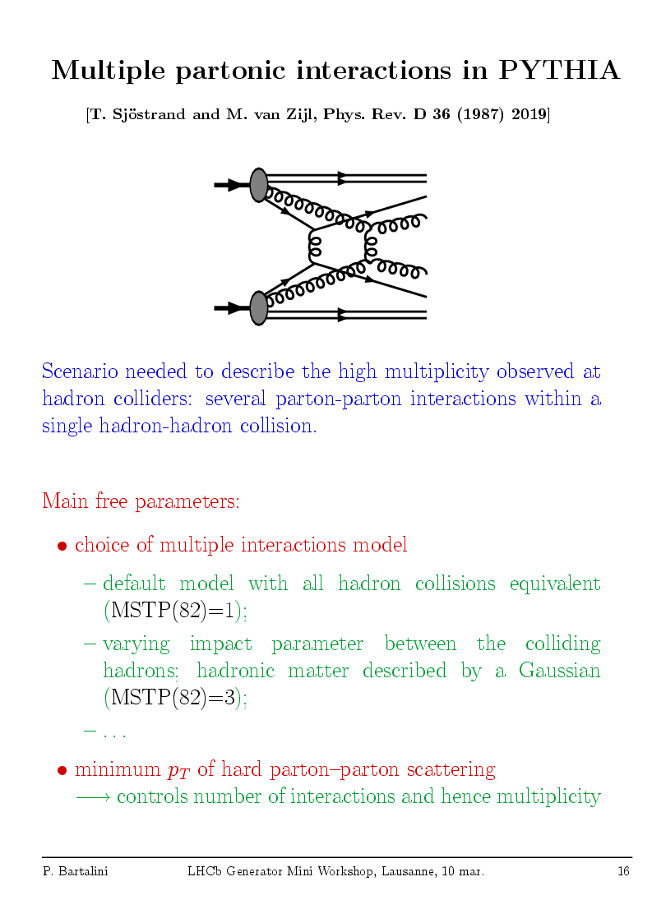
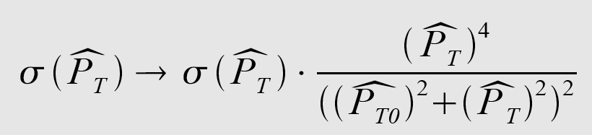
pQCD Models
ISR, FSR, SPECTATORS…
Not enough to account for
the observed multiplicities
& P_{T} spectra
The Pythia solution:
[T. Sjöstrand et al. PRD 36 (1987) 2019]
Multiple Parton Interactions (MPI)
(now available in other general purpose MCs: Herwig/Jimmy, Sherpa, etc.)
→
Inspired by observations of
double high P_{T} scatterings
Main Parameter: P_{T} cut-off P_{T0}
(dampening)
Cross Section Regularization for P_{T}→ 0.
P_{T0} can be interpreted as inverse of effective colour screening length.
Controls the number of interactions hence the Multiplicity:
< N_{int} > = σ_{parton-parton} /σ_{proton-proton}
Tuning for the LHC: Emphasis on the Energy-dependence of the parameters.
“post Hera” PDFs have increased color screening at low x ?
  x g(x,Q²) → x^{-ε/2} for x → 0
P_{T0}^{s’} = P_{T0}^{s} (√s’ / √s)^{ε}
7/23/10
P.Bartalini - ICHEP 2010
5

Slide 6
Pythia tunes/versions in CMS
  Virtuality ordered showers, old MPIs
    Pythia 6 Tunes DW(T), D6(T), CW (R.Field, CDF, CMS UE team).
    [arXiv:1003.4220].
    Pro-Q20 (Professor, automated, LEP fragmentation).
    [arXiv:0907.2973].
    Describe UE@Tevatron, Describe other very important observables at Tevatron like pT(heavy bosons) and Jet azimuthal decorrelation.
  New MPIs with interleaved pT-ordered showers.
    Perugia-0 (consider Professor tunes), referred to as P0.
    [arXiv:0905.3418].
    Pythia 8 (different model! only one tune along the lines of P0).
P_{T0}^{LHC} = P_{T0}^{Tevatron} (√s^{LHC} / √s^{Tevatron})^{ε}
where ε = PARP(90)
DWT, D6T → ε = 0.16
DW, D6, Pro-Q20, P0, Pythia 8 → ε ≈ 0.25
CW → ε = 0.3
Evolution of MB multiplicity@SPS [CERN 2000-004 pg. 293].
Consider 630 GeV and 1.8 TeV CDF UE data, compatible with UE@RHIC, UE@CMS (900 GeV).
Ad hoc for CMS studies, maximize the UE activity at 900 GeV still compatible with CDF & RHIC.
7/23/10
P.Bartalini - ICHEP 2010
6

Slide 7
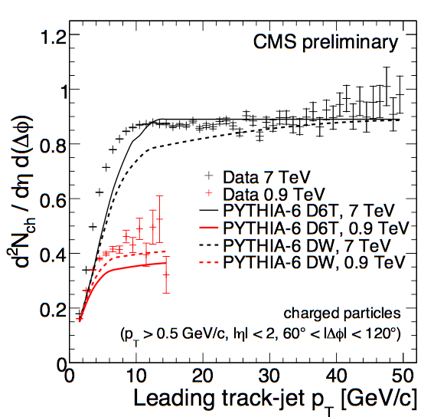
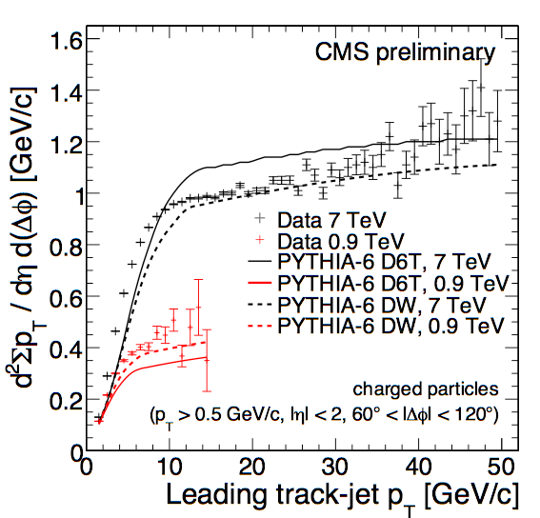
Densities in the Transverse Region
7 TeV and 900 GeV results for the reference charged multiplicity density and ΣpT density profiles including both D6T and DW predictions.
    d²Ν_{ch}/dηdφ
    d²ΣpT/dηdφ
Stat. (inner) &
total uncertainty
Stat. dominating
at high p_{T}
Fast rise for pT < 8 GeV/c (4 GeV/c), attributed mainly to the increase of MPI activity, followed by a Plateau-like region with ≈ constant average number of selected particles and a slow increase of ΣpT, in a saturation regime.
Increase of the activity with √s also corroborates MPIs (growth with PDFs).
7/22/10
P.Bartalini - ICHEP 2010
7

Slide 8
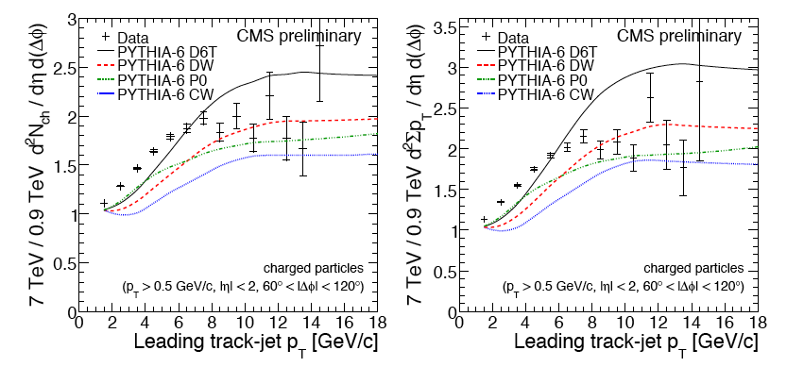
Comparison between 7 TeV and 900 GeV
    d²Ν/dηdφ vs pT (7 TeV)
    d²Ν_{ch}/dηdφ vs pT (900 GeV)
    d²ΣpT/dηdφ vs pT (7 TeV)
    d²ΣpT/dηdφ vs pT (900 GeV)
Leading track-jet
Leading track-jet
Poor description of the rise. P0 has the worst shape. CW underestimates the plateau regions. D6T, with slower energy dependency of the p_{T} cut-off, overestimates the plateau regions.
7/22/10
P.Bartalini - ICHEP 2010
8

Slide 9
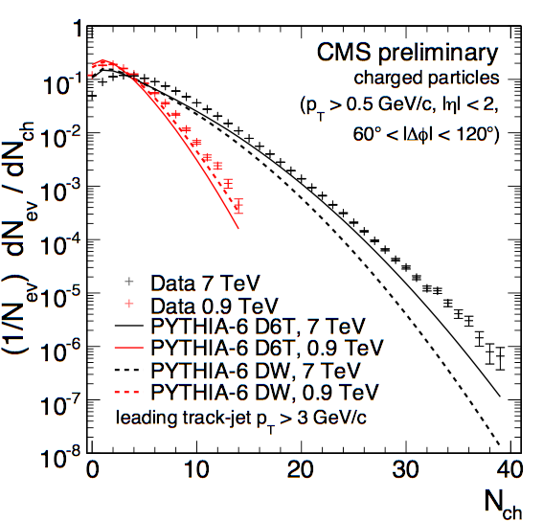
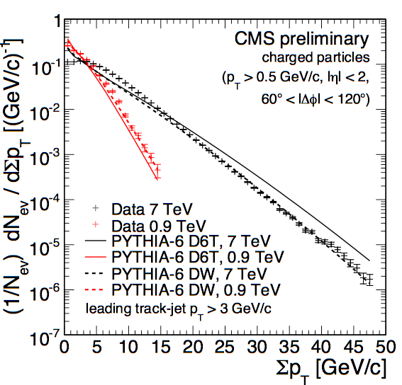
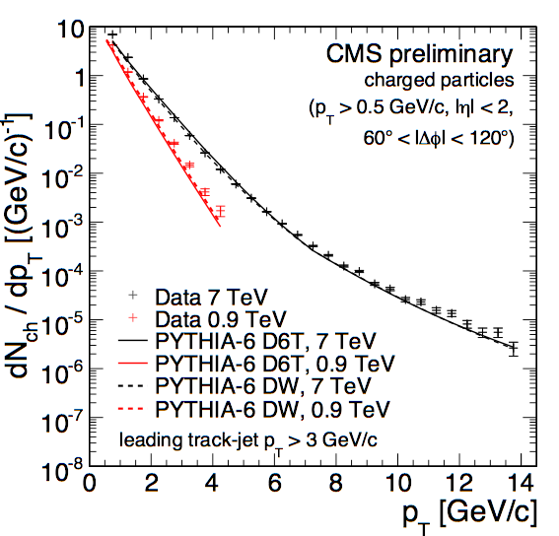
N_{ch}, Σ(pT) and pT in the Transverse Region
7 TeV and 900 GeV results for the reference distributions in the Transverse region including both D6T and DW predictions.
pT track-jet > 3 GeV for both 7 TeV and 900 GeV data
DW OK
The three distributions, which extend up to quite large values of the selected observables in the transverse region, are quite well described overall by the
various MC models, over several orders of magnitude!
At 7 TeV the charged particle spectrum extends up to pT >10 GeV/c
→ Hard component in particle production in the transverse region.
7/22/10
P.Bartalini - ICHEP 2010
9

Slide 10
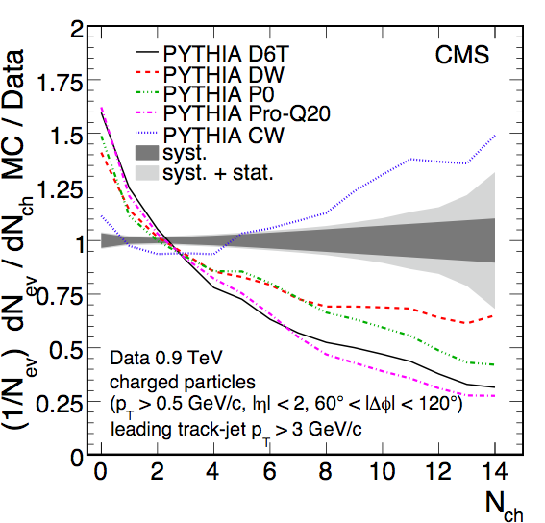
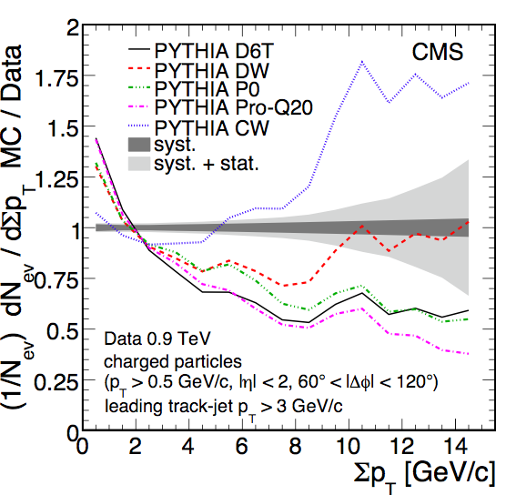
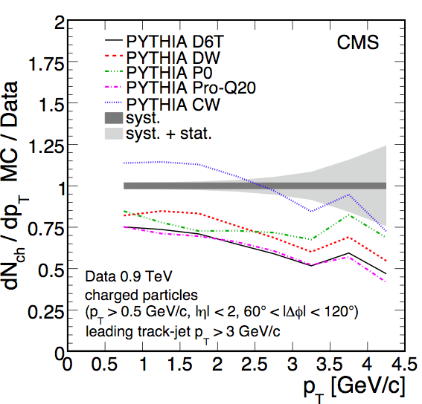
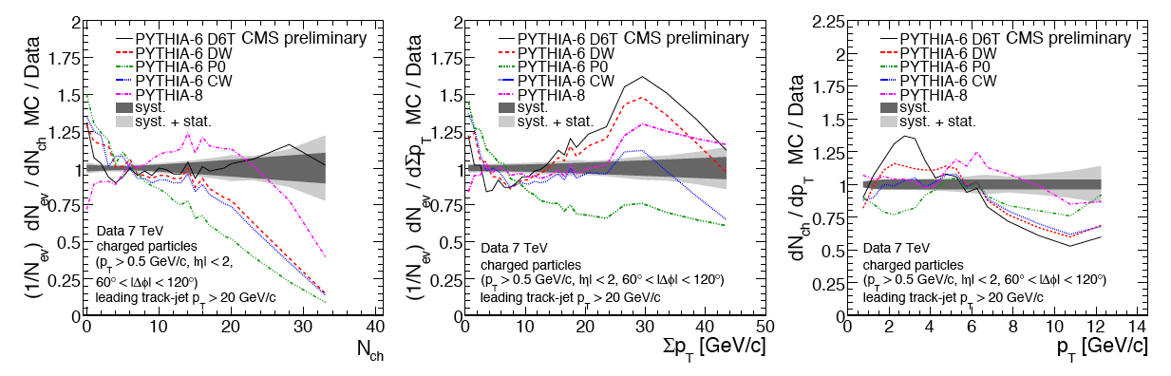
N_{ch}, Σ(pT) and pT in the Transverse Region
900 GeV. pT track-jet > 3 GeV
7 TeV. pT track-jet > 20 GeV
7/22/10
P.Bartalini - ICHEP 2010
10

Slide 11
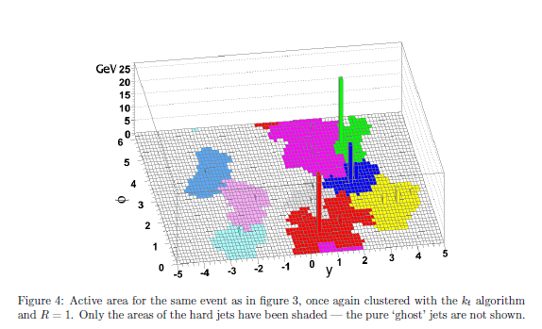
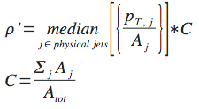
A new approach to UE: Jet Area/Median
Based on the paper: “On the characterisation of the underlying event”; JHEP04(2010)065; M. Cacciari, G. Salam, S. Sapeta.
CMS: Track jets using kT jet algorithm with R=0.6 (infrared safe).
  Preliminary results from 900 GeV data. Similar event, track selection and systematic uncertainty estimation as traditional UE method (see next slide).
The underlying event activity is given by ρ=median{pT/A}.
  The median is less sensitive to outliers, i.e. hard jets.
  To estimate the jet area η−φ cells are filled by ghost deposits of O(10⁻¹⁰⁰ GeV).
    FastJet [arXiv:hep-ph/0512210] essential to speed up the calculation.
    900 GeV: ghost jets dominate the median!!!
Adjusted observable for
low occupancy events:
kT jets
7/23/10
P.Bartalini - ICHEP 2010
11

Slide 12
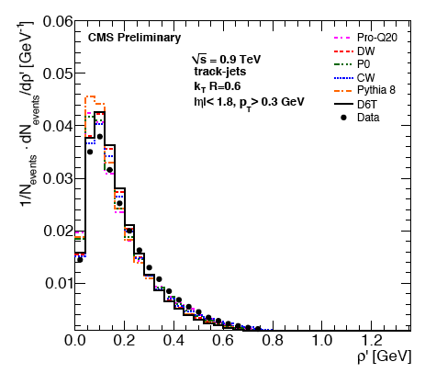
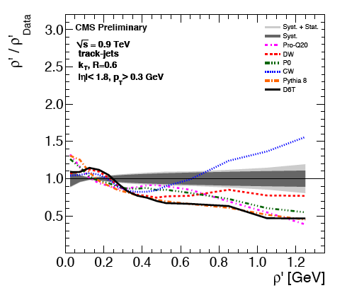
UE: Jet Area/Median (ρ’)
Event & Track Selection identical to the traditional UE measurement at 900 GeV, only differences →
pT track > 0.3 GeV instead of 0.5 GeV
|η| track < 2.3 instead of 2.5
|η| track-jet < 1.8 instead of 2.0
Clear sensitivity to the differences between the Models / Tunes
7/23/10
P.Bartalini - ICHEP 2010
12

Slide 13
UE Bottom line
First Measurement of the Underlying Event Activity at the LHC with √s = 0.9 TeV and Extension to 7 TeV.
  Exploits the performances of the CMS Tracker.
  Increase of the activities with the scale of the interactions and with √s corroborates MPIs.
  Detailed study of distributions in the transverse region.
  Challenging test of MC models in particular for what concerns the energy dependent parameters.
    Higher values of ε ( ≈ 0.25 ) favored by the data.
First measurement of the UE with Jet Area/Median approach
  Small adjustments (ρ to ρ') had to be made in order to account for the low particle multiplicity in 0.9 TeV MinBias events.
  Complementary approach to evaluate the UE activity, very robust and flexible against different topologies, additional observables for MC tuning.

Slide 14
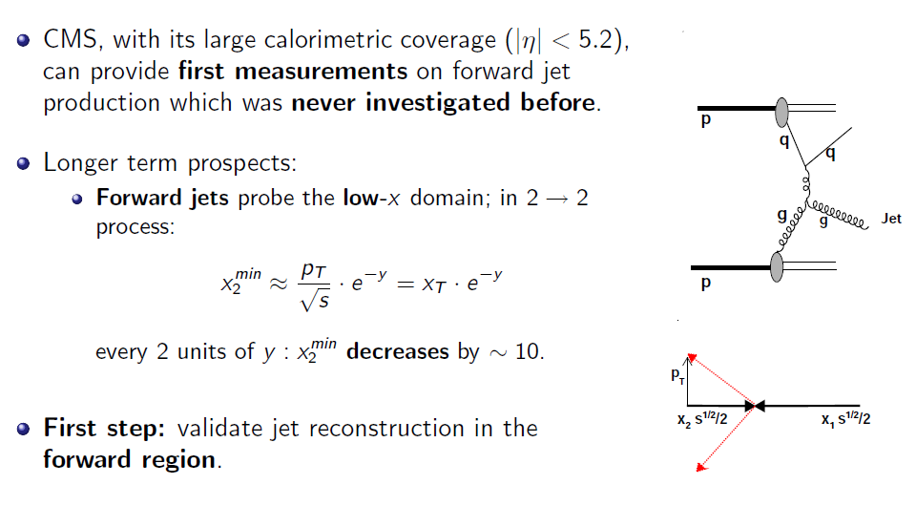
Forward Jets: Motivation
CMS, with its large calorimetric coverage (|η|<5.2) can provide first measurements on forward jet production which was never investigated before.
Longer term prospects:
  Forward jets probe the low-x domain; in 2→2 process:
  Every 2 units of y: x₂^{min} decreases by ≈ 10.
First step:
  validate jet reconstruction in the forward region.
7/23/10
P.Bartalini - ICHEP 2010
14

Slide 15
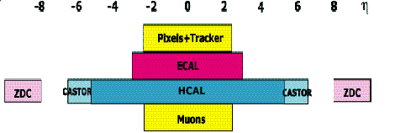
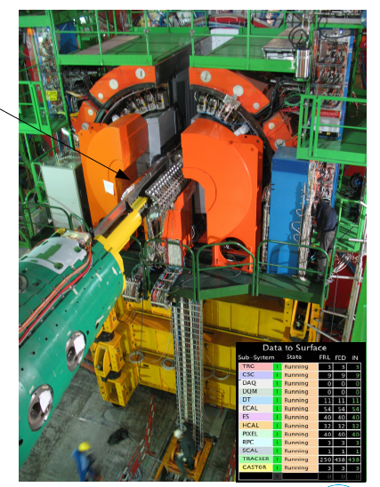
Measuring Forward Jets and other forward objects
η 5 2.5 0 −2.5 −5
HF
HF
First CASTOR unit
installed on collar
table of HF platform
(-z side) in June 2009
Fully functional and
integrated into
CMS operations
Rapidity coverage: 5.2 < |η| < 6.6
7/23/10
P.Bartalini - ICHEP 2010
15
Notes:
The central feature of the CMS apparatus is a superconducting solenoid, of 6 m
internal diameter. Within the field volume are the silicon pixel and strip tracker, the crystal
electromagnetic calorimeter (ECAL) and the brass-scintillator hadronic calorimeter (HCAL).
Muons are measured in gaseous detectors embedded in the iron return yoke.
The forward calorimeters provide almost hermetic coverage. They include
ZDC (>8.5), CASTOR (-6.6<eta<-5.3), and HF (2.9<eta<5.2). HF we use in the study
to see rap.gap.
HF, consists of steel absorbers and embedded radiation-hard quartz fibers, which provide a fast collection of Cherenkov light.
----------------------------------------------------------------------------------------------------
CMS uses a right-handed coordinate system, with the origin at the collision point,
the x-axis pointing to the centre of the LHC, the y-axis pointing up (perpendicular to the LHC
plane), and the z-axis along the anticlockwise-beam direction. The polar angle is measured from the positive z-axis and the azimuthal angle is measured in the x-y plane.
--------------------------------------
Two elements of the CMS detector monitoring system, the Beam Scintillator Counters (BSCs) and the Beam Pick-up Timing for the eXperiments (BPTX) devices , were used to trigger
the detector readout. The two BSCs are located at a distance of 10.86 m from the nominal
interaction point (IP) and are sensitive in the eta range from 3.23 to 4.65. Each BSC is a set of 16 scintillator tiles. The BSC elements have a time resolution of 3 ns and an average minimum ionizing-particle detection efficiency of 96.3%, and are designed to provide hit and coincidence rates. The two BPTX devices, located around the beam pipe at a distance of 175m from the IP on either side, are designed to provide precise information on the bunch structure and timing of the incoming beam, with better than 0.2 ns time resolution.

Slide 16
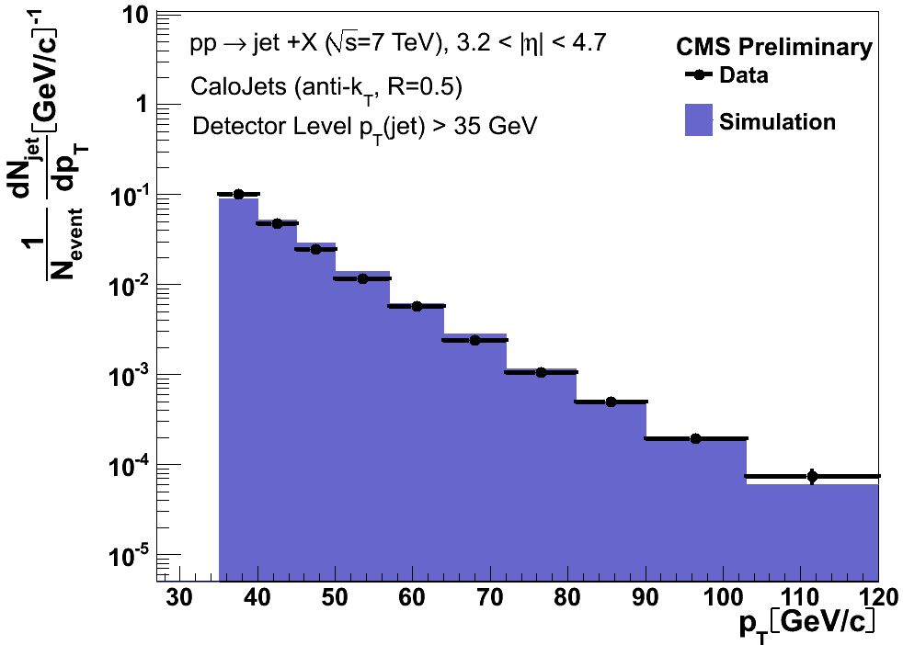
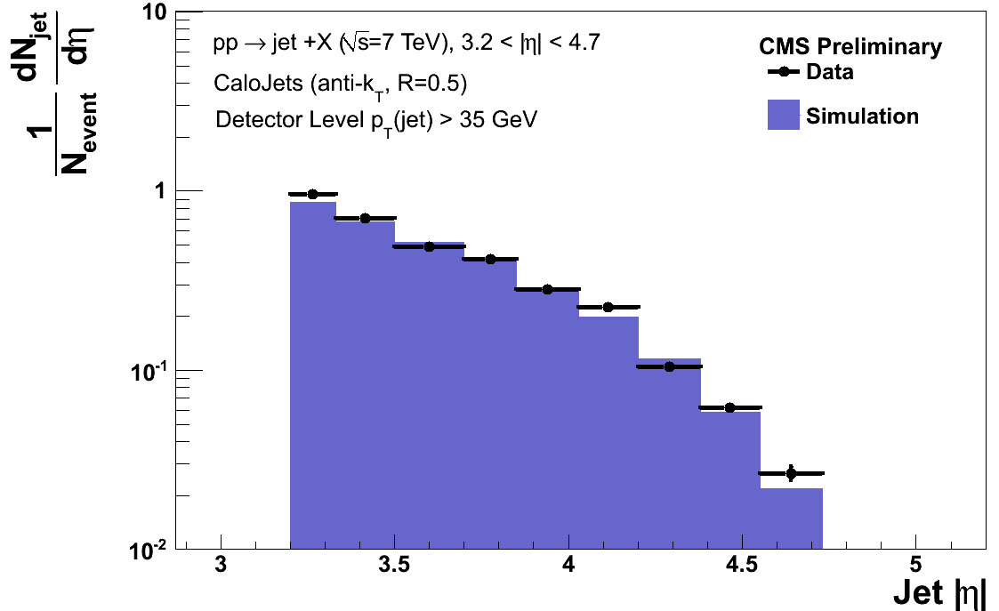
Forward Jet p_{T} and η spectrum
Here 7 TeV data considered. L ≈ 10 nb⁻¹.
Jets reconstructed in HF only: 3.2 < η < 4.7.
p_{T} > 35 GeV.
Distributions not corrected.
Reasonable data vs MC agreement.
Expected resolutions:
σ(p_{T})/p_{T} ≈ 12% @ 100 GeV.
σ(R)/R ≈ 0.035 @ 100 GeV, R = √(Δφ²+Δη²).
Statistical errors only
p_{T}
Statistical errors only
η
7/22/10
P.Bartalini - ICHEP 2010
16

Slide 17

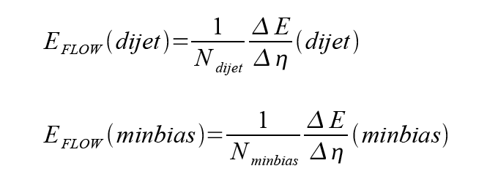
Energy flow in the forward region
Measurement relies on the energy flow in the Hadron Forward Calorimeter (3 < η < 5) in the presence of events “triggered” by a more central activity (Minimum Bias, di-Jets)
→Test of central-forward correlations
Detector level no corrections to the hadron level applied
Distributions studied:
Three different cms energies included: 900 GeV, 2360 GeV, 7000 GeV
Definition of di-Jet samples:
  p_{T} Calo Jet > 8 GeV at 900 and 2360 GeV
  p_{T} Calo Jet >20 GeV at 7 TeV
(Definition of Minimum Bias samples along the lines of the other analyses)
7/22/10
P.Bartalini - ICHEP 2010
17

Slide 18
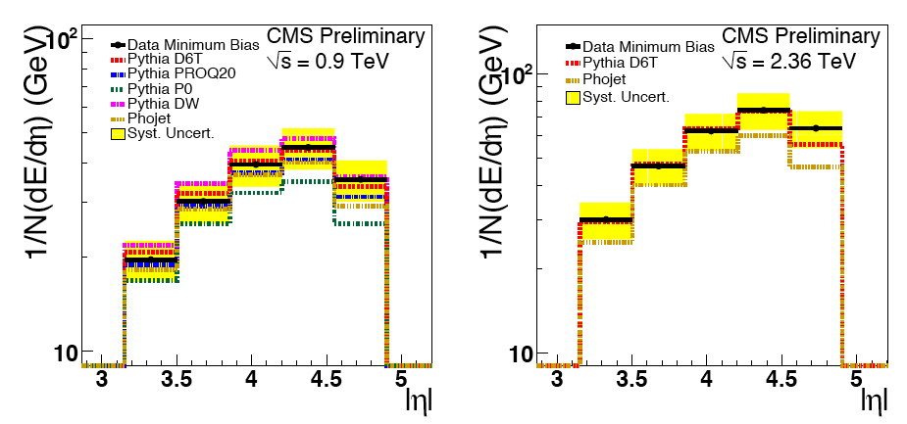
Energy flow in the forward region
Energy flow in the Minimum Bias sample at 0.9 and 2.36 TeV:
Systematic uncertainty dominated by the energy scale (applies to all the distributions)
The increase of the fwd e-flow with the c.m.s. energy is well reproduced by the simulations.
At 900 GeV and 2.36 TeV the energy flow in minimum bias events is described by the D6T tune while PHOJET is lower than the data. PROQ20 and P0, tested at 900 GeV, are also too low.
7/23/10
P.Bartalini - ICHEP 2010
18

Slide 19
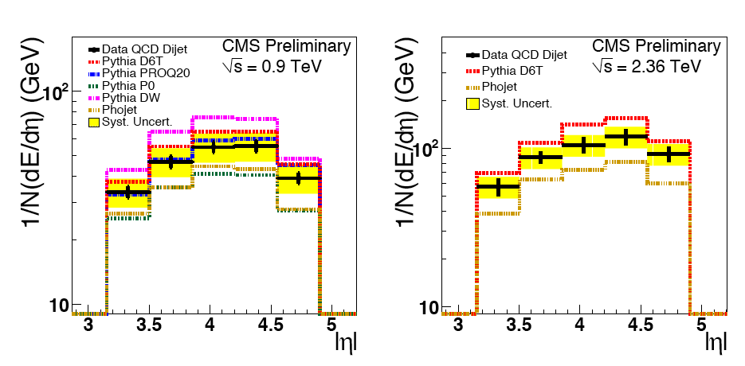
Energy flow in the forward region
Energy flow in the di-jet sample at 900 GeV and 2.36 TeV:
The increase of the fwd energy flow with increasing energy scale is qualitatively reproduced by the simulations. … but now the D6T tune predicts too high energy flow while PHOJET is below the data. 900 GeV: PROQ20 provides the best description while P0 is still too low.
7/23/10
P.Bartalini - ICHEP 2010
19

Slide 20
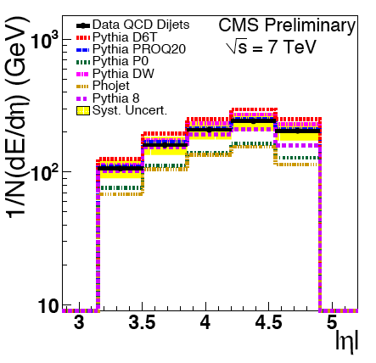
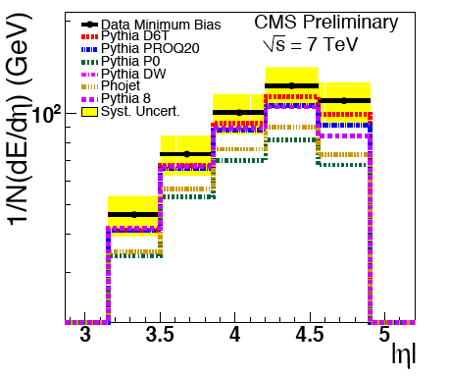
Energy flow in the forward region
Energy flow in the MB and di-jet samples at 7 TeV:
MB
di-Jet
MB: the predicted fwd energy flow is below the data for all the tunes.
Di-jet: PROQ20 confirmed as the best tested tune, the PYTHIA8 model is also fine. The D6T tune lays above the data. P0 and PHOJET turn out to be too low.
7/23/10
P.Bartalini - ICHEP 2010
20

Slide 21
Forward jets and energy flow: Bottom Line
Reconstruction of Forward Jets in HF well assessed.
  Calo Jets up to |η| ≈ 5.
Measurement of the Forward energy flow provides complementary information with respect to the traditional measurements relying just on the central activity.
  Forward central correlations well described by MPI models.
  Conclusions on the preferred MC tunes differ with respect to the conclusions drawn in the CMS UE studies.
Notes:
And now summary slide.
So we can state a first observation of diffraction at LHC at 900 GeV
And 2.36 TeV. SD events observed in two ways: peak at low Xi and
presence of rap.gap.
Exp. Data have been compared with 2 MC generators PYTHIA and PHOJET.
PYTHIA gives a better description of non-diffractive part of spectrum.
Phojet describes better the diffractive contribution.
Constraint from diffraction is important to improve MB MC tunes.
At the moment our data can not distingish between D6T, DW and CW tunes.

Slide 22
Diffraction at the LHC
Single diffraction (SD)
Double Pomeron Exchange (DPE)
p
p1
p
X
LRG
forw. det.
X
central +
forw. det.
p
LRG
p
p
LRG
p2
2 gluon exchange with
vacuum quantum numbers
“Pomeron”
ξ₁ ξ₂ s = M(X)²
ξ s = M(X)²
Diffractives ~ 1/3 of the inelastic cross section at the LHC
(Processes can be hard or soft, scale given by X)
Measure fundamental quantities of QCD: SD and DPE inclusive cross sections, their s, t, M_{X} dependences, with X including jets, W’s, Z’s, Higgs, …
Info on proton structure (dPDFs and GPDs), discovery physics, MPI, …
No measurement of the proton for the time being, rely on Large Rapidity Gaps
Going step by step, first of all let’s observe diffraction! Starting with SD
7/23/10
P.Bartalini - ICHEP 2010
22

Slide 23
SD Observation at the LHC: Strategy
Single diffraction (SD)
ξ = M_{X}² / s
σ ≈ 1 / ξ
Δy ≈ - ln ξ
ξ ≈ Σ_{i} (E_{i} ± p_{z,i})
p
X
Along the lines of a 35y old ISR paper
[Phys.Rep.55, No. 1(1979)1-132]
p
LRG
p
LOOK FOR A SD PEAK @ low ξ = Σ_{i} (E_{i} ± p_{z,i})
Sum runs over all the
Calo Towers:
p_{z,I} = E_{i} cos ϑ_{i}
CONFIRM SD PEAK @ low E_{HF±}, N_{HF±}
E_{HF±} = energy deposition in HF±
N_{HF±} = multiplicity of towers above threshold in HF±
7/23/10
P.Bartalini - ICHEP 2010
23
Notes:
Diagram of SD is shown again on the slide, and in addition on the sketch of CMS detector.
At present design of CMS there is no possibility to measure diff. proton, but we can measure
particles from diff. cluster X and then reconstruct some proton parameters, Xi.
We can identify reaction using LRG: absence or particular absence of energy in the forward CMS
Calo. Here we use absence signal in HF for LRG.
I’m going to make brief introduction to the main kinematical variabales and dependencies in SD proc.
Xi of proton is proportional to the mass square of diff. cluster X. Rapidity gap is equal to the minus logarithm of xi,
and also depends on mass of X. It can be shown that Xi is also proportional to the sum over all energies and
longitudinal projection of the momentum of all particles in cluster X. Cross-section of SD is inversely proportional to
the X mass square and so inversely proportional to the Xi.
Also we can conclude that diffraction should dominate at small Xi / or varianble ( E\pm pz).
As we will talk about first observation of SD at LHC, it will be quite appropriate to tell about history of SD study.
But it is too long story which come from the low energy fix target experiments,
Continue at ISR , first pp collider at CERN, when it was observed production of diffractive clusters with the masses several times higher than mass of proton. And where all main kinematical dependencies of SD were proved. Than SPS experiments, where hard diffraction
was observed first time. Hera with study of diffractive structure functions and diffractive PDF. Tevatron where hard scattering factorisation violation was observed. And now we start new
period of diffraction study at LHC. I decided to show one of the first result from ISR, obtained around 35 y. before: mass dependence of the cs, rapidity gap observation for different masses, and diffractive peak observed at small Xi. Approximately the same distribution we observed now with CMS.

Slide 24
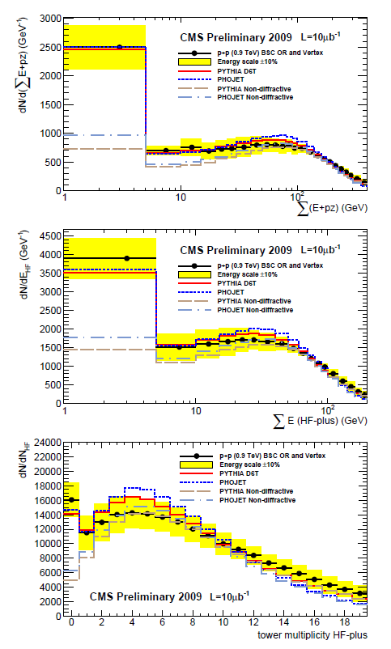
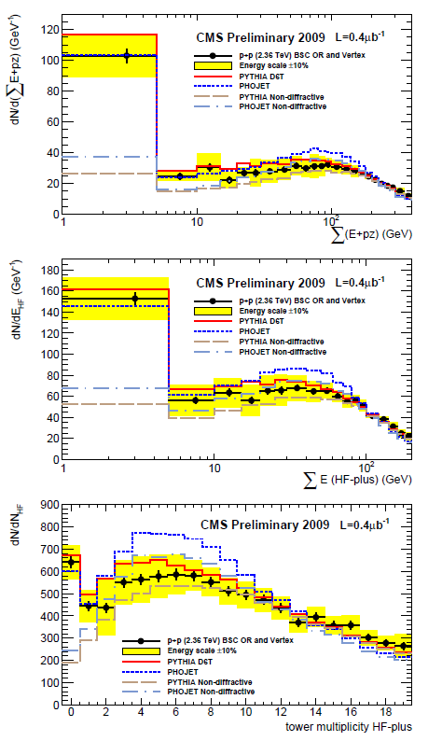
SD Observation at the LHC: Results
Uncorrected Distributions.
900 GeV
2360 GeV
SD seen in Σ E+pz distribution
due to cross section peaking at small values of ξ
Systematic uncertainty
dominated by energy scale
Notes:
Figures on this slide show distribution ob the variable discussed above.
Left ones for 900 GeV and the right ones for 2360 GeV.
Yellow band illustrate the effect of 10% energy scale uncertainty in calorimeters.
The greater part of diffractive events are consentrated in the first bin in all histograms.
Plots show also MC events for diffractive and non-diffractive events.
You can see that data is consistent with MC for diff. events. This is seen clear in the first bin.
For E+pz this diference appear due to SD cross section peaking at small Xi
For HF distributions we see absence of fwd hadron activity due to rap.gap.

Slide 25
SD Observation at the LHC: Results
SD signature confirmed by the
absence of forward hadronic activity (presence of a LRG)
900 GeV
Low
Σ Ε(HF+)
2360 GeV
Low HF+
Multiplicity
Notes:
Figures on this slide show distribution ob the variable discussed above.
Left ones for 900 GeV and the right ones for 2360 GeV.
Yellow band illustrate the effect of 10% energy scale uncertainty in calorimeters.
The greater part of diffractive events are consentrated in the first bin in all histograms.
Plots show also MC events for diffractive and non-diffractive events.
You can see that data is consistent with MC for diff. events. This is seen clear in the first bin.
For E+pz this diference appear due to SD cross section peaking at small Xi
For HF distributions we see absence of fwd hadron activity due to rap.gap.

Slide 26
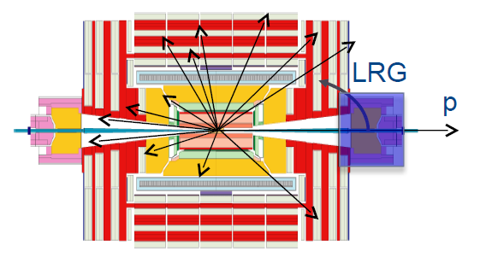

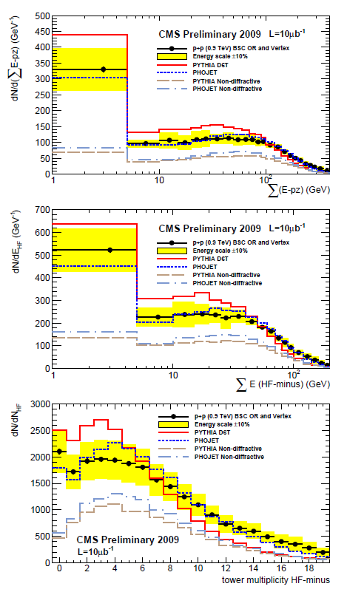
Enriched diffractive samples
(X)
Requirement of low activity in one side of CMS
SD component of the data LRG in z+ direction
Concentrating on the fragmenting object
(X) boosted in z- direction
ξ = Σ_{i} (E_{i} ± p_{z,i})
HF- Multiplicity
Uncorrected data shown and compared to PYTHIA D6T & PHOJET
PHOJET gives a better description of the system with enhanced diffractive component
Notes:
We can enhance the fraction of diffraction by requare rap.gap.
We use HF for it and require Ehf to be less than 8 GeV in the HF+.
It enhances diffractive component as seen on the distributions
Of the same variable as on the prev. slide. In the first bin
The difference of diff. and non-diff. events become 1.5 bigger.
And this difference is seen at higher values of E-pz.
We can conclude that …..read slide

Slide 27
SD Observation. Bottom Line
First observation of SD events at LHC in pp collisions at 0.9 & 2.36 TeV
  Peak at low ξ values and
  Presence of a Large Rapidity Gap
Comparison to the MC event generators
  PYTHIA gives a better non-diffractive description
  PHOJET describes the diffractive contribution better
  No sensitivity to Pythia 6 Tunes
Notes:
And now summary slide.
So we can state a first observation of diffraction at LHC at 900 GeV
And 2.36 TeV. SD events observed in two ways: peak at low Xi and
presence of rap.gap.
Exp. Data have been compared with 2 MC generators PYTHIA and PHOJET.
PYTHIA gives a better description of non-diffractive part of spectrum.
Phojet describes better the diffractive contribution.
Constraint from diffraction is important to improve MB MC tunes.
At the moment our data can not distingish between D6T, DW and CW tunes.

Slide 28
Underlying Event Studies and Forward Physics at CMS
ICHEP 2010 – July 22-28, 2010 – Paris
PAS QCD-10-001 & CERN-PH-EP/2010-014, submitted to EPJC: “First Measurement of the Underlying Event Activity at the LHC with √s = 0.9 TeV”
PAS QCD-10-010: “Measurement of the Underlying Event Activity at the LHC with √s = 7 TeV and Comparison with √s = 0.9 TeV”
PAS QCD-10-005: “Measurement of the Underlying Event Activity with the Jet Area/Median Approach at 0.9 TeV”.
PAS FWD-10-002: “Measurement of the energy flow at large pseudorapidity at the LHC at √s = 900, 2360 and 7000 GeV”
PAS FWD-10-001: “Observation of diffraction in proton-proton collisions at 900 and 2360 GeV centre-of-mass energies at the LHC”
CREDITS: QCD and FWD colleagues, in particular:
H. Jung, G. Brona, A. Vilela Pereira, A. Sobol, G. Cerati, L. Mucibello

Slide 30
BACKUP QCD-10-001

Slide 31
PYTHIA tunes
Several PYTHIA tunes considered, differing in the description of parton fragmentation and multiple parton interaction.
PYTHIA regularizes the 1/pT⁴ divergence for ﬁnal state parton pT→0 using a cut-off parameter pT0, used both for hard-scattering and MPI.
The energy dependence of the cut-off is given by pT0(√s) = pT0(√s0)·(√s/√s0)^{ε}
All considered tunes are compatible with Tevatron data.
Tune | pT0(1.8TeV) | ε | notes/other features
D6T | 1.8 GeV/c | 0.16 | Energy dependence from UA5 Minimum Bias data at SppS. Uses CTEQ6L.
DW | 1.9 GeV/c | 0.25 | “Best fit” of Tevatron data: pT(Z) and di-jet Δϕ
Pro-Q20 | 1.9 GeV/c | 0.22 | Professor fit program using LEP data for fragmentation
P0 | 2 GeV/c | 0.26 | As above + new PYTHIA MPI model + pT-ordered shower
CW | 1.8 GeV/c | 0.3 | Maximizes MPI at 900 GeV, still compatible with Tevatron

Slide 32
BACKUP QCD-10-010

Slide 33
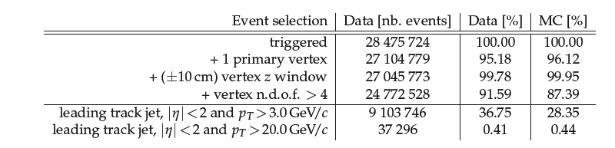
Event selection. UE 7 TeV
Table 1.
Only 1 real
good vertex
Events used for “cumulative” distributions.
Lower threshold moved to 3.0 GeV to enable comparison
w.r.t. 900 GeV UE Analysis (QCD-10-001)

Slide 34
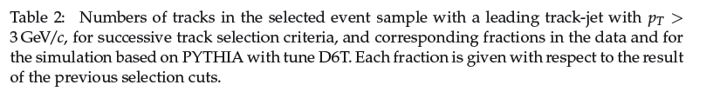
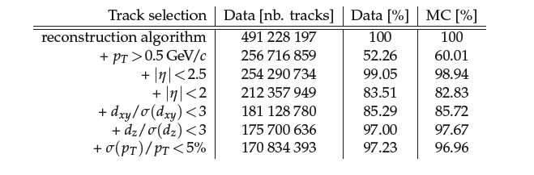
Track selection. UE 7 TeV
PLENTY OF RESULTS SCRUTINIZED IN PAG/POG Meetings. See BACK-UP SLIDES
Table 2.
highPurity algo
Analysis oriented
primary tracks
impact param. at real vtx
vertex error propagated
Quality requirement
{each efficiency computed w.r.t. previous surviving class}

Slide 35
BACKUP FWD-10-001

Slide 36
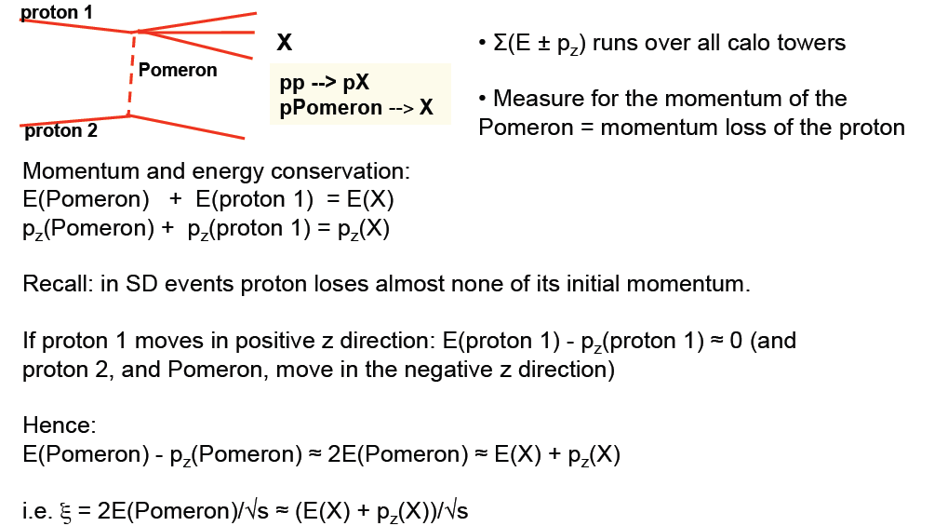
Meaning of (E ± pz)

Slide 37
Single diffraction (SD)
ξ = M_{X}² / s
s ≈ 1/ξ
Δy ≈ - ln ξ
ξ ≈ Σ_{i} (E_{i} ± p_{z,i})
p
X
p
LRG
p
Along the lines of 35y old ISR paper
Phys.Rep.55, No. 1(1979)1-132.
HF
HF
2
σ ~ 1/M = 1/ξ
SD peak
@ low E_{HF±}, N_{HF±}
E_{HF±} = energy deposition in HF±
N_{HF±} = multiplicity of towers above threshold in HF±
ξ=1-x
SD peak @ low ξ = Σ_{i} (E_{i} ± p_{z,i})
→ Sum runs over all the Calo Towers: p_{z,i}= E_{i} cos ϑ_{i}
7/23/10
P.Bartalini - ICHEP 2010
37
Notes:
Diagram of SD is shown again on the slide, and in addition on the sketch of CMS detector.
At present design of CMS there is no possibility to measure diff. proton, but we can measure
particles from diff. cluster X and then reconstruct some proton parameters, Xi.
We can identify reaction using LRG: absence or particular absence of energy in the forward CMS
Calo. Here we use absence signal in HF for LRG.
I’m going to make brief introduction to the main kinematical variabales and dependencies in SD proc.
Xi of proton is proportional to the mass square of diff. cluster X. Rapidity gap is equal to the minus logarithm of xi,
and also depends on mass of X. It can be shown that Xi is also proportional to the sum over all energies and
longitudinal projection of the momentum of all particles in cluster X. Cross-section of SD is inversely proportional to
the X mass square and so inversely proportional to the Xi.
Also we can conclude that diffraction should dominate at small Xi / or varianble ( E\pm pz).
As we will talk about first observation of SD at LHC, it will be quite appropriate to tell about history of SD study.
But it is too long story which come from the low energy fix target experiments,
Continue at ISR , first pp collider at CERN, when it was observed production of diffractive clusters with the masses several times higher than mass of proton. And where all main kinematical dependencies of SD were proved. Than SPS experiments, where hard diffraction
was observed first time. Hera with study of diffractive structure functions and diffractive PDF. Tevatron where hard scattering factorisation violation was observed. And now we start new
period of diffraction study at LHC. I decided to show one of the first result from ISR, obtained around 35 y. before: mass dependence of the cs, rapidity gap observation for different masses, and diffractive peak observed at small Xi. Approximately the same distribution we observed now with CMS.

Slide 38
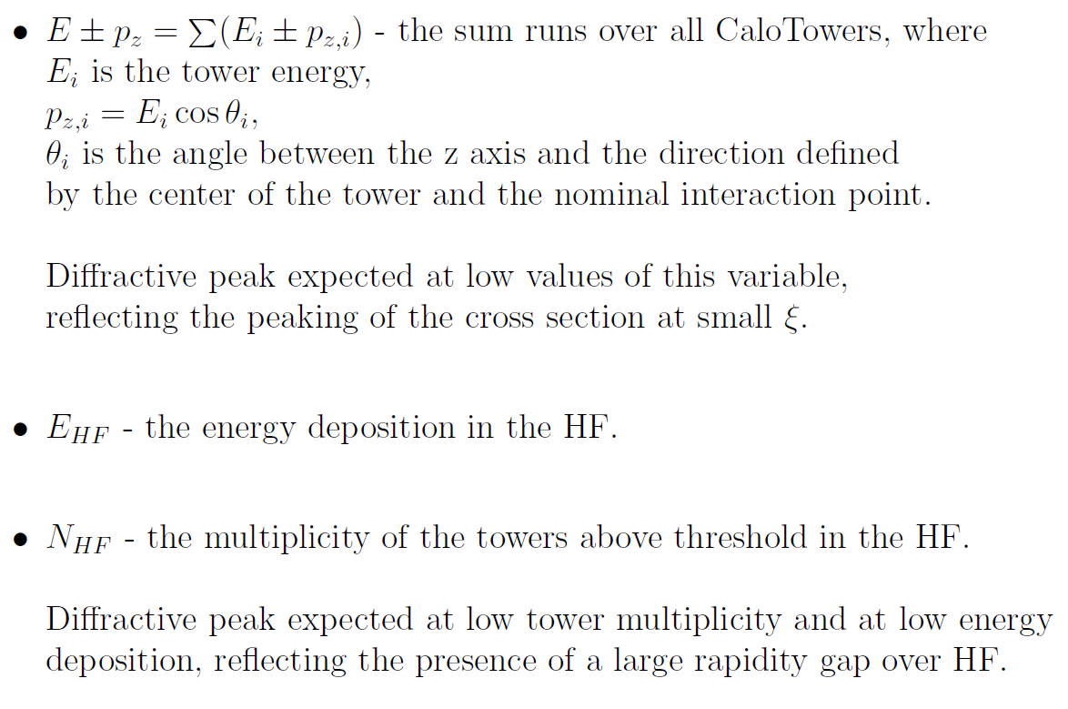
Result: definition of variables
The selected events are plotted as a function of:
Notes:
1. Energy and longitudinal momentum
conservation can be used to show that this variable approximately equals twice the
Pomeron energy; the plus (minus) sign applies to the case in which the proton emitting
the Pomeron moves in the +z (−z) direction. Diffractive events cluster at very
small values of E± pz, reflecting the peaking of the cross section at small x. Since it is
not possible, on an event-by-event basis, to determine which is the proton emitting
the Pomeron, the distributions from the data contain an admixture of ”wrong-sign”
events for which the proportionality between x and E ± pz does not hold.
2. Here diffractive events appear as a peak in the
zero-energy bin of either the HF at forward rapidities (HF+) or the HF at negative
rapidities (HF−), reflecting the presence of a large rapidity gap extending over HF+
or HF−.
3. Diffractive events cluster at zero multiplicities, also reflecting the presence of a
large rapidity gap over HF.

Slide 39
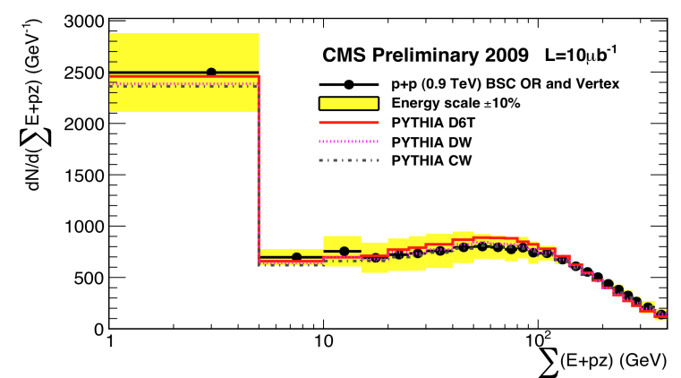
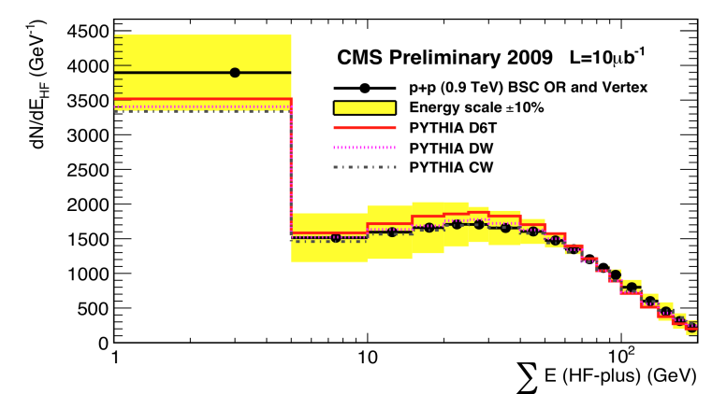
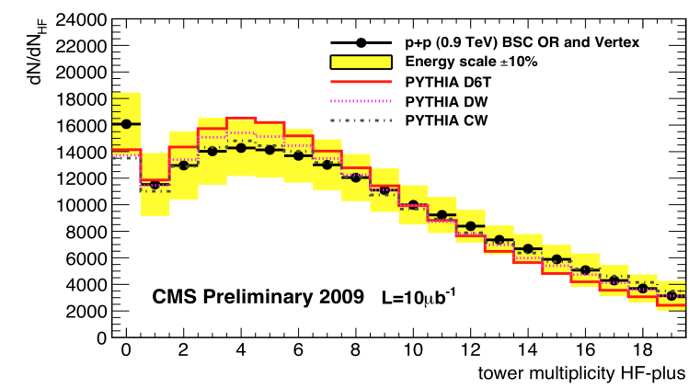
Comparison with different PYTHIA tunes: D6T, DW, CW
900 GeV
PYTHIA tunes D6T, DW and CW900A
give similar overall description
Notes:
Using our data we test 3 PYTHIA tunes for MPI.
So called D6T, DW and CW.
In Pythia perturbative 2 to 2 partonic cs is described by
Introduction of pt0 cut. This cut regularizes amount of MPI.
Larger MPI activity correspondes for smaller values of pt0.
Pto is parametrizied by the following equation with 3 parameters.
Different tunes correspond to different parameters.
We tested all 3 tunes and can conclude that can not distinguish between
them. All tunes give similar overall description.
==================from PYTHIA
Here each of the beam particles contains a multitude of partons, and so the
probability for several interactions in one and the same event need not be negligible.
In principle these additional interactions could arise because one single parton from one
beam scatters against several different partons from the other beam, or because several
partons from each beam take part in separate 2 ! 2 scatterings. Both are expected, but
combinatorics should favour the latter, which is the mechanism considered in Pythia.
The dominant 2 ! 2 QCD cross sections are divergent for p? ! 0, and drop rapidly
for larger p?. Probably the lowest-order perturbative cross sections will be regularized
at small p? by colour coherence effects: an exchanged gluon of small p? has a large
transverse wave function and can therefore not resolve the individual colour charges of
the two incoming hadrons; it will only couple to an average colour charge that vanishes
in the limit p? ! 0. In the program, some effective p?min scale is therefore introduced,
below which the perturbative cross section is either assumed completely vanishing or at
least strongly damped. Phenomenologically, p?min comes out to be a number of the order
of 1.5–2.5 GeV, with some energy dependence.

Slide 40
BACKUP FWD-10-002

Slide 41
FWD Jets

Slide 42
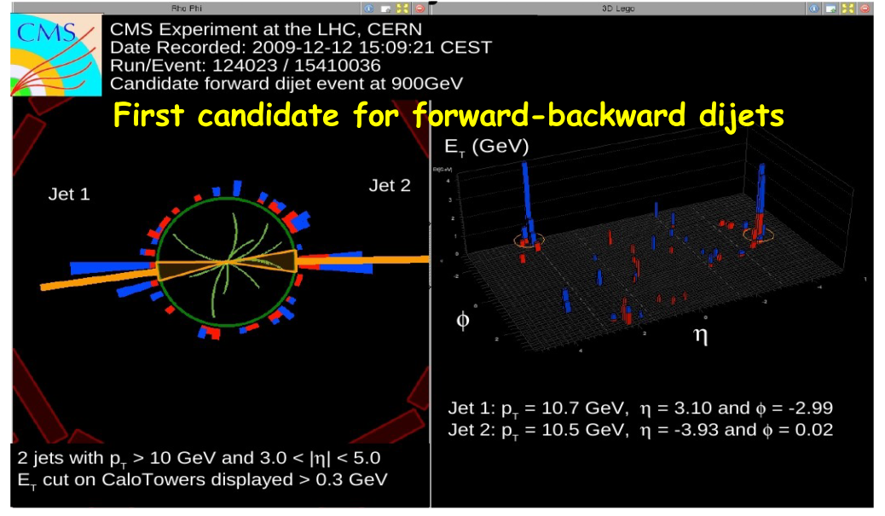
Forward Jets in CMS
7/22/10
P.Bartalini - ICHEP 2010
42

Slide 43

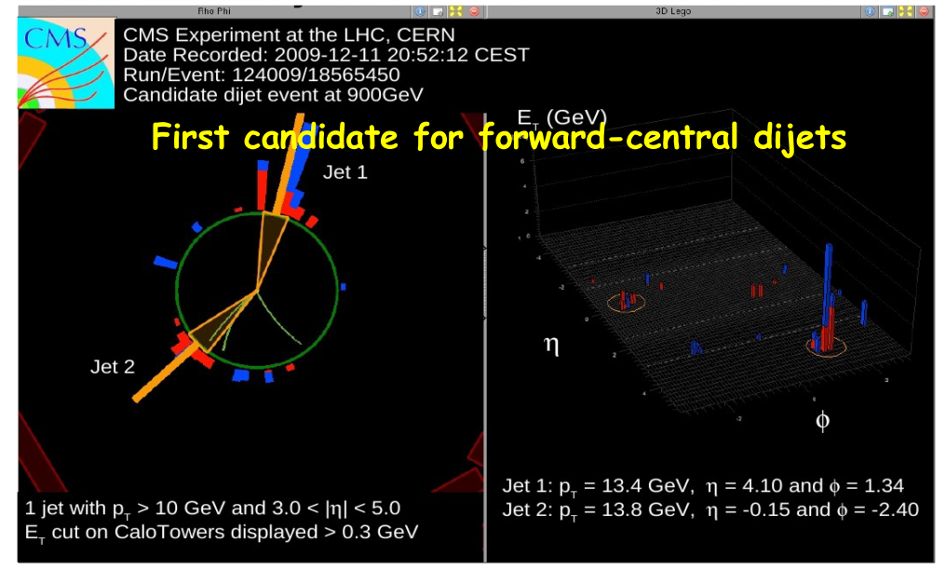
First Forward Jets from CMS
18
7/22/10
P.Bartalini - ICHEP 2010
43

