Slide 1
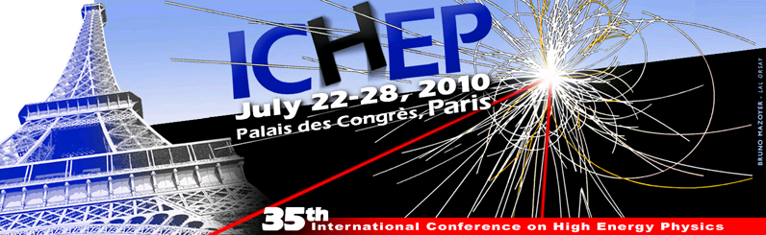
Present Limits and Future Prospects for Dielectric Acceleration
Eric R. Colby*
SLAC
Advanced Accelerator Research Department
Prepared with generous assistance from:
The E163 Collaboration The FACET Collaboration Wei Gai, ANL Jay Hirshfield, Yale Jamie Rosenzweig, UCLA Levi Schächter, IIT Gennady Shvets, UT-Austin Ben Cowan, Tech-X
* ecolby@slac.stanford.edu
Preparation of this work supported by DOE funding grants DE-AC02-76SF00515 (SLAC) and DE-FG06-97ER41276

Slide 2
Overview
What is meant by “dielectric acceleration” and why is it worth pursuing?
Current work on dielectric-based accelerator concepts at microwave, terahertz, and optical frequencies
Outline e⁺e⁻ collider configurations and parameters
Discuss limitations and open questions
Future Prospects

Slide 3
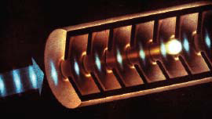
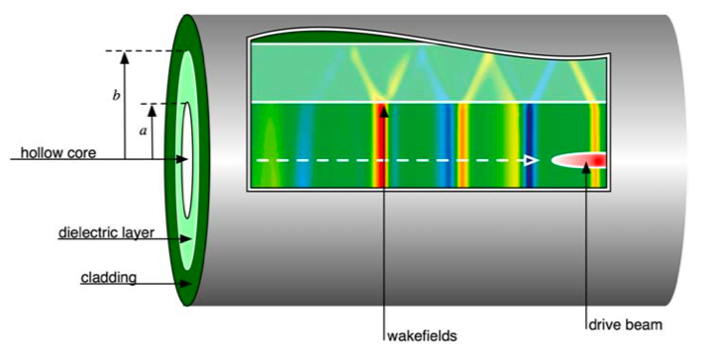
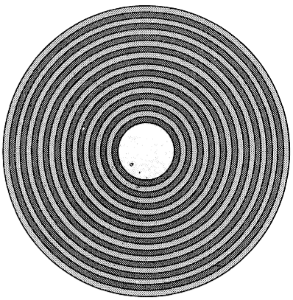
What is dielectric acceleration?
Conventional (conducting) case:
  EM wave guiding is enforced by outside metal wall
  Phase velocity synchronism is enforced by periodic loading (metal irises)
  Tend to be high-Q resonators requiring long low-power pulses
  Limited (at present) to ~150 MV/m (short structures)
Dielectric case:
  Guiding is by either metal wall or Bragg reflector
  Synchronism is enforced by manipulating the effective index
  Tend to be low-Q structures requiring short high-power pulses
  Potentially capable of sustaining >1 GV/m gradients
Conventional Iris-Loaded Structure
Dielectric-Lined Waveguide
Bragg Waveguide

Slide 4
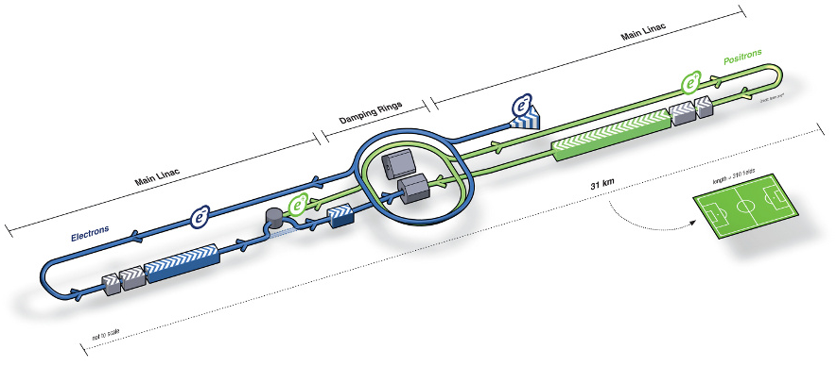
Motivation
31 km
The International Linear Collider
31.5 MV/m – the ILC design gradient (superconducting)
150 MV/m – maximum achieved in a metallic structure (75 years)
~1,000 MV/m – gradient expectation for dielectric acceleration
13,800 MV/m – maximum achieved in a dielectric structure (25 years)
~10,000 MV/m – gradient expectation for high-quality plasma acceleration
50,000 MV/m –maximum gradient achieved in plasma over ~1 meter
>200,000 MV/m—maximum gradient achieved in plasma over ~1 mm
Marx panel (a HEPAP subpanel) recommendation -- July 2006
“A major challenge for the accelerator science community is to identify and develop new concepts for future energy frontier accelerators that will be able to provide the exploration tools needed for HEP within a feasible cost to society. The future of accelerator-based HEP will be limited unless new ideas and new accelerator directions are developed to address the demands of beam energy and luminosity and consequently the management of beam power, energy recovery, accelerator power, size, and cost.”

Slide 5
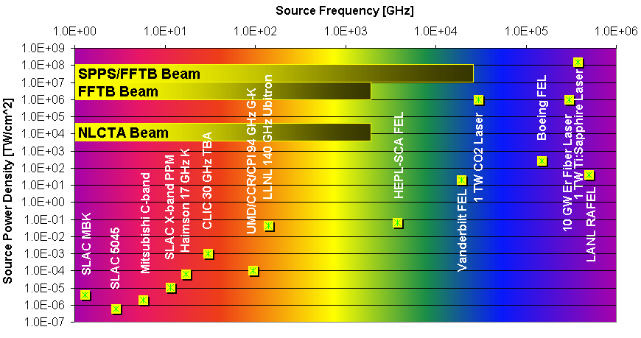
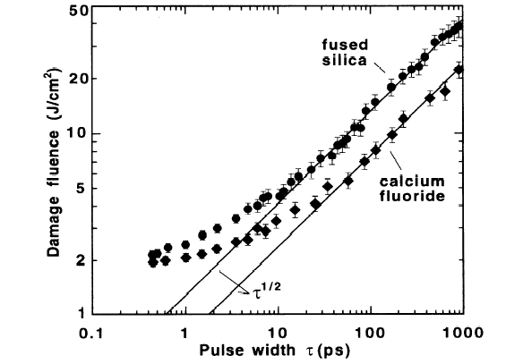
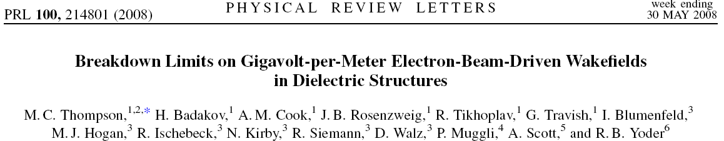
Dielectric Breakdown Resistance
P/λ ²
Dielectric Damage Threshold
1053nm
2 J/cm² @ 1 ps
⬄>2 GV/m
30cm 3cm 3mm 300μ 30μ 3μ 300nm
Source Wavelength
λ
B. C. Stuart, et al, Phys. Rev. Lett., 74, p.2248ff, (1995).
Fused silica, THz range, ~psec exposure

Slide 6
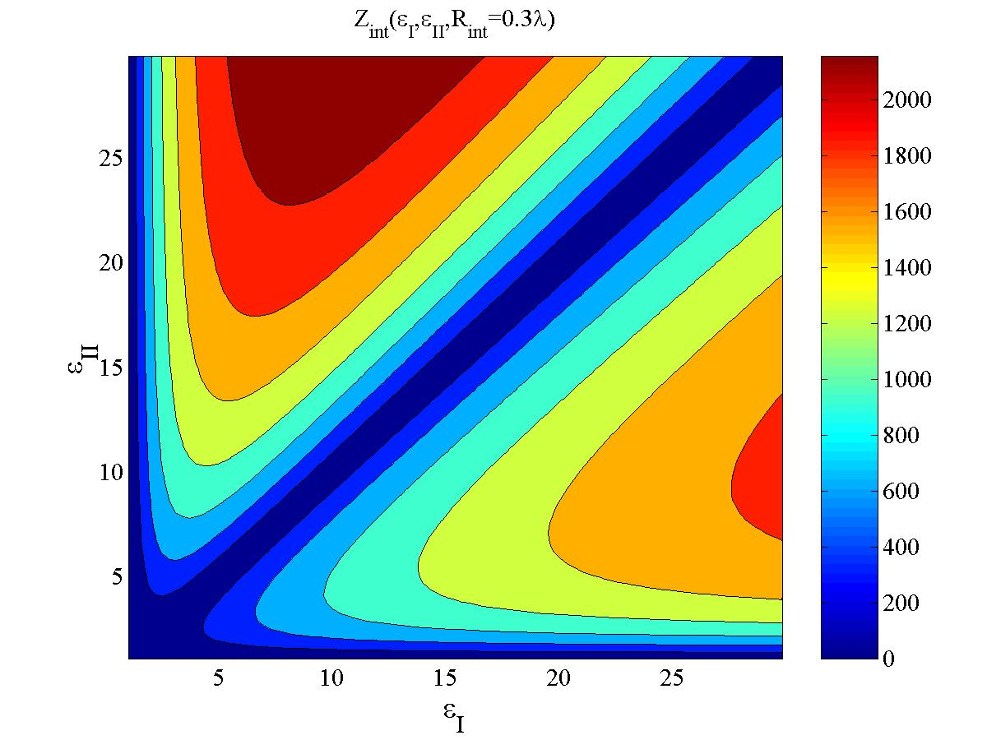
Narrowband boundary conditions can be designed to mitigate instabilities—Bragg Fiber
With the exception of the first (matching) layer, each layer:
Interaction impedance peaks for large contrast. Optimal materials.
Harness developments in the communication and semiconductor industry: e.g. solid state laser wall-plug to light efficiency.
At optical wavelengths, dielectrics sustain higher electric fields than metals and have smaller loss.
A. Mizrahi and L. Schächter, Optical Bragg Accelerator, Phys. Rev. E, 70, 016505 (2004).

Slide 7
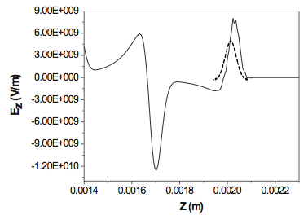
Driving a Dielectric Wakefield Accelerator
(Common to both Microwave and Terahertz cases)
Electron bunch (β ≈ 1) drives Cerenkov wake in cylindrical dielectric structure
  Dependent on structure properties
  Multimode excitation
  Can be resonantly driven by a pulse train
Wakefields accelerate trailing bunch
*
Mode wavelengths (quasi-optical)
Design Parameters
Peak decelerating field
Extremely good
beam needed
E_{z} on-axis
(OOPIC)
Transformer ratio (unshaped beam)
J. Rosenzweig, UCLA.

Slide 8
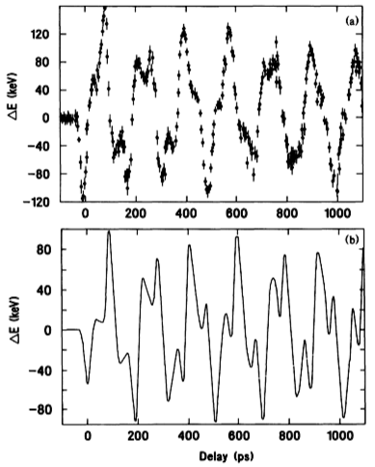

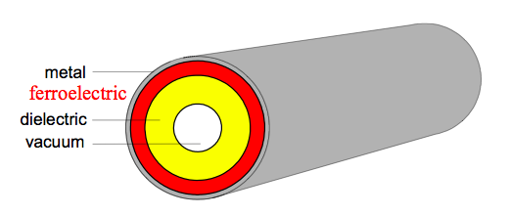
Progress Developing Microwave
Two-Beam Structures
ΔE vs. witness delay
Proof-of-principle experiments
(H. Figueroa, et al, PRL, 60, 2144–2147 (1988))
  ANL AATF
Mode superposition
(J. Power, et al. and S. Shchelkunov, et al.)
  ANL AWA, BNL
Transformer ratio improvement
(J. Power, et al.)
  Beam shaping
Tunable permittivity structures
  For external feeding
(A. Kanareykin, et al.)
Tunable permittivity
Demonstrated gradients limited to <100 MV/m by available drive beams
The FACET facility will enable significant extension of results in both gradient and frequency

Slide 9
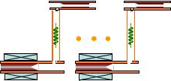
High-Gradient DWA Accelerator Module
T_{rf}=28ns
Competitive rf-beam efficiency for the short pulse TBA
3ns
3ns
3GeV module (15m)
(38 DWPE & 38 DLA→ fill factor=76%)
T_{beam}=16ns=416rf cycles →4160bunches (Q_{total}=2080nC), 1bunch/2 rf periods, 0.5nC/bunch
T_{f}=9ns
1.33GW output/Dielectric PETS; 5% rf transportation loss; E_{load} =267MV/m (I_{b}=6.5A);
 | AWA Short Pulse (1.5TeV,e+)
Average drive beam current | 80 mA
Average drive beam power | 68.8 MW
Average rf power to main linac | 60MW
Average main beam current | 10.4 uA
Average main beam power | 15.6 MW
Drive beam becomes 80MeV, main beam gain 3GeV
W. Gai, ANL.

Slide 10
ANL 26GHz 3TeV Dielectric-based Short Pulse Two Beam Linear Collider (conceptual layout of one side of a 3TeV e⁺e⁻ collider)
150 GeV stage #1
100us
150 GeV stage #10
5us
16ns
3 GeV module #1
3 GeV module #2
3 GeV module #50
main beam structure (100us consists of 20 beam pulses, 6.5A inside the pulse)
0.86GeV drive beam
1.5TeV
24ns
100ns
Beam pulse #
2
50
1
51
52
100
1.3GHz rf
photons
951
952
1000
Drive beam structure (one 100us macro pulse consists of 1000 beam pulses, 65A inside the pulse)
W. Gai, ANL.

Slide 11
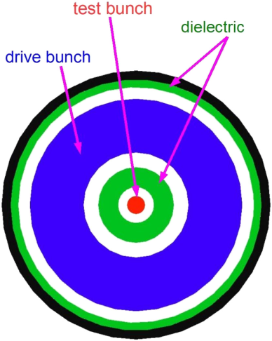
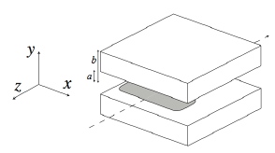
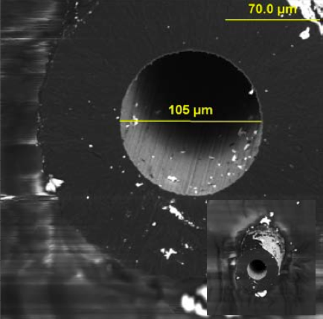
DWA Variations
Coaxial two-beam DWA
  High transformer ratios (~10!)
  Sotnikov, et al, PRST-AB, 12, 061302 (2009).
Terahertz Structures
  Collinear DWA
    Scaled to λ~300μm
  Slab structure collinear DWA
    Suppressed transverse wakes
    Reduced gradient, but larger bunch charge
    A. Tremaine, et al, Phys. Rev. E, 56, 7204 (1997)
  Other Materials
    CVD Diamond (doped for low SEY)
      Euclid Techlabs LLC
    Silicon, GaAs
CVD deposited diamond

Slide 12
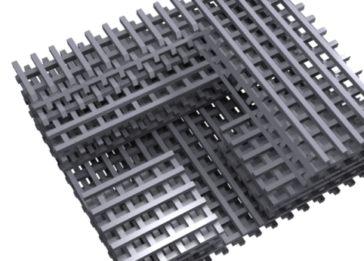
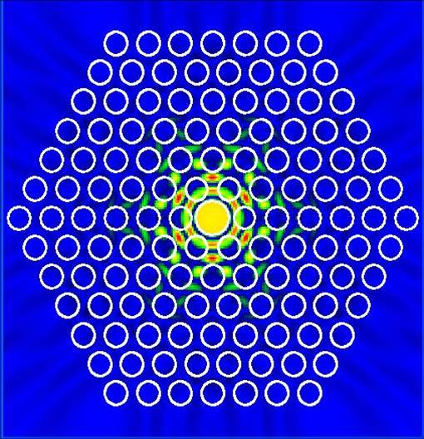
Laser-Driven Dielectric Accelerators
Structure Candidates for High-Gradient Accelerators
Projected maximum gradients based on measured material damage threshold data
Photonic Crystal Fiber
Silica, λ=1890 nm, E_{z}=400 MV/m
beam
Input waveguide
Photonic Crystal “Woodpile”
Silicon, λ=2200nm, E_{z}=400 MV/m
Transmission Grating Structure
Silica, λ=800nm, E_{z}=830 MV/m
B. Cowan, et al, PRST-AB, 11, 011301 (2008).
X. Lin, PRST-AB, 4, 051301 (2001).
T. Plettner, et al, PRST-AB, 9, 111301 (2006).
Wave Guiding Structures
Phase Mask Structure

Slide 13
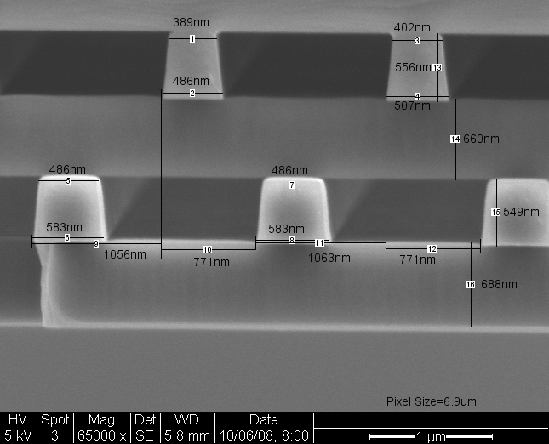
3D Photonic Crystal: Woodpile Structures in Silicon
Silicon woodpile structure produced at the Stanford Nanofabrication Facility (SNF)
Detailed Tolerance Studies of CDs
Best achieved:
Width Variation:
<40 nm RMS (~λ/125)
Layer Thickness:
<65 nm RMS (~λ/75)
Layer Alignment:
<65 nm RMS (~λ/75)
Measurement Technique Granularity: 7nm
Designed for acceleration at λ~4 μm
C. McGuinness, et al, J. Mod. Opt., 56, 18 & 19 p. 2142ff, (2009).

Slide 14
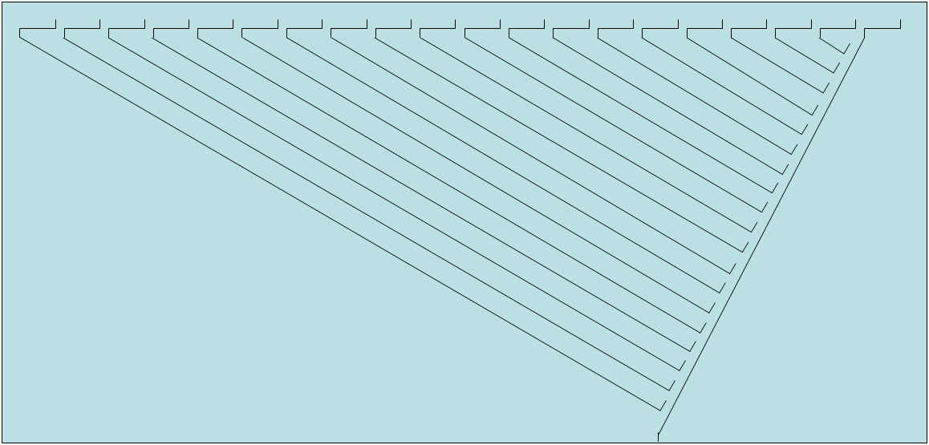
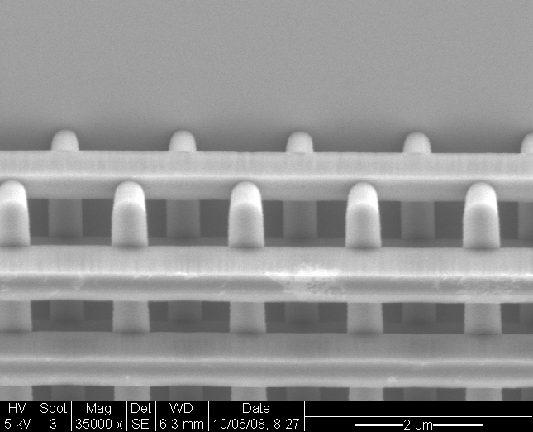
The next level of integration: A Single-Pulse 32 MeV-Gain Woodpile Accelerator Chip
(1 chip ≈ 1 ILC cavity)
input
beam
L_{eff}=2mm
beam
Distribution, delay, and mode shaping lines
~8 cm
Silicon Chip
Fiber coupled input
λ=2 μm 20 μJ/pulse 1 ps laser pulse
beam
Input waveguide
Cutaway sketch of coupler region
4-layer Structure Fabrication (completed at SNF)
Image courtesy of B. Cowan, Tech-X.
Image courtesy of C. McGuinness, Stanford.

Slide 15
Strong coupling impedance comes at a price
Strong coupling to E⊥ ➔r<γλ ; Strong coupling to E// ➔ r~λ
Structure aperture ➔ ~λ
  Terahertz: has been achieved with CVD diamond deposition and capillary drawing
  Optical: Has been achieved with semiconductor and fiber drawing technology
Optimum beam loading requires bunch charge ➔
  Terahertz: ~picoCoulombs per bunch
  Optical: ~femtoCoulombs per bunch
Beam transmission requires very small emittances ➔ ~nm
  Possible with metal tip emission sources
  Naturally leads to reduction in IP spot sizes
Narrow energy spread ➔ Bunch length ~λ/100
  Terahertz: Bunching by conventional means to ~λ/30 already achieved
  Optical: Single-stage bunching at ~410as (~λ/8) demonstrated
Beam current ~1-10 μA requires high repetition rates ➔
  Terahertz: klystron-based power sources imply low rep rate and long pulse trains
  Optical: lasers operating in the ~10-100 MHz are commercially available
BBU→Alignment tolerances ➔ ~λ/100
  Single-mode structures with no confined deflecting modes
  Terahertz: Moderately high rep rate ➔ effective position stabilization feedback
  Optical: Very high repetition rate➔ very broadband position stabilization feedback

Slide 16
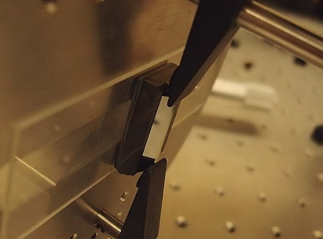
Present Status of Optical Structures
Dominant effort to date has been on designing and making structures that can support high gradient and scale to high energy (efficiently transfer power, preserve beam quality)
  Wave guiding
  Phase mask and swept-laser methods
Demonstrations of “large-aperture” but inefficient acceleration concepts (r>>λ) at λ=10 μm and 0.8 μm have been done
Facilities and accelerator techniques for working in the picosecond-micron-pC domain have matured
Research on suitable electron sources is underway
  Laser-triggered field emission sources
  Laser-triggered ferro-electric sources
Work to experimentally quantify structure limitations is underway (damage threshold, dephasing, thermal, etc.)
Image credit: Gennady Shvets, UT Austin

Slide 17
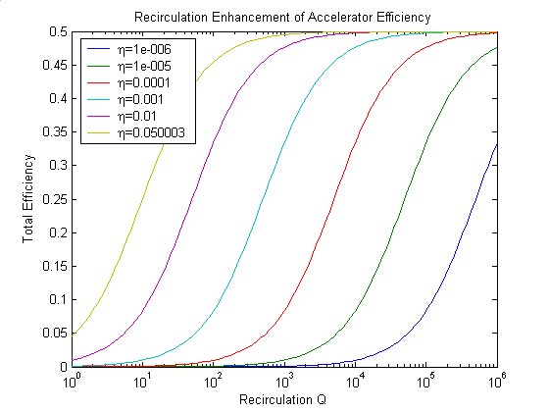
Laser-Driven Dielectric Accelerator LC Cartoon
…
CW Injector
Warm rf gun Cold Preaccelerator Optical Buncher
433 MHz x 6E03 e⁻/macropulse (145 μpulse/macropulse)
ε_{N}~10⁻¹⁰ m (but note Q/ε_{N} << 1 nC/μm)
Laser Accelerator
λ=2-4 μ, G~1 GeV/m
Photonic Band Gap Fiber structures embedded in optical resonant rings
Permanent Magnet Quads (B’~2.5 kT/m)
Resonant ring path length: λ_{rf}=23 cm
An Acceleration Unit
Laser amplifier
Optical resonator
Phase control
PBG accelerator structure
…
Optical Debuncher Final Focus I.P.

Slide 18
Strawman 3 TeV Collider Parameters
 |  | RF Source | RF Source ==> Beam Driven |  |  | Laser-Driven
 |  | "ILC" | "CLIC" | Microwave | Terahertz | Grating | Waveguide
E_cms | GeV | 3000 | 3000 | 3000 | 3000 | 3000 | 3000
Bunch Charge | e | 2.0E+10 | 3.7E+09 | 3.1E+09 | 1.1E+08 | 6.5E+03 | 3.5E+03
# bunches/train | # | 1700 | 500 | 4160 | 4160 | 145 | 145
train repetition rate | Hz | 4 | 50 | 5 | 120 | 50 MHz | 125 MHz
design wavelength | micron | 230610 | 24983 | 11530 | 300 | 4 | 2
Invariant Emittances | micron | 10/0.04 | 0.7/0.02 | 0.3/0.02 | 0.008/0.001 | 1e-04/1e-04 | 1e-04/1e-04
I. P. Spot Size | nm | 185/1.7 | 49/1.2 | 33/1.1 | 8/0.2 | 0.1/0.1 | 0.1/0.1
Enh Lumi | /cm^2/s | 1E+39 | 9E+38 | 9E+38 | 9E+38 | 1E+39 | 9E+38
Beam Power | MW | 32.7 | 22.2 | 15.6 | 13.2 | 11.3 | 15.2
Beamstrahlung Power | MW | 14.1 | 7.4 | 6.3 | 1.2 | 0.0 | 0.0
Beamstrahlung Loss | % | 43.1 | 33.4 | 40.2 | 8.9 | 0.1 | 0.3
Gradient | MV/m | 31.5 | 100 | 270 | 2000 | 1000 | 500
Linac Length | km | 95 | 30 | 11 | 2 | 3 | 6
cm
micron
For illustrative purposes only!

Slide 19
Limitations and Questions
Physics Issues
  Deflecting-mode-driven instabilities are severe, requiring small bunch charge and innovations in focusing and damping
  Two-beam short-pulse accelerators require efficient broadband mode convertors
  What process ultimately limits the achievable gradient?
Material Issues
  Degradation with high field and radiation exposure
  Charging and multipactoring
  Nonlinear polarizability and Raman scattering
  What materials have the best combination of attributes?
Particle Source Issues
  How can electron and positron sources with the required properties be made?
Power Source Issues
  Drive beam stability and power transfer structure design
  Efficient production of the drive beam
  How can compact, cost-effective drive sources be built?
Fabrication Issues
  How can the required tolerances be achieved for THz and optical structures?
  How can the required alignment tolerances be achieved?

Slide 20
Future Prospects
Dielectrics offer higher damage resistance than metals and a natural way to provide synchronism with β<1 particles
Frequency-selective boundary conditions are possible, allowing destructive HOMs to radiate out of the accelerator
Higher frequency methods will require smaller bunch charges and increased repetition rates, providing experimental advantages of reduced beamstrahlung background and event pileup
In contrast to higher-gradient plasma wakefield techniques, dielectric acceleration is linear, the structure is solid-state, and the technique is inherently more stable
High power structure and beam tests are planned or underway for microwave, terahertz, and optical technologies and clear evidence as to the suitability of each technique should be available in the next few years

