Slide 1

The LHCb trigger
Eric van Herwijnen, on behalf of the LHCb collaboration
Thursday, 22 july 2010

Slide 2
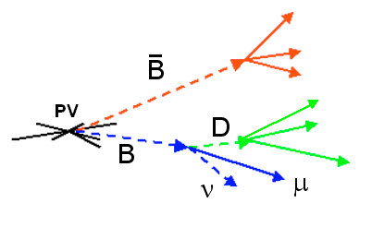
Aim of LHCb trigger
Exploit finite lifetime & large mass of charm & beauty hadrons to distinguish heavy flavour from background in inelastic pp scattering
Aim of trigger is to reject not interesting events as soon as possible
Assume LHCb design luminosity 2*10³² cm⁻²s⁻¹

Slide 3
Structure of trigger
L0 is implemented in hardware. It reduces the visible (2 tracks in detector acceptance) interaction rate to a maximum of 1 MHz (nominal rate into LHCb)
HLT is a C++ application running on an Event Filter Farm composed of several thousand CPU nodes.
40 MHz
LHC clock
~ 30 MHz
bunch Xings
<10 MHz (inelastic)
visible in LHCb
1. L0
1 MHz
Max readout
2. HLT
2 kHz written to
tape

Slide 4
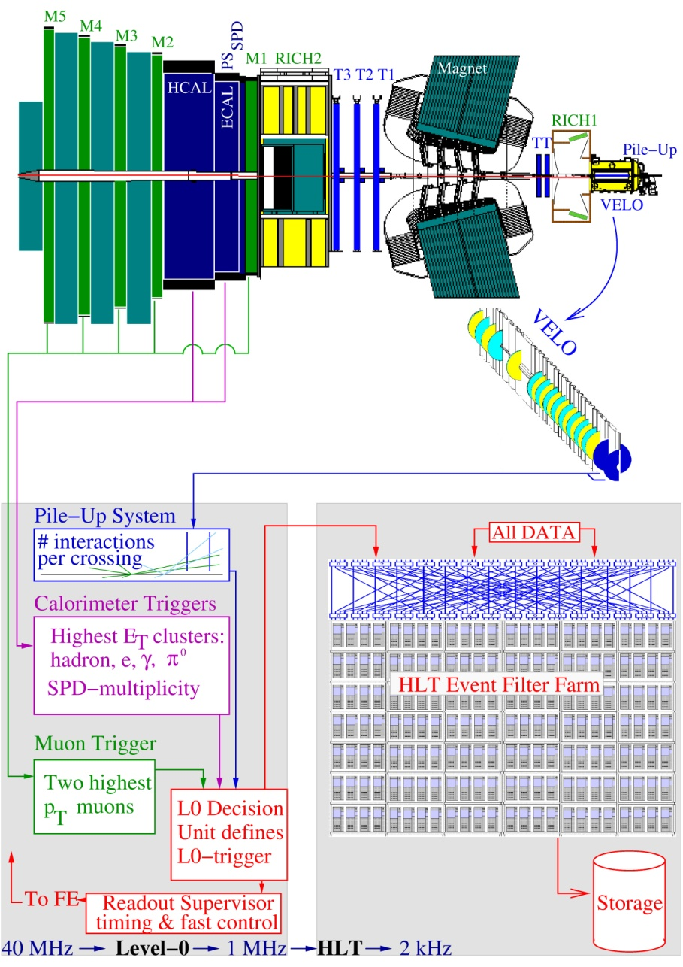
L0 trigger
Highest E_{T} ^{hadron} ≥ 3.5, E_{T} ^{e, γ, π0} ≥ 2.5 GeV clusters in Calorimeters
Highest p_{T}^{μ,} ^{μμ} ≥ 1 GeV muons, in Muon Chambers

Slide 5
HLT Trigger
detector data:
up to 1 MHz
HLT first level (HLT1):
  confirm L0 decision using tracking system
  reconstruction in region of interest
  trigger on simple signatures (pt, IP, ..)
→ increase fraction of ccbar and bbbar
HLT second level (HLT2):
  Use full detector information to produce a mixture of inclusive and exclusive channels
→ selection of interesting ccbar, bbbar and other
HLT 1
full event
reconstruction:
up to 40 kHz
HLT 2
2kHz
exclusive
inclusive

Slide 6
Commissioning
L0 used cosmics to commission; running smoothly from day 1 last year
HLT: prepare/test offline using MC and also new “unbiased” data
Inject MC and real data into EFF to test new online versions of HLT
Benchmarks:
  Configuration time
  Time per event
  HLT1 & 2 rejection rates
If all ok, put new version in production

Slide 7
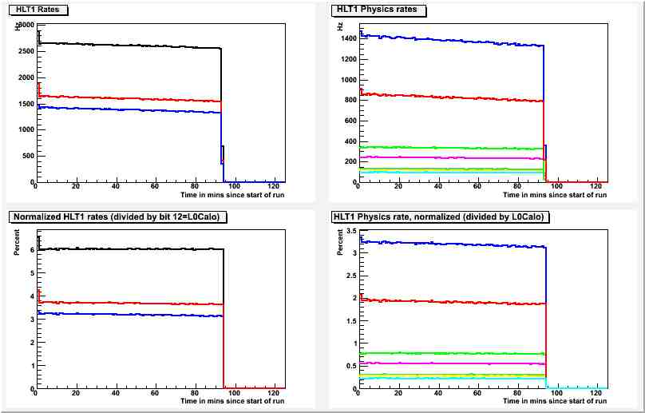
Monitoring
HLT/L0 rate trend plots, e.g.
physics
hadrons
single muon
mutrack
dimuon
photon
electron

Slide 8
Experience with early data taking
Running conditions: factor 100 lower than design luminosity
Relaxed cuts for efficiency, maximizing charm while exploiting 2kHz output rate
However, increased luminosity per bunch due to lower β* (3.5 m instead of 10 m) means we have a higher average number of pp interactions per visible event (1.5 instead of 1.2, but we even saw 2.3)
CPU increases dramatically

Slide 9
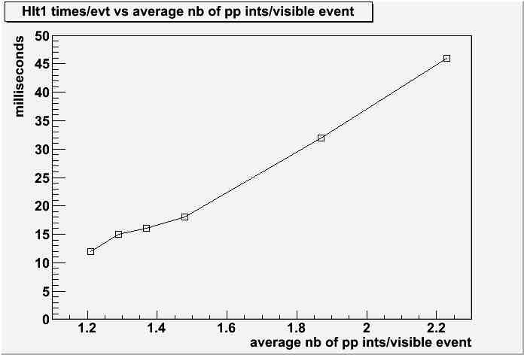
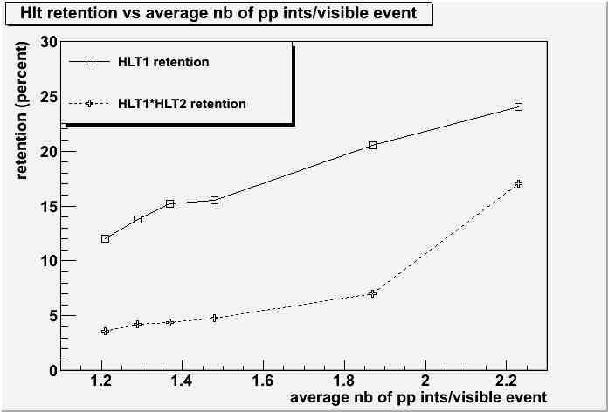
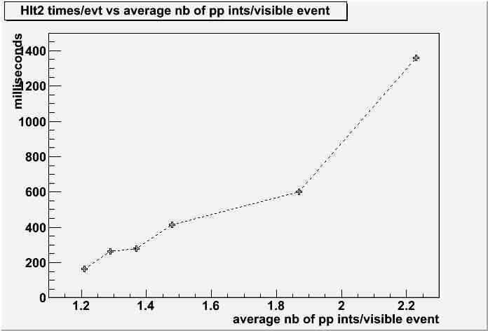
HLT1 & 2 times/evt and retention rates
nominal running conditions with relaxed cuts

Slide 10
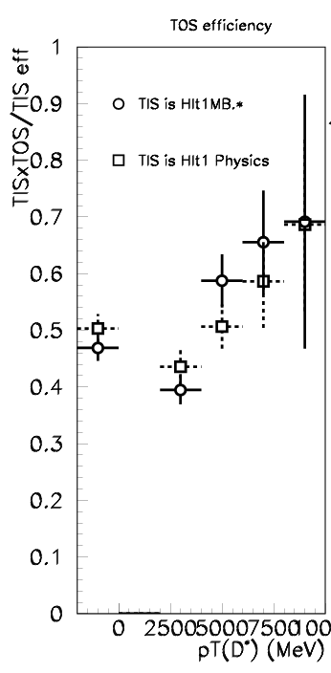
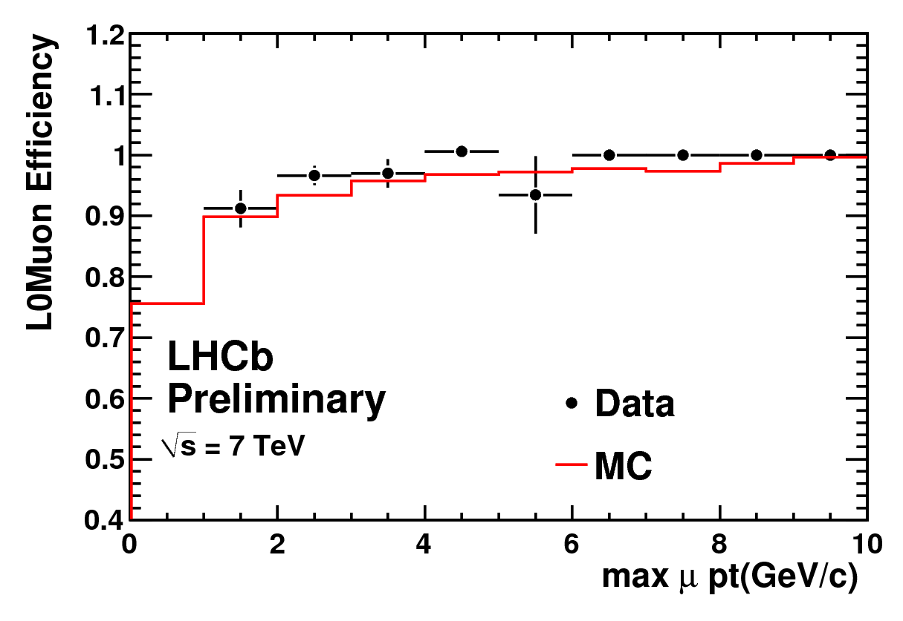
Trigger performance
L0 Muon trigger efficiency to select J/ Ψ events as a function of
p_{T} of the muon coming from J/Ψ
HLT efficiency in D^{*+} p_{t}
LHCb
Preliminary
√s=7 TeV

Slide 11
Conclusions
The full trigger is operational in the experiment
Efficiencies are as expected
At low luminosity we are running with much relaxed thresholds, and quickly adapting to more challenging than nominal conditions
  higher average # of pp ints/visible event

Slide 12
Backup slides

Slide 13
Trigger Configuration Key (TCK)
Allows selecting and keeping track of trigger conditions of data
A running HLT job can change to a new TCK (in the same family) on the fly (“fast run change”)
Can follow luminosity evolution, lower thresholds without reloading code in the Event Filter Farm

Slide 14
Operational constraints
Storage:
  Nominal design conditions (ave pp ints/vis xing = 1.2)
  L0 accept rate: 1 MHz. Evt size: 35 kb. HLT accept rate: 2 kHz. Thru-put to storage: 70 MB/s.
  Now (13/7/2010) higher pileup makes events bigger:
  For 12b_8_8_8 bunches, L0 rate: 53 kHz, ave pp ints/vis xing 1.5. HLT rate 1.9 kHz, evt size 52 kb, thru-put to storage: 100 MB/s.
  Theoretical limit: 500 MB/s
CPU:
  L0 rate 60 kHz: current (=1/5 of final) farm can handle 73 ms/evt. With current ave pp ints/vis xing (1.5, 50 kHz) : 45 msec/evt.
  CPU usage increases exponentially with higher pileup and L0 rate
  Complete (increase factor 5 in power) planned for november

