Slide 1
Optimization algorithms for PyHEADTAIL Multibunch simulations
J. Komppula
Acknowledgements:
K. Li

Slide 2
Outline
Background
Wake algorithms
Benchmarking
Performance
Applications

Slide 3
Background
Motivation: FCC-hh transverse feedback studies
Significant code development needed:
April 2016
Beta version of the FB module (single bunch, distributed systems)
September 2016
1st stable version of the FB module
December 2016
1st multibunch version of the FB module
New algorithms
∝ N_{tot} log N_{tot}
May 2017
Wakes optimized for 1000 bunches
July 2017
Full beam wakes
(10 000 bunches)
May 2017
Point bunch code for
CBI damping
Wake calculations ∝ Nbunches²
October 2017
Tracking optimized
for full beams
November 2017
Parallelization for hundreds of cores
March 2018
Multi location wakes,
more benchmarking

Slide 4
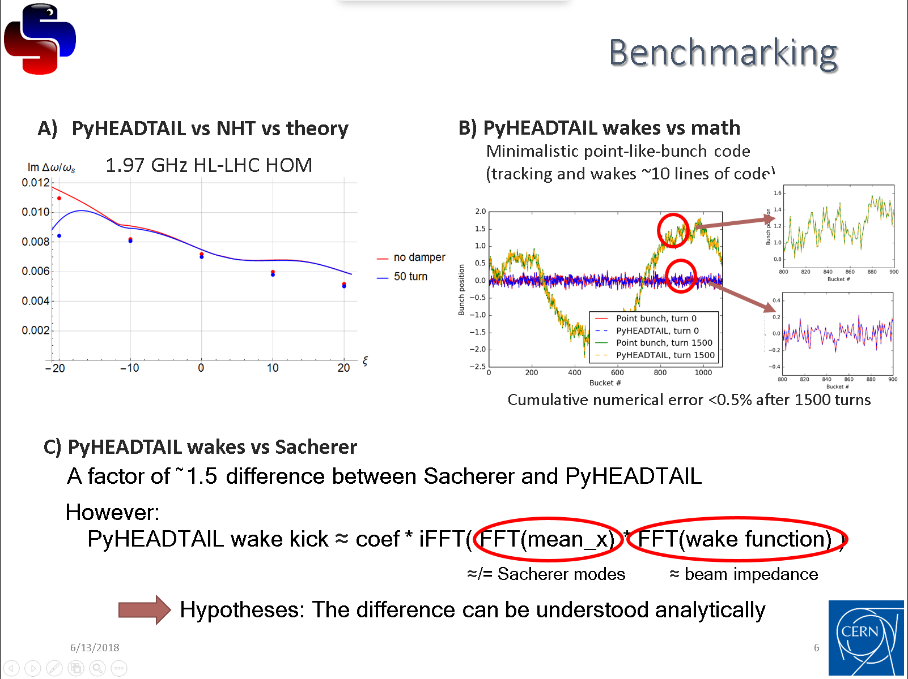


Background
PyHEADTAIL meeting #16
Challenge arose from the unclear picture, which of the results from different theories/codes is correct and what are tolerable deviations.
I tried my best, the approach was valid,
but there was still a problem:
$FFT(W\left(z\right)$)
should have been
${FFT(W\left(z\right)∗e}^{−i∗\left(Q_{x}\% 1\right)∗z/C}$)
Because of the different ways to implement multibunch wakes, it wasn’t even clear to me if the original implementation was fully correct (but it is!).
In order to avoid this in future, I’ll explain why.

Slide 5
PyHEADTAIL tracking, single bunch
There are two ways to think tracking
1) Bunch goes physically through all the one turn map elements
Transverse
tracking
Wakes
Longitudinal
tracking
What is the difference?
There is no difference
Transverse
feedback
Synchrotron
radiation
2) One turn map elements operate the bunch object on each turn
Transverse
tracking
Wakes
Longitudinal
tracking
Transverse
feedback
Synchrotron
radiation

Slide 6
PyHEADTAIL tracking, beam
There are two ways to think tracking
1) Bunches go physically through all the one turn map elements
Transverse
tracking
Wakes
Longitudinal
tracking
Transverse
feedback
Synchrotron
radiation
2) One turn map elements operate the beam object on each turn
Transverse
tracking
Wakes
Longitudinal
tracking
Transverse
feedback
Synchrotron
radiation

Slide 7
PyHEADTAIL tracking, beam
There are two ways to think tracking
1) Bunches go physically through all the one turn map elements (linear convolution wakes)
Transverse
tracking
What is the difference?
The only difference is the wake implementation!
Wakes
Longitudinal
tracking
Transverse
feedback
Synchrotron
radiation
Linear convolution wakes allow proper beam passing through the elements
Circular convolution wakes allow more flexible bunch interactions, but beam is handled as a circular object.
Because of the (wake) causality in z-direction,
bunches can be tracked as a compressed train (no low beta multibunch wakes!).
2) One turn map elements operate the beam object on each turn (circular convolution wakes)
Transverse
tracking
Wakes
Longitudinal
tracking
Transverse
feedback
Synchrotron
radiation

Slide 8
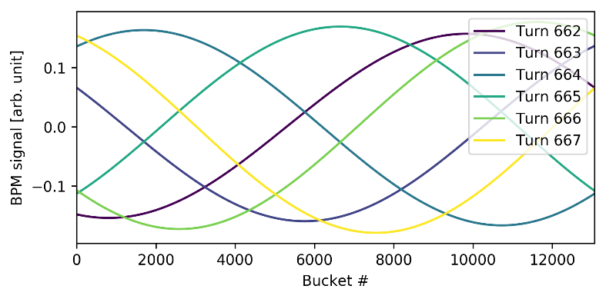
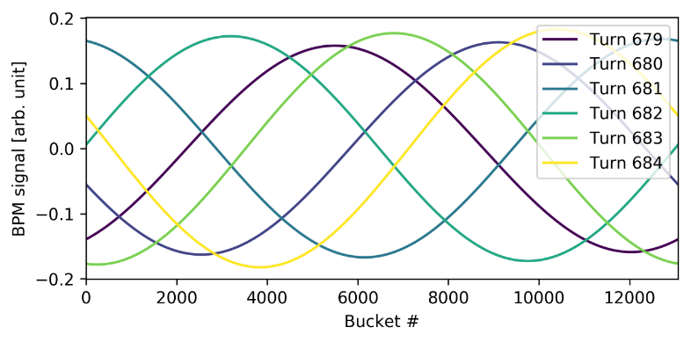
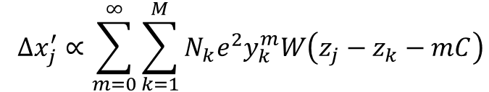

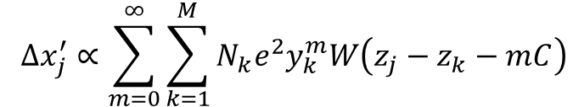

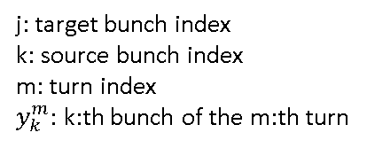

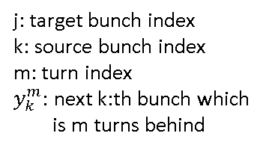
What is the difference between tracking?
Linear convolution wakes
Circular convolution wakes
$$Δx_{j}^{′}∝\sum_{m=0}^{∞}{\sum_{k=1}^{M}{N_{k}e^{2}y_{k}^{m}W\left(z_{j}−z_{k}−mC\right)}}$$
$$Δx_{j}^{′}∝\sum_{m=0}^{∞}{\sum_{k=1}^{M}{N_{k}e^{2}y_{k}^{m}W\left(z_{j}−z_{k}−mC\right)}}$$
Wake kick:
j: target bunch index
k: source bunch index
m: turn index
$y_{k}^{m}:$ next k:th bunch which
is m turns behind
$${∙e}^{−i(Q mod 1)\frac{z_{j}−z_{k}}{C}}$$
j: target bunch index
k: source bunch index
m: turn index
$y_{k}^{m}:$ k:th bunch of the m:th turn
Transformation between
the reference frames
Beam position monitor signal,
convenient for the wakes kicks
Snapshot picture of a beam,
convenient for the CBI modes
Reference frame:
Coupled bunch
mode wavelength:
$$\frac{circumference}{m+Q}$$
$$\frac{circumference}{m}$$
Turn by turn data
(mode -1):

Slide 9
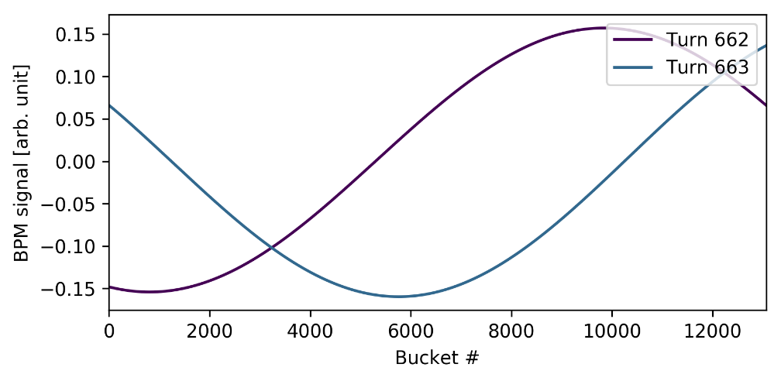
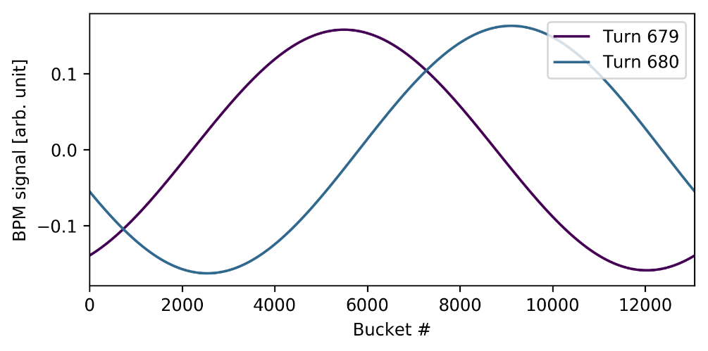



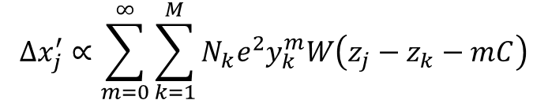
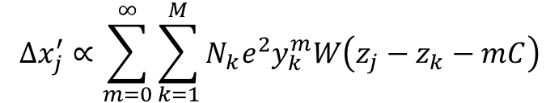
Where is the correction term coming from?
Code for transverse tracking is same for both convolutions
Only difference is the definition of the index
  The reference frame differences arise self consistently from the properties of the convolutions
  Linear convolution: turn by turn tracking of independent bunches, BPM monitor reference frame
  Circular convolution: turn by turn tracking of the entire beam, as a snapshot photo without betatron motion
$$y_{k}^{m}$$
Linear convolution wakes
Circular convolution wakes
$$Δx_{j}^{′}∝\sum_{m=0}^{∞}{\sum_{k=1}^{M}{N_{k}e^{2}y_{k}^{m}W\left(z_{j}−z_{k}−mC\right)}}$$
$$Δx_{j}^{′}∝\sum_{m=0}^{∞}{\sum_{k=1}^{M}{N_{k}e^{2}y_{k}^{m}W\left(z_{j}−z_{k}−mC\right)}}$$
$${∙e}^{−i(Q mod 1)\frac{z_{j}−z_{k}}{C}}$$
Discrete betatron transition between the turns
-> smooth betatron motion with
No discrete transitions in the beam between the turns
$$e^{−i(Q mod 1)\frac{z_{j}−z_{k}}{C}}$$

Slide 10
Positive outcomes from the journey with the circular wakes
Naturally led to explore circular convolution for the PyHEADTAIL wake kick computations -> all the optimizations
Leads naturally to complementary theory to the Sacherer approach can be used when only wake field is at hand
Allows treatment of wakefields which extend far ahead of bunches
Automatically comes with complementary numerical implementation which can be used for benchmarking, cross checking, etc
Faster algorithm

Slide 11
Outline
Background
Wake algorithms
Benchmarking
Performance
Applications

Slide 12
PyHEADTAIL wake algorithms
There are several different multibunch wake algorithms in PyHEADTAIL
  Differences in the algorithms do not change the results!
  Only difference is the reference framebetween the linear and circular convolution wakes
Linear convolution wakes:
  mpi=True
    The original algorithm
  mpi=“memory_optimized”
    Wake kicks are calculated for each tracked bunch
    Optimized for a few bunches, (up to 150-250 bunches with the LHC)
  mpi=“linear_full_ring_fft”
    Wake kicks are calculated for each bucket, even if empty, which allows “compressed convolution”
    Allows efficient use of the FFT convolution
    -> faster when filling factor >5-10%
Circular convolution wakes:
  mpi=“circular_full_ring_fft”
    Wake kicks are calculated for each bucket, even if empty
    Allows efficient use of the FFT convolution
    In theory 2x faster than “linear_full_ring_fft” because the FFT convolution is naturally circular
I’ll focus
on this
See more details from Nicolas’ presentation

Slide 13
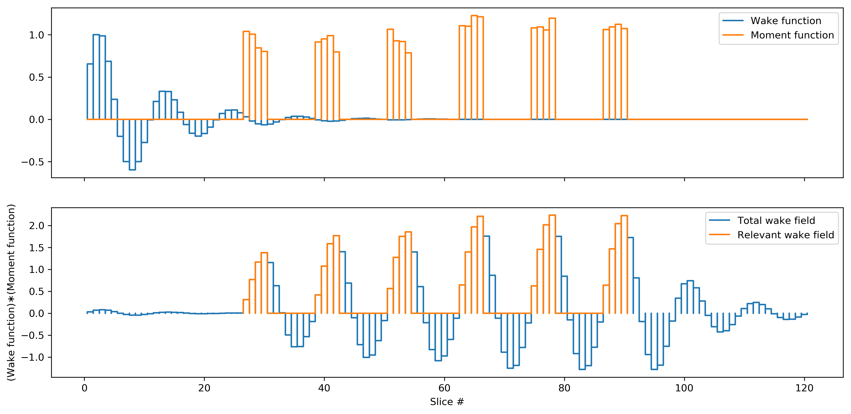
How compressed convolution works?
Full convolution between wake function and bunches without optimization

Slide 14
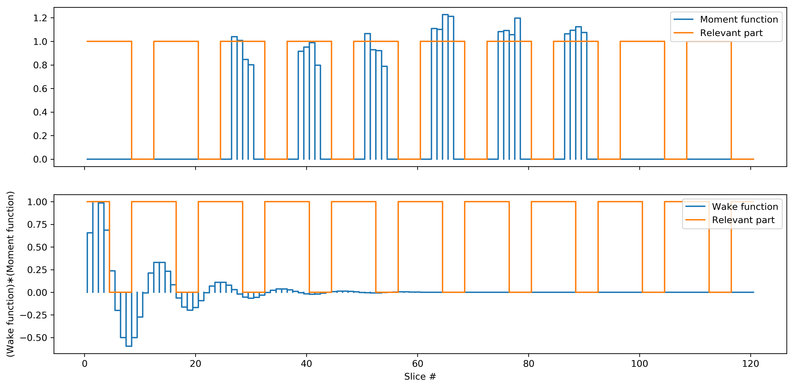
How compressed convolution works?
1) Pick relevant periodic data from the moments and the wake function
These parts can be removed

Slide 15
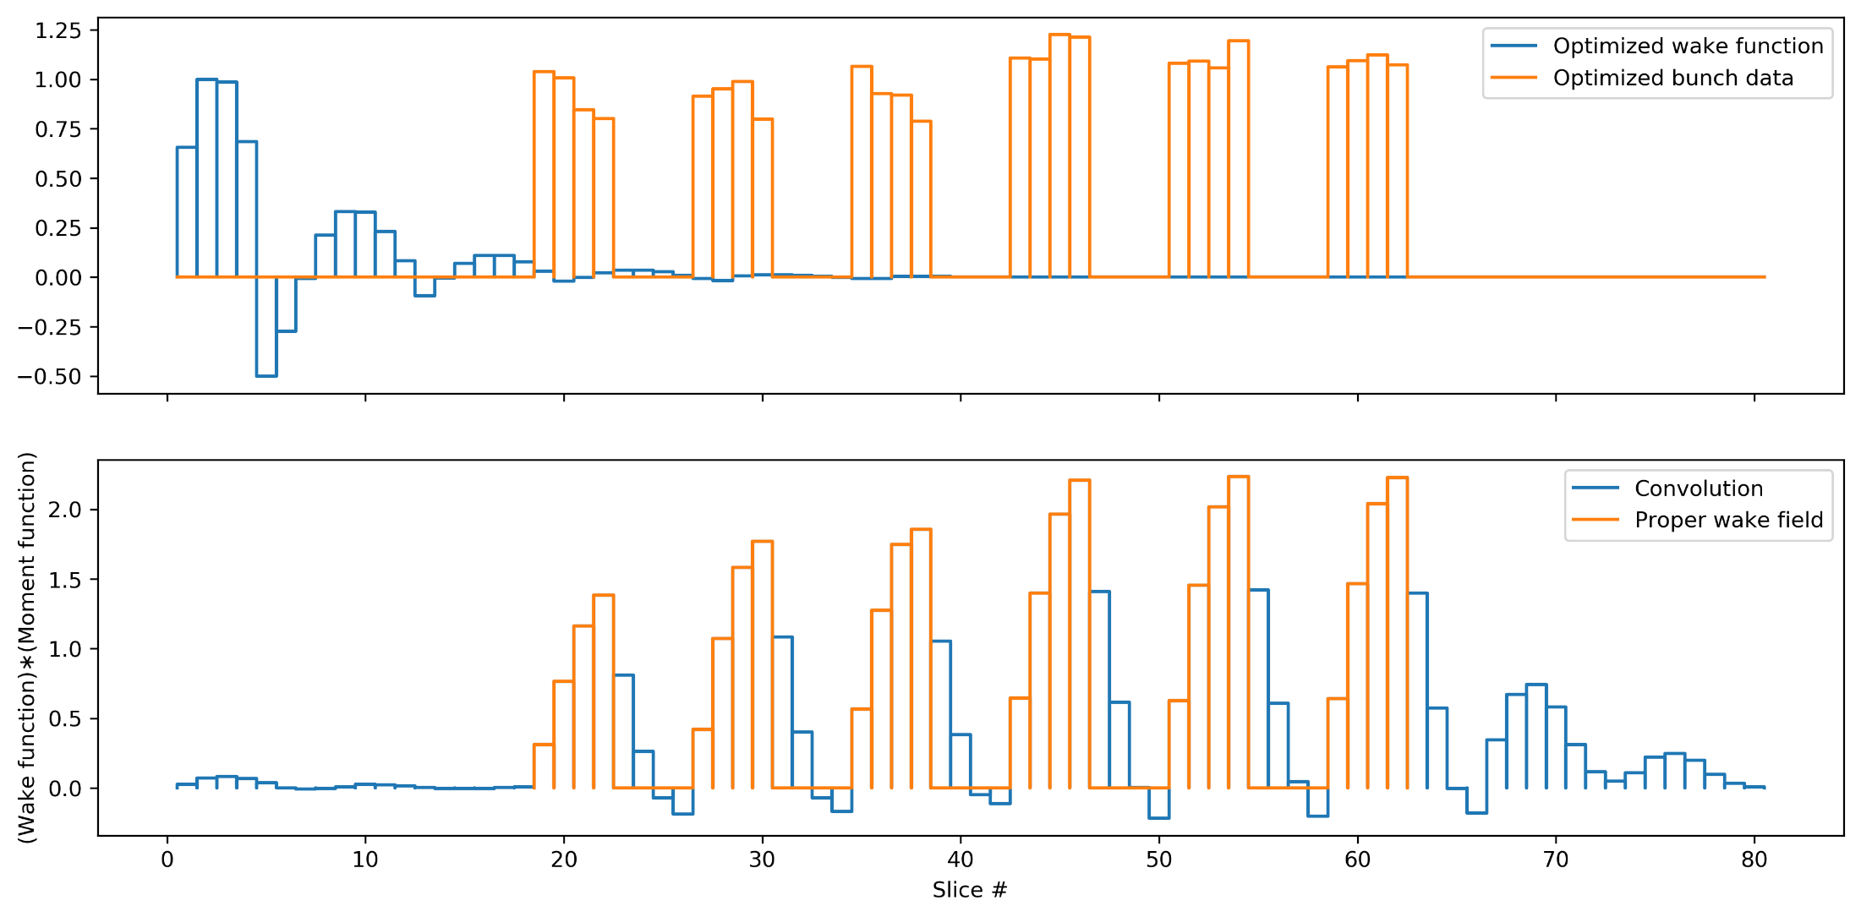
How compressed convolution works?
2) Compress data and calculate convolution

Slide 16
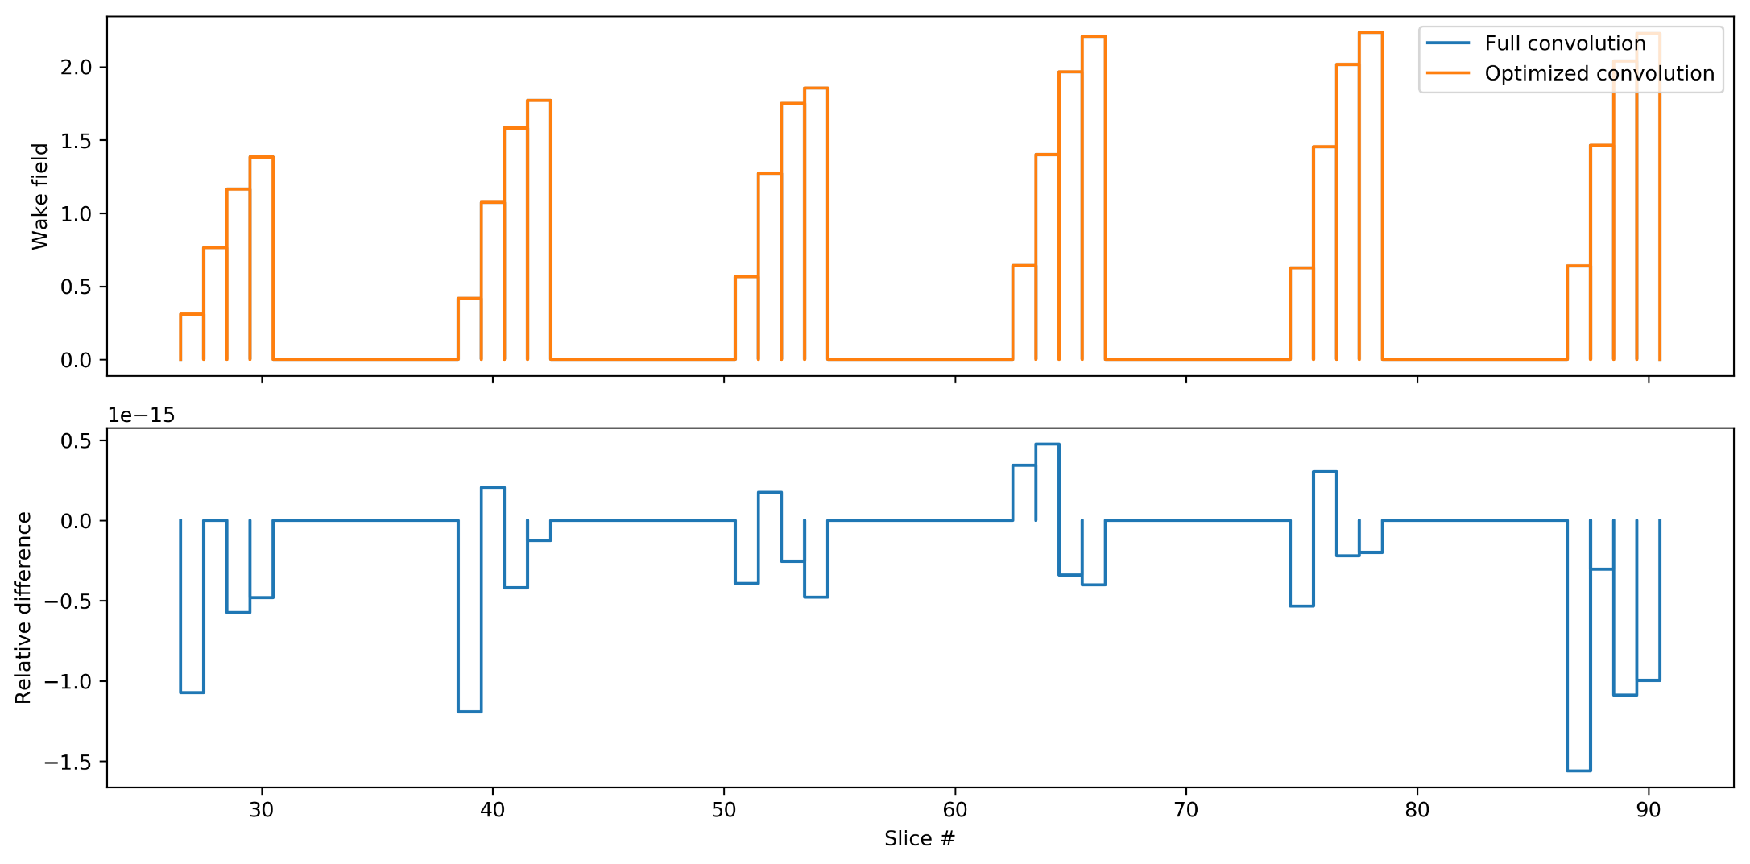
How compressed convolution works?
The results from the full convolution and the compressed convolution are exactly same
See more detailes from the Nicolas’ presentation

Slide 17
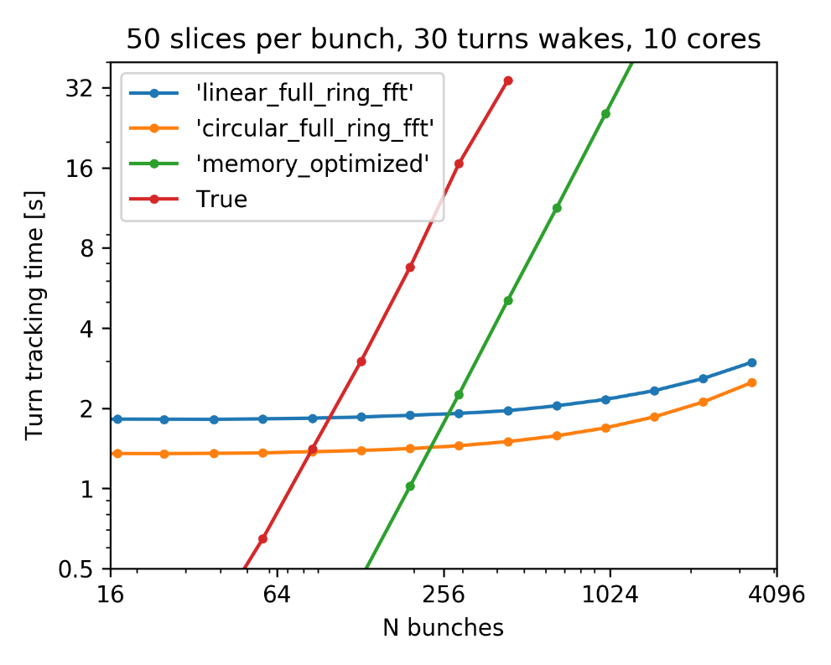
How efficient is it?
Benefits
  FFT convolution scales as N_{tot} log(N_{tot})
  Wake field calculations can be efficiently parallelized to one turn length blocks
  Faster than N² algorithms when filling factor >5-15%
Drawbacks
  Padding needed -> doubles the number of slices
  Includes all the buckets, even if they are empty
  Can be efficiently parallelized only to the total number of wake turns in the simulation (all wake kick objects in all planes)
  More data transfer between nodes, but reasonable
N_{tot} log(N_{tot})
algorithms
N² algorithms
log-log scale

Slide 18
Outline
Background
Wake algorithms
Benchmarking
Performance
Applications

Slide 19
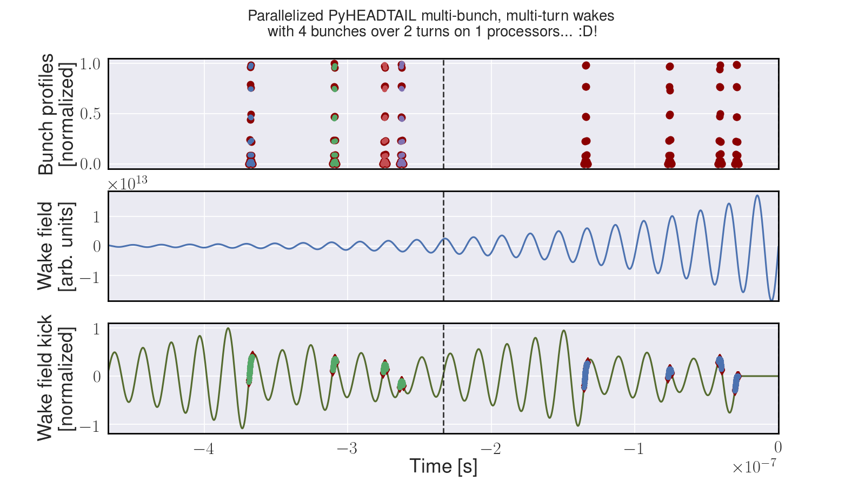
Benchmarking
004_test_split_slicing.py

Slide 20
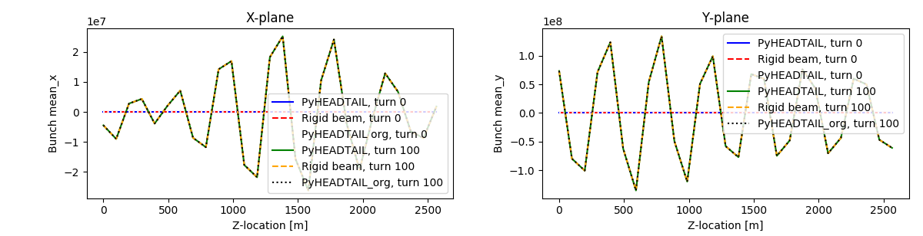
Benchmarking
All the linear convolution wake implementations give exactly same traces
  mpi=‘linear_mpi_full_ring_fft’
  mpi=‘memory_optimized’
  mpi=True (original (py)HEADTAIL implementation)
  Independent minimalistic code with an uniformly sliced ring
003a_rigid_beam_test__linear_convolution.py

Slide 21
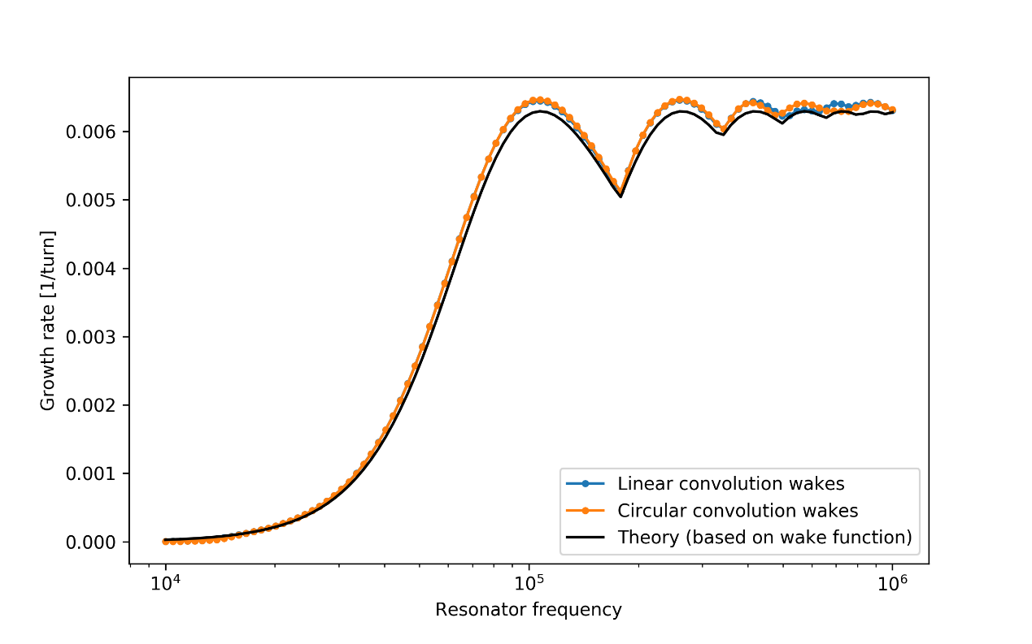
Benchmarking
Point like bunch beams are good tests for wake implementations
  Intra bunch motion does not affect results
  Simpler theories
Different wake approaches give exactly same growth rates
The results match excellently to the point like bunch theory from wake function
005_compare_wake_implementations.py

Slide 22
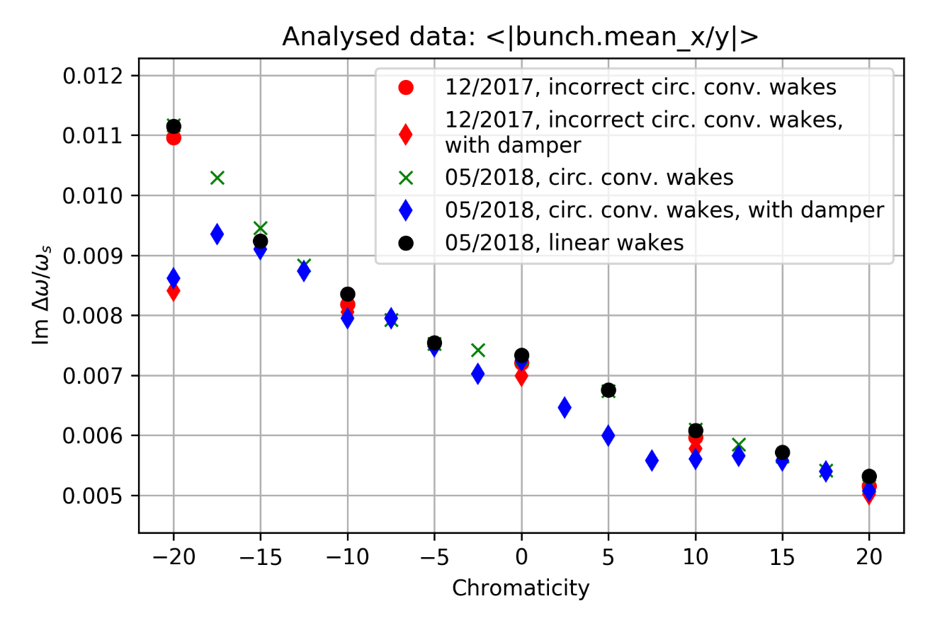
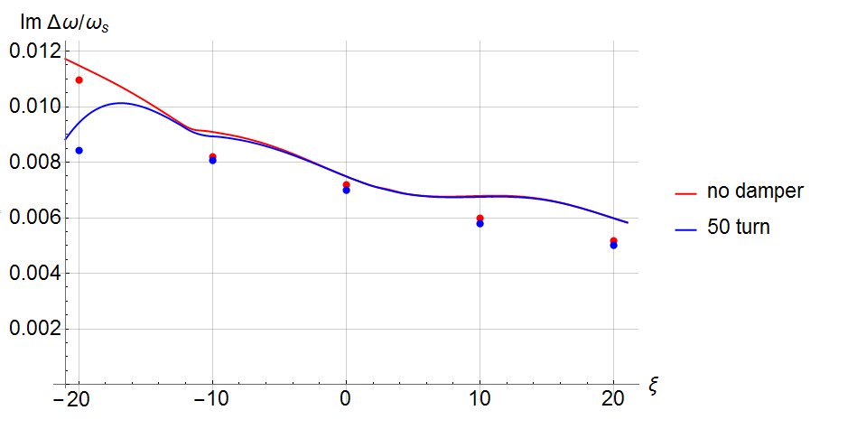
PyHEADTAIL vs NHT
1.97 GHz HL-LHC HOM
Solid lines: NHT
Dots: PyHT, 12/2017
Results between the Nested Head-tail and PyHEADTAIL match well
  The error in the wake implementation had negligible effect because of the relatively short length of the wake function

Slide 23
Outline
Background
Wake algorithms
Benchmarking
Performance
Applications

Slide 24
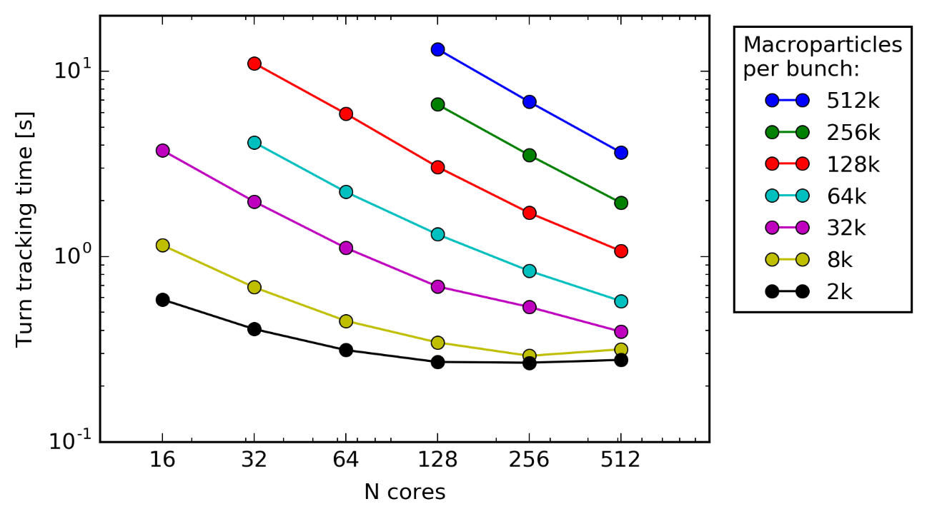
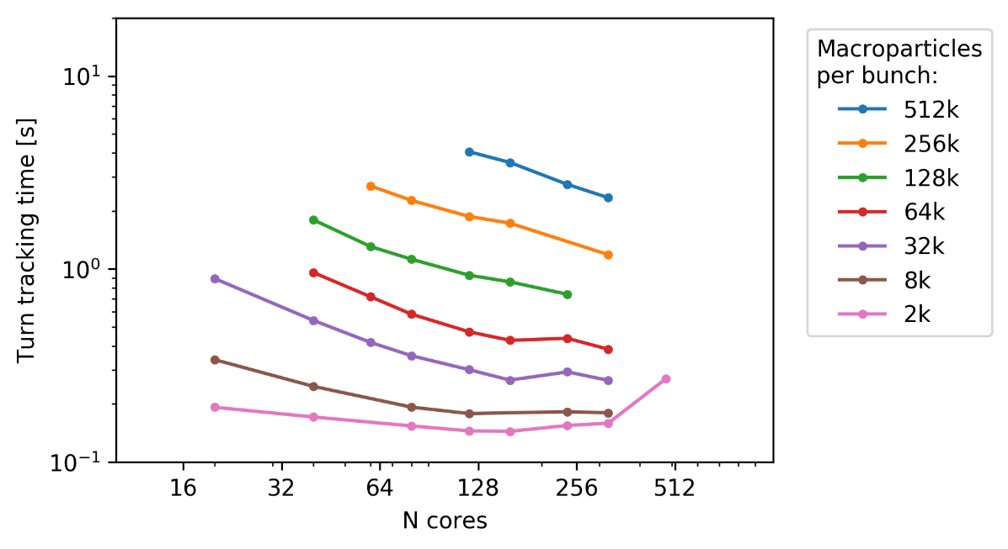
Performance evolution
December 2017, batch-nodes
June 2018, be-nodes
3564 bunches, 20k mppb
20 slices per bunch
3 turns wake, chromaticity
mpi=‘circulat_full_ring_fft’
A factor of 2-3 better performance now
  Improved code and cluster performances, still room for code improvements
  Cluster optimization procedure is unclear, it might be possible to improve cluster/MPI efficiency at high number of cores
Perspective
  The HL-LHC 2GHz HOM test is easy: 3564 bunches, 20k mppb, 20 slices per bunch, 3 turns wake, chroma
    => 0.7 s per turn on 40 cores (2 nodes)
  One-tenth of the CERN HPC be-long queue: 8 nodes = 160 real cores / 320 ranks
    1 month = 2.6*10⁶ seconds => 10⁶ turns when tracking 2.6 s per turn
  => Full LHC beam can be simulated with chromaticity with 100k mppb and 100 slices per bunch

Slide 25
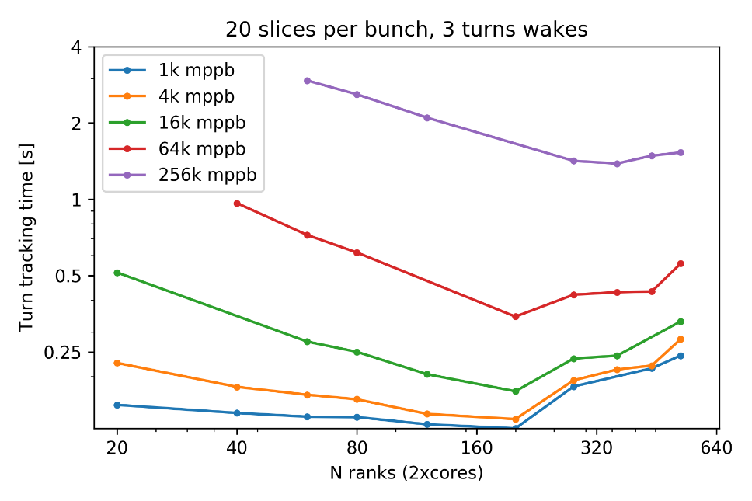
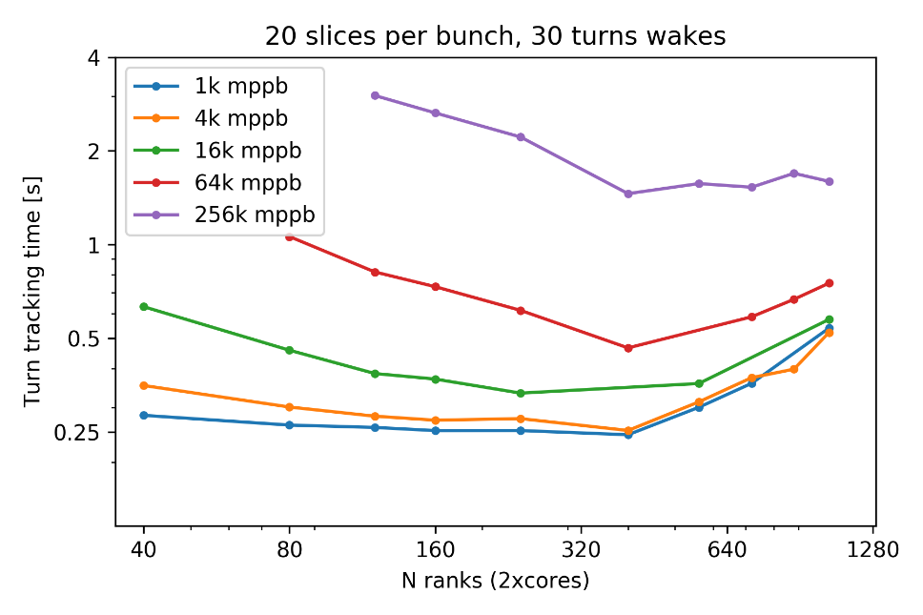
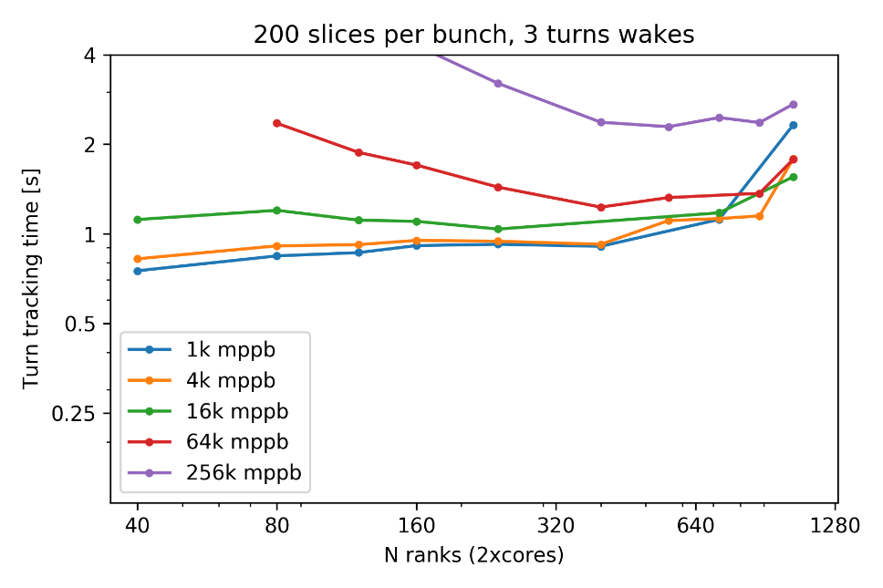
Simulation performance
Wake calculations are parallelized to one turn segments
  Number of wake turns has minor effects
  Linearly proportionally to the total number of slices in the simulation
  Further improvements possible
    Direct convolution parallelization scales as 1/sqrt(N_cores/(all_wake_turns))
    Accumulated wake approach allows separate cores or node(s) for long range wakes
    etc.

Slide 26
Outline
Background
Wake algorithms
Benchmarking
Performance
Applications

Slide 27
Good enough for the FCC transverse feedback studies?
The goals were:
  Study CBI instability mitigation of the baseline damper
  Probe impedance/intensity margin given by the feedback system

Slide 28
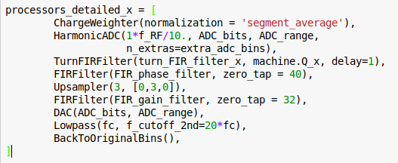
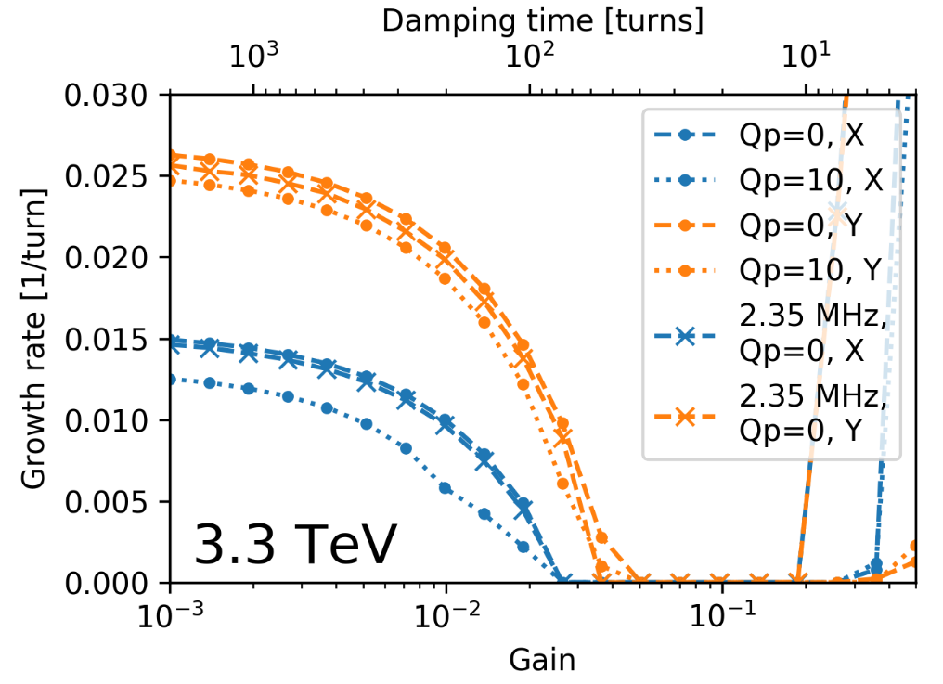
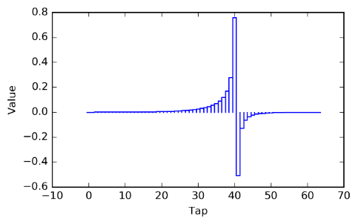
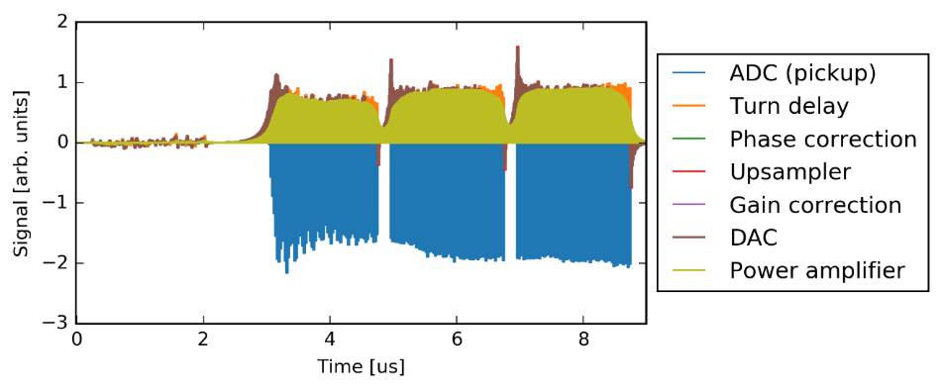
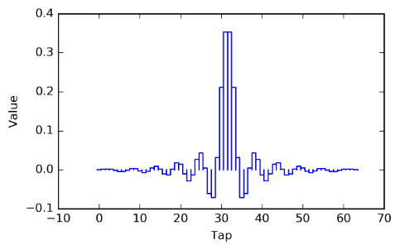
Good enough for the FCC transverse feedback studies?
The goal A: Stairgforward
  Full FCC-hh beam simulations including a filling pattern, multi-ten-turn-wakes and the detailed damper model
LHC ADT PyHEADTAIL model
FIR filters are the “soul” of the ADT.
Exactly same filters can be used both
in the simulations and the machine
(pyJapc interface).
Damper gain scans for different chromas and planes
for verification of the damper performance

Slide 29
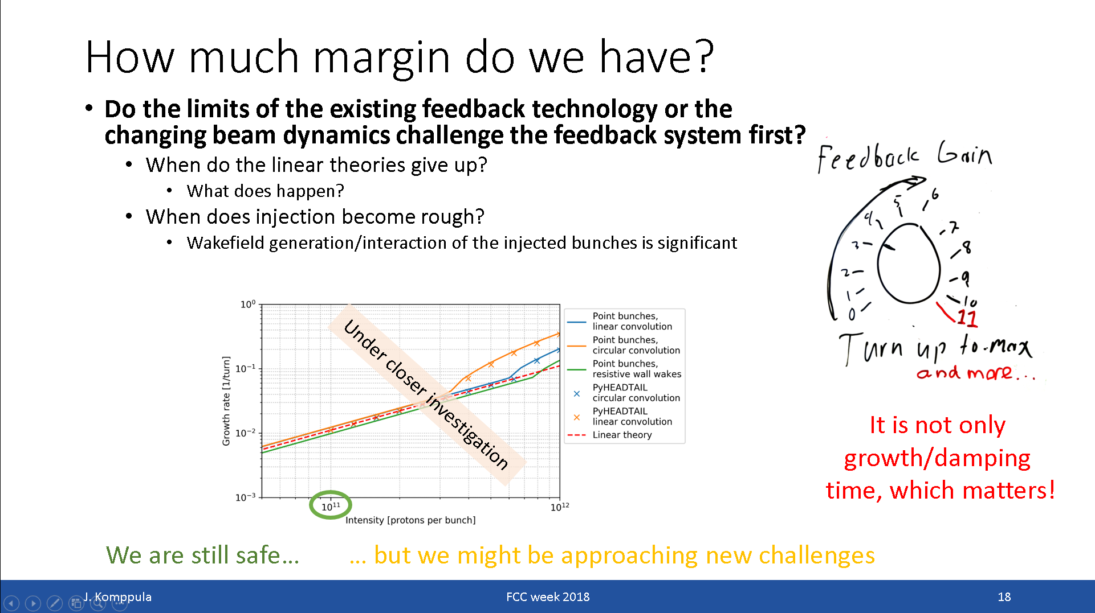
Good enough for the FCC transverse feedback studies?
The goal B: The code is sufficient, but the challenges arise from physics at very high intensities

Slide 30
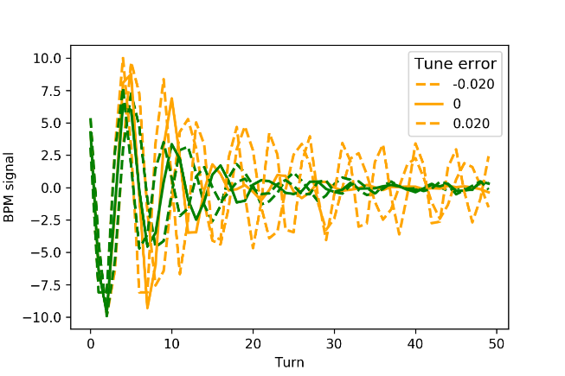
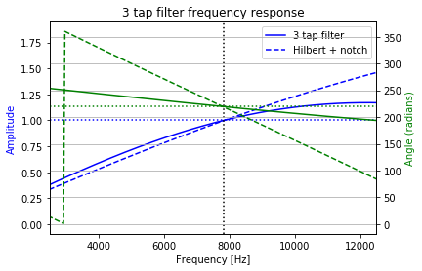
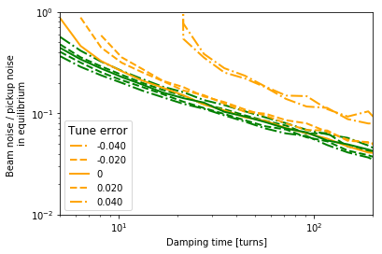
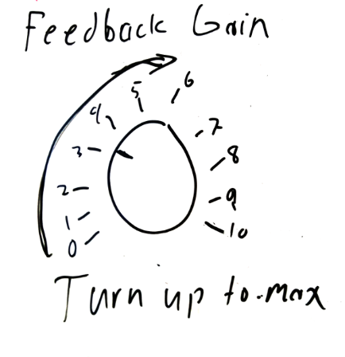
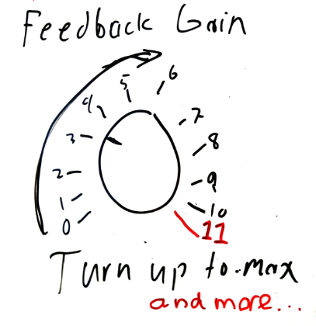
How feedback simulations could help beam dynamics and R&D studies?
Example: ongoing SPS tests of the FIR filter approach for betatron phase and close orbit offset corrections
  All steps can be simulated with the developed tools
  Same feedback model can be used in all simulations
Accelerator physicist
Operators
and users
RF engineer
Instabilities
Injection emittance growth
Performance
Operational
flexibility
Safety margins
Damping performance
Emittance growth
Tune footprint at high
gain values
Noise performance
Signal response of the filter
(simulations + network analyzer)
Straightforwardly measurable
beam properties with amplified
beam/accelerator parameters
More precise simulations and
experiments about the real effects
for daily operations

Slide 31
Summary
Several different implementations for multibunch wakes
  Linear and circular convolution wakes allow different multibunch reference frames
  Different optimization algorithms allow efficient wakes for different filling factors
  Full beam simulations are here!
Benchmarking
  All the wake implementations pass all the tests
  The tests are included into the multibunch PyHEADTAIL branch
  The validity of the ‘convolution compression’ mathematically proven by Nicolas
Simulation tools allow to fill the gaps between the ideal and real world as well as approaches and communication challenges between different expertises
Future studies would benefit from some basic studies of the collective effects and the feedback systems
  Shapes of wake functions at short time scales
  Transparent comparison of the different theories and codes and their limits (also control theory of the feedback systems)
  Well defined measurable, relevant, performance meters for the feedback systems
  Fundamental mechanisms and limitations for the feedback stabilization from the beam dynamics point of view

Slide 32
Thank you!

Slide 33
Spare slides

Slide 34
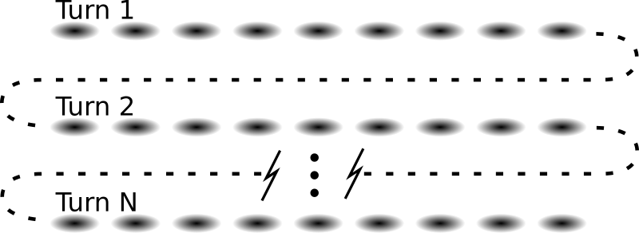
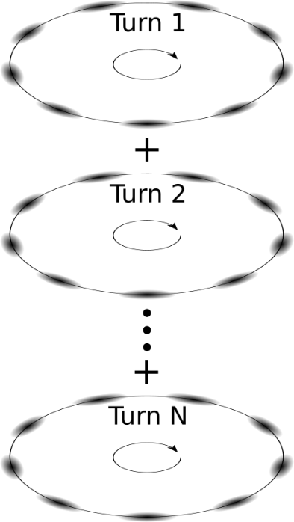
What is the difference between trackings?
Linear convolution wakes
  Definition of the turn depends on the choice of the first bunch (smoot transition between the turns)
  Source bunches for the wake kick are all the previously tracked bunches
  Beam oscillation modes are self consistently continuous between the turns because of convolution properties
Circular convolution wakes
  Well defined turns for all bunches because of turn-by-turn tracking of the beam
  Source bunches are bunches from previous turns which location rotate (circular convolution)
  Beam oscillations are self consistently continuous inside the turn, but there is discontinuity between the turns
  => “helix” correction

Slide 35
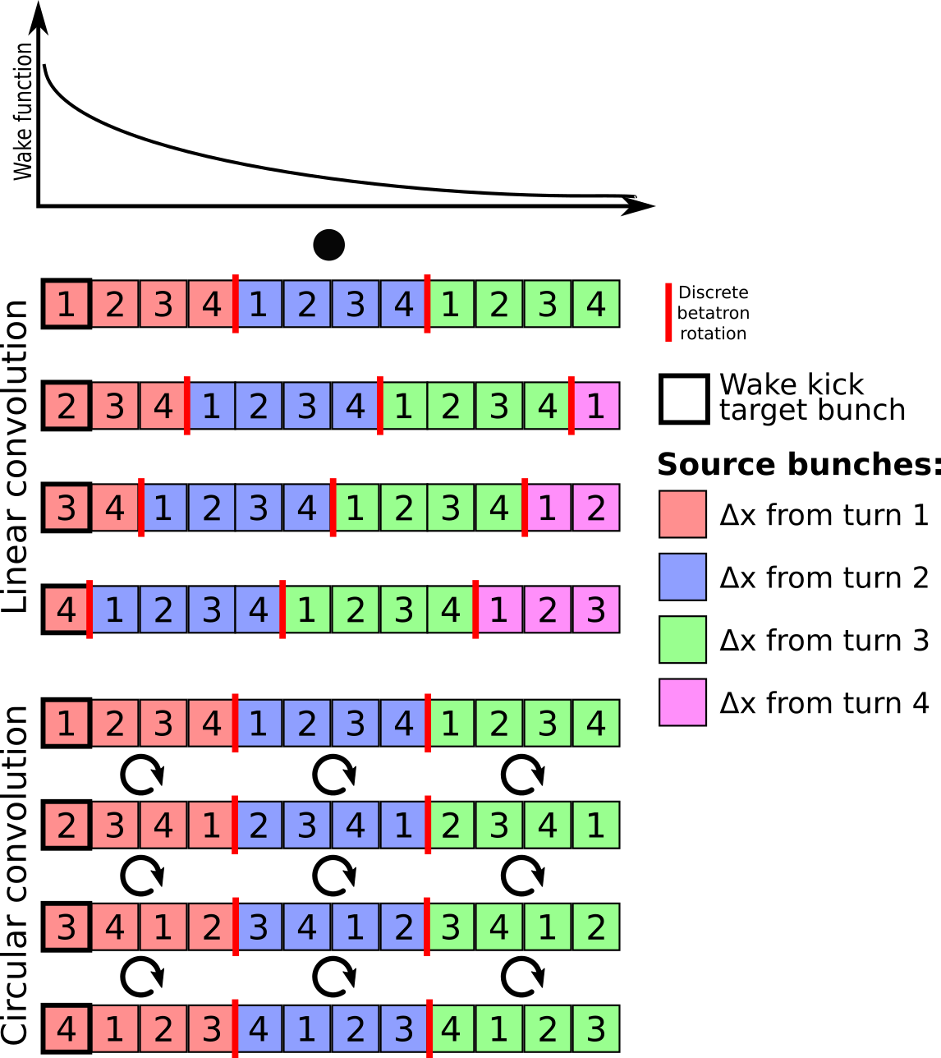
What is the difference between tracking?
Linear convolution wakes
  Definition of the turn depends on the choice of the first bunch (smoot transition between the turns)
  Source bunches for the wake kick are all the previously tracked bunches
  Beam oscillation modes are self consistently continuous between the turns because of convolution properties
Circular convolution wakes
  Well defined turns for all bunches because of turn-by-turn tracking of the beam
  Source bunches are bunches from previous turns which location rotate (circular convolution)
  Beam oscillations are self consistently continuous inside the turn, but there is discontinuity between the turns
  => “helix” correction

Slide 36
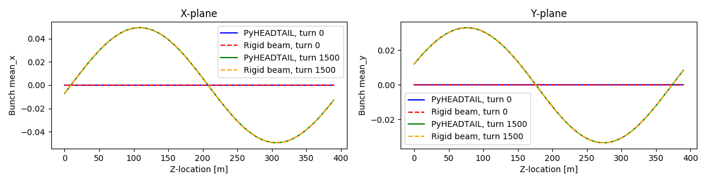
Benchmarking
Comparison of different linear convolution wake implementations
  mpi=‘circular_mpi_full_ring_fft’
  Independent minimalistic code with an uniformly sliced ring
Relative differences in the slice or bunch positions < 10⁻¹² after the tracking
003b_rigid_beam_test__circular_convolution.py

Slide 37
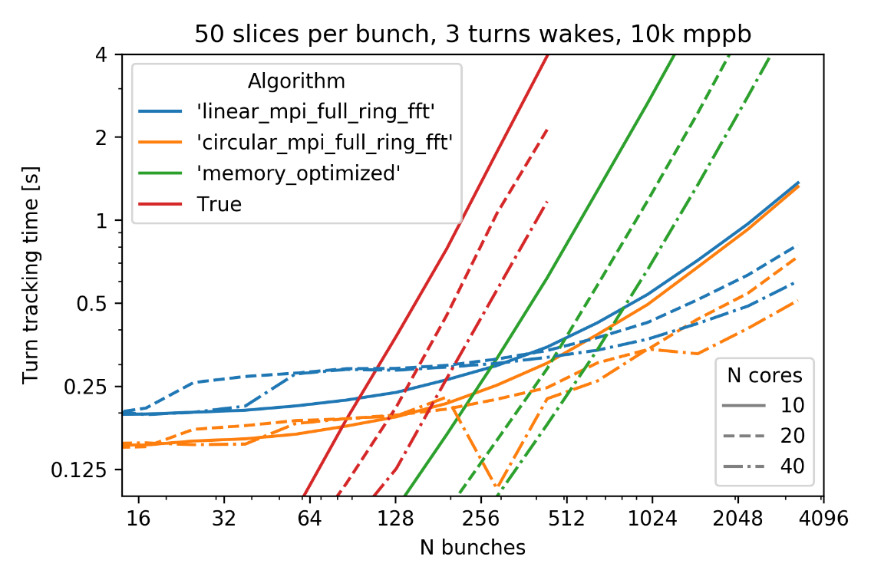
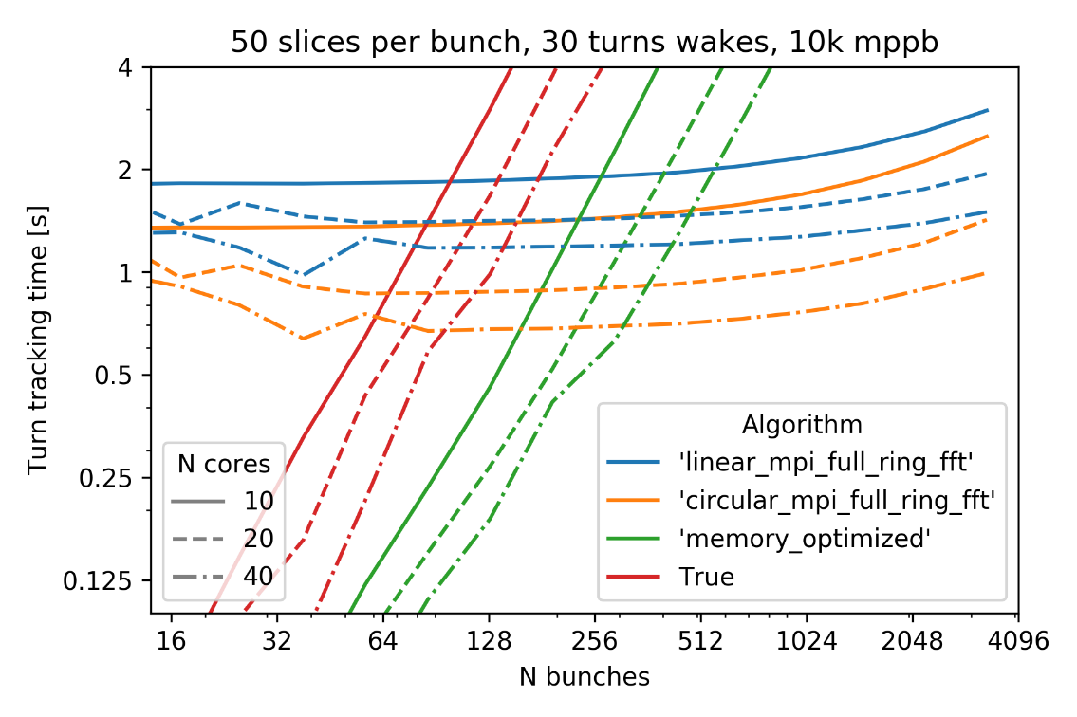
Performance of the different algorithms
Note the log-log scale!
N² algorithms
N_{tot} log(N_{tot})
algorithms
N² algorithms are efficient when filling factor is low
N_{tot} log(N_{tot}) algorithms faster when over 2-15% filling factor
  Circular convolution wake algorithm is the fastest

