Slide 1
ARIES Industrial and Societal Applications Network
Rob Edgecock / University of Huddersfield & STFC

Slide 2
Outline
Welcome
Agenda
WP3 talks in the plenary
WP3 tasks
Deliverables
Milestones
Proof of Concept fund proposals
H2020

Slide 3
Agenda
Task 3.1/Introduction - R. Edgecock
Task 3.2
  General review of activities - A.G.Chmielewski
  Current applications of electron beam accelerators up to 10 MeV - Z.Zimek
  Electron beam technology for preservation of cultural heritage artefacts - D. Smietanko
Task 3.3
  General review of activities - F-H.Roegner
  Low energy electron beam to treat biological cell-substrates - F-H.Roegner
Task 3.4
  General review of activities - A.Faus-Golfe
  Consulting company in environmental applications - E.Marin
Task 3.5
  General review of activities - D.Campos

Slide 4
WP3 in the Plenary
Thursday 24th

Slide 5
WP3
ISA: Industrial and Societal Applications of accelerators
Three science areas:
  Industrial and environmental applications of electrons up to 10MeV
  Accelerator radioisotope production
  Applications of electron beams up to ~140 MeV
Will do real work (i.e. not organise workshops)
Focus is on improving or developing new applications

Slide 6
WP3
Task 3.1. Coordination and Communication (Rob Edgecock)
- Coordinate the WP activities
- Monitor the progress of WP tasks and ensure the obligations are met
- Manage the WP budget and use of resources and prepare internal and deliverable reports
Task 3.2. Low energy electron beam applications: new technology development (Andrzej Chmielewski)
- Study and document the requirements for current e-beam applications
- Study the introduction of new technology from the research area to bring improvements to these applications
- Develop a standard electron beam unit to make the transition to electron beam applications easier for newcomers
Task 3.3. Low energy electron beam applications: new applications (Frank-Holm Roegner)
- Study the use of electron beams in the environmental area
- Study the expansion of the use of electron beams in the industrial area
- Document the new applications and the requirements on the accelerator technology
Task 3.4. Medium energy electron beams (Angeles Faus-Golfe)
- Study of the applications of electron beams up to 140 MeV in the medical and other areas
- Study of the construction of high performance electron linear accelerator up to 140 MeV
Task 3.5. Radioisotope production (Diego Campos/Conchi Oliver)
- Document the requirements for compact accelerators for radioisotope production
- Optimise the design of a new compact cyclotron for PET isotope production, with the aim of maximising the production
- Analyse different solutions for a compact source for PET, with the aim of improving the performance and cost
- Study which existing and possibly new therapeutic isotopes are of interest clinically and how they can be produced
using particle beams
- Study and compare novel acceleration techniques for ^{99m}Tc and therapeutic isotope production

Slide 7
WP3 - Partners
Full partners:
  CERN (Switzerland)
  Ciemat (Spain)
  CNRS (France)
  Fraunhofer FEP (Germany)
  University of Huddersfield (UK)
  IBA (Belgium)
  INCT (Poland)
Associates:
  EBtech
  IAEA
  iiA
  Slovak Medical University

Slide 8
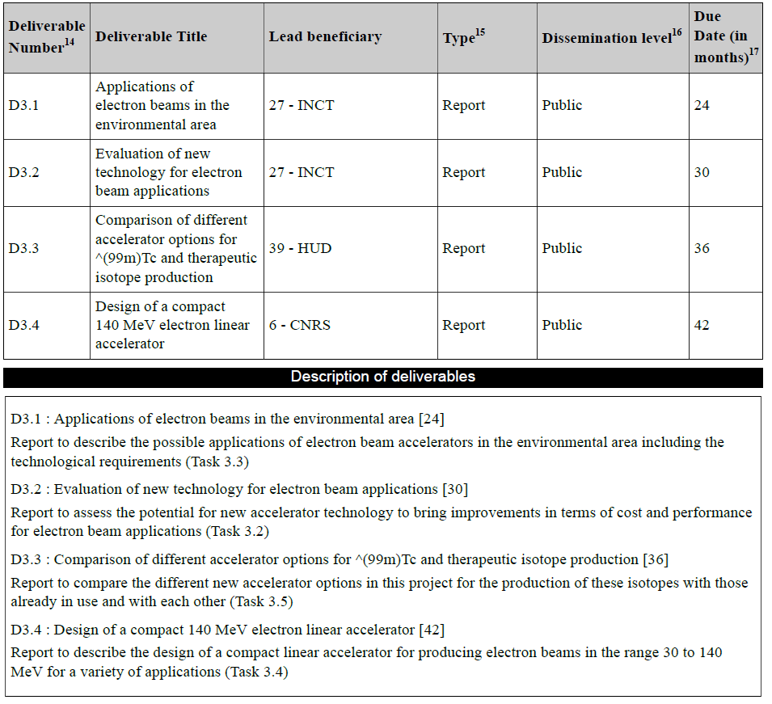
Deliverables

Slide 9
Deliverables
Go to the EU, so important
Must be on time
Approval procedure:
  well in advance, start writing using template on website
  >1 month in advance, send to me for comments, etc
  1 month in advance, send to Maurizio
  Will allow the deliverable to be uploaded by the deadline
“Reasonable” length: 12-20 pages?
Scientific documents

Slide 10
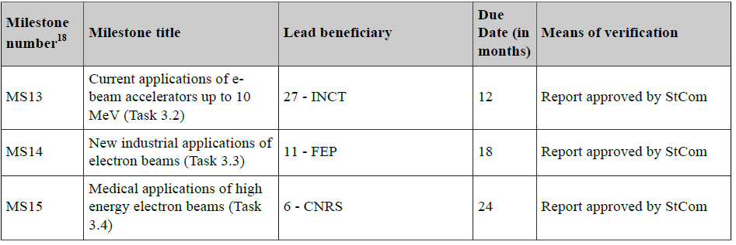
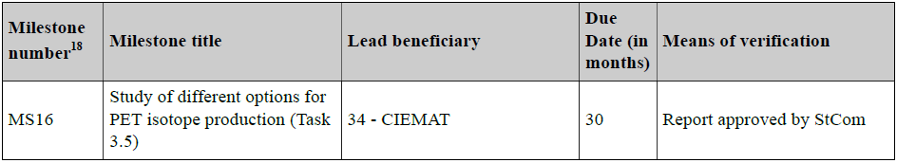
Milestones
Done!

Slide 11
Milestones
Don’t go to the EU, so not quite as important
Should still be on time
Approval procedure:
  well in advance, start writing using template on website
  >1 month in advance, send to me for comments, etc
  1 month in advance, send to Maurizio
Can be short length: >4 pages?
Scientific documents

Slide 12
Papers
Worth considering whether deliverables & milestones could be converted to refereed papers
Papers are encouraged
Three rules:
  Must ensure open access (free of charge, online access for any user) to all peer-reviewed scientific publications relating to its results. In particular, it must as soon as possible and at the latest on publication, deposit a machine-readable electronic copy of the published version or final peer-reviewed manuscript accepted for publication in a repository for scientific publications.
  Must have an acknowledgement to EU funding
  Must be uploaded onto the ARIES website

Slide 13

Papers
Acknowledgement
All ARIES publications (including Transnational Access) must include the following acknowledgement:

Slide 14
Proof of Concept Fund
WP3 part of/submitted 4 proposals:
  “Eliminating the spread of AMR through wastewater” (HUD)
  “Development of hybrid electron accelerator system for the treatment of marine diesel exhaust gases” (RIGA)
  Production of 99Mo using an electron beam (IBA)
  Novel ion source for AMIT (CIEMAT)
Still waiting for any form of feedback!

Slide 15
H2020
Societal Challenges area
Two calls perhaps still of interest
SC2: CE-SFS-30-2019: High-quality organic fertilisers from biogas digestate: - up to 5 MEUR - in collaboration with at least 3 Chinese partners - companies required - opens: 16th Oct 2018; closes: 23rd January 2019
SC4: LC-MG-1-8-2019: Retrofit solutions and next generation propulsion for waterborne transport - 4 – 6 MEUR - company required - two stage proposals - opens: 5th Sep 2018; closes: 16th Jan 2019

Slide 16
CE-SFS-39-2019: High-Quality Organic Fertilisers from Biogas Digistate
Part of FAB: agreement between EU and Chinese Academy of Agricultural Sciences
Scope: Projects shall develop treatment technologies to convert digestate into a suitable fertiliser or soil amender. They could focus on a specific digestate type or develop a flexible process covering a variety of digestates. These treatments shall:
  reduce risks linked to biological and chemical hazards (including AMR) to acceptable levels
  improve fertilising properties
  address issues related to format, formulation and handling. Proper solutions must be sought for the liquid phase to avoid pollution
Our proposal: use electron beams
Requirements:
  The fertiliser developed must be suitable for direct use, or for mixed formulation with other fertilisers
  Field tests must be implemented over an appropriate period of time to assess its agronomic properties, as well as its effect on the environment (including greenhouse gas emissions), and on food safety
  Projects shall focus on technologies that could be deployed in a decentralised manner, at a relatively small scale
  Such technologies shall achieve a technology readiness level (TRL) 6-7 by the end of your project
  A comprehensive impact assessment (economic, environmental and social) of the business model shall be carried out, and policy recommendations shall be provided to boost its deployment

Slide 17
CE-SFS-39-2019: High-Quality Organic Fertilisers from Biogas Digistate
Part of FAB: agreement between EU and Chinese Academy of Agricultural Sciences
Scope: Projects shall develop treatment technologies to convert digestate into a suitable fertiliser or soil amender. They could focus on a specific digestate type or develop a flexible process covering a variety of digestates. These treatments shall:
  reduce risks linked to biological and chemical hazards (including AMR) to acceptable levels
  improve fertilising properties
  address issues related to format, formulation and handling. Proper solutions must be sought for the liquid phase to avoid pollution
Our proposal: use electron beams
Requirements:
  The fertiliser developed must be suitable for direct use, or for mixed formulation with other fertilisers
  Field tests must be implemented over an appropriate period of time to assess its agronomic properties, as well as its effect on the environment (including greenhouse gas emissions), and on food safety
  Projects shall focus on technologies that could be deployed in a decentralised manner, at a relatively small scale
  Such technologies shall achieve a technology readiness level (TRL) 6-7 by the end of your project
  A comprehensive impact assessment (economic, environmental and social) of the business model shall be carried out, and policy recommendations shall be provided to boost its deployment

Slide 18
Requirements (cont):
  Proposals shall ensure solid collaboration between agro-food actors, technology providers, research centres, end-users (farmers and farmers associations), and public administration
  Projects shall perform a thorough analysis of the state of the art, and demonstrate that your proposed activities go beyond this state and do not overlap with past or ongoing research
  Proposals shall include a task to cluster with other projects financed under topic RUR CE-08-2018/2019/2020 and — if possible — with other relevant projects in the field funded by Horizon 2020
  Proposals shall promote balanced research and innovation cooperation between the EU and China. China-based entities that will participate in joint projects with European partners under Horizon 2020 have also the possibility to apply for funding under the Chinese co-funding mechanism.
Impact: Projects are expected to provide the technologies needed to develop commercial fertilisers based on biogas digestate. This will help to:
  replace conventional, non-renewable mineral fertilisers, hence reducing external dependence and risks related to depletion
  reduce the environmental impacts linked to the inadequate management of biogas digestate, and to the production of fossil-based fertilisers
  develop new business models in rural areas, that are synergised with existing ones, creating value from digestate.
In the long term, this shall contribute to a more circular, resource-efficient and sustainable agro-food sector, and create wealth and quality jobs in rural areas.
Projects shall also contribute to increasing the innovation capacities of participating organisations, and to strengthening scientific and industrial collaboration between the EU and China.

Slide 19
Funding available: up to 5 MEUR Rate: 70% for companies 100% for non-profit legal entities
Duration: ?
Opening date: 16th October 2018
Closing date: 23rd January 2019
Innovation action:
  Action primarily consisting of activities directly aiming at producing plans and arrangements or designs for new, altered or improved products, processes or services. For this purpose they may include prototyping, testing, demonstrating, piloting, large-scale product validation and market replication.
  Projects may include limited research and development activities
TRLs:
  6: technology demonstrated in relevant environment (industrially relevant environment in the case of key enabling technologies)
  7: system prototype demonstration in operational environment
PHOEBe: Production of High-Quality Organic Fertiliser using Electron Beams

