Slide 1
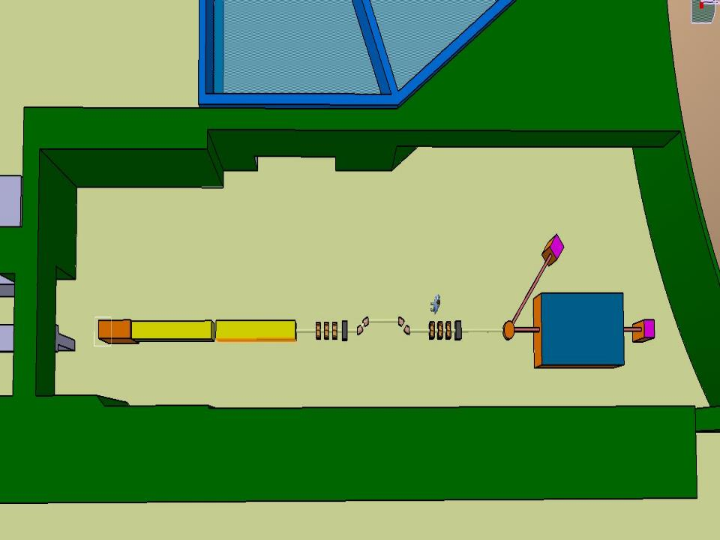




Task 3.4:
Medium energy electron beams: new technology development
Faus-Golfe
on behalf of the LAL team

Slide 2
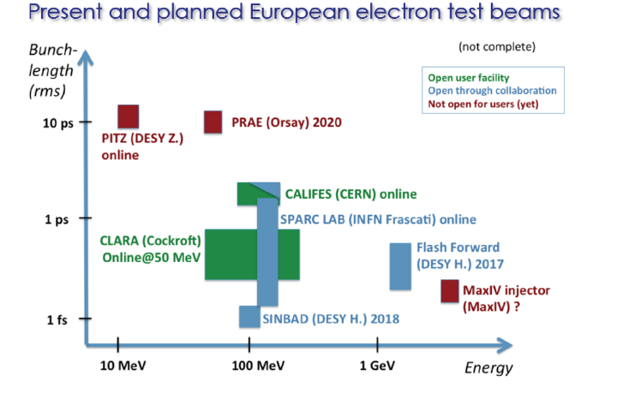
Motivation:
From lowest to highest energies, electron beams represent exploration and measurement tools of high quality and unparalleled wealth. If the number and quality of research tools at both ends of the energy scale are encouraging, it should be noted the poverty of the accelerator park in the range of tens to hundreds of MeV.

Slide 3

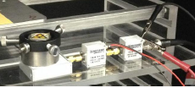
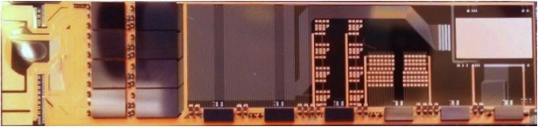
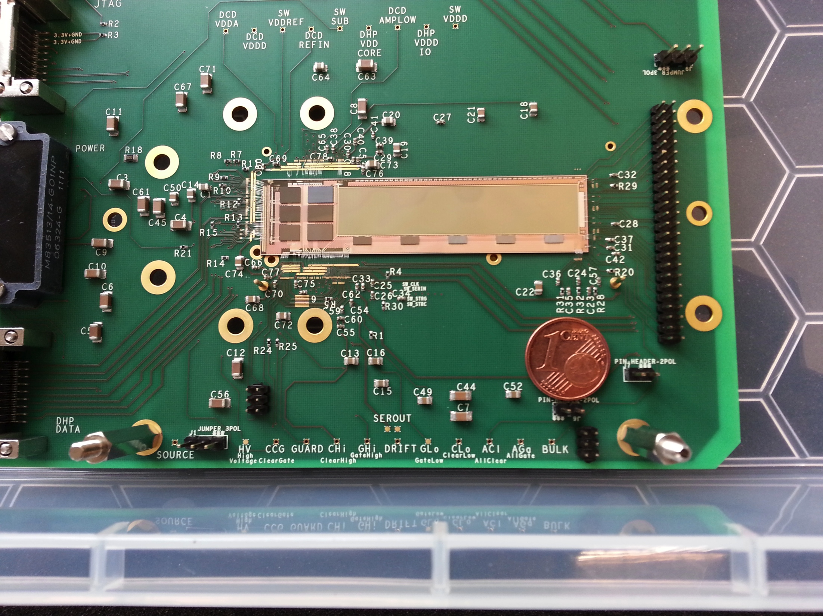
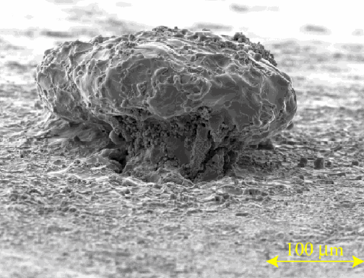
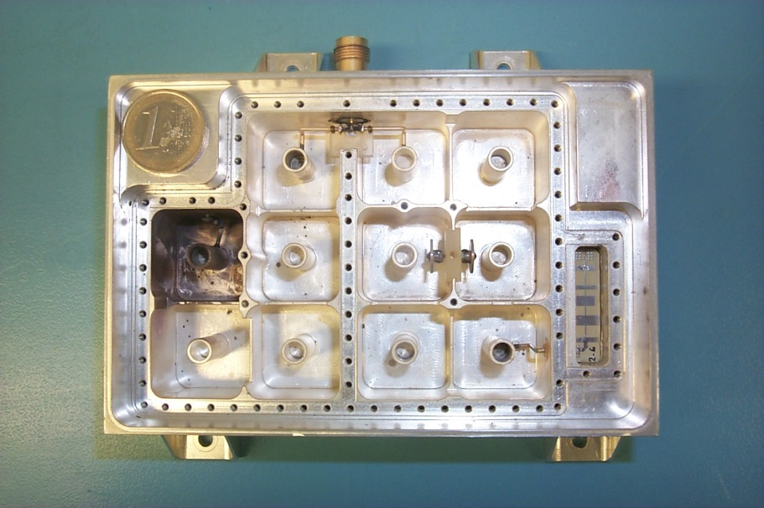
Task objectives
Applications of electron beams and construction of high performance electron linear up to 140 MeV
Biomedical:
New radiotherapy approaches: mini-beams, flash…
Detector Developments:
MAPS, HV-CMOS, DEPFETs, Diamonds
Space:
Multipactor
Others:
Subatomic physics, laser, beam instrumentation, laser plasma lens, THz radiation…
Notes:
Depfet for beam test and dummy electric
Diamond detector and diamond detector at PHIL test
- Multipactor effect in a diplexer with “combline” technology and surface effect seen at SLAC due to e- cloud in a beam pipe (2010)
(diplexor en tecnolgía "combline", que es una tecnología muy usada en filtros de satélites para bajas frecuencias (1 a 5 GHz) en las etapas de salida del satélite (donde circula la alta potencia); se basa en resonadores coaxiales inmersos en cavidades rectangulares, y son bastante difíciles de diseñar desde un punto de vista electromagnético)

Slide 4

Work plan:
Organization of dedicated workshops:
There is already one being organized in medical applications
https://www.cockcroft.ac.uk/events/VHEE17/
Special session in the CLIC 2018 workshop dedicated to CLEAR where the applications in: beam instrumentation developments (cavity BPMs, Diamond Cherenkov diffraction beam size monitor, Electro-Optical BPMs, wake field monitors…) , irradiation of material and components, plasma lens acceleration, Tera-Hertz radiation developments, VHEE RT, https://indico.cern.ch/event/656356/overview
A general workshop the other possible applications will be organized at Fall 2018 in Orsay (PRAE).
Make a survey about the accelerators at this energy in Europe and investigate what will be the best technology in order to make more compact (High-Gradient warm linac...), efficient and adapted to the different applications. Synergies with others EU projectshttp://www.compactlight.eu

Slide 5






Projet Emblématique
Programme SESAME
PRAE:
Platform for Research and Applications with Electrons
Faus-Golfe
on behalf of the PRAE team
and support from
Imagerie et Modélisation
en Neurobiologie et Cancérologie
Institut de
Physique Nucléaire
Laboratoire de
l’Accélérateur Linéaire
Centre de Protonthérapie d’Orsay

Slide 6
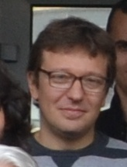

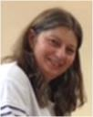



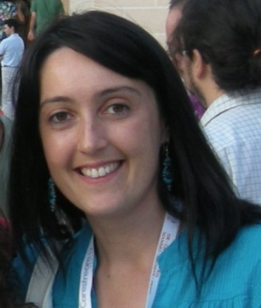

The PRAE Project
PRAE
Multidisciplinary R&D Platform
Transversal, Complementary expertise
Scientific
responsible
Technical
coordinator
User’s
coordinator
PROJET PHASES
Phase A (2016-2019) : 70 MeV
Phase B (from 2020): 140 MeV
Sergey Barsuk
(LAL)
Patricia
Duchesne
(IPNO)
Dominique
Marchand
(IPNO)
4 AXES DE DEVELOPPEMENT
Accelerator
Nuclear Physics
Detectors R&D
Radiobiology
Angeles Faus-Golfe (LAL)
Eric Voutier (IPNO)
Bernard Genolini (IPNO)
Yolanda Prezado (IMNC)
FUNDING

Slide 7
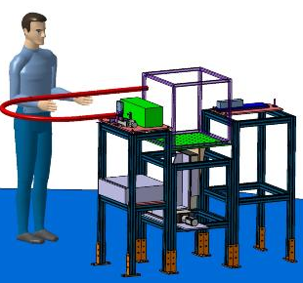
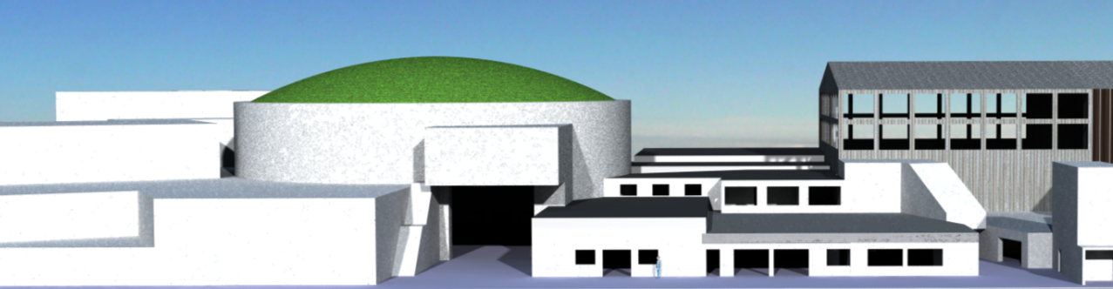
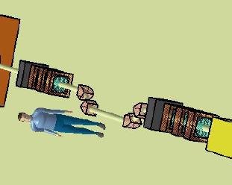

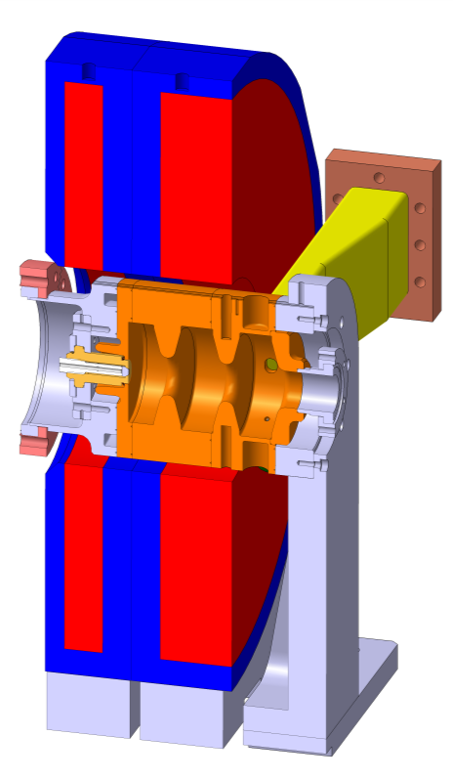
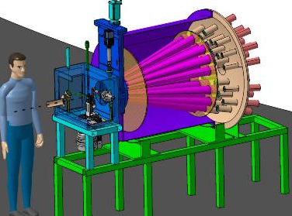
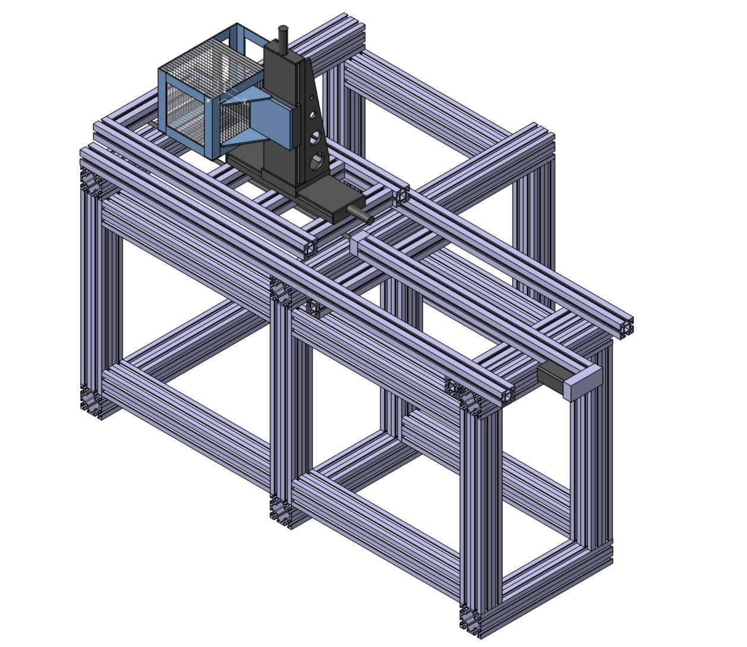
PRAE in one slide
Instrumentation
Energy compressor
RFgun
ProRad
Linac
Radiobiology
Abstract
Abstract
Abstract
Abstract

Slide 8
The accelerator construction and related R&D
Parameters and Phases
RF gun and High-Gradient Linac
Optics design and simulations
Beam diagnostics

Slide 9

PRAE Parameters and Phases
Beam parameters | Phase A-B
Energy, MeV | 50-70 (100-140)
Charge (variable), nC | 0.00005 – 2
Normalized emittance, mm.mrad | 3-10
RF frequency, GHz | 3.0
Repetition rate, Hz | 50
Transverse size, mm | 0.5
Bunch length, ps | < 10
Energy spread, % | < 0.2
Bunches per pulse | 1
Phase A: RF gun at 50 Hz; 50-70 MeV, two lines:
Direct: magnetic chicane for ProRad and radiobiology in mode “Push-Pull”
Deviated: for Instrumentation
Phase B:
Spectrometer for Instrumentation line
Scanning dipole for radiobology
Complete set of channels
140 MeV
Instrumentation
RFgun
Linac
Energy compressor
ProRad
Radiobiology

Slide 10

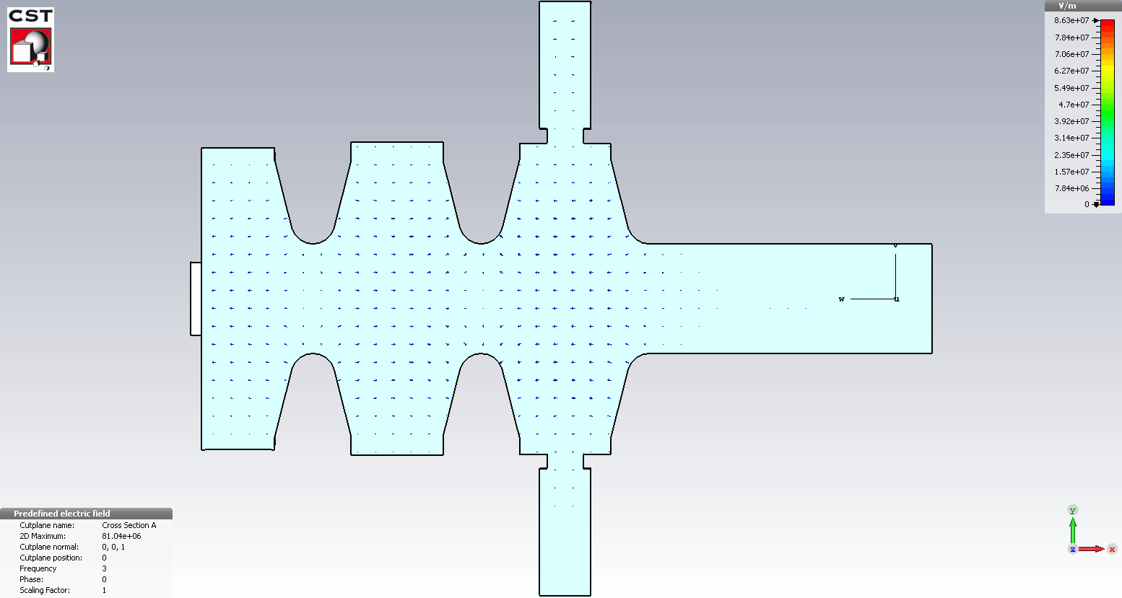
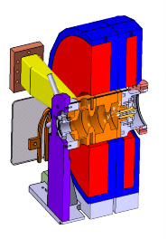

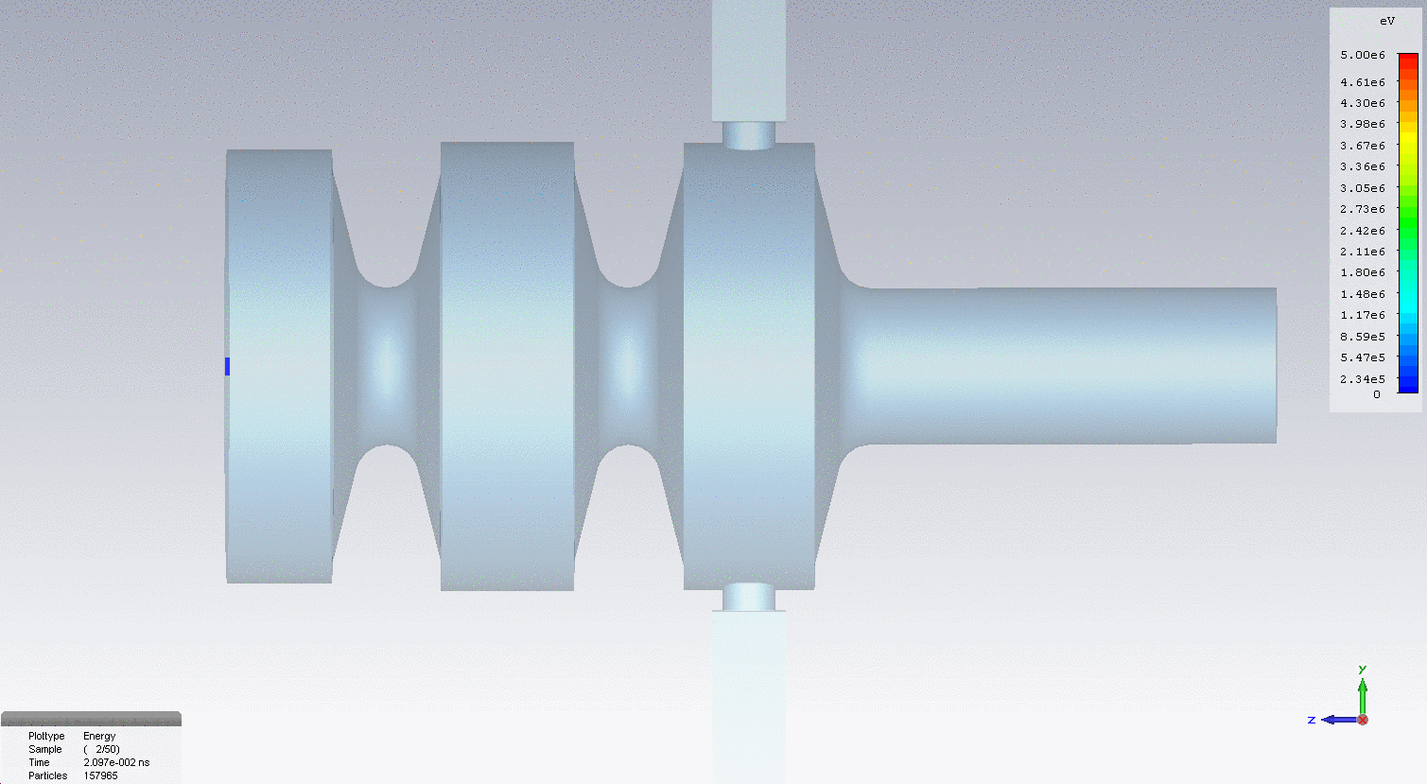
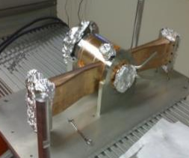
The RF gun “revisited”
Accelerating gradient (TM₀₁₀ _ π mode ): 80 MV/m at P_{in}=5 MW
Photoinjector specification
RF power (5 MW)
Operation frequency | 2998,55 MHz (30°C, in vacuum)
Charge | 1 nC
Laser wavelength, pulse energy | 266 nm, 100 µJ
RF Gun Q and Rs | 14400, 49 MΩ/m
RF Gun accelerating gradient | 80 MV/m @ 5 MW
Normalized emittance (rms ) | 4.4 π mm mrad
Energy spread | 0.4 %
Bunch length (rms) | 5 ps
Photocathode
Coupling slot compensating the Field distortion
Short circuit
new coil configurations
2.5 cells RF gun designed and produced at LAL for ThomX
focusing coil
bucking coil
CST-Particle in cells, simulation results
20 cm
Energy gain = 5 MeV for Pin =5 MW
Notes:
Coils separated by 23 cm to mitigate the emittance growth in the free space of 1.3 m between RF gun and linac

Slide 11
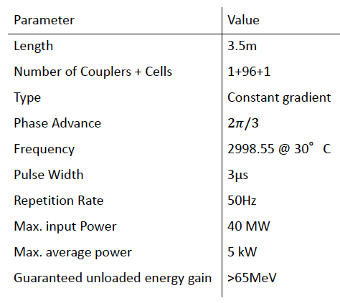

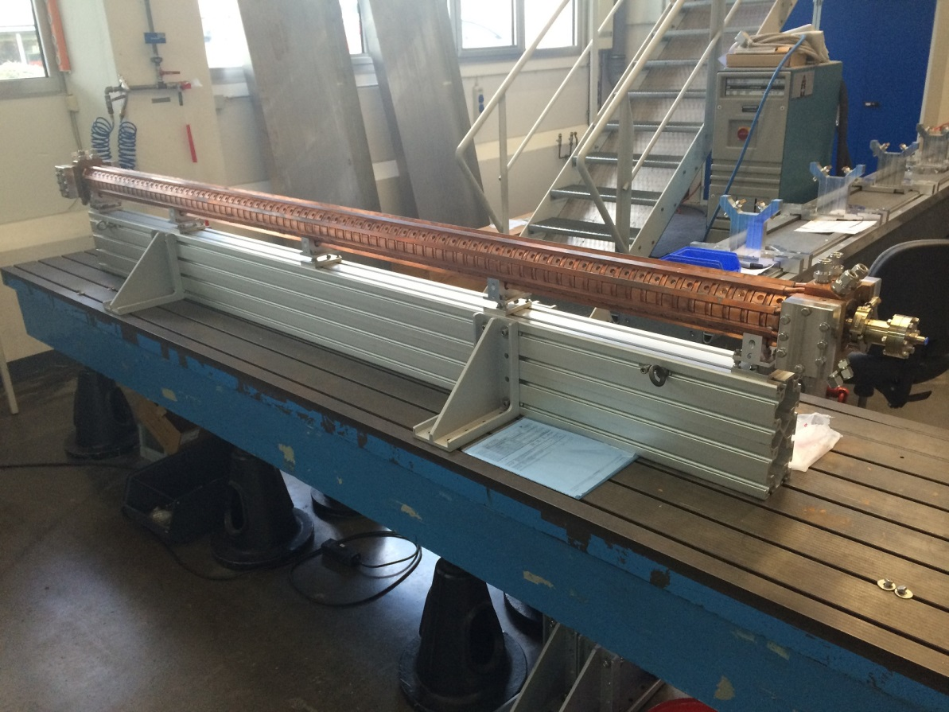
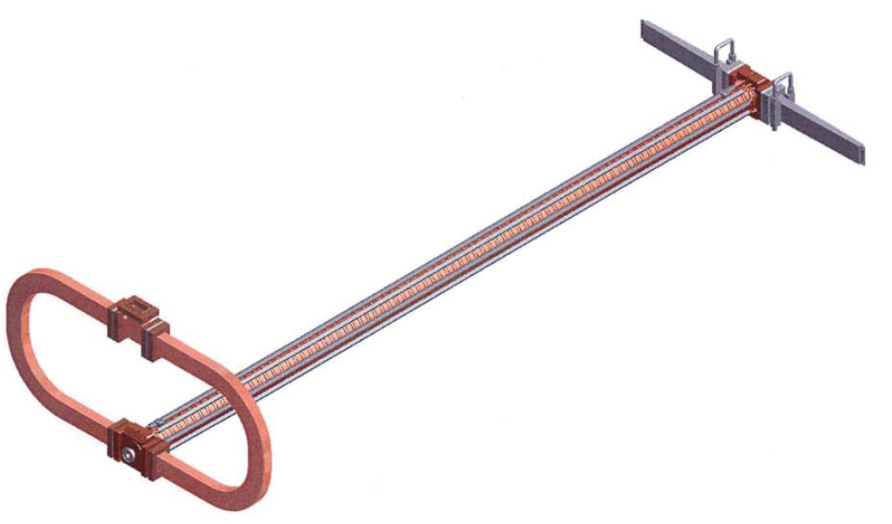
The High-Gradient linac
TW S-Band structures from RI
The Structures are SLAC-type structures
Constant gradient
Race track coupler for quadrupole compensation
BIG Splitter for dipole compensation
2 RF loads

Slide 12
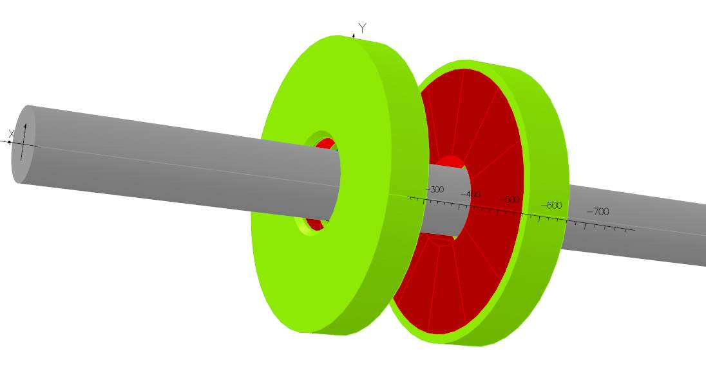
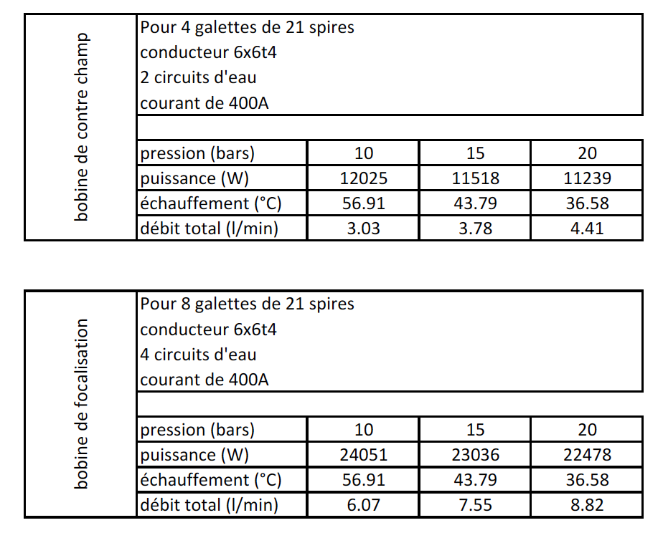
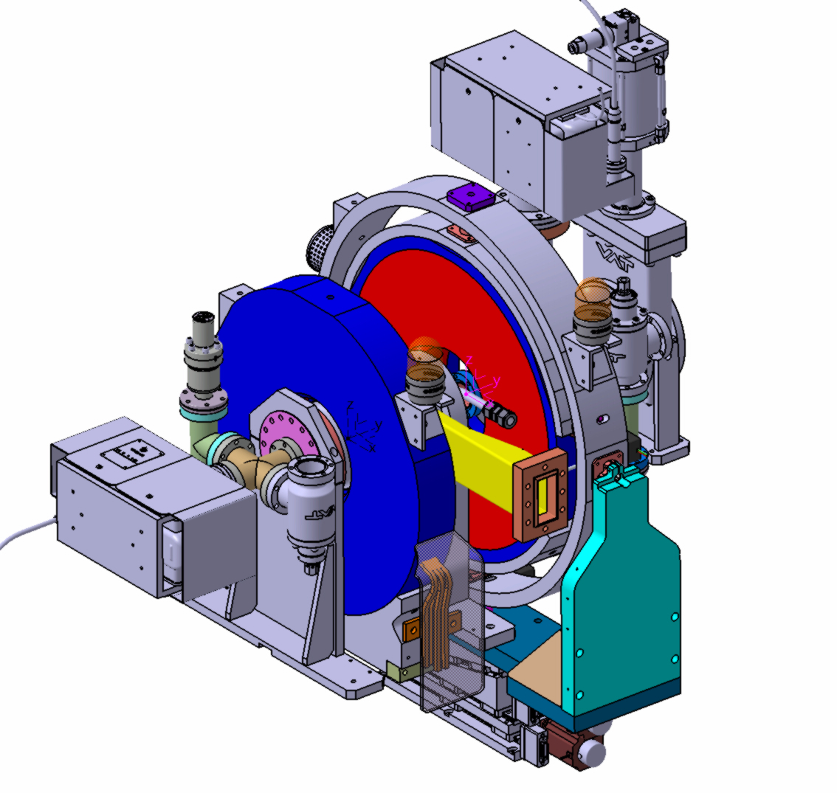
The RF gun solenoids
Based on ThomX RF Gun configuration
Beam direction
New solenoids configuration

Slide 13
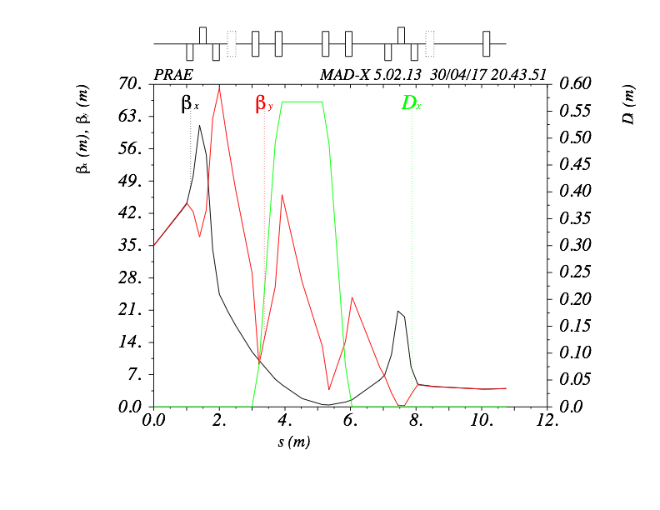
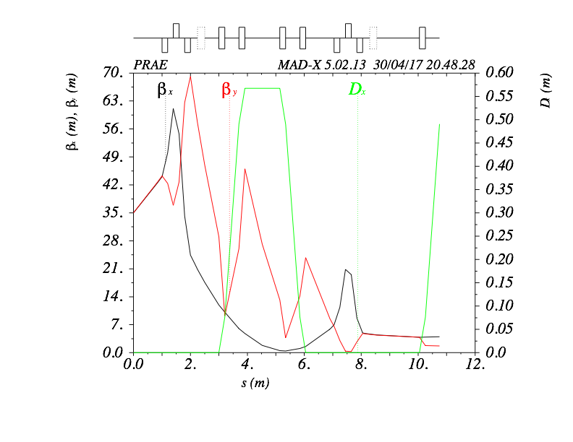
Optics design and Simulations
Two triplets, flexible final conditions, with a Energy compression System (ECS) in the direct line and a dedicated Beam Energy Measurement in the deviated line.
Direct line:
ProRad and Radiobiology
Deviated line:
Instrumentation

Slide 14
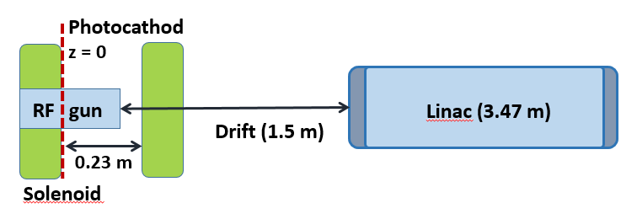
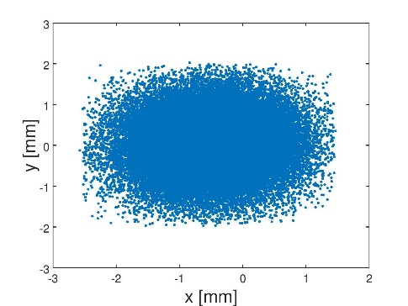
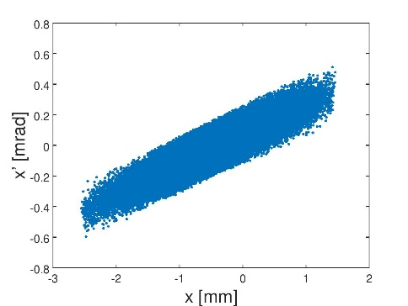
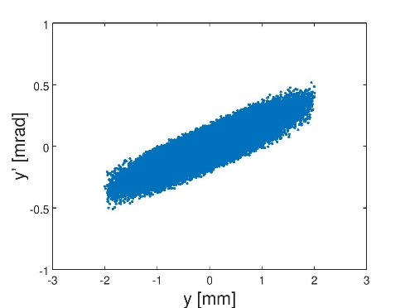
Beam dynamics
RF-track simulations
RF-Track is a novel tracking code developed at CERN for the optimization of low-energy linacs in presence of space-charge effects. The RF structures are described by means of the 3D electromagnetic fields and it is able to treat directly the output of HFSS or CST programs.
Subsequent calculations are performed using the full 3D EM field (97 cells) of the HG accelerating structure generated via CST.
HG accelerating section
Bucking solenoid
Beam profiles at the exit of linac
Focusing solenoid
transverse phase space at the exit of linac
Beam performances at the exit of linac
E [MeV] | 67
∆E/E [%] | 0.2
ε_{x, y} [mm mrad] | 5.31/5.40
σ_{x, y} [mm] | 0.66/0.65
β_{x,y} [m] | 10.33/10.96
Realistic and reliable result based on the analysis of the given EM field.
The next beam optimization are planned to be performed using the RF track.
A. Vnuchenko et al, Proceedings of IPAC 2018, Vancouver, Canada

Slide 15
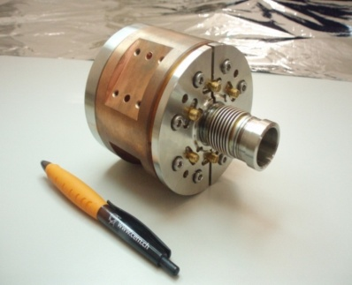
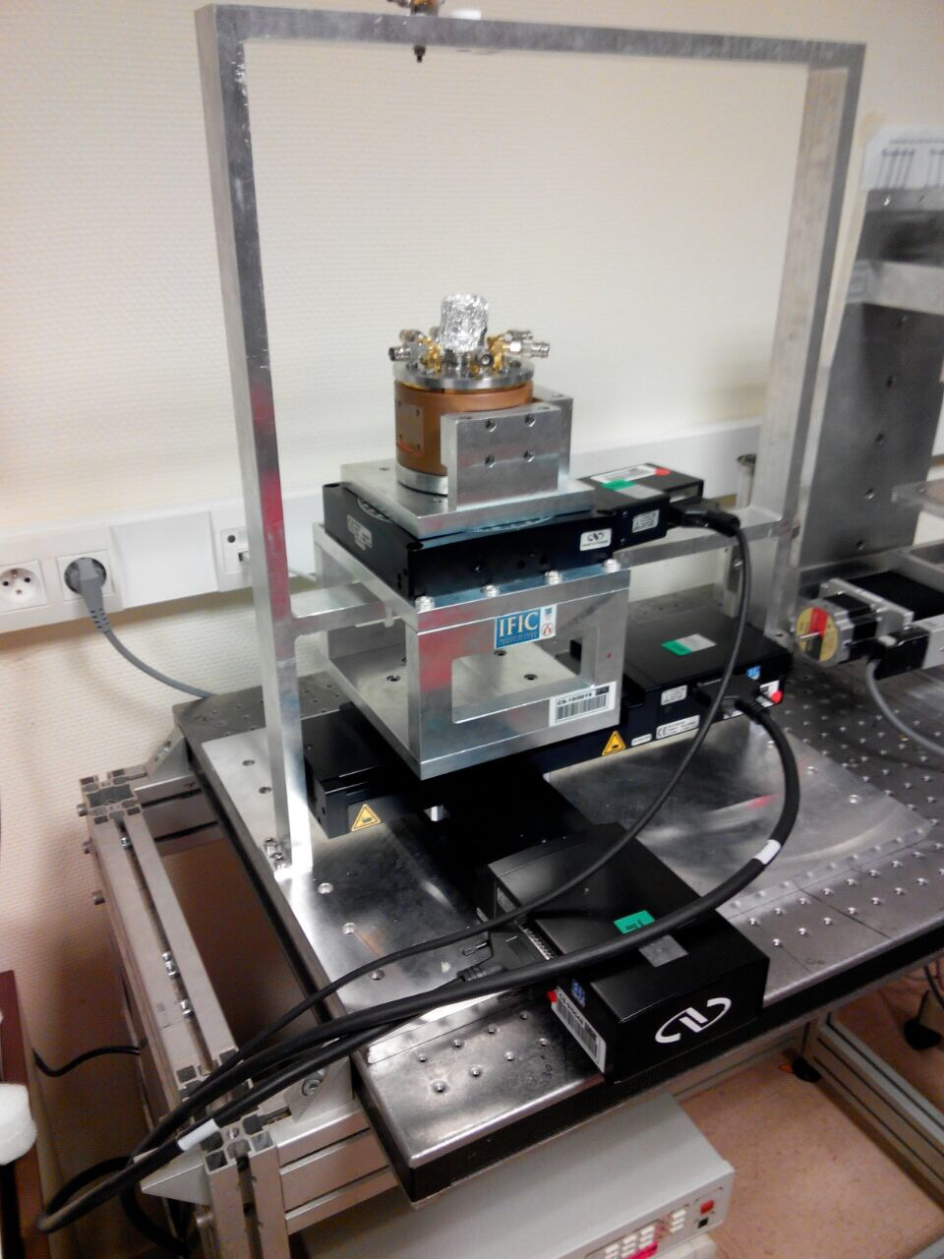
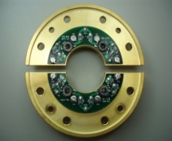
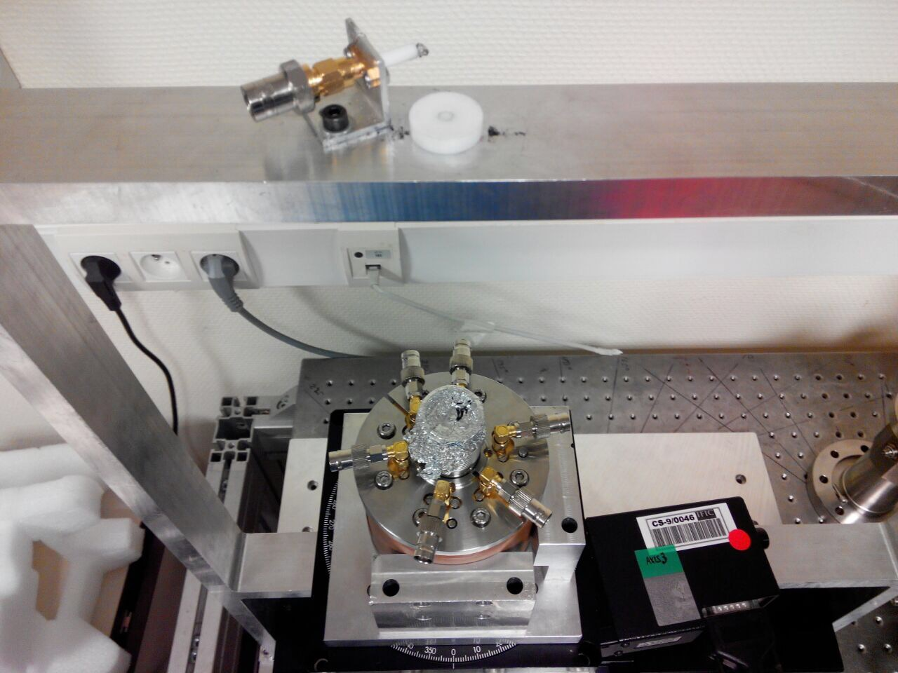
Beam Diagnostics
Inductive BPMs recuperated from CTF3, tests at IPNO in collaboration with BI-CERN
BPM Test bench At IPNO labs.
Inductive BPm
On going work…

Slide 16
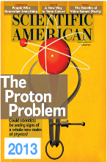
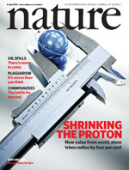
The nuclear physics / nucleon structure
Principle experiment: proton charge radius measurement, 30-70 MeV

Slide 17


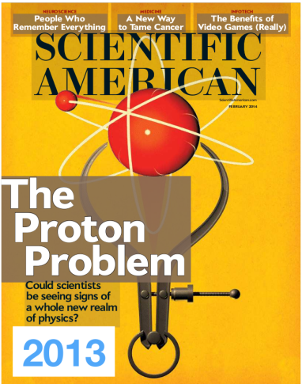
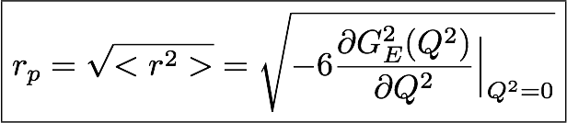
ProRad: the proton radius puzzle
5σ
Muonic hydrogen spectroscopy
Electron scattering experiments
r_{p} = 0.84184±0.00067 fm
r_{p} = 0.87900±0.00800 fm
Direct measurement
(10 times more precise)
Indirect measurement
(extrapolation of Form Factor data to Q² =0)
→ Problem: the proton is smaller as « seen » by muons than by electrons

Slide 18
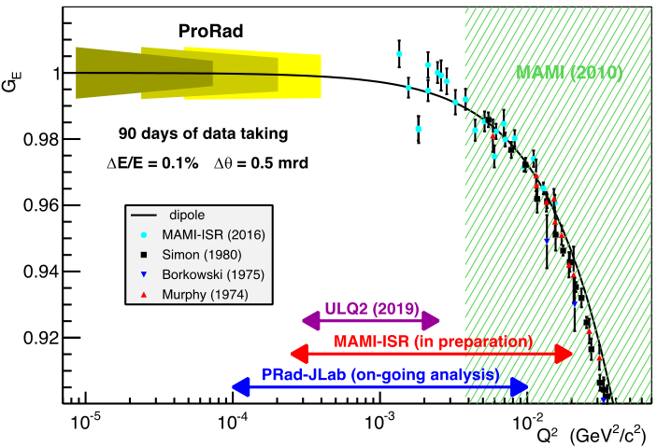

ProRad: the proton radius puzzle
Need for low Q² experimental electron scattering data
linear region in the form factor:
‘Exact extrapolation’
MUSE
ProRad goal: A high precision measurement of the proton electric form factor at very low Q²
Foreseen results:
Better knowledge of the dependence of Form Factor on Q²
Significant impact on the measurement of the proton charge radius
new physics?
Notes:
Q² = momentum transfer.
Message : il y a beaucoup d’experiences qui se préparent pour cette mesure, mais + haute énergie et haut Q2 → motivation internationale sur la question
Si l’écart expérimental se confirme, alors il y a de la nouvelle physique à trouver dans la nature de l’interaction

Slide 19
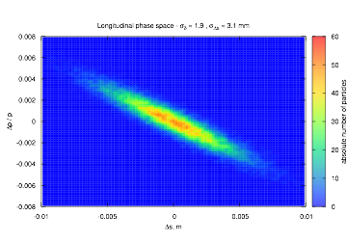
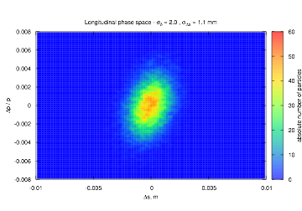
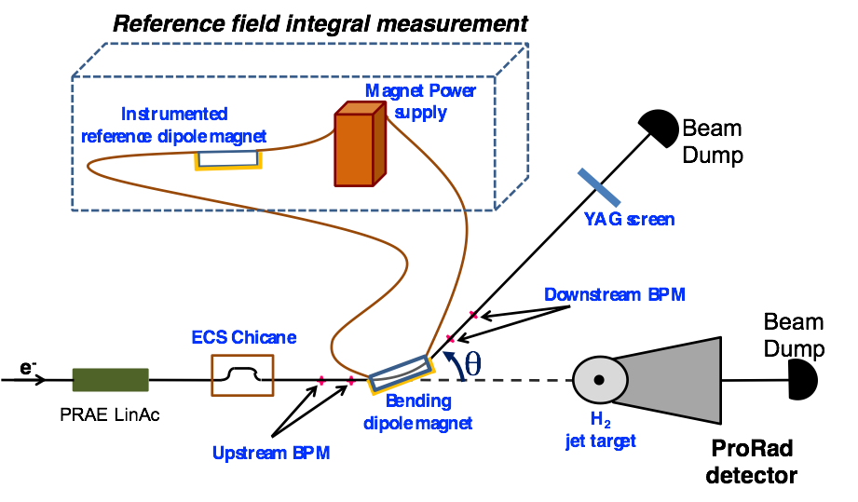

ProRad: experiment requirements
ProRad accelerator experiment requirements:
High precision beam: reduced energy dispersion (5x10⁻⁴)
Precise knowledge of the beam energy (5x10⁻⁴)
Association with a RF cavity or dechirping structure
Energy Compression System
D chicane of 4 identical dipoles
Longitudinal phase space (σ_{Δs}≈ 3 mm)
Longitudinal phase space (σ_{Δs}≈ 1 mm)
Δp/p
Δp/p
q = 60º
Δs (m)
Δs (m)
Beam energy measurement
Deviate the beam in a controlled magnetic field: absolute knowledge of the beam energy
With a possible configuration of 1 m long dipole with 0.5 T field and a 60º deviation angle
Notes:
Alternative solution is to add a passive structure based on magnetic field created by the beam flow in tubes (wakefield). The form of this structure is essential to generate the field necessary to compress the beam to a dispersion of 5x10⁻⁴.
Beam Position Monitors (BPM) to measure θ
Control magnet connected serially with the dipole magnet → precise measurement of the integral field

Slide 20
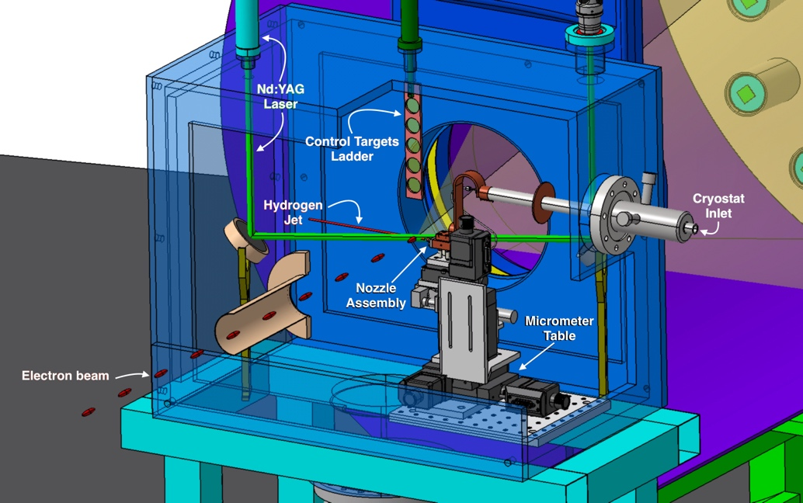
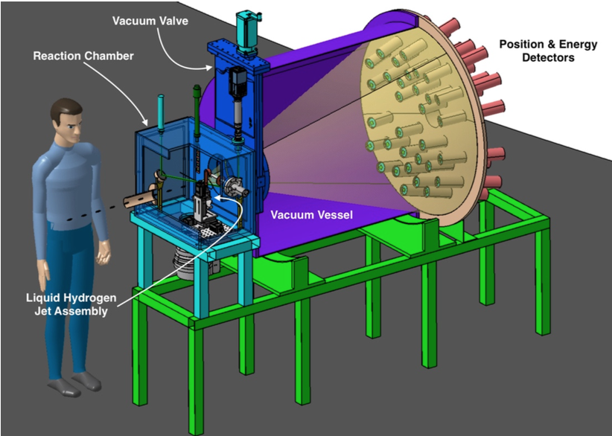
ProRad: experiment requirements
ProRad target experiment requirements:
A stable hydrogen target
Optimized measurement of the scattered electron energy and position
French-German collaboration
Reaction chamber with target assembly
Hydrogen target
32 elementary detectors placed at 5 different scattering angles at a distance of 1.5 m from the target
A very stable windowless and self-replenishing target of 15 µm diameter
Endcap
Ultra cold liquid technology developed at Frankfurt University
Notes:
Windowless target: reduced background
Thin target: precise knowledge of interaction vertex
Each elementary detector made of
2 planes of scintillating fibres
A cylindrical BGO crystal (π2.5²x15 cm³)
BGO Crystals: from Saint-Gobain (4 k€) and from Alpha Spectra (3.7 k€)

Slide 21
Instrumentation R&D
Principle goal is to construct versatile tool for detector R&D and tests: deliver calibrated beam with adjusted and known kinematics and number of electrons per sample

Slide 22
Instrumentation R&D at PRAE
Fully-equipped versatile tool for precision instrumentation R&D based on high-performance electron beam
Excellent technical performance
Timing reference, < 10 ps bunch length
Charge accuracy, RMS < 2×10⁻³
Low straggling (energy >> 1 MeV)
High-performance, remotely controlled tools
Beam position, profile and monitoring
60 digitization channels for users on NARVAL-based data acquisition
Motorized moving table for scans, accuracy < 500 µm
No need to place the detectors in vacuum
Measure the time, charge and imaging performance of particle detectors
→ Calibration for charge, trigger, tracking detectors
Notes:
The timing performance is a major difference compared to other facilities (such as Legnaro)

Slide 23
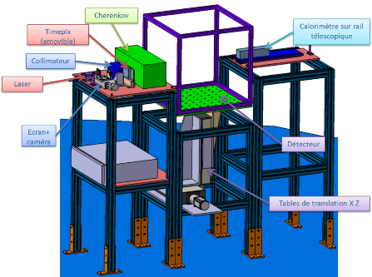
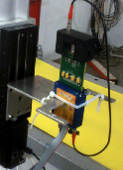
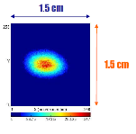
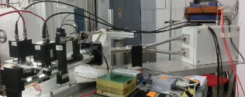





Deliverables
Timepix detector for precision spot measurement
Cherenkov quartz counter for intensity monitoring
2 channel Cherenkov counters (LAL) tested at BTF (Frascati); installed in the SPS (CERN) beam pipe
DAQ + slow control
Calorimeter for energy monitoring
60 user digitization signals (WaveCatcher)
DCOD = NARVAL + ENX
BGO scintillator crystals in compact matrix geometry
SPS beam
Participation of
Centre de Sciences Nucléaires et de Sciences de la Matière
Example of a calorimeter realized at IPN
Notes:
Available know-how to process the recorded traces of wavecatcher

Slide 24



Instrumentation R&D: draft implementation
Accelerator
Platform
SPECTROMETER

Slide 25
The Radiobiology experiment
New approaches in radiotherapy: VHEE
Delivery doses:
Grid mini-neam (Y. Prezado, R. Delorme, IMNC)
FLASH (V. Fauvadon CPO)

Slide 26
New approaches in radiotherapy
Radiotherapy (RT): treatment of some radio resistant tumors, pediatric cancers and tumors close to a delicate structure (i.e. spinal cord) is currently limited
One main challenge is to find novel approaches to increase normal tissue resistance
Standard RT restricted to the few temporal and spatial schemes, dose rates, broad field sizes: mainly photons, 2 Gy/session, 1 session/day, 5 days/week, dose rates ~ 2 Gy/min, field sizes > cm2, homogeneous dose distributions
Possible strategies to spare normal tissue
Different particle types: Very High Energy Electrons (VHEE)
Different dose delivery methods: Grid Mini-beam or FLASH

Slide 27


VHEE State of the art:
5-25 MeV electrons are classically used in the clinic but, due to their physical energy deposition profile, their use is restricted to treat superficial tumors. Increasing the energy above 70 MeV (VHEE) will overcome these limitations and, in addition, present the following advantages:
i) the penetration becomes deeper and the transverse penumbra sharper thus allowing a more precise treatment of deeper tumors
ii) the small diameter VHEE beams can be scanned avoiding mechanical solutions such as the multileaf collimator
iii) a rather smaller sensitivity to tissue heterogeneity can be achieved with VHEE beams under certain conditions
iv) VHEE accelerators may be constructed at significantly lower cost than current proton facilities.
5-25 MeV electrons are classically used in the clinic but, due to their physical energy deposition profile, their use is restricted to treat superficial tumors. Increasing the energy above 70 MeV (VHEE) will overcome these limitations and, in addition, present the following advantages:
i) the penetration becomes deeper and the transverse penumbra sharper thus allowing a more precise treatment of deeper tumors
ii) the small diameter VHEE beams can be scanned avoiding mechanical solutions such as the multileaf collimator
iii) a rather smaller sensitivity to tissue heterogeneity can be achieved with VHEE beams under certain conditions
iv) VHEE accelerators may be constructed at significantly lower cost than current proton facilities.
5-25 MeV electrons are classically used in the clinic but, due to their physical energy deposition profile, their use is restricted to treat superficial tumors. Increasing the energy above 70 MeV (VHEE) will overcome these limitations and, in addition, present the following advantages:
i) the penetration becomes deeper and the transverse penumbra sharper thus allowing a more precise treatment of deeper tumors
ii) the small diameter VHEE beams can be scanned avoiding mechanical solutions such as the multileaf collimator
iii) a rather smaller sensitivity to tissue heterogeneity can be achieved with VHEE beams under certain conditions
iv) VHEE accelerators may be constructed at significantly lower cost than current proton facilities.
Treatment plan comparison between VHEE, VMAT and PBS
5-25 MeV electrons are classically used in the clinic but, due to their physical energy deposition profile, their use is restricted to treat superficial tumors. Increasing the energy above 70 MeV (VHEE) will overcome these limitations and, in addition, present the following advantages:
i) the penetration becomes deeper and the transverse penumbra sharper thus allowing a more precise treatment of deeper tumors
ii) the small diameter VHEE beams can be scanned avoiding mechanical solutions such as the multileaf collimator
iii) a rather smaller sensitivity to tissue heterogeneity can be achieved with VHEE beams under certain conditions
iv) VHEE accelerators may be constructed at significantly lower cost than current proton facilities.

Slide 28




Grid or mini-beam therapy:
One possible strategy to further improve the healthy tissue tolerance by using the concept of Spatially Fractionated Radiation (SFR) dose is the Grid or Mini-Beam Therapy (MBRT). In contrast to conventional RT the lateral dose-profile resulting of such grid-irradiation consist in a pattern of high doses in "peaks " and low doses in "valleys”.
First beam optics design to get transverse beam sizes of less than 700 mm with low beam divergence and tracking simulations have been performed.

Slide 29




FLASH therapy:
The FLASH methodology consists of millisecond pulses of radiation (beam-on time ≤ 100-500 ms) delivered at a high dose-rate (≥ 40-100 Gy/s), hence over 2000 times faster than in conventional RT. Recently it has been shown that FLASH spares normal brain in mice from the loss of both memory and neural stem cells as endpoints.
In PRAE direct beam line two different scenarios for FLASH tests in small animals:
i) Sparing brain from radiation-induced loss of stem cells: round transverse beam sizes of around 10 mm with a dose of 10 Gy with beam on time 100 ms (5 bunches at 50 Hz), i.e. 10Gy/s
ii) Sparing lung from radiation-induced fibrosis: transverse beam sizes of around 26 mm in horizontal and 18 in vertical with a dose of 15 Gy with beam on time 500 ms (25 bunches at 50 Hz), i.e. 30 Gy/s.

Slide 30


BDSIM simulations : modelling and beam evolution:
Tracking simulations of a Gaussian bunch through the under vacuum accelerator beam line, an air gap of 10 cm and liquid water phantom of 3 cm depth has been performed with a Geant4 (Penelope module) based program BDSIMfor 70, 140 and 300 MeV. A benchmarking of the BDSIM results with MADX for the vacuum part and with the results with GATE (Geant4-based) in air and water has been made.

Slide 31





FEVHER Feasibility and Experimental Validation of Very High-Energy Electron Radiotherapy
Angeles Faus-Golfe
Manjit Dosanjh
Philip Poortmans
Roger Michael Jones

Slide 32
Motivation and Objectives:
The main goal of FEVHER project is to demonstrate that VHEE are suitable for innovative RT applications in particular by allowing Grid and FLASH methodologies, which are likely to represent a major breakthrough in RT.
Adaptation and Exploitation of the existing Facilities
Medical Physics: Modelling and Dosimetry
CNRS, University of Manchester, Institute Curie, CERN
In Vitro Radiobiology
In Vivo and pre-Clinical studies
Design of an optimized future machine for VHEE

Slide 33
FEVHER facilities
Beam performances of CLEAR, VELA-CLARA and PRAE
CLIC-CERN
U. MANCHESTER
CNRS-LAL

Slide 34
Summary
Task 3.4 is progressing well
A dedicated session for others applications of e- up to 140 MeV could be organized in the PRAE workshop in Fall 2018

