Slide 1
Persistent identifiers:
DOI
Annette Holtkamp
CERN-UNESCO School on Digital Libraries
Nairobi, Oct 8–12, 2018

Slide 2


Slide 3
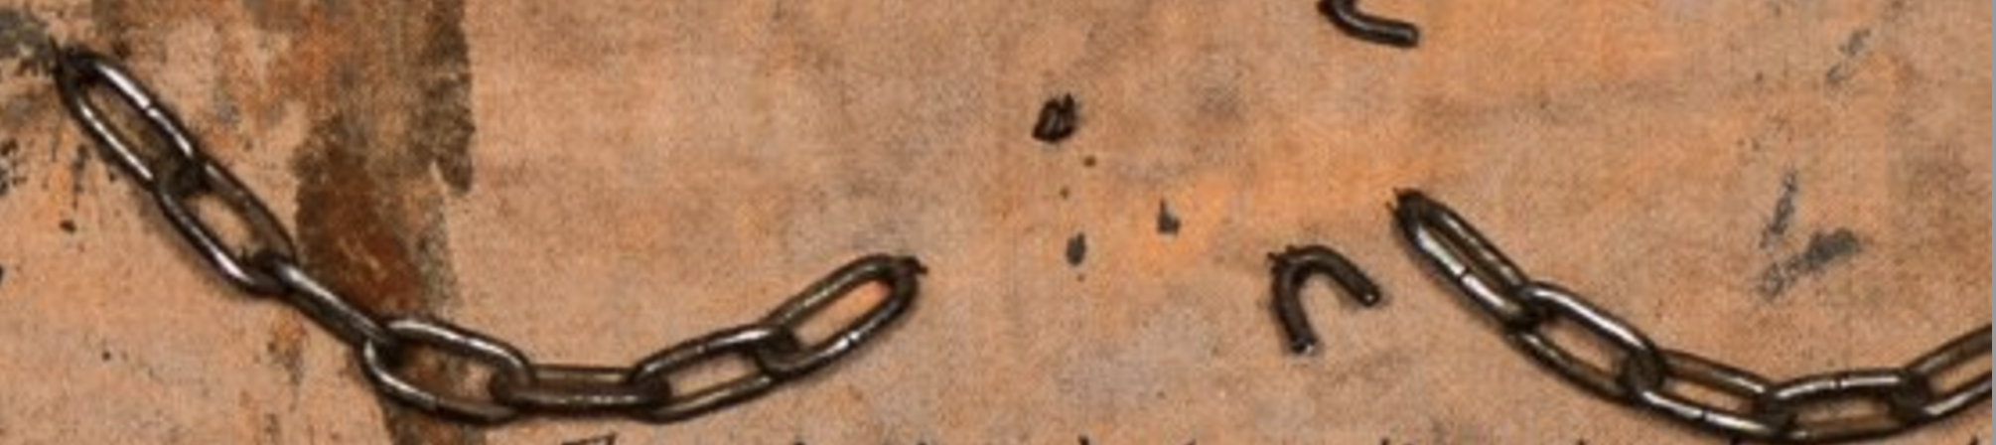
Problem: link rot

Slide 4
Problem: link rot
One remedy: persistent identifier

Slide 5
Problem: link rot
One remedy: persistent identifier most well-known: DOI

Slide 6
URI

Slide 7
URI: Uniform Resource Identifier
String of characters identifying a resource
2 functions:
  name
  localize
Most common form: URL
Less often used: URN

Slide 8
URI syntax
<scheme>:<hierarchical part>[?query][#<fragment>]
URI scheme
  Protocols like http, ftp, mailto…
  File
  RDF ressources, XML name space…
  Specifies a concrete syntax
Hierarchical part
  “//”
  Authority: hostname
  path

Slide 9
URL: Uniform Resource Locator
“web address”
Identifies a resource
allows to obtain a representation of it
  Specifies network location
  Specifies access mechanism

Slide 10
URN: Uniform Resource Name
Provides a mechanism for identifying a resource in a particular namespace
  E.g. urn:isbn:<isbn>
Does not specify location or access method

Slide 11


Digital Object Identifier
Digital identifier of an object
Identifier of a digital object
Persistent identifier for all research artefacts
Established in 2000
Managed by International DOI Foundation (IDF)
Federation of registry agencies worldwide
Actionable, interoperable

Slide 12
DOI syntax
Character string: <prefix>/<suffix>
Prefix:
  identifies registrant of the DOI
  Usually 10.NNNN (at least 4 numbers)
Suffix:
  chosen by registrant
  Most legal Unicode characters allowed
Resolved e.g. by https://dx.doi.org/<doi> or https://doi.org/<doi.

Slide 13
DOI benefits
Persistent identification of an object
  Does not depend on location
No disambiguity
Associated metadata
  May be updated any time

Slide 14
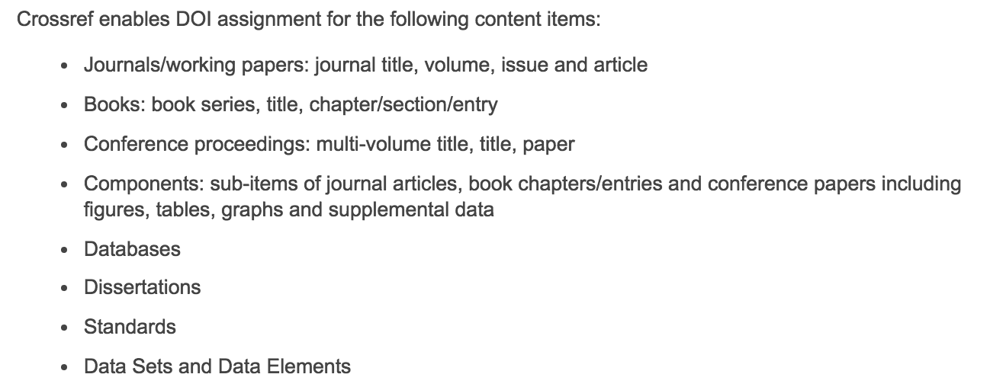
CrossRef

Slide 15

Datacite
Persistent identifiers (DOIs) for research data
Global non-profit organization
DOIs allocated by Datacite members
  Currently 55 registration agencies
Membership fee 8.500 Euro p.a.
Members charge own fee for DOIs
> 14.6 million DOIs allocated
Data centers register with a registration agency

Slide 16
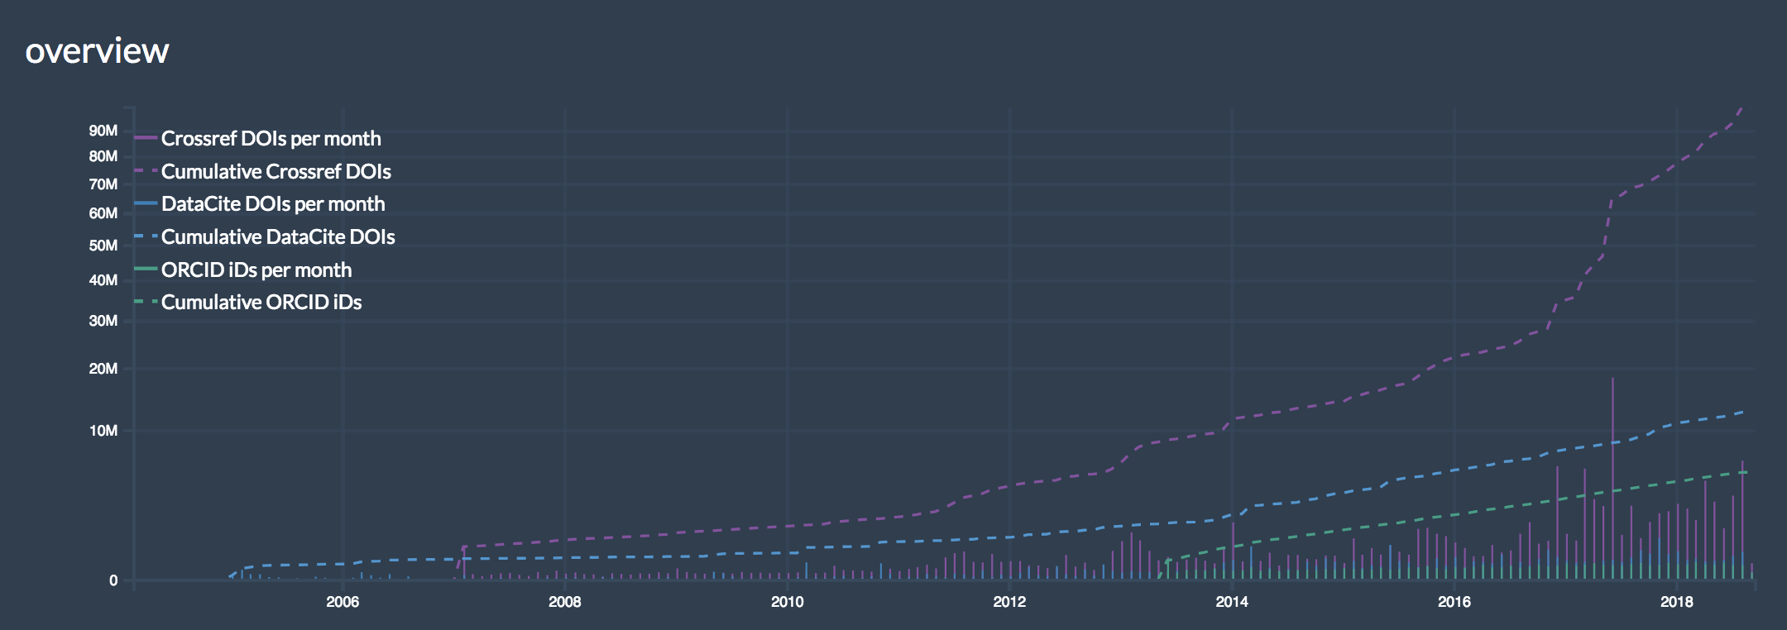
Growth of DOIs
  http://dashboard.project-thor.eu/dashboard/
~175 million DOIs assigned (Sep 2018)
+30% in 2 years
DOI fact sheet

