Slide 1

A vectorization approach for multifaceted solids in VecGeom
Mihaela Gheata for the VecGeom team
CHEP 2018
9-13 July, Sofia

Slide 2
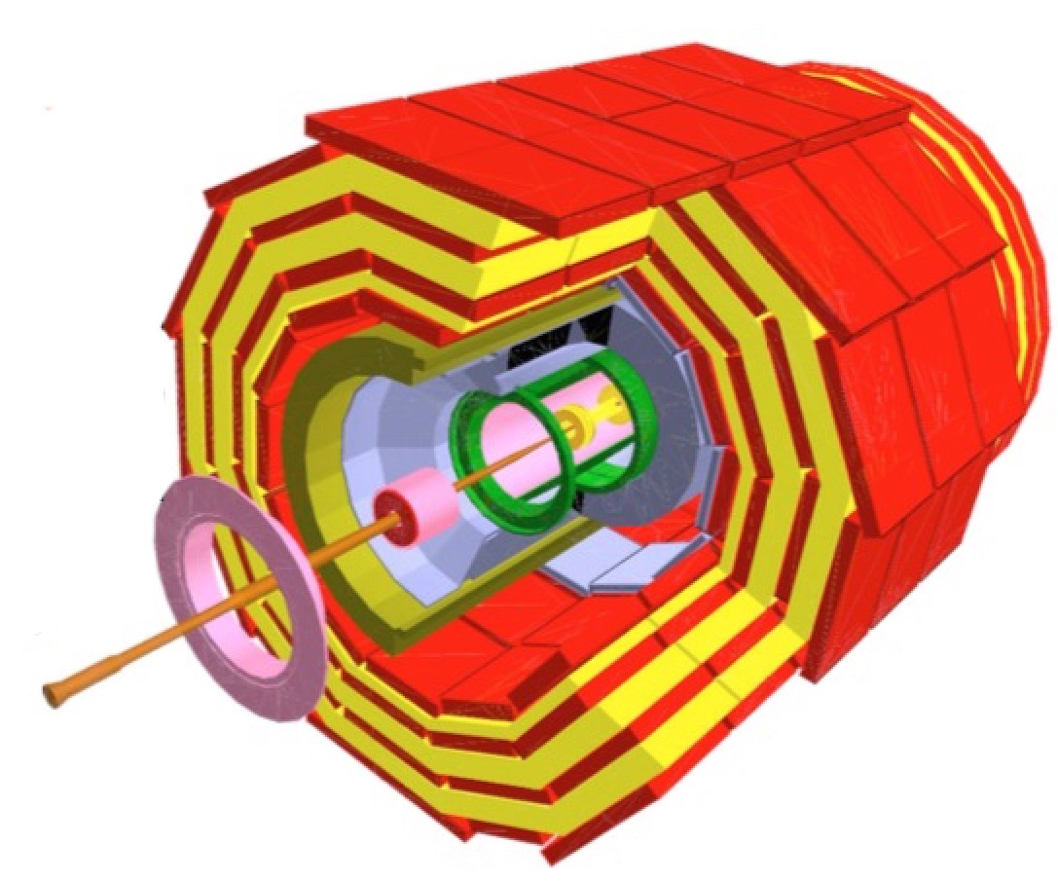
Context
Geometry modeling is a performance-critical component for detector simulation and tracking
  Locating tracks, computing line/solid intersections, surface normals, …
VecGeom development started 5 years ago aiming to optimize this functionality for multi-particle queries
  Vectorize on multiple inputs provided by GeantV as “baskets” of tracks
VecGeom started an important R&D on vectorization techniques
  Resulting in the VecCore vectorization library
    https://github.com/root-project/veccoreVecGeom
Extended USolids effort for unifying/replacing the existing geometry solids algorithms (AIDA project)

Slide 3
VecGeom = vectorized geometry
Many particle input -> vectorization on input data
  Using SIMD operations based on VecCore
  Close to ideal efficiency for simple solids, not so good for very complex ones
  Complexity (branching, early returns) creates bottlenecks for vectorization
Single particle input -> vectorization on internal loops
  Multiple facets (trapezoids, polyhedra, tessellated, extruded solids), or multiple sections of same type (polycones)
  Very important optimization mode for scalar clients (Geant4, tracking)
Vector inputs
shape
data
Vector outputs
+
SIMD
algorithms
SIMD operations
Scalar input
shapefacets
Scalar output
+
SIMD

Slide 4
VecGeom & Geant4
Geant4
G4Box
G4Tubs
VecGeom solids can be used instead of native Geant4 solids since release 10.2
  Activated with compilation option – transparent to users
Used in production by CMS in 2018
  Overall simulation time benefits of ~7-13%
  Other experiments investigating this option
Most benefits are due to internal vectorization of complex solids (polycones, polyhedra)
  Worth extending vectorization in scalar input mode for more multi-faceted solids
G4VSolid
G4UAdapter
VecGeom
UnplacedVolume
Implementation
Helper
Unplaced
Box
Unplaced
Tube

Slide 5

The obvious candidate: tessellated solid
Simulation of complex surfaces is needed in certain cases
  Medical applications, applications sensitive to material budget, space applications for shielding studies
Surfaces are represented as meshes of connected facets (coming from CAD programs)
  Vectorization seems natural for the loop over facets
A better approach is to pre-select the facets to be checked
  In most cases not all facets have to be checked. Can we select the subset of candidates also in vectorized mode?
  In Geant4 voxelization is used for this purpose
The LHCb RF-foil loaded from GDML as tessellated solid (164k facets) and visualised in Geant4 through VecGeom

Slide 6
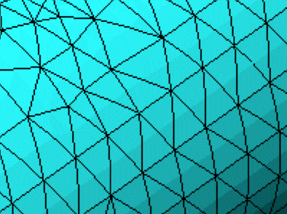
Multi-level vectorization
Tessellated solid
Group neighbour triangles in clusters, 4 per cluster. Store data in vecCore::Double_v
Make groups of bounding boxes of clusters, 8 per group
Example:
SIMD_size[AVX double] = 4
SIMD_size[AVX float] = 8
Continue grouping by 8 and make “super” bounding boxes
-> bounding volume hierarchy (BVH)
Vectorize in double computation of distances to triangles in each cluster
Vectorize in float computation of distances to super-boxes to select only hit candidates
Repeat the same with the content of the boxes being hit, until we get the candidate clusters
e⁻

Slide 7
Tessellated solid performance
O(10) speed-up compared to Geant4 in both initialization and run time for up to 100K facets
AVX double

Slide 8
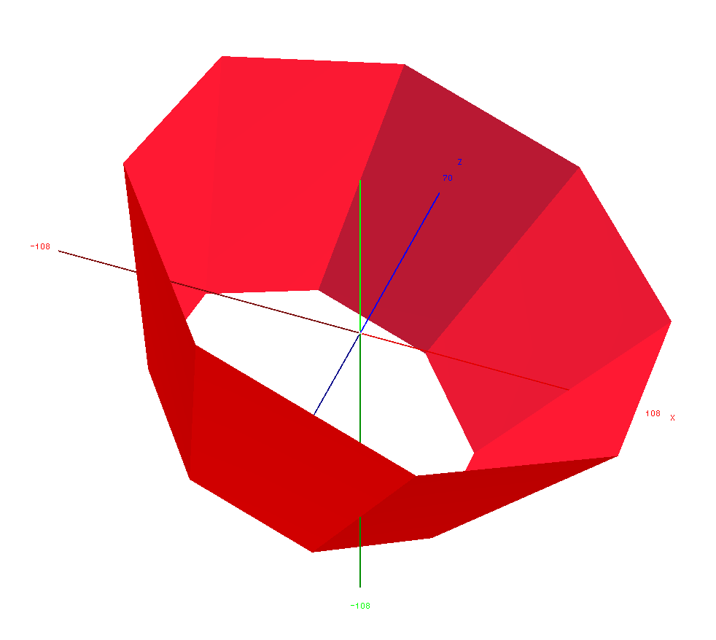
Extending multi-faceted approach
Generalized to more multi-faceted solids
  Trapezoids, polyhedra, extruded solids
Created a new SIMD helper class
  Representing a surface made of quadrilateral tiles, organized in clusters of size = vector length
  Delimited by two Z planes
  Using explicit vectorization on tiles based on VecCore

Slide 9
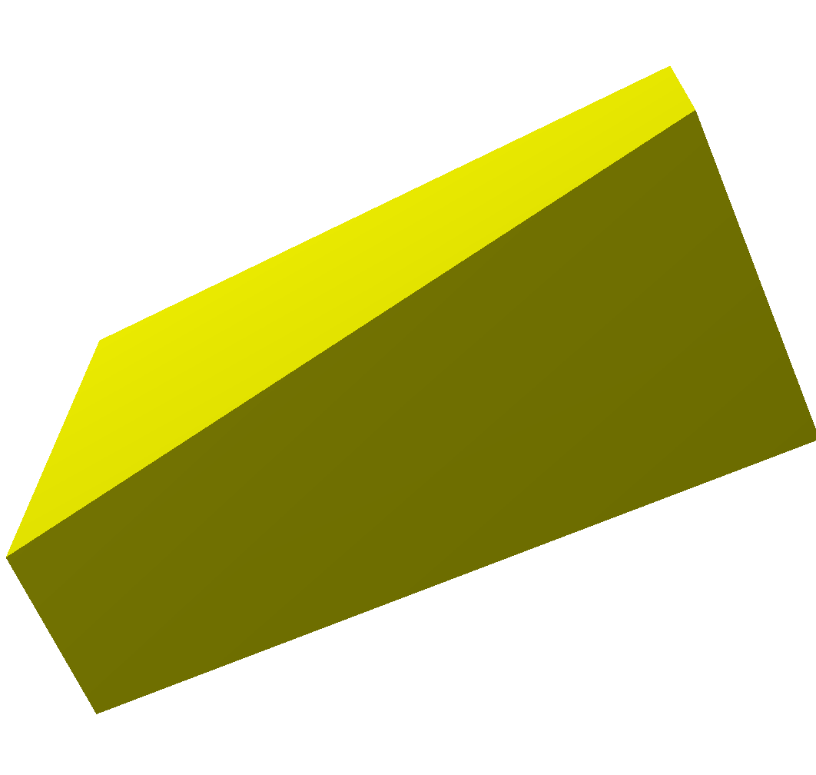
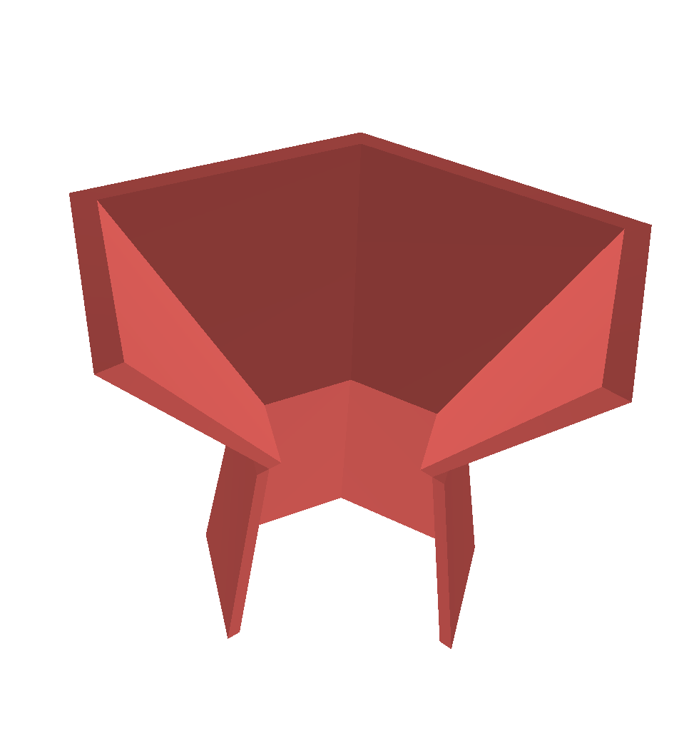
Tessellating other solids
No benefits measured for simple solids (box, simple trapezoids)
  Faster without loops
Other solids already vectorized in the scalar case -> marginal gain
  Polyhedron, Trapezoid
Important improvements observed for previously non vectorized cases
  General planar trapezoids
  Extruded solids

Slide 10
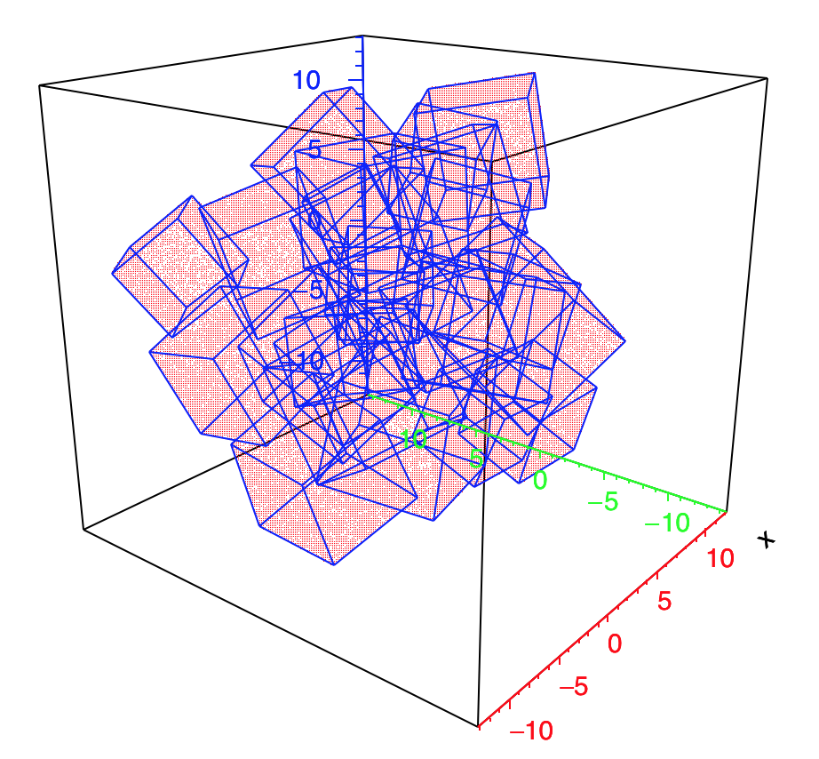
Other scalar optimizations: multi-unions
Boolean unions are represented as binary trees
  Pathologically slow in simulation - too many individual checks
Multi-unions representing nodes at same level
  Implementation in Geant4 using voxelization helper
Re-implemented in VecGeom based on Bounding Volume Hierarchies (BVH)
  Vectorized search of candidates
+
+
+
+
+
+
+
+

Slide 11
Benefits of using VecGeom multi-union
3x-4x speed-up compared to corresponding implementation in Geant4 for up to several hundred components

Slide 12
Replacing Boolean union with VecGeom multi-union
Implemented automatic conversion of Boolean volumes to the new multi-union structure
Much better performance for large number of components
+
+
+
+
+
+
+
+

Slide 13
Conclusions
VecGeom library became production quality
  Can be used transparently with Geant4 simulations
Scalar optimizations become very important
  Achieving vectorization for solids having many facets
Several vectorized optimizations explored for many solids
  Bounding volume hierarchies, tessellated clusters and sections, multi-union solids
  Important performance gains in some cases
These new features available in release 1.0 of VecGeom library

Slide 14
Contributors
CERN-EP/SFT + AIDA 2020: G. Amadio, J. Apostolakis, G. Cosmo, A. Gheata, M. Gheata, P. Mato, W. Pokorski, E. Tcherniaev
J. Martinez Castro, A. Miranda Aguillar (Mexico), P. Canal, G. Lima (FNAL), R. Sehgal (BARC), S. Wenzel (CERN-ALICE), D. Savin (GSoC student)
Repository for VecGeom
  https://gitlab.cern.ch/VecGeom/VecGeom
JIRA issue tracking tool
  https://its.cern.ch/jira/projects/VECGEOM

