Slide 1
A top to bottom framework approach to vectorization
A. Gheata for the GeantV team
CHEP 2018
9-13 July 2018, Sofia, Bulgaria

Slide 2


Preamble
“You need to go faster for Run3 !!!
“But… I’ve reached the theoretical stroke rate limit!...”
“Manufacturers made a longer model for you! It’s called AVX-512”
“Tried it, doesn’t go faster …”
“You maaay need to fill it up…”
  “I have few ideas how to
  do that…”
“Some coordination is also needed”
  “Can I use my old whistle?”

Slide 3
Vector workflows: vectorizing the data loop
Scalar data
Scalar data
Scalar data
Scalar data
algorithm
algorithm
algorithm
s
s
s
s
Vector data
Vector data
Vector data
Vector data
Vector
algorithm
Vector
algorithm
Vector
algorithm
v
v
v
v
Online
s
algorithm
s
algorithm
if
s
algorithm
s
algorithm
s
algorithm
Simulation, tracking, analysis
s
algorithm
s
s
algorithm
if
s
algorithm
s
s
algorithm
if

Slide 4
Complex workflows in vector approach
s
algorithm
s
algorithm
if
s
algorithm
s
algorithm
s
algorithm
s
algorithm
s
Buffer outputs to next stages
s
algorithm
if
s
algorithm
s
s
algorithm
if
Stage
To which extent?
Potential benefits?
Programmability?
Maintainability?
-> GeantV R&D
basketizer
Algorithm_v
Stage
Stage
buffer
selector
basketizer
Algorithm_v
High-level branching algorithms become “stages”
Branching becomes streaming
basketizer
Algorithm_v
Buffer more inputs
Stage
Vectorize lower-level algorithms and feed more particles at once

Slide 5
GeantV version3 workflow
Both scalar/vector flow are supported
Handler 1
scalar
virtual
DoIt(Track*)
GeantPropagator
SimulationStage
Select(track)
SimulationStage
virtual DoIt(std::vector<Track*>)
SimulationStage
Handler “i”
vector
SimulationStage
Basketizer “I”
threads of the same propagator collaborate
Stage buffer
Stage buffer
Stage buffer
Stage buffer
GeantTrack *
serving tracks for ALL threads
gen_{N}
gen₁
gen₀
Event server
Priority filter
…
policy to consume showers first
secondaries…
primaries

Slide 6
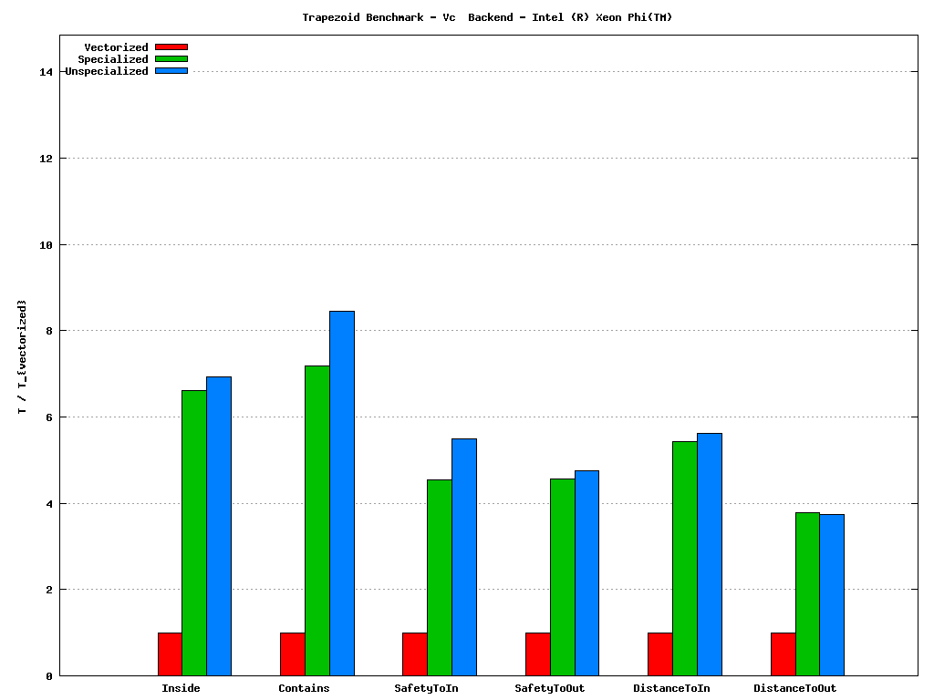
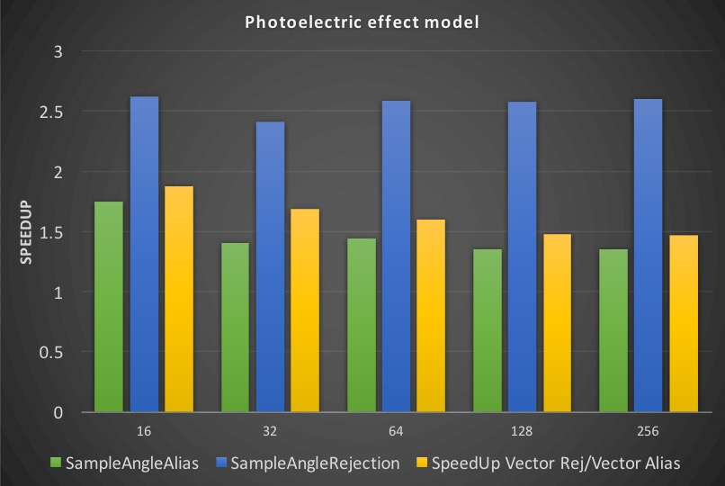

The bottom view: core components
https://github.com/root-project/veccore
Vectorization of low-level algorithms
  Geometry (M.Gheata talk), physics (M. Bandieramonte talk), propagation in field
  Vectorizing on multi-particle inputs, but also on internal loops when possible
https://github.com/root-project/vecmath
Arch specs,
White background
Trapezoid benchmark on Xeon Phi (AVX-512 double)
vectorized
specialized
unspecialized

Slide 7
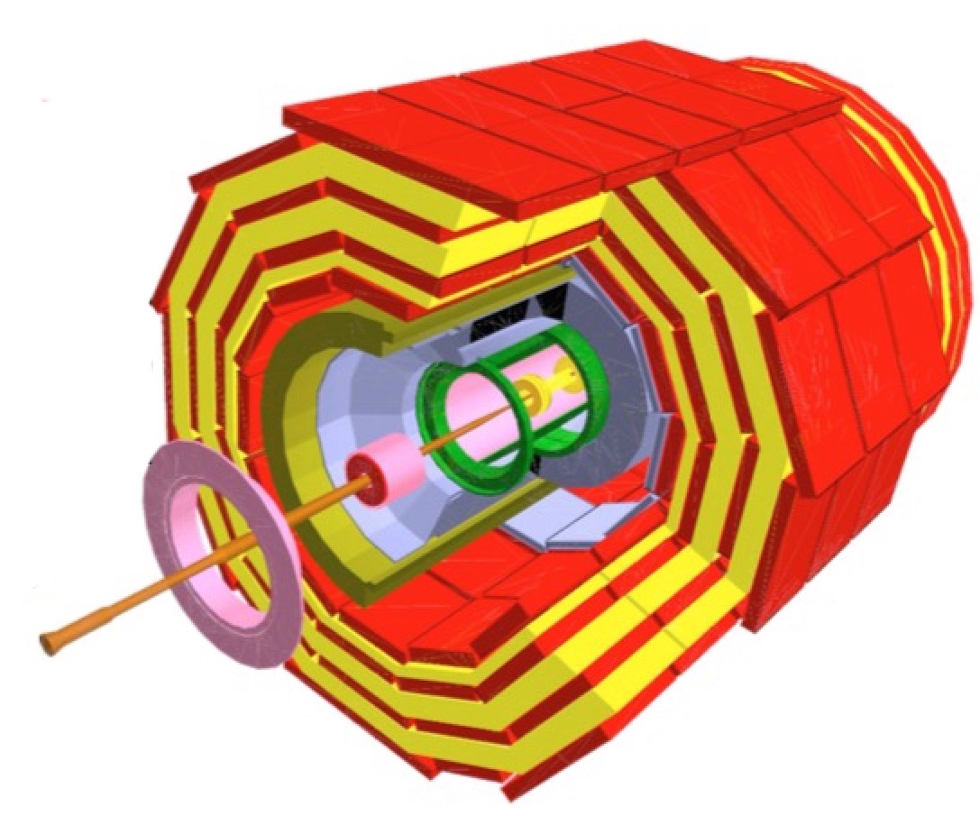
The top view: simulation stages
Top-level profile of basketized GeantV simulation of CMS
The relative weight depends on the setup
  Geometry complexity, physics list, user cuts
Many stages containing already vectorized code
  Field propagation giving expected speed-up in the full flow
  Not yet the case for geometry and post step action physics stage
Thorough benchmarking against equivalent Geant4 application ongoing
Current phase: performance optimizations
  Detailed profiling to understand overheads and bottlenecks

Slide 8
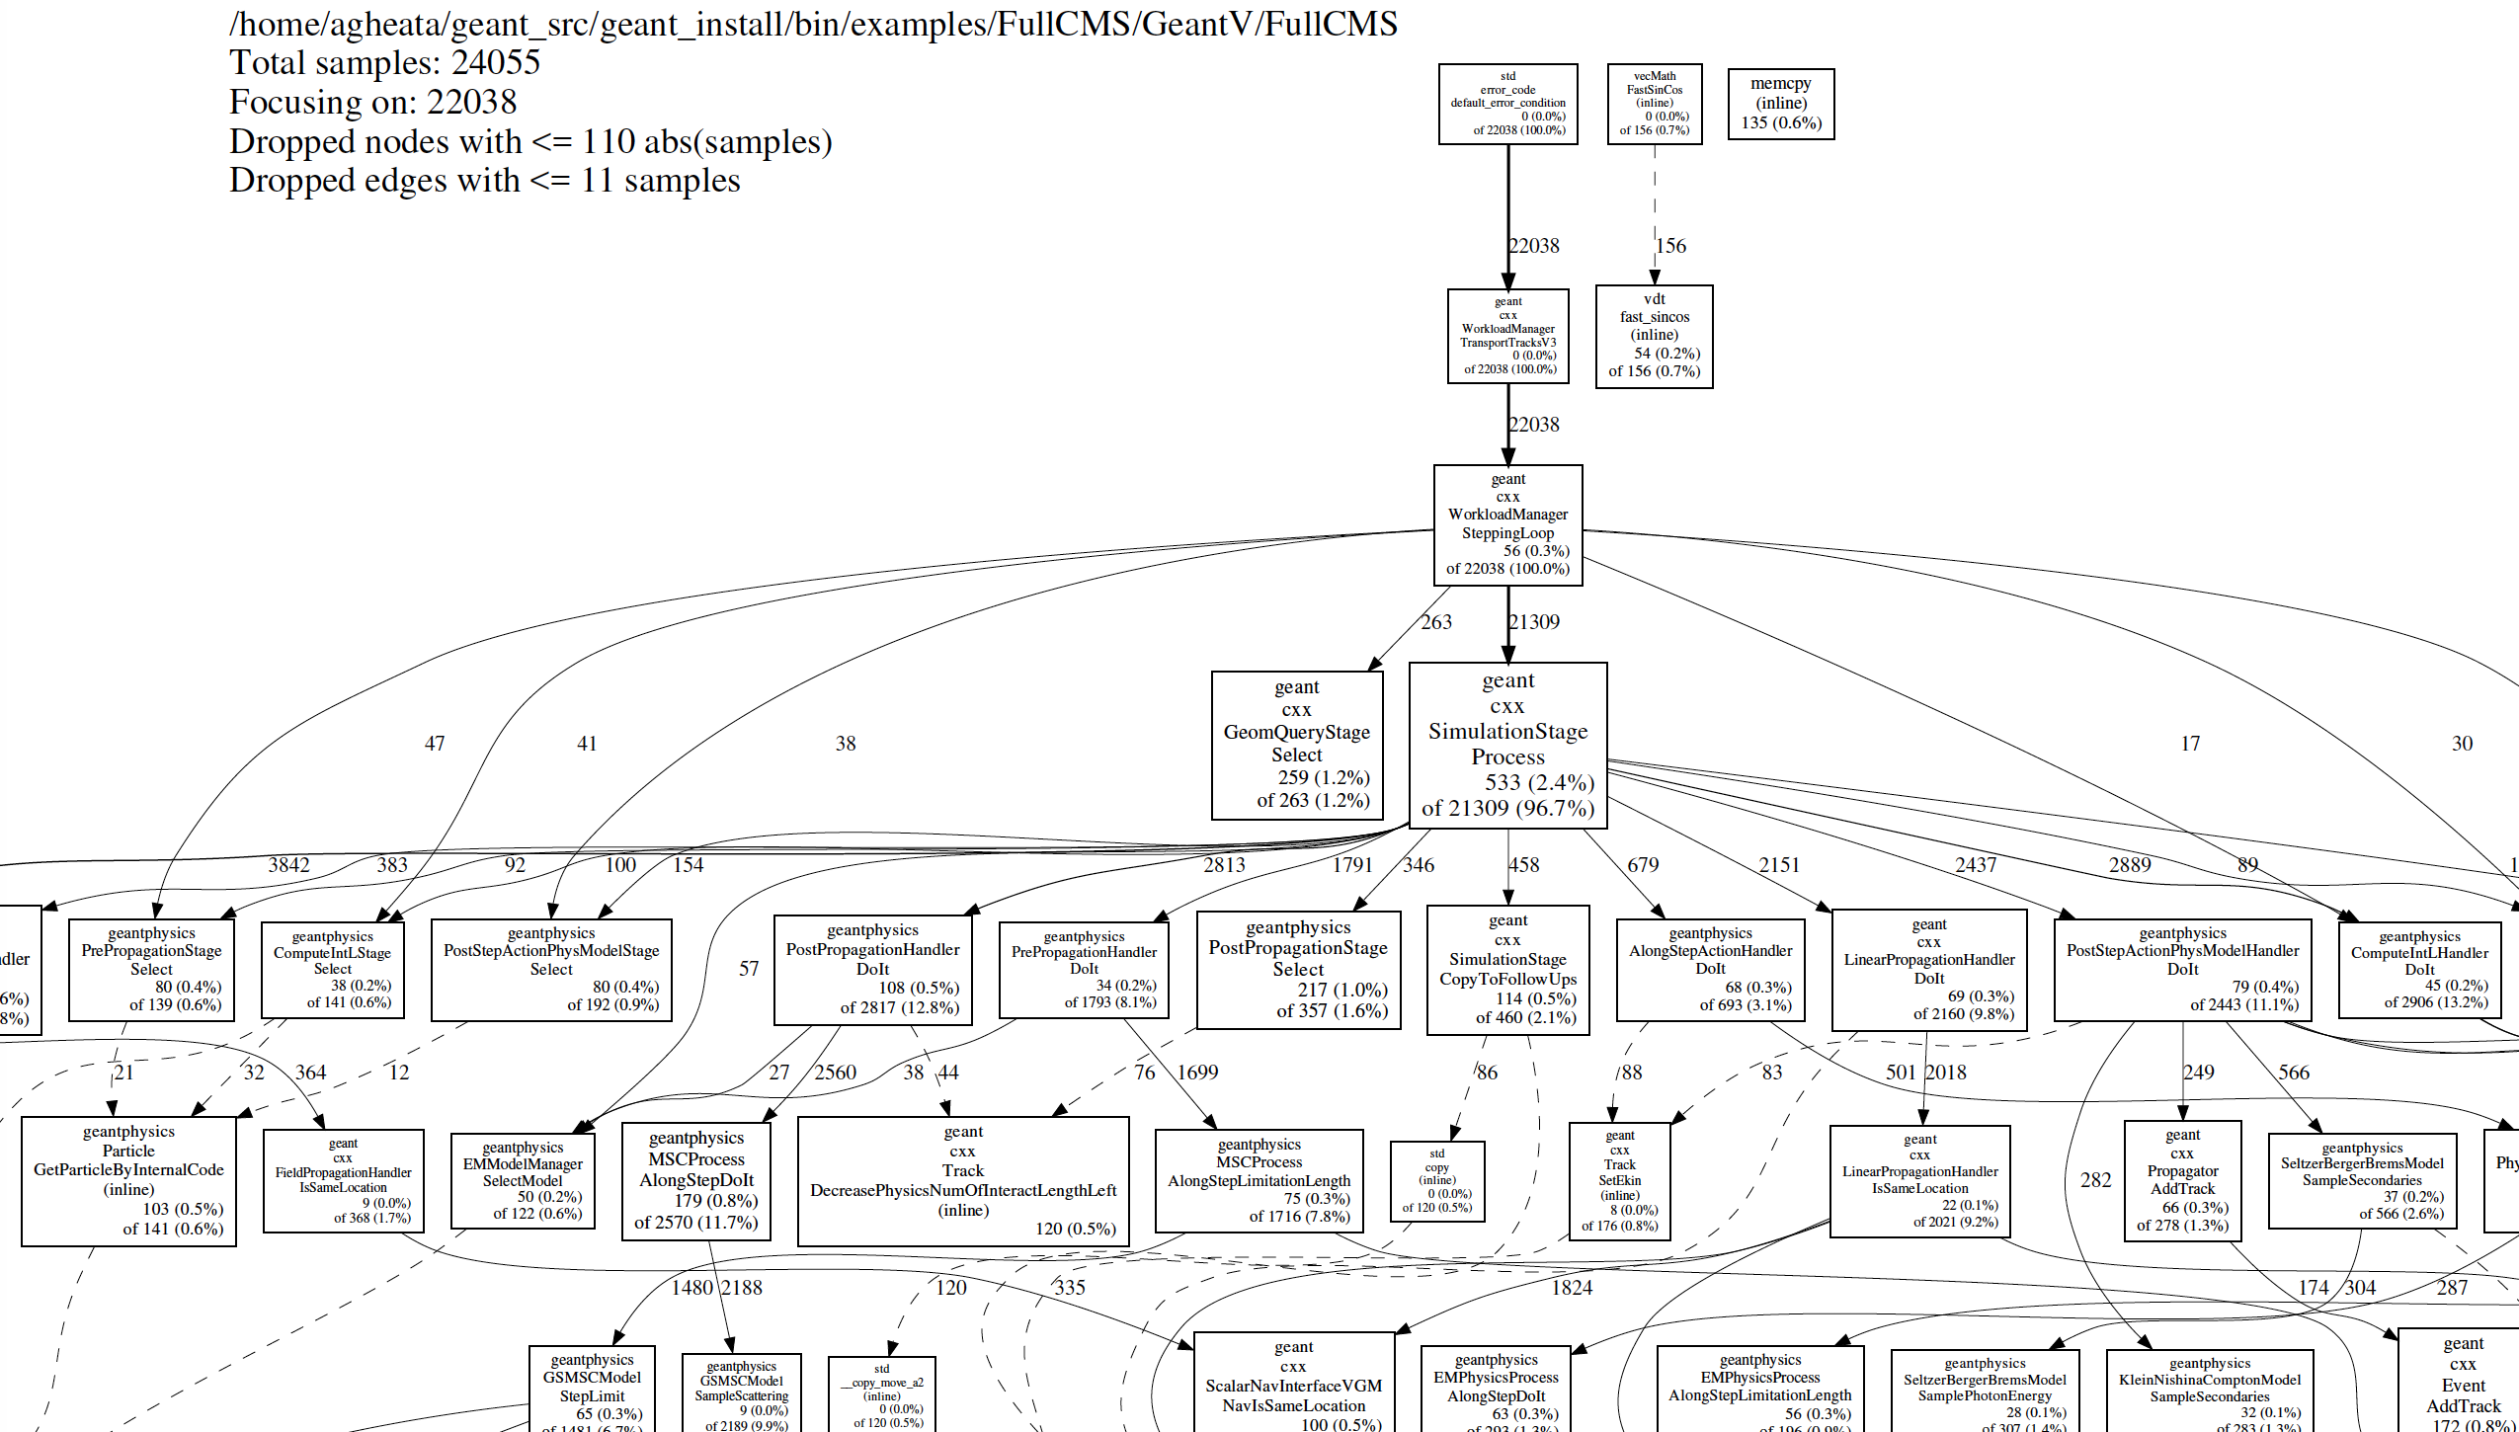
Profiling GeantV application
Spotting things we can improve
Understanding hotspots
Understanding basketization overheads
Working on reducing scalar bottlenecks
gperftools
Comparing scalar with basketized profiles

Slide 9
Benchmarking metrics
e⁻
TestEm3 example, 100 GeV e⁻ fixed gun, GeantV EM physics list
Benchmarking several different configurations
  Magnetic field ON/OFF
  Field Runge-Kutta vs. helix
  Physics, field, (geometry in future) basketizing ON/OFF
  Basket emulation as scalar loops (understand basketization overheads)
  MT simulation
Corresponding profiles extracted
  Plan to do the same for Geant4 with different field configurations
Field basketization working properly
Physics basketization not yet very efficient

Slide 10
Current performance benchmarks - CMS
Xeon® E5-2630@2.40GHz
gcc 7.3 AVX2, Vc backend
CMS geometry, 100 GeV e⁻ isotropic gun
GeantV EM physics list, same geometry & production cuts GV/G4
Best realistic case speedup vs. Geant4: ~60%
Speedup vs. Geant4

Slide 11
Ongoing work
Vectorization work and connection of vectorized code
  Multiple scattering and photoelectric model (first implementation available)
Reducing basketization overhead
  Light version (no track exchange among threads)
Geometry optimizations
  Specialized volume navigators (reducing scalar bottlenecks + de-virtualizing + caching)
Physics optimizations + new features
  Selective switch-on alias tables for ”hot” regions instead of rejection sampling, for models where it brings profit
  Use of floating point instead of double case by case
  Work on pRNG to support reproducibility in MT + basketized mode
These can bring to a factor of ~2x for the full CMS benchmark for the beta tag end 2018 compared to Geant4
  Out of which 25-40% from basket vectorization

Slide 12
Outlook
Top to bottom vectorization on input data opens new optimization opportunities
  New algorithms become vectorizable
  Pipeline workflows are perfect candidates, but more complex workflows can also benefit
  Basketizing data comes with benefits (better caching, vectorization), but also overheads (data copying, larger memory footprint)
Benefits of basketized approach become visible in GeantV
  Not as large as initially expected due to the large complexity of simulation code
  A detailed profiling analysis and optimizations ongoing
Beta release by the end of 2018
  Demonstrator for realistic simulation of EM showers in the context of LHC
  Targeting a factor of 2 speed-up, out of which up to ~40% from vectorization

Slide 13
GeantV collaborators
BARC: S. Behera, A. Bhattacharyya, H. Kumawat, R. Sehgal
CERN: A. Ribon, A. Gheata, D. Konstantinov, F. Hariri, F. Carminati, G. Cosmo, G. Amadio, GR Khattak, I. Goulas, J. Apostolakis, M. Bandieramonte, M. Gheata, M.Novak, O. Shadura, P. Mendez Lorenzo, PR Karpinki, R. Brun, S. Wenzel, S. Vallecorsa, V. Ivantchenko, W. Pokorski, K. Nikolics
FNAL: D. Elvira, G. Lima, K. Genser, P. Canal, SY Jung, A. Miranda-Aguillar, J. Martinez
Students 2017-2018: R. Schmitz, V. Drogan, S. Sharan, E. Orlova, Ananya, D. Savin
Thank you !

