Slide 1
BI@ELENA

Slide 2
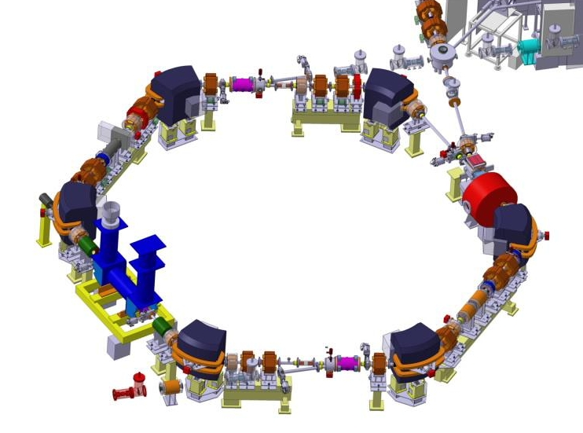
Extra Low ENergy Antiproton ring
Secondary emission monitors
Scraper
BTV systems
30.4 m circumference
5.3 MeV to 100 keV
N < 2.5 x 10⁷ pbars
Ultra high vacuum
  2 x 10⁻¹² torr
30 sec cycle with electron cooling at 35 MeV/c and 13.75 MeV/c
Recombination monitor
Electron cooler
Beam position monitors (10+2)
Tune measurement (PU+kicker)

Slide 3
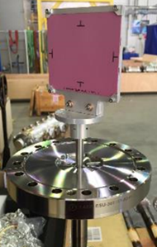
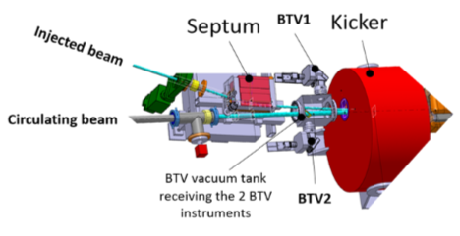
BTV
Type Al₂O₃:CrO2
Thickness 1mm
Calibration marks No grid to better optimize the S/N with image digitalization
Magnetic coupled actuator
Resolution of 190um/px and 215um/px
Three monitors installed – one in pbar line, two in common tank at injection

Slide 4
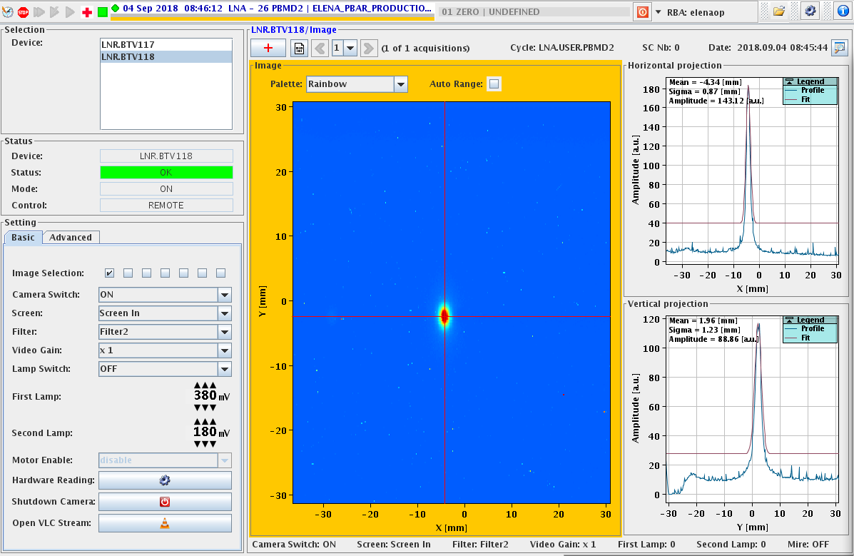
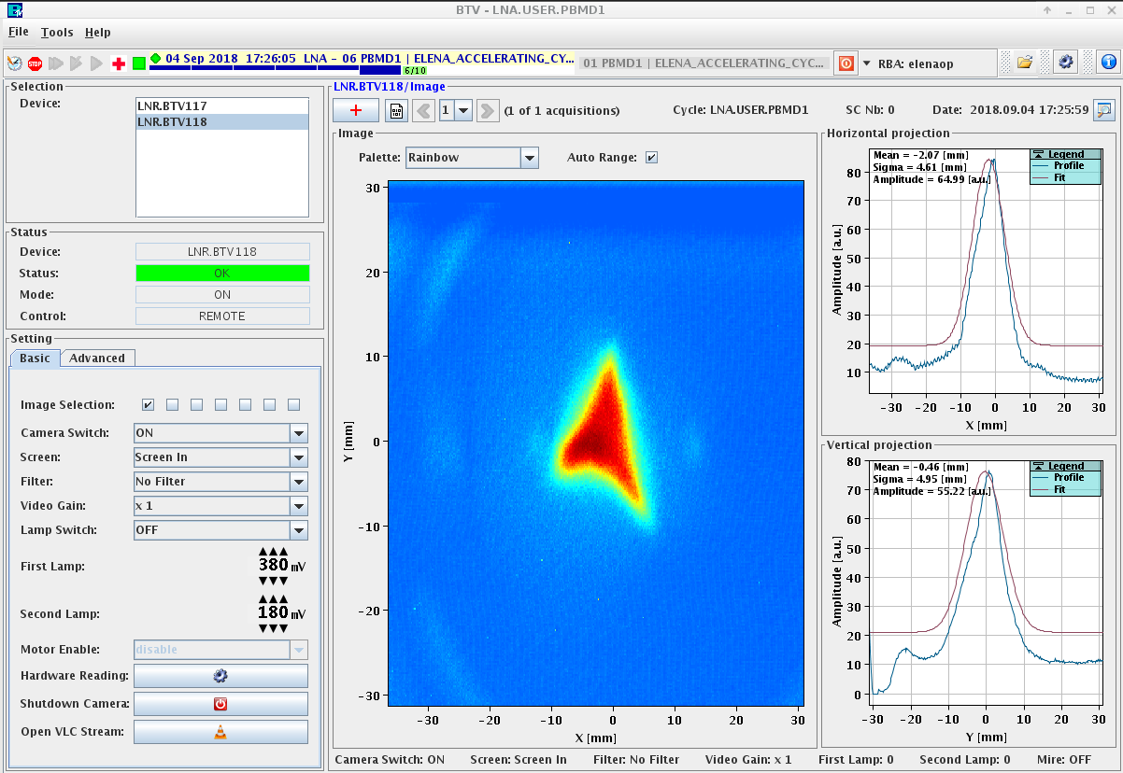

Slide 5
BPM
The orbit system consists of electrostatic pick-ups equipped with charge amplifiers, preamplifiers and VXS-DSP-FMC-Carriers. The charge amplifiers send sum and difference signals from the pick-ups, via preamplifiers to ADCs placed on FMC boards. The ELENA RF system sends the actual revolution frequency as an integer value via an optical gigabit link, from which the orbit system will generate its own local oscillator frequency on the wanted harmonic used for digital down mixing of the sum and difference signals. Position calculations are performed in DSP modules and the results are sent to the real-time software that makes the data available to the control room. The orbit system also computes a real-time mean radial horizontal position for the RF radial feedback. The system is only capable of producing beam position data during the times when the beam is bunched.

Slide 6
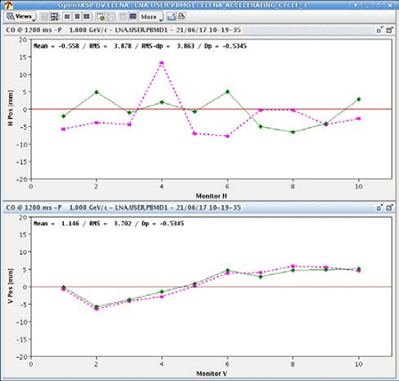
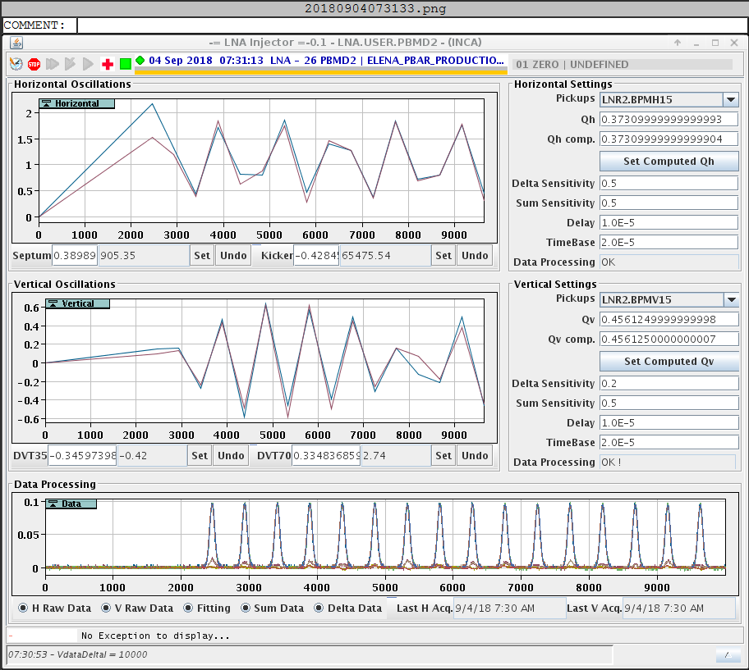

Slide 7
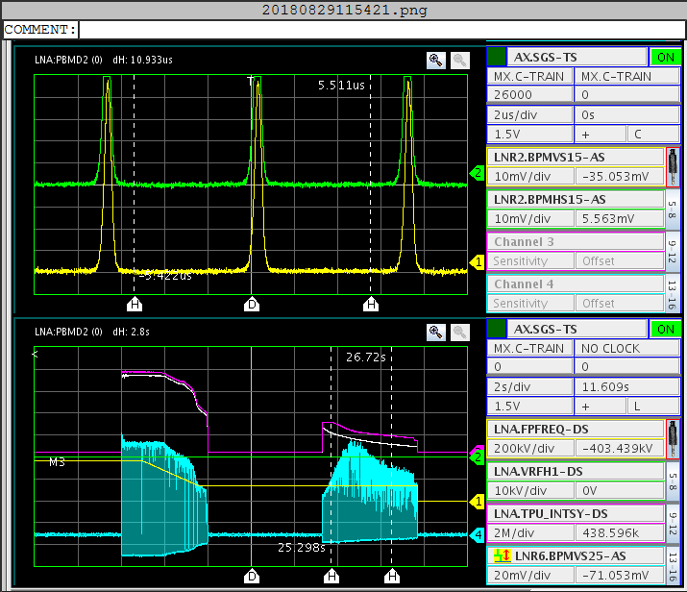
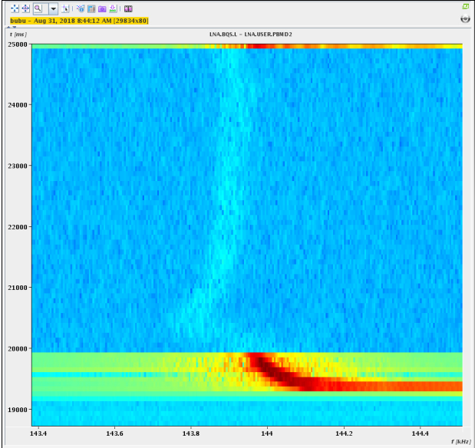

Slide 8
BBQ
The tune measurement system uses two identical pick-ups (PUs) with four 340 mm electrodes. One PU is used to capture beam signals and the second for beam harmonic excitation.
Beam signals from the four electrodes of the capture PU are amplified with four low noise amplifiers installed directly on the PU ports. The amplifiers have high input impedance to assure good PU response for relatively long ELENA bunches. The amplified signals are send to the tune signal processing electronics based on diode detectors, a so called Base Band Tune (BBQ) front-end. The amplified and filtered base-band horizontal and vertical tune signals are then digitized with two 16bit ADCs sampling at the 8th harmonic of the machine revolution frequency. The ADCs are accommodated on a mezzanine of an FPGA VME board, performing signal processing and beam spectra computing. The system is sensitive enough to measure tunes in favorable conditions even without beam excitation.
Chirped beam excitation signals are produced by two 12-bit DACs clocked with the same 8th harmonic of the revolution frequency. The DACs are accommodated on the second mezzanine of the FPGA board. The DAC output signals are amplified to provide currents in the order of 100 mA passing through the electrodes of the excitation PU.

Slide 9
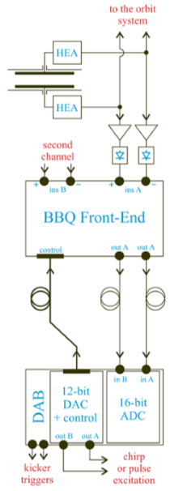
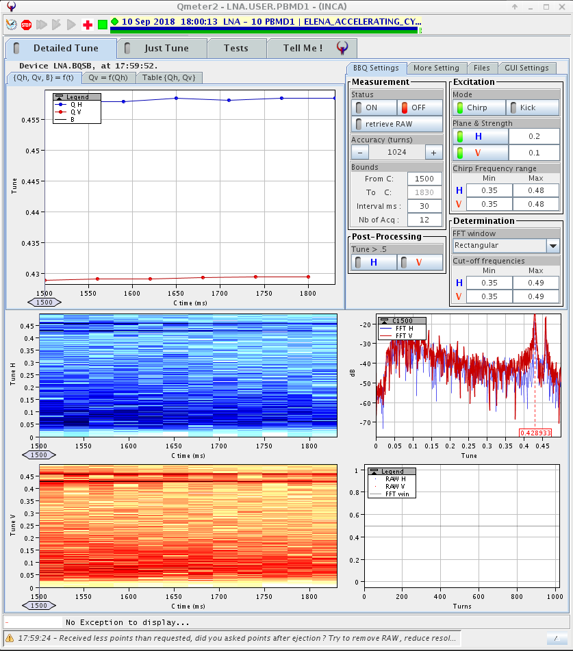

Slide 10
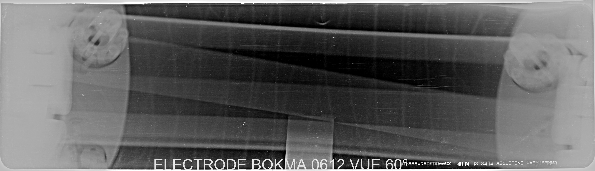
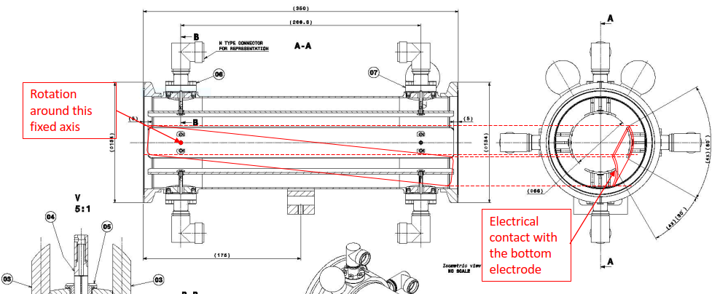

Slide 11
Scraper
The scraper device is a destructive diagnostic device using a motorised blade as a scraping tool which is moved into the circulating beam at constant speed. Secondary particles are emitted by the interaction of the beam with the blade. The flux of secondary particles detected is proportional to the beam density, and one can reconstruct the beam profile by plotting the flux as a function of the blade position.
Two detection systems have been implemented to cover the different particle types that are available in ELENA. For antiprotons two scintillator paddles outside the vacuum chamber capture the pions created by the annihilation of the particles with the blade. For protons and H- ions, secondary electrons are measured on four micro-channel plates (MCP) installed inside the vacuum tank.

Slide 12
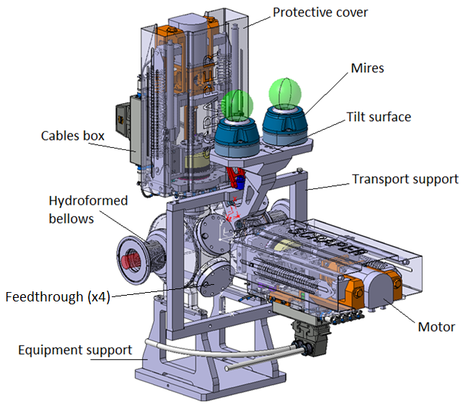
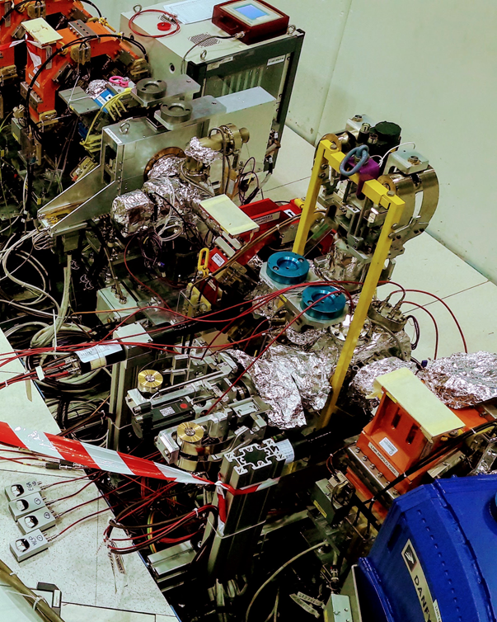
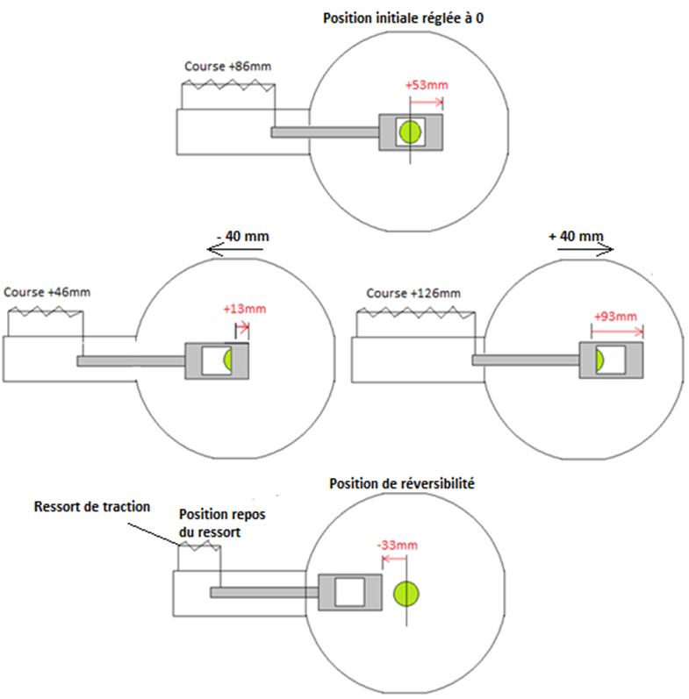

Slide 13
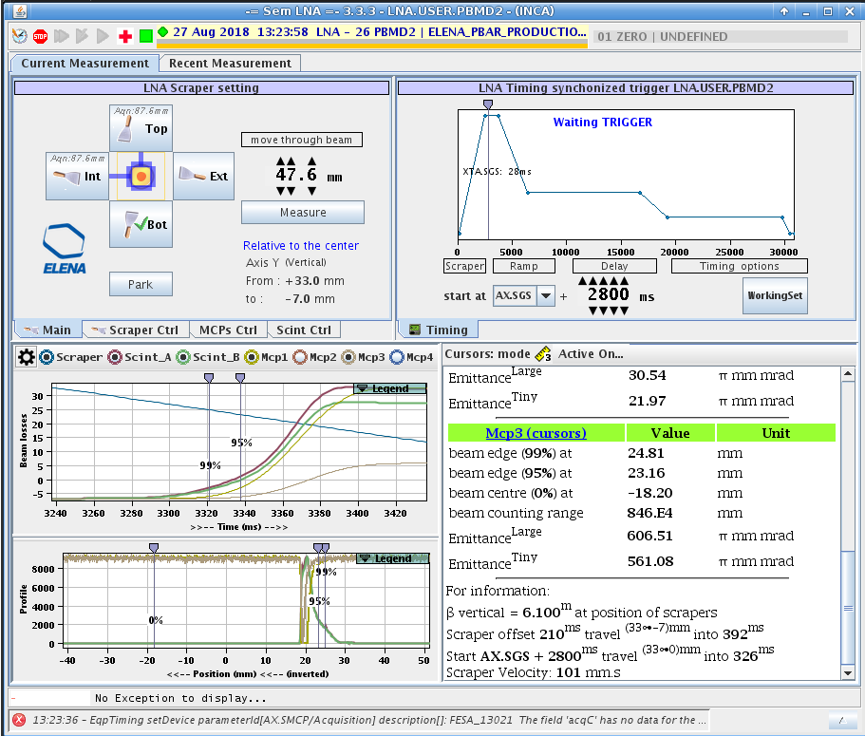
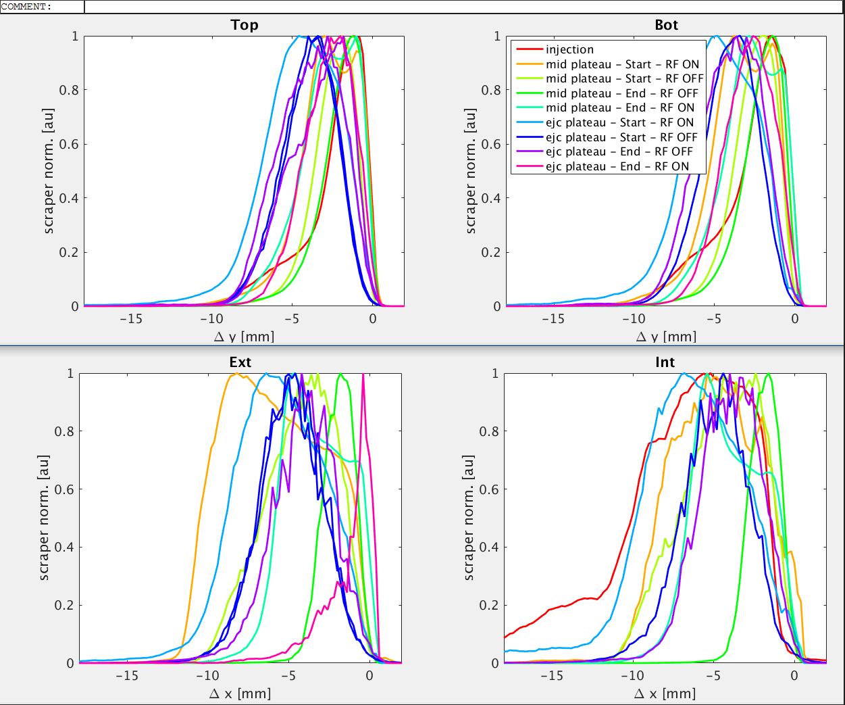

Slide 14
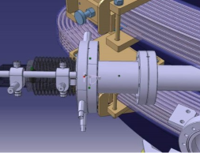
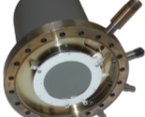
Recombination Monitor
Neutral hydrogen atoms, created either by the striping of the loosely bound electron of the H- ion by the residual gas molecules or the recombination of protons with the electrons of the cooler device, can be detected in the extension of the downstream bending magnet. The monitor consists of a chevron mounted MgO coated MCP coupled to a P43 phosphor screen. The image, acquired by a CMOS camera connected to a PC, is a direct image of the circulating beam from which the transverse profiles can be inferred. During beam cooling, the integral of the signal is proportional to the recombination rate from which the transverse energy of the electron beam can be evaluated. It will be a good means to correct any angular deviations between the electron and ion beams.

Slide 15

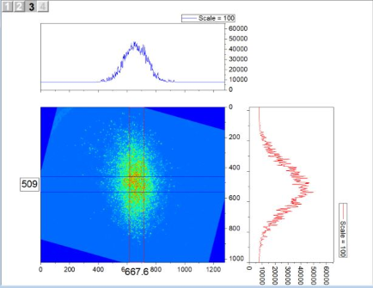

Slide 16
SEM (μwire monitor)
Semi-non-destructive monitor allows most of the particles to pass through without any degradation, while the small portion (1-3%) intercepted by the wires produces the signal.
The device is sensitive to antiproton, proton, and H- beams of energies between E =10 keV and 5.3 MeV.
It consists of two position-sensitive photocathode grids providing the X- and Y- projections of the beam, sandwiched between three anode grids with a distance of 2 mm between them.
Each grid consists of 48 gold-coated tungsten wires of diameter of 10 um stretched over a ceramic frame, with a pitch of 1.0 mm between neighbouring wires.
The cathode grids at ground potential are irradiated by the beam, and the secondary electrons emitted from them are accelerated toward the anode grids biased at 50 V.
The beam profile is obtained by using charge-sensitive preamplifiers to measure the charge Qi ejected from the cathode wires on the X- and Y-grids with high sensitivity.

Slide 17
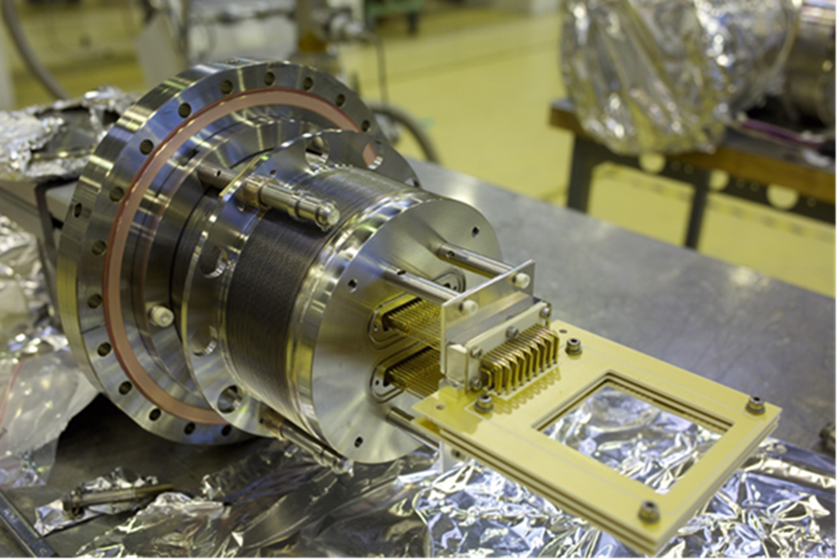

Slide 18
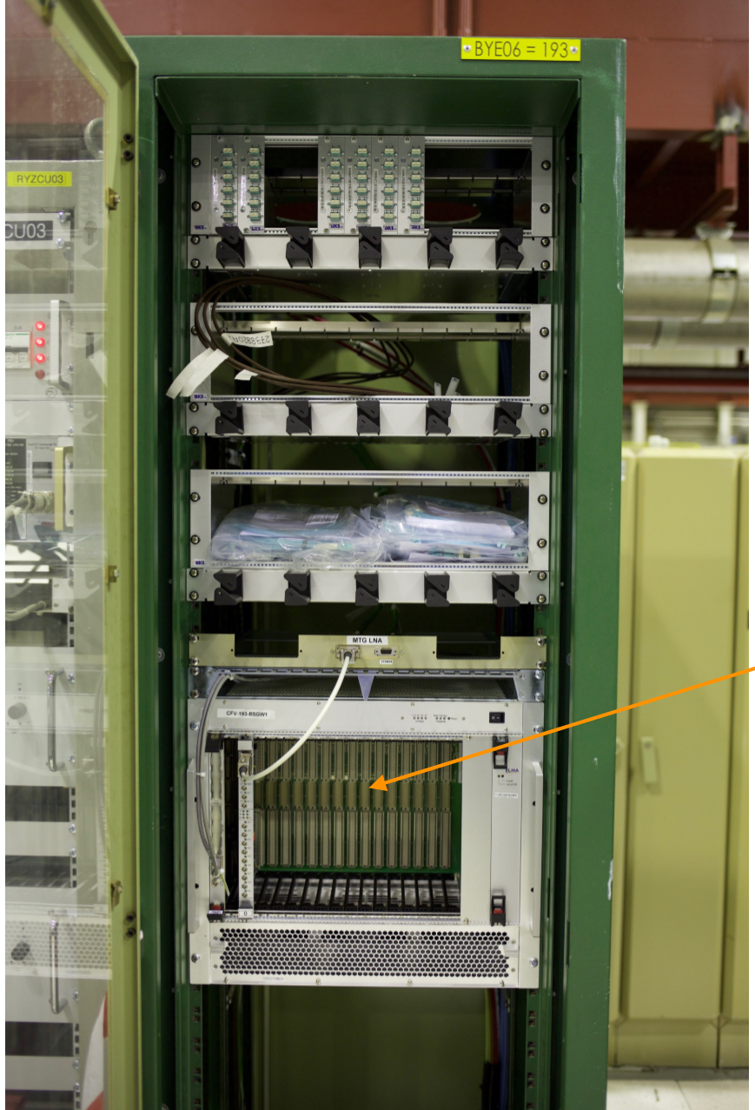
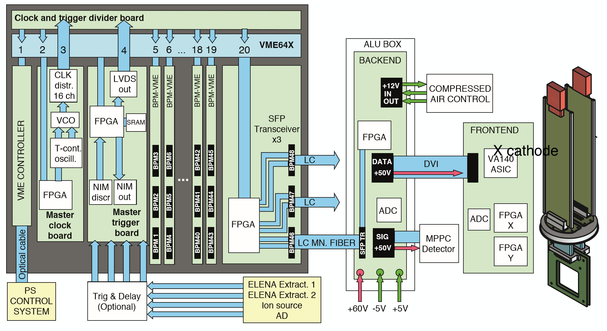
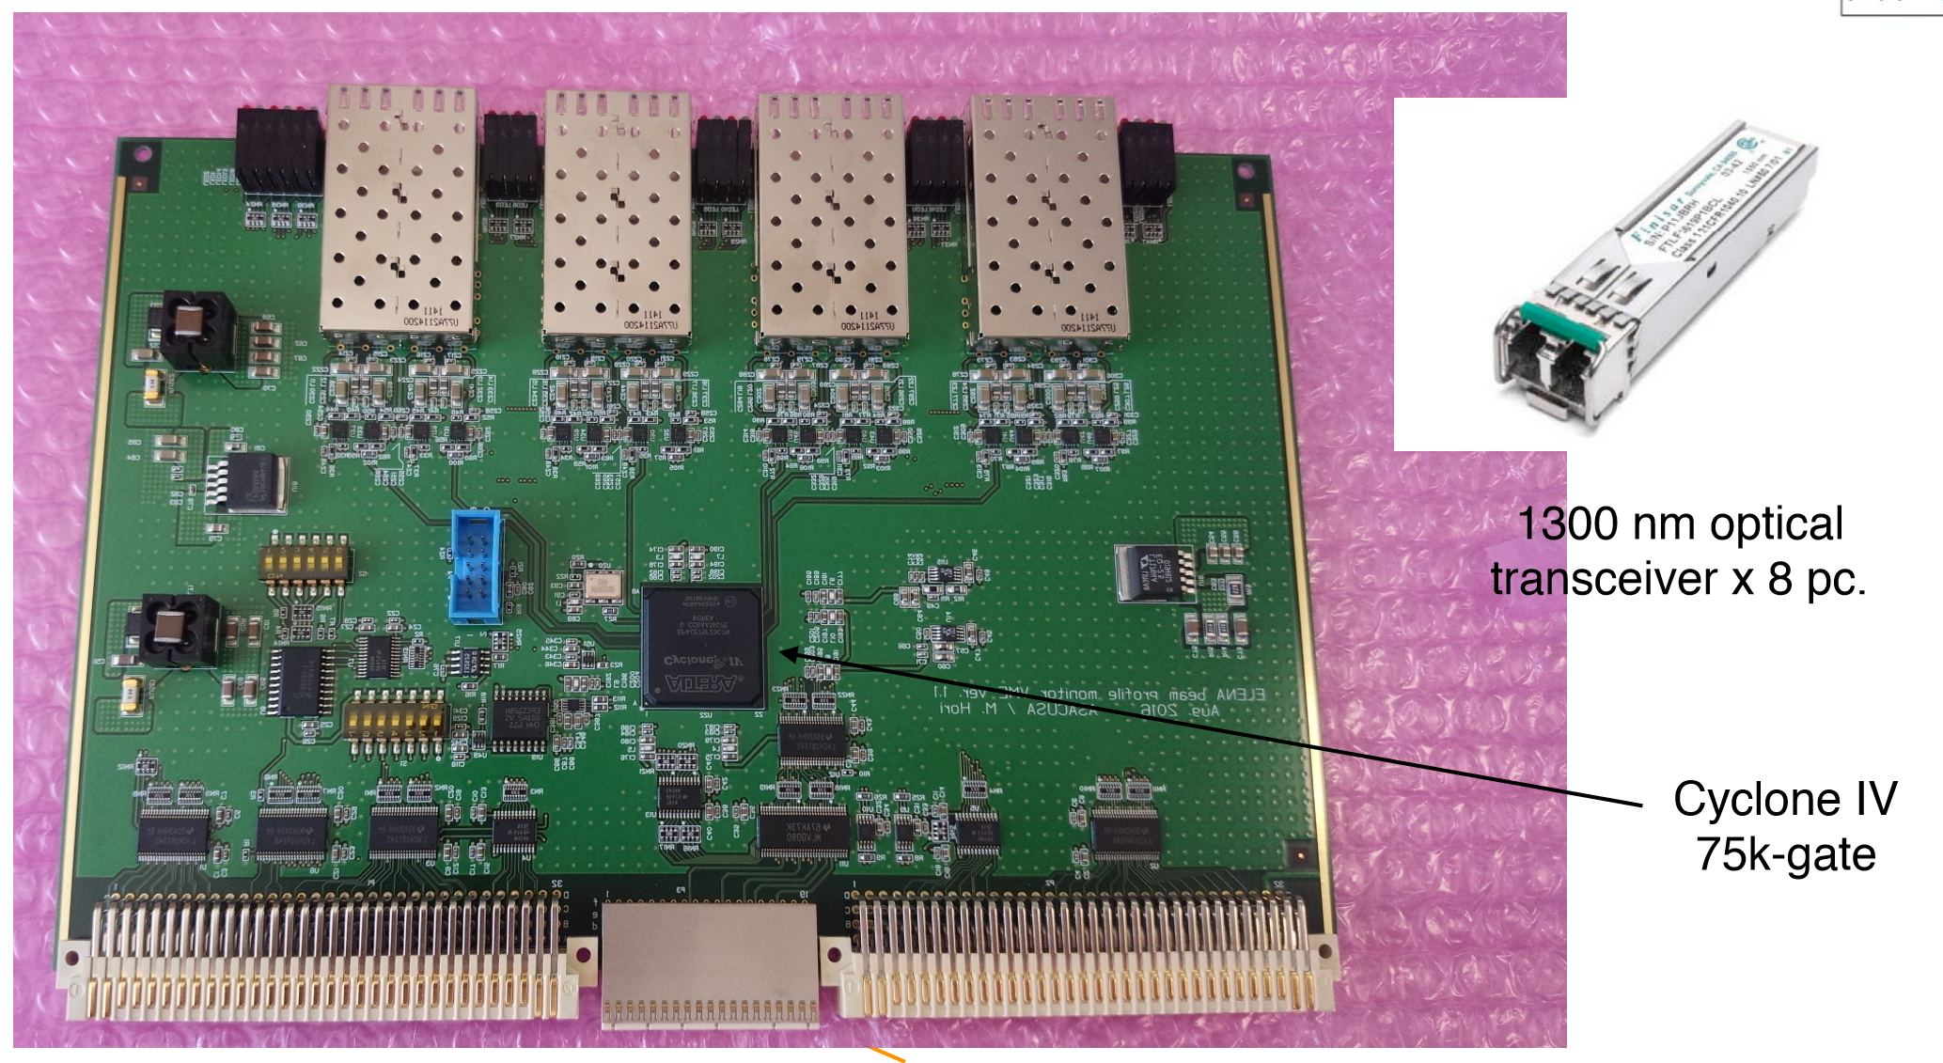
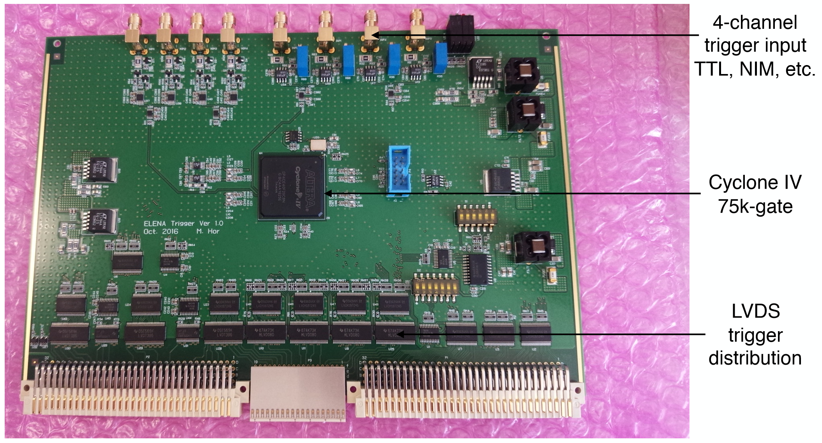

Slide 19
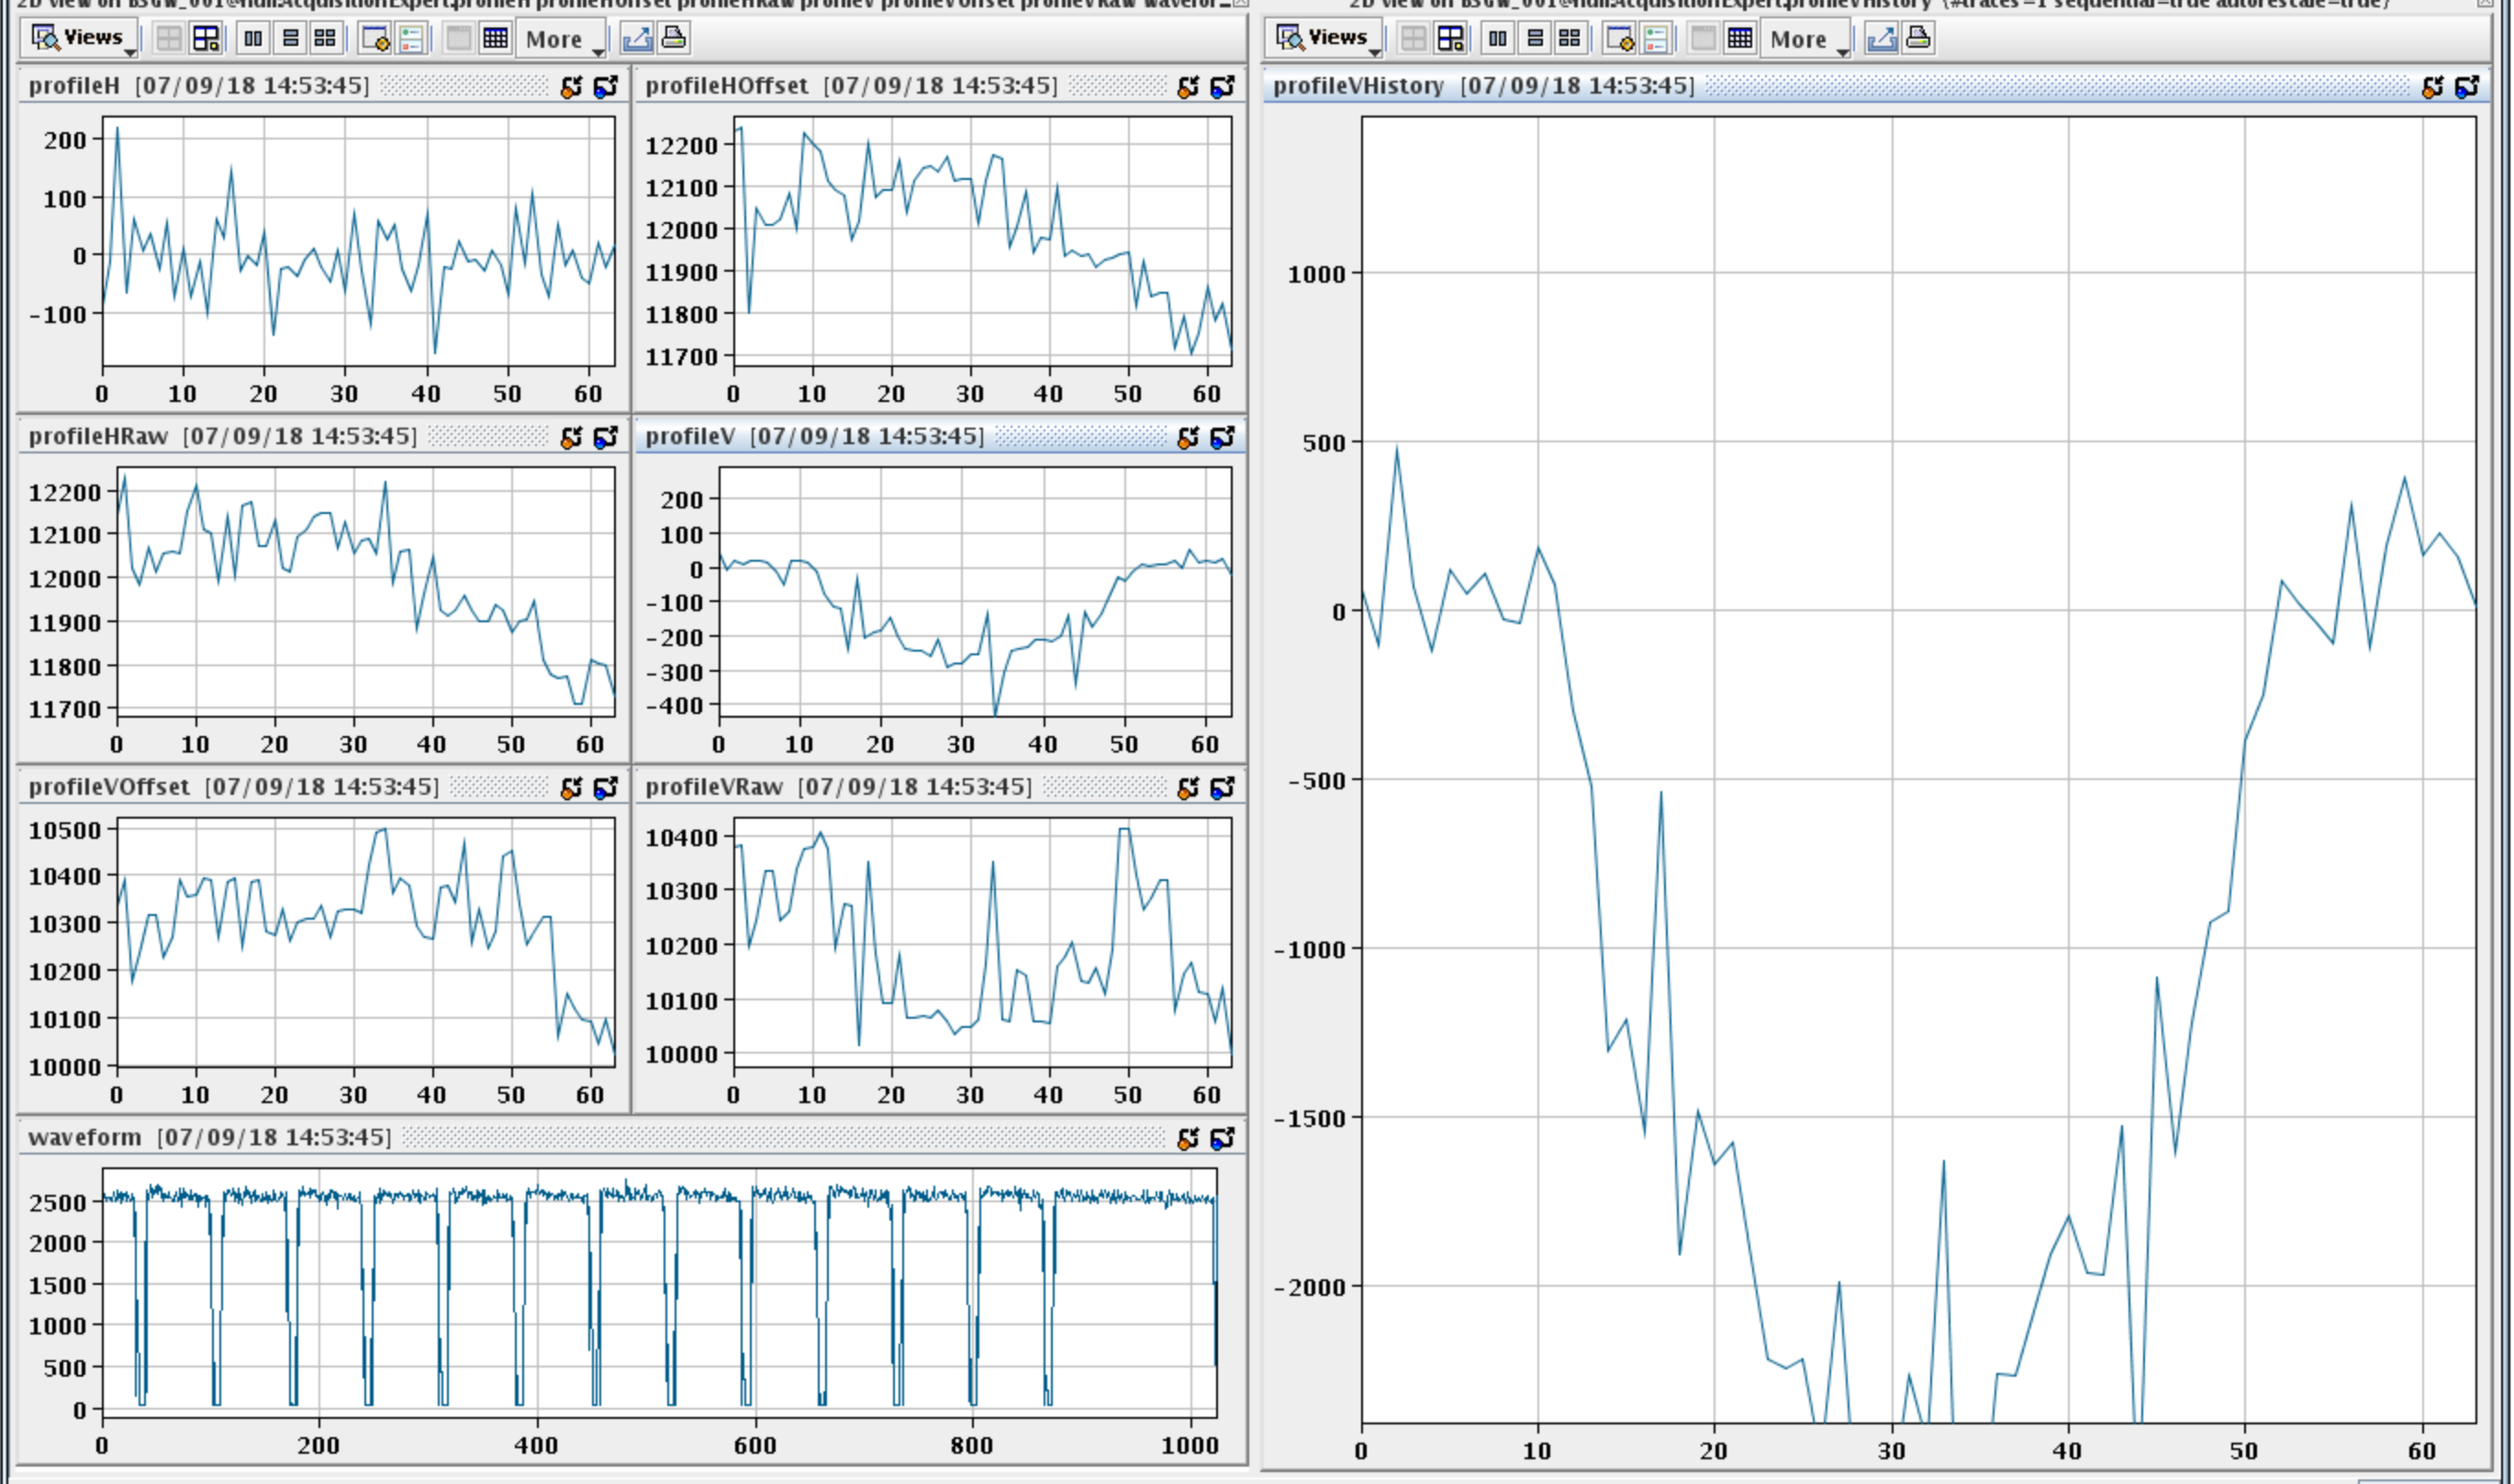
8 monitors installed during 2017-18 shutdown.
36 more to install during LS2!!!!
Electronics not fully debugged. Only one functional set available at the moment.

Slide 20
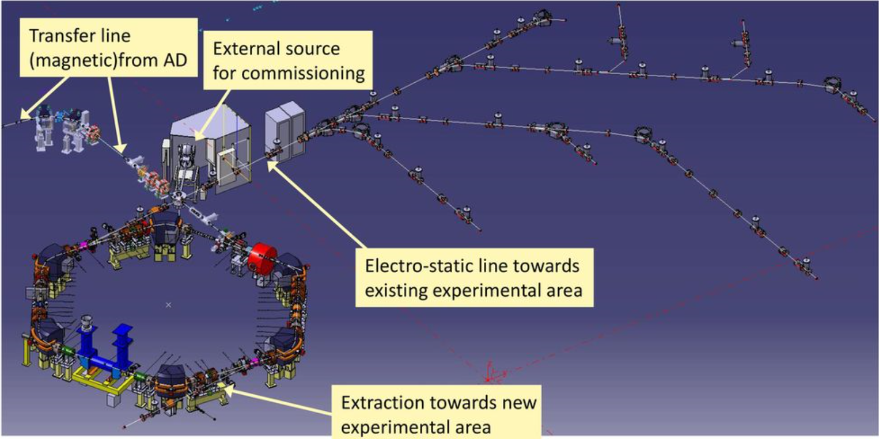

Slide 21
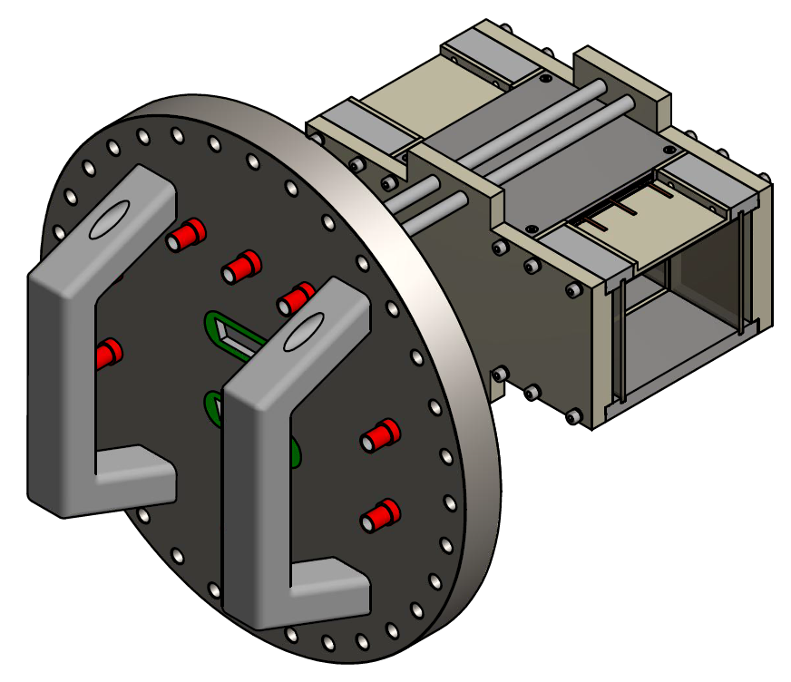
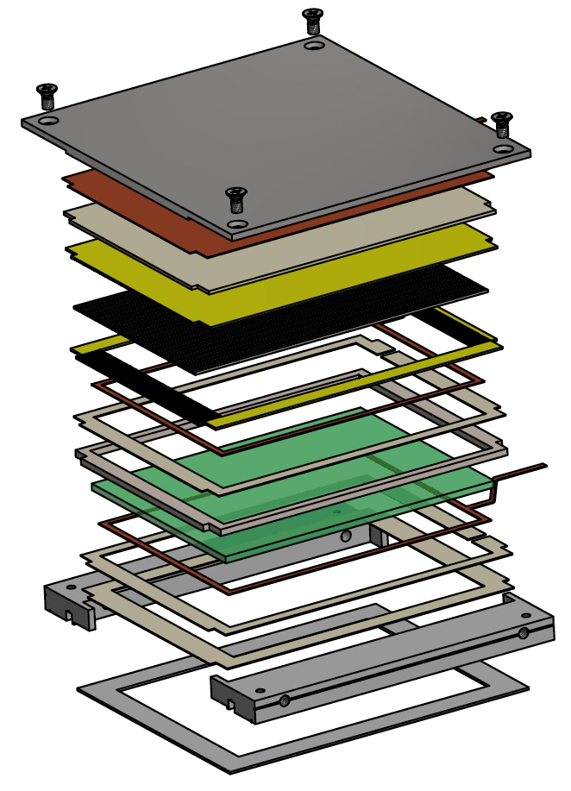
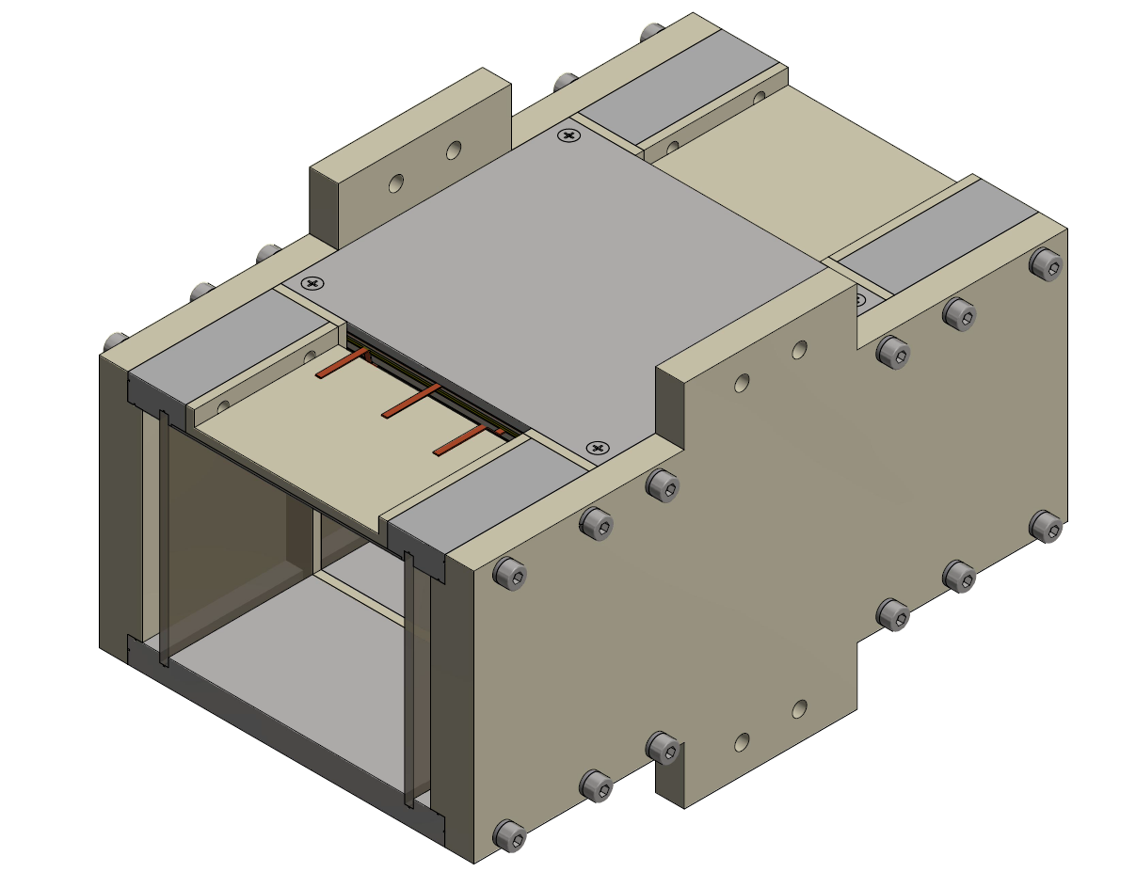
IPM
Design based on AD and LEIR IPM
Double MCP
Read-out : stainless steel tubes
XHV material compatible only
Two orbit correction electrodes
Long detection length : 80mm
External dimensions: 206 x 140 x 128 mm
Beam aperture: 82 x 70 mm

Slide 22
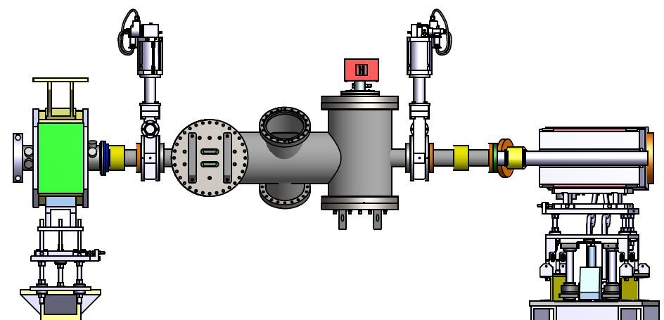
integration in ELENA
Bellow
Gas injection
Bellow
Horizontal BIPM +
NEXTorr D 1000-10
Vertical BIPM +
NEXTorr D 1000-10
Turbo-molecular
pump

Slide 23
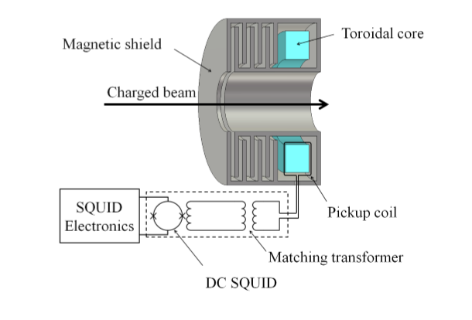
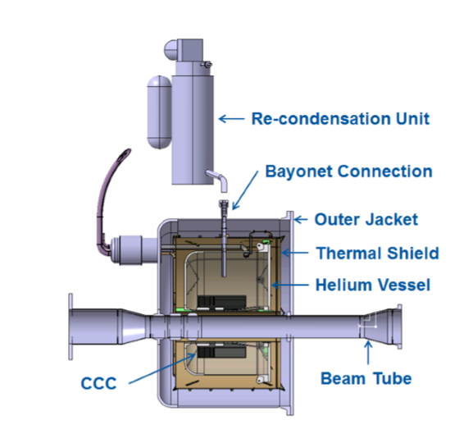
Cryogenic Current Comparator
The CCC works by measuring the magnetic ﬁeld induced by the particle beam current. This ﬁeld is concentrated in a high-permeability ferromagnetic pickup core, from which it is coupled into a SuperconductingQUantumInterferenceDevice(SQUID).Theseare highly sensitive magnetic ﬂux sensors that permit sensing the weak ﬁelds created by the beam. A superconducting magnetic shield structure around the pickup-core renders the coupled magnetic ﬁeld nearly independent of the beam position and makes the system practically immune to external magnetic ﬁeld perturbations.

Slide 24
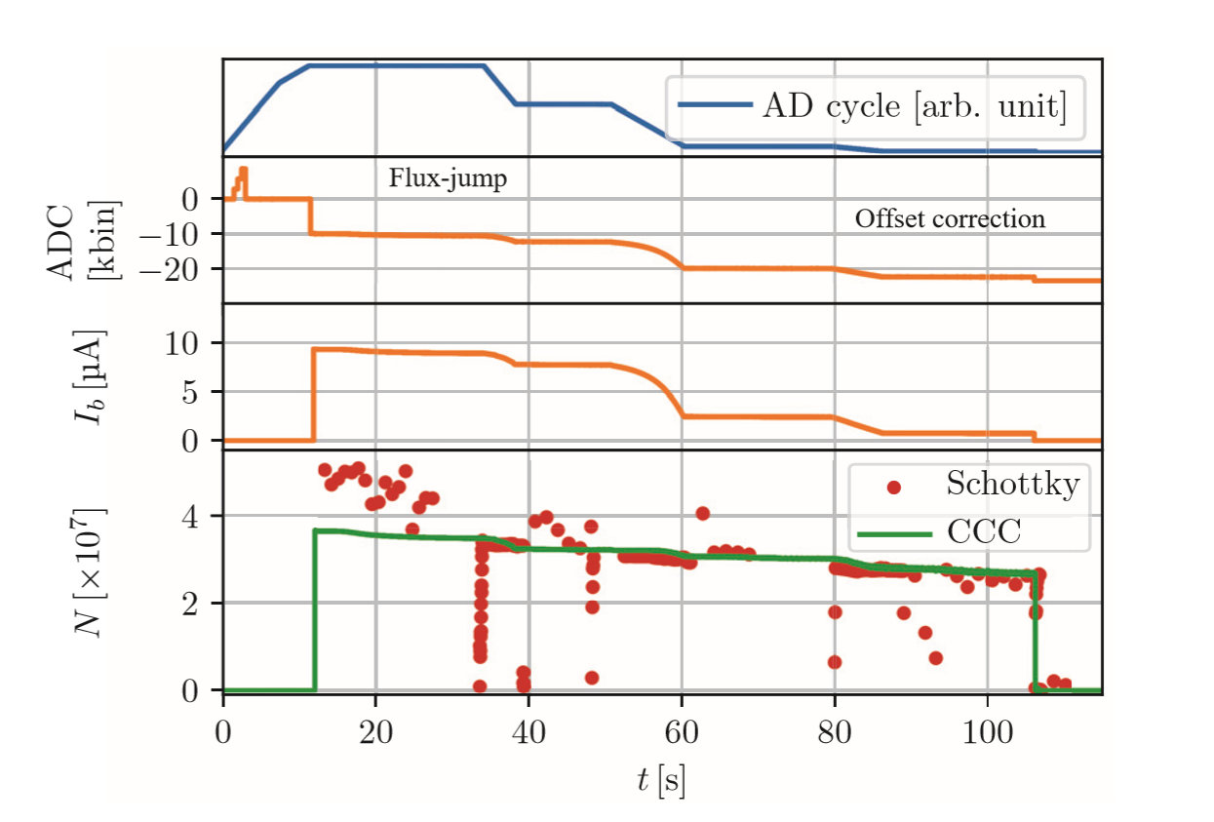

Slide 25
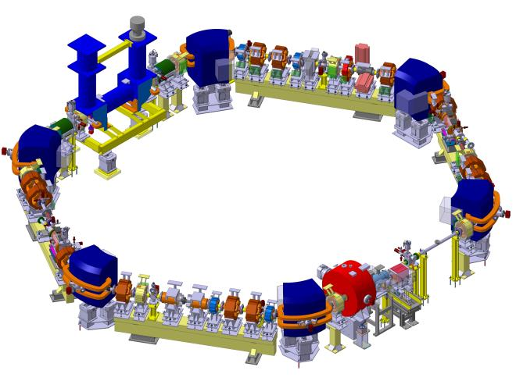
Recombination monitor
Scraper
Electron cooler
Beam position monitors (10+2)
Tune measurement (PU+kicker)
Secondary emission monitors
BTV systems

