Slide 1




GridPP Security Background
David Crooks & David Kelsey (STFC)
GridPP41 29 Aug 2018

Slide 2

Aims and activities
Background paper - work towards case for support in GridPP6
Security, Trust & Identity
  Security – Risk management, security plans, technical and operational controls, operational security (handle incidents, vulnerabilities, monitoring, training, security challenges, procedures), …
  Trust – management controls (aka policies), collaboration with other Infrastructures, SCI, WISE, US Internet2, ESnet, EU GEANT, US NSF/TrustedCI, …
  Identity – EUGridPMA, IGTF, REFEDS, FIM4R, Internet2, GEANT, UK AAI bodies
An ongoing process to manage security risks
  Aim is to maintain: Confidentiality, Integrity and Availability

Slide 3
US NIST Cybersecurity Framework v1.1
Https://www.nist.gov/cyberframework
A never-ending CIRCLE of activity!
Credit: N. Hanacek/NIST

Slide 4
(Some) Background
GridPP started many of the groups/activities (or was a co-founder)
  CA Coordination Group (2000), Security Requirements/Risk Analysis (2001), WLCG Security Policy (2003), Joint (WLCG/EGEE) Security Policy (2004), WLCG/EGEE CSIRT/OSCT (2005), SVG (2006), SCI (2010), FIM4R (2011), WISE (2015), …
Many lead roles for GridPP security people (over the years)
Everything we do (even for EU/EGI) benefits WLCG
The WLCG CSIRT in Europe is the EGI/EOSC-hub CSIRT
  Plus the WLCG Security Officer at CERN
Our work in WLCG is vital to security of Data and Services, e.g.
  DavidC co-leading WLCG SOC working group
  DavidK is the WLCG policy coordinator
Other EGI/EOSC-hub security partners are not so closely engaged with WLCG

Slide 5

History: role for a “Grid” CSIRT
NREN CSIRTs versus EGEE/EGI CSIRT
  Research Security vs Enterprise security
  User/Identity based incidents versus DDOS, port scans, web services, …
Many NREN CSIRTs claimed a Grid CSIRT was not needed
  But we convinced them!
  We tackle different threats and add value
EGI CSIRT is now fully Certified by Trusted Introducer (since 2014)
  Very positive comments at a Jisc UK Security and AAI meeting Andrew Cormack (Jisc) about the EGI CSIRT

Slide 6
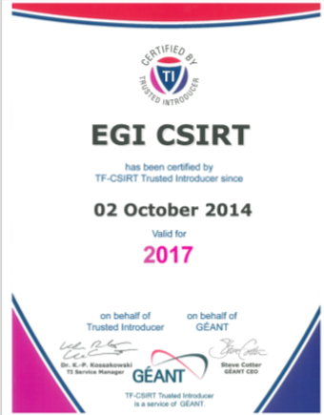
EGI CSIRT Collaborations
  Oct 2012: Trusted Introducer
    Member of TERENA TF-CSIRT
  EGI CSIRT is an accredited team in the European database of CSIRTs
  Oct 2014: full certification
  EGI-CSIRT collaborations
  Public and non-public vetted networks
    FIRST and NREN CERTS
  Grid-SEC: coordinated response to cross-grid security incidents (vetted security representatives from WLCG, OSG, XSEDE, EGI)
  WISE and related Trust bodies

Slide 7
Another tribute
Ian Bird’s statement from his TNC2011 Keynote talk (Prague)
  while he was discussing “Grids versus Clouds”
“The reason we have a Grid is because we need to collaborate and we need to share resources. So no matter what we do and no matter what technology we deploy underneath we will always have a Grid. Our network of trust and all of the security infrastructure that goes with that is of enormous value to us and I don't think we want to lose that. I think it is also of enormous value to eScience in general because I think this is one of the things that allows people to collaborate across these infrastructures and I think that probably should sit on top of the pile as one of the major achievements of this 10 years of work on Grids.”
https://tnc2011.terena.org/web/media/archive/7A
  (audio/video archive - at 41 mins 35 secs)

Slide 8
Cybersecurity: We Don’t Have It Right Yet
Von Welch
Director, Trusted CI
Director, IU CACR
2018 NSF Cybersecurity Summit
August 22nd, 2018

Slide 9
Cybersecurity Is a New Profession.
Is It Possible We Don’t Have It Right Yet?
Notes:
TODO: Stats here on youth of cybersecurity

Slide 10
The Dreaded Cybersecurity Demo

Slide 11
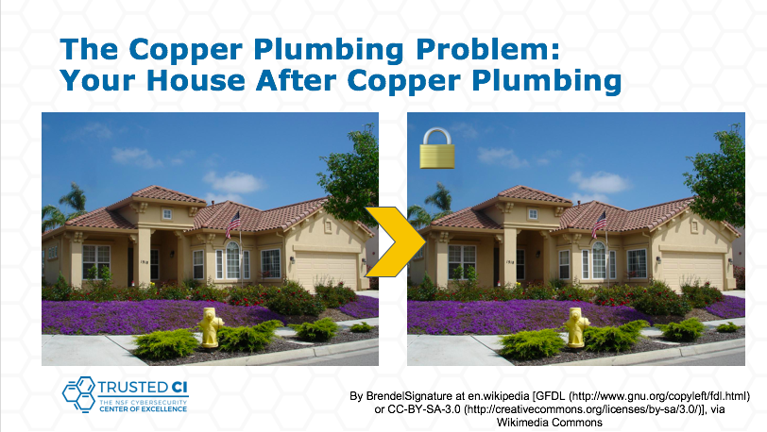

Slide 12
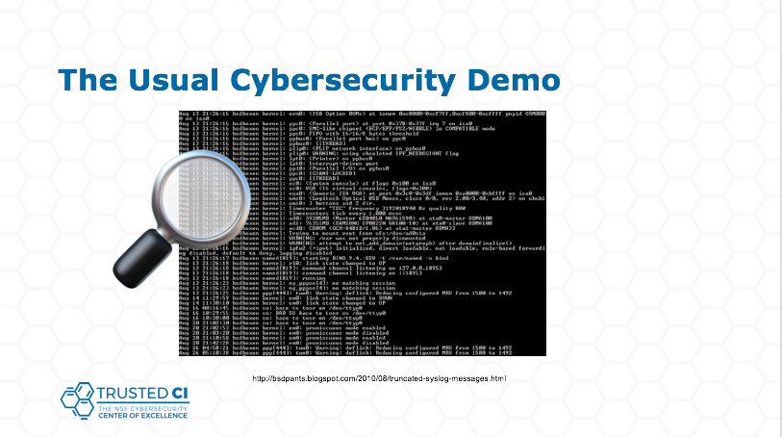

Slide 13
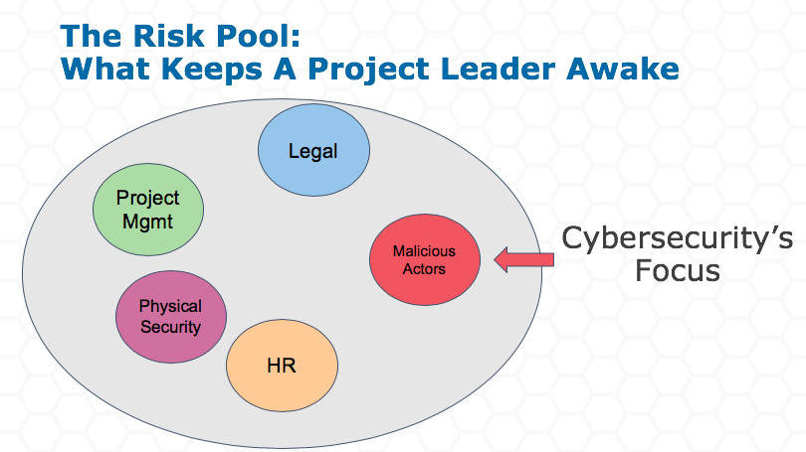

Slide 14
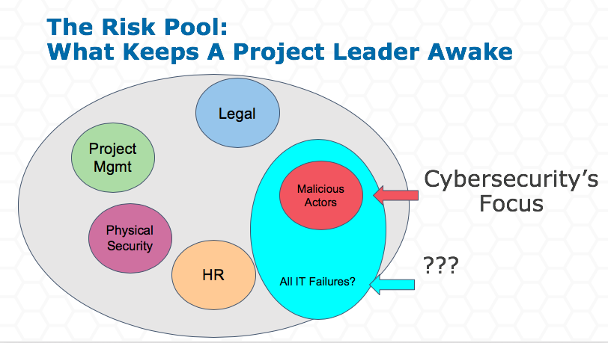

Slide 15
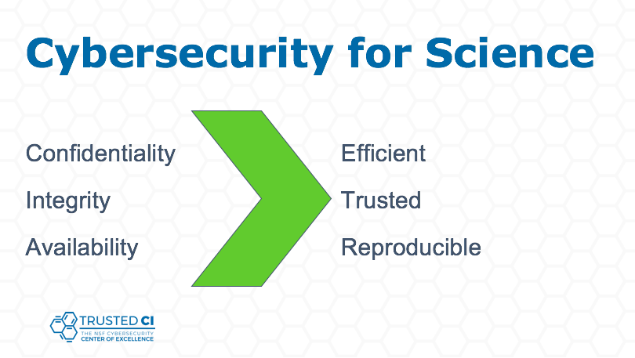
Worthy of more thought!

Slide 16
Security, Trust and Identity FY18/19
2018-19 activities and source of funding
GridPP5 & WLCG (1.5 FTE)
  Security 0.9 FTE
  Trust and Identity Management 0.45 FTE
  Co-funding for EGI 0.15 FTE
EU H2020 EOSC-hub (0.7 FTE) / EGI Core (0.15 FTE)
  Security, Trust and Identity Management 0.85 FTE
EU H2020 AARC2
  Trust and Identity Management 0.6 FTE
STFC/RAL PPD National Labs
  Security 0.25 FTE
Total funded effort = 3.2 FTE (across 4 people)
of which 1.5 FTE is GridPP5

Slide 17
What should we bid for in GridPP6?
The UK NGI team works very well and should continue in GridPP6
Increasing technical complexity increases risk
Decreasing Tier 2 effort may increase the security risk
  And emphasises importance of a central team
We play an important role in UK/EU and WLCG and we want to continue
  Build on our success
  As the basis for a larger/more general activity in the UK
Security is ONGOING – new threats, new risks, new mitigations
  Handling incidents, vulnerabilities, monitoring, evolution of policies and procedures, training and dissemination, compliance, collaboration, global trust
  New AAI technologies

Slide 18
Future funding – our proposal
Largest uncertainty – will EU Framework Europe funding happen? (BREXIT)
  If allowed, we will seek funding in EOSC/EGI
  If not then seek UKRI funding
To continue doing everything we need ~3 FTE (~2 Security, ~1 Trust & Identity)
We MUST continue supporting GridPP security (~1.0 FTE)
and WLCG Security & international collaboration (~1.0 FTE),
  including Trust & Identity
  and we need appropriate T&S funds
We should aim to build a broader UK team
  to meet needs of growing infrastructures and more communities (UK IRIS etc)
TOTAL size of team ~5 FTE
  Of which we should bid 2.0 FTE from GridPP6

Slide 19
Questions and discussion?

