Slide 1
Testing weak-field gravity with wide binary stars
Indranil Banik, MNRAS, 480, 2660

Slide 2

Alexander von Humboldt Research Fellowship.
Sponsored by the Alexander von Humboldt Foundation.
  http://www.humboldt-foundation.de

Slide 3
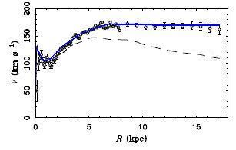
Galaxies
Visible mass  Newtonian Gravity = Acceleration
The observed acceleration is discrepant with this prediction
Living Reviews in Relativity, 15, 10 (2012), by
Famaey & McGaugh
Dark matter?
Notes:
3

Slide 4
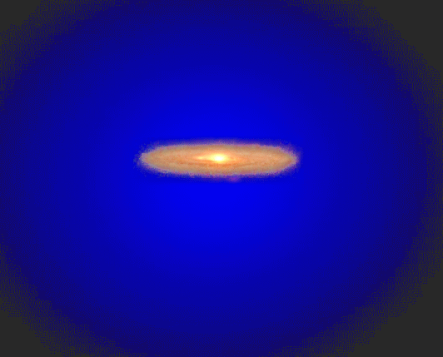
No direct evidence
Notes:
4

Slide 5
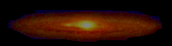
Notes:
5

Slide 6
Introduction
Modified Newtonian Dynamics (MOND, Milgrom 1983) posits that gravity transitions from inverse square law to inverse distance law for accelerations < a₀ = 1.2x10⁻¹⁰ m/s²
Designed to explain why galaxy rotation curves flatten instead of decreasing outwards beyond visible extent of galaxies, like in Solar System
MOND?
Living Reviews in Relativity, 15, 10 (2012), by
Famaey & McGaugh

Slide 7
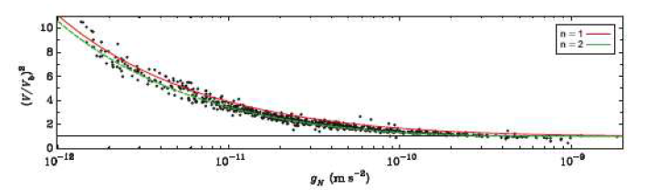
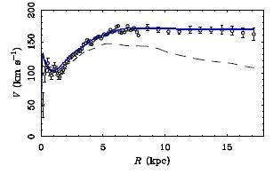
The Acceleration Discrepancy
Observed acceleration ÷ Newton’s prediction
Data from ~100 disk galaxies
Predicted acceleration
Dark matter must exist if the visible mass is insufficient to predict the dynamics
But if it is sufficient, then extra degree of freedom in invisible mass unnecessary
DM disfavored by data (Occam’s Razor)
Gravity may need modifying…
Notes:
7

Slide 8
Observed acceleration
Latest data
2693 data points
153 galaxies
Physical Review Letters, 117, 201101 (McGaugh+, 2016)
Gas fraction has no effect on this relation
Neither does the surface brightness
Error budget
Line of equality
Predicted acceleration
Residuals
Predicted acceleration
Notes:
8

Slide 9
Modified Newtonian Dynamics
MOND (Milgrom, 1983) says Newtonian dynamics off by some factor, depending on acceleration (or energy density)
Gives more gravity for same mass
Empirical theory (as is Newtonian gravity)
Flexibility required as we don’t know exactly what happens at low accelerations
Notes:
9
9
Reduce text load.

Slide 10
Basics Of MOND
Observed acceleration ÷ Newton’s prediction
Predicted acceleration
But is gravity non-Newtonian or is this dark matter?
Notes:
10

Slide 11

Wide binary stars
For Sun, $\frac{GM}{r^{2}}< a_{0}$ if $r>7000$ AU (MOND radius)
Gravity enhanced ~1.5x at Solar Circle of MW
Gaia can’t accurately resolve line of sight separation as distance accuracy ~80 kAU
Focus on $\tilde{v}≡v÷v_{c,Newton}\left(r_{p}\right)=v÷\sqrt{GM/r_{p}}$
v = relative velocity of stars, M = total mass
As sky-projected radius r_{p} < true radius r, must have $\tilde{v}$ below its true 3D value
$\tilde{v}< \sqrt{2}$ in Newtonian gravity, limit ~1.7 in MOND
Stars with high $\tilde{v}$ would strongly support MOND

Slide 12
Doing the test with GAIA data
Gaia should detect thousands of wide binaries (WBs) within ~150 pc
Very low chance of random 3D alignment in position and velocity
At ~0.5 km/s, wide binaries would separate ~10⁵ AU in only a few Myr
But Gaia data can’t accurately resolve line of sight separation of components as distance accuracy ~80 kAU – enough to make it likely that system is a binary

Slide 13
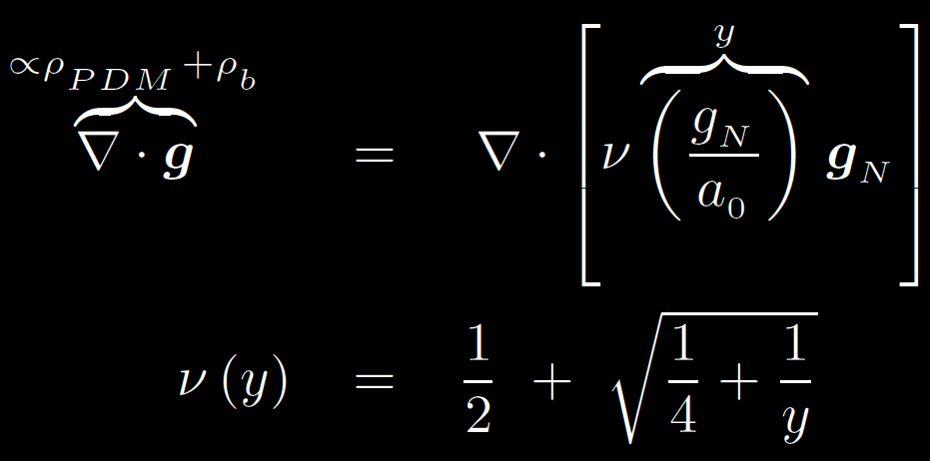
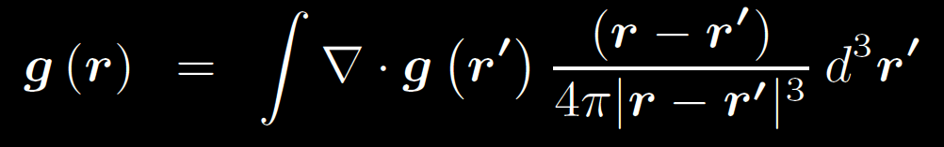
MOND governing equations
External field (EF) from rest of Galaxy must be considered as it is ~a₀
Solve numerically:
Treat binary as single mass + test particle to make g axisymmetric (Banik & Zhao 2018, MNRAS, 480, 2660)

Slide 14
Forces in MOND
For widely separated WBs, EF dominates
Get analytic result from Arxiv: 1509.08457
Force not entirely radial and depends on angle of system relative to EF
Can check force library with azimuthally averaged radial force at fixed distance
Get inverse square law at long range, but with renormalized G and some angular dependence

Slide 16
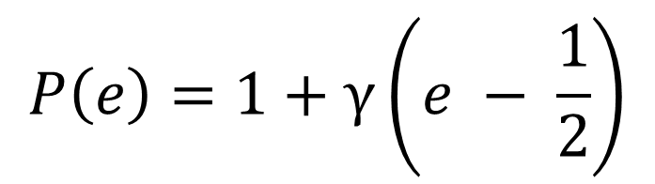
Typical velocity differences
$$P\left(e\right)=1+γ\left(e − \frac{1}{2}\right)$$
10 m/s @ 100 pc = 21 μas/yr

Slide 17

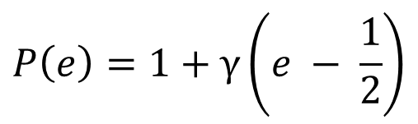
The $\tilde{v}$ distribution
$$P\left(e\right)=1+γ\left(e − \frac{1}{2}\right)$$

Slide 18
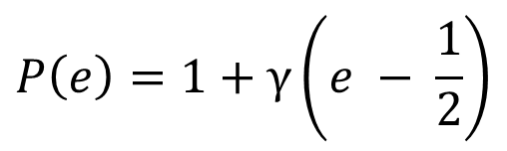
…without radial velocities
$$P\left(e\right)=1+γ\left(e − \frac{1}{2}\right)$$

Slide 19

The detection probability
Integrate for 20 revolutions to get probability distribution over $(r_{p}, \tilde{v})$
Try different viewing angles, semi-major axes, eccentricities, masses and orbital planes. Marginalise over their priors.
For some region e.g. $(r_{p}>2 kAU, \tilde{v}>1.3)$, get Newtonian binary fraction e.g. 0.1
Get 99% CL upper limit e.g. ≤15/100
Get chance of ≥16/100 systems in MOND
This is the detection probability of MOND

Slide 20

Detection probabilities
Consider previous method applied to all possible ranges of $(r_{p}, \tilde{v})$.
Get range which maximises probability. This gives P_{detection} for a particular model (set of model parameters)
Try different eccentricity distributions $γ$ for Newtonian model to minimise chance of detecting MOND effects. Mimics scientific process if MOND correct – $γ$ will be varied.
Repeat for different numbers of WB systems

Slide 22
Theoretical uncertainties
MOND interpolating function constrained within ~10% by extragalactic rotation curves (Lelli+ 2018, ApJ, 836, 152 & P. Li+ ’18)
Different MOND formulations yield similar results (Arxiv: 1509.08457, Banik & Zhao ’18)
Treating binary as single mass is OK in Newtonian and EF-dominated regimes. Small error at intermediate separations.
Consider force between two stars aligned with EF with different q₁, fraction of total system mass M in the less massive star

Slide 23
The wide binary mass ratio
OK to treat system as single mass + test particle

Slide 24
Recently ionised systems
Some WBs were ionised recently – may hamper the wide binary test
WB velocity only ~0.3 km/s while interstellar velocity dispersion ~15 km/s
Ionisation possible only if field star passed within ~200 AU of star in a WB
System would disperse within orbital timescale of ~1 Myr
Very few WBs ionised so recently that they are still nearby in 3D
Similarly, molecular clouds not big problem

Slide 25
Undetected third star
System could have a third undetected low-mass star
Must be quite close to one of the WB stars to significantly affect its velocity
Would cause a large orbital acceleration
May be detectable as radial velocity trend or as acceleration of sky position (astrometry)
Technique fails further out, but then star must be more massive, so easier to detect directly

Slide 26
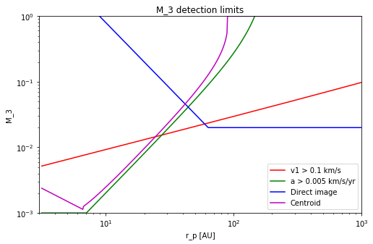
Closing the gap
Credit: William Sutherland (Queen Mary, University of London)
Detectable via direct imaging
?
Noticeably affects v
Detectable via acceleration
Centroid = sky position deviates from proper motion + parallax fit by > 100μas in 7 years @100 pc

Slide 27

Are relative velocities orbital?
•
Systems with highest $\tilde{v}$ should be moving ~ within sky plane and near pericentre
WB separation and relative velocity should be orthogonal
Focus on angle ψ between these directions
ψ should be isotropic if relative velocity due to undetected star near star in WB
For WB orbital motion, ψ should be anisotropic and prefer values near 90°

Slide 30
Closest wide binary = nearest star
Proxima Centauri is on a ~13000 AU orbit around α Cen A & B (~17 AU apart) – Kervella 2017 (A & A, 598, Letter 7)
Can treat system as a central point mass + test particle (Proxima Cen), embedded in external field from Galaxy
Orbit usually stable over several Gyr, though some orbital orientations would be unstable (observed one is stable)
Gravity on Proxima Cen ~40% higher in MOND
Testable with proper motions?

Slide 31
Theia mission (Arxiv: 1707.03148)
Radial velocity difference only ~0.52 cm/s after a decade
Positions change quadratically whereas velocities change linearly, so proper motion better in long run

Slide 32
Conclusions
Gravity may deviate from Newtonian inverse square law at low accelerations (like in MOND)
Motivation is from galaxies, but can be tested using wide binary stars with separations ~(3-20) kAU
Orbital velocities ~300 m/s, but ~20% faster in MOND (with EFE). Detectable with ~500 systems.
Huge excess without EFE that could be detected easily, but not well motivated theoretically
Main systematic is third faint star in system
Testable by direct imaging (large separation & mass) + secular RV/PM acceleration (close-in & low-mass)
May need follow-up of high relative velocity systems

Slide 33
Sky-projected velocities
MOND easily detectable without EFE
MOND easily detectable without EFE, but this is not well motivated theoretically
Such models will be ruled out before wide binaries constrain conventional MOND

