Slide 1
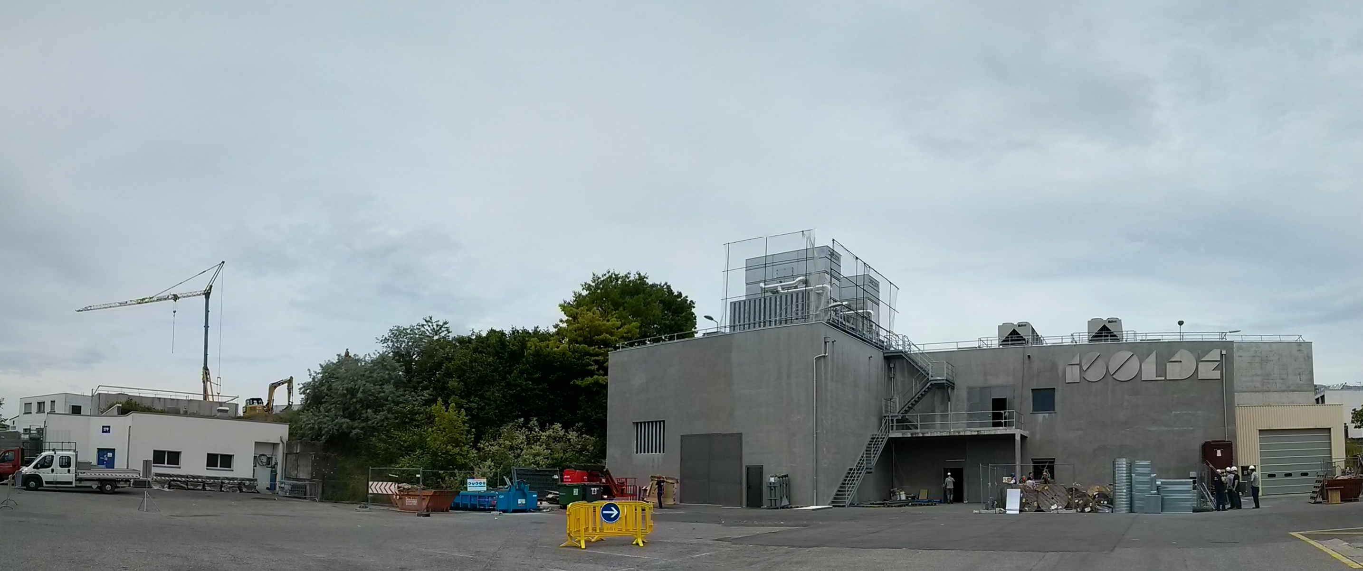

ISOLDE physics coordinator report: INTC 27th June 2018
Karl Johnston
Planning for 2018
Schedule so far: preparation for HIE-ISOLDE and end of year
Safety/training
ISOLDE Technicians

Slide 2
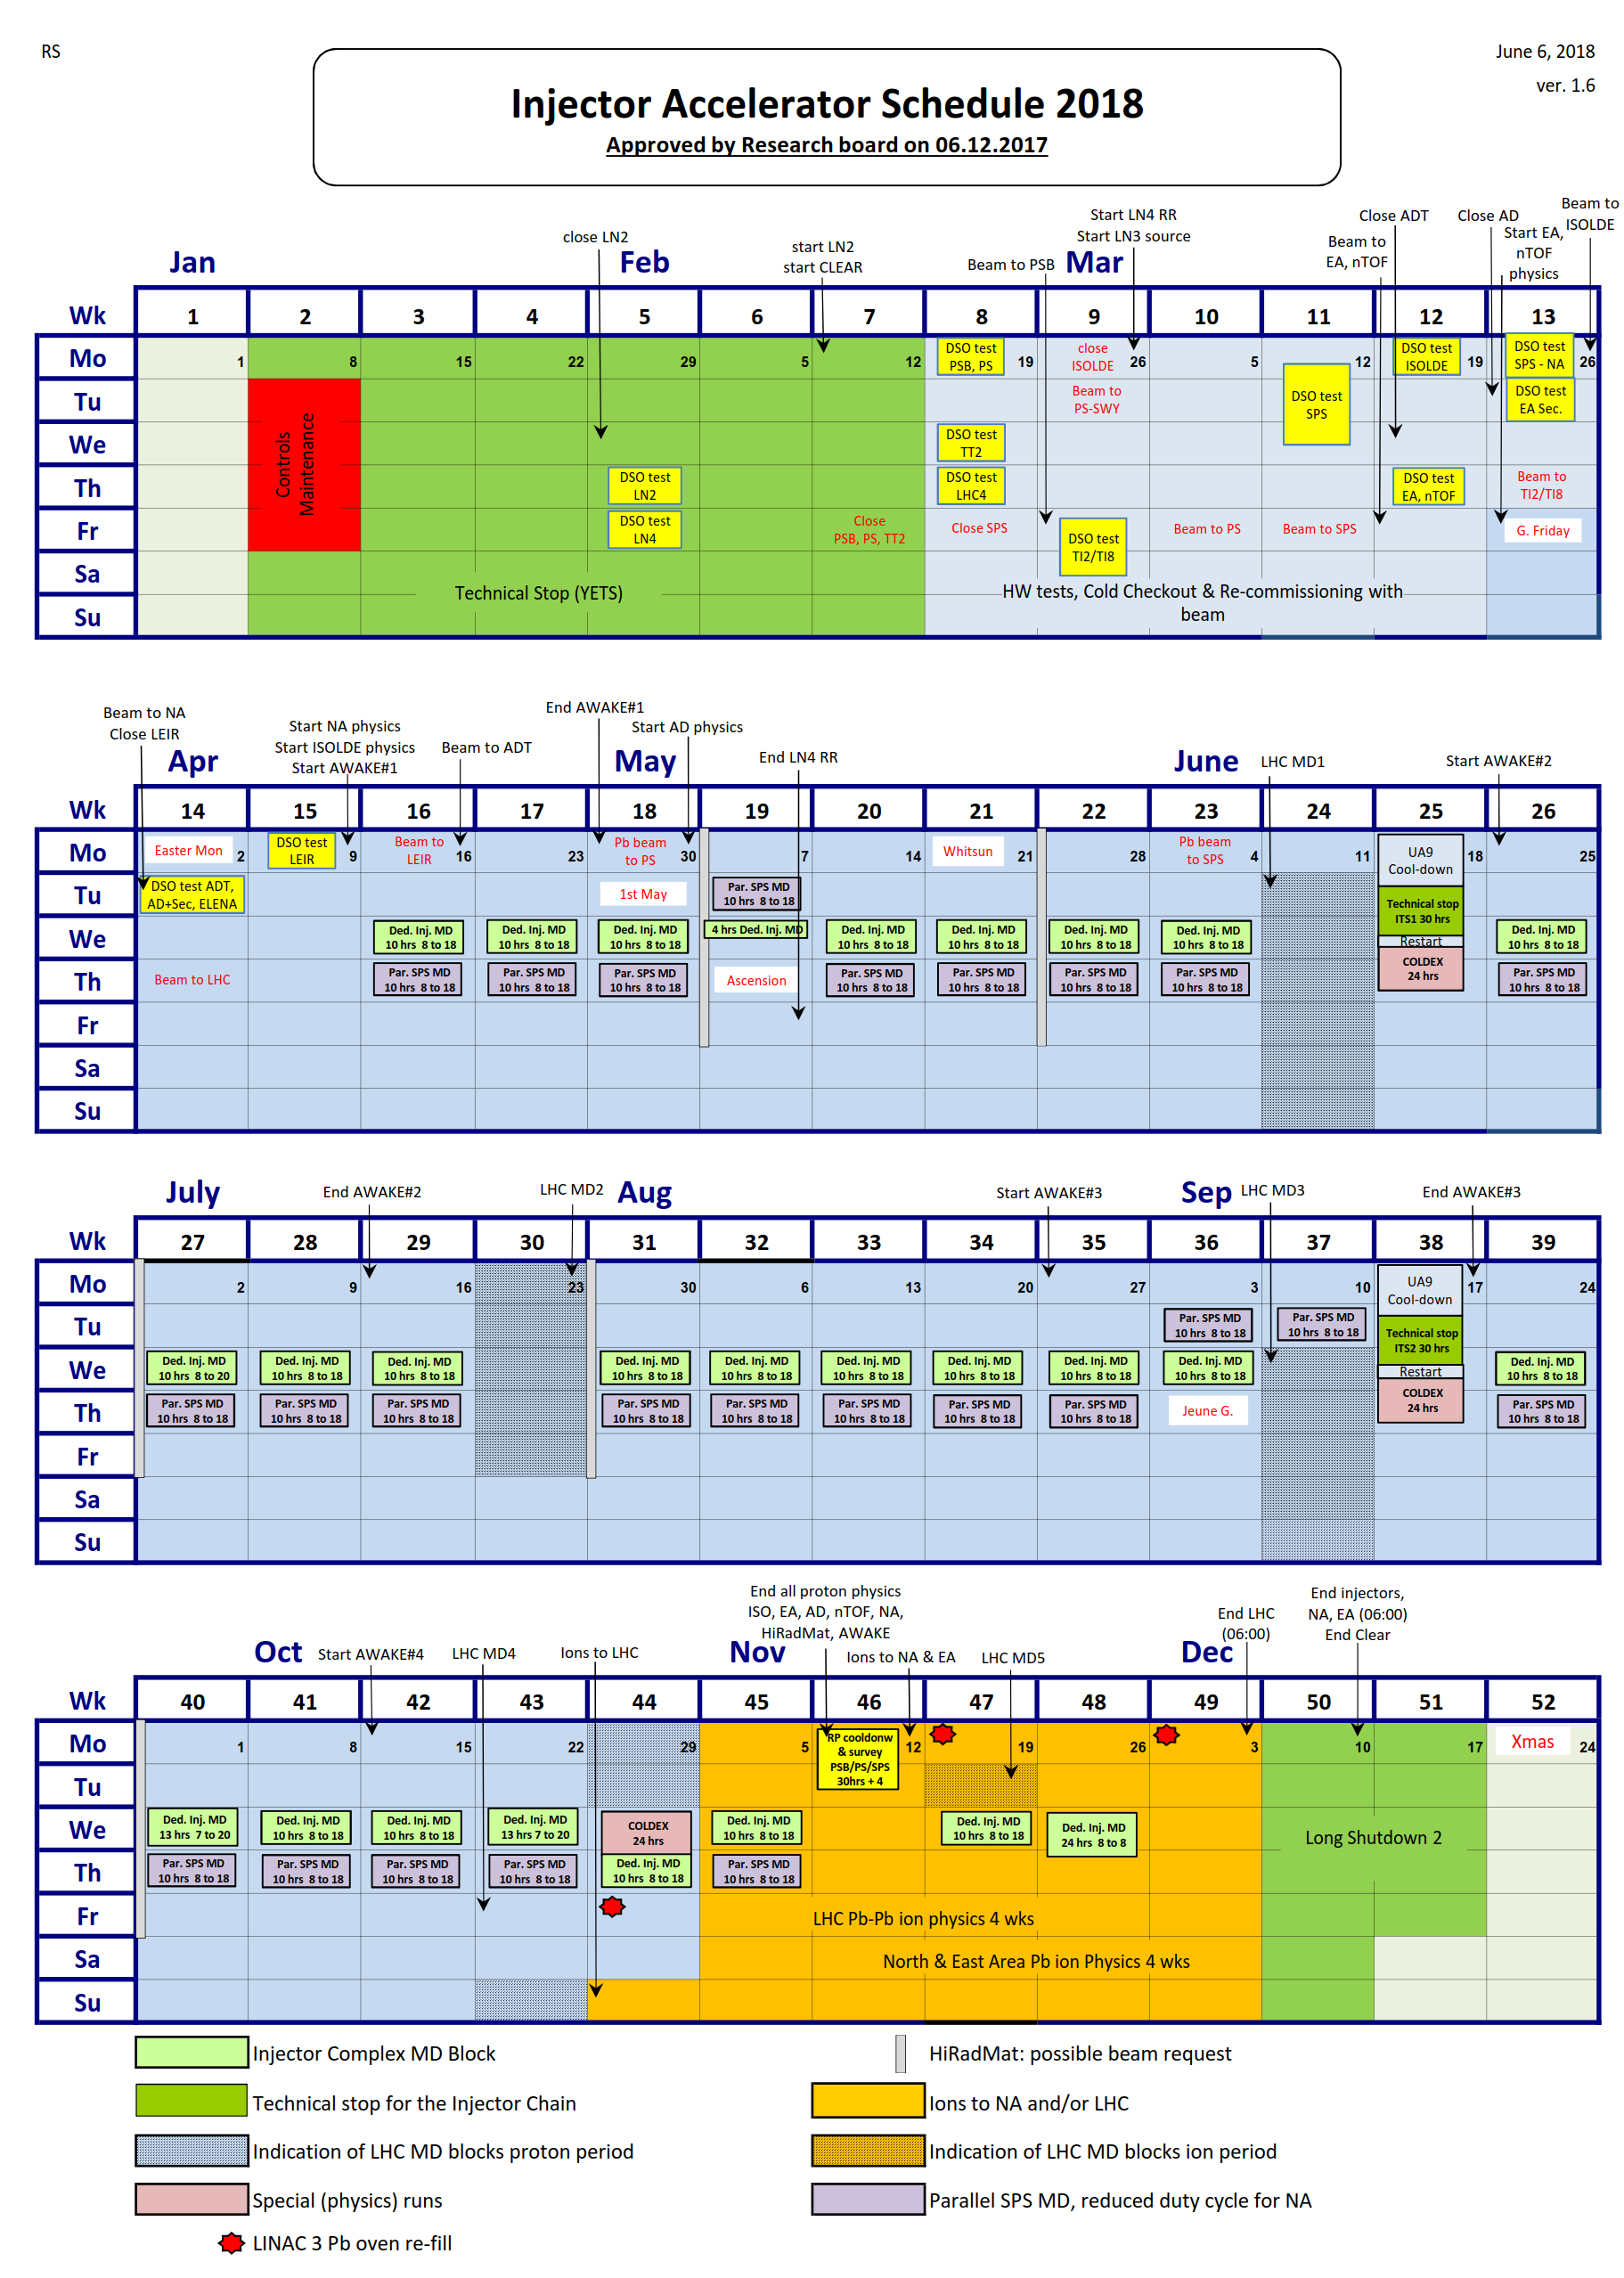
Protons available for physics to ISOLDE from 9th April – 12th November 2018.
217 days for physics (compared to 224 in 2017)
HIE ISOLDE on track for physics the week of July 9.
This leads to ~ 126 days available for HIE ISOLDE, compared to 150 in 2017. (at least with protons)
Dedicated low energy block from 9th April: ~ 90 days for LE.
Interleave HIE and LE runs as in 2017.
Strategy for HIE: 4CMS so optimized for reactions.
10MeV/u only available for lighter masses ~ 7.4MeV/u for mid/heavy: consequences for reaction runs.
Starting with CE then switch to T-Rex; XT03 and ISS to be accommodated.

Slide 3
Summary of beam requests 2018
Row Labels | Sum of Requested shifts
Biophysics | 35
COLLAPS | 25
Collections | 1
CRIS | 57
GANDALPH | 16
HIE | 629.5
IDS | 84.501
ISOLTRAP | 38
Medical | 20
NICOLE | 8
SSP | 65
TAS | 5.5
TISD | 18
TISD | 0
TISD/EC/IDS | 3
VITO | 18
WIZARD | 15
(blank) | 1
LA1: 22Mg | 10
LA1: 8B | 8
Grand Total | 1057.501

Slide 4
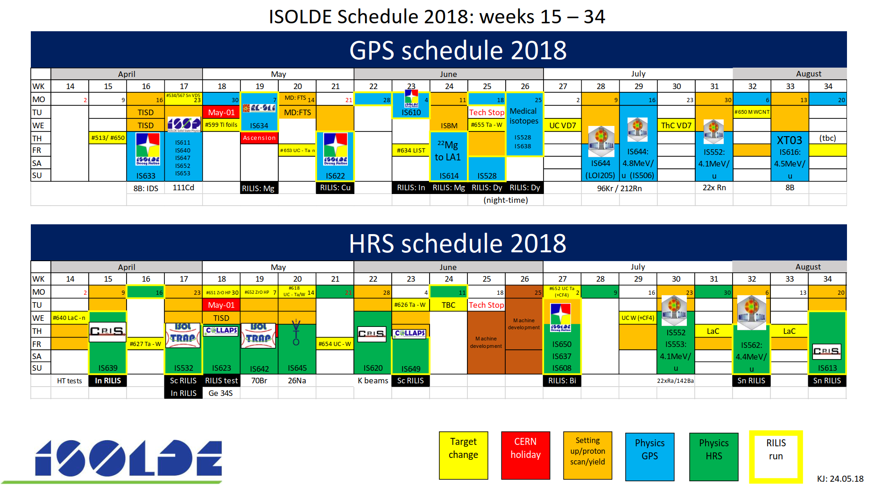
Challenging runs

Slide 5
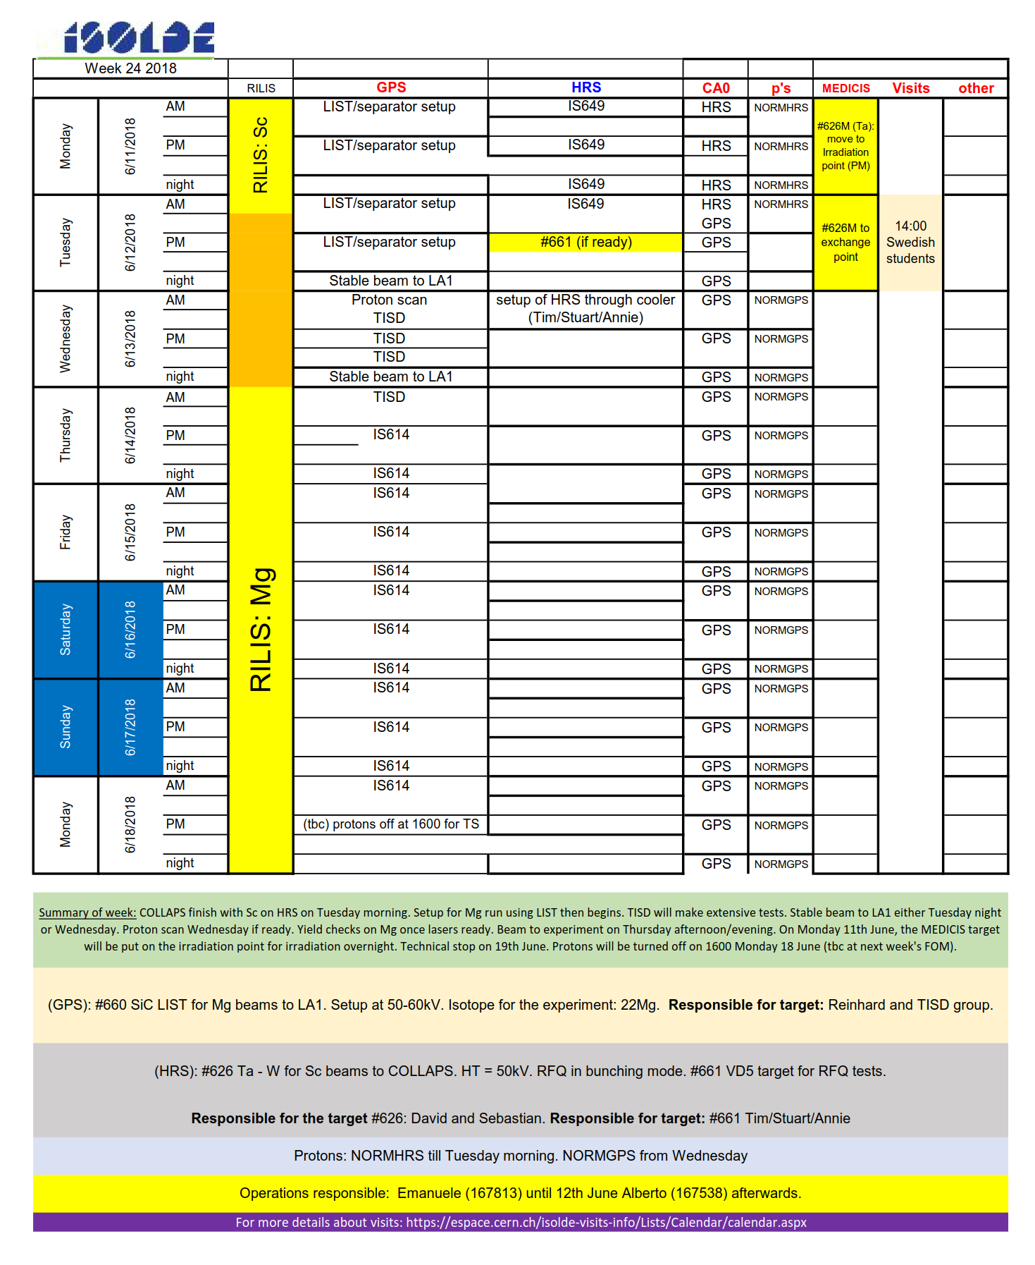
New column to the weekly planning: MEDICIS.
So far no consequence on ISOLDE programme.
MEDICIS station possibly available for offline irradiation of ISOLDE targets in Autumn
New ISOLDE Schedule “TAC” (Technical advisory committee). Similar to what takes place before INTC but for the schedule to avoid surprises, discuss yields, targets impurities, feasibilities etc. (start-up meetings often too close to the beamtime to make changes).

Slide 6
Currently on day 80
~ 163 number of shifts so far (excluding current medical run…)
18 experiments
ISSUES: Autotune: currently working on a new CERN supported programme and investigating Tim’s programme.
Observations: Machine performing even in spite of late start-up (later arrival of water than 2017) compressed cold check out…protons were available before ISOLDE was able to take them….

Slide 7


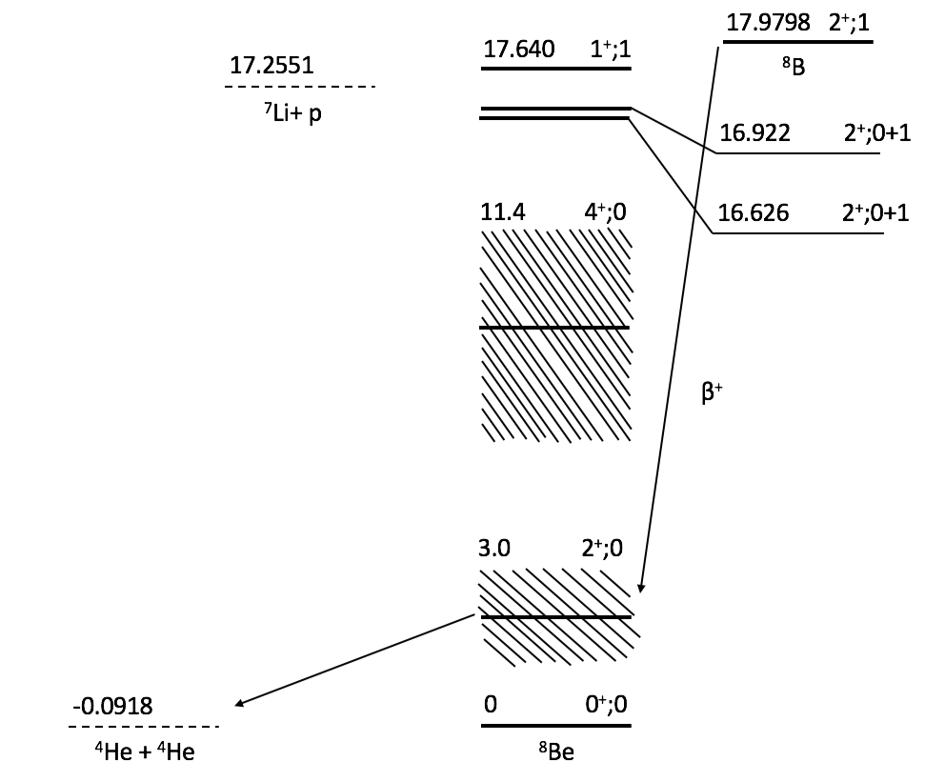
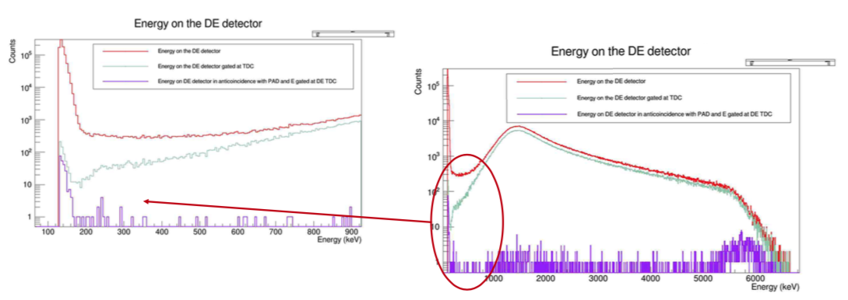
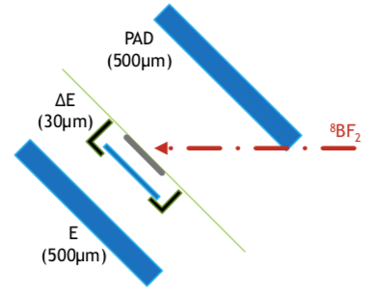
IS633: Electron capture of ⁸B into the highly excited states of ⁸Be
2018; determining the branching ratio to the state at 17.64 MeV → 7Li+p
Blue: IS633 in 2018
Red: IS633 in 2017
Experimental set-up at La1:
ΔΕ 30 μm thick, 20mm² Si detector to detect the 330 KeV proton
in anti-coincidence with two 5x5cm² Si-PAD
The main decay of ⁸B is β → α+α, determining the branching ratio depends on the overall statics obtained. We had very good yield 1E5 ⁸B/μC; with 70% of the data analysed we have 3.64E⁸ events in ΔE+PAD coincidence
The task is to have the region of 300KeV clean enough in order to give an experimental limit on the branching ratio to the 17.25 MeV level.
The theoretical upper limit is 2.3·10-8 [3] was calculated factorizing the wave function as a proton halo.
Thesis: Silvia Viñals i Onses
Many thanks to Olof Tengblad

Slide 8

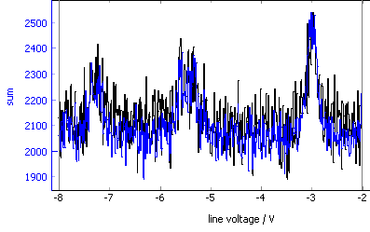
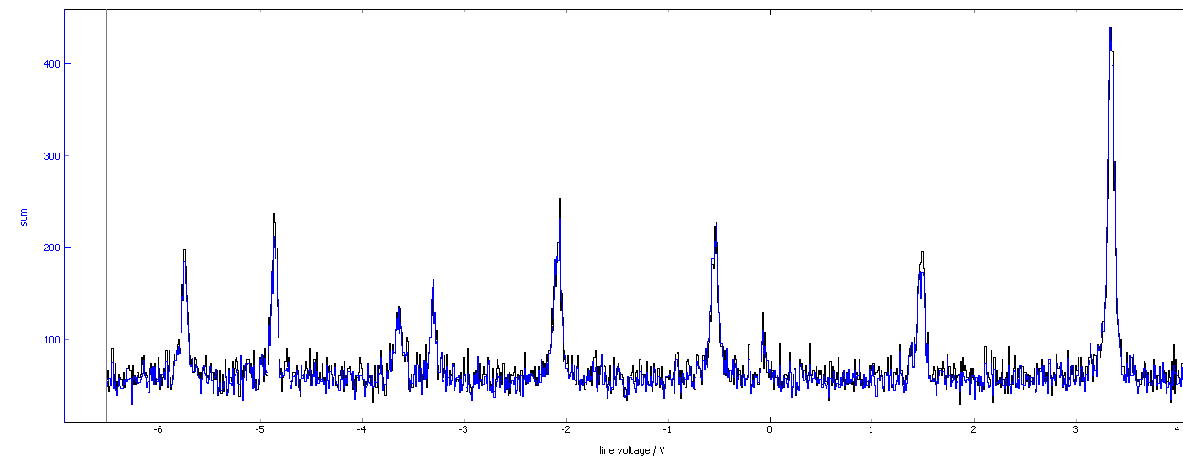
Spring 2018 at
Ge (Z = 32) isotopes across the N=40 subshell closure
⁶⁸⁻⁷⁴Ge (N = 36 – 42)
  Part of physics goal was reached
  ☹ ^{65-67,75-76} Ge and isomers in ^{71,73}Ge out of reach
First use of new laser frequency mixing unit
BUT …
Overwhelming amount of contamination
  nA of beam at some masses (luckily decreased over time)
No Ge mass marker (in combination with large contamination) slowed down setting up COLLAPS
Sc (Z = 21) isotopes across N=28
⁴⁴⁻⁵⁰Sc (N = 23 – 29)
  Main physics goal reached
  Only partial spectrum of ⁵⁰Sc
Smooth ISOLDE operation
⁶⁹Ge
⁴⁹Sc
Generally
Continuous AC problems in laser lab
Frequent tripping of power supplies at ISOLDE make long scans even more difficult!
Many thanks to Hanne Heylen

Slide 9
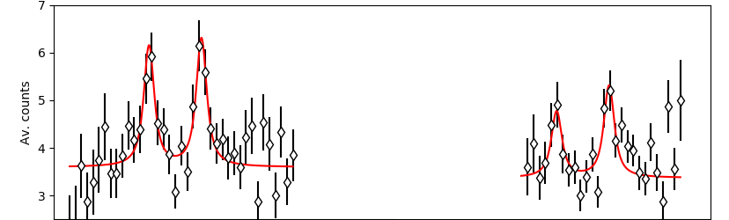
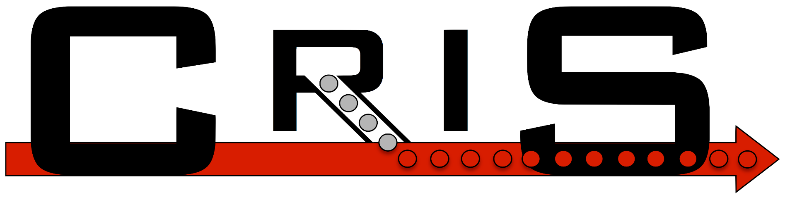
Study of neutron-rich K isotopes at CRIS IS620
Goal of the experiment
  Measuring the hyperfine structure of ^{52,53}K
  Investigating the N=32,34 shell closures
Results
  Hyperfine structure of ^{38,41,42,47-51}K using ion detection
  Due to high (stable) contamination at mass 52, 53 ion detection was not possible at these masses
  Beta detection of resonantly laser ionized isotopes enabled the measurement of ⁵²K
  First use of beta detection at CRIS
  ⁵²K (N=33) is an excellent laboratory to investigate the N=32 shell closure
  Hyperfine structure of ⁵³K was not obtained
PRELIMINARY
Hyperfine structure of ⁵²K obtained by detecting the beta decay of resonantly ionized ⁵²K isotopes
Contamination @ mass 52 | ~ 10⁷ ions/s
⁵²K yields | ~300 ions/s
Many thanks to Agi Koszorus

Slide 10
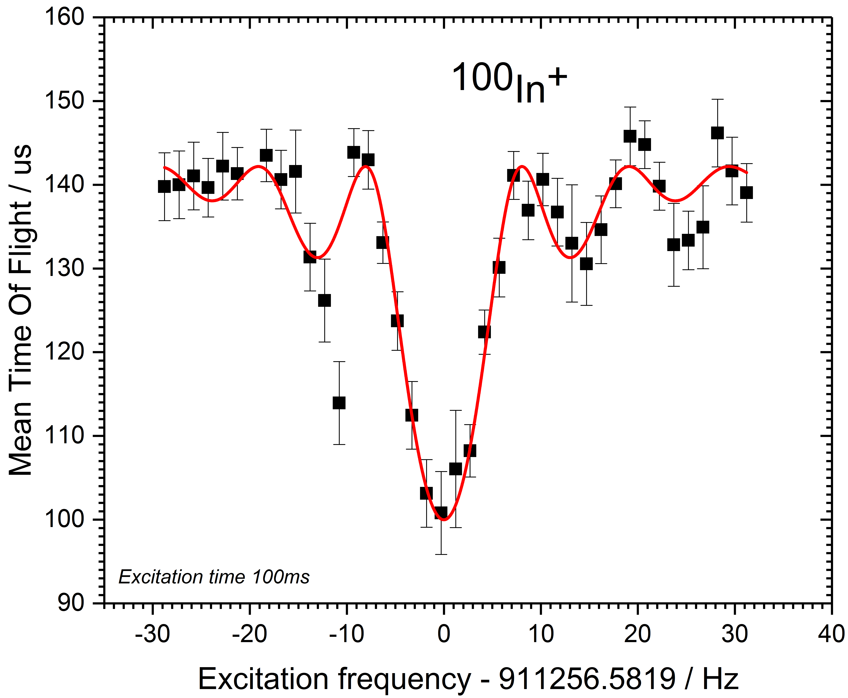
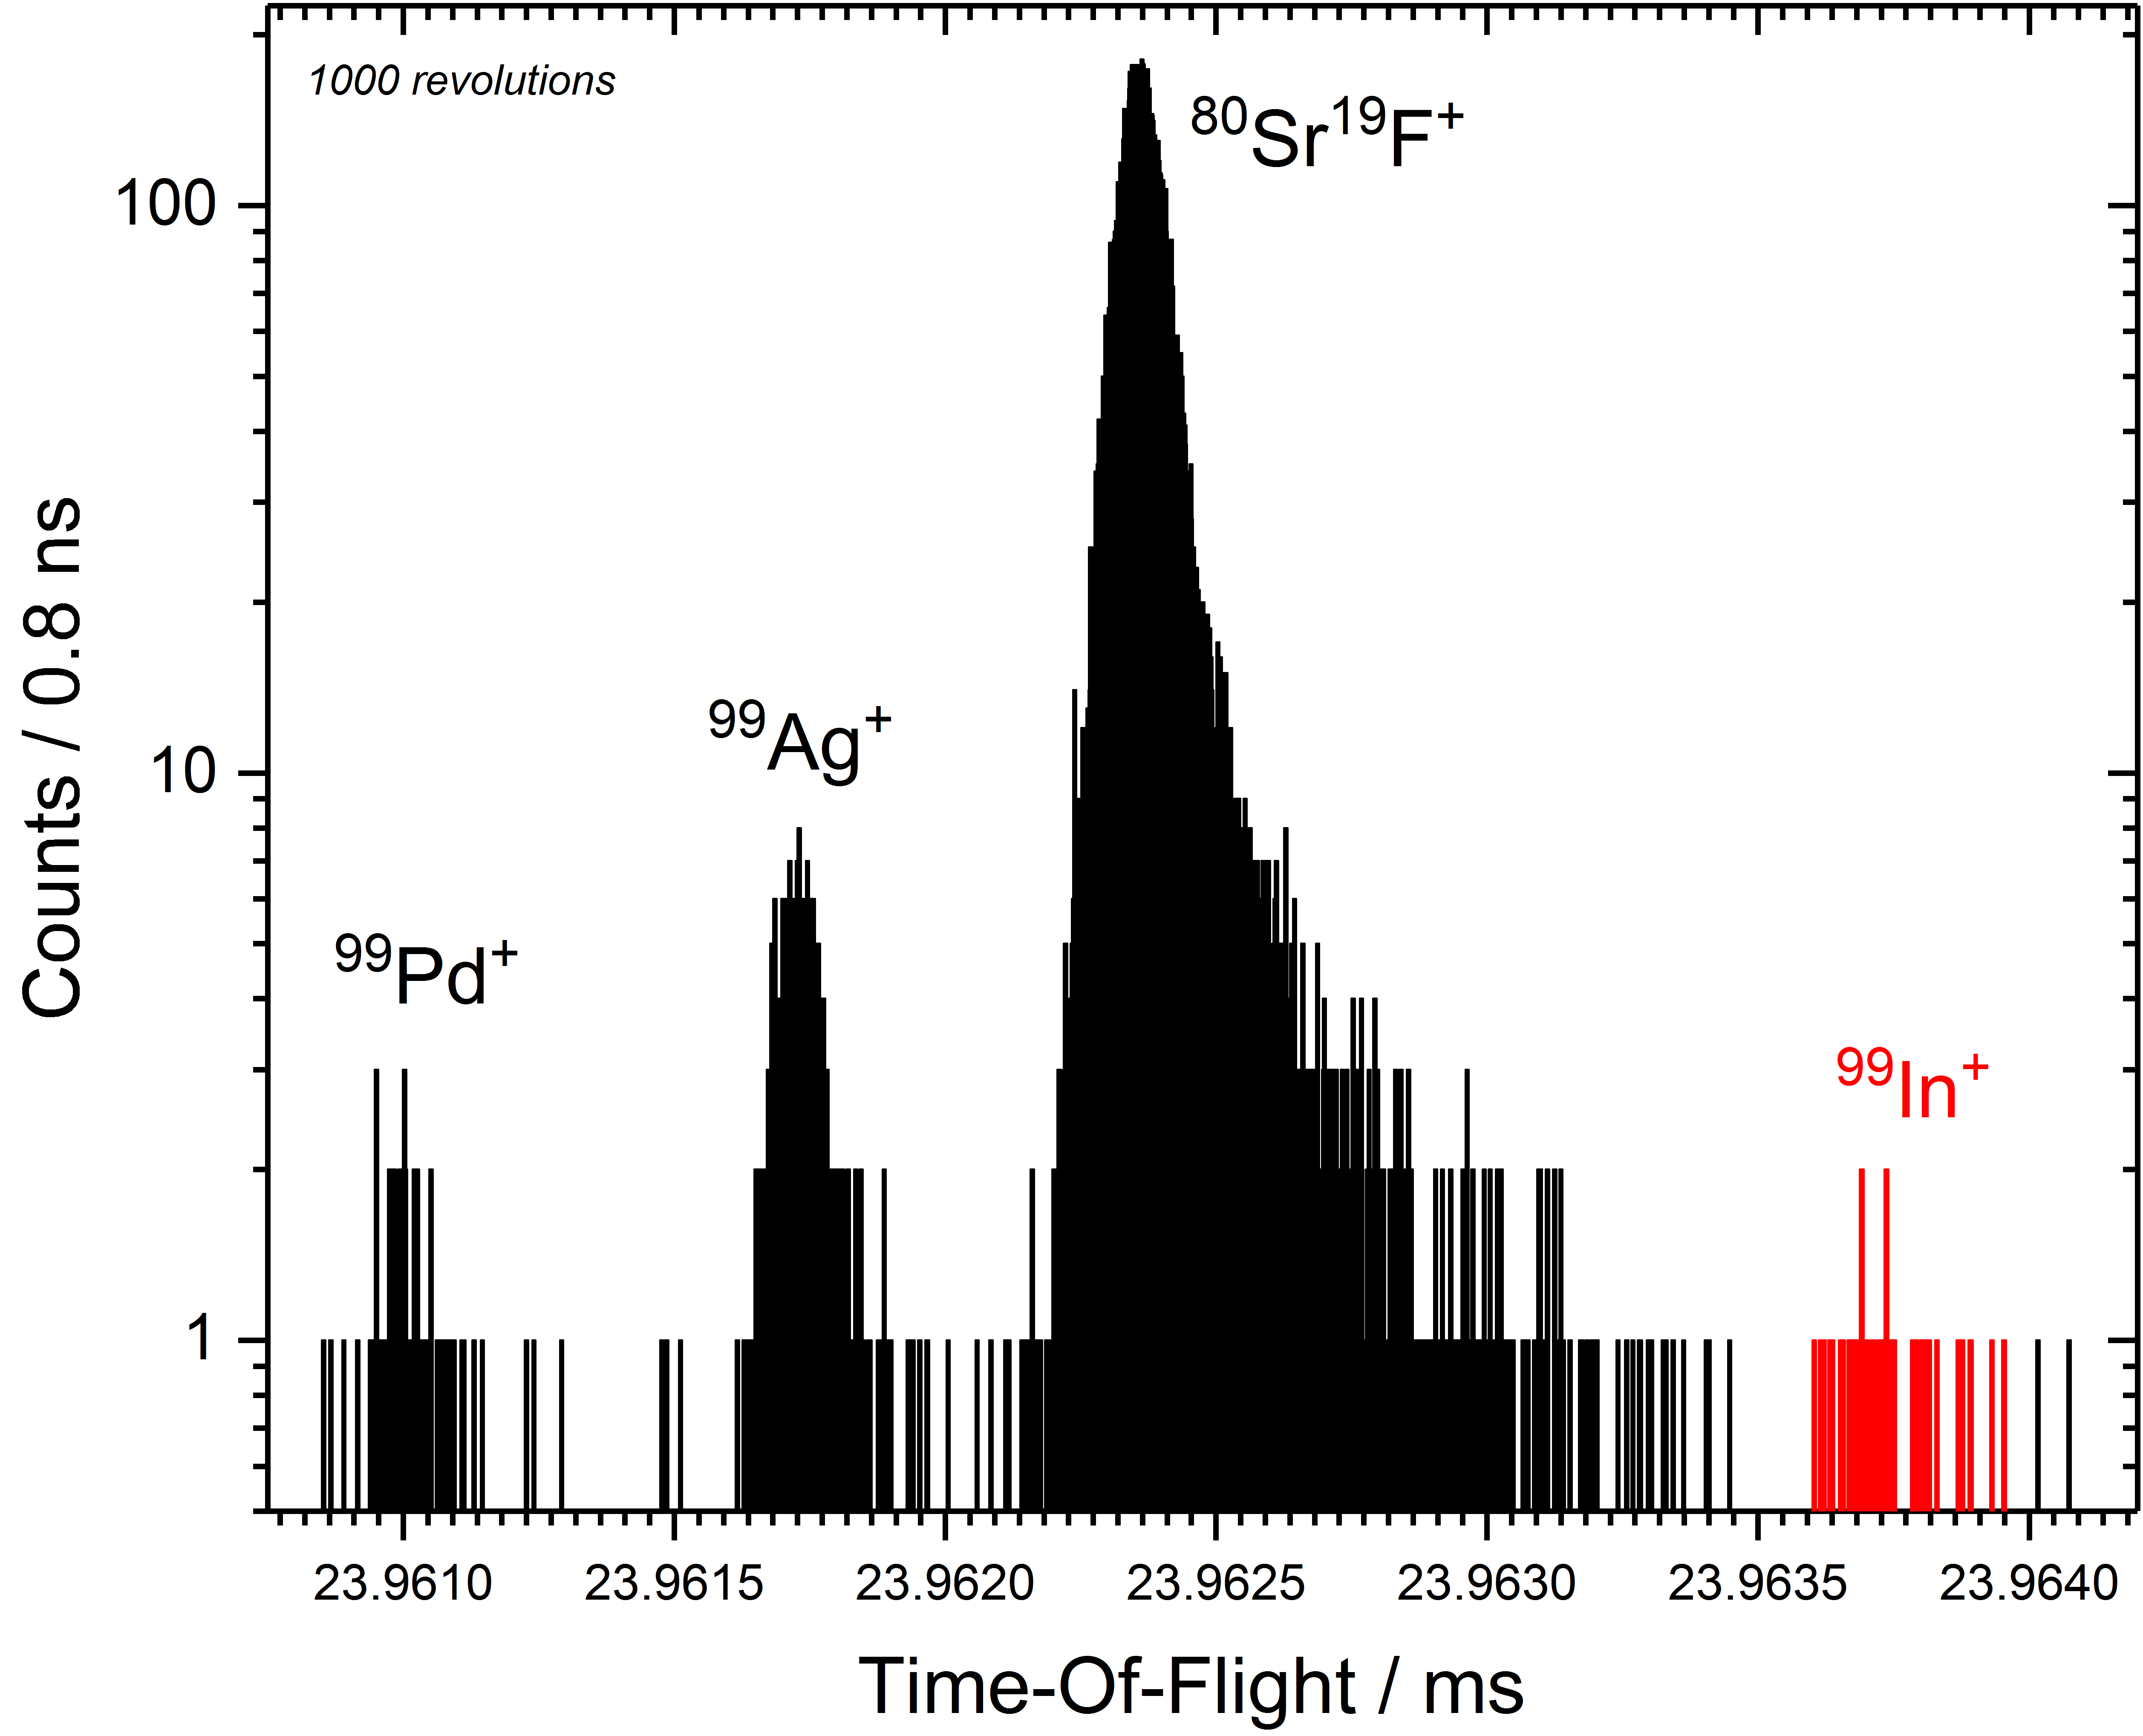
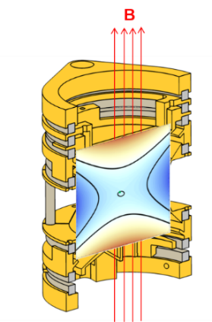
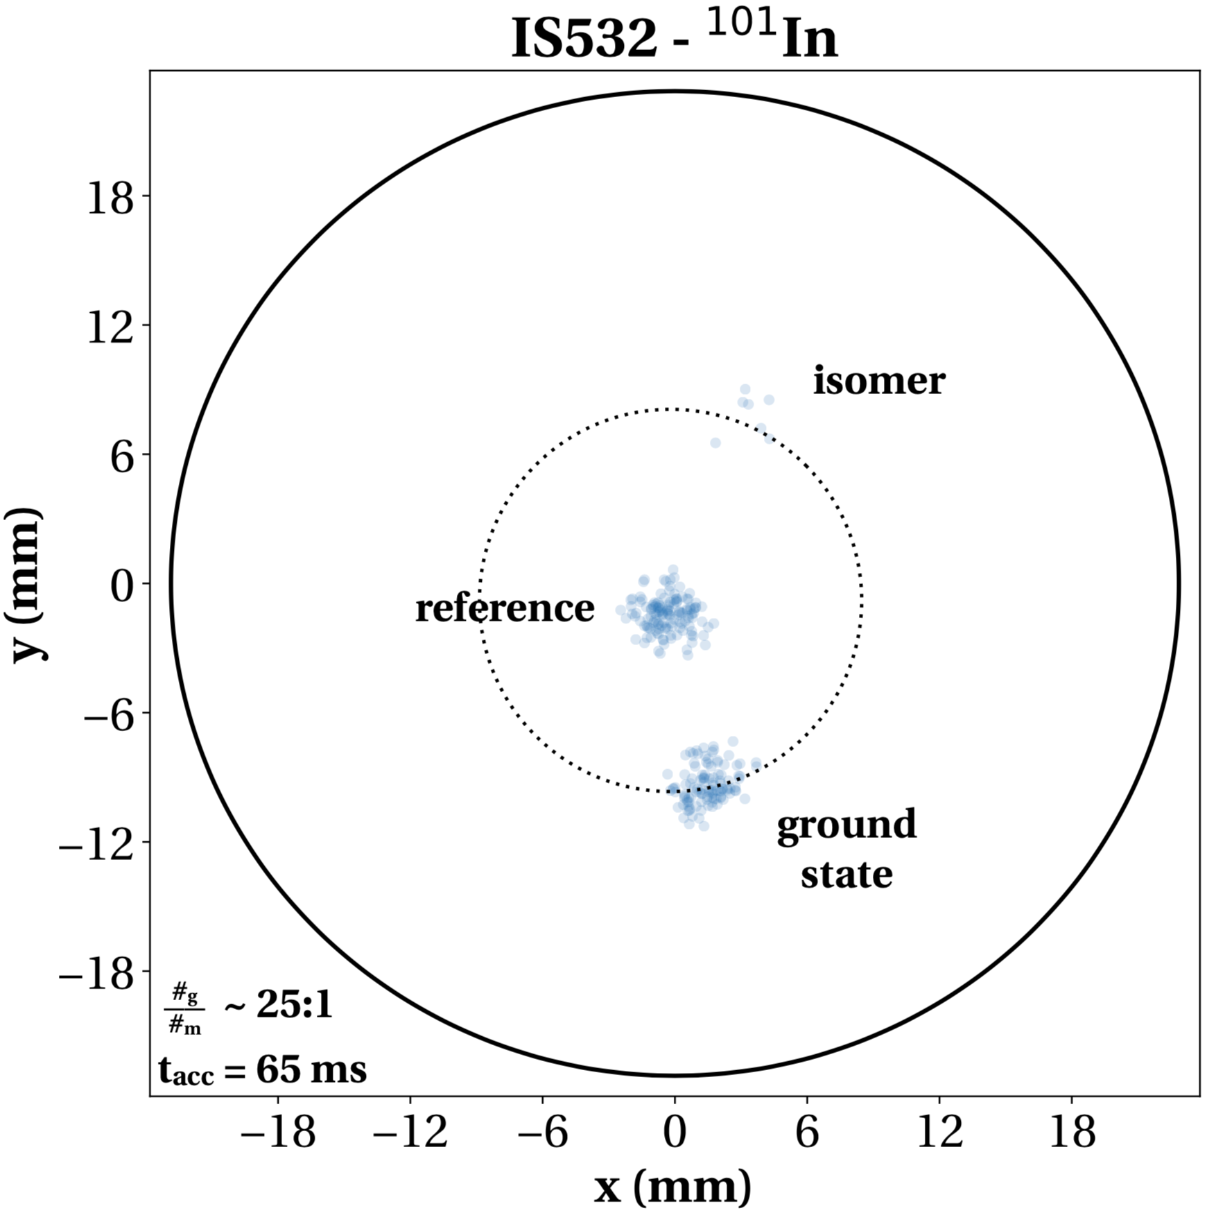
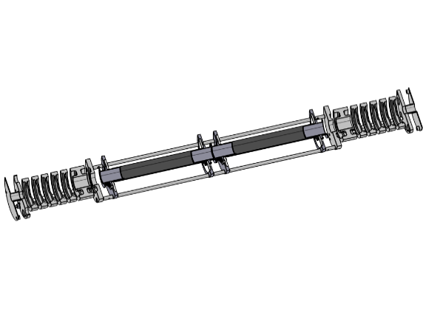

ISOLTRAP : experimental campaigns in 2018
April 2018 – LaC_{x} + RILIS: high-quality Indium beams.
PI-ICR technique allows first mass measurement of ¹⁰¹In^{g,m}.
PRELIMINARY
PRELIMINARY
PRELIMINARY
Penning trap measurements improve the mass uncertainty of ¹⁰⁰In by a factor 100.
MR-TOF MS
c
Precision
Penning trap
MR-TOF MS allows first mass measurement of ⁹⁹In
⁵²⁻⁵⁵Sc run (RILIS+Ta-foil target)
  Confirms that neutron rich Sc up to A=52 are produced ☺
  Stable Ti-V-Cr isobaric contamination too strong ☹
  Impossible to measure the Sc isotopes of interest
  Run redirected to In ☺☺☺
⁷⁰Br Q_{ec} value : Mai 2018
  lower production rate and higher than expected contamination ☹
Many thanks to Maxime Meugeot

Slide 11

IS634: Exploring the limits of p-type doping in GaN
Aim of 2018 beam time: explore lattice location (substitutional vs interstitial) of ion implanted Mg in GaN
at technologically relevant doping levels
20 kV operation of GPS
Interstitial Mg undergoes a fast drop within fluence range up to 1x10¹³ cm⁻²
Even for Mg fluences as high as 5x10¹⁴ cm⁻², i.e.
[Mg] ~1.6x10²⁰ cm⁻³ = 0.3%, interstitial Mg does not reappear, ~93% of Mg continues to be implanted into Ga sites
Many thanks to Uli Wahl

Slide 12
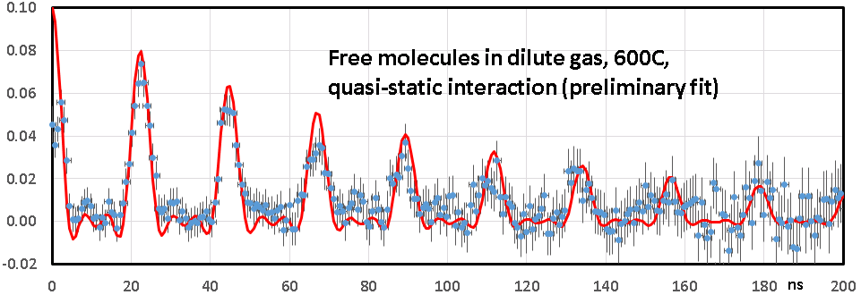
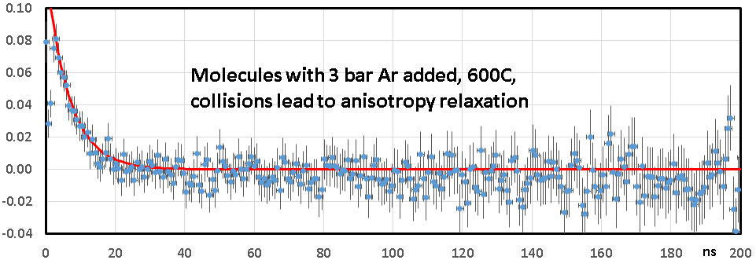
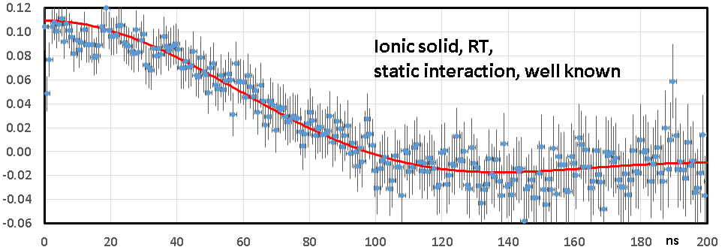
First ¹¹¹Cd PAC measurements of free molecules (IS640), here CdI₂
The problem: Measure quadrupole
interaction in free molecules to
determine Q for ^{111*}Cd (and ^{199*}Hg)
The concept: Freely rotating linear
molecules have the rotation axis J perpendicular to the molecule, thus the EFG along J is (minus) half the molecular one
The task: Produce highly dilute
samples so that collisions do not
change the orientation of J during
the measuring time, typically 100ns
The status: Concept has been confirmed for Hg halides last year. Now high precision data for CdI₂ (less precise for CdCl₂ and CdBr₂)
The next step: Quantum chemistry calculations (in progress)
Many thanks to Heinz Haas

Slide 13
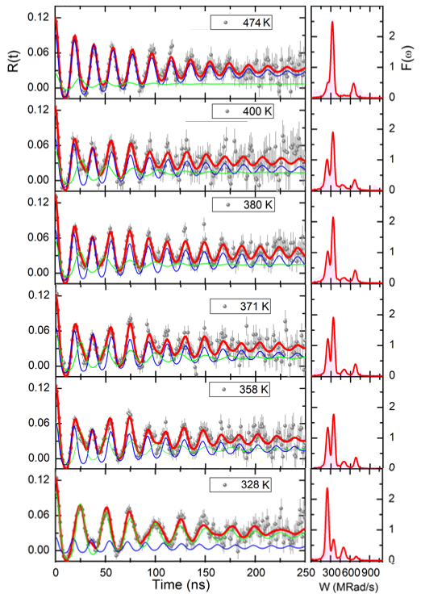
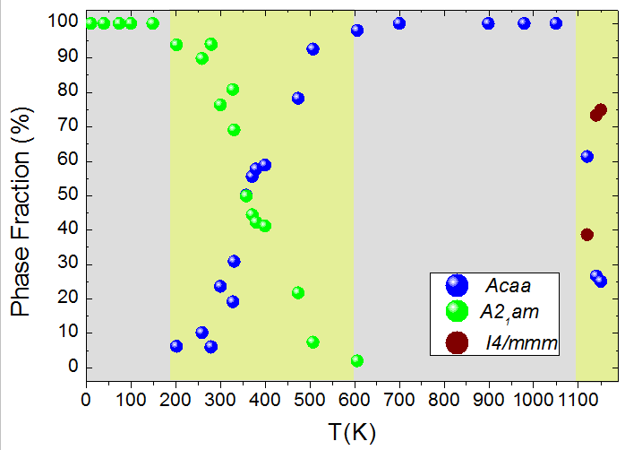
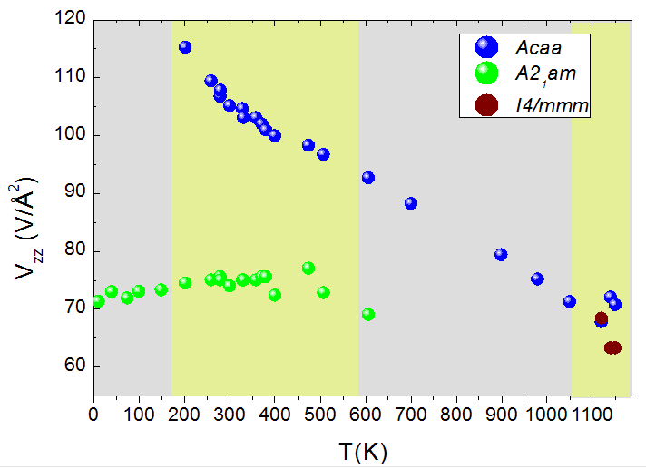
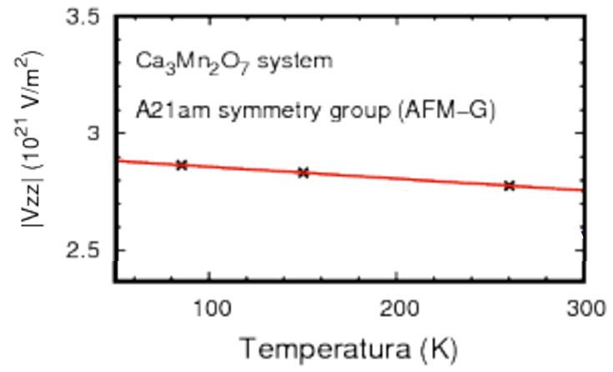

IS647 - PAC studies in Ca3Mn2O7 naturally layered perovskite
Hybrid Improper Ferroelectric
NON LOCAL METHODS say:
We say: PAC / DFT results
^{111m}Cd/Cd PAC at CERN-ISOLDE (May 2018)
Is there a negative thermal expansion (NTE) and/or soft mode?
YES IT IS POSSIBLE
Where? In the High T Acaa non polar or Low T A2₁am polar phase?
Acaa non polar phase Low T A2₁am
Is phase coexistence indeed needed to see NTE and/or soft mode
YES SEEMS NOT !!
Orthorhombic
Acaa – non polar
Phase Cohexistence & Transitions
A2₁am atypical Vzz negative termal dependency
Acaa
Also good data from new Brazilian collaboration (proposal at last INTC)
A2₁am
DFT A21am Vzz thermal dependency calculations using the high-resolution synchrotron X-ray diffraction data from PRL 114, 035701, 2015
!?
Orthorhombic
A2₁am – polar
Many thanks to Dina Lopes
Reporting A.M.L. Lopes FCT, CERN-FIS-PAR-0005-2017 and BFBF, 05K16PGA

Slide 14
Draft planning (from October onwards very much a draft….do not get excited/emotional yet…).
Mixture of T-REX/ISS and XT03 for HIE ISOLDE: try to maximize range of HiE ISOLDE experiments. Interleaving low energy and negative runs (last year before 2022). Also quite a few setups coming together at end of year…
After protons finish on Nov 12th: 7Be to XT03 (if target available); 44Ti to XT03 (Edinburgh); RaF to CRIS.

Slide 15
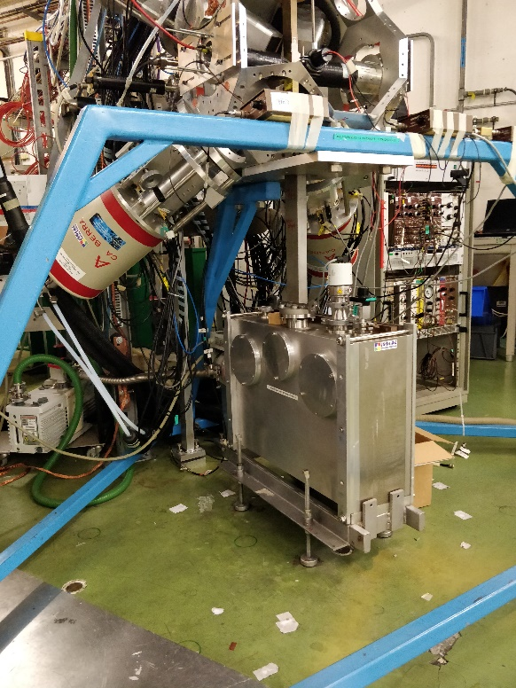
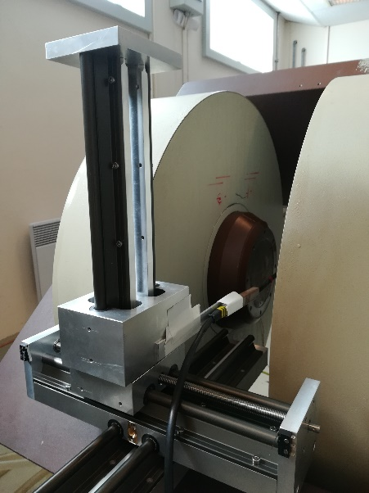
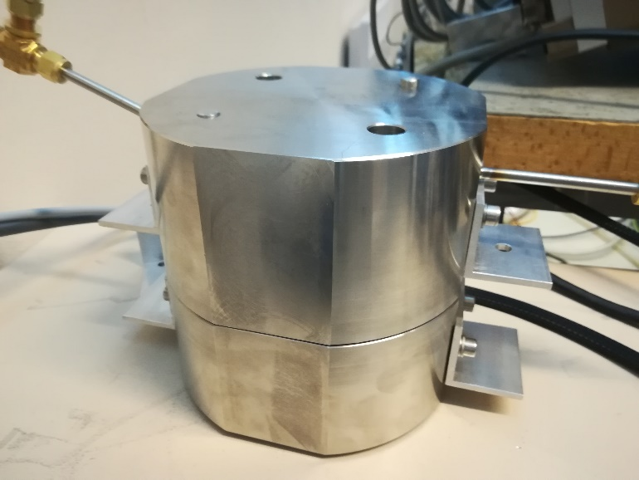
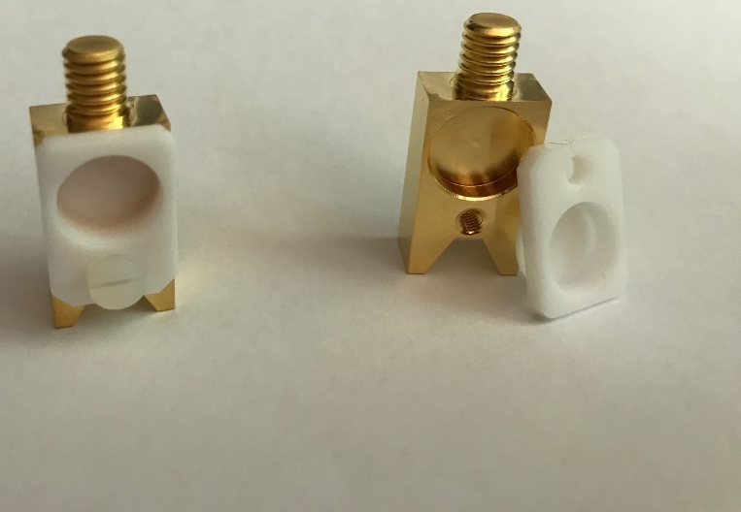
EP technicians
Antonio Goncalves and Francois Garnier: supported by the ISOLDE collaboration.
Available for jobs for users to assist experiment: especially mechanical work.
Work carried out for MIRACLS, IDS, HIE-ISOLDE, VITO, biophysics and others.
Day to day presence in the hall could be increased, otherwise very positive feedback.

Slide 16
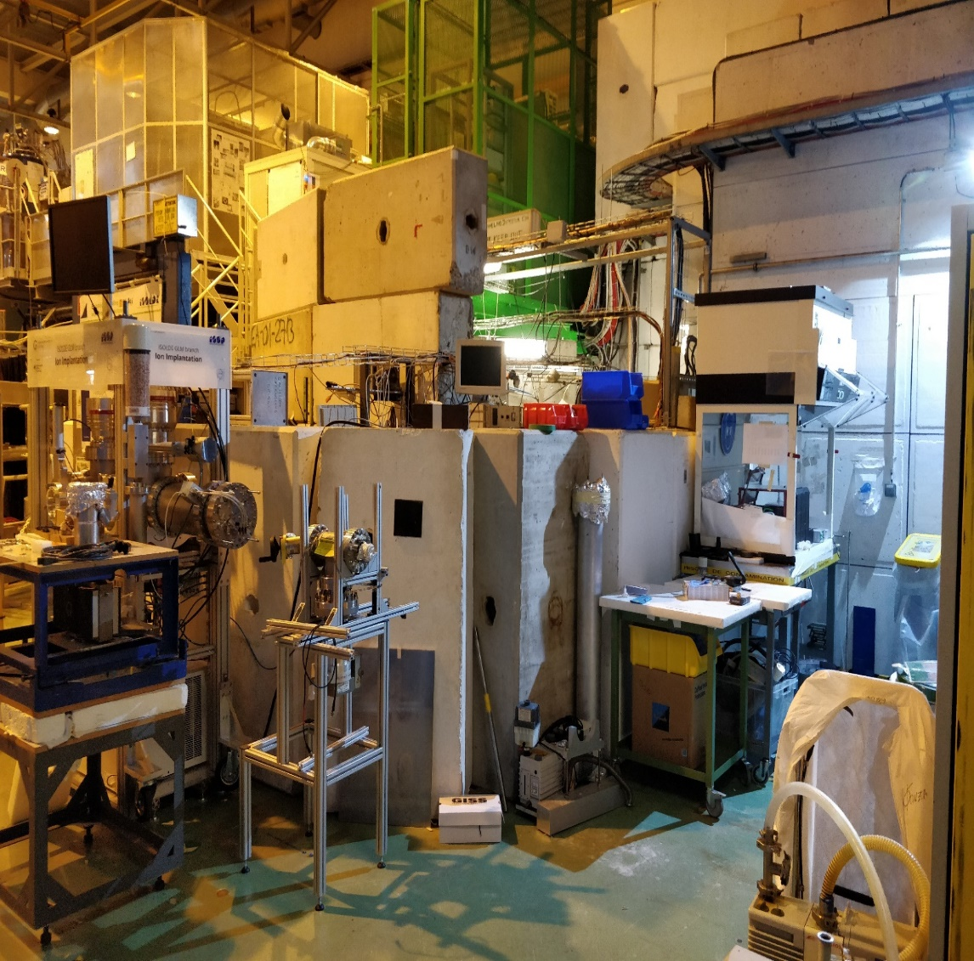
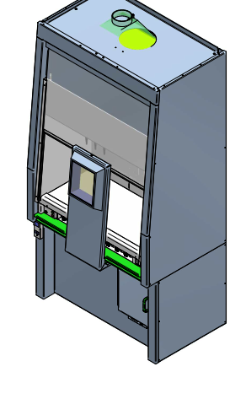
Safety: Ergonomy around GLM/GHM area
New working group to optimise the space. New shielded fume cupboard ordered (paid by EP)
Training etc
Hands on courses: electrical awareness and RP
Online courses: safety at CERN, RP supervised area
Expiration date for hands on courses: appears to be a mistake, but still needs to be reset….
Backup solution being sought n case of problems with the trainer (coming from Belgium: strikes etc).
Refreshing courses: new approach during LS2, currently being finalized. More frequent.
Installation foreseen end of August

