Slide 1


Status of n_TOF
Laurent Tassan-Got
on behalf of the n_TOF collaboration

Slide 2
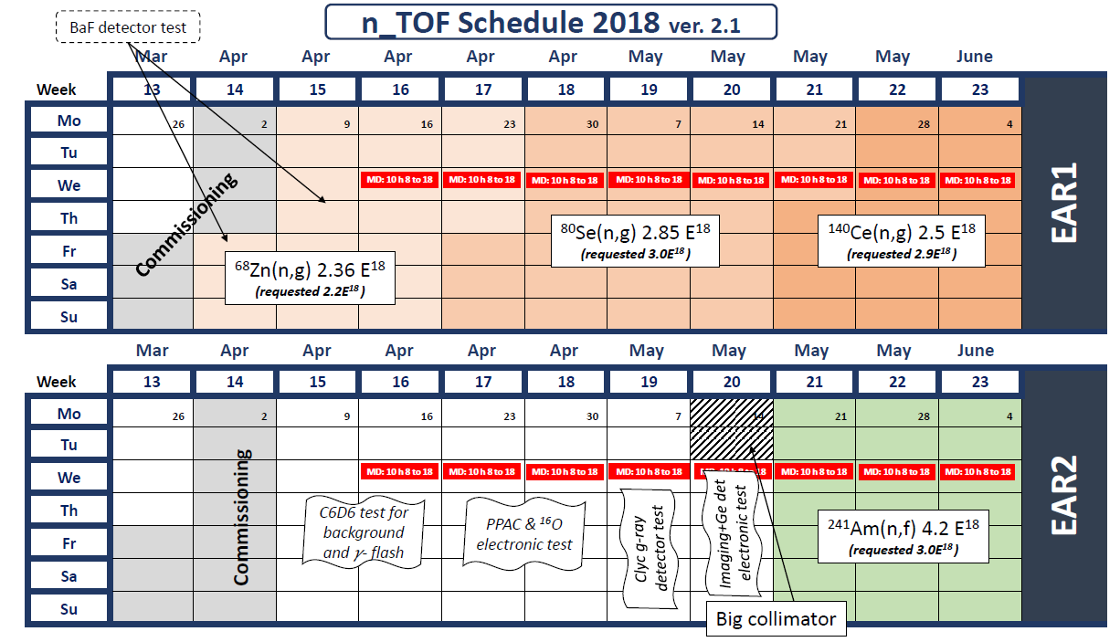
April-May

Slide 3
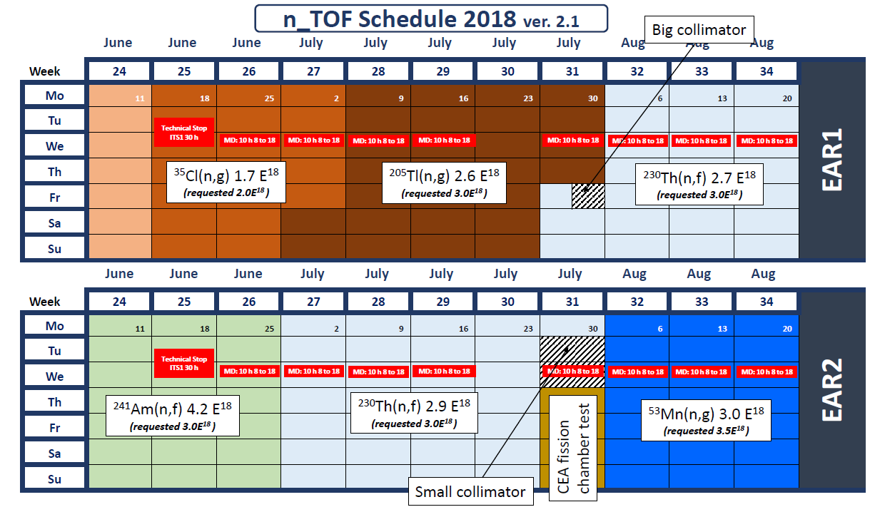
June-August

Slide 4
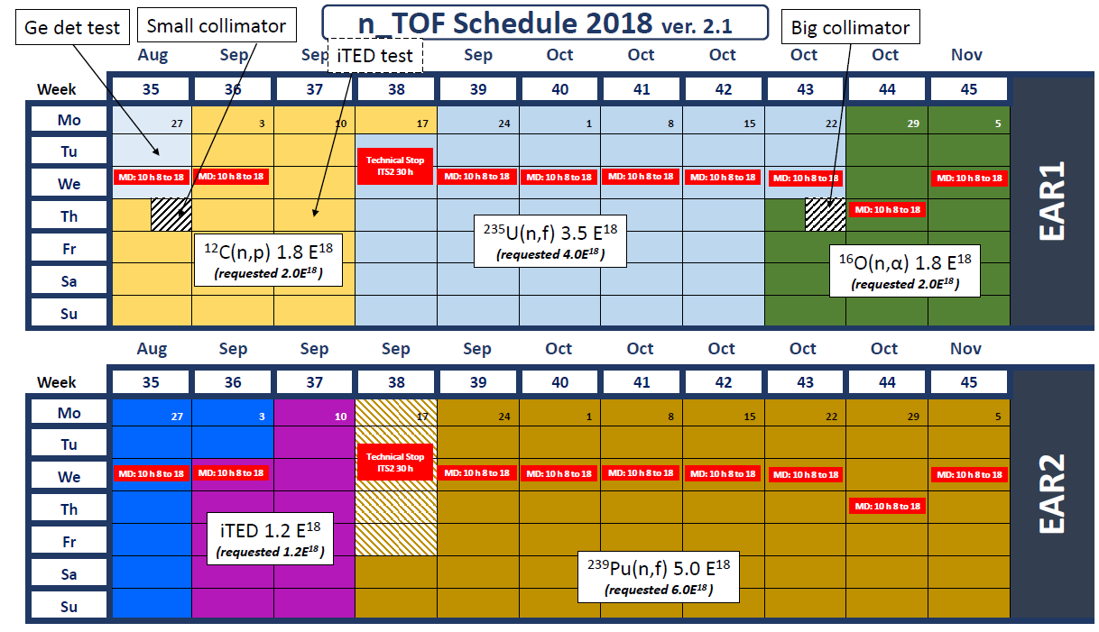
September-November

Slide 5
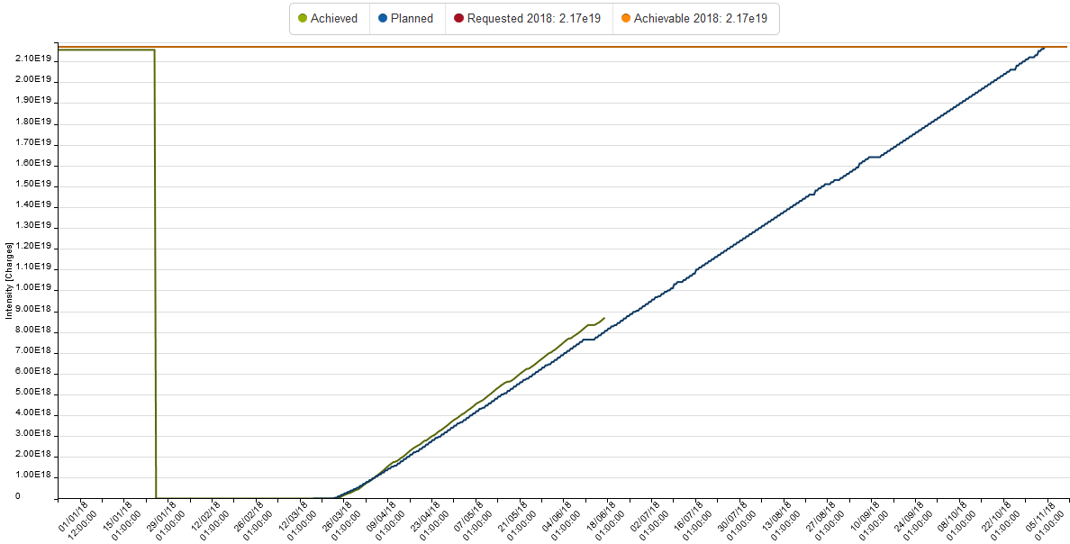
Proton delivery

Slide 6
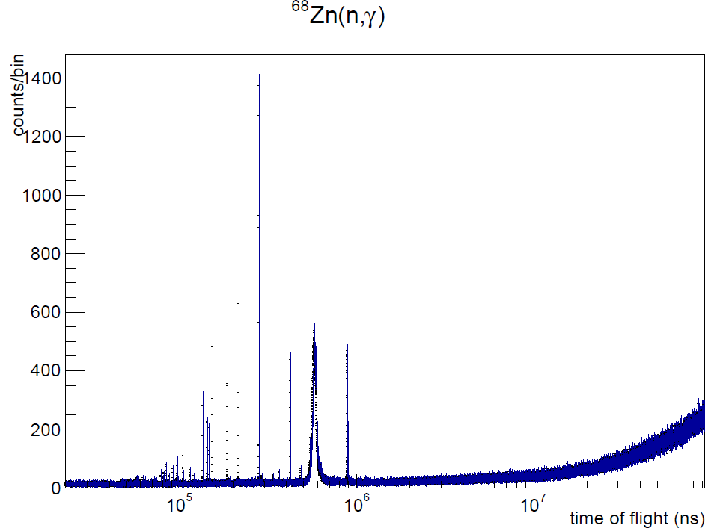
A few preliminary results
⁶⁸Zn(n,γ)
The main nuclear uncertainty for the abundance of ⁶⁸Zn, produced in AGB stars (s-process)

Slide 7
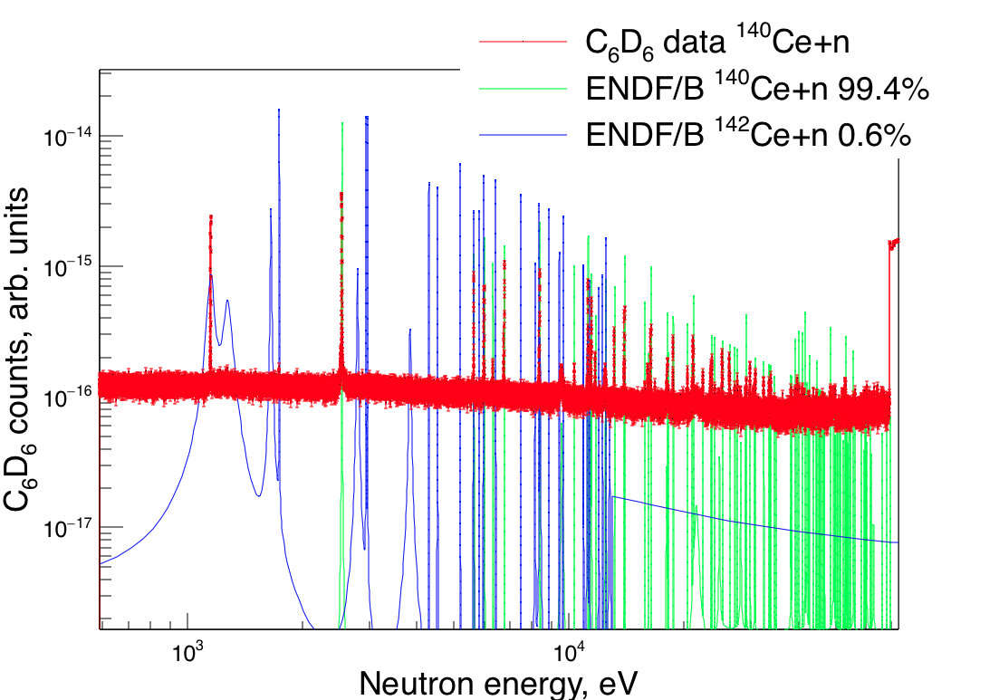
A few preliminary results
¹⁴⁰Ce(n,γ)
Neutron closed shell.
Problem in simulation of the natural abundance through the s-process
New assignation of the 1st resonance !

Slide 8
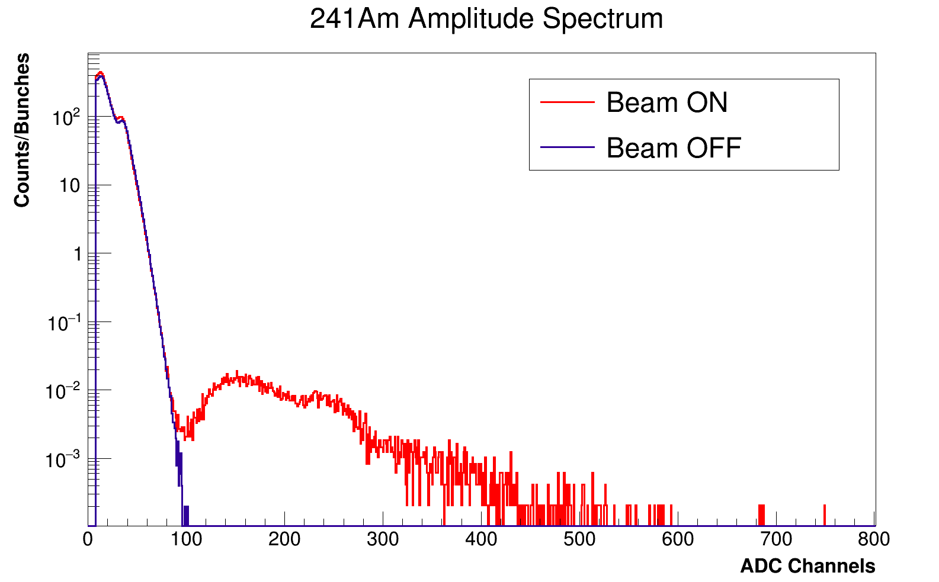
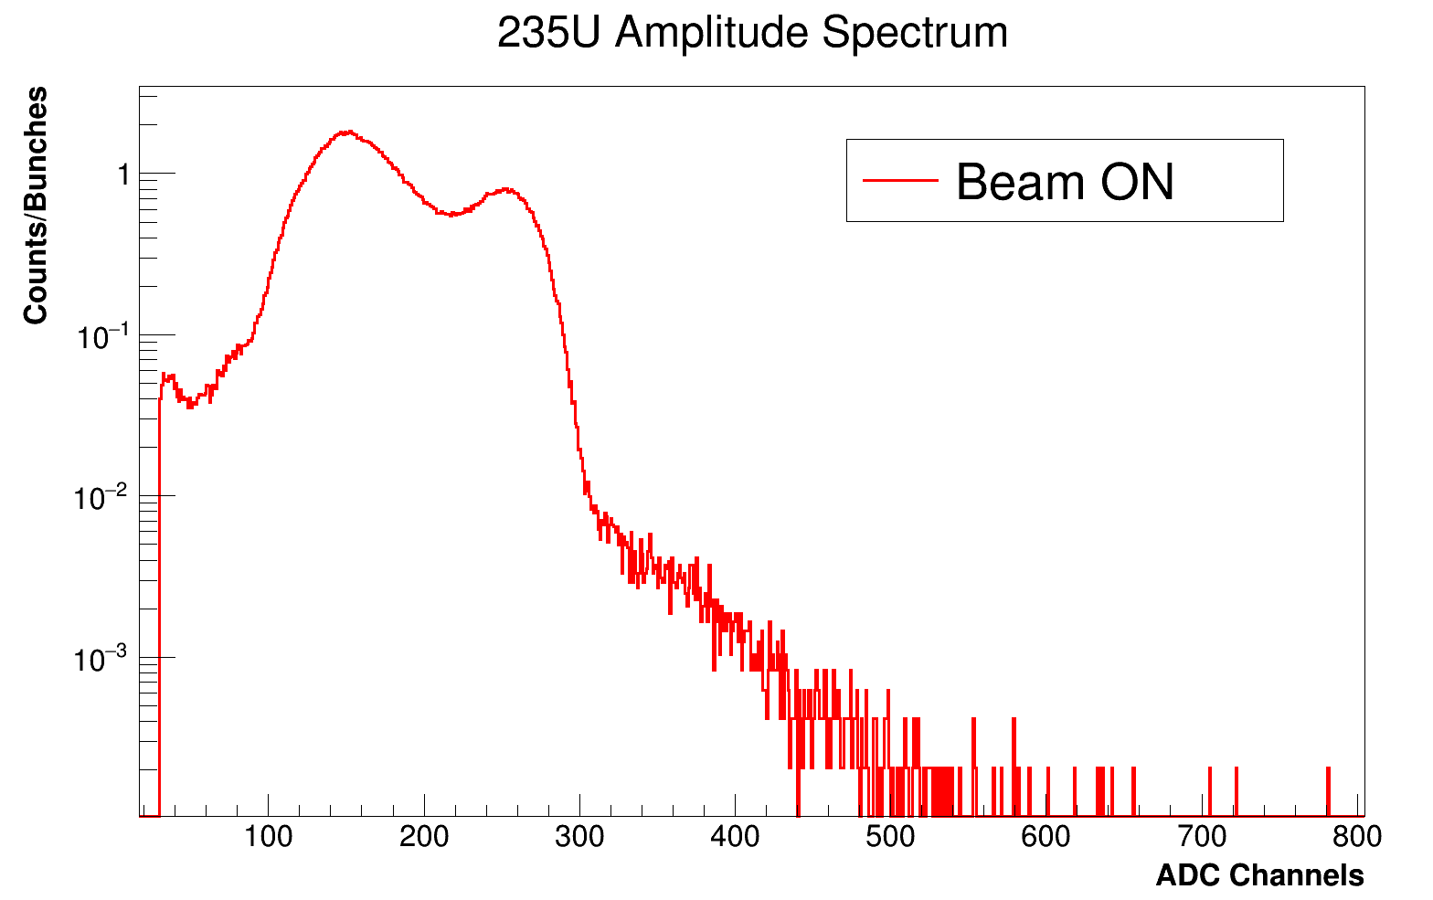
A few preliminary results
²⁴¹Am(n,f)
Important for incineration in fast reactors
High α activity (100 MBq)
Alpha Background
Separation point between α- particles and fission fragments
Fission Fragments

Slide 9

²³¹Pa(n,f) replaced by important detector tests
²³¹Pa samples could not be done (fundamental electrochemistry problem)
Experiment replaced by important tests:
  neutron dosimeter
  neutron imaging (energy selectivity)
  voltage divider for small BaF2 crystals to measure at short
  time close to the γ-flash
  fast localisation on PPACs for high energy fission
  switch technology against γ-flash

Slide 10

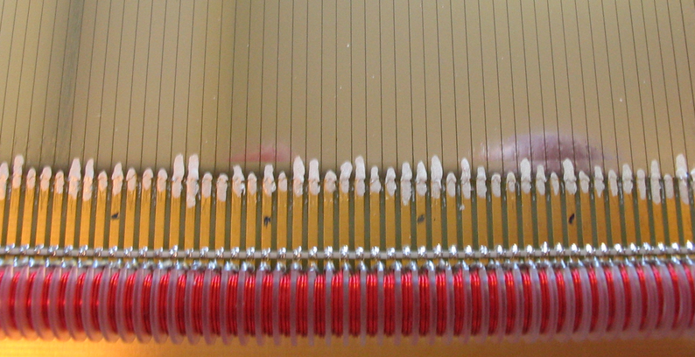
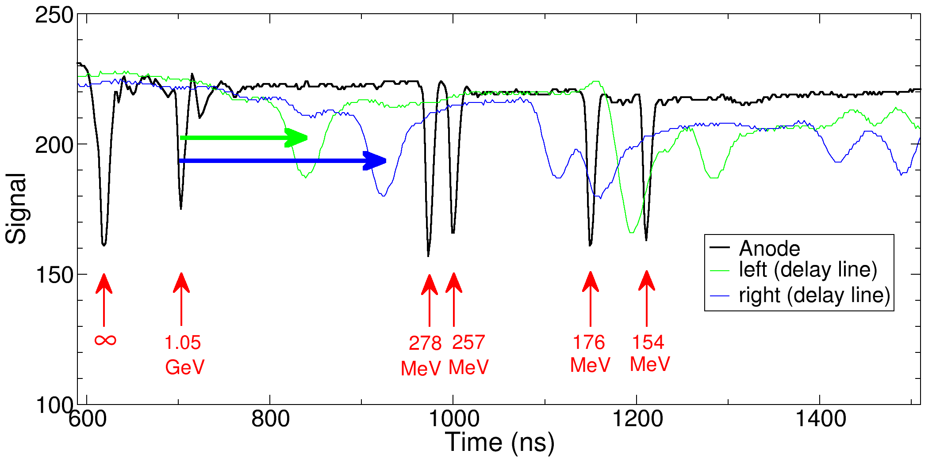
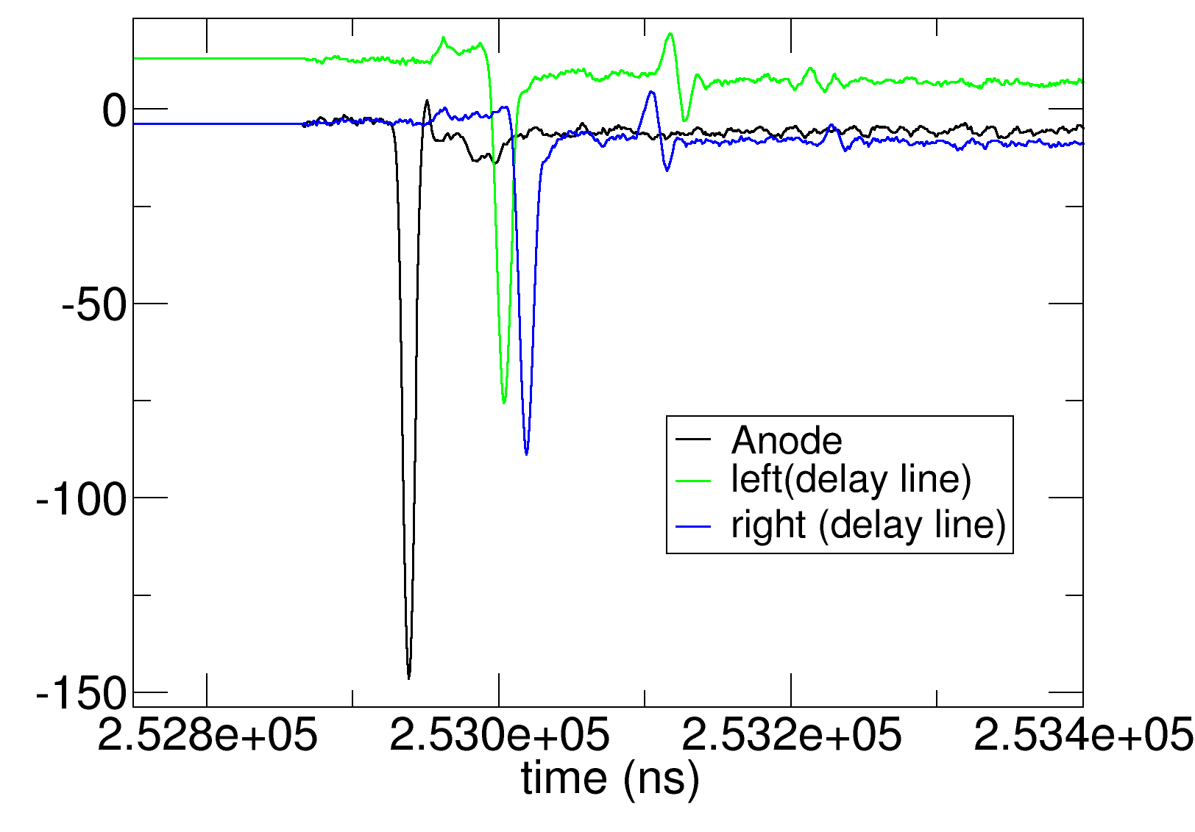
PPAC localisation
Localisation strips
Before
Delay line
Pile up beyond 200 MeV (EAR1)
(wide localisation signals)
After
After re-design of delay lines and preamps: localisation signals as narrow as anodes

Slide 11

Switch technology
For reactions above MeV involving low energy particles (LCP, γ) the γ-flash is a concern because its intensity is typically 1000 higher than the energy of particle to be detected.
As a result the preamplifier gets saturated and takes a long time to be de-saturated (100μs).
Ionisation chambers, μMegas, silicon, HPGe detectors suffer from this problem.
The solution… (with HZDR)
Insert an electronic switch between the detector and the preamplifier. The device has to be low noised and has to have a large bandwidth (GHz).
He has to be gated by the proton pulse or ancillary detector

Slide 12
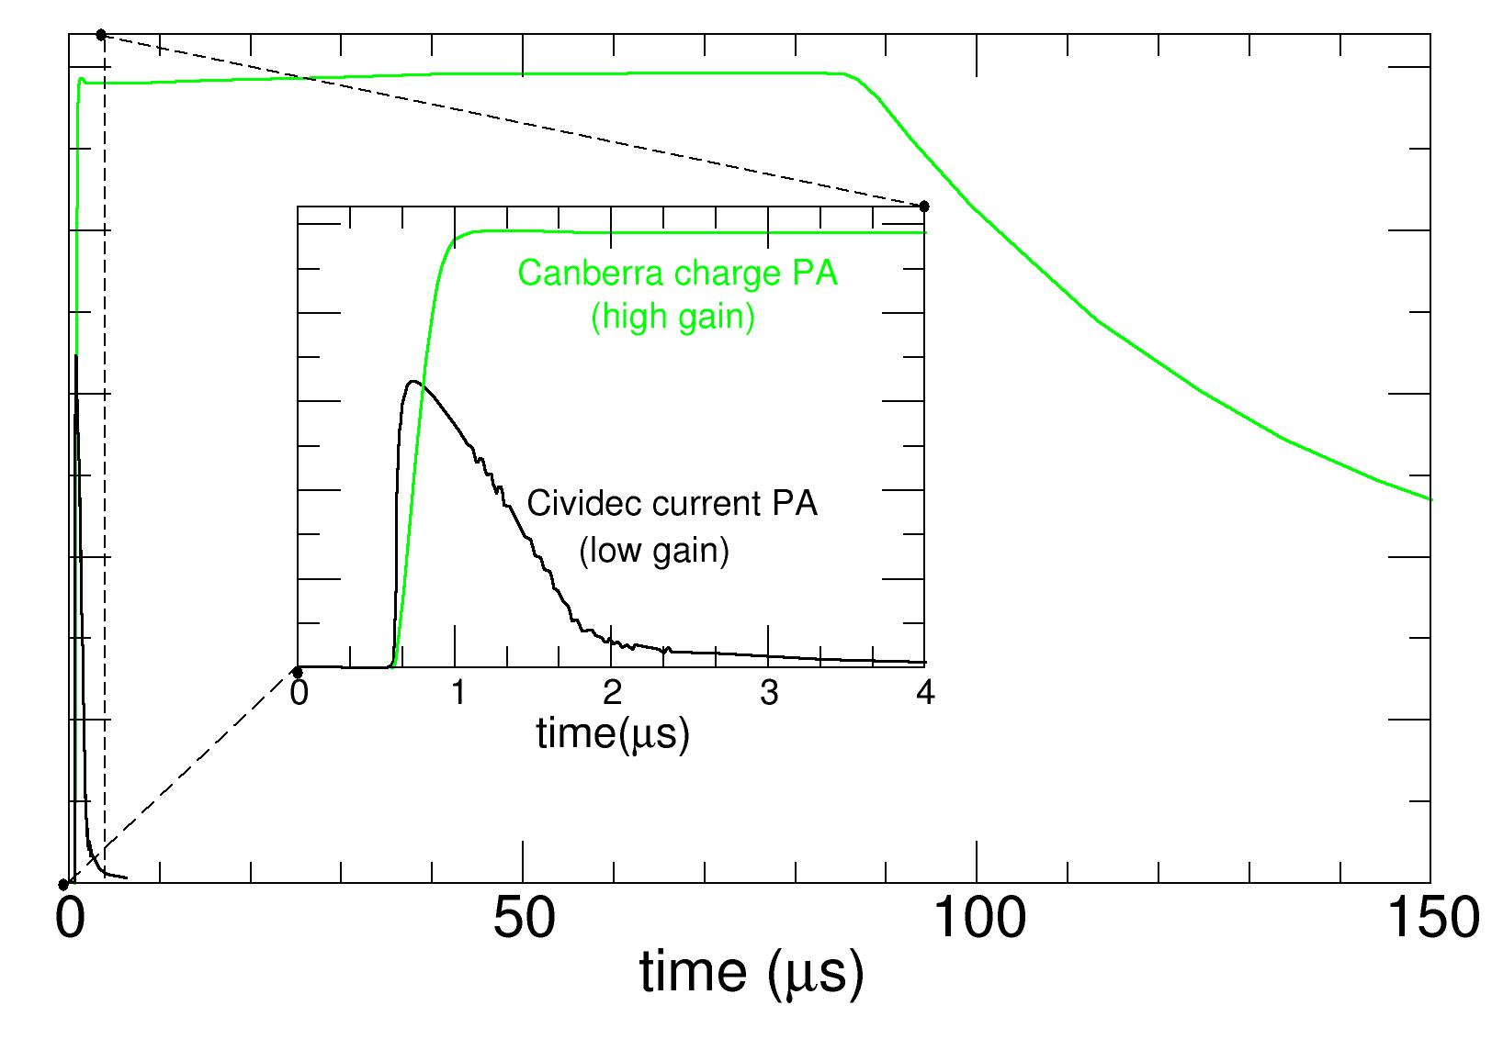
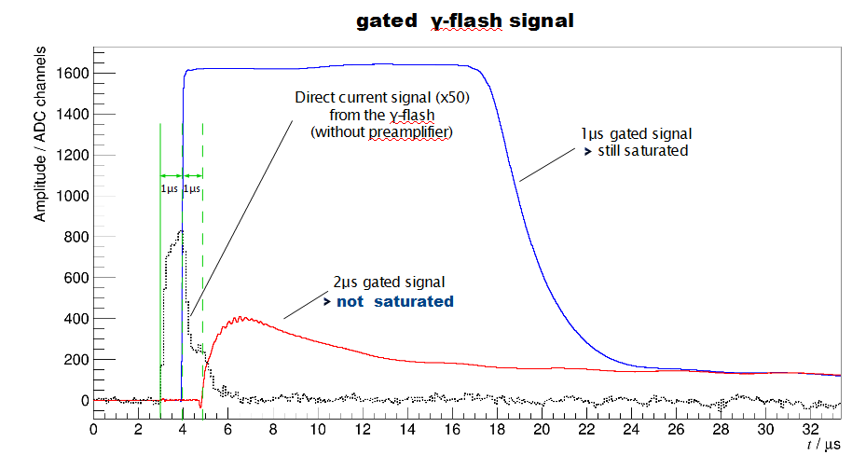
Switch technology
γ-flash gated
by the switch

Slide 13
Conclusion
All the experiment accepted by INTC have been scheduled before LS2
10% cut of the experiments at EAR1 to fit into the available beam time, partly compensated by the higher number of delivered protons
²³¹Pa(n,f) cancelled due to the unexpected difficulty to make the targets (electroplating)
All other experiments perform as expected
Replacement by several detectors tests:
  Neutron dosimetry
  Imaging (neutron energy selectivity)
  Small BaF2 scintillators with new PMT’s and VD
  PPAC: narrower localisation signals: avoid pile up at high energy
  Switch technology (with HZDR) for gaseous and semiconductor detectors: measurement close to the gamma-flash opening the study of threshold reactions.

