Slide 1


HIE-ISOLDE Status Report
Y. Kadi, W. Venturini Delsolaro, O. Pirotte, J.A. Rodriguez, E. Siesling
for the HIE-ISOLDE project team

Slide 2
Outline:
Status of Phase 2
  YETS activities
  Cryogenic plant
  Survey & Alignment
  HW & Beam commissioning
  Spares production
Activities foreseen for LS2
Summary
59th Meeting of the INTC – June 27th 2018

Slide 3
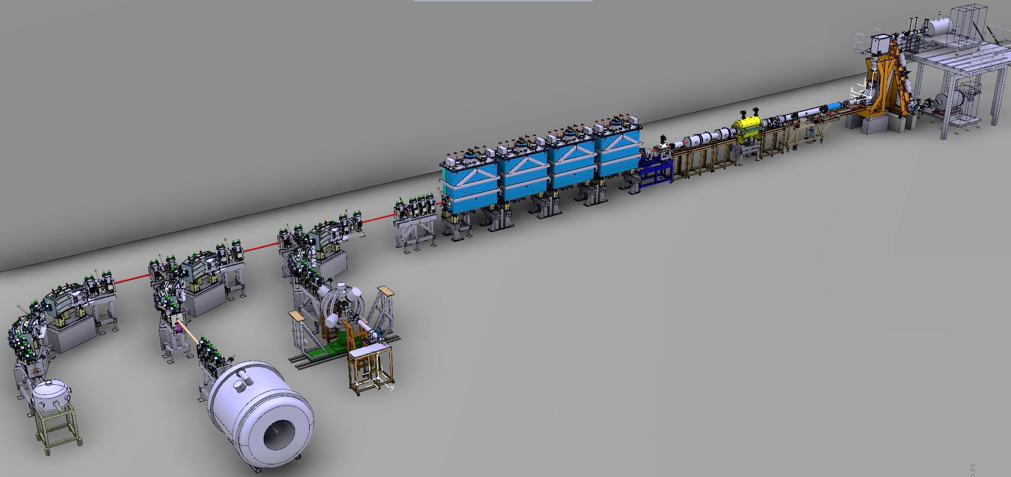
Phase2 reached completion in May 2018
Main installation activities since last INTC, Feb 2018 were:
Installation CM4 services (Cryo, Vac, RF, etc.)
Completion maintenance of the compressor station and cold box
Completion repair of the Cryo Distribution System by CRIOTEC
REX RF maintenance
XT00 WIC recommissioning
XLN2 repair & Silicon detector XT02 & XT03 cabling
Survey smoothing campaign of HIE LINAC & HEBT lines after cooldown
Others: Installation Solenoid power supply, CM4 RF amplifiers, ISS He filling, tunnel roof fences, REX power supplies consolidation (YETS)
CM4 and XT00 modifications
HEBT & LINAC survey smoothing campaign
REX NC linac
HIE SC linac
Miniball
SEC
ISS
59th Meeting of the INTC – June 27th 2018

Slide 4
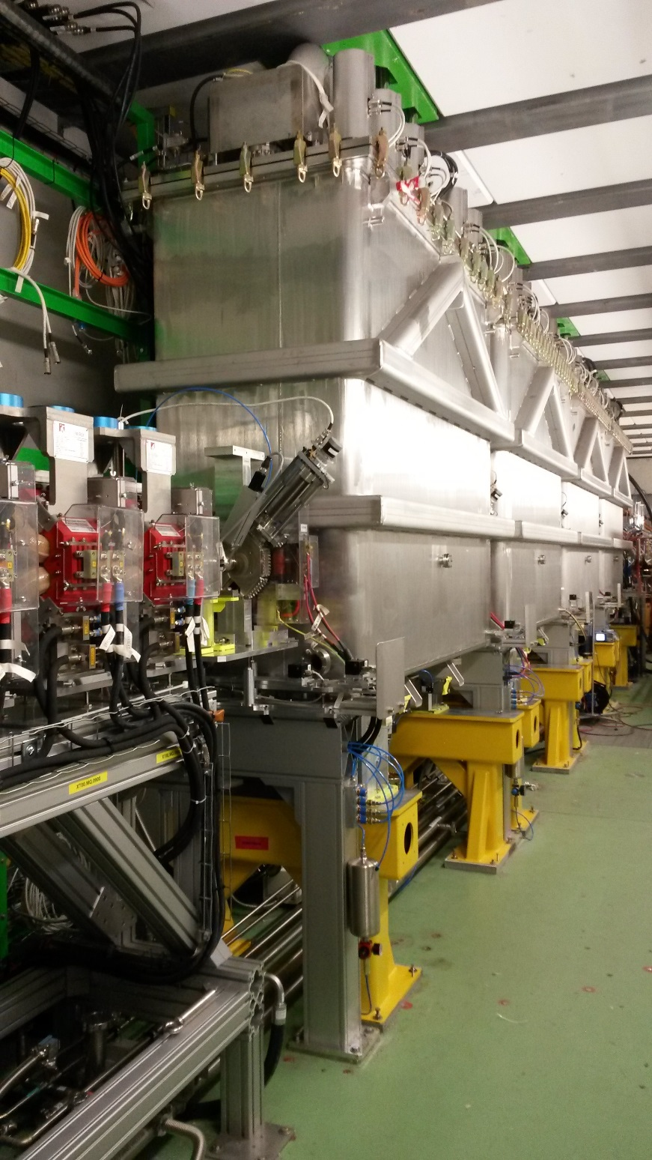
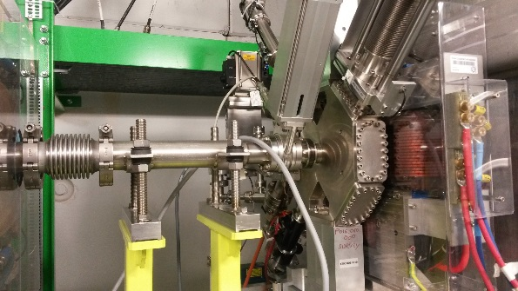
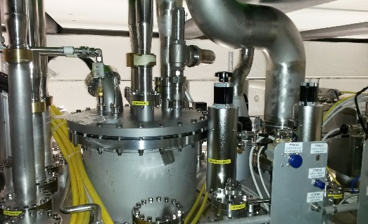
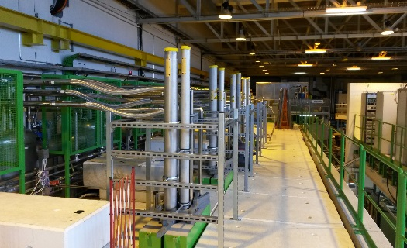
Installation works Feb/March
Vacuum and cryogenics interconnections
- RF patch panels and cabling, RF motors and controls, LVDT controls, instrumentation and Solenoid connections
BCAM Survey system (MATHILDE) was (re-) installed
Despite YETS manpower availability issue CM4 hardware
and beam commissioning dates were not affected
58th Meeting of the INTC – Feb. 7th 2018

Slide 5

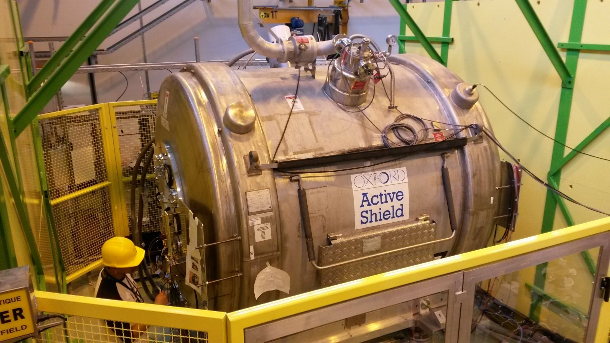
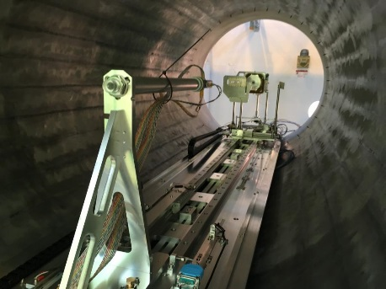
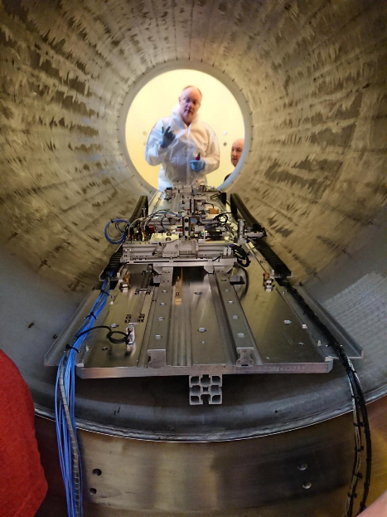
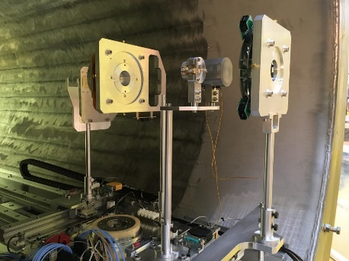
ISS at XT02 installation status
During different installation campaigns the ISS installation has grown steadily
DAQ and electronics racks installed and cabling infrastructure in place and powered
End flanges modified with feedthroughs and remounted
Detector table and carriage mounted inside. Small part of the detector array has been mounted for tests
Beam diagnostic carriage, Faraday Cup (HIE long type) and Recoil detector (silicon dE-E) have been installed
ISS has been ramped up to 2.5T and stable beam has successfully been sent to the setup as part of the HIE ISOLDE beam commissioning
59th Meeting of the INTC – June 27th 2018

Slide 6
Cryogenics works
Maintenance of the cryo-plant
    => Performed in December 2017
Repair of the Cryogenic Distribution System to restore nominal performance
    Performed during Jan-Feb 2018 and validated during the commissioning and the filling with liquid helium of the four cryomodules
Integration and connection of CM4
    => Performed during Feb 2018
Upgrade of the process control for Phase 2 (operation with four cryomodules)
    => Performed during Feb-Mar 2018
59th Meeting of the INTC – June 27th 2018

Slide 7
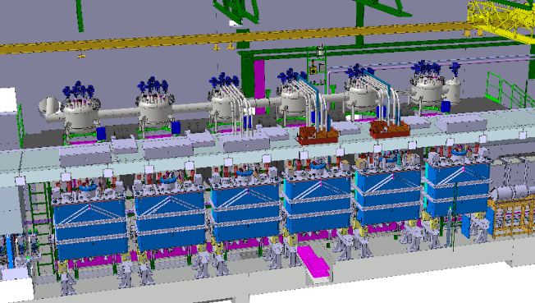
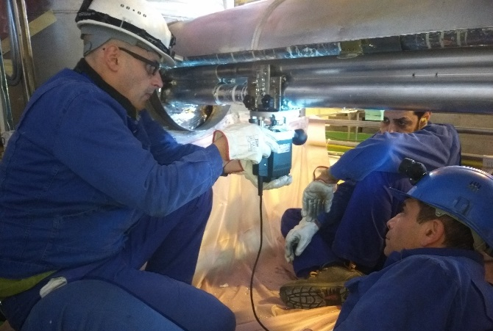
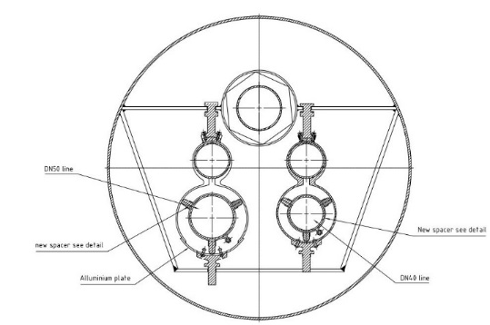
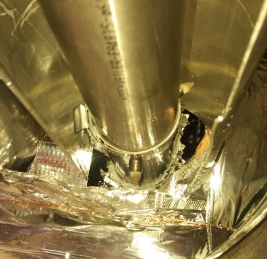
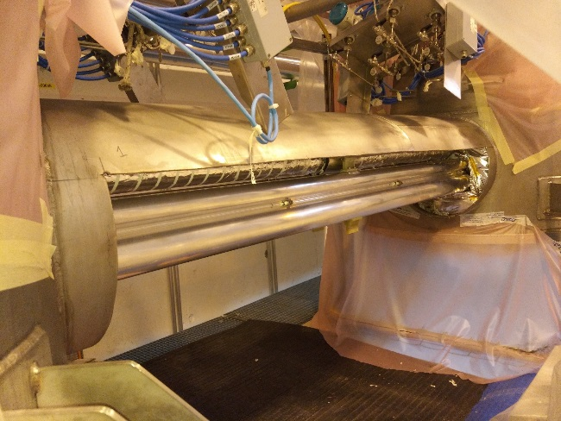
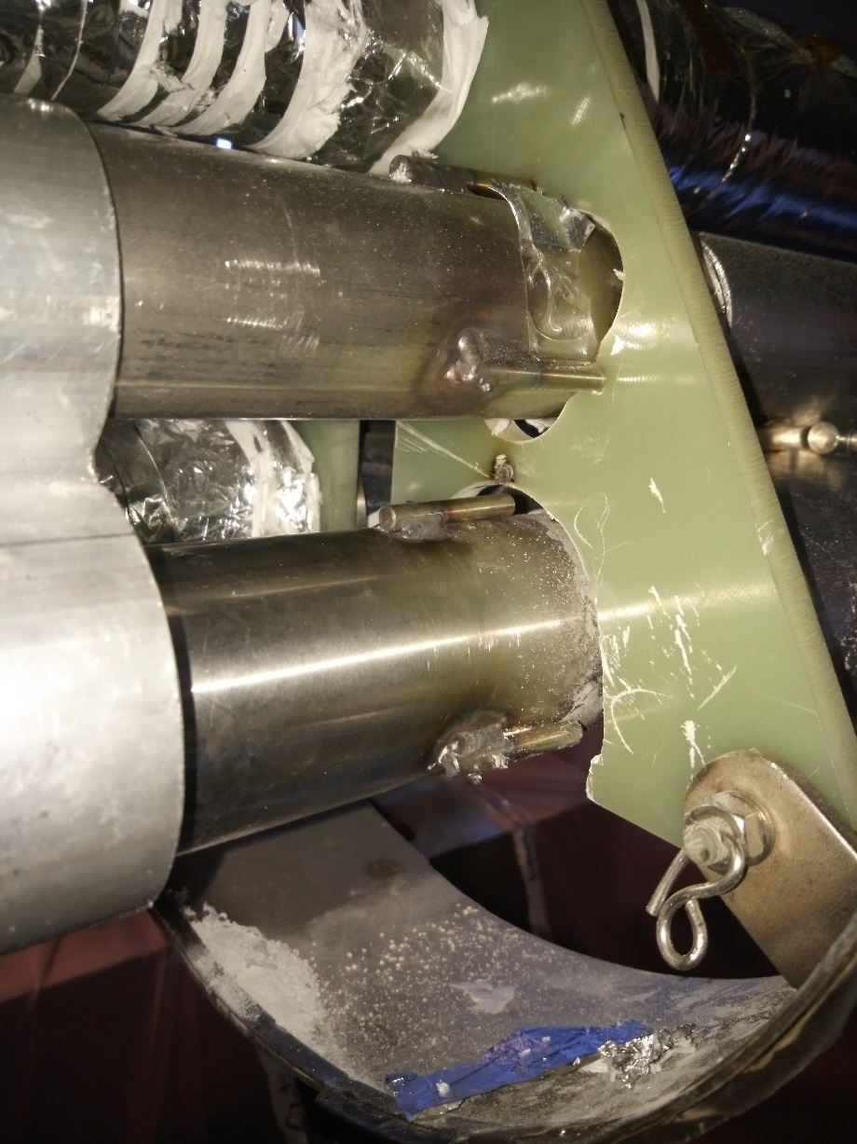
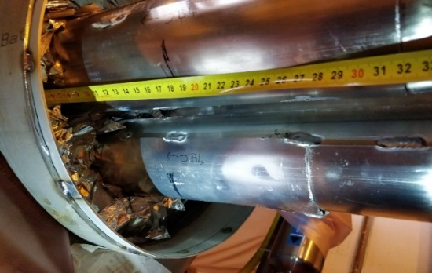
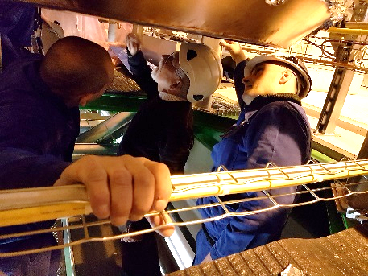
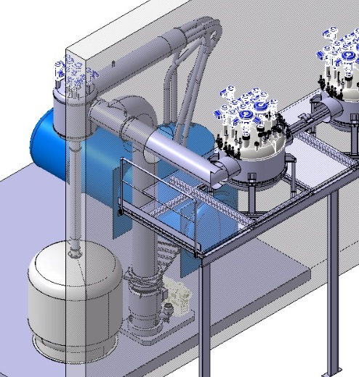
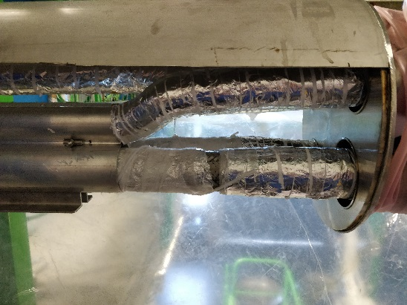
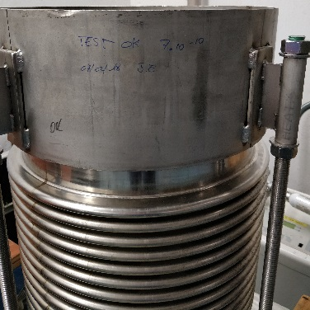
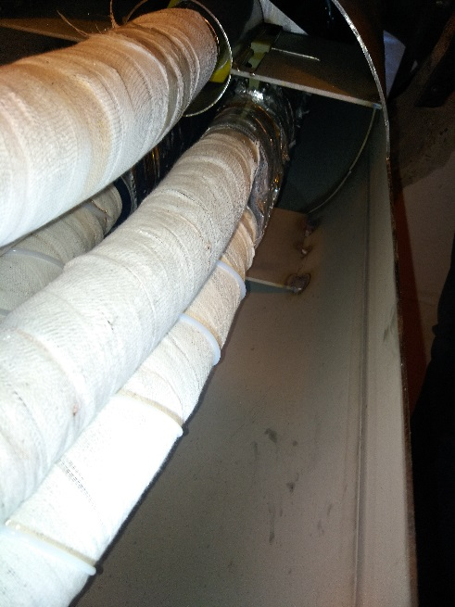
Cryogenic Distribution System repair
Removing of all vacuum jacket
Opening of Al shield
New spacer installation
Shield
4K return
Closing shield & check of spacers position
Liberating fixed point
Installation of a compensator on the vacuum line
Connection between
CDS and Refrigerator

Slide 8
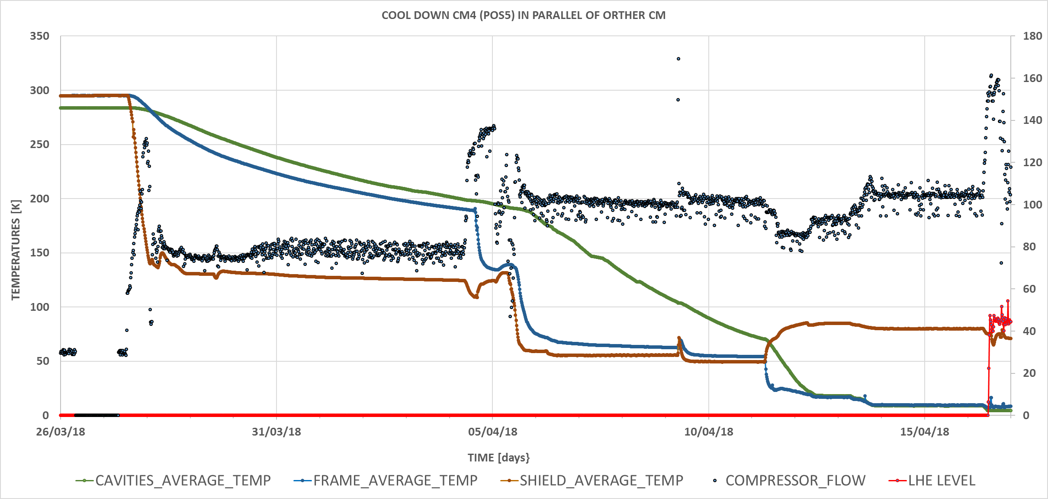
Commissioning of cryogenics system
Cool down and filling of the four cryomodules
  => Limit of the cryo-plant has been reached (estimated margin < 10 %)
Cool down of CM4
GHe cool down
LHe cool down
RF activities
Compressor flow
LHe level of the vessel
RF activities
(conditioning)
Shield+
Frame+Vessel
Cool down
RF activities
Shield cool down
Shield+Frame+Vessel +CAVITIES cool down
59th Meeting of the INTC – June 27th 2018

Slide 9
Commissioning of cryogenics system
Static heat losses test performed on all cryomodules. Three within specifications, one with about three times higher static heat losses
Tuning of the process control to limit pressure oscillations as much as possible (+/- 10 mbar) : dynamic compensation of the RF power in each cryomodule and fine adjustment of PID parameters
 | CM1 | CM2 | CM3 | CM4
Heat losses @ 4.5 K [W] | 8.4 | 21.1 | 8.5 | 11.8
59th Meeting of the INTC – June 27th 2018

Slide 10
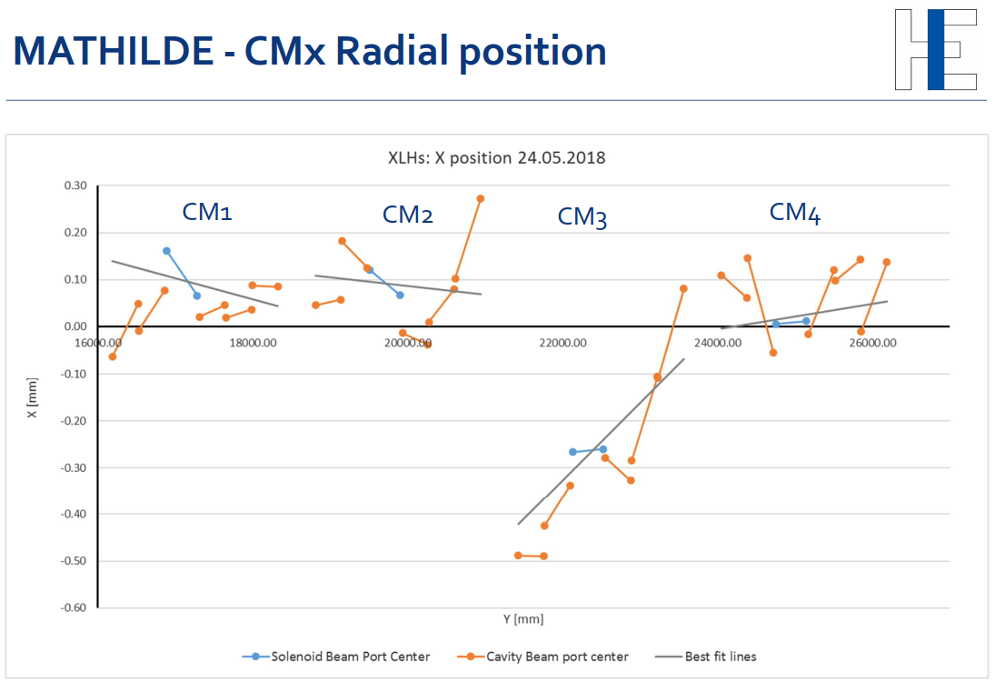
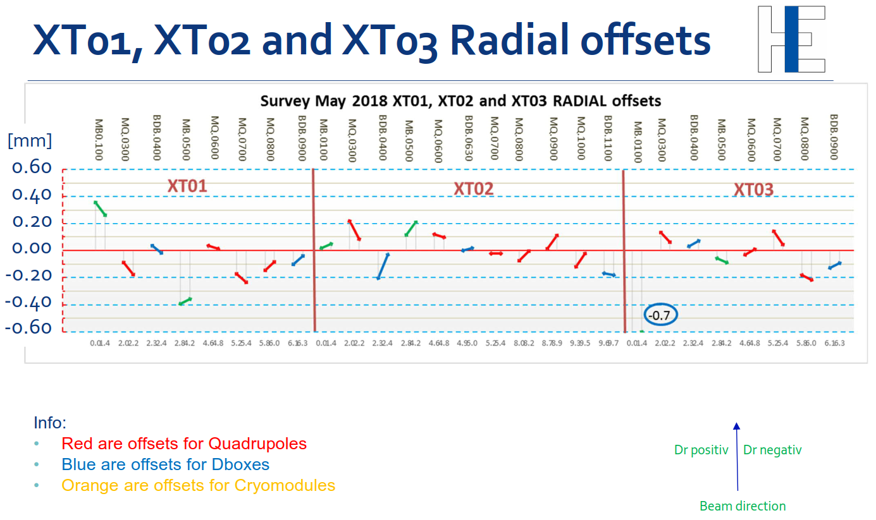
Survey Smoothing campaign
Hall and HEBT survey measurements outside the tunnel were done during CM4 hardware commissioning, the first half of May
CM’s and XT00 inside the tunnel were measured during a 2 day stop of the RF
After calculations all appeared to be within tolerances. It was decided to only do a radial correction on CM3 and a tilt correction for the first dipole in XT03 (XT03.MB.0100). Best-fit line for the CM’s is biased by the solenoids. For the XT lines the goal is to keep the RMS misalignment of the quads to about 0.2 mm and tilt of the dipoles below 0.2 mrad.
Survey observed seasonal deformation of the cavern hall/survey network of 0.3mm/10m in horizontal direction (expansion in summer) and a difference in vertical direction (going up in winter)
The opportunity was used to scan several areas around the REX LINAC for future REX Dbox installation
Survey results 25.05.2018
59th Meeting of the INTC – June 27th 2018

Slide 11
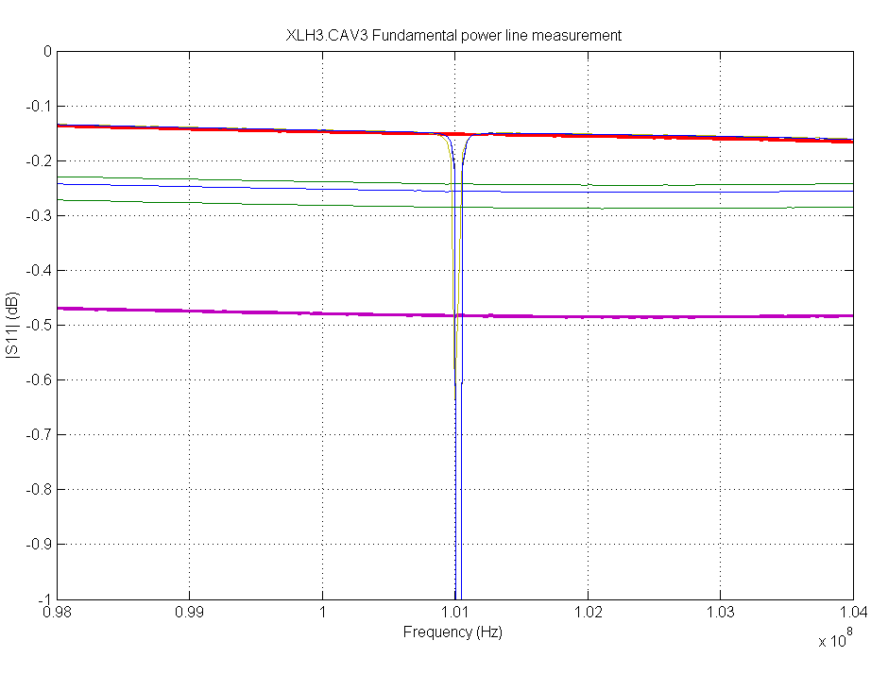
Cavity Conditionning above Tc: XLH3.CAV3 anomaly
After cool down to 200 K it turned out, it is not possible to inject power into Cavity 3 of CM4
Warm measurement were normal
Investigations narrowed down the problem to the connection to the fundamental power coupler
We decided not to put power in this cavity: the risk is to contaminate the whole cryomodule in case of release of material in the common vacuum
59th Meeting of the INTC – June 27th 2018

Slide 12
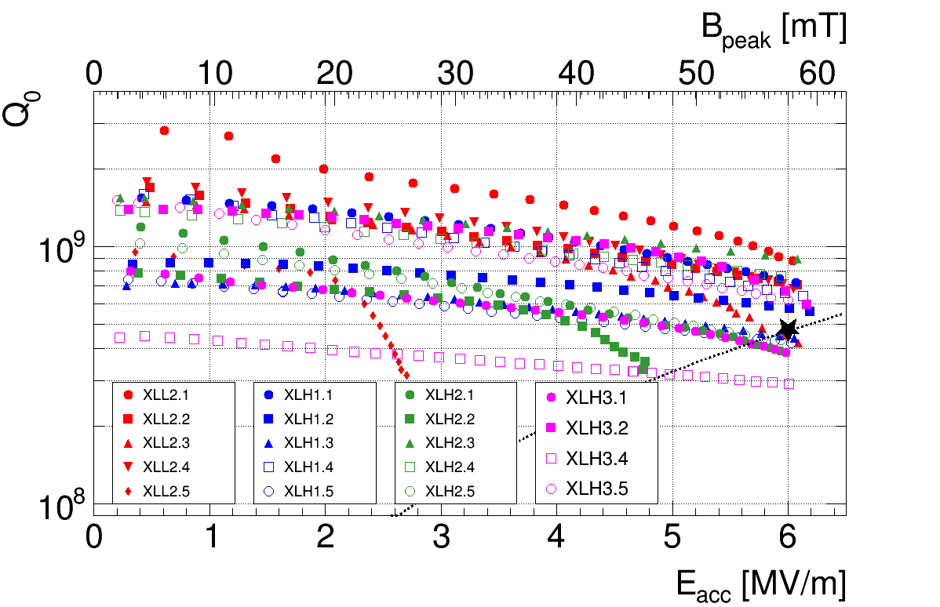
SC Cavitiy Performance
Cool down gradients over Tc less favourable than in the past
Most cavities reaching 6 MV/m above specified Q
3 cases of field emission (one new). For the moment, no He processing
CAV3 of CM4 will not be used in 2018
59th Meeting of the INTC – June 27th 2018

Slide 13
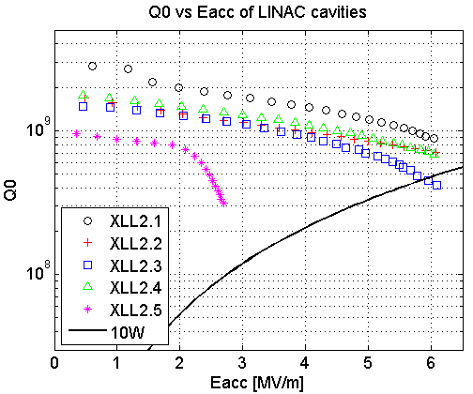
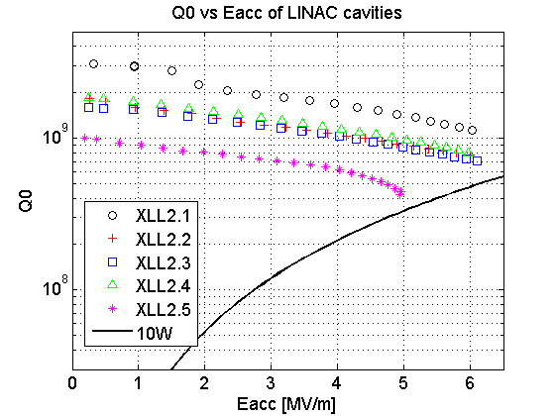
SC Cavitiy Performance: CM1
This Year
Last Year
Field emission ☹
Performance is comparable but contamination produced when coupler was changed at the end of 2015 is still present and a different cavity shows field emission
59th Meeting of the INTC – June 27th 2018

Slide 14
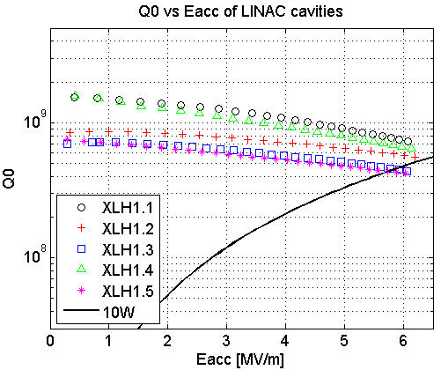
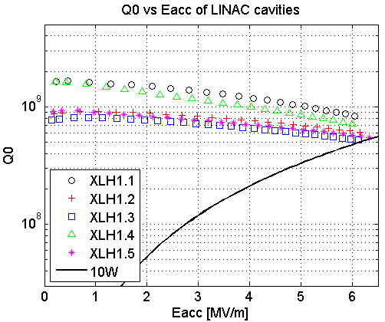
SC Cavitiy Performance: CM2
This Year
Last Year
Slightly worse Q caused by slightly worse temperature gradient during cool down
59th Meeting of the INTC – June 27th 2018

Slide 15
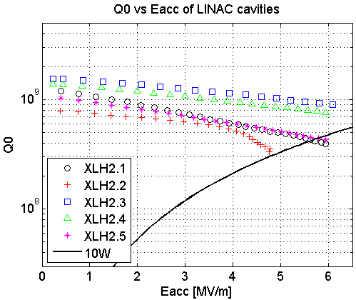
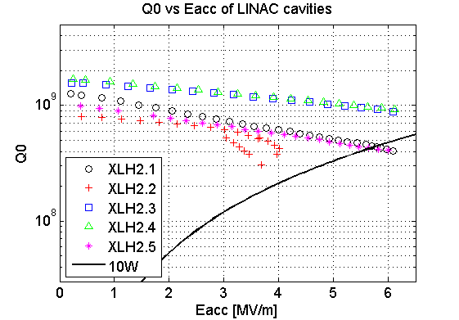
SC Cavitiy Performance: CM3
This Year
Last Year
Field emission ☹
Slightly worse Q caused by slightly worse temperature gradient during cool down
59th Meeting of the INTC – June 27th 2018

Slide 16
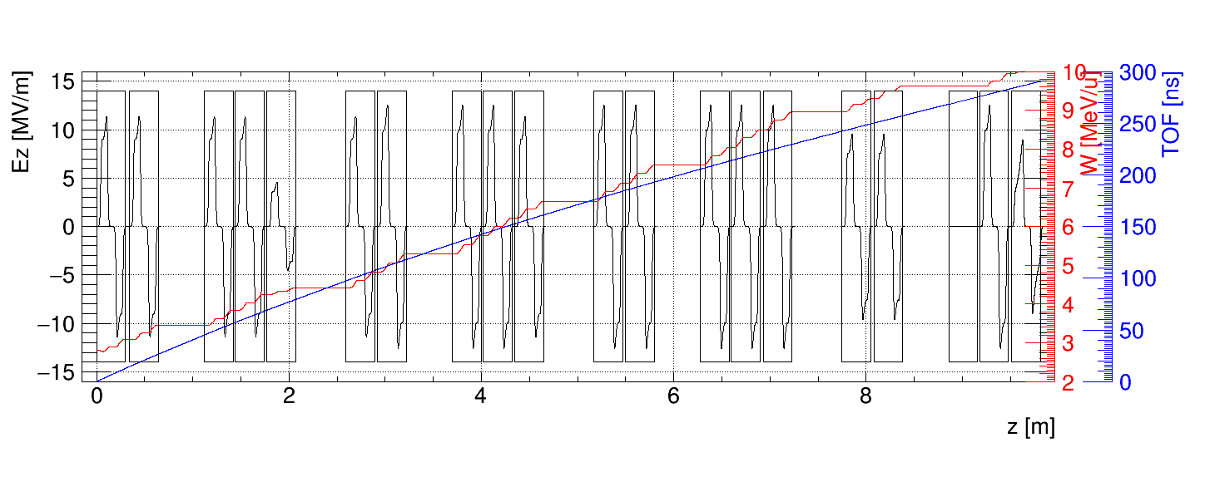
SC Cavitiy Performance:
cavity | proposal [MV/m] | Achieved [MV/m]
XLL2.1 | 5 | 5
XLL2.2 | 5 | 5
XLL2.3 | 5 | 5
XLL2.4 | 5 | 5
XLL2.5 | 2 | 2
XLH1.1 | 5.5 | 5
XLH1.2 | 5.5 | 5
XLH1.3 | 5.5 | 5
XLH1.4 | 5.5 | 5
XLH1.5 | 5.5 | 5
XLH2.1 | 5 | 5.5
XLH2.2 | 4 | 5.5
XLH2.3 | 5 | 5.5
XLH2.4 | 5 | 5.5
XLH2.5 | 5 | 5.5
XLH3.1 | 5 | 4.2
XLH3.2 | 5 | 4.2
XLH3.3 | 0 | 0
XLH3.4 | 5 | 5.5
XLH3.5 | 5 | 4
CM1
CM2
CM3
CM4
10.172 MeV/u for A/q=3.0 expected
7.7 MeV/u for A/q=4.5
Further adjustments of LLRF loops after reliability assessment
59th Meeting of the INTC – June 27th 2018

Slide 17
Beam Commissioning:
Commissioning of the REX-TRAP, REX-EBIS and REX Linac:
All systems recommissioned by week 20 (similar to 2017)
Proof of concept for a new method to characterize very weak stable contaminants from the REX-EBIS (N. Bidault, IPAC’18 conference proceedings)
Machine Check-out and Beam Commissioning of HIE-ISOLDE (completed):
Field regulation and automatic degaussing of the HEBT dipoles
Set-ups for ¹²C⁴⁺ and ²²Ne⁷⁺ using all the SRF cavities to end of XT01 and XT02
Beam to Miniball (65 hours of ²²Ne⁷⁺ at 6.16 MeV/u)
Beam to ISS (99 hours of ²²Ne⁷⁺ at 9.48 MeV/u)
Initial set-up for A/q=4.0 using all the SRF cavities to XT01.0400
Beam Commissioning of HIE-ISOLDE (pending):
Set-up for ⁴⁰Ar⁹⁺ (A/q=4.44) at 7.44 MeV/u to the end of XT01 and XT02
Transverse and longitudinal phase space characterization
Beam-based calibration of the SRF cavities
59th Meeting of the INTC – June 27th 2018

Slide 18
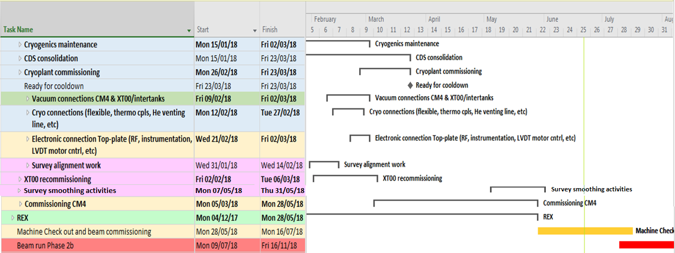
Phase2 Schedule
Due to sufficient contingency and reshuffling of some of the activities the milestones for Commissioning of CM4 (5 March), Cooldown of the cryo modules (26 March), Machine check-out and beam commissioning (28 May) could be kept.
The CM4 commissioning phase as well as the Survey smoothing campaign finished in time, end of May. Beam Permit was signed and OK given for beam through the LINAC start of June
HIE ISOLDE Beam Commissioning started as foreseen end of May
Start of physics foreseen as of 9 July.
59th Meeting of the INTC – June 27th 2018

Slide 19
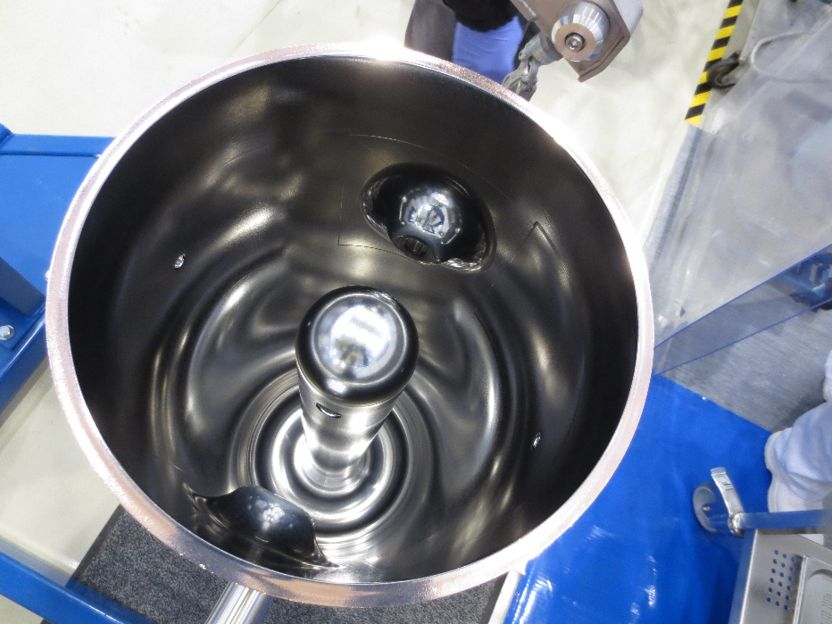
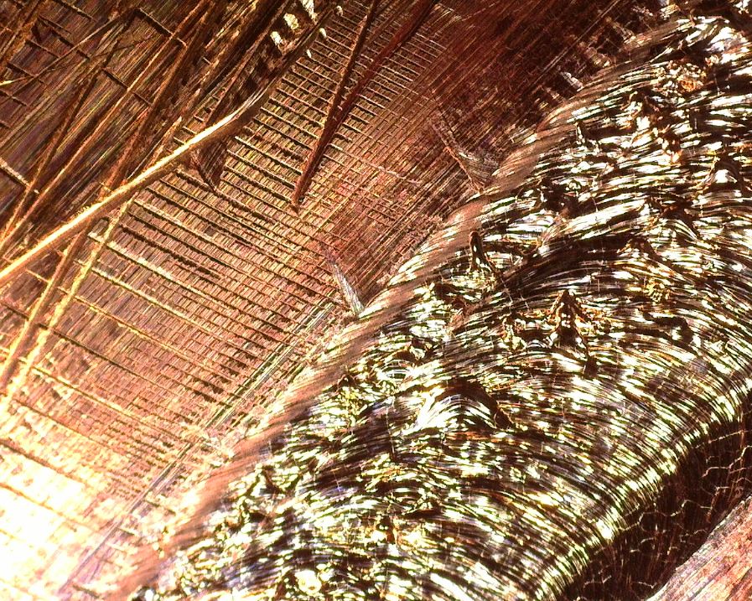
Status of Spare Cavities
QSS2, QS18, QS20 are fully qualified as spares
QS20 has the lowest Q, it could be stripped and re-coated
QSS3 substrate delivered at CERN and just accepted→ to be processed
The fifth spare cavity should come from either QS6 or QS18, both substrates are in bad conditions
A fourth seamless substrate will be ordered
(raw material is available, pending acceptance)
59th Meeting of the INTC – June 27th 2018

Slide 20
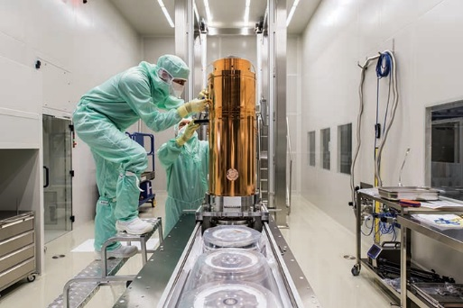
Proposed Intervention for XLH3.CAV3
Bring back the cryomodule #4 to SM18, open and repair the cable
  Dis-installation, transport to SM18 (right after physics run?)
  Conditioning for ISO5, slow venting
  Repair works in clean room
Profit to replace some of the cavities with the best spares
  Spares will be prepared prior to the intervention (minimise “open” time)
  Anyway advisable to LPW rinse all cavities (→ dismounting)
Possibly cold test the cryomodule in M9 bunker
Endorsed by LS2C on 22 June
(to be schedule starting May 2019)
59th Meeting of the INTC – June 27th 2018

Slide 21
Summary:
HIE-ISOLDE phase 2 is deployed
The 2018 commissioning campaign is over, machine is operational
  Anomalous static heat load in CM2… not understood
  Issue with CAV3 of CM4: not a showstopper for 2018,
  An intervention during LS2 was approved by LS2C
Spares:
  3 cavities already secured
  2 solenoids in store
  2 cryo compressor engines in store
59th Meeting of the INTC – June 27th 2018

Slide 22
Acknowledgement
EN/EA : FABIO FORMENTI
GS/SE : DANIEL PARCHET
EN/ACE : STEPHANE MARIDOR, JEAN-CHRISTOPHE GAYDE, ESTRELLA FERNANDEZ, ANTJE BEHRENS, ALEX BEYNEL
BE/ABP / OP : FREDERIK WENANDER, JOSE ALBERTO RODRIGUEZ, ELEFTHERIS FADAKIS, MIGUEL LOZANO BENITO
PH/SME : MARIA BORGE, KARL JOHNSTON, GERDA NEYENS
BE/RF : DANIEL VALUCH, WALTER VENTURINI DELSOLARO, MATHIEU THERRASSE, AKIRA MYAZAKI
EN/CV : AZIZ AMAMOU, NICOLAS ROGET, HASSANE SABRI
EN/EL,TE/EPC : RENE NECCA, GEORGI GEORGIEV, MICHELE MARTINO, PAWEL BURDELSKI, NICOLAS DAVID
TE/CRG : JOS METSELAAR, OLIVIER PIROTTE, NICOLAS GUILLOTIN, REMI GUEYDAN
EN/STI : RICHARD CATHERALL, ANA-PAULA BERNARDES
GS/DI : CYRILLE BEDEL, YANNICK BERAUD
TE/MSC : YANN LECLERCQ, LLOYD WILLIAMS, VITTORIO PARMA, JEREMIE BAUCHE, DAVID SMEKENS, GRAEME BARLOW, JEAN BAPTISTE DESCHAMPS
DSG/RP : JOACHIM VOLLAIRE, ALEXANDRE DORSIVAL, ELODIE AUBERT
TE/ABT/ MPE : MATTHEW FRASE, RICHARD MOMPO
TE/VSC : JOSE FERREIRA SOMOZA, GUILLERMO FERNANDEZ, ABEL GUTIERREZ, PAUL DEMAREST
BE/BI : WILLIAM ANDREAZZA, SERGEY SADOVICH
EN/MME : ANTTI KOLEHMAINEN, MARC TIMMINS
EN/HE : JEAN-LOUIS GRENARD, FRANCK SCHNEITER and the entire Transport Team
58th Meeting of the INTC – Feb. 7th 2018

Slide 23
Required resources, schedule constraints, risks if not done
Required resources (estimates based on experience with CM1 refurbishment):
BE-OP: coordination of de-installation and re-installation
BE-RF: coordination, clean room assembly work, rinsing, RF testing in SM18 (~ 160 days*FTE)
EN-HE: roof shielding removal, handling, special transport (~ 10 days*FTE)
EN-SMM: survey/alignment in clean room and in the linac (~ 10 days*FTE)
HSE-RP: radiation verification (very low dose rate) (~ 4 days*FTE)
TE-CRG: disconnection in linac, cool down in SM18 (~ 25 days*FTE)
TE-VSC: disconnection, controlled venting, slow pump down, leak detection, etc. (~ 20 days*FTE)
TE-MSC: advise, assistance, and support at critical points in dis-assembly/assembly (~ 25 days*FTE)
Scheduling aspects/constraints:
Time for preparation: (finalization of spare cavity set by May 2019)
Time for dis-installation and transport: ~2 weeks (special transports take 1 day)
Time for intervention in clean room: 5+2 weeks
Time for re-qualification: (cold test in M9): 6 weeks (with SM18 cryogenics availability)
Time for re-installation: ~3 weeks
→ About 4 months: may start anytime between May and October 2019
Risks if not done: Physics program at 10 MeV/u with A/q=4.5 would be compromised

