Slide 1

INTC Technical Report
Richard Catherall EN-STI-RBS
ISOLDE Technical Coordinator
59th INTC meeting 27th June 2018

Slide 2
Outline
Recent developments
  Start up
  Tape station
  HT upgrade
  Target Development
  RILIS
Long Shutdown 2
  Activities postponed
  Target area
    Frontend replacement
  ISOLDE Hall
    Scanner and FC upgrade
    HT upgrade
    Slits
    REX
    HIE-ISOLDE
  Building 179
    Nanolab construction
  Overall Planning

Slide 3
Start-Up 2018
Water back on 26th February
Cold check out from 26th February till 26th March
SEM Grid tests done in week before and during Easter
HT tests on new modulator done in week after Easter
First experiment as from 9th April
Lots of initial beam diagnostics and controls issues during cold check out
Too many co-activities…
  RFQ Cooler tests
  Cold check out
  RILIS developments

Slide 4
Fast Tape Station check out
Two days of beam time allocated in week 20 but not very conclusive
  The local control screen has been removed. Managed to operate it through FESA navigator
  Triggering had to be repaired.
  Beamgate wired up and working but timing still needs to be tested.
  The collimator was not working and had to be moved in manually
  Numerous issues with the beamline including inversion of quadrupole polarities and scanners not working. Equally the HT was unstable at 60kV. The detector counters are incorrectly configured.
  A new NIM module caught fire and damaged the crate power supply, causing one of the rails to over-voltage. The supply was replaced, but it looks as though the discriminators were damaged.
Further testing will be done in August.
The tape station has to be successfully tested before being installed in the CA0 beam line during LS2

Slide 5
New HT modulator
HT (kV) | 1E13ppp | 2E13ppp | 3E13ppp
30 | 350 | 370 | 370
40 | 400 | 480 | 550
50 | 530 | 650 | 750
55 | - | - | 870
60 | 620 | 780 | 980
Recovery time (µs) of HT (+/-0.6V) with protons on convertor
Specification < 2ms
Compares to ~8ms on the previous Astec supply
TE-ABT-EC request to install a new modulator and power supply on the GPS in Q1 2019.
Benefit from the existing FESA controls and not put resources into making a new FESA class for the very old Astec supply
Drawback – no negative ion run in 2021. Bi-polar power supply needs further testing before being installed.

Slide 6
Target Overview APR-JUN 2018
#614 | empty | VD5 | Mn tests PSI , Se tests ILL
#633 | Nb foil | MK4 negative LaB6 | Development, GANDALPH
#640 | LaC | RILIS | In -> CRIS
#650 | MWCNT | VD7 | 8B -> IDS
#627 | Ta | RILIS | Sc
#567 | Sn molten | VD7 | backup for #534
#657 | No target | VD7 | LIEBE test
#651 | ZrO | VD5 | GeS /Ge -> COLLAPS
#652 | ZrO | VD5 | 70Br
#653 | UC (UC-2018-01) | MK1-Ta | Cu
#654 | UC (UC-2018-02) | MK1-W | K
#626 | Ta | RILIS | Sc
#660 | SiC | LIST - 90mm | 22Mg
#661 | Empty | VD5 | MD ISCOOL
#655 | Ta | RILIS | Tb /Dy
#570 | n.a. | GANDIS | Gandalph offline source
#656 | empty | VD5 | Mn tests PSI
#658 | UC (UC-2018-04) | RILIS | Bi
#502 | empty | n.a. | n-Converter dev
#628 | empty | n.a. | nConverter / MEDICIS dev
#634 | empty | LIST - 34 mm | LIST development
12 targets retrieved from ISR
Cibles | Matériau | Operation 2018
#513 | MWCNT-VD5 | Tested in April
#534 | Sn | used in April
#619 | Pb-VD5 | #577 backup
#620 | LaC-Ta | #640 backup
#629M |  | Used at MEDICIS
#621M |  | Used at MEDICIS
#541 | UC-VD7 | #659 backup
#565 | Ta-W | #655 backup
#577 | Pb-VD5 | #619 backup
#599 | Ti-Foils | used in May
#618 | Uc-n | used in May
#596 | CaO-VD | Not scheduled
21 targets used / tested at offline
Units for development
11 Units irradiated at ISOLDE

Slide 7
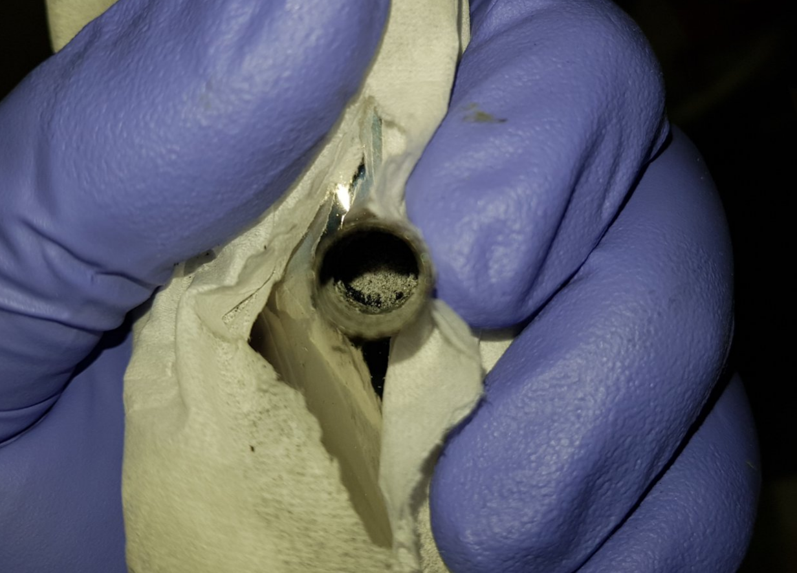
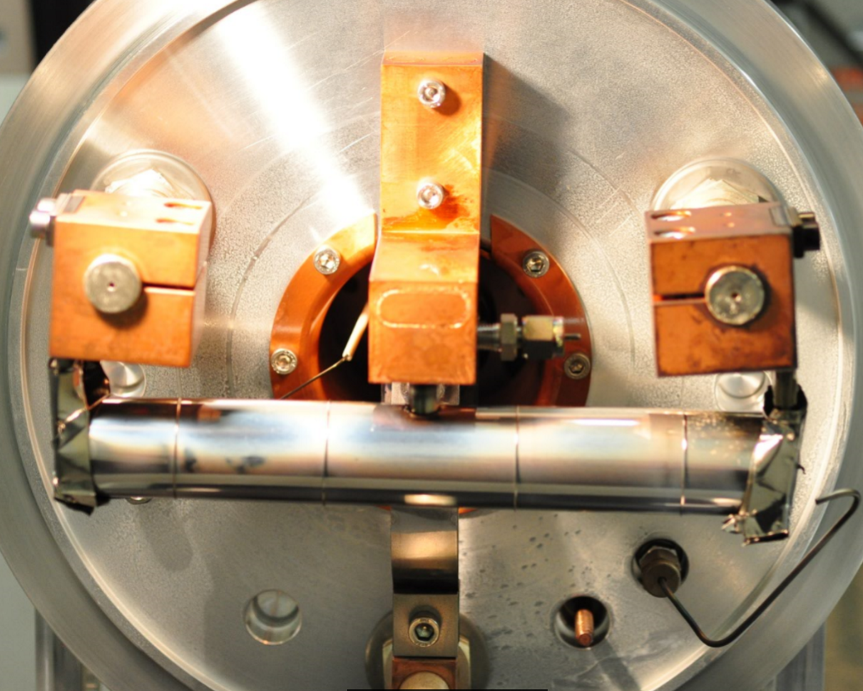
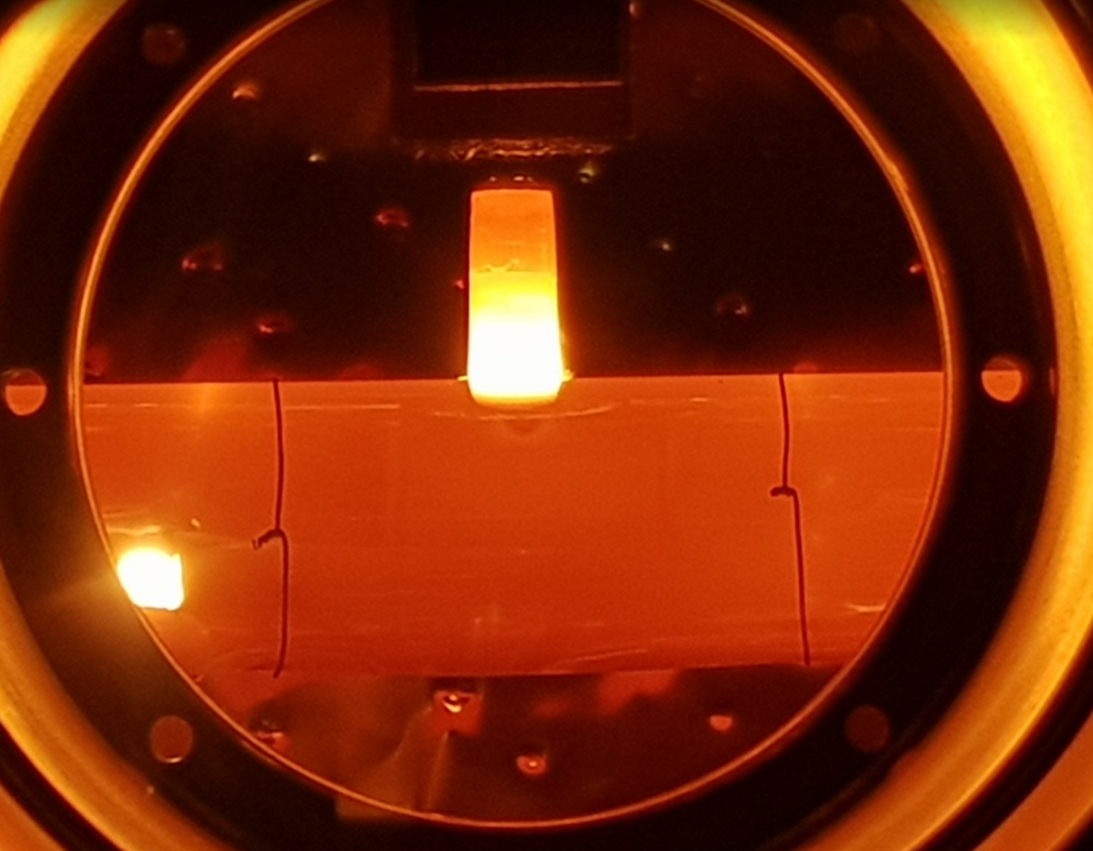
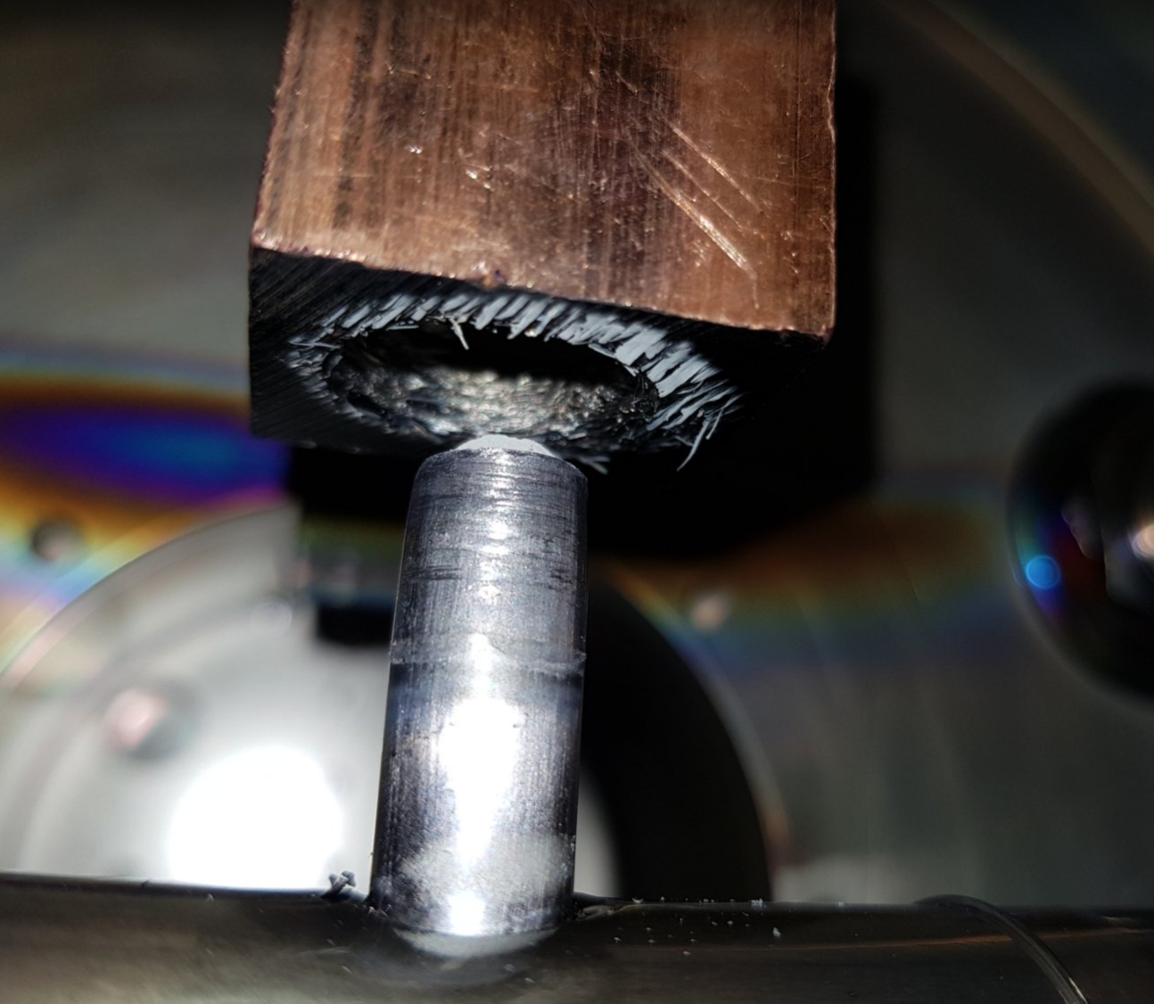
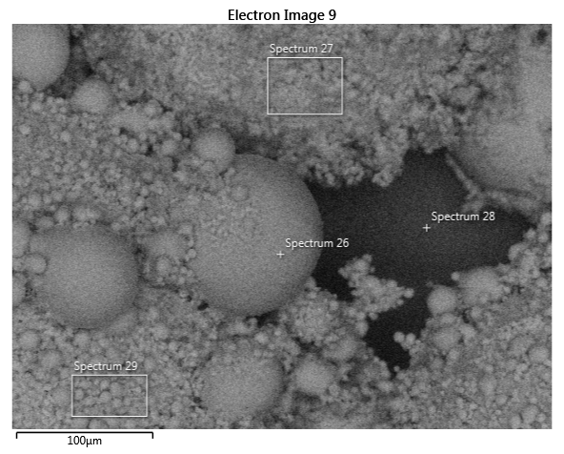
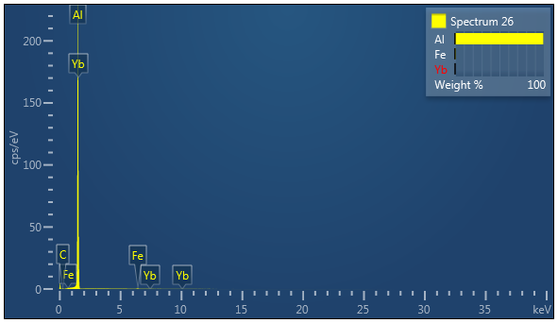
Target #606 -> #650
MWCNT for 8BF2 beams at IDS
2017: #606 Target could not be delivered, #513 was used
No infrastructure available to handle C nano tubes
Decided to recuperate charge from #606 for #650
Disassembly: transfer line found clogged with AlF
Target outgassed to remove contaminants
Found macroscopic amount of Aluminum in transfer line
Successfully used #650 for IDS run
Factor 10 yield increase compared to #513
- > #650 rescheduled for HIE ISOLDE

Slide 8
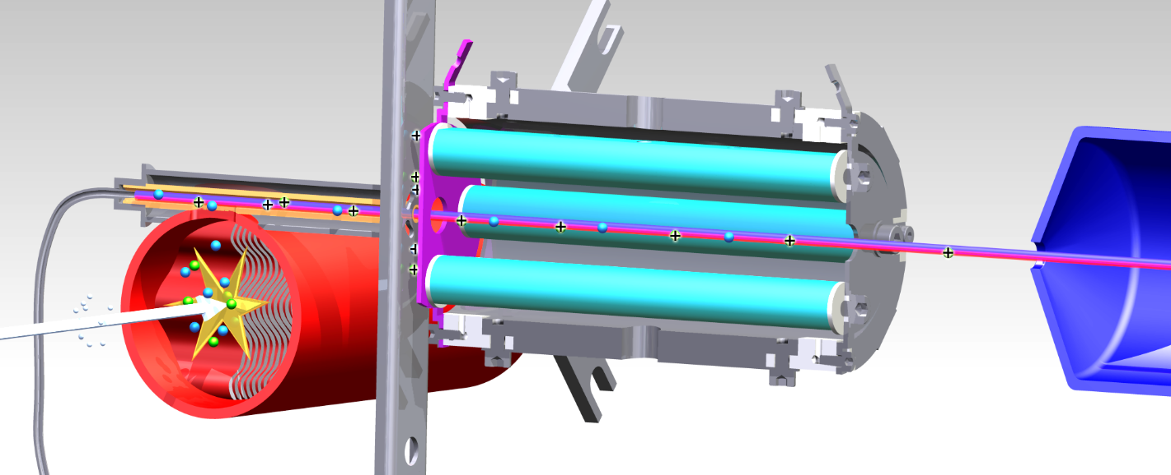
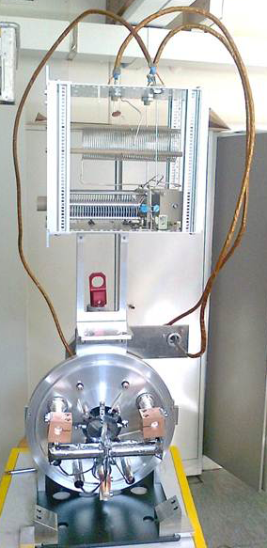


LIST v 1.0
HFS studies of polonium / supression of francium (IS456, September 2012)
90 mm
Final on-line characteristics with SiC target:
Suppression factor 1E6 measured for ²¹Na
Laser ion loss factor of 27 on ²²Mg
No ²²Na seen in IS614 detectors
Factor ~20 less yield on ²²Mg compared to database
Isobaric suppression > 1000, efficiency loss ≈ 50
Proton
beam
On-line implementation and first operation of the Laser Ion Source and Trap at ISOLDE/CERN, D. Fink et al., NIMB 344, 83-95 (2015)
In-Source Laser Spectroscopy with the Laser Ion Source and Trap: First Direct Study of the Ground-State Properties ^{217,219}Po, D. Fink et al., PRX 5, 011018 (2015)
R.Heinke

Slide 9
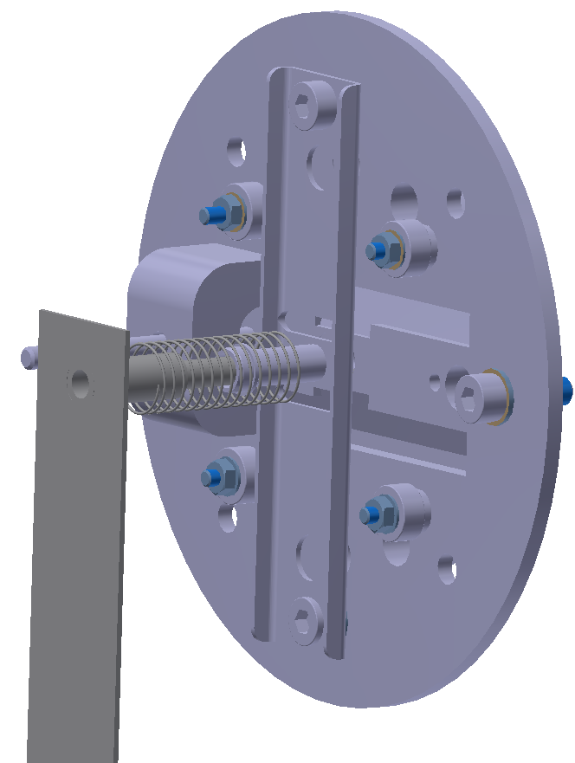
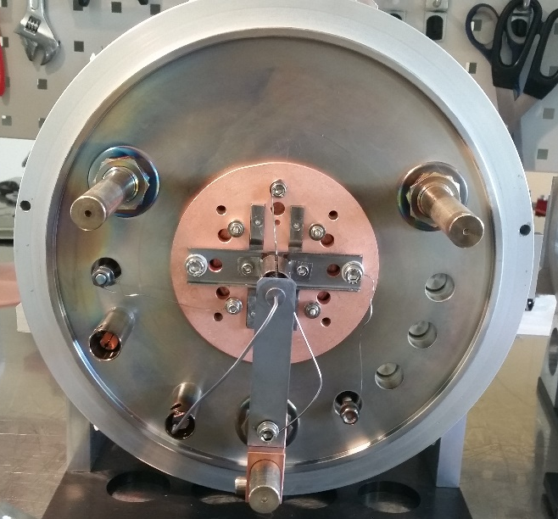
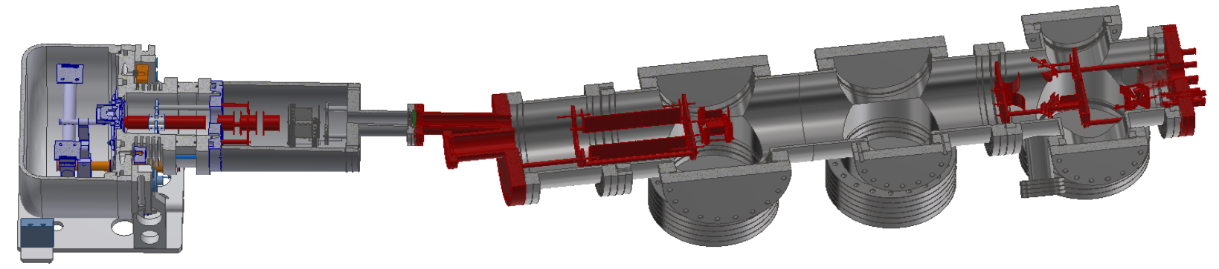
#570 GANDALPH negative Ion source (GANDIS)
Goal: off-line testing of photodetachment setup
Ion extraction via negative source potential
  Electrical Isolation of the source from the base avoids faraday cage
  external heating required
D. Leimbach

Slide 10
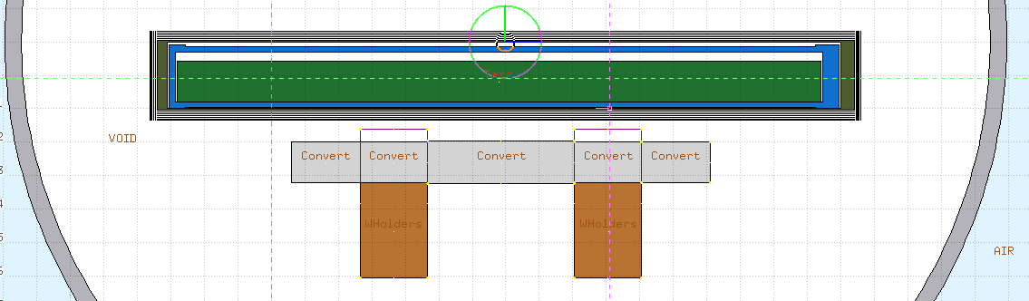
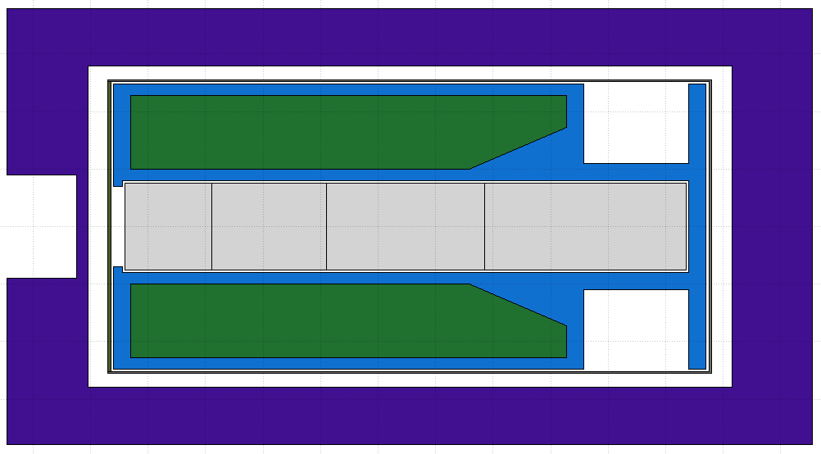
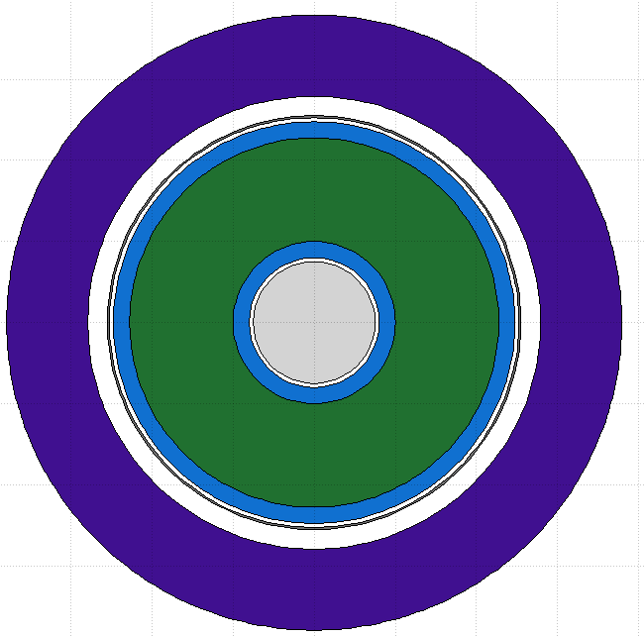
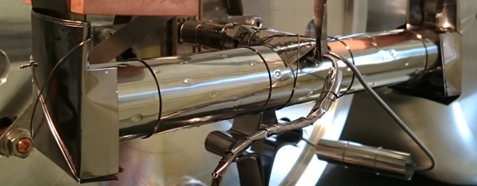
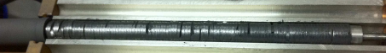
P2n Converter
Converter very close to uranium carbide – high neutron flux!
W converter
ø15 mm (12 mm - standard)
Sliced to mitigate thermal shocks
Operated at 2000 °C
Graphite container
100 mm
p beam
51 mm
Avoid proton scattering
Thermal Shielding
Sigratherm® -
“graphite foam”
0.2 g/cm³
Low thermal conductivity
UC_{x}: new procedure has to be made for annular shape
Standard UC_{x} pellets
J.P.Ramos

Slide 11
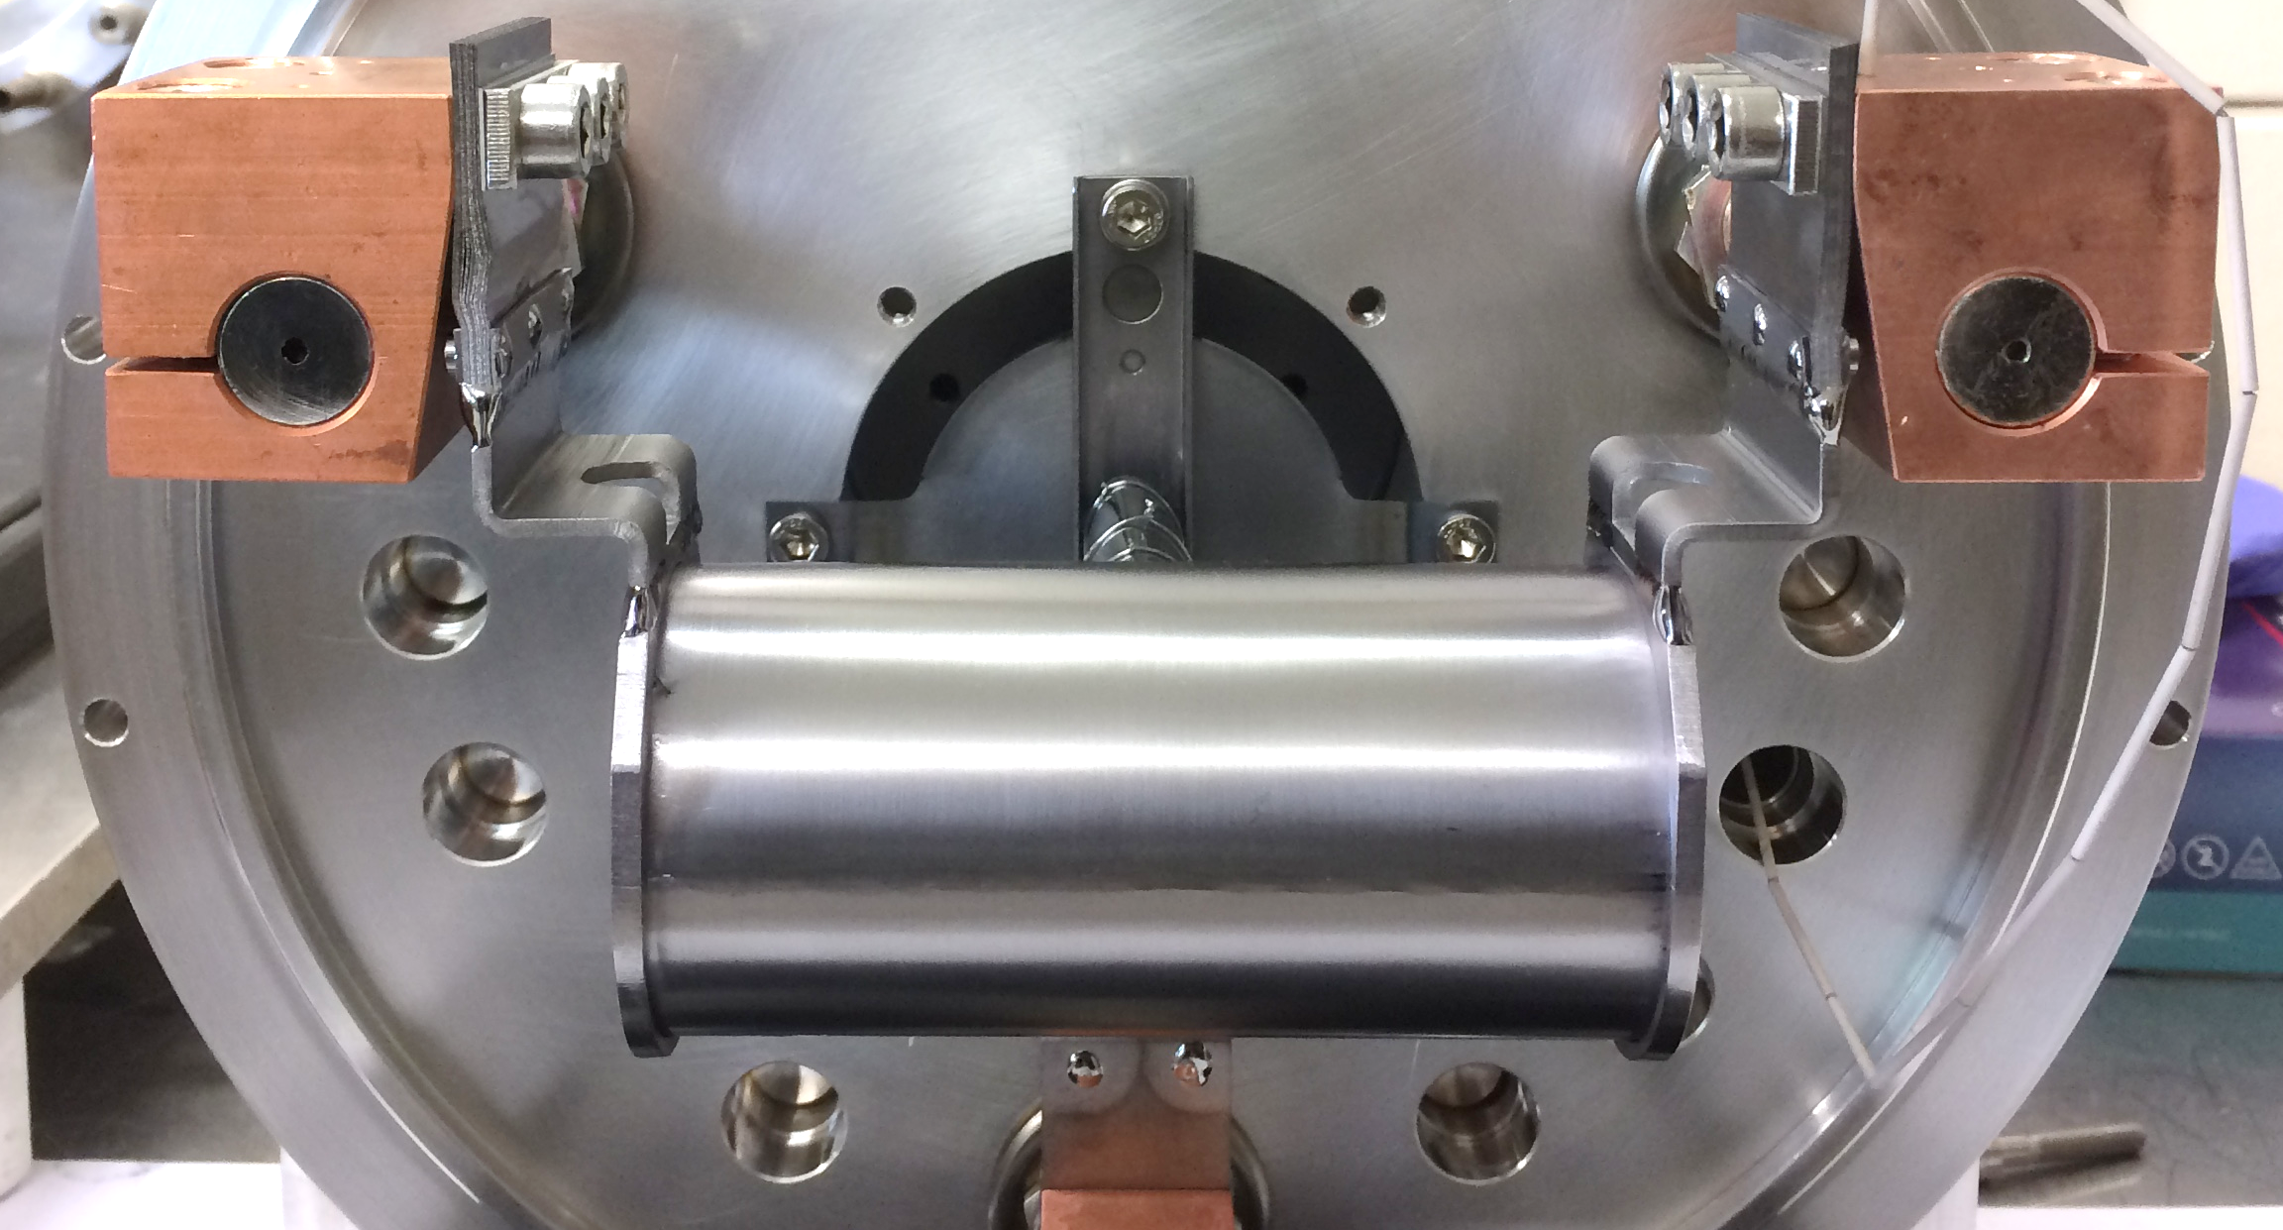
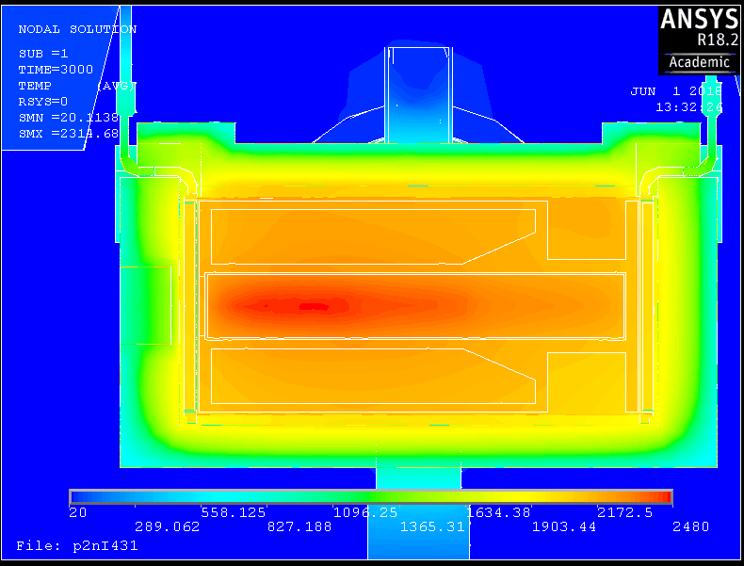
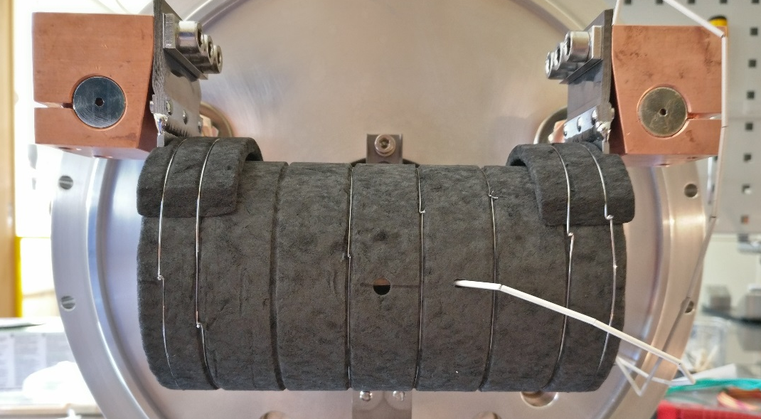


p2n Challenges: beam heating
700 A (2 kW) target heating
850 A (2.5 kW) without beam to reach the same temp.
ANSYS Thermoelectrical simulations + beam power deposition
No currrent on the target
2150 °C have been reached in the target
First spallation source to be operated at +2000 °C
J.P.Ramos

Slide 12
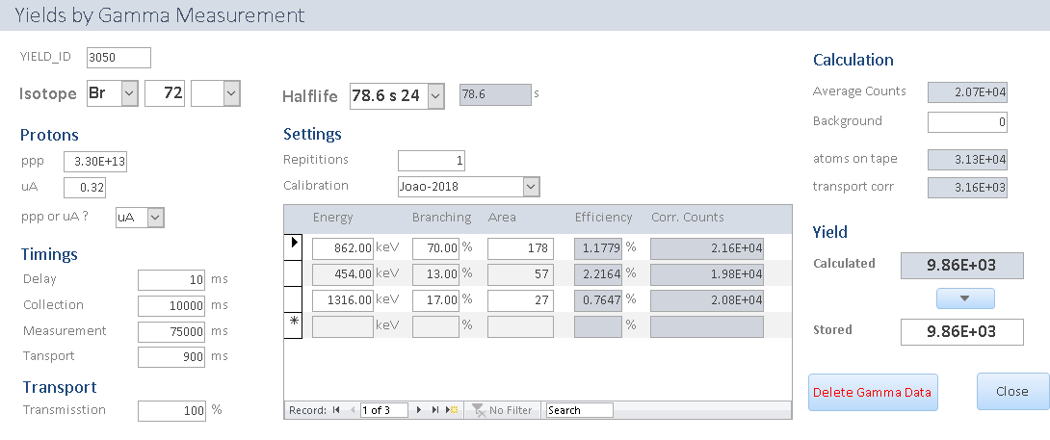
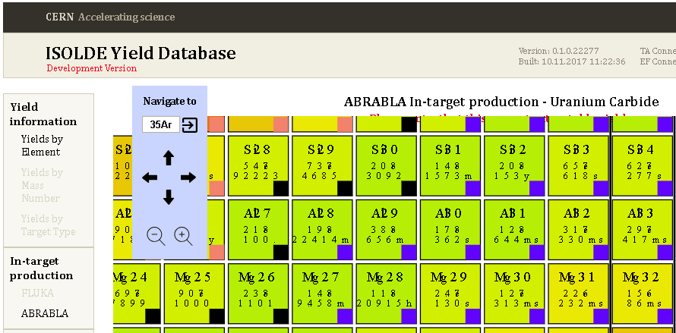
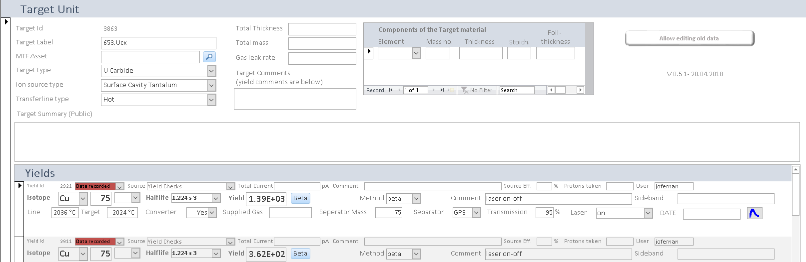
Yield Database
A new application for fast yield insertion
Yields of this year all entered in database
Web interface needs minor adjustments to avoid confusion
Issues to tackle
- Reliability of CERN webserver not yet fully satisfactory
Status and new developments
Summer student (Andreas Molander) working on:
Presentation of in-target yields for all ISOLDE target materials
Extended search functions in the database
Yield predictions / extrapolations
Integration of Infor-Data
…
J.Ballof

Slide 13
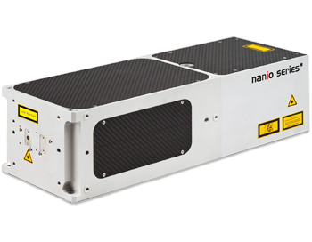
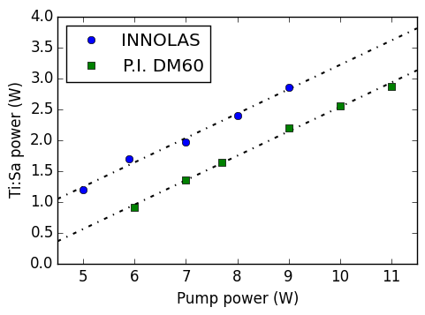
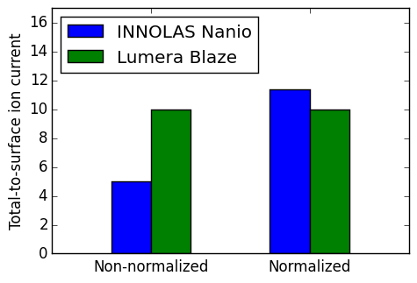
New RILIS pump laser
New DPSS laser Innolas Nanio for Ti:Sa pumping and other applications
  TEM00 – mode
  18W outpout @ 10kHz pulse rate, 30ns pulse length
Simpler cooling mechanism → decreased risk for chiller failures
Proposed laser for CERN-MEDICIS (Tender underway)
Ti:Sapphire pumping test:
Increased efficiency:
lasing at <5W pump power
Non-resonant ionization test:
Demonstrated to be effective for non-resonant ionization

Slide 14
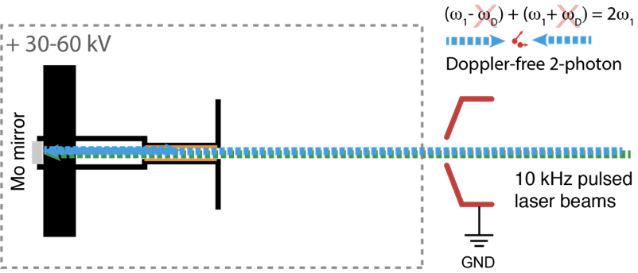
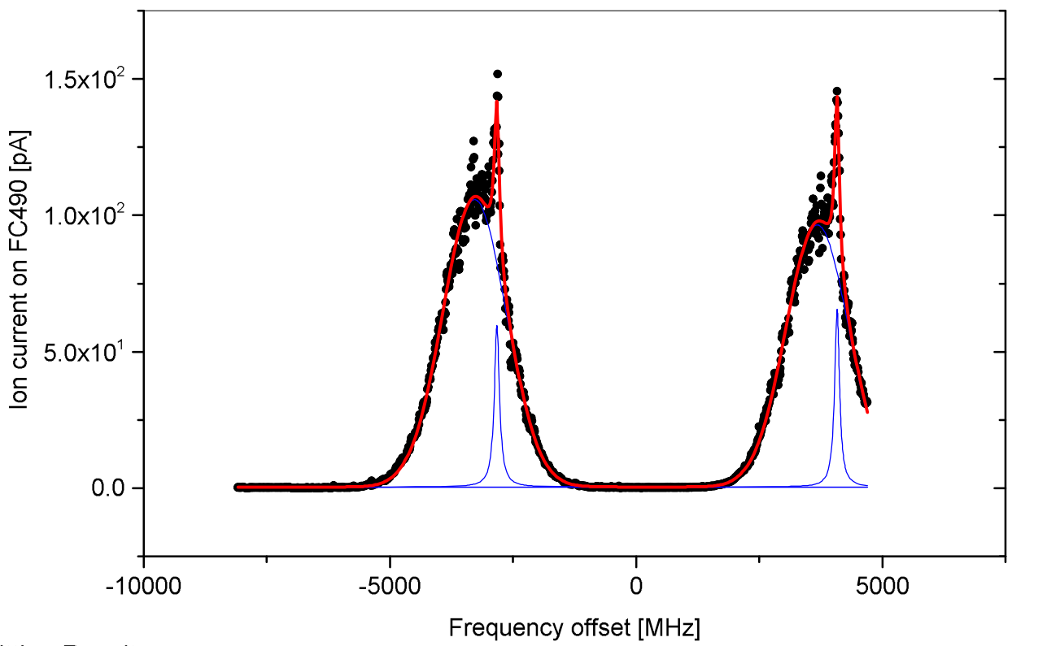
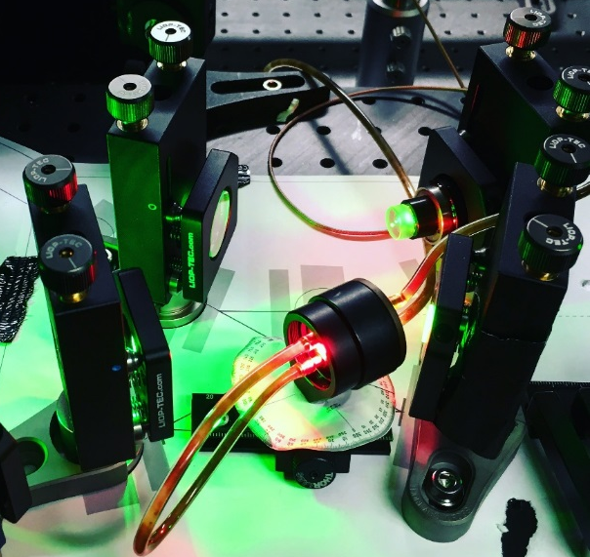
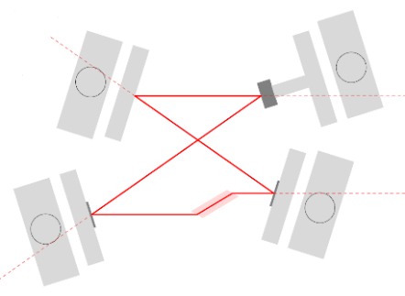
1St Demonstration of Doppler-free RILIS ionization at ISOLDE
Main objective-
Use pulse-amplified single-mode narrow linewidth laser to make RILIS capable of:
1) High-resolution laser spectroscopy for nuclear physics studies
2) Enhanced selectivity – isomer selective ionization
3) Laser ionization of non-metals
March 2018, Rb ionization
Miniature
Ti:Sapphire ring
cavity amplifier
now operational
Doppler-free
peaks
PhD study of Katerina Chrysalidis

Slide 15
Outline
Recent developments
  Start up
  Tape station
  HT upgrade
  Target Development
  RILIS
Long Shutdown 2
  Activities postponed
  Target area
    Frontend replacement
  ISOLDE Hall
    Separator upgrades
    REX – HIE-ISOLDE
  Building 179
    Nanolab construction
  Overall Planning

Slide 16
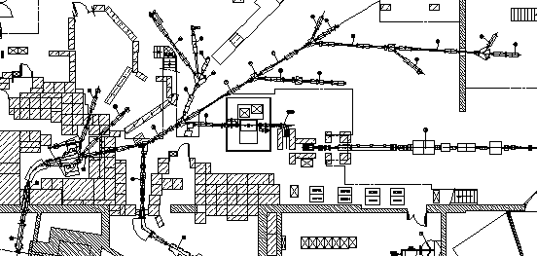
Activities postponed
ISOLDE hall beam line re-alignment
  Decision by ISCC to postpone this activity. Risk analysis revealed that start-up in 2020 could be jeopardized.
  Verification of alignment to be done.
Replacement of beam line power supplies
  Not foreseen during LS2
  Cables and interlocks to be verified.
Ventilation controls upgrade
  Budget available only in 2023
  Might be possible during 2022-2023 YETS

Slide 17
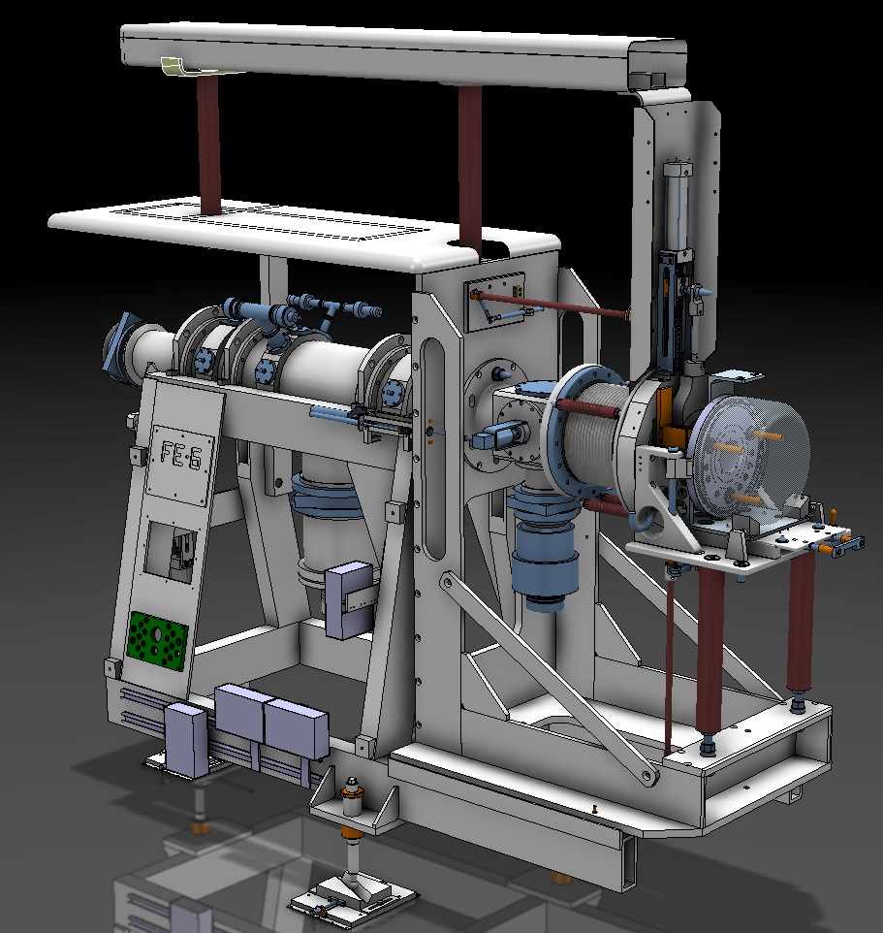
Target Area: Frontend replacement
The two existing Frontends (GPS & HRS) will come to the end of their expected lifetime during the LS2 period.
LS2 will provide a significant cool down period to minimise collective dose rates.
The opportunity will be taken to improve on design features and upgrades
  Beam instrumentation
  Extraction electrode mechanics
  Local cable replacement
  Beam line modification
Main groups involved:
EN-STI-RBS/ECE
TE-VSC
EN-SU
TE-EPC
DGS-RP
Assembly and installation to be done mainly by
EN-STI-RBS
Projection
2018: procurement & assembly
Q4 2019: testing
Q2-Q3 2019: installation
Q3 2020 - commissioning

Slide 18
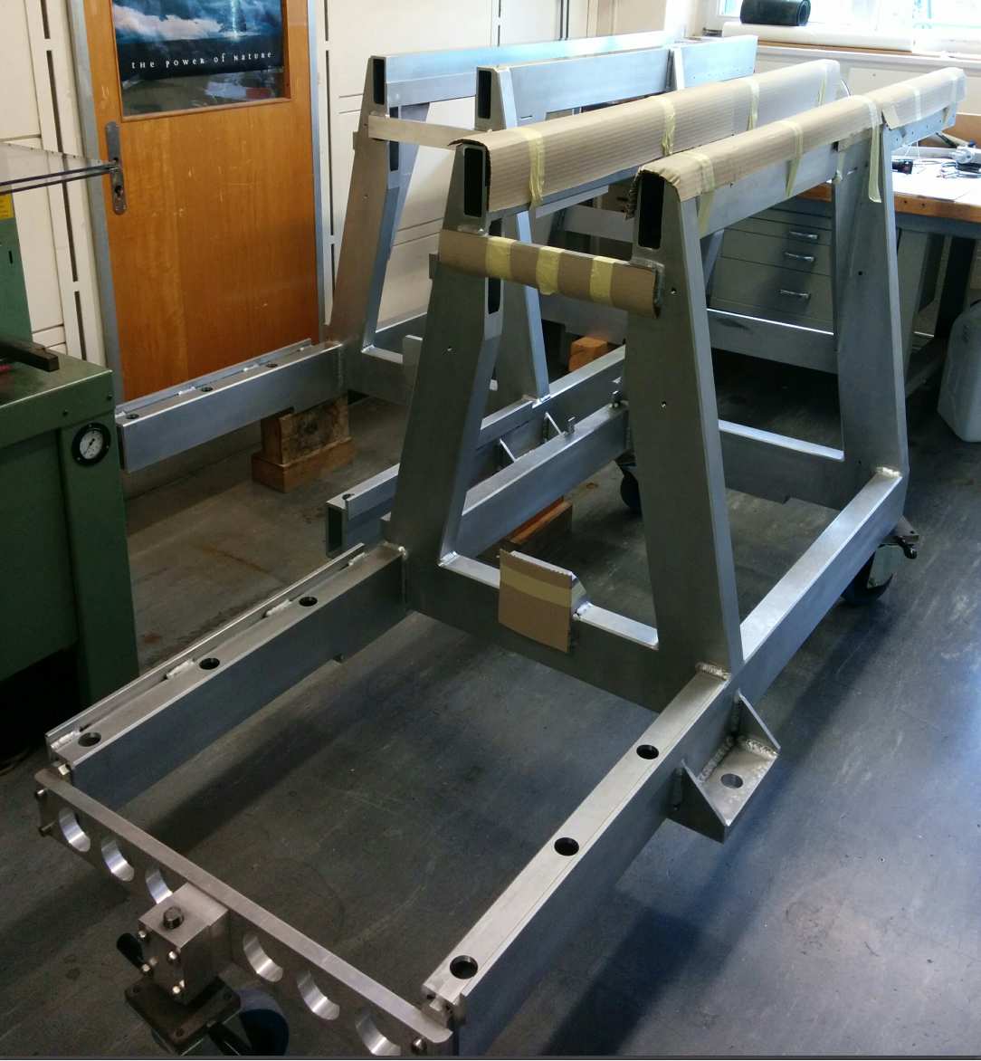
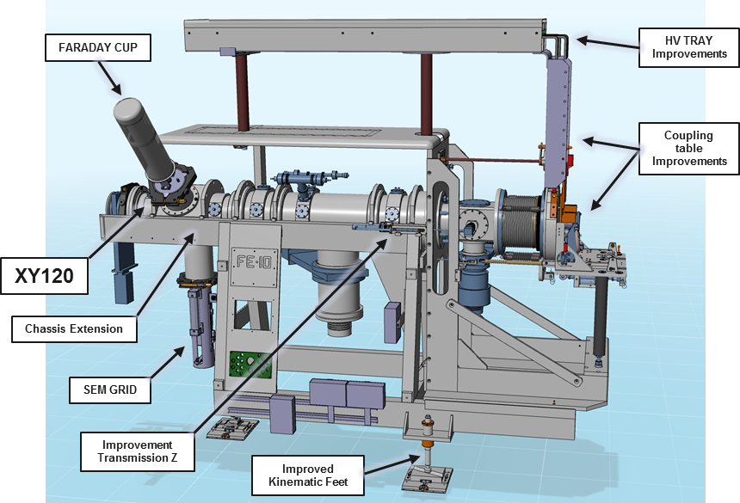
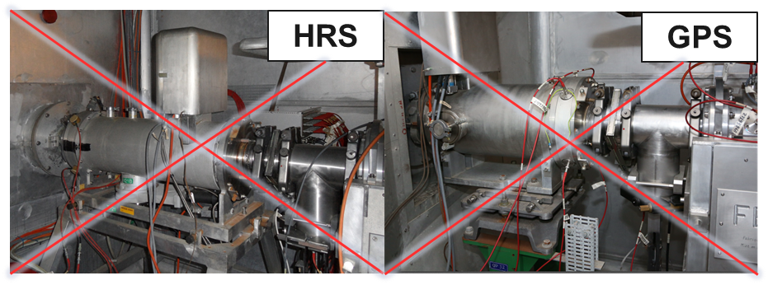
FRONTEND 10 & 11
FRONTEND 10&11 modifications:
XY120 Vacuum vessel - Extension
  XY Deflectors
  Faraday Cup
  SEM Grid
Coupling table
  New metal seals piston
Cable Tray
  Aluminium Conductors
  Improved layout
FRONTEND Chassis
  Extended chassis
  Improved stability/Weight distribution
Faraday Cage
  Removal of XY120 Vacuum Vessel
Manufacturing/Assembly
Complex pieces and vacuum components ordered
Finalizing orders of small components (June 2018).
Assembly to begin August 2018 in 3/R-035
Testing in October/November 2018 on OFFLINE 2
In Development
Aluminium flexible Conductors
FRONTEND Removal System
Metal Seal Piston
J. Cruikshank

Slide 19
Outline
Recent developments
  Start up
  Tape station
  HT upgrade
  Target Development
  RILIS
Long Shutdown 2
  Activities postponed
  Target area
    Frontend replacement
  ISOLDE Hall
    Separator upgrades
    REX – HIE-ISOLDE
  Building 179
    Nanolab construction
  Overall Planning

Slide 20
ISOLDE Hall: Separator upgrades
Mechanical slits on HRS
  Revise the mechanics (EN-STI-RBS)
Replacement of flexible compressed air lines
Installation of Fast Tape Station in CA0 beam line
Target and ion source gas system to be refurbished
Beam gate controls in ICR
Beam diagnostics
  BE-BI group to procure 20 FC/scanner units by Q1 2019
  Also new scanner units for the separators are under procurement
  To be installed in Q2 – Q4 in 2019
N2 supply line for experiments
CRIS platform integration and installation?
Installation of second HT modulator…?

Slide 21
REX/HIE-ISOLDE: RF List of activities (I)
Design and install a new cooling system for IH structure (beyond LRF team capacity: external resources are required)
90kW Bertronix amplifiers: profound status evaluation
  Disassemble one amplifier
  Define the strategy for the others and execute
Purchase of two 101MHz 5kW solid-state amplifiers
  One to be used to supply the Buncher
  One spare
Luca Timeo, Suitbert Ramberger (BE-RF-LRF)

Slide 22
REX/HIE-ISOLDE: RF List of activities (II)
Consolidate the 202MHz Dressler solid-state amplifier used as tube amplifier pre-driver (obsolescence of some strategical components)
Develop new FESA 3 classes for remote control of power amplifiers
  Implement the automatic ramp-up of the equipment after “reset”
  Improve the monitoring/logging (e.g., critical interlocks, tube gain)
Replace the optical links in the power amplifiers
  Consolidate the “Measurements Units”
Replace Grid1 and Grid2 variacs with solid state modules
Luca Timeo, Suitbert Ramberger (BE-RF-LRF)

Slide 23
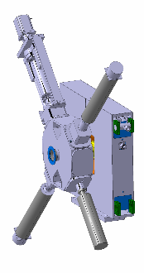
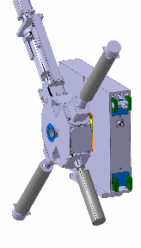
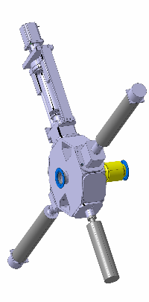
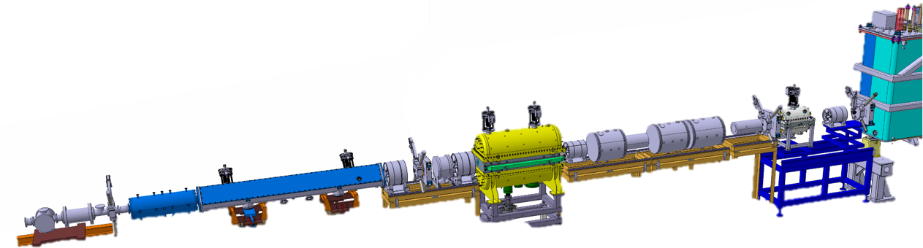
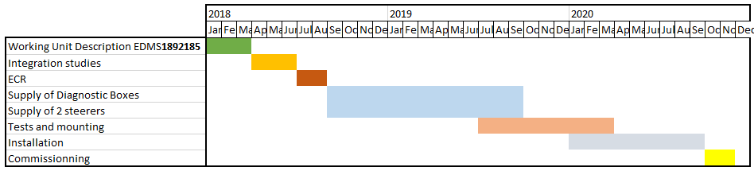
Request for 3 beam diagnostic boxes & 2 steerers between REX and HIE-ISOLDE
Around 20% of beam is lost between the REX separator and the HIE-ISOLDE LINAC
Meetings indico 9995 and Activity declared in PLAN ID 11617.
ECR will be written in July and circulated for comments and approvals at the end of summer

Slide 24
HIE- ISOLDE activities
Cryogenics
  Preventive maintenance of the cryogenic system including major overhauling of rotating machinery
  Cryo operation: Setup of the automatic controls for transient modes
Installation of fixed radiation monitors for each CM (4x) in the HIE tunnel connected to the monitoring system in the ICR
HIE-LINAC
  Possible repair of CM 4
    RF coupler issue on cavity 3 of CM4
  W. Venturini investigating the possibility of repairs during LS2
  E. Siesling has provided a planning for the removal of CM4 straight after the last physics run this year

Slide 25
Outline
Recent developments
  Start up
  Tape station
  HT upgrade
  Target Development
  RILIS
Long Shutdown 2
  Activities postponed
  Target area
    Frontend replacement
  ISOLDE Hall
    Separator upgrades
    REX – HIE-ISOLDE
  Building 179
    Nanolab construction
  Overall Planning

Slide 26
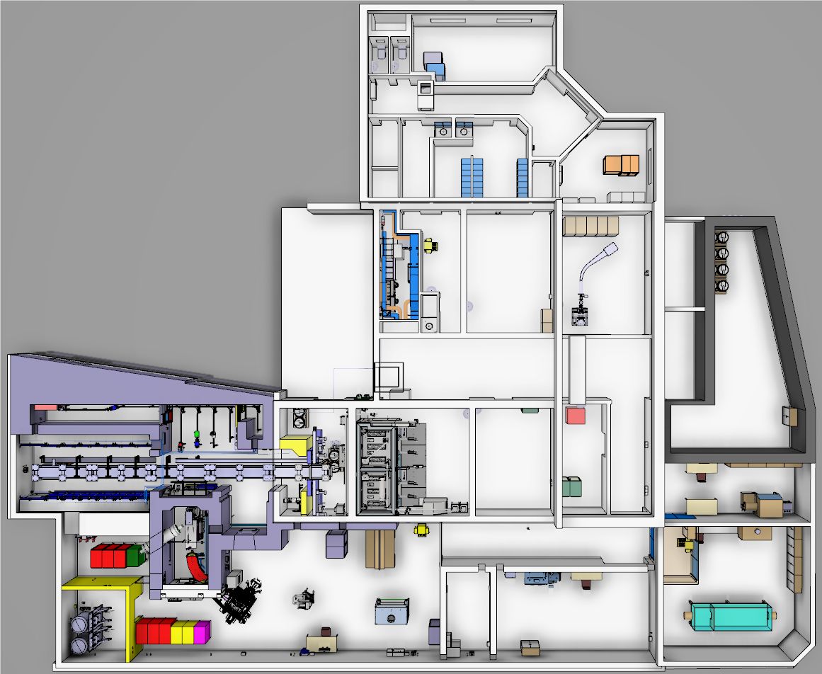





Layout of the Class A Extension (nano-lab)
Produce actinide nano materials targets by having a laboratory equipped for Uranium Nano target production
Provide a safe working environment for the manipulation of actinide nano-materials - confinement
Having a specific laboratory equipped for the validation of the oxidation process (target dismantling)
Move the buffer area and increase its capacity
Existing Building
New Extension
E.Fontaine & R.Catherall 27/04/2018

Slide 27
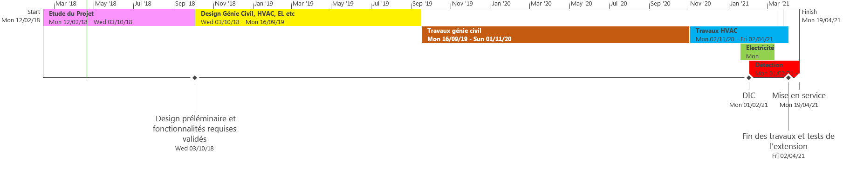
Nano-lab Preliminary Schedule
LS2
Mon 12/11/18 - Mon 11/01/21
Today
Key Dates :
    Launch of the design in October 2018
    Beginning of LS2 in November 2018 until January 2021
    Beginning of civil engineering works in September 2019
    Installation of the remaining infrastructure from November 2020 to the end of March 2021
    Commissioning of the extension April 2021
E.Fontaine & R.Catherall 27/04/2018

Slide 28
Outline
Recent developments
  Start up
  Tape station
  HT upgrade
  Target Development
  RILIS
Long Shutdown 2
  Activities postponed
  Target area
    Frontend replacement
  ISOLDE Hall
    Separator upgrades
    REX – HIE-ISOLDE
  Building 179
    Nanolab construction
  Overall Planning

Slide 30
Thank you for your attention

