Slide 1
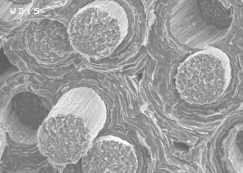

Testing of composite materials samples and structures
Corrado Gargiulo
14 October 2018

Slide 2
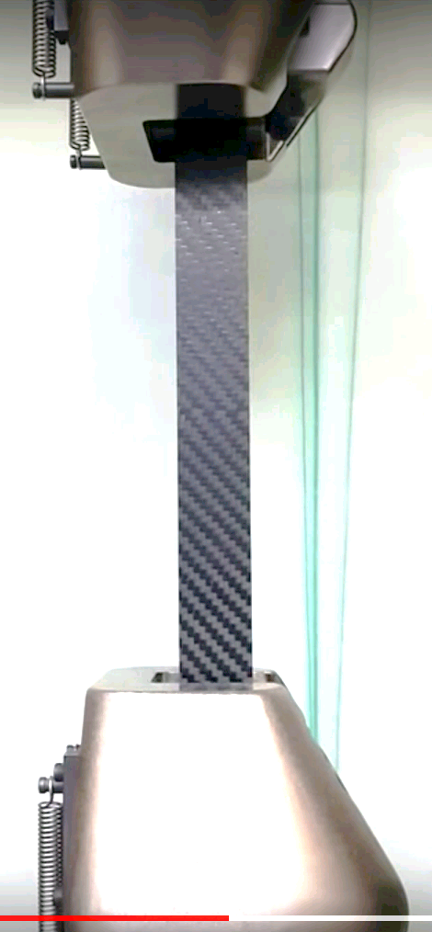
Tests done to determine intrinsic Composite material properties such as modulus and strength for use in design and analysis
Tests done to determine quality or acceptability of specific Composite components after manufacturing

Slide 3
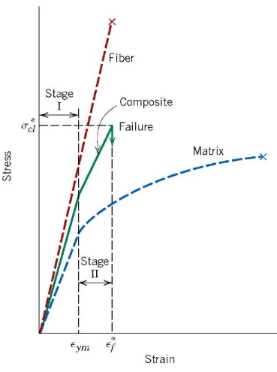
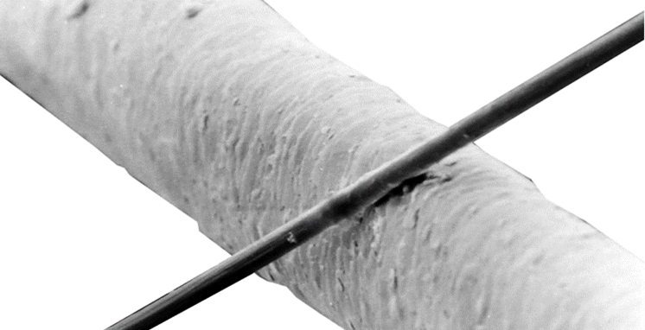

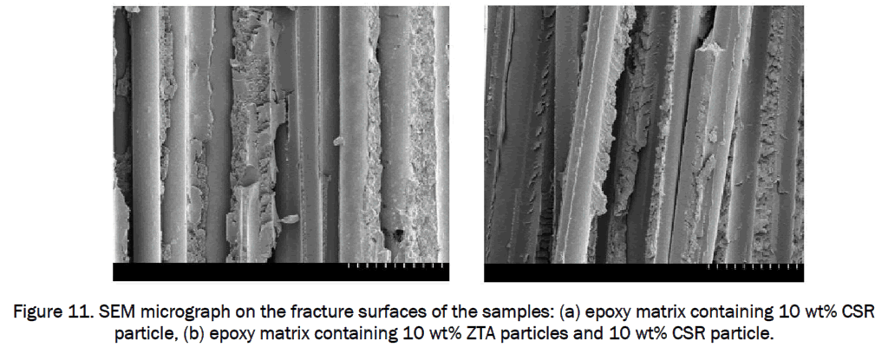
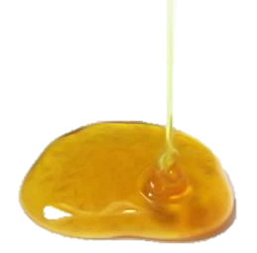
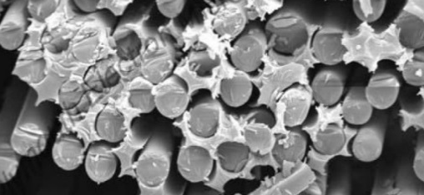
















FIBRE & RESIN
Micromechanical behaviour of a lamina
Estimation by the rule of mixtures
1
$$E_{1}= E_{f}V_{f} + E_{m}V_{m}$$
$${⇒ E}_{1} ≈ E_{f}V_{f}$$
$$V_{f}$$
$$σ_{1} = σ_{f}V_{f} + σ_{m}V_{m}$$
$${⇒σ}_{1} ≈ σ_{f}V_{f}$$
Human hair
$ν_{12} = ν_{f}V_{f} + ν_{m}V_{m}$;
$\frac{1}{E_{2}} = \frac{V_{f}}{E_{f}} +\frac{V_{m}}{E_{m}}$;
2
$\frac{1}{G_{12}} = \frac{V_{f}}{G_{f}} +\frac{V_{m}}{G_{m}}$ ;
fibres
+
=
lamina
How calculate $V_{f}$ and $V_{m}$?
resin
$$V_{f} =1\frac{1−V_{v}}{1+\frac{ρ_{f}}{ρ_{m}} ∙ \frac{M_{m}}{1−M_{m}}}$$
$CPT_{estimate}≔\frac{FAW}{ρ_{f} V_{f}}$;
we need $M_{m}$...
$M_{m} =1−FAW ∙A/m_{final}$
You can check V_{f} experimentally if you know the fiber areal weight (FAW) and measure the cured-ply thickness (CPT)
$$V_{m}$$
or $M_{m} =1−\frac{FAW}{PAW} ∙\frac{m_{initial}}{m_{final}}$
How to measure $V_{f}$ and $V_{m}$?
Removal of resin matrix from composite sample by either chemical digestion with acids or other chemicals (carbon fiber composites), or resin burn-off in a furnace (glass fiber composites) according to ASTM Standard D3171-09
While these micromechanics equations are useful for a first estimation of lamina properties when no data are available, they generally do not yield sufficiently accurate values for design purposes. For design purposes, basic lamina and laminate properties should be determined using actual mechanical property testing.

Slide 4
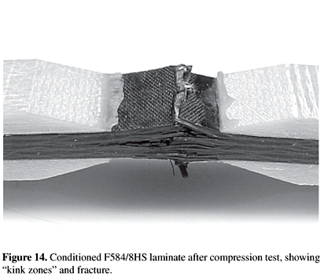
UNIAXIAL LOAD TESTS
on
composite laminate samples

Slide 5
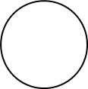
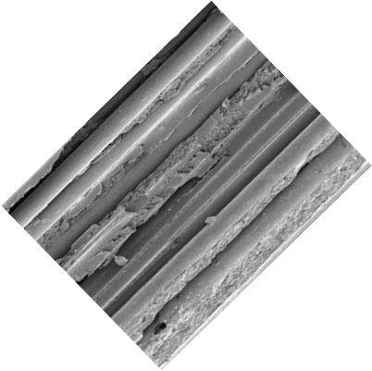

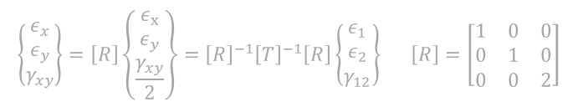


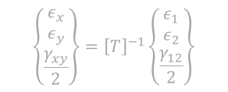
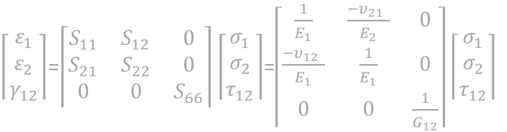
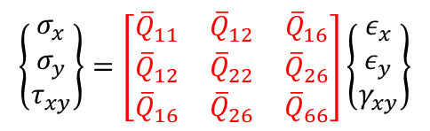

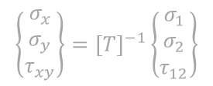


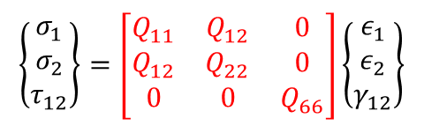

LAMINA
Constitutive equations for an ortotropic lamina, plane stress
X
1
Determined elastic properties enter in the constitutive relation (follow the red)
Y
1
$Q_{11}$= $\frac{E_{1}}{ 1−{υ_{12}υ}_{21}}$
2
$Q_{22}$= $\frac{E_{2}}{1−{υ_{12}υ}_{21}}$
$\left\lceil \begin{aligned}ε_{1} \\ ε_{2} \\ γ_{12}\end{aligned}\right\rceil$=$\left\lceil \begin{matrix}S_{11} & S_{12} & 0 \\ S_{21} & S_{22} & 0 \\ 0 & 0 & S_{66}\end{matrix}\right\rceil \left\lceil \begin{aligned}σ_{1} \\ σ_{2} \\ τ_{12}\end{aligned}\right\rceil$=$\left\lceil \begin{matrix}\frac{1}{E_{1}} & \frac{{−υ}_{21 }}{E_{2}} & 0 \\ \frac{{−υ}_{12 }}{E_{1}} & \frac{1}{E_{1}} & 0 \\ 0 & 0 & \frac{1}{G_{12}}\end{matrix}\right\rceil \left\lceil \begin{aligned}σ_{1} \\ σ_{2} \\ τ_{12}\end{aligned}\right\rceil$
2
$$\left\{\begin{matrix}σ_{1} \\ σ_{2} \\ τ_{12}\end{matrix}\right\}=\left[\begin{matrix}Q_{11} & Q_{12} & 0 \\ Q_{12} & Q_{22} & 0 \\ 0 & 0 & Q_{66}\end{matrix}\right]\left\{\begin{matrix}ε_{1} \\ ε_{2} \\ γ_{12}\end{matrix}\right\}$$
$$Q_{12}=\frac{{ν_{12}E}_{2}}{1−ν_{12}ν_{21}}=\frac{{ν_{21}E}_{1}}{1−ν_{12}ν_{21}}$$
$Q_{66}$=${ G}_{12}$
The relation between stress and strain is expressed in a coordinate system aligned to the fibres, through a certain number of elastic parameters
x
$$\left\{\begin{matrix}σ_{x} \\ σ_{y} \\ τ_{xy}\end{matrix}\right\}={\left[T\right]}^{−1}\left\{\begin{matrix}σ_{1} \\ σ_{2} \\ τ_{12}\end{matrix}\right\}$$
$$\left\{\begin{matrix}ε_{x} \\ ε_{y} \\ \frac{γ_{xy}}{2}\end{matrix}\right\}={\left[T\right]}^{−1}\left\{\begin{matrix}ε_{1} \\ ε_{2} \\ \frac{γ_{12}}{2}\end{matrix}\right\}$$
1
Ѳ
$$\left\{\begin{matrix}σ_{x} \\ σ_{y} \\ τ_{xy}\end{matrix}\right\}=\left[\begin{matrix}{\overline{Q}}_{11} & {\overline{Q}}_{12} & {\overline{Q}}_{16} \\ {\overline{Q}}_{12} & {\overline{Q}}_{22} & {\overline{Q}}_{26} \\ {\overline{Q}}_{16} & {\overline{Q}}_{26} & {\overline{Q}}_{66}\end{matrix}\right]\left\{\begin{matrix}ε_{x} \\ ε_{y} \\ γ_{xy}\end{matrix}\right\}$$
$$\left[T\right]=\left[\begin{matrix}\cos^{2}{θ} & \sin^{2}{θ } & 2\sin{θ}\cos{θ} \\ \sin^{2}{θ } & \cos^{2}{θ} & −2\sin{θ}\cos{θ} \\ −sin{θ}\cos{θ} & \sin{θ}\cos{θ} & \cos^{2}{θ}−\sin^{2}{θ }\end{matrix}\right]$$
$${\left[\overline{Q}\right]=\left[T\right]}^{−1}\left[Q\right]{\left[T\right]}^{−T}$$
y
$$\left\{\begin{matrix}ε_{x} \\ ε_{y} \\ γ_{xy}\end{matrix}\right\}=\left[R\right]\left\{\begin{matrix}ε_{x} \\ ε_{y} \\ \frac{γ_{xy}}{2}\end{matrix}\right\}={\left[R\right]}^{−1}{\left[T\right]}^{−1}\left[R\right]\left\{\begin{matrix}ε_{1} \\ ε_{2} \\ γ_{12}\end{matrix}\right\} \left[R\right]=\left[\begin{matrix}1 & 0 & 0 \\ 0 & 1 & 0 \\ 0 & 0 & 2\end{matrix}\right]$$
$$\left\{\begin{matrix}σ_{x} \\ σ_{y} \\ τ_{xy}\end{matrix}\right\}={\left[T\right]}^{−1}\left\{\begin{matrix}σ_{1} \\ σ_{2} \\ τ_{12}\end{matrix}\right\}={\left[T\right]}^{−1}\left[Q\right]\left\{\begin{matrix}ε_{1} \\ ε_{2} \\ γ_{12}\end{matrix}\right\}={\left[T\right]}^{−1}\left[Q\right]\left[R\right]\left[T\right]{\left[R\right]}^{−1} \left\{\begin{matrix}ε_{x} \\ ε_{y} \\ γ_{xy}\end{matrix}\right\}$$
2
$\left[R\right]\left[T\right]{\left[R\right]}^{−1}$ can be shown to be ${\left[T\right]}^{−T}$ where the superscript T denotes the matrix transpose.
The lamina is used in a laminate with a certain angle, the elastic relation can then be rotated to be expressed respect to a common reference system

Slide 6


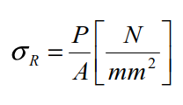
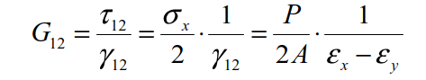
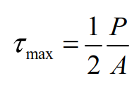


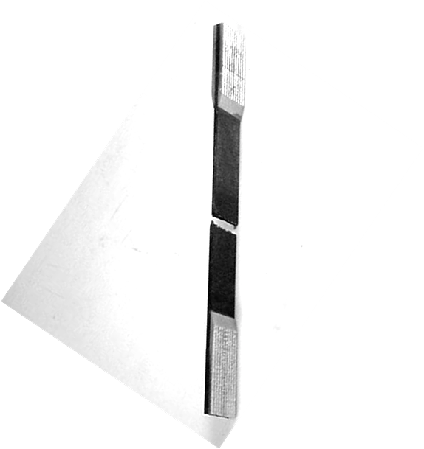
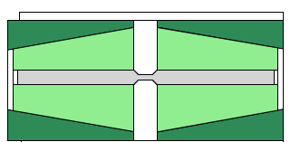
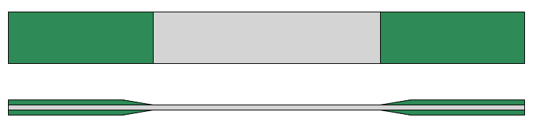

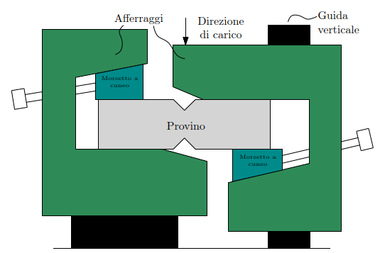
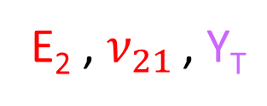
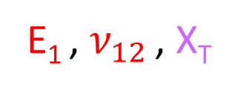
TEST
Lamina mechanical properties experimental determination
P
Tensile tests
Compressive test
0◦C -axis
X_{C,} Y_{C}
E₁ , $ν_{12}$ , X_{T}
x
90◦C -axis
Celanese
y
E₂ , $ν_{21}$ , Y_{T}
ASTM D3410
Shear test (alternative to ±45◦C -axis tensile test)
G₁₂ , S
±45◦C -axis
G₁₂ , S
Thin pipe
P
Iosipescu Shear Test
ASTM D3039/D3039M, EN 2561, EN 2597
ASTM D5379

Slide 7
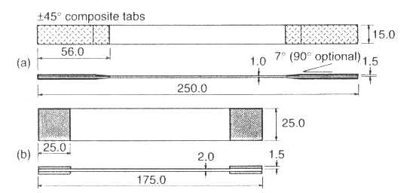
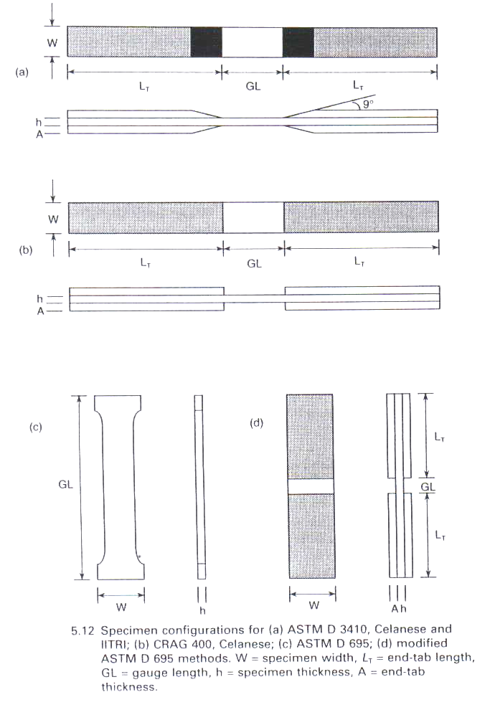
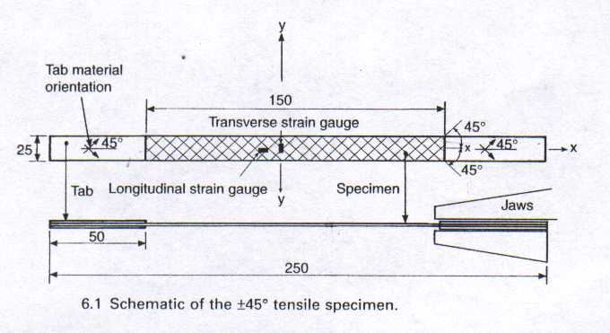
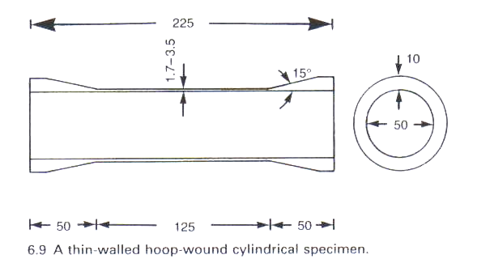
TEST
Test specimens
ASTM D3410
CELANESE
Standard Test Method for Compressive Properties of Polymer Matrix Composite Materials with Unsupported Gage Section by Shear Loading
ASTM D3039/D3039M, EN 2561, EN 2597
Standard Test Method for Tensile Properties of Polymer Matrix Composite Materials
MIL-HDBK-17
ASTM D3518
The most nearly ideal test from a theoretical standpoint involves torsion of thin walled filament wound tubes
Standard Test Method for In-Plane Shear Response of Polymer Matrix Composite Materials by Tensile Test of a ±45° Laminate

Slide 8
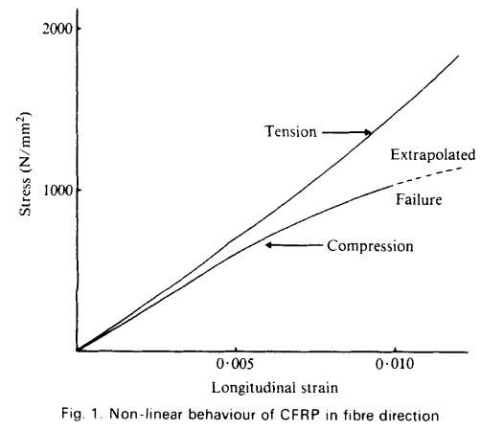
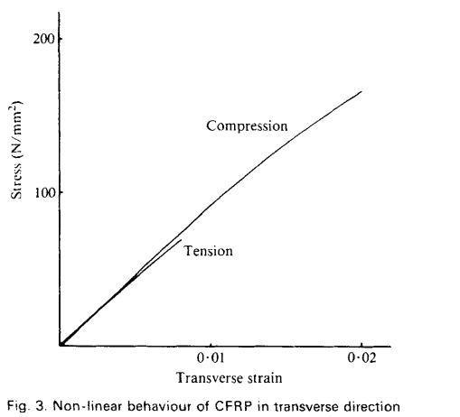
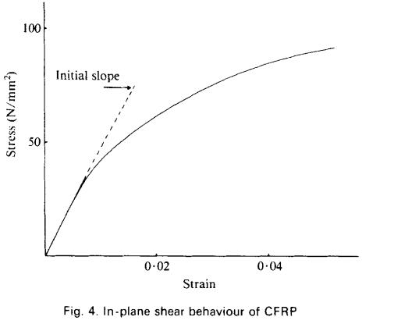
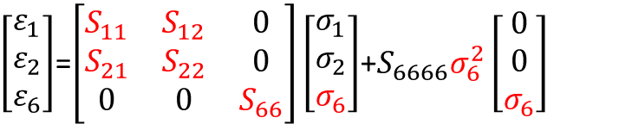
TEST
Lamina mechanical properties experimental determination
E₁
E₂
G₁₂
$\left[\begin{aligned}ε_{1} \\ ε_{2} \\ ε_{6}\end{aligned}\right]$=$\left[\begin{matrix}S_{11} & S_{12} & 0 \\ S_{21} & S_{22} & 0 \\ 0 & 0 & S_{66}\end{matrix}\right]\left[\begin{aligned}σ_{1} \\ σ_{2} \\ σ_{6}\end{aligned}\right]$+$S_{6666}σ_{6}^{2}\left[\begin{aligned}0 \\ 0 \\ σ_{6}\end{aligned}\right]$
Han Tsai
Most of laminated composites used in modern structures exhibit nonlinearity even under elastic conditions. Probably, the most evident case that reveals this effect is the plane shear test, where the stress strain diagram is apparently nonlinear directly from low values of load.
This test demonstrates the decrease in shear modulus during increase of shear stress and strain.

Slide 9
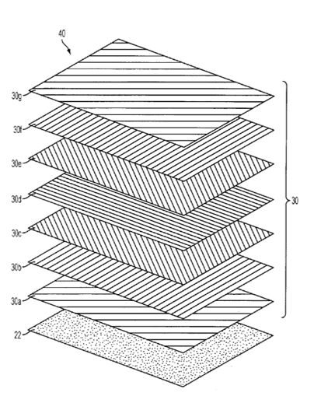
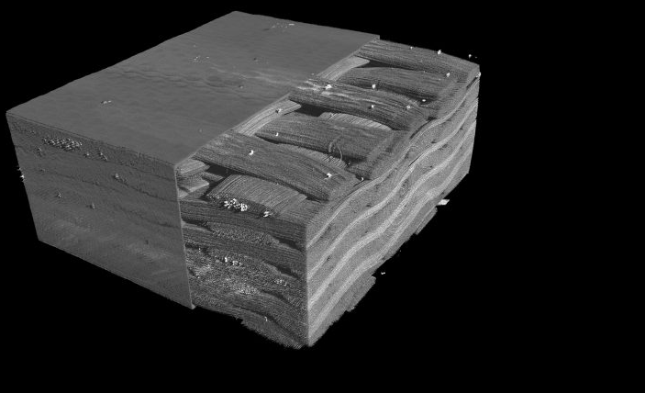

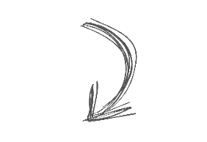
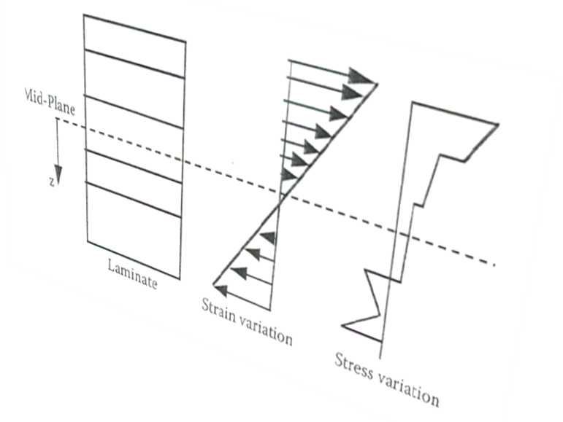

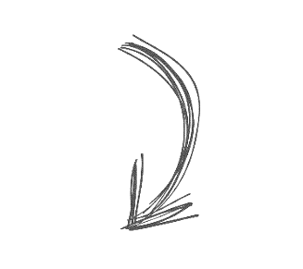


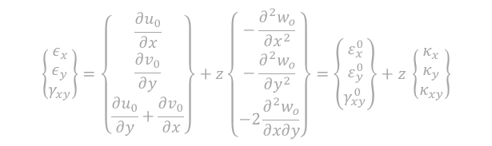
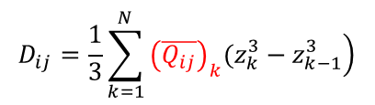





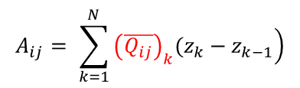







From lamina to LAMINATE
Equilibrium Equations
X
1
$$\frac{∂N_{xy}}{∂x}+\frac{∂N_{y}}{∂y}+Y=0$$
Cinematic equations
$$ε_{x}=\frac{∂u}{∂x} = \frac{∂u_{0}}{∂x}−z\frac{∂^{2}w_{o}}{∂x^{2}} ,$$
Y
$$\frac{∂N_{x}}{∂x}+\frac{∂N_{yx}}{∂y}+X=0$$
$$ε_{y}=\frac{∂v}{∂y} = \frac{∂v_{0}}{∂y}−z\frac{∂^{2}w_{o}}{∂y^{2}} ,$$
2
$$\frac{∂^{2}M_{x}}{∂x^{2}}+\frac{∂^{2}M_{xy}}{∂x∂y}+\frac{∂^{2}M_{y}}{∂y^{2}}+P=0$$
$$γ_{xy}=\frac{∂u}{∂y}+\frac{∂v}{∂x}= \frac{∂u_{0}}{∂y}+\frac{∂v_{0}}{∂x}−2\frac{∂^{2}w_{o}}{∂x∂y} .$$
P
$$u=u_{0}−z\frac{∂w_{0}}{∂x}$$
X
$$\left\{\begin{matrix}ε_{x} \\ ε_{y} \\ γ_{xy}\end{matrix}\right\}=\left\{\begin{matrix}\frac{∂u_{0}}{∂x} \\ \frac{∂v_{0}}{∂y} \\ \frac{∂u_{0}}{∂y}+\frac{∂v_{0}}{∂x}\end{matrix}\right\}+z\left\{\begin{matrix}−\frac{∂^{2}w_{o}}{∂x^{2}} \\ −\frac{∂^{2}w_{o}}{∂y^{2}} \\ −2\frac{∂^{2}w_{o}}{∂x∂y}\end{matrix}\right\}=\left\{\begin{matrix}ε_{x}^{0} \\ ε_{y}^{0} \\ γ_{xy}^{0}\end{matrix}\right\}+z \left\{\begin{matrix}κ_{x} \\ κ_{y} \\ κ_{xy}\end{matrix}\right\}$$
$$v=v_{0}−z\frac{∂w_{0}}{∂y},$$
Y
Myx
Constitutive equations
Mxy
$$A_{ij}= \sum_{k=1}^{N}{\left.{\left(\overline{Q_{ij}}\right)}_{k}(z_{k}−z_{k−1}\right)}$$
My
$$B_{ij}=\frac{1}{2}\sum_{k=1}^{N}{\left.{\left(\overline{Q_{ij}}\right)}_{k}(z_{k}^{2}−z_{k−1}^{2}\right)}$$
Nxy
Ny
Nyx
$$D_{ij}=\frac{1}{3}\sum_{k=1}^{N}{\left.{\left(\overline{Q_{ij}}\right)}_{k}(z_{k}^{3}−z_{k−1}^{3}\right)}$$
Mx
$$z_{k−1}$$
Lamina k
Nx
$$z_{k}$$
$$\left\{\begin{matrix}N_{x} \\ N_{y} \\ N_{xy} \\ M_{x} \\ M_{y} \\ M_{xy} \\ \end{matrix}\right\}=\left[\begin{matrix}\begin{matrix}A_{11} & A_{12} & A_{16} \\ A_{21} & A_{22} & A_{26} \\ A_{61} & A_{62} & A_{66}\end{matrix} & \begin{matrix}B_{11} & B_{12} & B_{16} \\ B_{21} & B_{22} & B_{26} \\ B_{61} & B_{62} & B_{66}\end{matrix} \\ \begin{matrix}B_{11} & B_{12} & B_{16} \\ B_{21} & B_{22} & B_{26} \\ B_{61} & B_{62} & B_{66}\end{matrix} & \begin{matrix}D_{11} & D_{12} & D_{16} \\ D_{21} & D_{22} & D_{26} \\ D_{61} & D_{62} & D_{66}\end{matrix}\end{matrix}\right]\left\{\begin{matrix}{ε_{x}}^{0} \\ {ε_{y}}^{0} \\ {γ_{xy}}^{0} \\ κ_{x} \\ κ_{y} \\ κ_{xy} \\ \end{matrix}\right\}$$
[B]=0 Decoupling between in-plane and out-of plane action *
A16=A26= 0 Decoupling between traction/compression and shear actions**
D16= D26= 0 Decoupling between flexural and torsional actions***
* at each lamina + Ѳ at +z correspond a lamina of the some thickness + Ѳ at – z Ex. [-45/+35/0/0/+35/-45]= [-45/+35/0]s
** at each lamina +Ѳ corresponds a lamina of the some thickness – Ѳ Ex. [+45/-45/0/0/+35/-35]
*** at each lamina +Ѳ corresponds a lamina of the some thickness – Ѳ at – z Ex. [+45/-35/0/0/+35/-45]

Slide 10
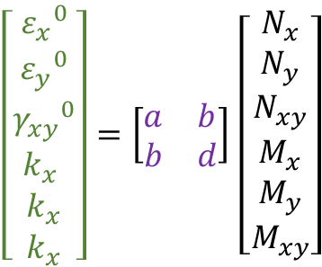

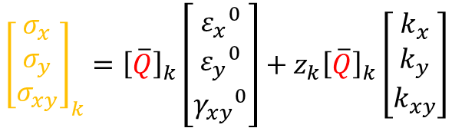
$$\left[\begin{aligned}{ε_{x}}^{0} \\ {ε_{y}}^{0} \\ {γ_{xy}}^{0} \\ k_{x} \\ k_{x} \\ k_{x}\end{aligned}\right]=\left[\begin{matrix}a & b \\ b & d\end{matrix}\right]\left[\begin{aligned}N_{x} \\ N_{y} \\ N_{xy} \\ M_{x} \\ M_{y} \\ M_{xy}\end{aligned}\right]$$
Equilibrium Equations
From applied load on the laminate to lamina stress
X
1
Y
2
P
X
$${\left[\begin{aligned}ε_{x} \\ ε_{y} \\ γ_{xy}\end{aligned}\right]}_{k}=\left[\begin{aligned}{ε_{x}}^{0} \\ {ε_{y}}^{0} \\ {γ_{xy}}^{0}\end{aligned}\right]+z_{k}\left[\begin{aligned}k_{x} \\ k_{y} \\ k_{xy}\end{aligned}\right]$$
Y
$${\left[\begin{aligned}σ_{x} \\ σ_{y} \\ σ_{xy}\end{aligned}\right]}_{k}={\left[\overline{Q}\right]}_{k}\left[\begin{aligned}{ε_{x}}^{0} \\ {ε_{y}}^{0} \\ {γ_{xy}}^{0}\end{aligned}\right]+z_{k}{\left[\overline{Q}\right]}_{k}\left[\begin{aligned}k_{x} \\ k_{y} \\ k_{xy}\end{aligned}\right]$$
Myx
Mxy
My
Nxy
Ny
Nyx
Mx
Lamina k
Nx
Usually, the mechanical loads N and M , are known, so that the strains and curvatures can be obtained by multiplying these loads by the inverse of the compliance matrix. The strains and curvatures so obtained can be used to find the stresses in each lamina through the laminate stress-strain equations.

Slide 11
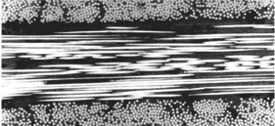

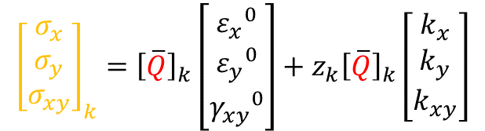
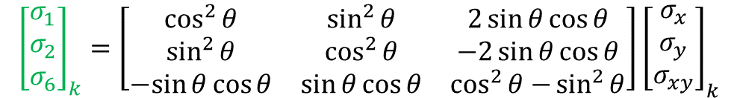

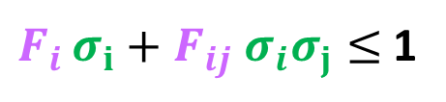

Form lamina stress to lamina failure
X
1
Y
$${\left[\begin{aligned}σ_{x} \\ σ_{y} \\ σ_{xy}\end{aligned}\right]}_{k}={\left[\overline{Q}\right]}_{k}\left[\begin{aligned}{ε_{x}}^{0} \\ {ε_{y}}^{0} \\ {γ_{xy}}^{0}\end{aligned}\right]+z_{k}{\left[\overline{Q}\right]}_{k}\left[\begin{aligned}k_{x} \\ k_{y} \\ k_{xy}\end{aligned}\right]$$
2
$$z_{k−1}$$
$$z_{k}$$
$${\left[\begin{aligned}σ_{1} \\ σ_{2} \\ σ_{6}\end{aligned}\right]}_{k}=\left[\begin{matrix}\cos^{2}{θ} & \sin^{2}{θ} & 2\sin{θ\cos{θ}} \\ \sin^{2}{θ} & \cos^{2}{θ} & −2\sin{θ\cos{θ}} \\ −sin{θ\cos{θ}} & \sin{θ\cos{θ}} & \cos^{2}{θ−}\sin^{2}{θ}\end{matrix}\right]{\left[\begin{aligned}σ_{x} \\ σ_{y} \\ σ_{xy}\end{aligned}\right]}_{k}$$
$$F_{i },F_{ij}$$
$F_{i }σ_{i}+F_{ij}{ σ}_{i}σ_{j}≤$1
Failure criteria are quadratic empirical formulation
are experimentally determined material strength parameters
Tsai Hill, Hoffman, Tsai Wu, ...
Various failure criteria have been proposed to enable the onset of failure to be estimated
Each stress component is tested against an allowable stress which is based on measured properties from unidirectional specimens. If the stress distribution in any layer exceed the Failure criteria, the layer is deemed to have suffered “First Ply Failure” .
The matrix stiffness values for that layer are then suppressed and the load which caused the failures is re-applied. If no further layer failures occur at this load. the loading procedure continues until more layer failures are detected, up to the failure of the last ply, “Last Ply Failure”.

Slide 12

MULTI AXIAL LOAD TESTS
on
Composite laminate samples

Slide 13

Multiaxial load: pressure, axial load, torsion
Macro mechanics based failure theories applied to composite laminates under static loading conditions shows that there is a need to validate failure models for composite laminates under multiaxial loading conditions.
$F_{i }σ_{i}+F_{ij}{ σ}_{i}σ_{j}≤$1
α
Failure envelope surface
σ_{a}
τ
σ_{h}
τ
σ_{h}
τ
τ
σ_{a}
σ_{a}
σ_{a}
Biaxial load
τ
τ
σ_{h}
τ
σ_{h}
τ
Failure envelope curve
σ_{h}
σ_{h}
Pressure, axial load
Torsion, axial load
τ
Torsion, pressure
τ
σ_{a}
τ
σ_{a}
τ
Axial stress (MPa)
Shear stress (MPa)
Shear stress (MPa)
Hoop stress (MPa)
ref
Axial stress (MPa)
Hoop stress (MPa)

Slide 14





TEST
Test specimens
54,22
42
Conical reinforce to avoid stress concentration at the clamping area
6,11
6,11
45
40
Without conical reinforcement
Specimens production by filamnet winding
0,86
130
300
t
l =130mm
r =42mm
t = 0.86mm
40
45
α
Without conical reinforcement
[±α]
[+35/-35/+35/-35]
[+55/-55/+55/-55]
[+75/-75/+75/-75]

Slide 15



TEST
Experimental set-up and procedure
Pressure internal & axial load & torsion
Pressure internal/est & axial load
F
F
TENSION
TENSION
COMPRESSION
COMPRESSION
Shear stress
PRESS est
Hoop stress
olio
Axial stress
specimen
Press _{int}
oil
failure
X
M_{t}
R=cost
Specimen
PRESS int
oil
Mt/F= cost
Mt/P= cost
P/F= cost

Slide 16


Failure prediction; Failure envelope numerical
Winding angle effect
Failure criteria influence
Axial stress (Mpa)
Axial stress (Mpa)
Hoop stress (Mpa)
Hoop stress (Mpa)
Non linear shear stress strain influence
α
Axial stress
Hoop stress.
Hoop stress.
Procedure implemented in Finite Element Code
Axial stress

Slide 17








Composite structural behavior prediction: failure
Reference
55° axial traction 7800 N
Experimental test: failure
75° ext pressure
55°
Net Theory
Test results
Axial stress
55° ext press 25 bar
1
55° internal press 260 bar
55° axial compression
Hoop stress
35° axial compress
75° axial compression

Slide 18





TESTS
on
HEP composite structures

Slide 19





Typical Carbon Composite material used in HEP
Human hair
Use of Composite material in HEP mainly address requirements on
… stiffness…
~5µm mech
~ 10 µm therm
Carbon Fleece: continuous-strand mat finished with a chemical binder to hold fibers in place. Filament diameter= 5µm, th=20 µm, 8g/m2.
Carbon Roving: Bunches of filament parallel to each other. Filament diameter=5 µm
Carbon
filament
E [GPa] | X_{t} [GPa] | HT fiber
240 | 4,4
 | Filaments [K=1000] | Tex [g/km] | E [GPa] | X_{t} [GPa] | K [W/mK] | CTE [K⁻¹]
M60j | 3K | 103 | 588 | 3,92 | 151 | -1,1x 10⁻⁶
M55j | 6K | 218 | 540 | 4,02 | 155 | -1,1x 10⁻⁶
20 µm
K thousand
of filament in a fibre tow
… thermal management
Thermal Pyrolytic Graphite: Thermal management material with very high thermal conductivity and flexibility
 | Thick. [µm] | Density [g/cm3] | K pl [W/mK] | K th [W/mK]
Amec FGS_003 | 30 | 1.6 | 1500 | 15
Carbon «thermal fibres» are thicker and stiffer, they break if bent to minimum radius
M60J
K13D2U
Mech
fibre
Therm
fibre
Carbon Unidirectional Prepreg: Ready to mold or cure material in sheet form which contains fiber all aligned in one direction. Filament diameter=11 µm
 | Filaments [K=1000] | E1 [GPa] | X_{t} /X_{c} [MPa] | E2 [GPa] | Y_{t} [MPa] | K [W/mK] | CTE [10⁻⁶K⁻¹]
K13D2U [0] fibre | 2K | 935 | 3688 |  |  | 800 | -1,1
K13D2U [0] prepreg | 2K | 563 | 1800/340 | 6 | 25 | ~450 | -1,2 / 61
45 (g/m²) FAW

Slide 20













Typical Carbon Composite structure used in HEP
Non standard use of composite material tailored to fulfil requirements of minimum material, high stiffness and high thermal conductivity
FPC
Receipt
290 mm , 1.7 gram
Array of MAPS chip
Manual lay-up on mould 1: Cfleece/K13D2U 90°/Cfleece
Manual lay-up on mould 2: Pipes/Cpaper/Cfleece
Mould 1 and 2 closure
Curing at 24°C for 24h
Post Curing at 125°C for 3h
Remove pipes mandrels @ 80°C
Cold Plate Finishing
Locate the Cold Plate in the winding moulds
Place the three vertex M55J longitudinal threads
Wind with M60J
Cure at 24°C for 24h
Remove inside mandrel
Cut wound thread at moulds interfaces
Space Frame Finishing
Connectors gluing
Hydraulic Fitting gluing
ITS Inner Barrel
3 layers
ALICE ITS Inner Barrel

Slide 21












Characterization test of HEP composite structure
…to validate stiffness
static
dynamic
Sine sweep test
& Random vibration
Beam with Concentrated Mass:
$$Natural frequency, fn=\frac{1}{2π}\sqrt{\frac{g}{sag}}$$
Mile’s equation SDOF,
Constant PSD input (P value),
$ξ$ damping ratio
1.5 kg
$$Accel. response, \ddot{X}GRMS\left(fn,ξ\right)=\sqrt{\frac{π}{2}\frac{fn}{2ξ} P}$$
1.5 m, 35 gram
1.5mm
ASTM RUM40%
3D Scanning Vibrometry System
Bending test
$$Flexural stiffness, EI=\frac{F{ L}^{3}}{a sag}$$
Type of fixation |  | a
Both ends free | concentrated load | a=48
Both ends fixed | concentrated load | a=192
$$Torsional stifness, GI_{p}=\frac{M L}{φ};$$
Bending test results
Touchless (fibre bragg grating, laser scan ) deformation measurement

Slide 22












Characterization test of HEP composite structure
Composite Thermal Management
operative condition
24.1 ⁰C
T_{in}=18.25 °C
Tin=18.25 °C
Inlet
Outlet
18.2 ⁰C
during start up
23 ⁰C
Inlet
Outlet
18 ⁰C
x2 speed
Thermal Test: operative mode, start-up, alternatives modes
Composite Thermal Expansion
$$Linear CTE, α=\frac{Δl}{L}\frac{1}{ΔT}$$
MME
measured by LVDT
Δl resolution:
0.125 nm / 1.25 nm

Slide 23
CONCLUSION
Experimental determination of Carbon Composite material properties is key for a correct prediction of the structure behavior, as well the understanding of their use in the calculation
For Composite, as the “material” is produced at the same time of the “final product”, it is often necessary that the manufacturer characterizes it own material
Characterization and Qualification of the final product, in particular for ultra light weight structure, often requires specific test procedures and equipment to avoid that the measure is affected by the test itself

Slide 24
Back up

Slide 25
Property | Meaning
E | tensile modulus
G | shear modulus
ν | Poisson ratio
X | tensile strength fibre direction
Y | tensile strength ⊥ fibre direction
S | shear strength
ρ | volume fraction
α | coefficient of thermal expansion
β | coefficient of moisture expansion
V | volume fraction
M | mass fraction
FAW | fiber areal weight
PAW | prepreg areal weight
CPT | cured ply thickness
Subscript | Meaning
1, 2, 3 | ply directions
x, y, z | laminate directions
f | fiber property
m | matrix property
v | void
c | compression
t | tension

