Slide 1
Introduction to HEP computing
J. Apostolakis & W. Pokorski
EP/SFT
CERN

Slide 2
Outline
modern High Energy Physics (HEP) experiments
physics software
  online processing
    triggering, selection
  offline processing
  simulation
conclusions

Slide 3
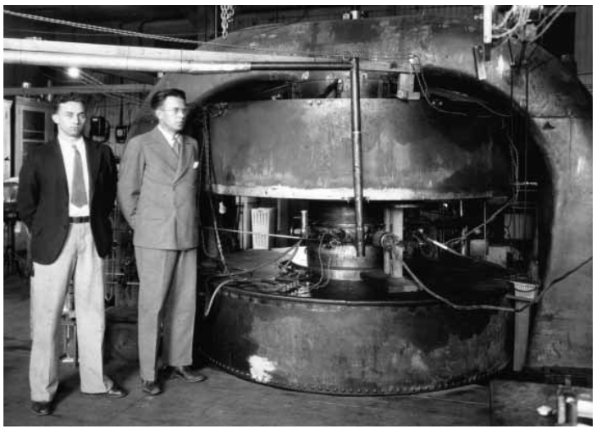
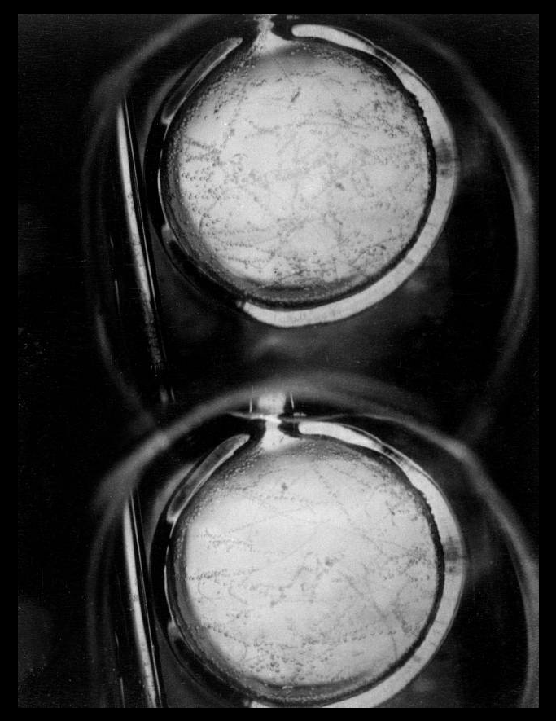
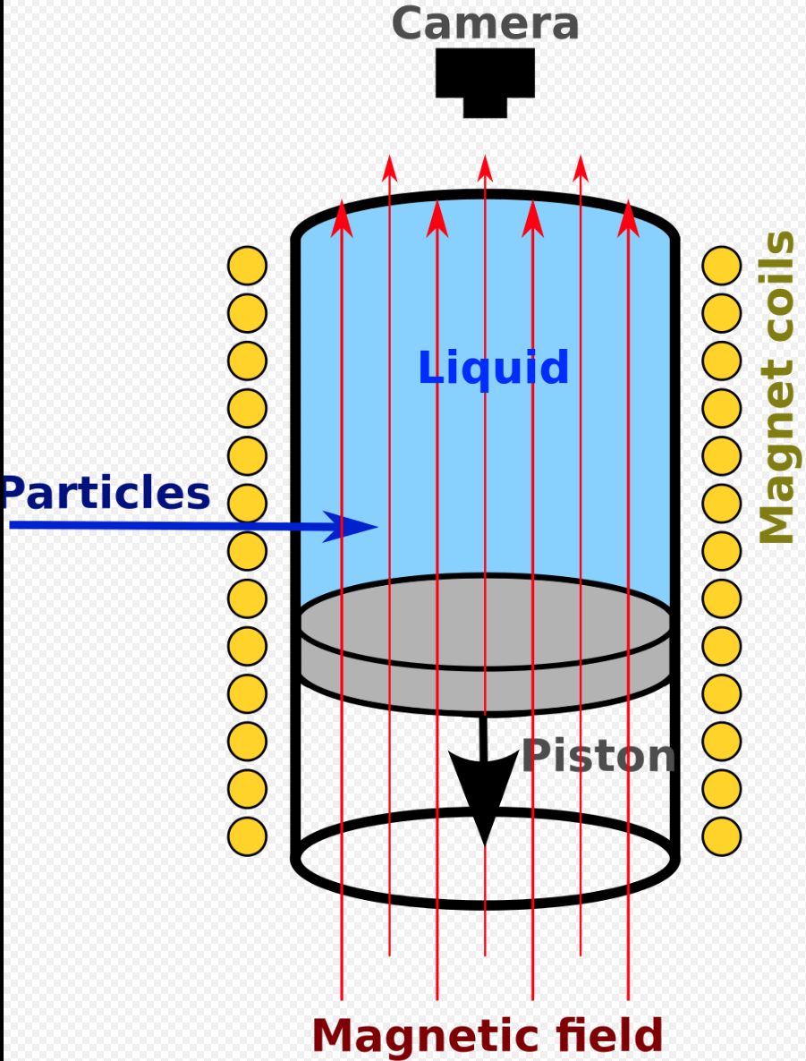
HEP experiments - past
S. Livingstone and E. Lawrence 69cm cyclotron

Slide 4
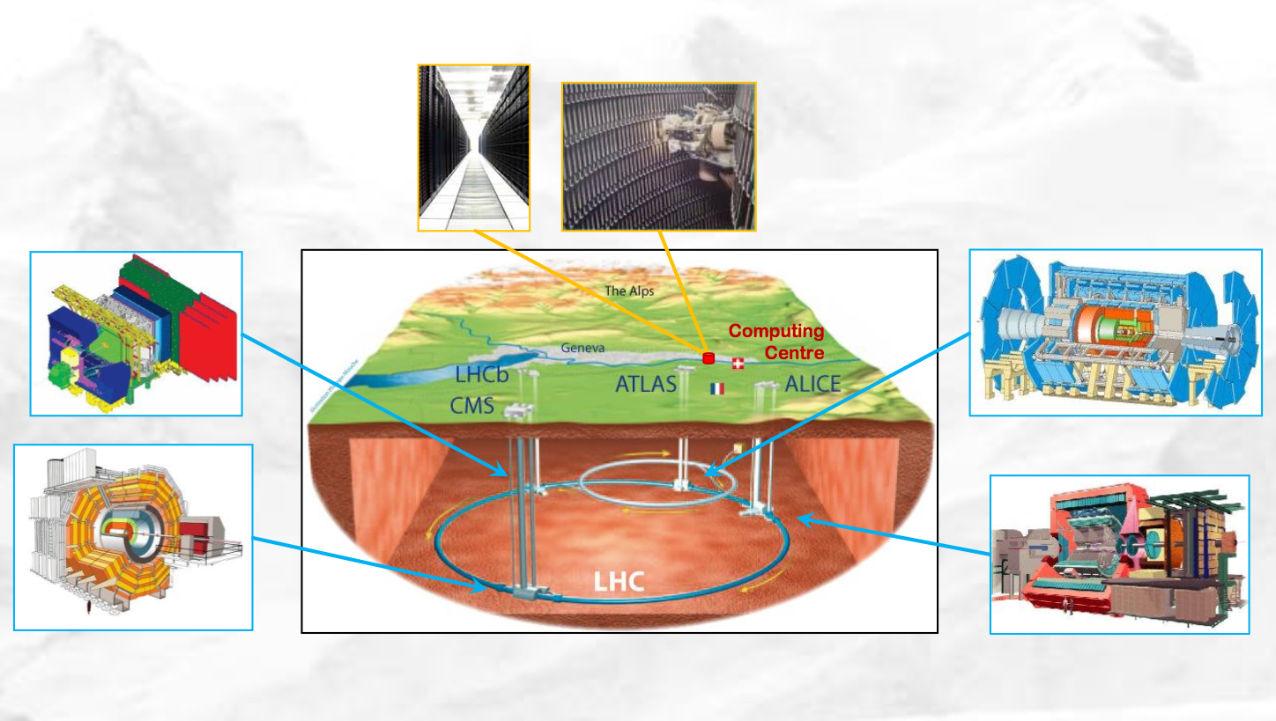
HEP experiments - present

Slide 5
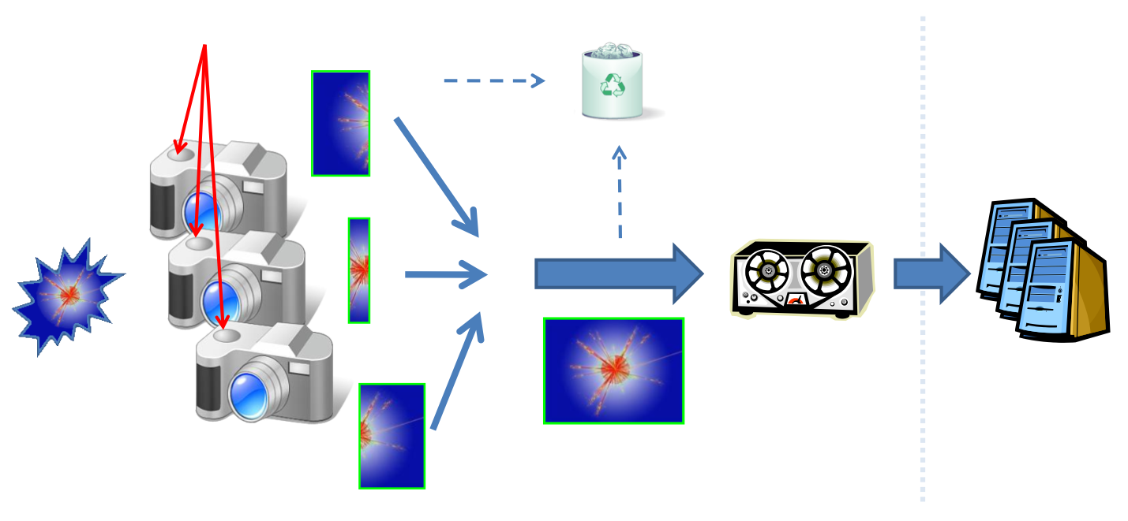
HEP experiments - present
Trigger
Collision
Detectors
Event
fragments
Full
event
Offline
analysis
Storage

Slide 6
Collisions at the LHC
Proton - Proton
2804 bunch/beam
Protons/bunch
10¹¹
Bunch
Beam energy
7 TeV (7x10¹² eV)
Luminosity
10³⁴cm⁻²s⁻¹
Proton
Crossing rate
40 MHz
Parton
(quark, gluon)
Collision rate ≈
10⁷-10⁹ Hz
l
Higgs
e
+
l
e
o
e
-
Particle
+
Z
Z
o
e
SUSY.....
jet
jet
-

Slide 7
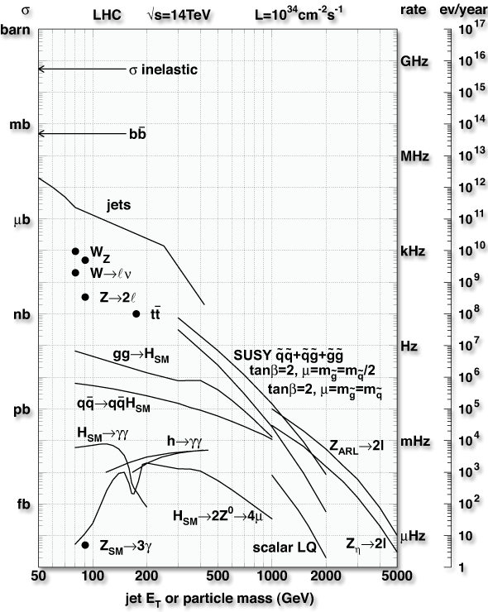
Physics selection at LHC
Cross sections of physics processes vary over many orders of magnitude
  Inelastic: 10⁹ Hz
  W→ l ν: 10² Hz
  t t production: 10 Hz
  Higgs (100 GeV/c²): 0.1 Hz
  Higgs (600 GeV/c²): 10^{–2} Hz
QCD background
  Jet E_{T} ~250 GeV: rate = 1 kHz
  Jet fluctuations → electron bkg
  Decays of K, π, b → muon bkg
Selection needed: 1:10^{10–11}

Slide 8
Physics Selection at LHC

Slide 9
Processing Stages
trigger,
event selection
Event Summary
Data (ESD)
processed
data
detector
batch
physics
analysis
raw
data
Analysis Object Data (AOD)
(extracted by physics topic)
event
reconstruction
event
simulation
individual
physics
analysis

Slide 10
Physics software
The scientific software needed to process this huge amount of data from the LHC detectors is developed by the LHC collaborations
  Must cope with the unprecedented conditions and challenges (trigger rate, data volumes, etc.)
  Each collaboration has written millions of lines of code
Modern technologies and methods
  Object-oriented programming languages and frameworks
  Re-use of a number of generic and domain-specific ‘open-source’ packages
The organization of this large software production activity is by itself a huge challenge
  Large number of developers distributed worldwide
  Integration and validation require large efforts

Slide 11
Processing Stages - Trigger
trigger,
event selection
Event Summary
Data (ESD)
processed
data
detector
batch
physics
analysis
raw
data
Analysis Object Data (AOD)
(extracted by physics topic)
event
reconstruction
event
simulation
individual
physics
analysis

Slide 12
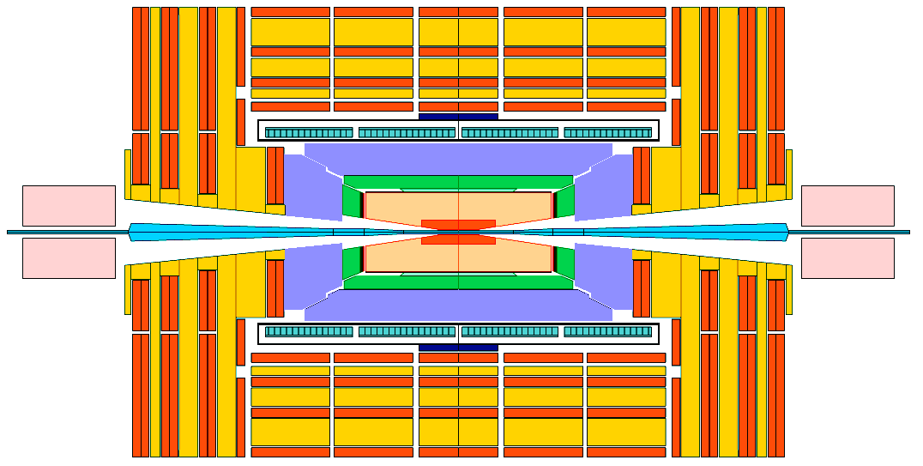
Trigger
Task: inspect detector information and provide a first decision on whether to keep the event or throw it out
The trigger is a function of event data, detector conditions and parameters
T
(
)
REJECTED
ACCEPTED
Detector data not (all) promptly available
Selection function highly complex
⇒T(...) is evaluated by successive approximations
TRIGGER LEVELS

Slide 13
Trigger Levels
Level-1
  Hardwired processors (ASIC, FPGA, …)
  Pipelined massive parallel
  Partial information, quick and simple event characteristics (pt, total energy, etc.)
  3-4 µs maximum latency
Level-2 (optional)
  Specialized processors using partial data
High Level
  Software running in processor farms
  Complex algorithms using complete event information
  Latency at the level of fractions of second
  Output rate adjusted to what can be afforded
~ 1:10⁴
~ 1:10¹
~ 1:10²

Slide 14
Trigger Levels and Rates
Detectors
Lvl-1
Front end pipelines
Lvl-2
Readout buffers
Switching network
HLT
Processor farms
“Traditional”: 3 physical levels

Slide 15
Processing Stages - Reconstruction
trigger,
event selection
Event Summary
Data (ESD)
processed
data
detector
batch
physics
analysis
raw
data
Analysis Object Data (AOD)
(extracted by physics topic)
event
reconstruction
event
simulation
individual
physics
analysis

Slide 16
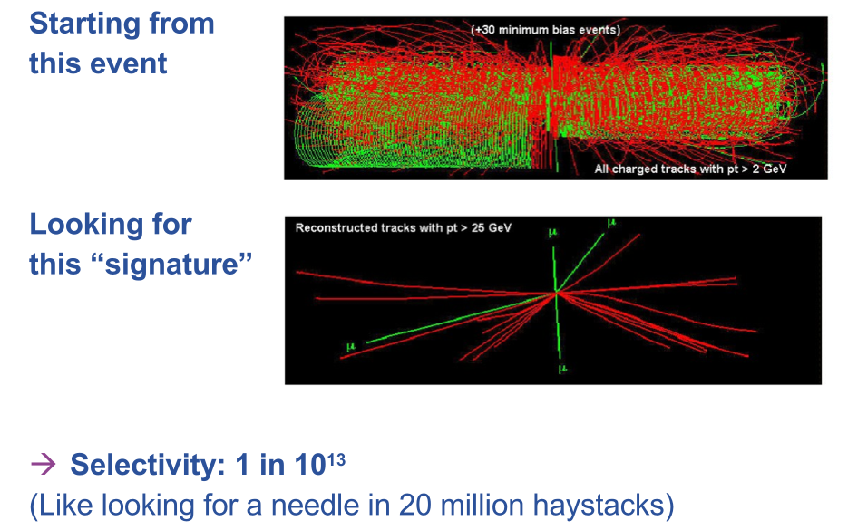
The Reconstruction challenge

Slide 17
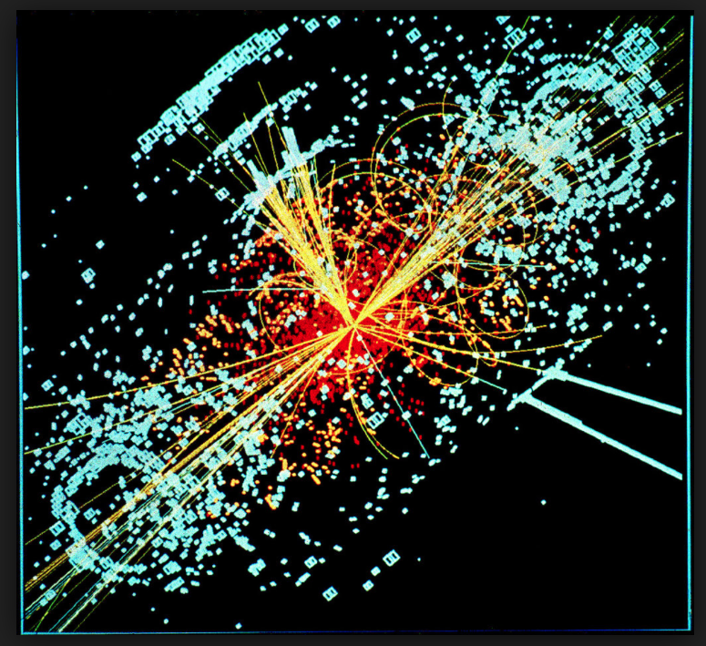
What is reconstruction
Tracker ‘hits’ form a puzzle
  Which tracks created them?
Each energy deposition is a clue
  There are thousands of measurements in each snap-shot
The experiment’s reconstruction must obtain a solution!
  In well measured magnetic field
  Matches the traces to tracks

Slide 18
How it works – a simple example
Start with the locations of the traces on first two planes
Magnetic field
Β

Slide 19
How it works – a simple example
Start with the locations of the traces on first two planes
Try different combinations
  Project to subsequent planes
  Calculate differences between measured positions and ‘predictions’
(Kalman filter)

Slide 20
How it works – a simple example
Start with the locations of the traces on first two planes
Try different combinations
  Project to subsequent planes
  Calculate differences between measured positions and ‘predictions’
Finally the candidate tracks are identified
  else look ‘quickly’ for the straight(er) ones – high energy tracks
P= 11 GeV/c
P= 22 GeV/c
P= 7.5 GeV/c

Slide 21
Detector conditions data
Reflects changes in state of the detector with time
Event Data cannot be reconstructed or analyzed without it
Versioning
Tagging
Ability to extract slices of data required to run with job
Long life-time
Version
Time
VDET alignment
HCAL calibration
RICH pressure
ECAL temperature
t1
t2
t3
t4
t5
t6
t7
t8
t9
t10
t11
Data Item
Time = T

Slide 22
Online and offline reconstruction
Are collisions first-tagged really interesting enough to keep (given capacity constraints)?
  Online reconstruction – seek to reconstruct ‘as much as you can’ quickly to enable decision
Critical part of experiment – collisions which are not recorded are lost
Later there is more time to reconstruct the contents of a collision – but this is also complex

Slide 23
Processing Stages - Analysis
trigger,
event selection
Event Summary
Data (ESD)
processed
data
detector
batch
physics
analysis
raw
data
Analysis Object Data (AOD)
(extracted by physics topic)
event
reconstruction
event
simulation
individual
physics
analysis

Slide 24
Data analysis
Uses the results of Reconstruction
  the products are reconstructed tracks, Energy deposits (calorimeters)
  Hierarchy of data from original (RAW), to summary (AOD)
An experiment’s physics teams use the (large) pool of data
  No longer in one central location, but in multiple locations (cost, space of building, computers, disks, network) .... using the GRID

Slide 25
Event bookkeeping
Run Data
Event 1
Event 2
…
Event 3
Run Data
Event 1
Event 2
…
Event 3
Bookkeeping
Run Data
Event 1
Event 2
…
Event N
Run Catalogue
Physics : Run 21437
MC: B -> π π
MC: B -> J/Ψ (μ⁺ μ⁻)
…
Collection Catalogue
B -> ππ Candidates (Phy)
B -> J/Ψ (μ⁺ μ⁻) Candidates
…
Dataset
Event 1
Event 2
…
Event 3
Dataset
Event 1
Event 2
…
Event 3
Event tag collection
Tag 1 5 0.3
Tag 2 2 1.2
…
Tag M 8 3.1

Slide 26
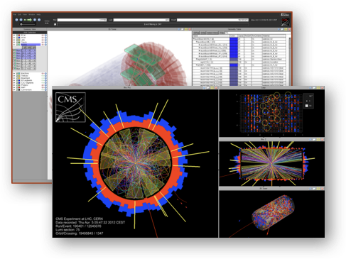
ROOT
“At the root of the experiments”, project started in 1995
Open Source project (LGPL3)
  mainly written in C++; 4 MLOC
ROOT provides (amongst other things):
  C++ interpreter
  Efficient data storage mechanism; 177 PB LHC data stored in ROOT
  Advanced statistical analysis algorithms
    histogramming, fitting, minimization, statistical methods …
  Scientific visualization: 2D/3D graphics, PDF, Latex
  Geometrical modeler
  PROOF parallel query engine

Slide 27
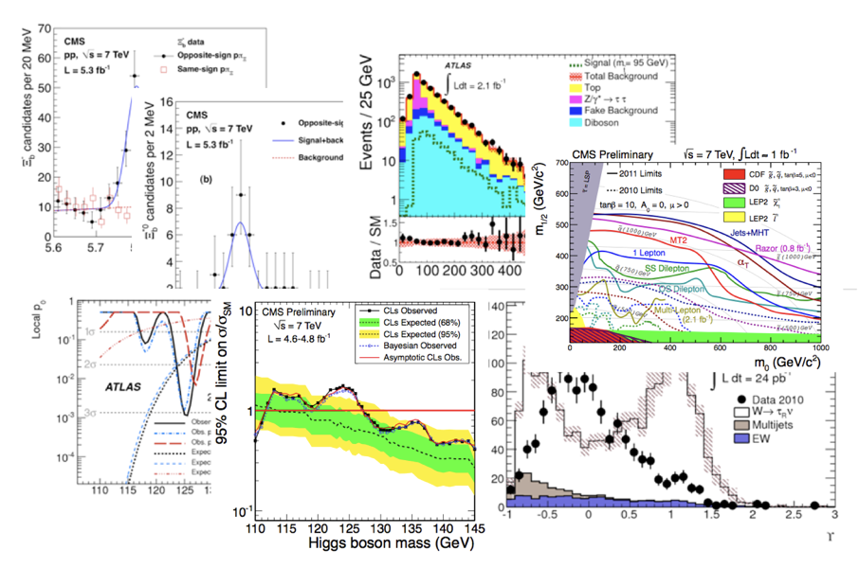
ROOT in plots

Slide 28
Processing Stages - Simulation
trigger,
event selection
Event Summary
Data (ESD)
processed
data
detector
batch
physics
analysis
raw
data
Analysis Object Data (AOD)
(extracted by physics topic)
event
reconstruction
event
simulation
individual
physics
analysis

Slide 29
What is simulation?
simulation = doing ‘virtual’ experiment
take all the known physics
start from your ‘initial condition’ (two protons colliding)
calculate the ‘final state’ of your detector to get the ‘experimental’ results
  solve equations of motion, etc
IMPOSSIBLE to be done analytically

Slide 30
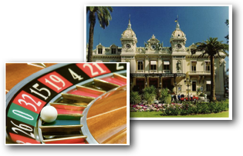
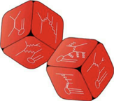
Monte Carlo simulation
What is Monte Carlo?
  Throwing random numbers
    to calculate integrals
    to pick among possible choices
Why Monte Carlo?
  complexity of the problem
  lack of analytical description
  need of randomness like in nature
    Quantum mechanics: amplitudes => probabilities
      Anything that possibly can happen, will! (but more or less often)
    Want to generate events in as much detail as Mother Nature
      get average and fluctuations right
      make random choices, ∼as in nature

Slide 31
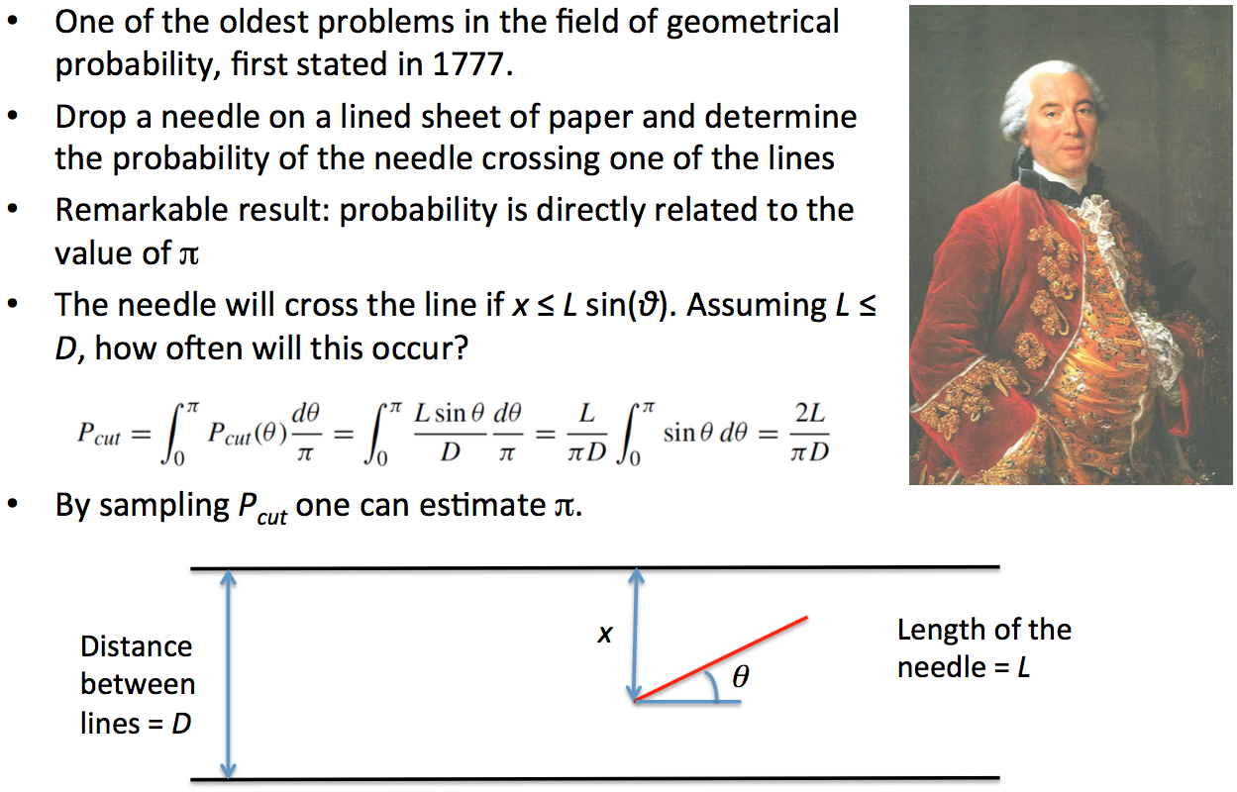
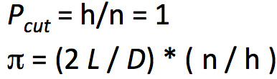
Buffon’s Needle

Slide 32
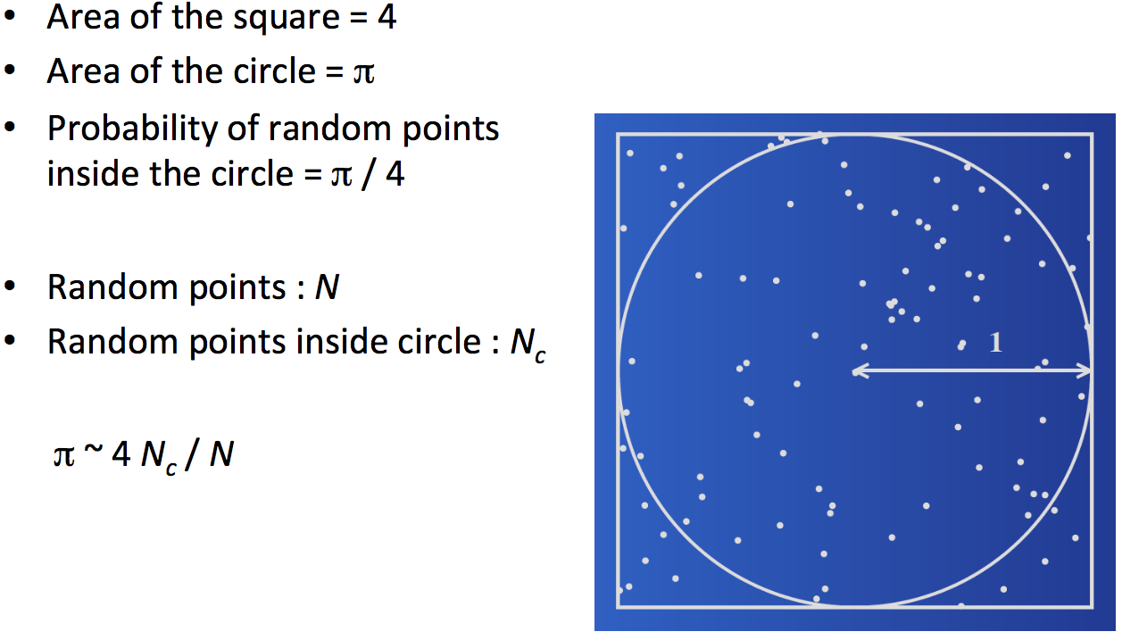
Laplace method of calculating π (1886)

Slide 33
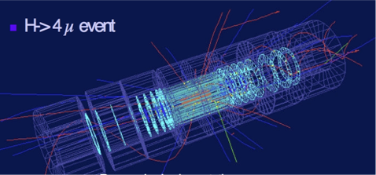
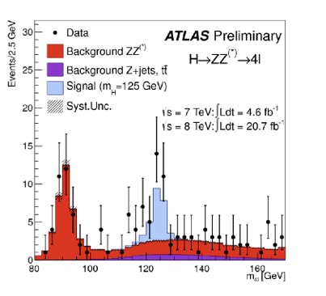
Why do we need simulation?
to design the apparatus (detector) to fulfill its role
to prepare the reconstruction and analysis of results
  training on ‘known’ (simulated) events
to understand the results
  we need to know what to expect to
    verify existing models
    find new physics

Slide 34
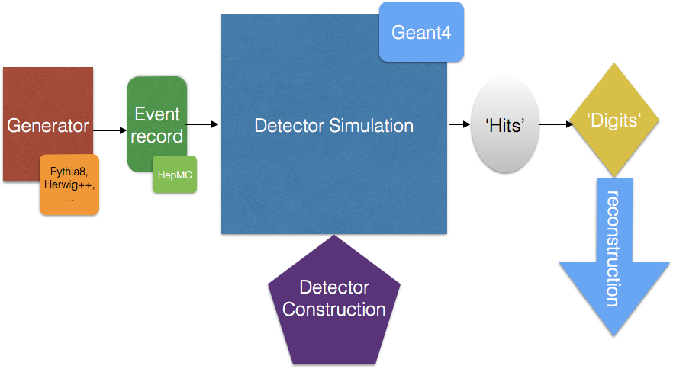
Simulation chain for HEP experiments

Slide 35
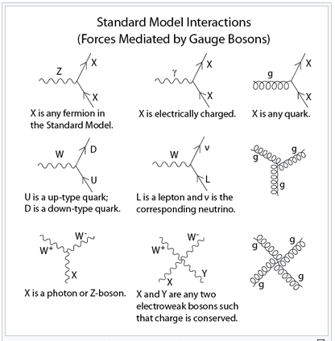
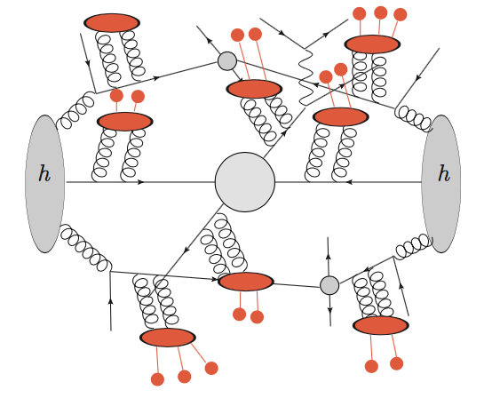
Monte Carlo generators
simulate particles reaction in vacuum
  knows nothing about the surrounding detector
all Standard Model processes are included
no propagation of particles, just generation of the products of the ‘primary’ collision
the output of the ‘generators’ is the input to the ‘transport’ code

Slide 36
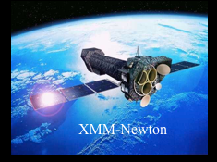
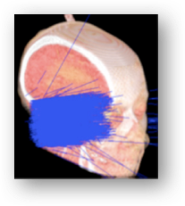
Transport Code: Geant4
Geant4 is a toolkit (C++) for the simulation of the passage of particles through matter.
Its areas of application include high energy, nuclear and accelerator physics, as well as studies in medical and space science
In HEP has been successfully employed for
  Detector design
  Calibration/alignment
  Data analysis

Slide 37
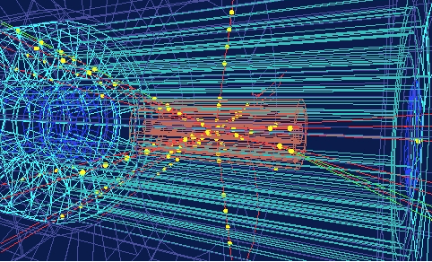
What does Geant4 do?
‘propagates’ particles through geometrical structures of materials, including magnetic field
simulates processes the particles undergo
  creates secondary particles
  decays particles
calculates the deposited energy along the trajectories and allows to store the information for further processing (‘hits’)

Slide 38
Simulation ingredients
Silicon
Tracker
we model
  Detector’s Geometry
    Shape, Location, Material
  Physics interactions
    All known processes
      Electromagnetic
      Nuclear (strong)
      Weak (decay
we ‘shoot’ particles and ‘propagate’ them through the modeled detector
2.5 MeV e⁻
σ_{total} = Σ σ_{per-interaction}
electron

Slide 39
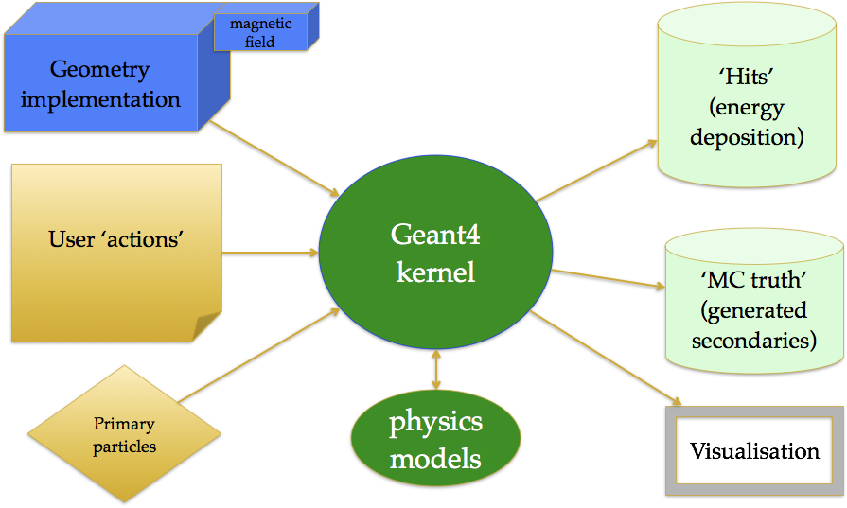
Geant4 application

Slide 40
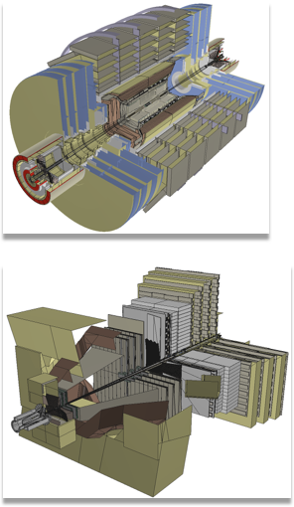
Geometry and Materials
How to implement (efficiently) this in your computer program?
You need ‘bricks’
  ‘solids’, ‘shapes’
  you need to position them
  you want to ‘reuse’ as much as possible the same ‘templates’
Database of Materials
  National Institute of Standards (NIST)
Magnetic Fields
  numerical integration of the equation of motion (Runge-Kutta method)

Slide 41
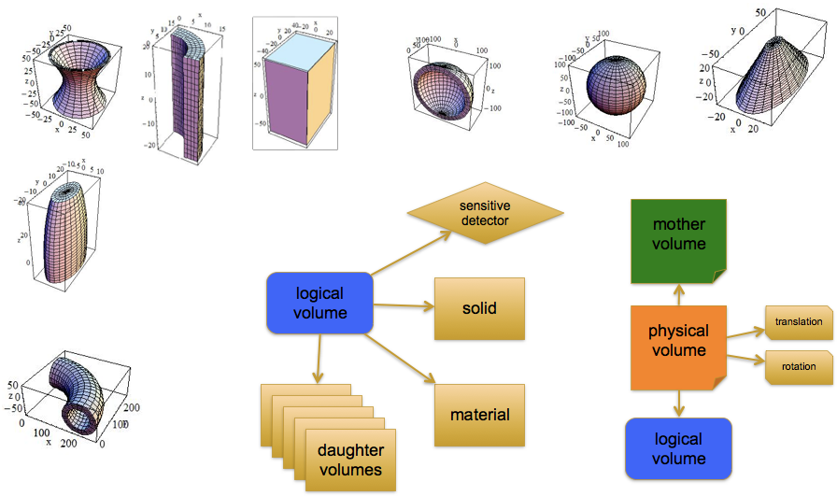
Geometry construction

Slide 42
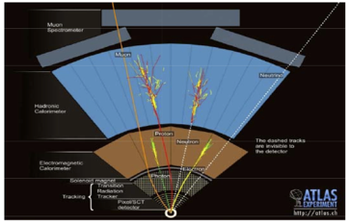
Physics…
What happens to particles in matter?
We want to model the physics we know
  each possible physics process provides the “interaction length” compared with distance to next geometrical boundary
    the smallest wins
  generating a “final state” and secondaries tracks
Electromagnetic
  gammas and charged particles
Hadronic
  neutrons, mesons (K,π), muons, ...
Because of the detailed geometries, the detailed physics and the required precision the simulation is very CPU hungry

Slide 43
Physics processes
models exist for different physics process
  none of the model is perfect
    sometimes different models for the same process cover different energy ranges
    tradeoff between precision and CPU
for example Electromagnetic processes include:
  Gammas:
    Gamma-conversion, Compton scattering, Photo-electric effect
  Leptons(e, μ), charged hadrons, ions
    Energy loss (Ionisation, Bremstrahlung) or PAI model energy loss, Multiple scattering, Transition radiation, Synchrotron radiation,
  Photons:
    Cerenkov, Rayleigh, Reflection, Refraction, Absorption, Scintillation
  high energy muons and lepton-hadron interactions

Slide 44
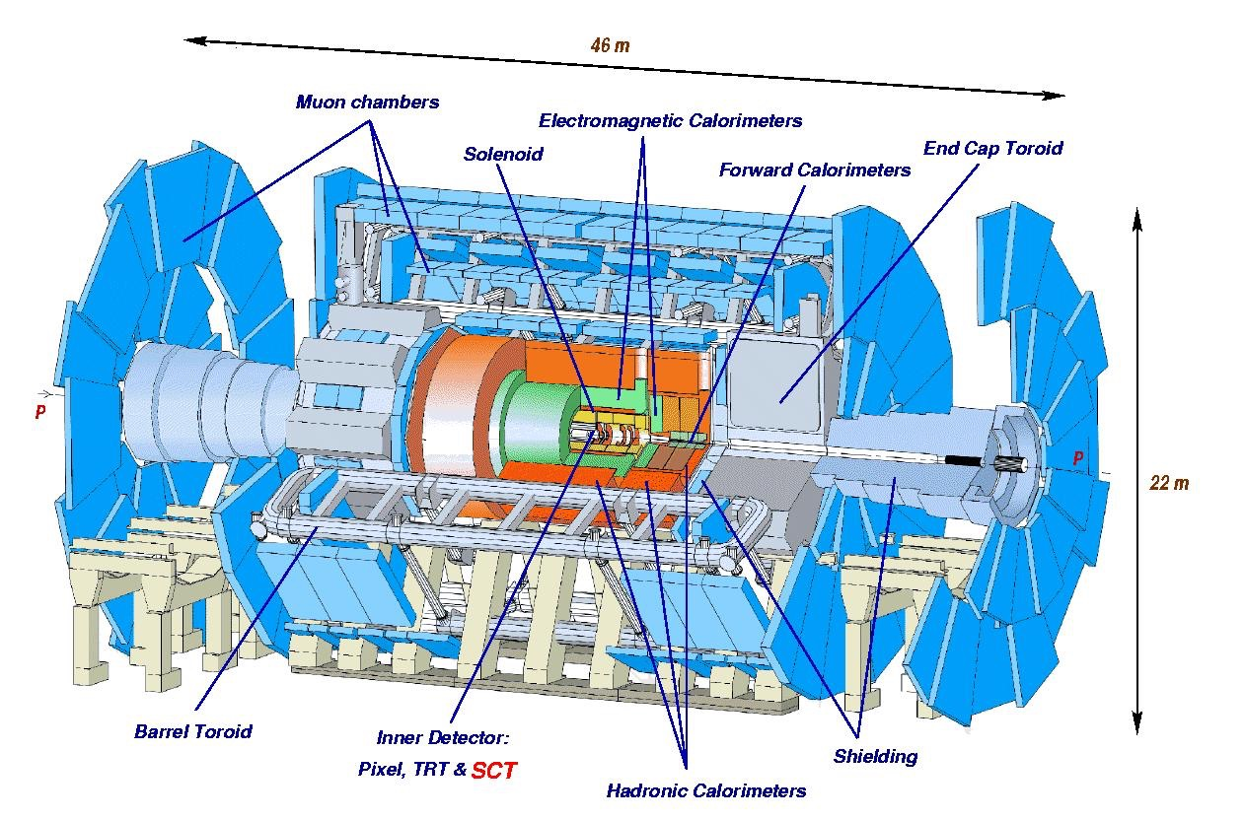
ATLAS

Slide 45
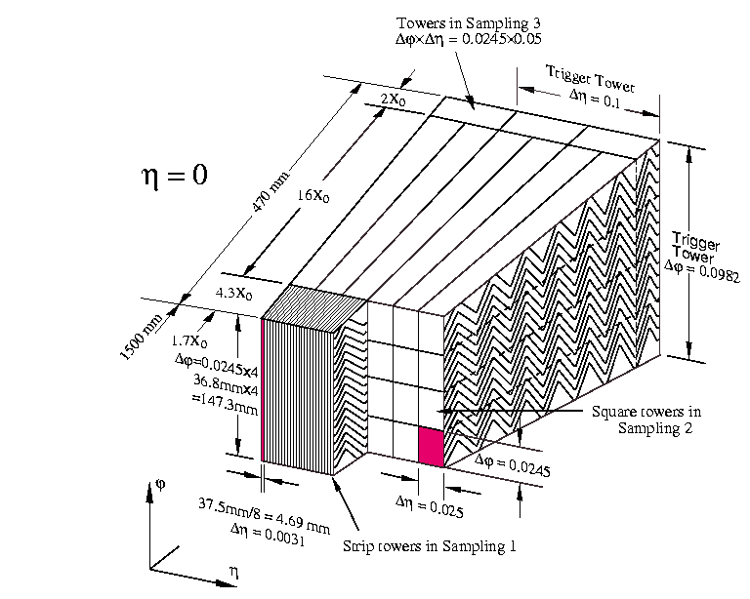
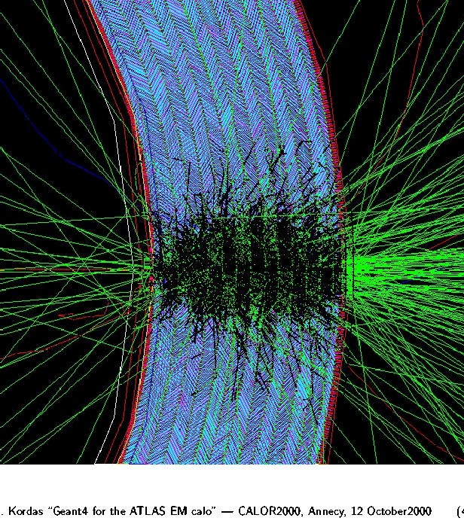
ATLAS Calorimeter (a very, very small part of it)

Slide 46
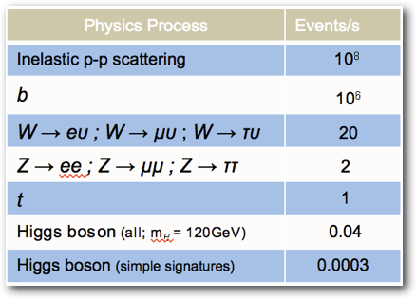
Data rates
Particle beams cross every 25 ns (40 MHz)
  Up to 25 particle collisions per beam crossing
  Up to 10⁹ collisions per second
Basically 2 event filter/trigger levels
  Hardware trigger (e.g. FPGA)
  Software trigger (PC farm)
  Data processing starts at readout
  Reducing 10⁹ p-p collisions per second to O(1000)
Raw data to be stored permanently: >15 PB/year
This is our Big Data problem!!

Slide 47
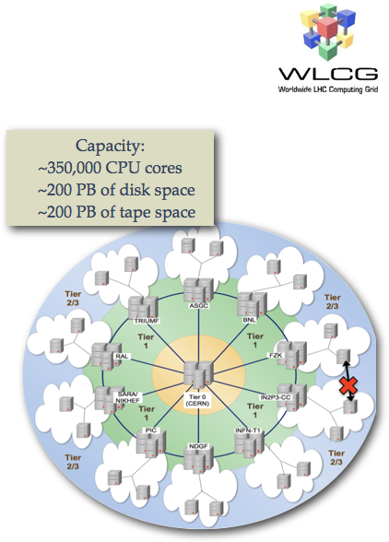
Big Data requires Big Computing
The LHC experiments rely on distributed computing resources:
  WLCG - a global solution, based on the Grid technologies/middleware.
    distributing the data for processing, user access, local analysis facilities etc.
    at time of inception envisaged as the seed for global adoption of the technologies
Tiered structure
  Tier-0 at CERN: the central facility for data processing and archival
  11 Tier-1s: big computing centers with high quality of service used for most complex/intensive processing operations and archival
  ~140 Tier-2s: computing centers across the world used primarily for data analysis and simulation.
So far computing was not a limiting factor for the Physics program of the LHC experiments

Slide 48
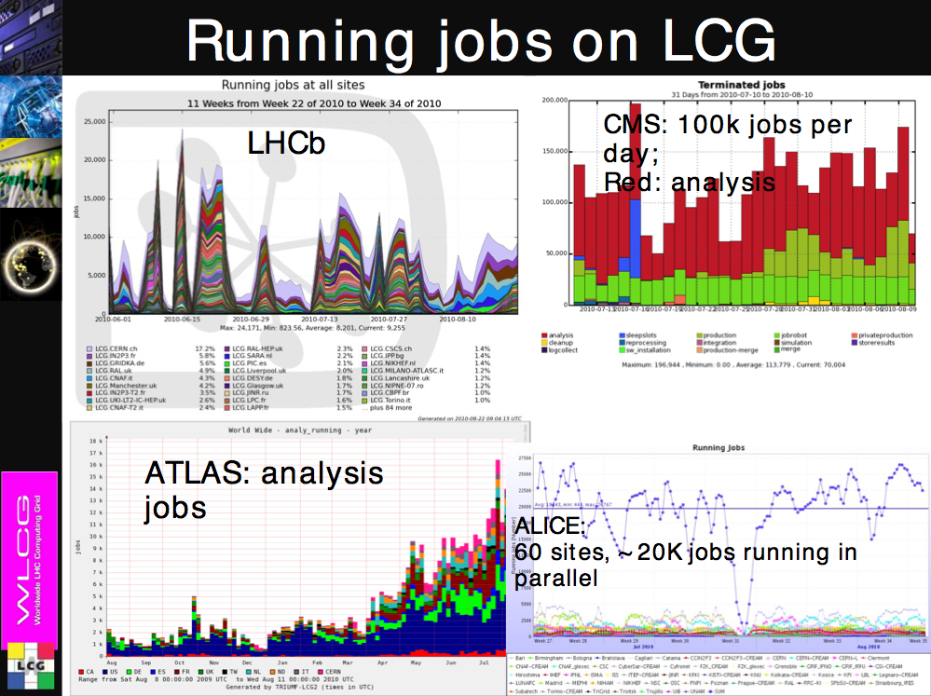
12 February 2016
J. Apostolakis

Slide 49
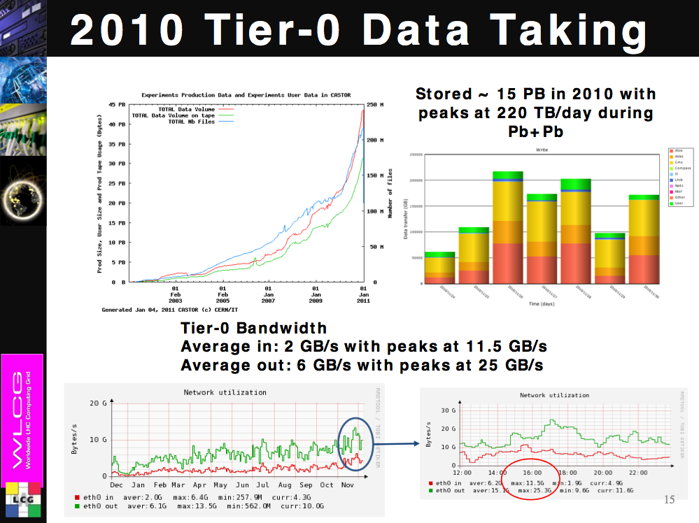
12 February 2016
J. Apostolakis

Slide 50
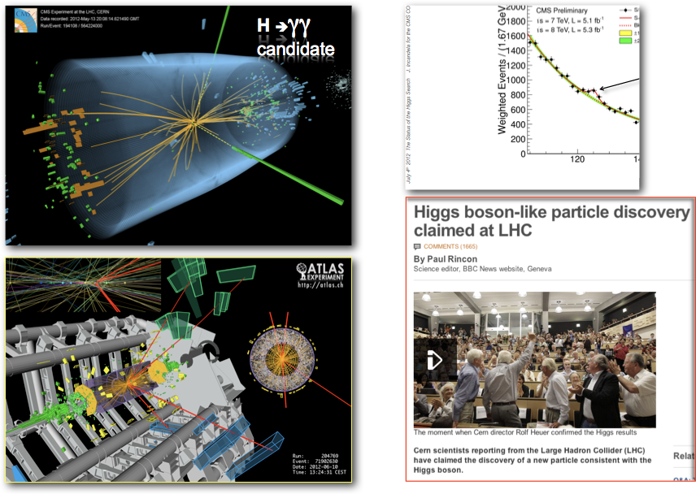
A Success Story!

Slide 51
Prospects for HEP Software
Potential gains can be made by exploiting features of todays CPUs’ micro architecture
  using vector registers, instruction pipelining, multiple instructions per cycle
  improving data and code locality and making use of hardware threading
New architectures to off-load large computations to accelerators (GPGPUs, Intel Xeon-Phi)
Today multi-core architectures employing O(10) cores are well exploited using a multi-process model (1 job/core).
However this performance will not scale to new generations of many-core architectures employing O(100) cores due to memory issues
  technical issues related to connecting many cores to shared memory
  memory footprint of HEP code is increasing due to increasing event complexity as the energy and luminosity of the LHC is increased

Slide 52
GeantV prototype
Transport particles in groups (vectors) rather than one by one
  Group particles by geometry volume or same physics
  No free lunch: data gathering overheads < vector gains
Dispatch SoA to functions with vector signatures
  Use backends to abstract interface: vector, scalar
  Use backends to insulate technology/library: Vc, Cilk+, VecMic, …
Redesign the library and workflow to target fine grain parallelism
  CPU, GPU, Phi, Atom, …
  Aim for a 3x-5x faster code, understand hard limits for 10x

Slide 53
Conclusion
modern HEP experiments would be impossible without computing
  online triggering and selection
  offline reconstruction, analysis and simulation
huge data volumes
distributed processing

