Slide 1
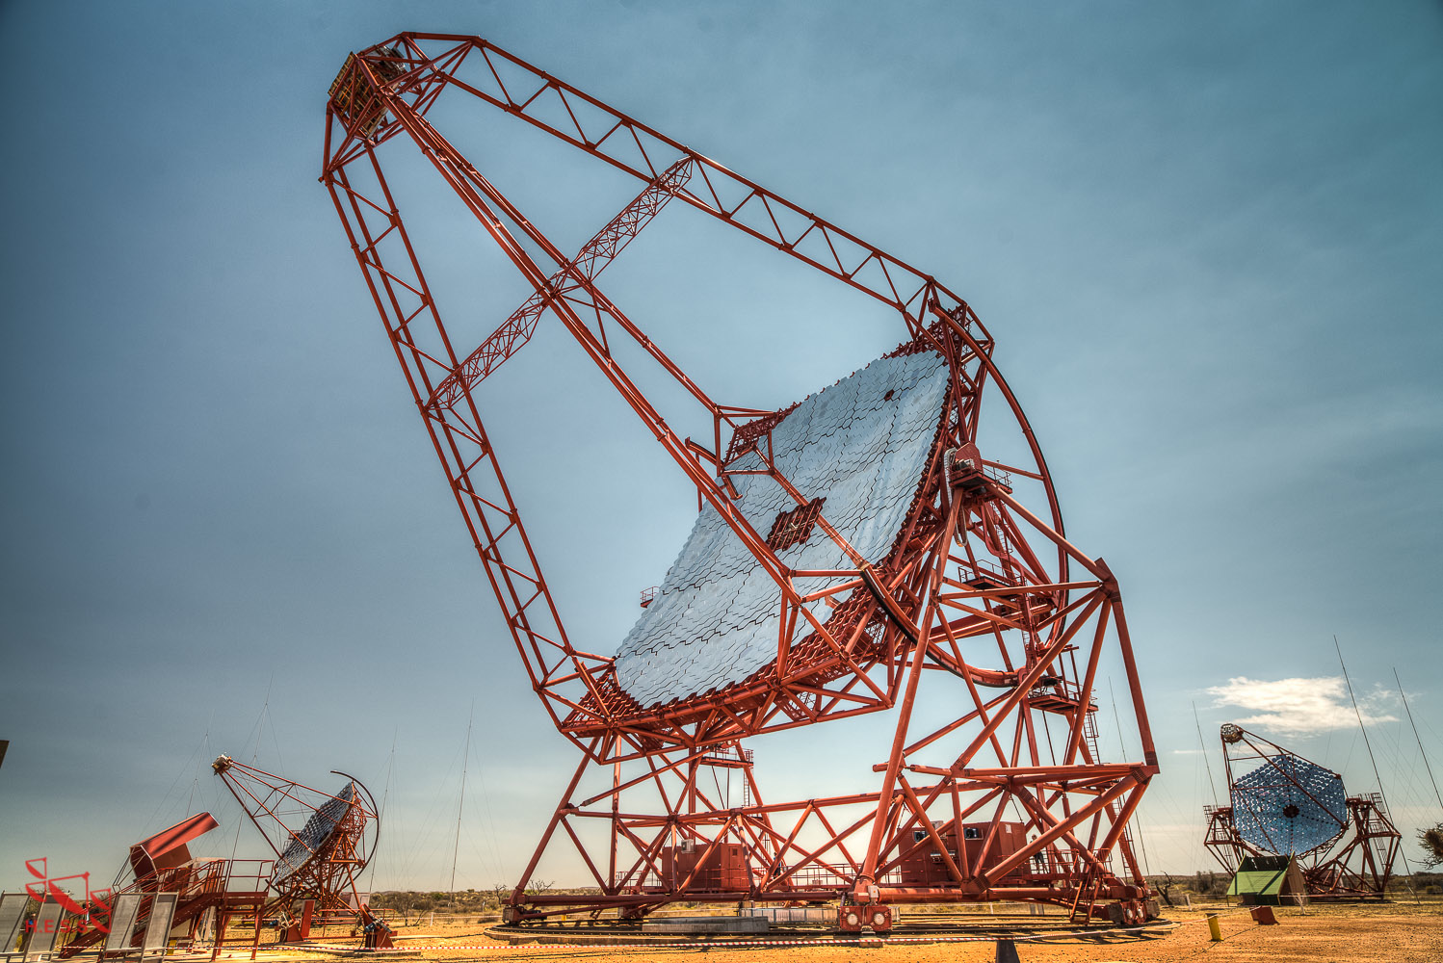
Multimessenger astrophysics
Studying the extreme Universe – recent trends and latest results
Stefan Ohm (DESY, Zeuthen)

Slide 2
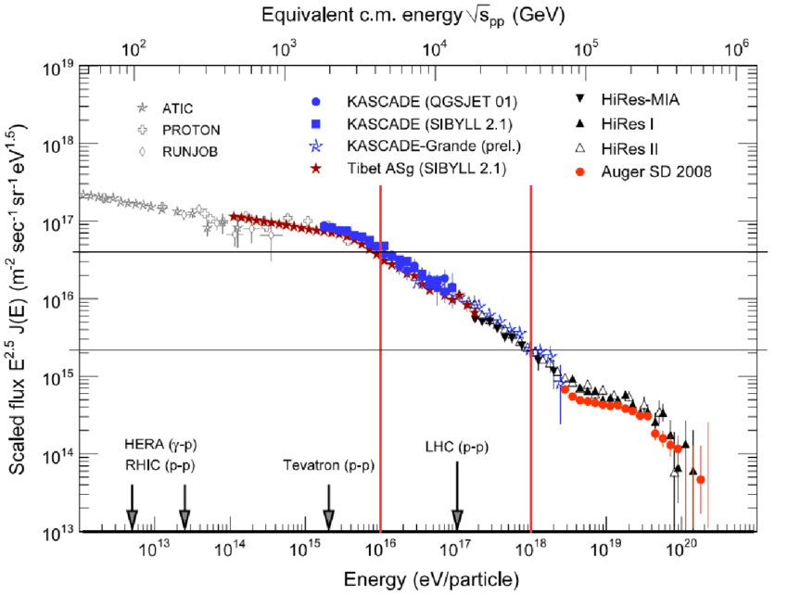
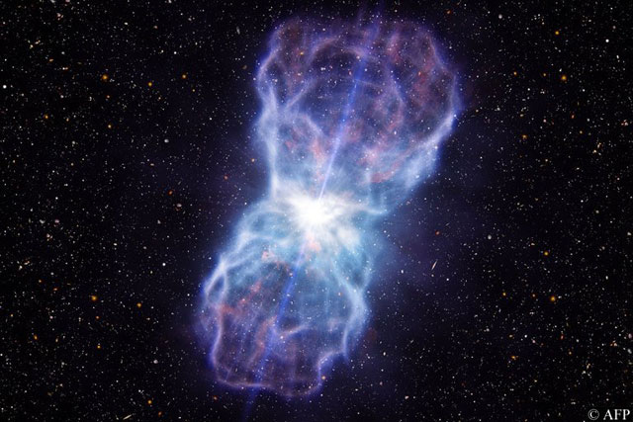
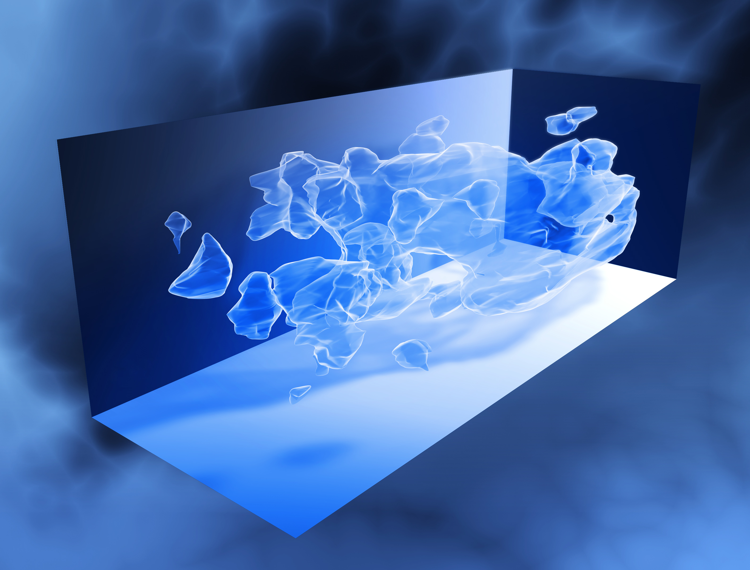
Astroparticle physics and the non-thermal Universe
Image Credit: COSMOS 3D team
Origin of cosmic rays?
Particle acceleration to 10²⁰ eV?
Impact of relativistic particles on evolution of the Universe?
Origin of astrophysical neutrinos?
Origin of dark matter?
Image Credit: Pierre-Auger Observatory
Notes:
Astroparticle physics is based at the interface between particle physics and astronomy. Almost always is astroparticle physics linked to non-thermal processes and extreme environments
The non-thermal Universe is full of unanswered questions ➝ some of them older than 100 years
Many of the questions are linked to the messenger itself, others can be answered with a different messenger (origin of CRs)

Slide 3
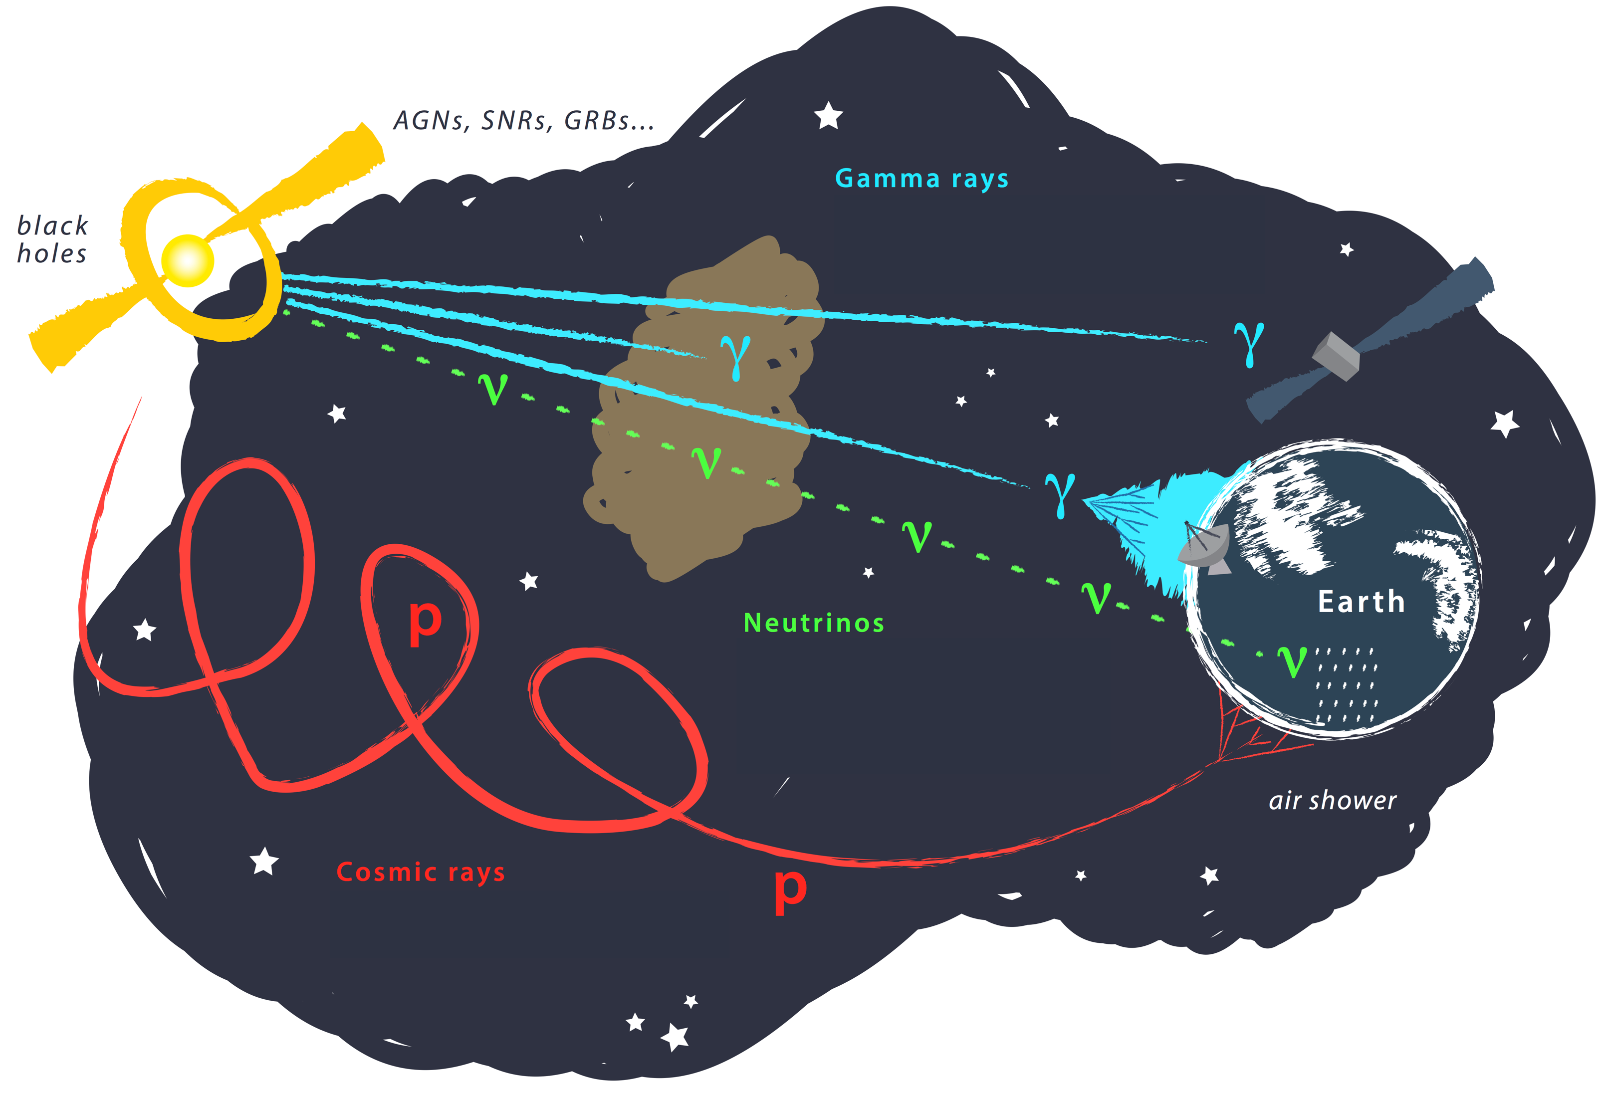
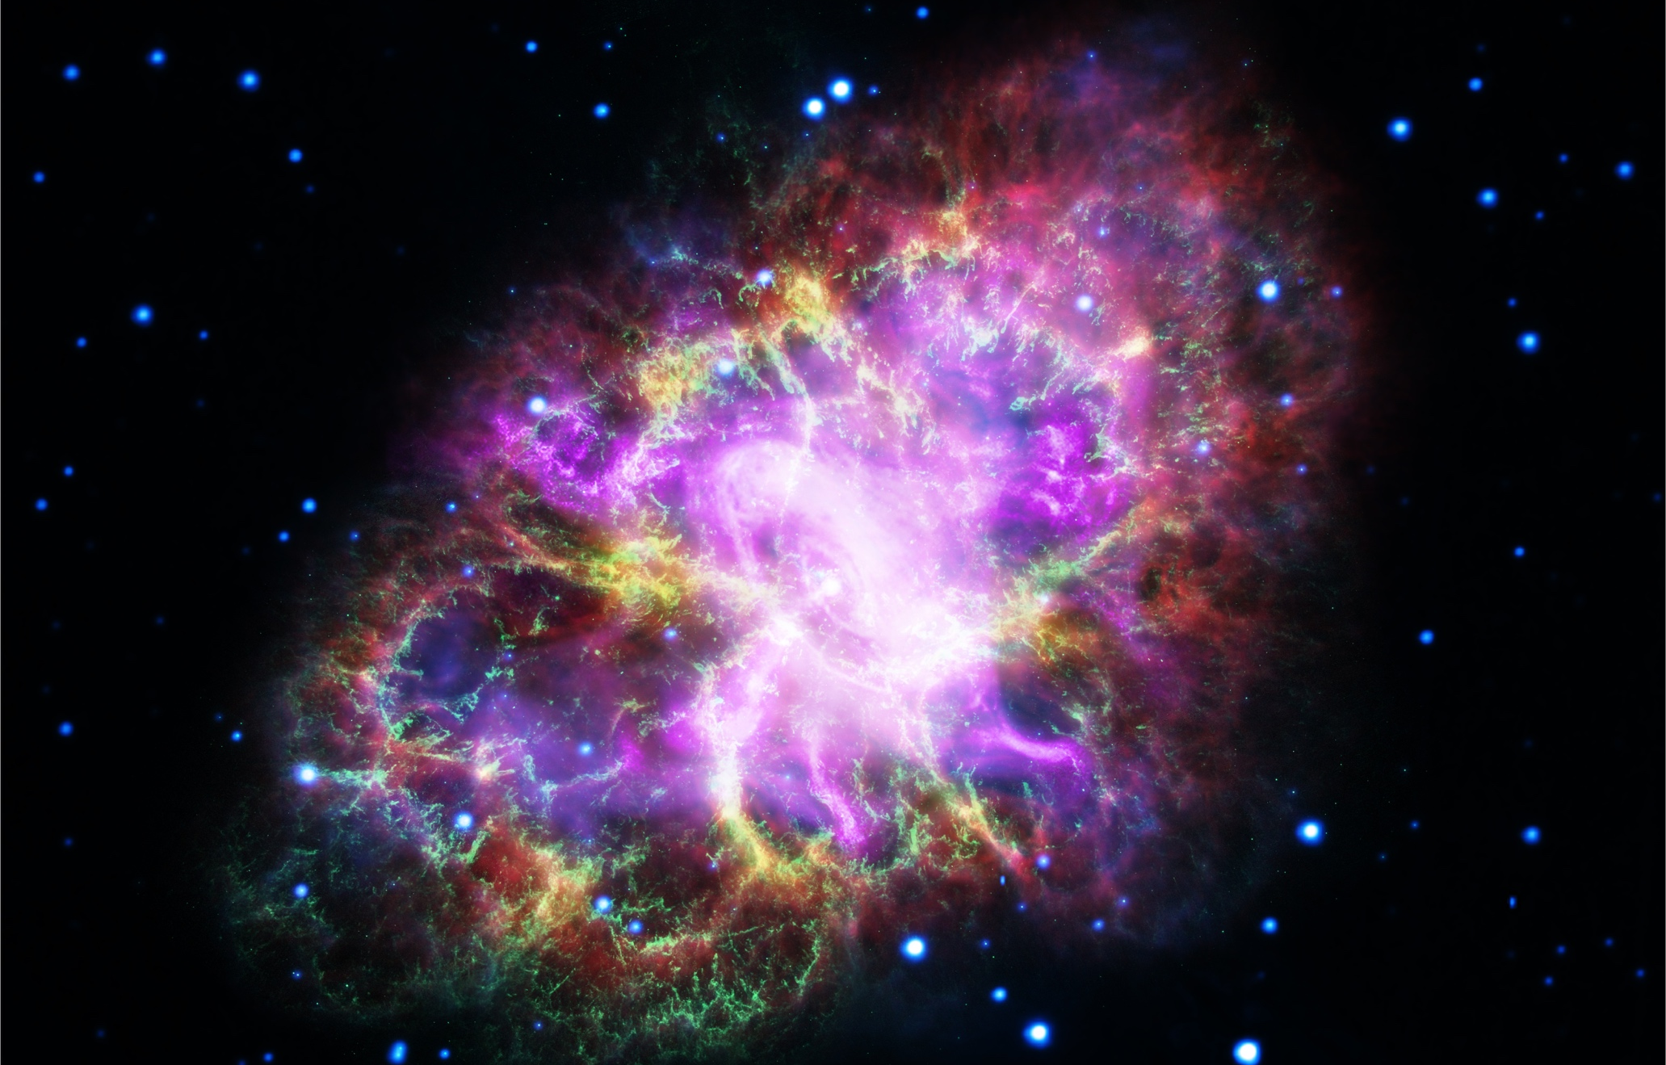
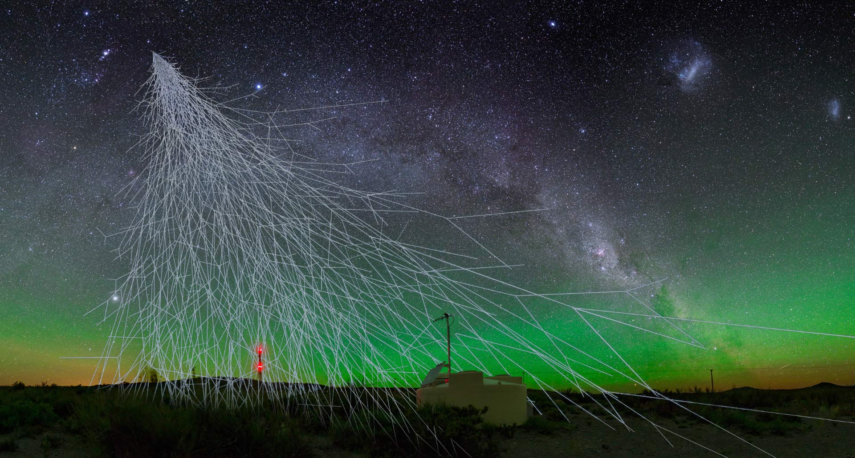
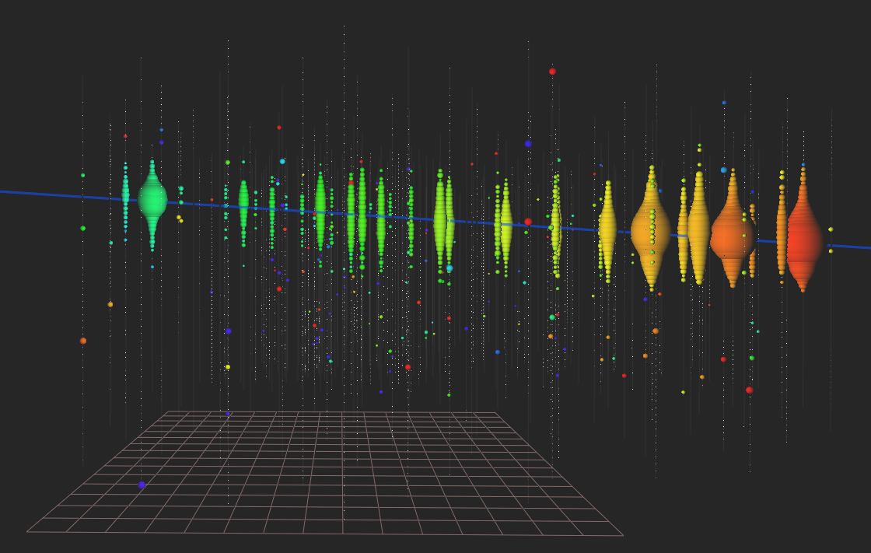
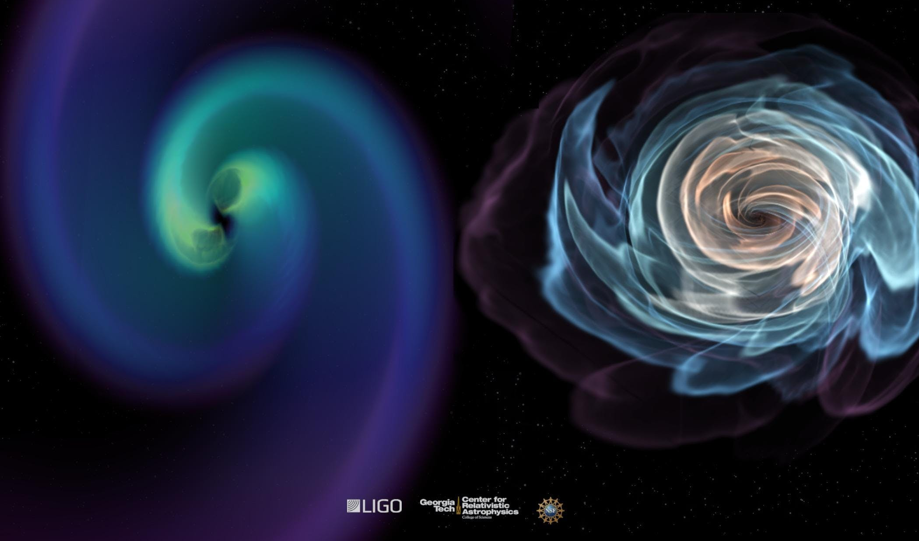
The Messengers
Gamma rays
Image Credit: NASA/ESA, STScl
Cosmic rays
Neutrinos
Gravitational waves
Est. ~1912
Est. 2013
Est. 2016
Credit: Pierre-Auger Observatory
Image Credit: IceCube
Image Credit: Pierre-Auger Observatory
Notes:
For instance, astrophysical particle accelerators can be studied in different wavelengths and with different messengers
Different messengers come with different observational properties
CRs reach the highest energies, but are deflected in magnetic fields
Neutrinos are unaffected from intervening matter and radiation, but are rare
Gamma rays are easy to detect, but are absorbed in the source and on the way to Earth
Gravitational Waves are unaffected, but hard to localize

Slide 4
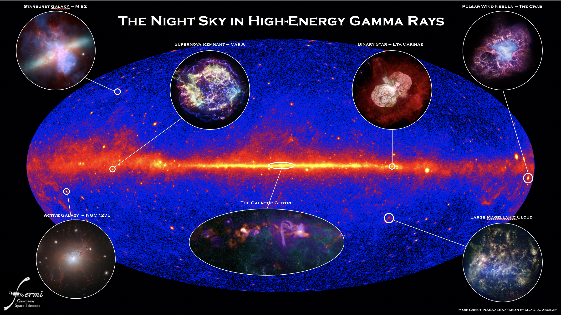
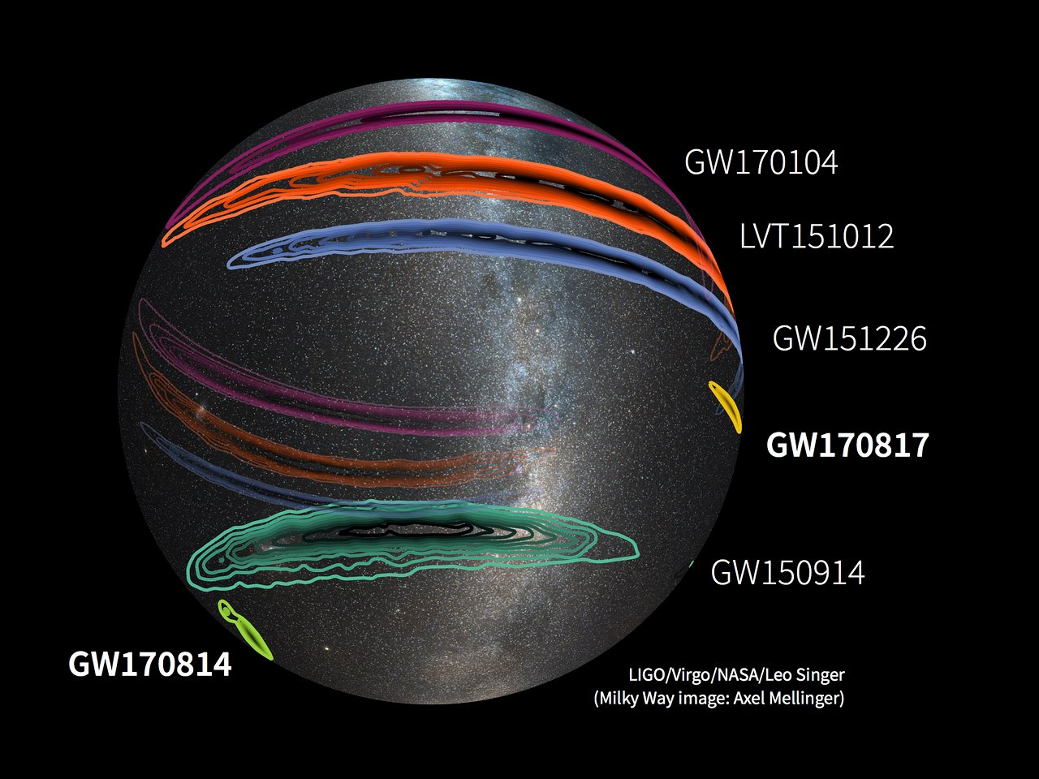
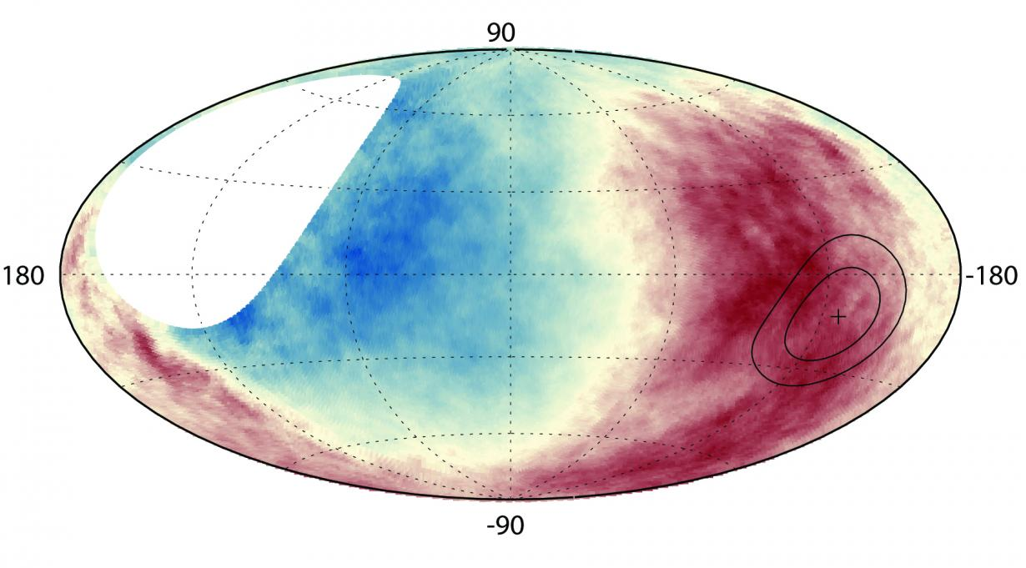
The Multimessenger sky
Gamma rays
Gravitational waves
Cosmic rays
Neutrinos
Image Credit: Pierre-Auger Observatory
Notes:
MM Astrophysics combines the information from more than one messenger
2 approaches:
Correlate events from different wavelengths or messengers ➝ allows to make statistical statements
Search for correlation in time and space
Transient science requires a somewhat different approach than normal astronomy (timescales, alert distribution, theoretical interpretation)

Slide 5
2017 / 2018
–
The multimessenger era starts

Slide 6
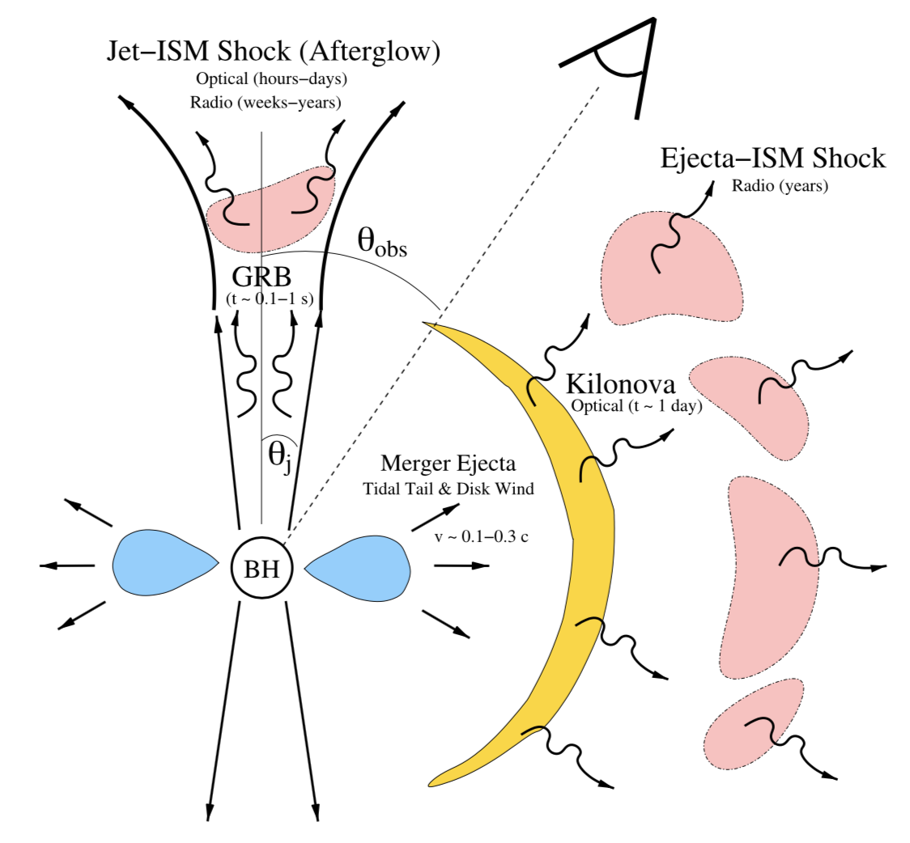
Binary neutron-star mergers
Expected electromagnetic emission
Binary NS mergers believed to be sources of GWs & progenitors of short GRBs
Prompt phase (0.1 – 2 seconds)
  Internal shocks in jet → particle acceleration
  Hard X-ray and soft gamma-ray production
Delayed phase (hours to days to years)
  Optical and radio emission from jet-ISM interaction
Baiotti & Rezzolla (2017, pre-GW170817)

Slide 7
Binary neutron-star mergers
Expected electromagnetic emission
Binary NS mergers believed to be sources of GWs & progenitors of short GRBs
Prompt phase (0.1 – 2 seconds)
  Internal shocks in jet → particle acceleration
  Hard X-ray and soft gamma-ray production
Delayed phase (hours to days to years)
  Optical and radio emission from jet-ISM interaction
  Optical emission from Kilonova
  Sub or trans-relativistic speeds of ejecta
  Ejected energy of 10⁴⁸ – 10⁵⁰ erg
➝ Optical, IR and UV emission from Kilonova
➝ Good conditions for particle acceleration
➝ Predicted radio and X-ray emitters
Baiotti & Rezzolla (2017, pre-GW170817)

Slide 8
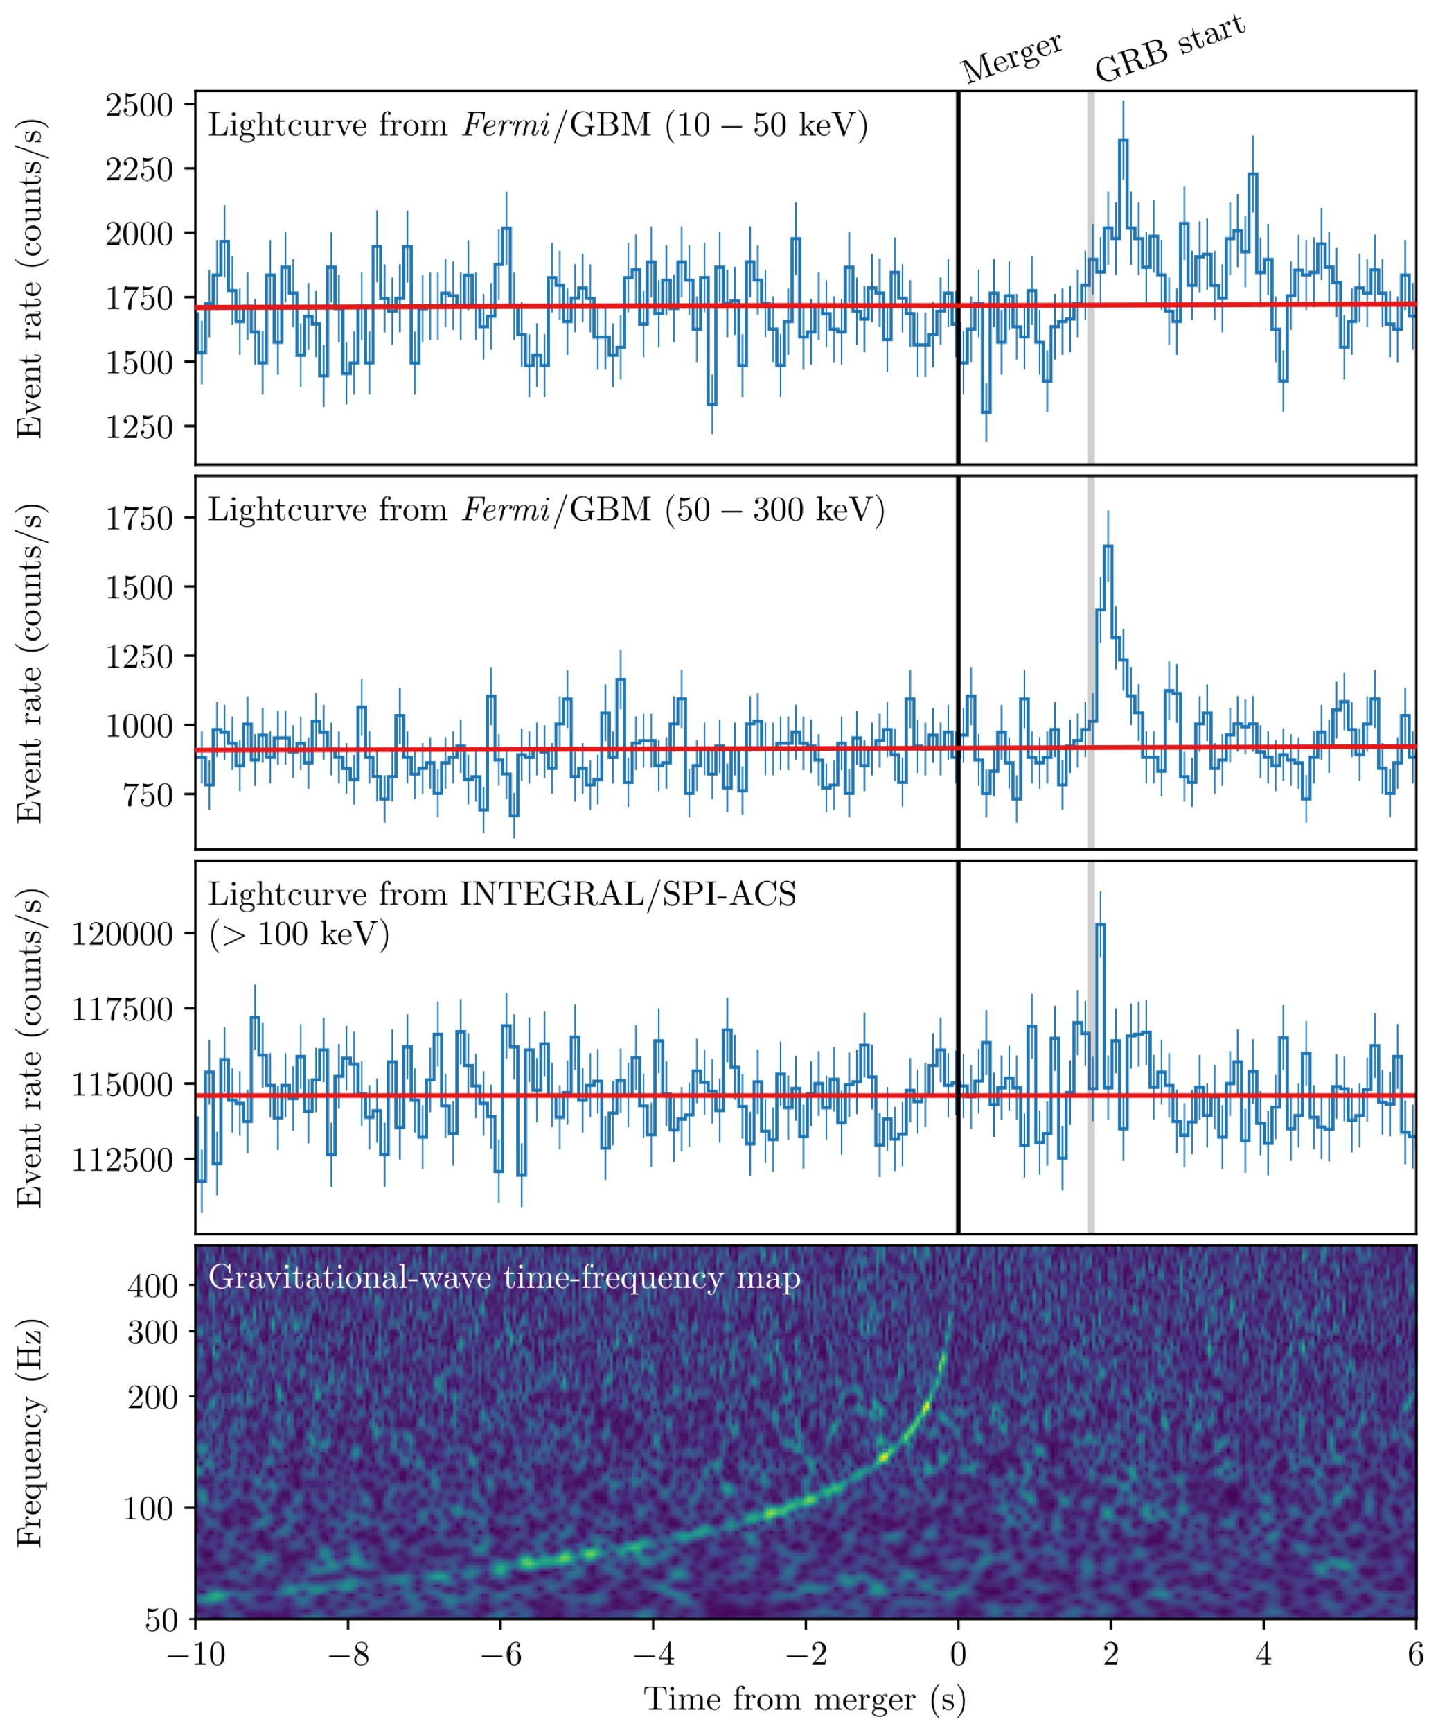
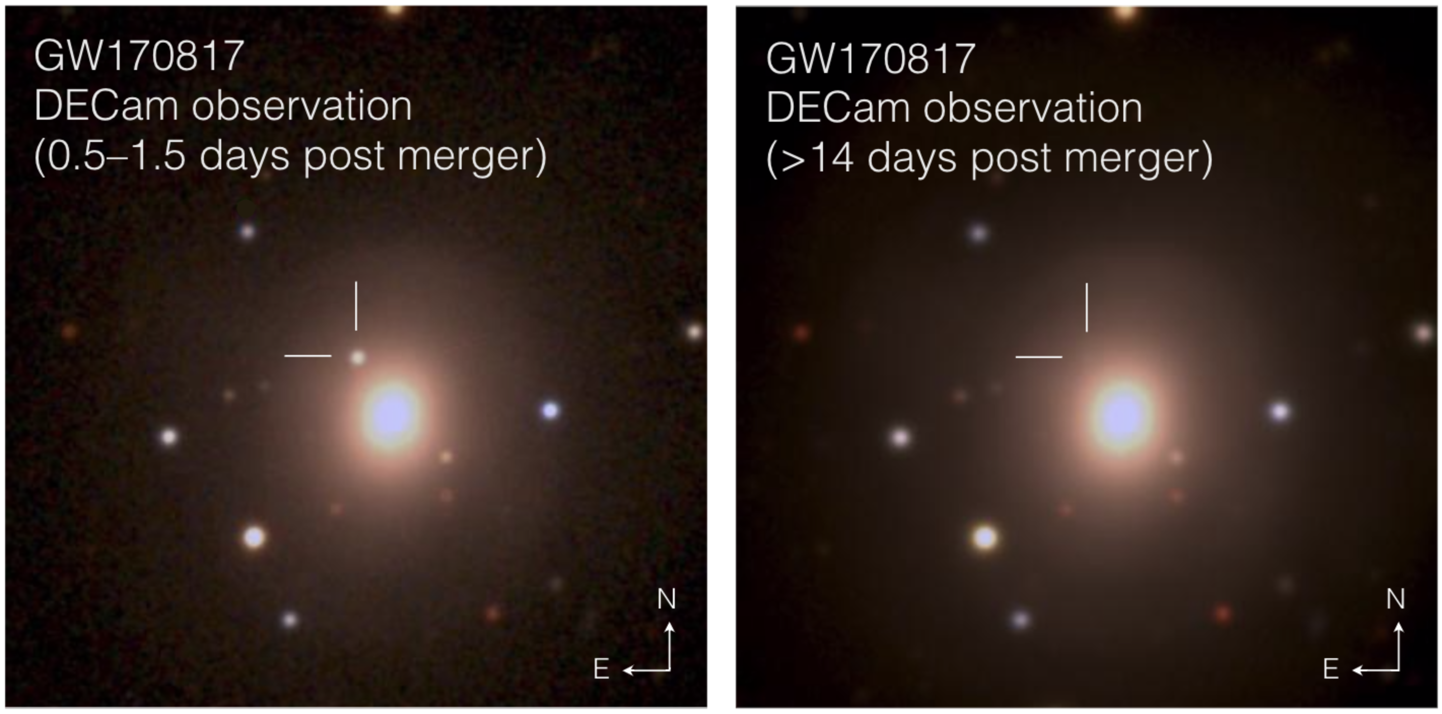
GW/EM170817
Gravitational Wave detection
  August 17th 2017: GW detected in both LIGO detectors
  Automatic classification algorithms suggest NS-NS merger
  Alert distributed to partners ~5 hours after inital detection
Multiwavelength / Multimessenger follow-up
  GRB signal detected in Fermi-GBM and INTEGRAL 2s after
  Largest astronomical follow-up campaign of all times (⅓ of worldwide community)
  Counterpart detected in optical, UV, infrared
  Gamma rays produced in shock-breakout in this scenario
  r-process elements forged in ejected material hours after merger
Abbott et al. (2017)
Soares-Santos et al. and
DES team
Notes:
Localisation is crucial (scanning follow-up or wide field-of-view instruments)

Slide 9
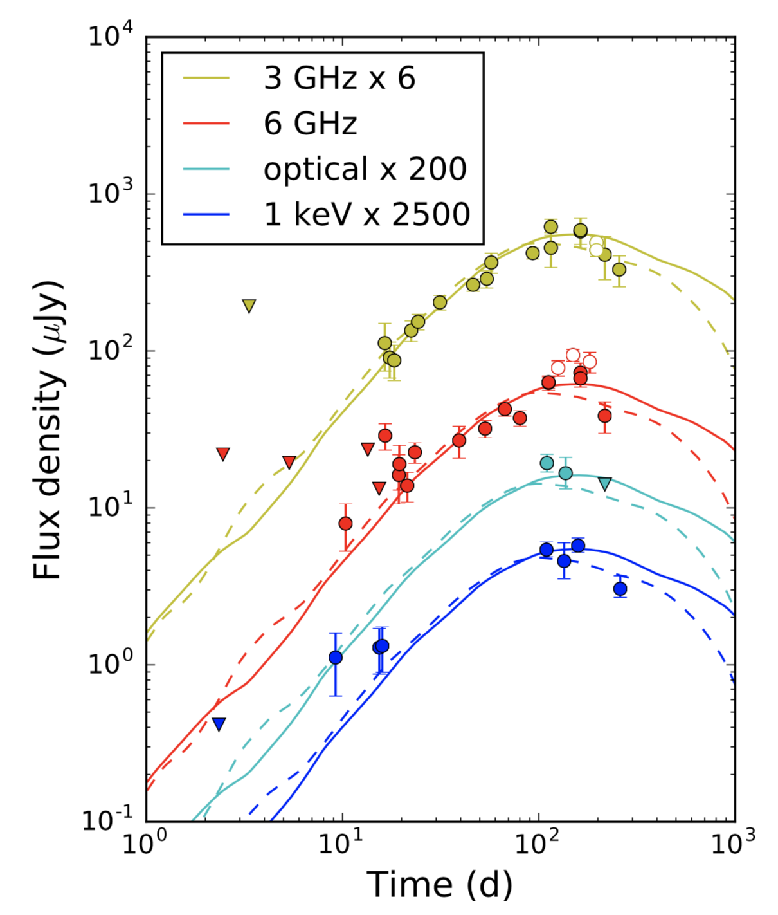
The ‘late-time’ follow-up of EM170817
What can we learn from MWL measurements
Radio and X-rays
  10x flux increase over 150 days
  Turnover after 220 – 260 days
  Electrons are accelerated efficiently
  Acceleration in strong shock
TeV gamma rays, neutrinos & cosmic-rays?
  Good conditions for gamma-ray and neutrino production ➝ no signal seen (yet)
  Long-term follow-up with H.E.S.S.
  Imaging Atmospheric Cherenkov Telescopes can constrain B-field in ejecta
H.E.S.S.
H.E.S.S.
Alexander et al. (2018)
Notes:
Prepare for CTA

Slide 10
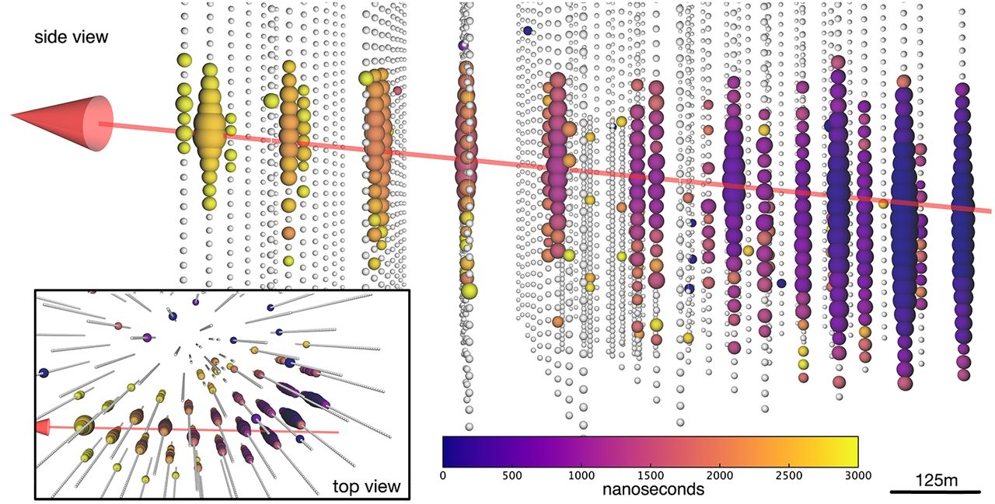
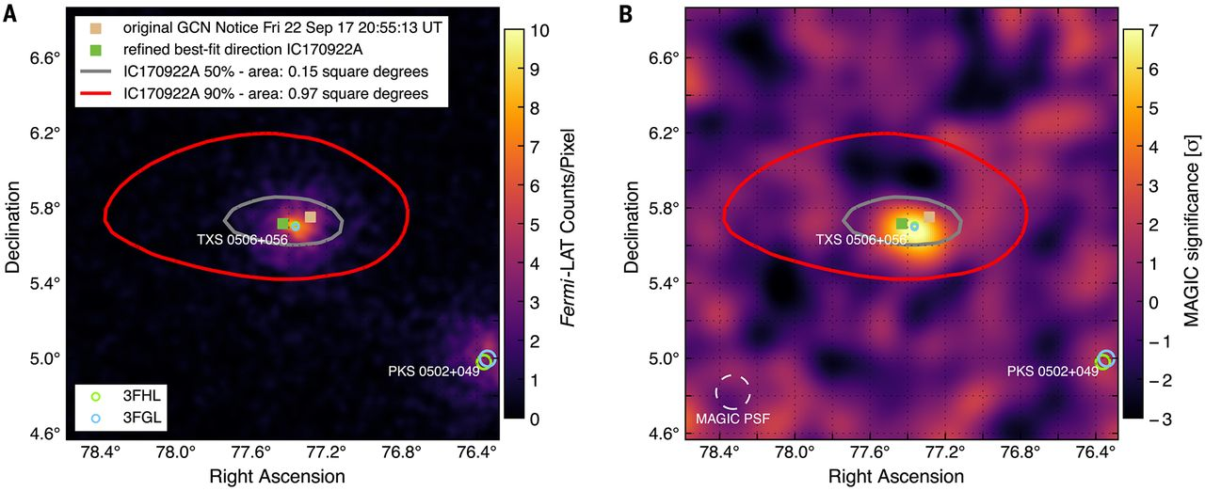
IceCube-170922A
The neutrino detection and EM follow-up
IceCube detection
  290 TeV neutrino detected on September 22nd 2017
  Alert distributed to all partners within 45 s
Multiwavelength / Multimessenger follow-up
  MWL campaign from radio to gamma-rays initiated
  TeV observations with H.E.S.S., MAGIC & VERITAS
  Association with GeV bright blazar TXS 0506+056 in Fermi-LAT archival data a week after
  MAGIC detection ~1 week after neutrino alert
IceCube++ (2018)

Slide 11
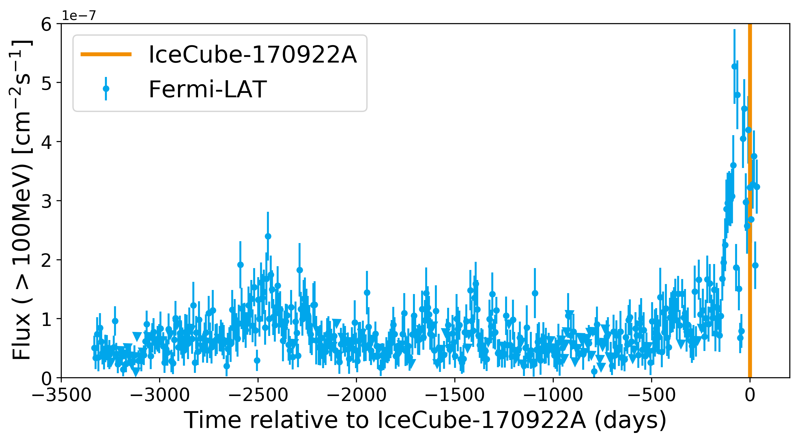
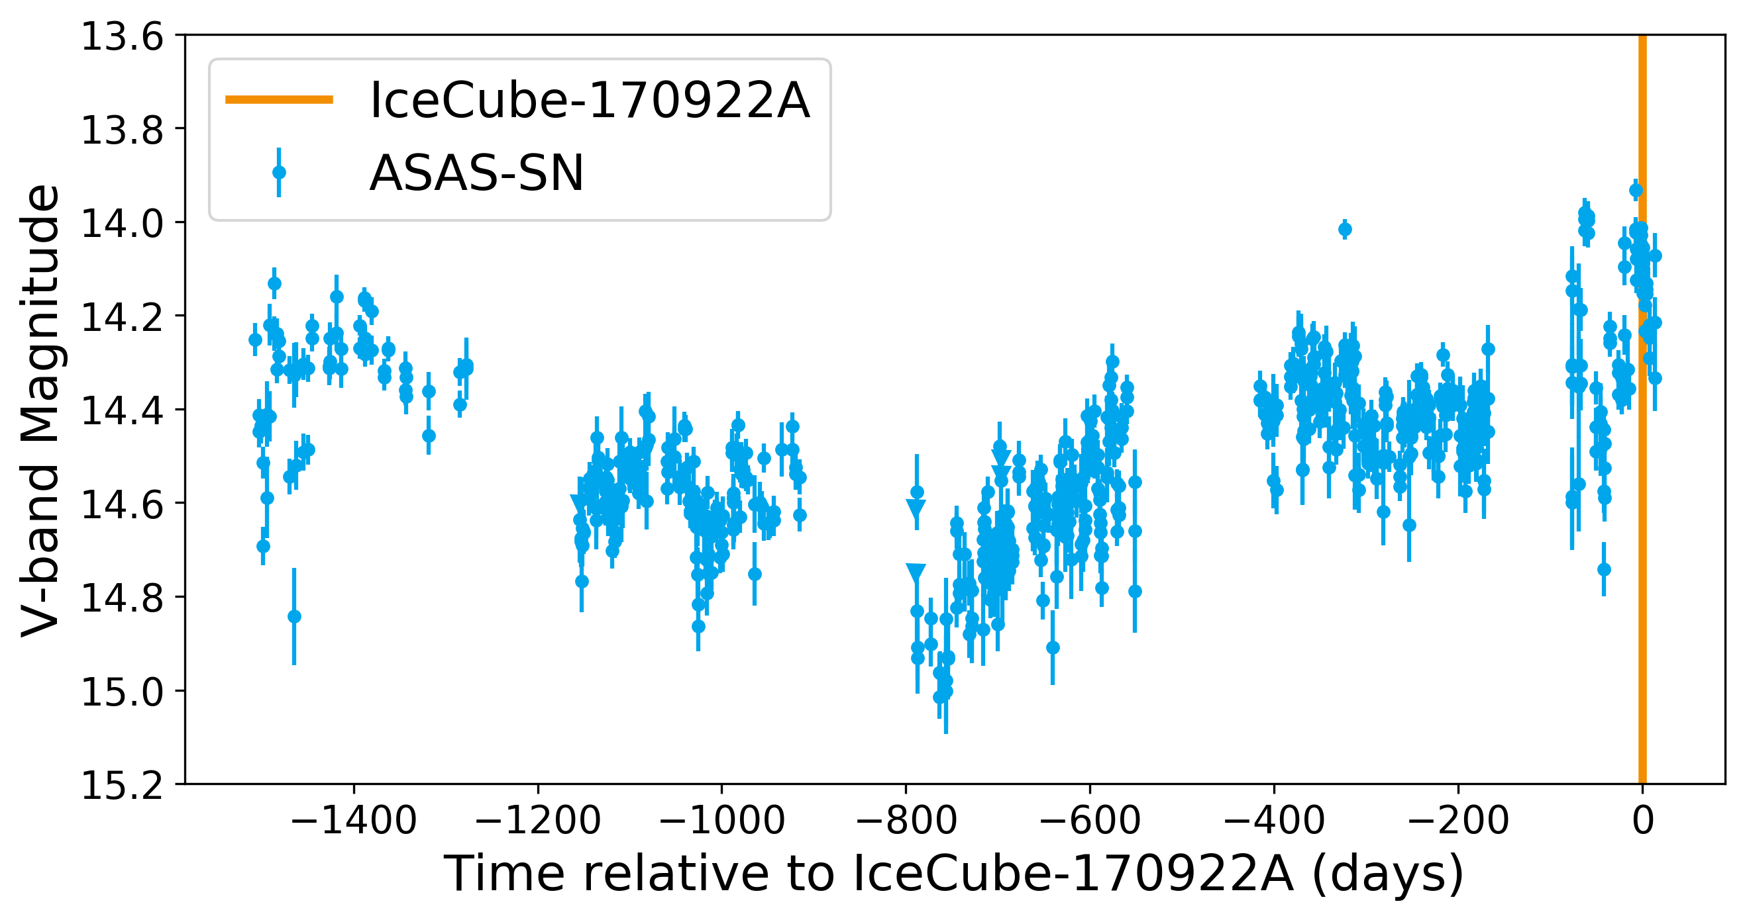
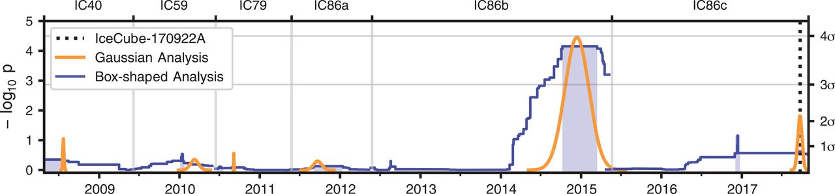
IceCube-170922A
Source properties and association
TXS 0506+056 characteristics
  A blazar in an elevated state in almost all wavelengths
  One of the brightest Fermi-LAT blazars
  In extended flaring state since ~6 months
  Redshift of 0.33 (gamma-ray absorption >100 GeV)
Probability for association
  Strong indications for association between neutrino and flaring blazar at >3 sigma level
Previous flaring episodes?
  >3 sigma excess seen in IceCube archival data
IceCube++ (2018)

Slide 12
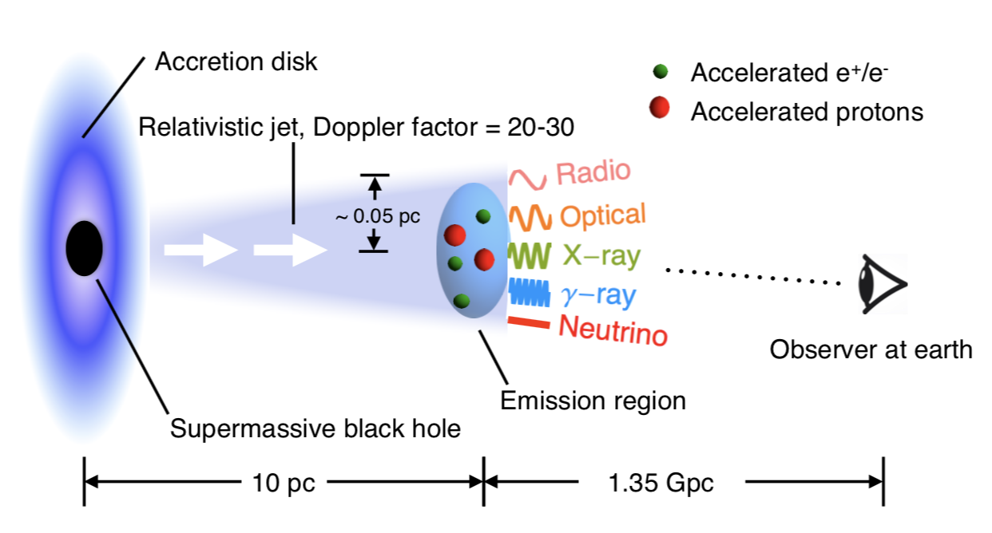
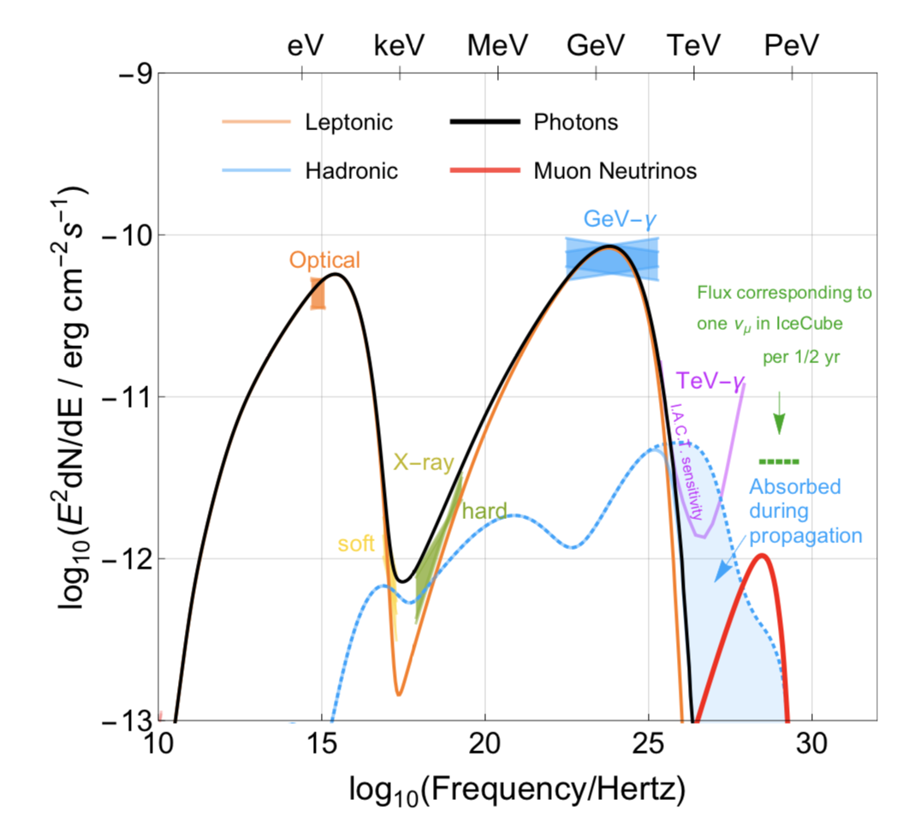
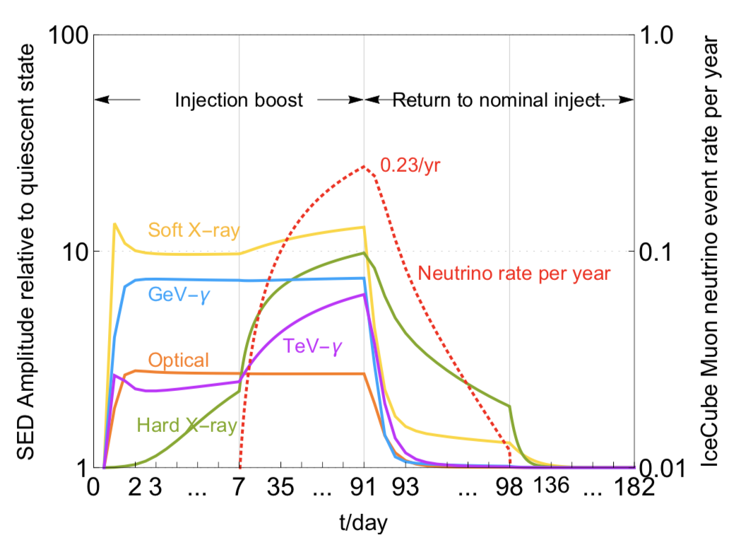
IceCube-170922A
Interpretation
Pure hadronic models don‘t work
Hybrid models can explain EM emission and neutrino
~0.25 neutrinos per year predicted by model
Gao et al. (2018)

Slide 13
Summary and Outlook
Different messengers probe different physics on different scales
Multimessenger astrophysics allows us to
  Probe the most extreme phenomena in the Universe
  Combine the pro‘s and mediate the con‘s of different messengers
Multimessenger astrophysics and time-domain science requires different thinking
Instruments:
  LIGO/VIRGO will be turned on for O3 in early 2019 ➝ boost in sensitivity and hence rate of mergers
  IceCube working on extension of detector (IceCube-Gen2, including PINGU)
  In gamma-rays, CTA will revolutionize our view of the TeV gamma-ray sky

Slide 14
Spares

Slide 15
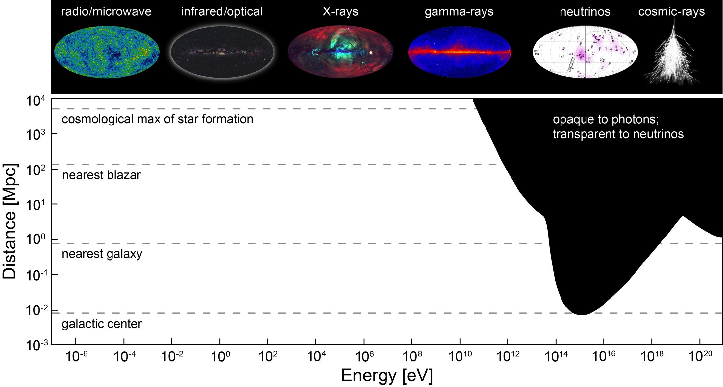
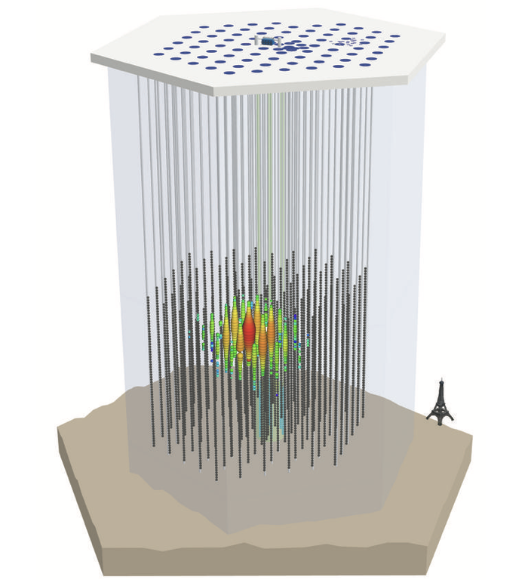
IceCube
IceCube
  continuous data taking since 2010
  Gives access to astrophysical neutrinos (est. 2013)
  most sensitive to northern-hemisphere sources
  10 TeV – 10 PeV energies
Origin of astrophysical neutrinos
  consistent with isotropy ➝ extragalactic sources
  limits on populations of sources
  first hints for identified counterpart
e⁻

Slide 16
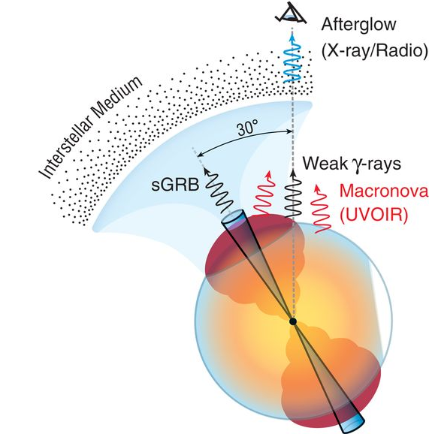
The binary neutron-star merger GW/EM170817
Prompt and delayed emission
Origin of the prompt EM emission consistent with
  NS-NS merger event propelled material into intra-merger medium
  wide-angle jet inflates ejecta forming a cocoon
  γ-rays produced in shock-breakout in this scenario
  r-process elements forged in ejected material hours after merger
➝ Emission traced in optical and soft γ rays
Non-thermal emission and long-term behaviour
  speeds of 0.1 – 0.3 c ➝ strong shocks
  ejected mass of few 10⁻² M⊙ ➝ baryon-rich material
➝ Good conditions for particle acceleration and γ-ray and neutrino emission
Kasliwal++, 2017

Slide 17
The EM follow-up of GW/EM170817
History
H.E.S.S. paper on GW170817

Slide 18
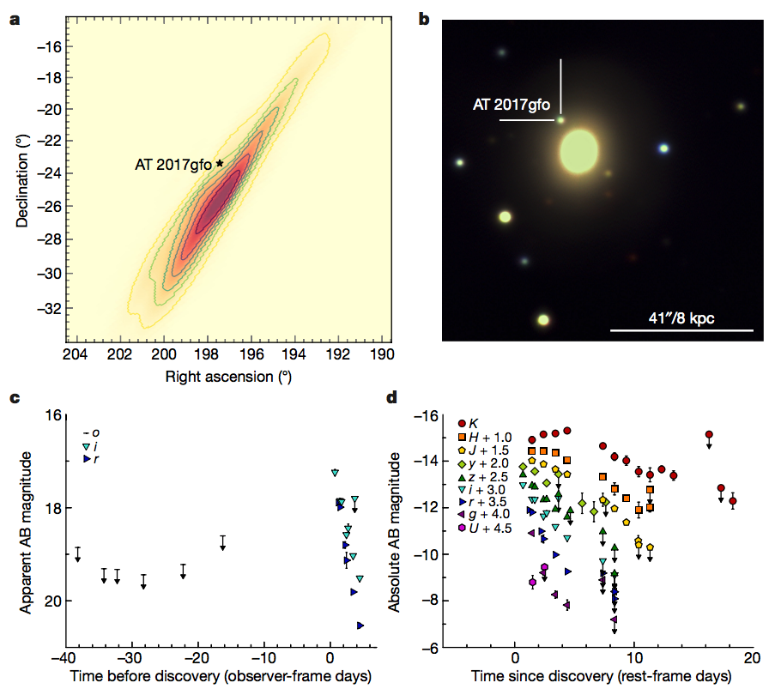
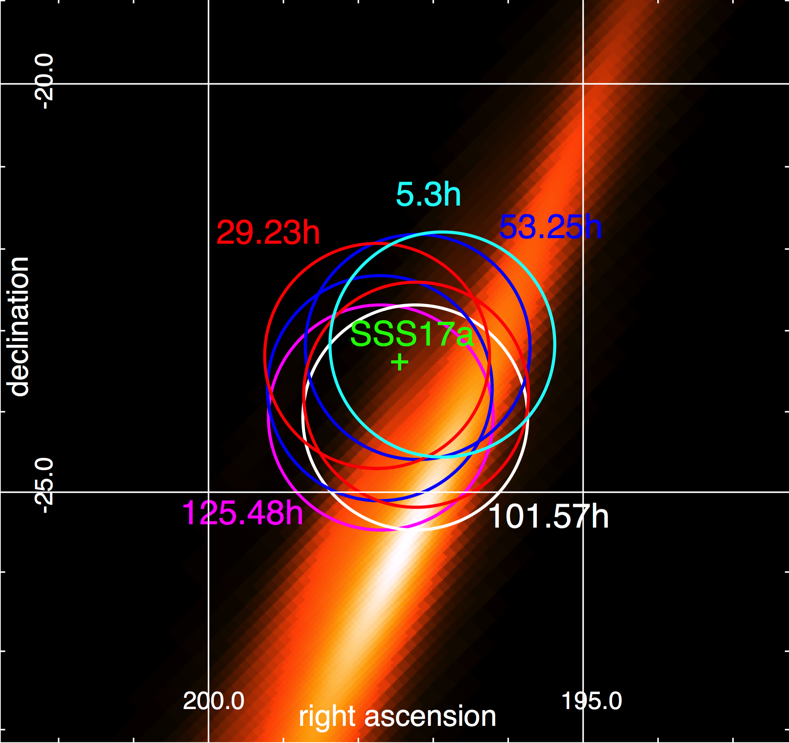
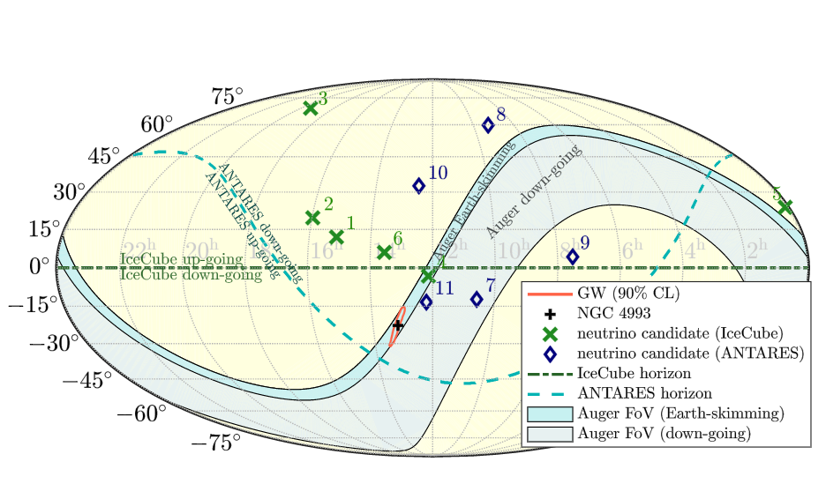
The ‘early’ follow-up of GW/EM170817
Optical
  ZTF was not yet online
  MK, AF & JN involved in ePESSTO follow-up
  Emission established to be of kilonovae origin
Neutrinos + UHECRs
  ANTARES, IceCube and Auger search did not reveal counterpart within ±500s of merger
  Neutrino provides direction and gives insight into source environment
VHE γ rays
  H.E.S.S. covers uncertainty region 5 hours after event
  1st ground-based pointing telescope to cover NS-NS merger
  no detection
Smartt++ (2017)
H.E.S.S. follow-up
LIGO, Virgo, Auger, ANTARES, IceCube,ApJ 850 (2017)
H.E.S.S. paper on GW170817

Slide 19
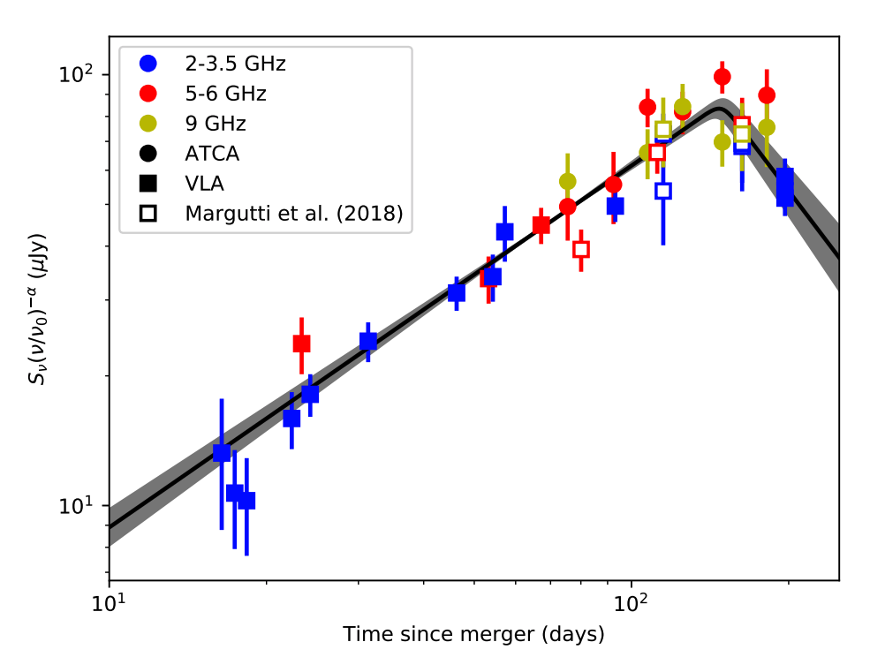
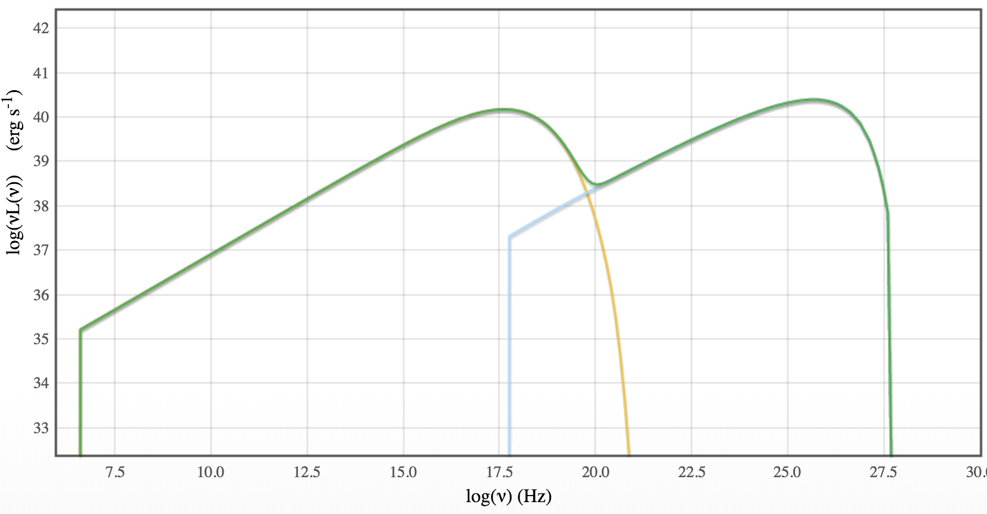
The ‘late-time’ follow-up of GW/EM170817
What can we learn from MWL measurements
Radio and X-rays
  spectral index of non-thermal electrons consistent with Γ_{e} ~ -2.0
  ➝ acceleration in strong shock
  steady increase in flux from 10 – 150 days after merger
  peak in radio at 150 ± 2 days
  indications for turnover in X-rays as well
Possible Interpretation
  ejecta decelerating ~now
GeV γ-rays
  no detection of emission after original discovery of prompt GRB emission
VHE γ-ray
  Expected peak in γ-ray SED between 100 – 500 GeV
  Sensitivity of H.E.S.S.: ~2 * 10⁻¹³ erg cm⁻² s⁻¹
  Data currently being taken and/or under calibration and analysis
Radio lightcurve

