Slide 1

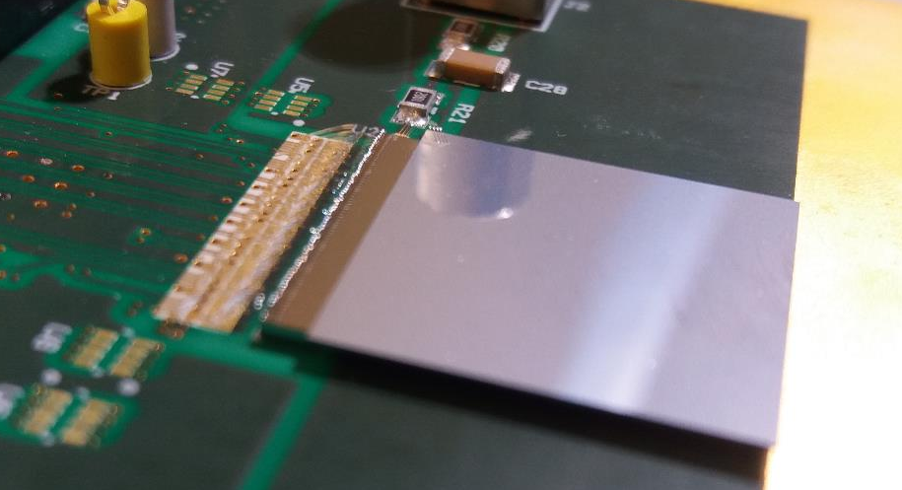

Velopix and Velopix++
J. Buytaert
Slides stolen from many other presentations.

Slide 2
Outline
Velopix
  Description and performances
Velopix++
  Key requirements
  Implementing high precision timing.
  Data rates.
  More Front end processing needed ?

Slide 3
Key requirements
Warning :
  speculation starts right here !
  My personal view
  Ideas presented come from many people.

Slide 4
Timing resolution
As high timing precision as possible:
  Push “local ring oscillator” concept as far as possible
 | Time resolution | Frequency of local ring oscillator | Count | Latch phase
Timepix3 | 1.56ns | 4 tap @ 640MHz. (VCO calibrated) | yes | no
Velopix | 25 ns | No local oscillator
Timepix4 | 195 ps | 4 tap at 640MHz. (VCO calibrated) | yes | yes
Velopix++ (“pix20” proposal NIKHEF) | 20 ps ? | 5 (?) tap @ ~5 GHz No VCO, free running, not calibrated, minimal gate propagation. | yes | yes

Slide 5
Timing resolution.
High time resolution will imply extra time bits per hit:
  20 ps over 25 ns range, requires 10bit.
  Velopix currently has ‘only’ 9 bits for timing (to cover the maximum latency of hits)
  So a total of 19 bit/hit will be required for time encoding.
Another 10 bit are added if a time calibration is added.
  Maybe this calibration could be applied locally (in-pixel)?

Slide 6

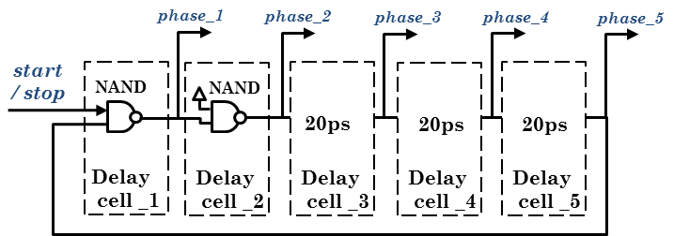
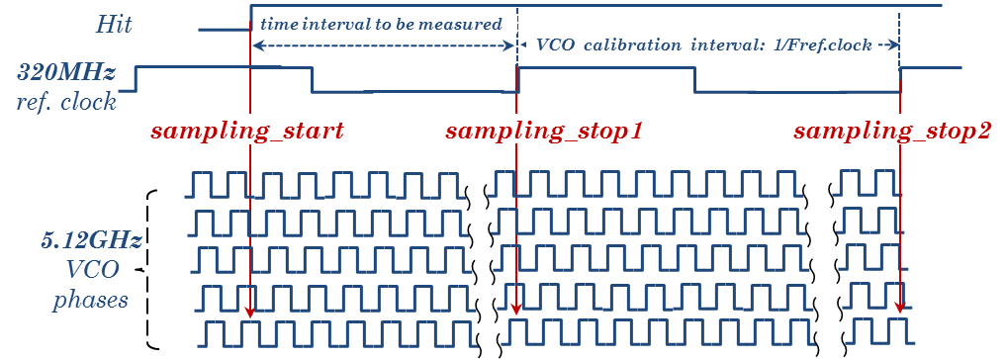

“pix20”: 20ps time resolution
Single-gate-delay 5.12GHz Ring Oscillator
main features of the circuit:
minimum delay cell (single gate)
NO control of the osc. frequency
osc. frequency is dependent on power supply voltage, temperature, manufacturing process etc.
osc. frequency will be calibrated right after each hit
the calibration data will be readout together with the hit time data for an offline correction
- double quantization error
- extra data in each data packet
Per-shot-Calibration approach
philosophy: the oscillators frequency is allowed to vary significantly (30%) from pixel to pixel
the VCO oscillation frequency is difficult to control
if we cannot control the VCO lets us calibrate it for each event (hit)
VELO Upgrade Retreat V.Gromov
01/03/18
6

Slide 7
Low jitter time reference clock.
A new concept is elaborated in Timepix4:
  DLL locked loop in each column synchronised at the bottom with jitter cleaning.
  This is also a very nice solution to the peak currents on the supply caused by synchronous switching. Constant current consumption in matrix !

Slide 8
Data rates
Particle fluence will increase by a factor 10.
Data bits per hit could double.
  Extra time encoding bits
  Smaller pixel size will require more (2 ?) pixel address bits.
  Pixel will remain binary readout (no TOT info).
Velopix currently requires16 Gbit/s for most intense region.
Velopix++ will require 20 x 16= 320 Gbits ??
Based on 10Gbit GWT developed for Timepix4 ?
I assume that super pixel concept will remain.
  This allows sharing of memory buffers and reduces the number of “access points” to the column readout bus.

Slide 9
Clustering
The filter farm for Upgrade 1 will spend too much time on “trivial” processing, like clustering.
Implement a cluster algoritm in superpixels ?
  This will also save in data rate, for clusters that cross superpixel regions.

Slide 10
Even more processing
Aim : to offload filter farm and reduce data.
Develop a digital asic that forms “tracklets” ?
  Implement proposal “search by triplet” from S. Ponce https://indico.cern.ch/event/681201/contributions/2894501/attachments/1608088/2555893/main.pdf
Note that combining hits from different sensors will first require to realign all hits in time !
  Data driven readout in pixel asic leads to random time ordering of hits .

Slide 11
Design Plan
Velopix designers (CERN & NIKHEF) are keen to start work after timepix4 has been submitted (mid 2019 ?). Transfer all knowledge and design blocks into Velopix++.
Open to discuss participation in this ‘adventure’.

