Slide 1
Inner detectors @CPPM
Eric Vigeolas 18/07/2018

Slide 2
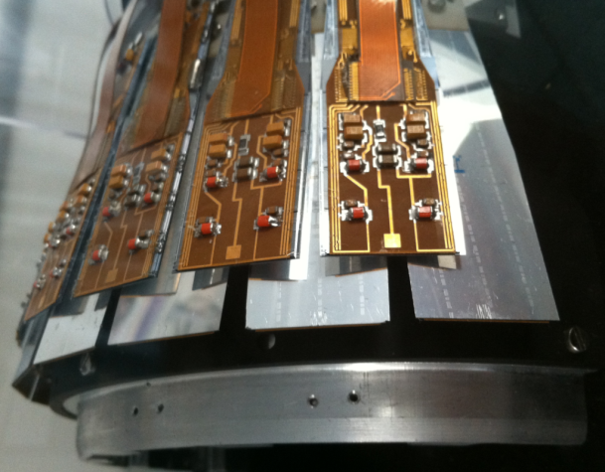
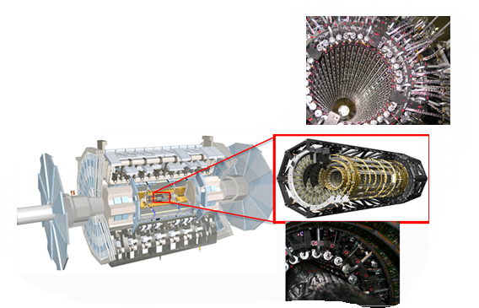
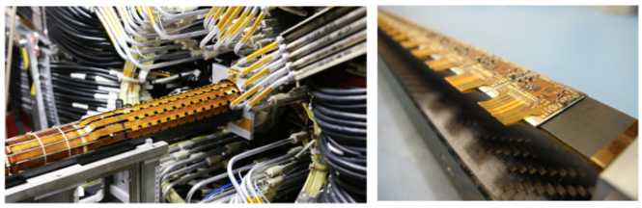
Long history @ CPPM
For the first time hybrids pixel sensors was used in a collider with Delphi experiment @ LEP (1994) → CPPM had an important role in the mechanic, services, electronic design and integration
Atlas Pixel detector (2006)
IBL 4th layer (2014)
Involvement in the ITK/Pixel detector (2024)

Slide 3
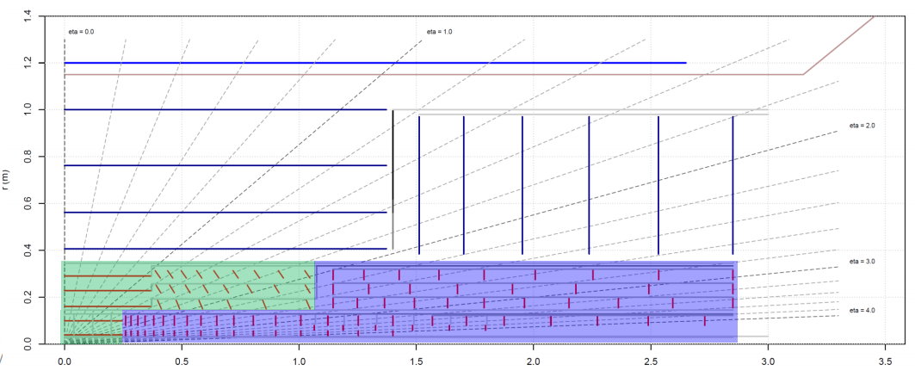
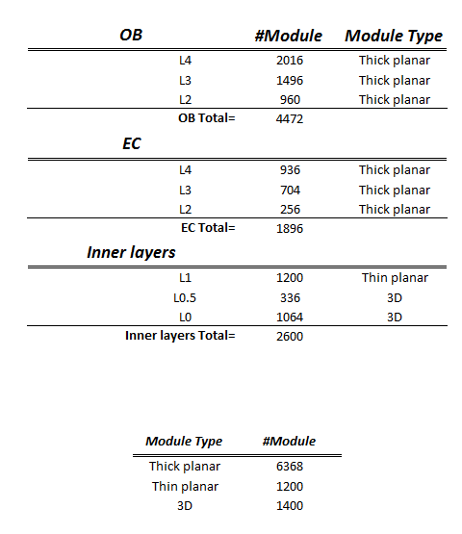
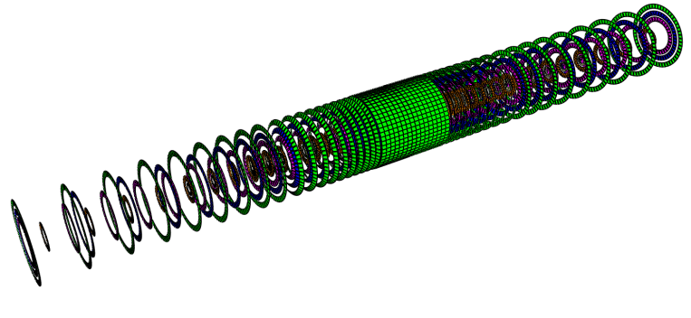
ITK Pixel detector
ITK pixel detector will the biggest detector we ever built → more than 8k modules ~10m^2 of Si
Assembly rules and technics will be adapted → lot of parallelization

Slide 4

Mechanical design
Most of our detectors are driven by minimizing the radiation length, preventing thermal runaway, high level of coverage and stability
Cooling
Radiation length
Stability

Slide 5
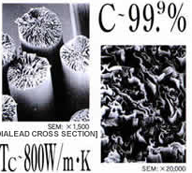
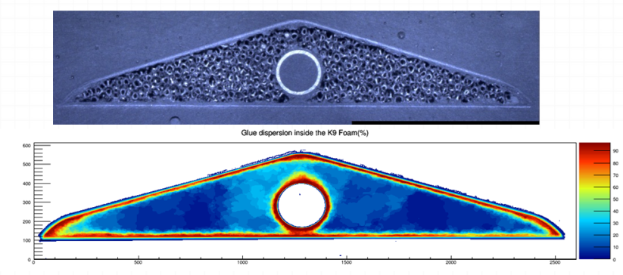
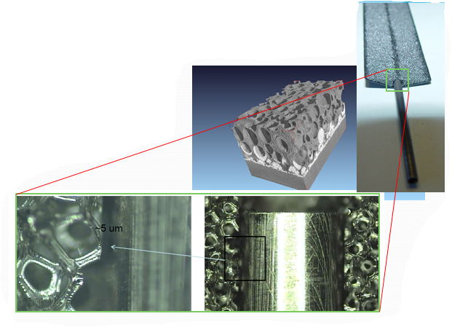
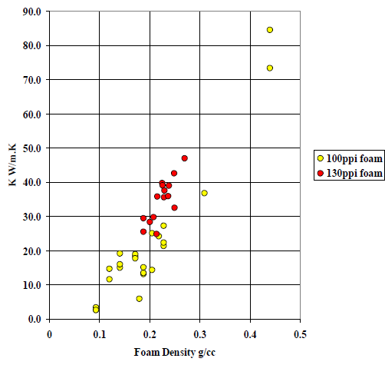
Material
Huge amount a carbon foam and composite material used
Thin structure (~0,15mm) with large opening for material saving
Thin services including cooling pipes

Slide 6
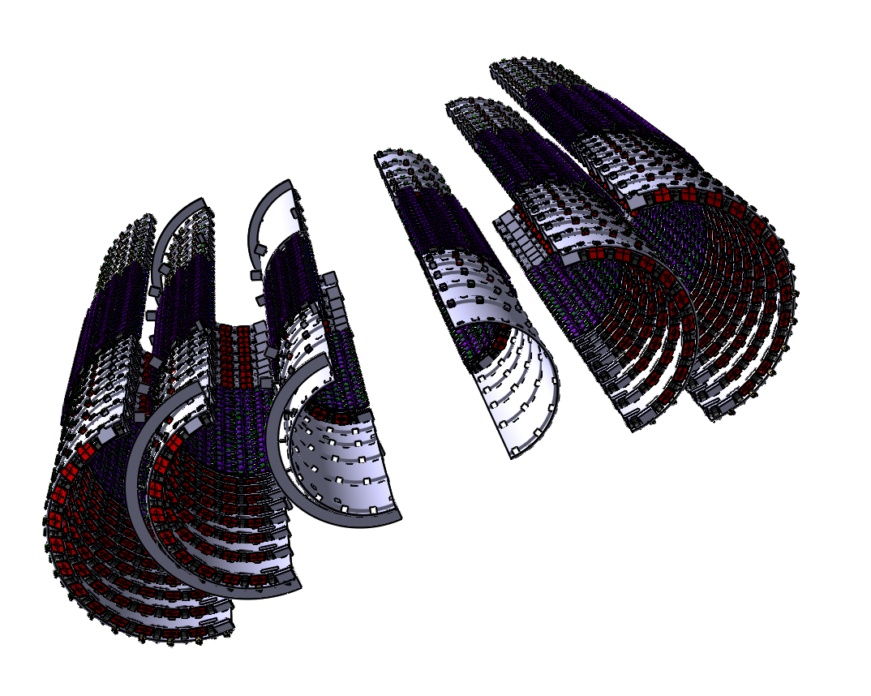
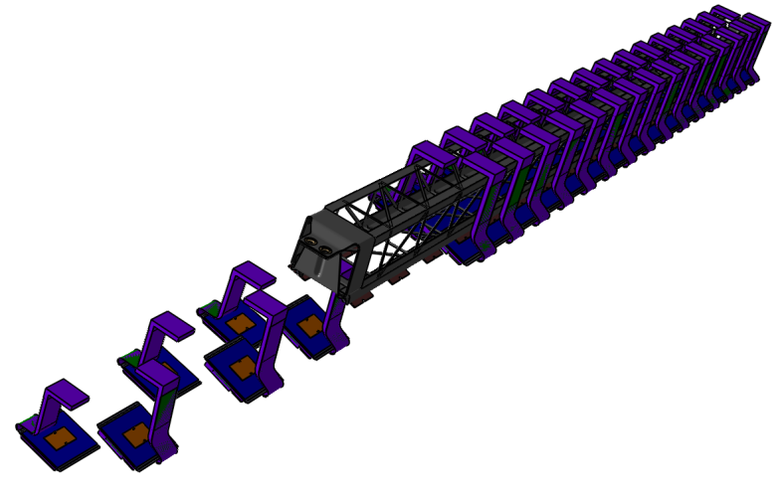
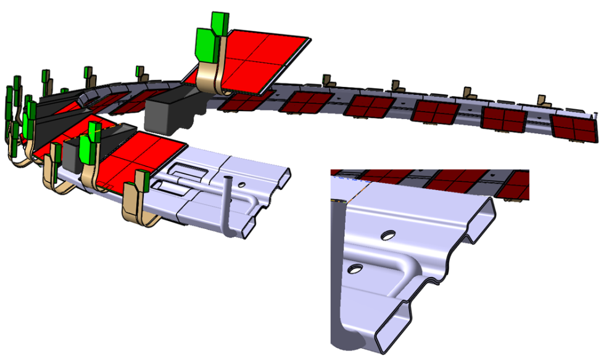
Geometry
Modules overlap R/Phi and Z → Complex insertions and integration scheme
Recently we introduced truss beam inspired from Alice vertex detector

Slide 7
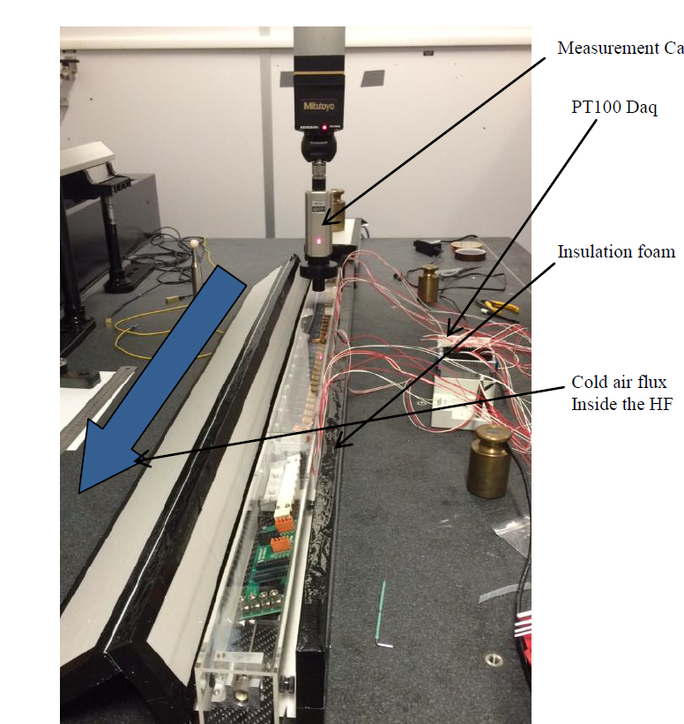
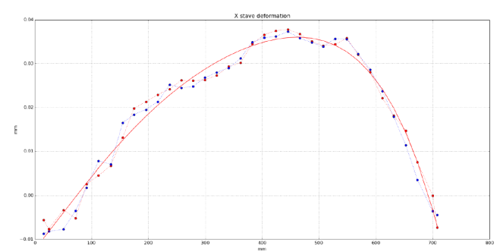
Stability, Temperature
Large possibilities of measurements @ CPPM:
  Thermal conductivity
  CTE
  Metrology
  Thermo-mechanical stability
35µm/ΔT 15°C

Slide 8
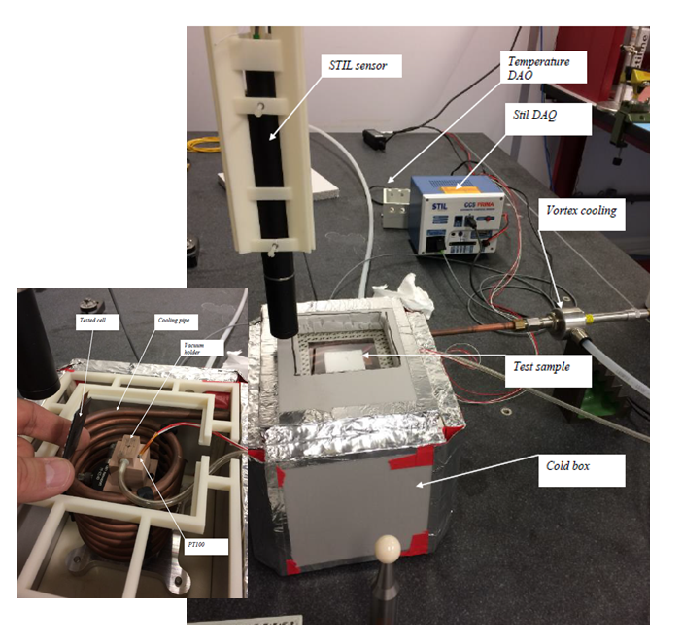
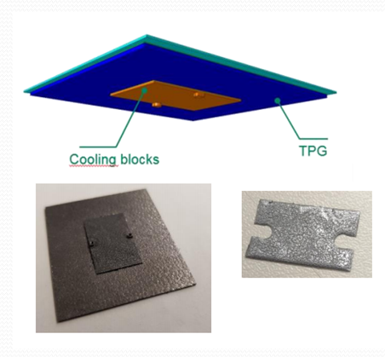
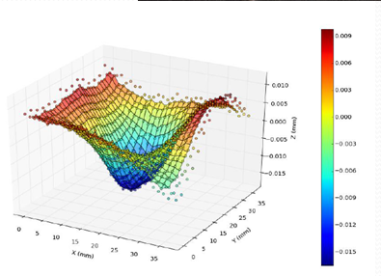
Thermo-mechanical measurements

Slide 9
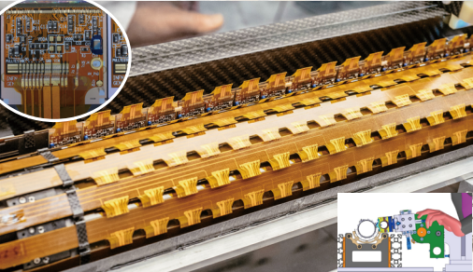
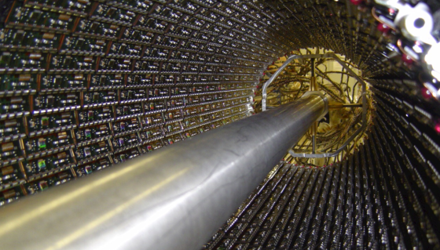
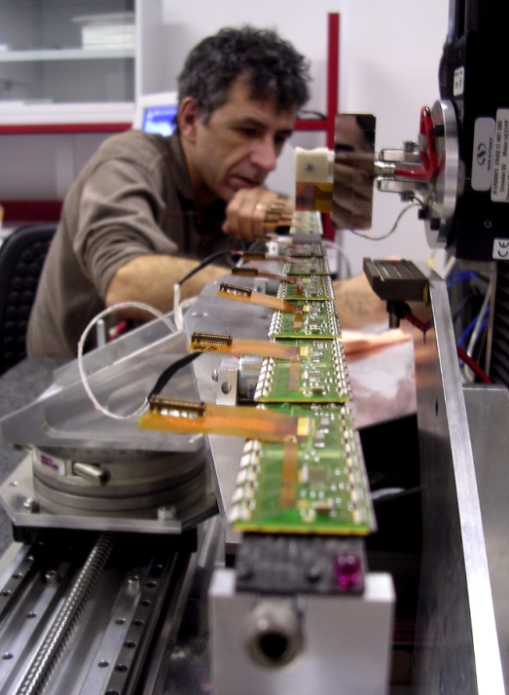
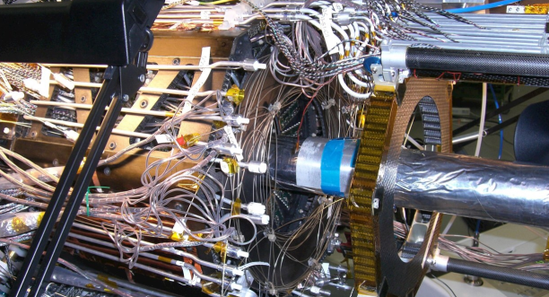
Complex assembly scheme
Required overlaps involve complex geometries and assembly processes
Attachment compound development involve frequently the need to find a way to rework (large number of module to assemble
With ITK new problem appear like assembling 8k modules in two year (parallelization, process control)

Slide 10
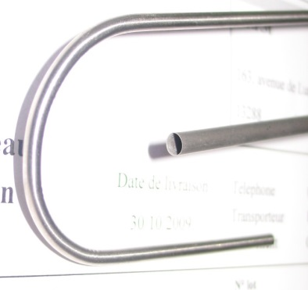
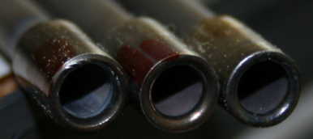
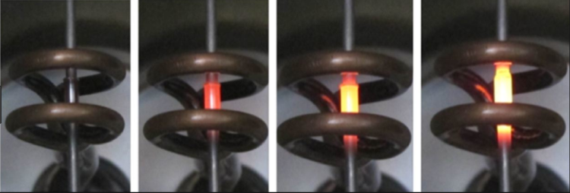
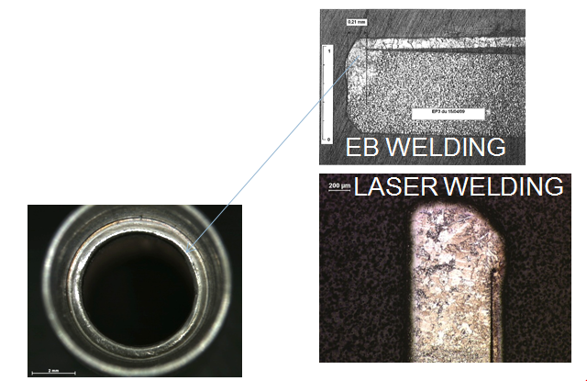
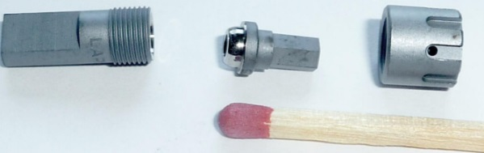
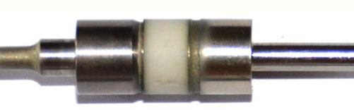
Cooling Service design
Thin wall cooling pipes was designed @ CPPM, it include the development of bending technics and joining technics
Specific fittings was designed and qualified a high level of reliability have been reach on IBL
Brazing
Welding
Bending

Slide 11
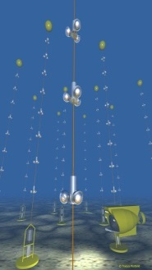
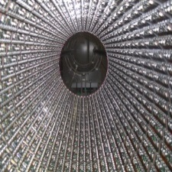
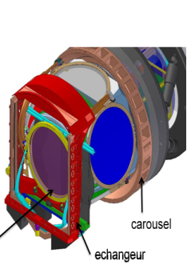
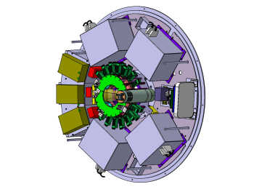
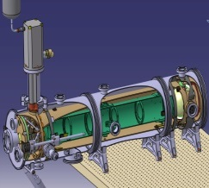
Mechanical Team:
20 people are involved in projects from sea to space
WorkShop
Design
Km3Net
Underwater telescope
Atlas
Pixel detector
Project management
LSST
Camera for Telescope
Imagerie
TEP/CT
Euclid
Space focal plane

Slide 12
Thank you for your attention

