Slide 1
RT2020
Student Paper award
The up to four Outstanding Student Paper Awards will honor the best student submissions accepted for an oral or a poster presentation.
To be eligible, the student/author must provide: two pdf documents along with the TNS-like paper.
1 - A letter from the graduate student's advisor that confirms that the student is the main contributor to the conference record paper.
2 - Evidence to his/her status as a graduate (master's or doctoral) student.
Present the work in an oral or poster session at the conference. Only work that is actually presented by the student-author will be eligible.
The award is based on the scientific content and the quality of the text (quality of English, clarity of the text, quality of figures, etc). Oral and poster presentations have equal chances of winning—the award is for the paper, not the presentation.

Slide 2
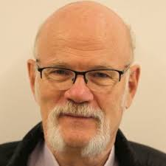
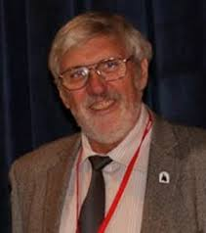
RT2020 Student Paper award
The number and type of awards presented will be dependent on the available funding as well as the total number, and overall quality, of entries.
Few applications this year -> Only 2 awards
Committee:
Christian Bohm Patrick LeDu
Stockholm University, Sweden Retired from CEA, France
We found two good papers that fulfill all criteria

Slide 3
1st Prize, Certificate and 250$, to
Miguel Astrain from
Grupo de Investigación en Instrumentación y Acústica Aplicada, Universidad Politécnica de Madrid
for the paper
Real-Time Implementation of the Neutron/Gamma discrimination in an FPGA-based DAQ MTCA platform using a Convolutional Neural Network
Miguel’s oral presentation was the first plenary presentation the first day
2nd Prize, Certificate, to
Adam Abed Abud from
University of Liverpool, UK and CERN
for the paper
Experience and performance of persistent memory for the DUNE data acquisition system
Adam’s poster was presented the first day

Slide 4

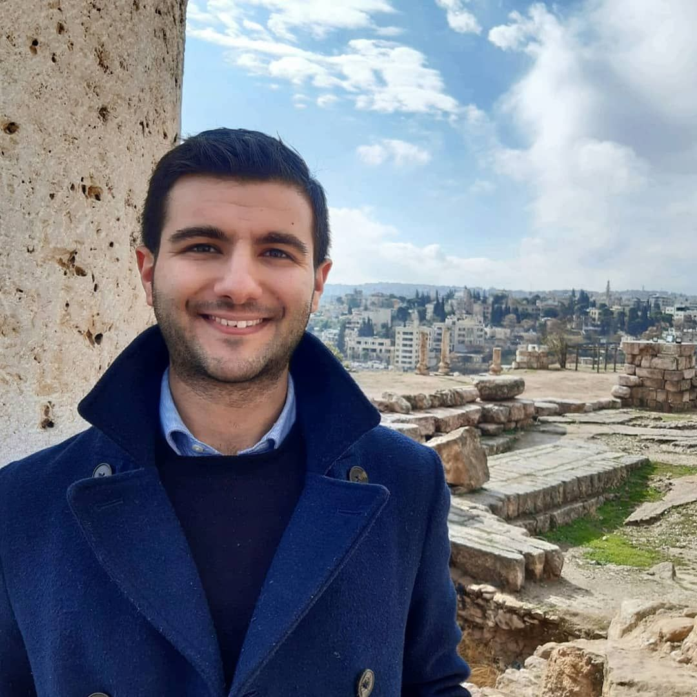
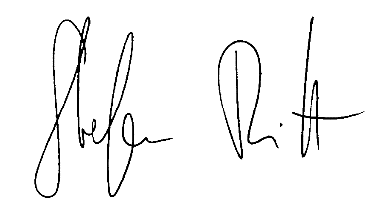

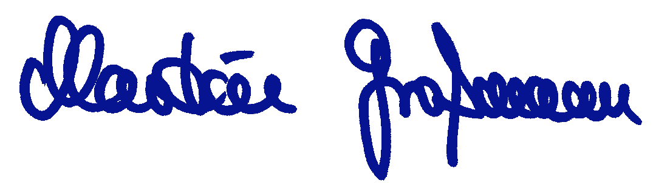
IEEE Nuclear and Plasma Sciences Society
takes pleasure in presenting the
2020 NPSS Student Paper Award
Second Prize
to
Adam Abed Abud
for the paper entitled
Experience and performance of persistent memory for the DUNE data acquisition system
Presented at the 22nd IEEE NPSS Real Time Conference
held virutally, 12-23 October 2020
Adam Abed Abud
Martin Grossmann
Chair
CANPS Technical Committee
Stefan Ritt
General Chair
RT2020 Conference

Slide 6
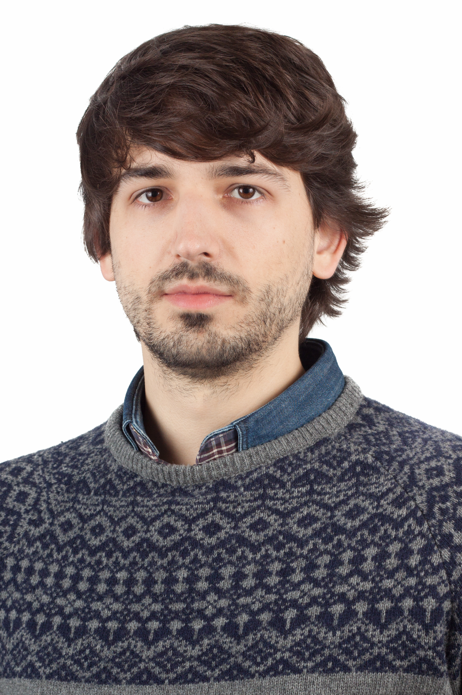
IEEE Nuclear and Plasma Sciences Society
takes pleasure in presenting the
2020 NPSS Student Paper Award
First Prize
to
Miguel Astrain
for the paper entitled
Real-Time Implementation of the Neutron/Gamma discrimination in an FPGA-based DAQ MTCA platform using a Convolutional Neural Network
Presented at the 22nd IEEE NPSS Real Time Conference
held virutally, 12-23 October 2020
Miguel Astrain
Martin Grossmann
Chair
CANPS Technical Committee
Stefan Ritt
General Chair
RT2020 Conference

