Slide 1
PS injection bumper update
D Bodart 26/06/2018

Slide 2
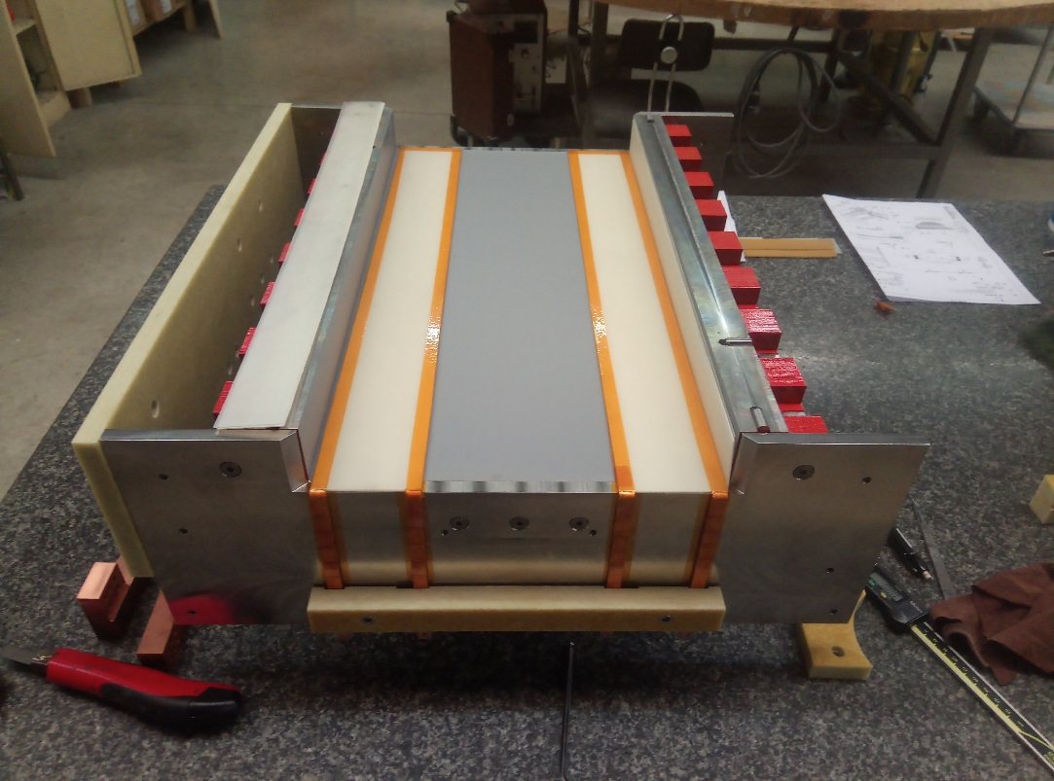
Status of the injection bumpers
The order of the pre-serie magnet was placed in January 2018.
The manufacturing of the yoke, the main coils and the compensation coils is completed.
The magnet is currently being assembled. All electrical and geometrical measurements are within tolerances.
The shipping of the magnet is scheduled for the end of the month.
Fig. 1 compensation coils

Slide 3
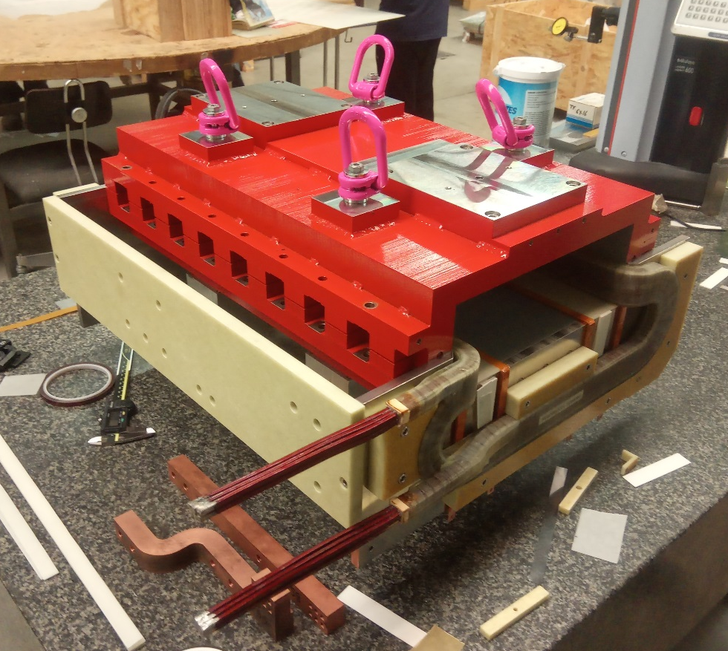
Status of the injection bumpers
The magnet certification including protection set-up wil start at reception and will last 2 to 3 weeks
The magnetic measurement can be started on 25th July. The power converter bench from TE/ABT shall be available to perform the tests.
The new vacuum chamber shall arrive at Cern mid July.
Measurements results in the present schedule will be available mid August.
The validation of the magnet design shall follow the measurement results.
Fig. 1 compensation coils

