Slide 1
Testing Particle Categorization Methods with the ATLAS-TPX Radiation Monitors
T. Billoud
billoud@lps.umontreal.ca

Slide 2
Overview
The ATLAS-TPX network
Particle categorization methods
Use of Allpix² : motivations, implementation
Notes:
Presenting ATLAS, why need study radiation field, which solution we propose
ATLAS-TPX: because it uses the Timepix chip (Medipix collaboration)
Data analysis methods: how do we identify radiation field particles, what properties we can extract.
With the same detector, we detect both neutron and charge particles, but in a different way:
Illustrate neutron field properties
Illustrate charged particles properties.

Slide 3
The ATLAS-TPX network
Notes:
The big picture
ATLAS-TPX name because of Timepix chip

Slide 4
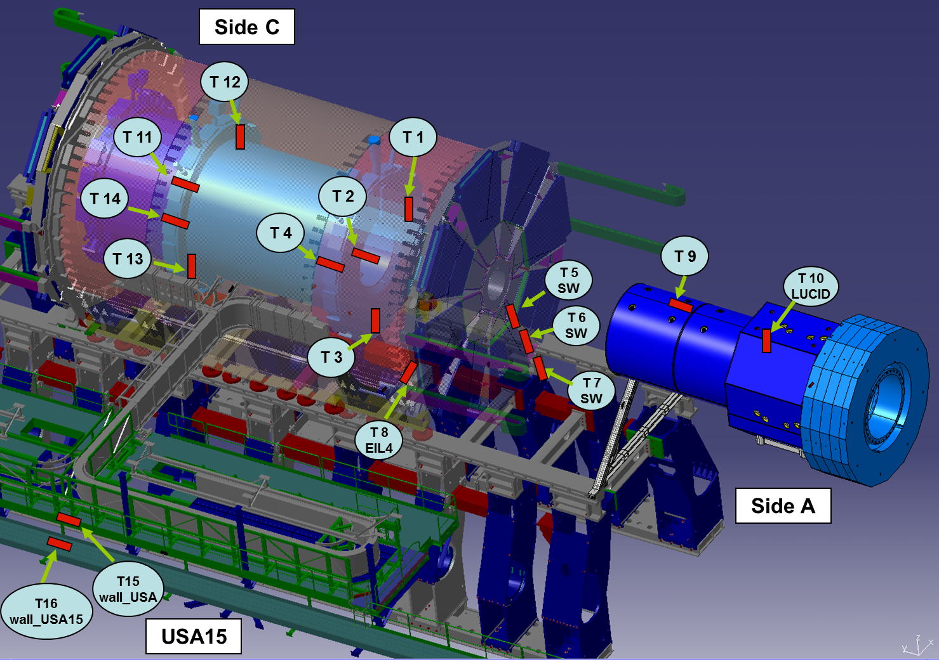
ATLAS-TPX: motivations
Use compact pixel detectors to characterize the radiation field in ATLAS
Benchmark ATLAS background simulations
Operation: LHC run 2 (2015-2018)
Radiation field properties:
Track by track analysis
Particle categorization: neutron vs charged particles
Dose measurements for each category
Energy estimation:
  Neutrons: thermal vs fast
  Charged particles: LET
Directional tendency for fast neutrons
Incident angle for charged particles with straight path
Notes:
Simulations can give at any location the incident particle type, energy, angle of incidence, particle origin, etc…
Measurements cannot replace simulations, but certain properties of the radiation field can be assessed.
Update of ATLAS-MPX (2008-2012): network of Medipix detectors (similar positions) gave fluxes for few broad categories of background particles.
ATLAS-TPX additional capabilities:
Identify fast neutron field (with 2 energy bins and directionality)
Linear Energy Transfer (LET) measurement for charged particles with straight paths.
Improve determination of charged particle incident angle (thanks to 2 layers and energy per pixel)
Radiation hardness: MPX network proved radiation hard at first LHC operation (integrated luminosity ). For TPX (LHC run with integrated luminosity …), Few detectors close to IP had to be changed once due to electronics issues. Small variations in charge collection are under study, but is not expected to affect pattern recognition.

Slide 5
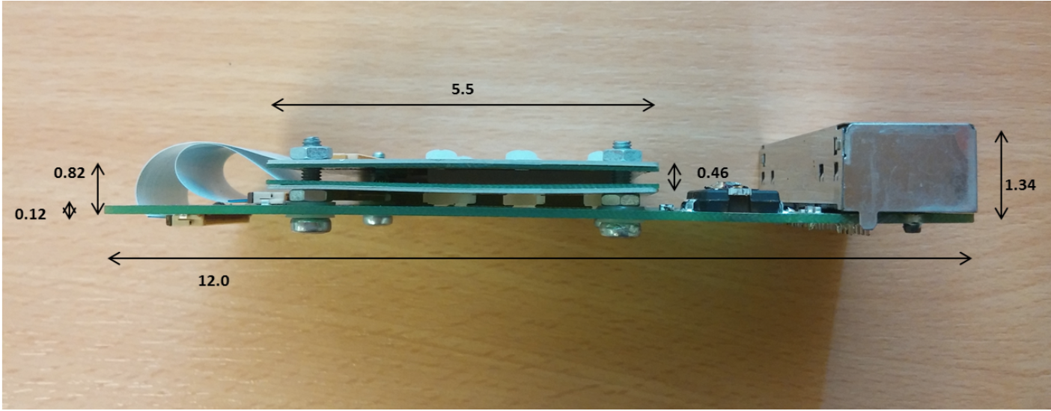
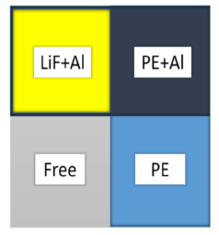
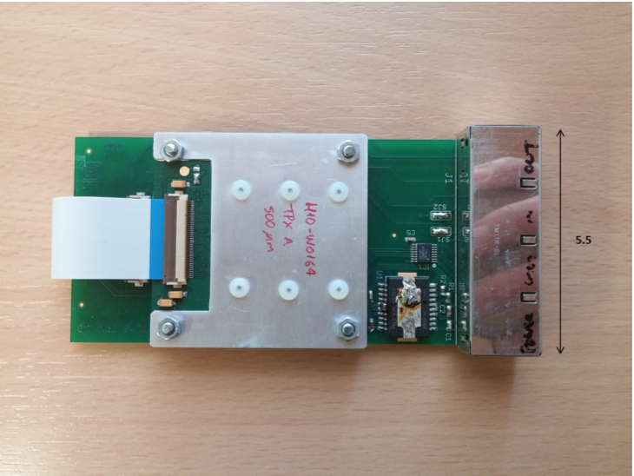
ATLAS-TPX: detector design
Two timepix chips facing each other
256 x 256 pixels each
Silicon sensors: 300 𝜇m and 500 𝜇m
Active area: 1.98 cm² for each sensor
Energy deposited in each pixel measured during constant time intervals (frames)
Neutron converters:
⁶LiF: thermal neutrons through tritons and alphas
CH₂ (PE ~ 1 mm): fast neutrons through recoil protons
CH₂ (PE ~ 1 mm) + Al (80 µm): fast neutrons above 4 MeV (Al acting as kinematic threshold)
Uncovered: to subtract events from fast neutrons interacting with Si.
Uncovered
Notes:
Dimension: 12x5x1cm, protected by Al box
4 Ethernet cables: bias, alimentation, data output, control
Thermal neutron: ⁶Li + n -> 𝛂 + ³H
Fast neutron: H + n -> p + n
Calibration done with several neutron sources: Los Alamos Neutron Science Center, Czech metrological institute, Van Der Graf Prague @ different energies.
²⁵Mg + 𝛂 and ²⁸Al + p

Slide 6
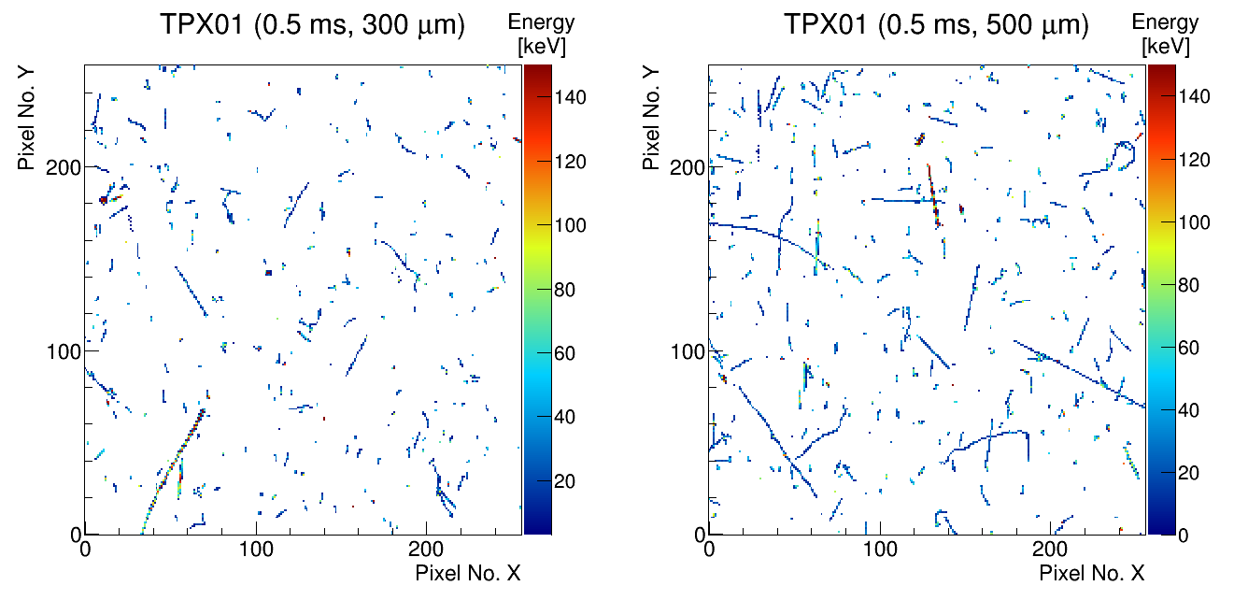
Example frames
31/05/2016: During LHC Fill 4965
Notes:
Example frame (images) recorded by one detector (left: thinest Si layer) during 500 ms.
X,Y pixel coordinates (256 x 256 pixels). Z: deposited energy in each pixel.
Each pixel has a digital counter measuring the time during which a signal is above a predefined threshold.
This time is converted to energy by a per-pixel calibration done using X-rays. Calibration valid up to ~900keV/pixel
A group of neighboring pixels is called a cluster/track.

Slide 7
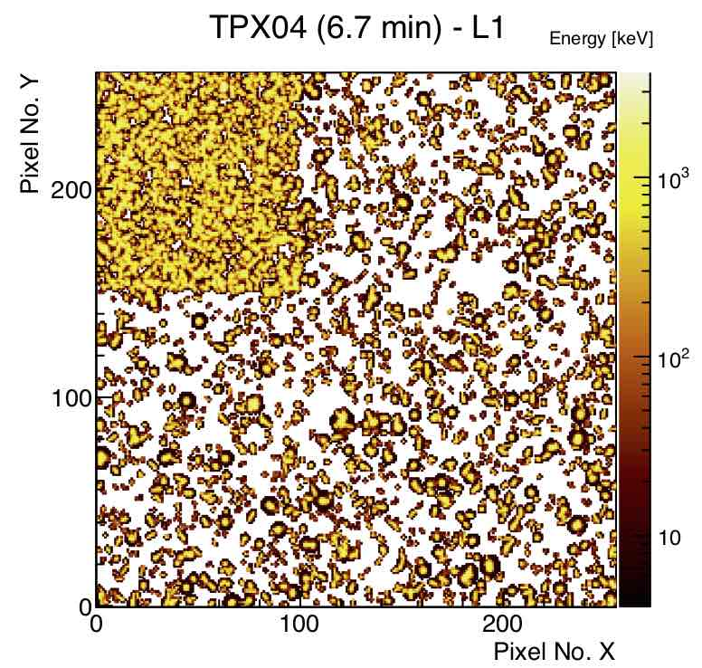
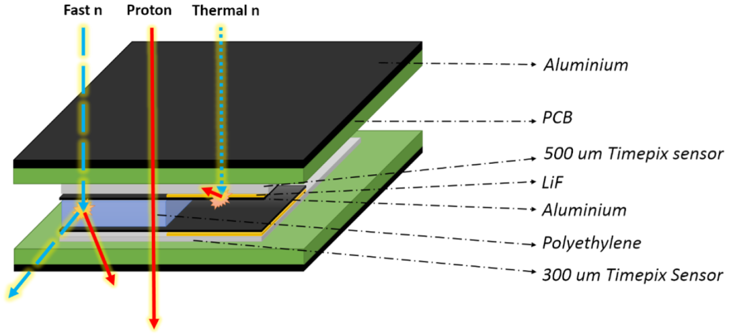
Neutron detection
Integrated energy deposits per pixel
Notes:
While charged particle are detected everywhere on the detectors surface, neutron detection depends on the area where events are recorded.
Not shown in the converter illustration: fast neutron reactions in Si sensor giving ²⁵Mg + 𝛂 and ²⁸Al + p

Slide 8
Particle categorization methods

Slide 9
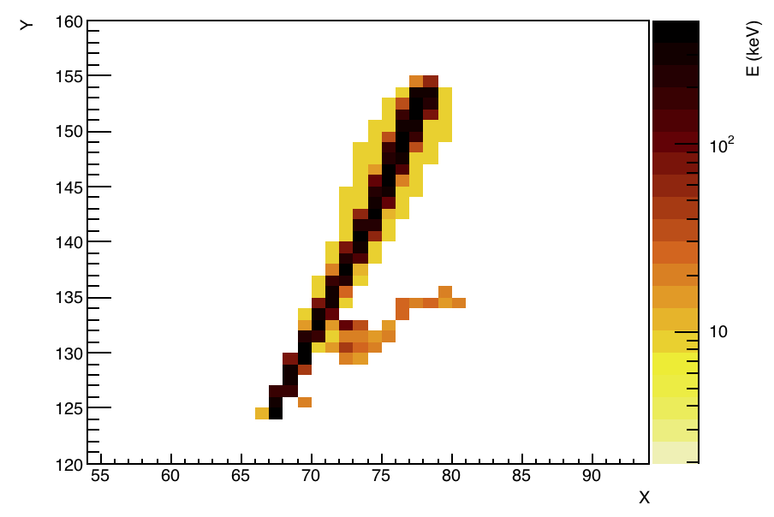
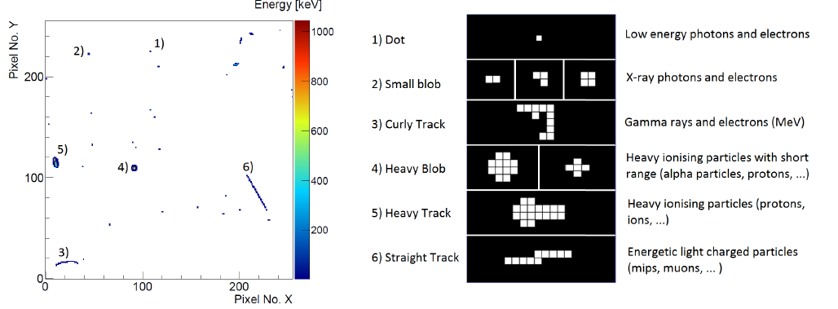
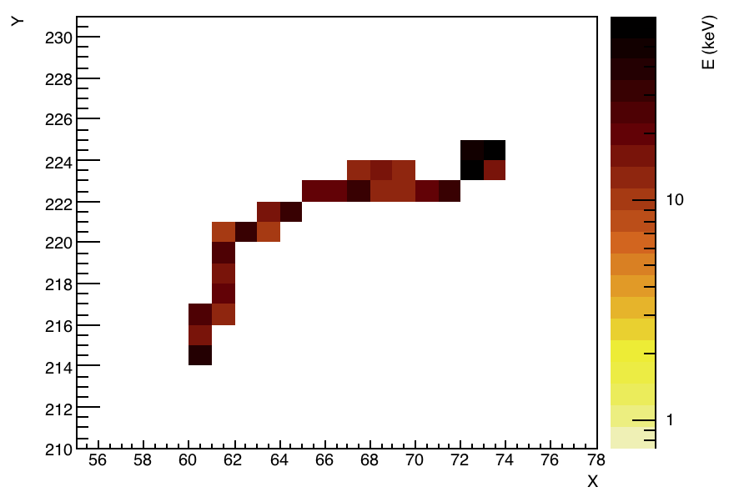
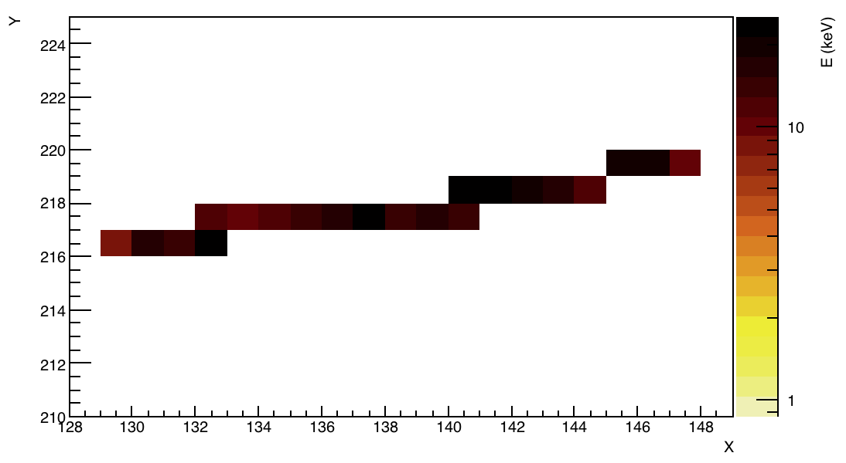
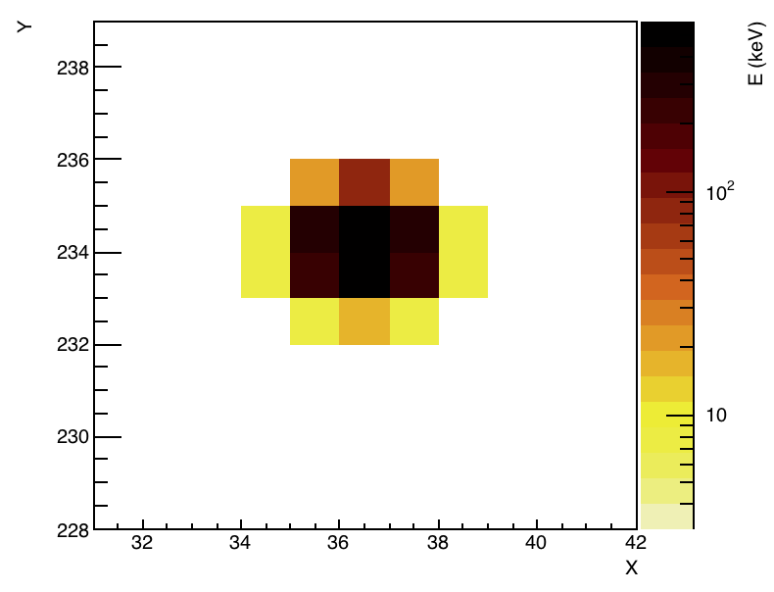
Methods
Pattern recognition
HET tracks
Notes:
Middle plot: geometrical categorization as was used with medipix detectors. Used as a first step for particle categorization.
Charge sharing effect when high energy transfer allows to distinguish from MIPs
Heavy blob: typically short range because if particle (eg proton) penetrates whole sensor its incident energy is high and thus LET is small (thin track)
High Energy Transfer particles (HET): in ATLAS mainly protons/pi/mu below MIP energy.
And below Li converter, mainly from tritons/aplha coming from (Li+n)

Slide 10
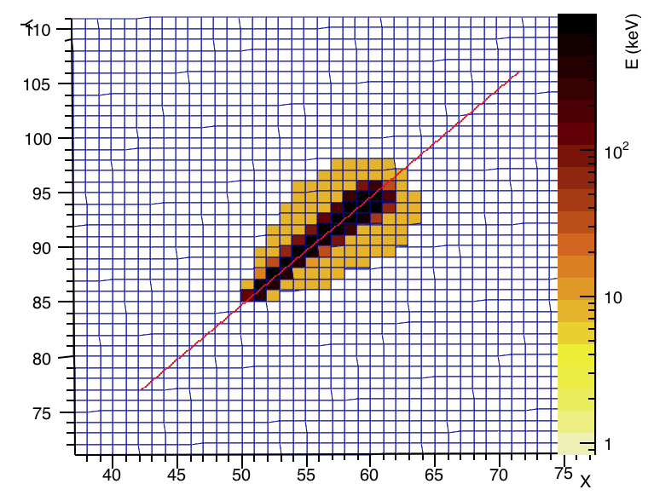
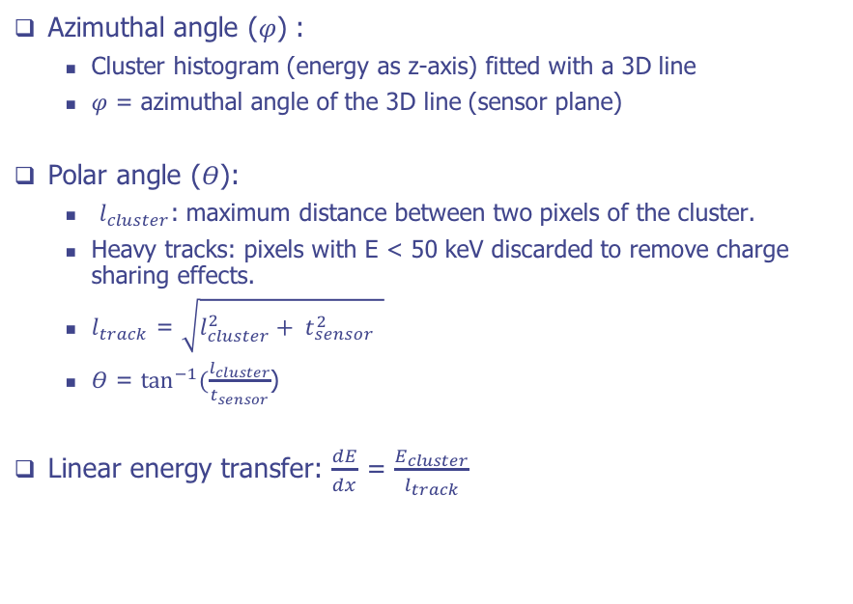
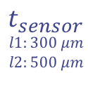


Angle/LET determination
Azimuthal angle (𝜑) :
  Cluster histogram (energy as z-axis) fitted with a 3D line
  𝜑 = azimuthal angle of the 3D line (sensor plane)
Polar angle (𝛳):
  $l_{cluster}$: maximum distance between two pixels of the cluster.
  Heavy tracks: pixels with E < 50 keV discarded to remove charge sharing effects.
  $l_{track}$ = $\sqrt{l_{cluster}^{2}+ t_{sensor}^{2} }$
  𝛳 = $\tan^{−1}{(\frac{l_{cluster}}{t_{sensor}}}$)
Linear energy transfer: $\frac{dE}{dx}$ = $\frac{E_{cluster}}{l_{track}}$
55 𝜇m
𝛳
$$l_{track}$$
$$t_{sensor}$$
$$l1:300 \text{μ}m$$
$$l2:500 \text{μ}m$$
$$l_{cluster}$$
Notes:
For particles with straight path in Si (proton, mu, pi): we calculate the angle of incidence
Used for incident angle determination, coincidence determination, LET calculation

Slide 11
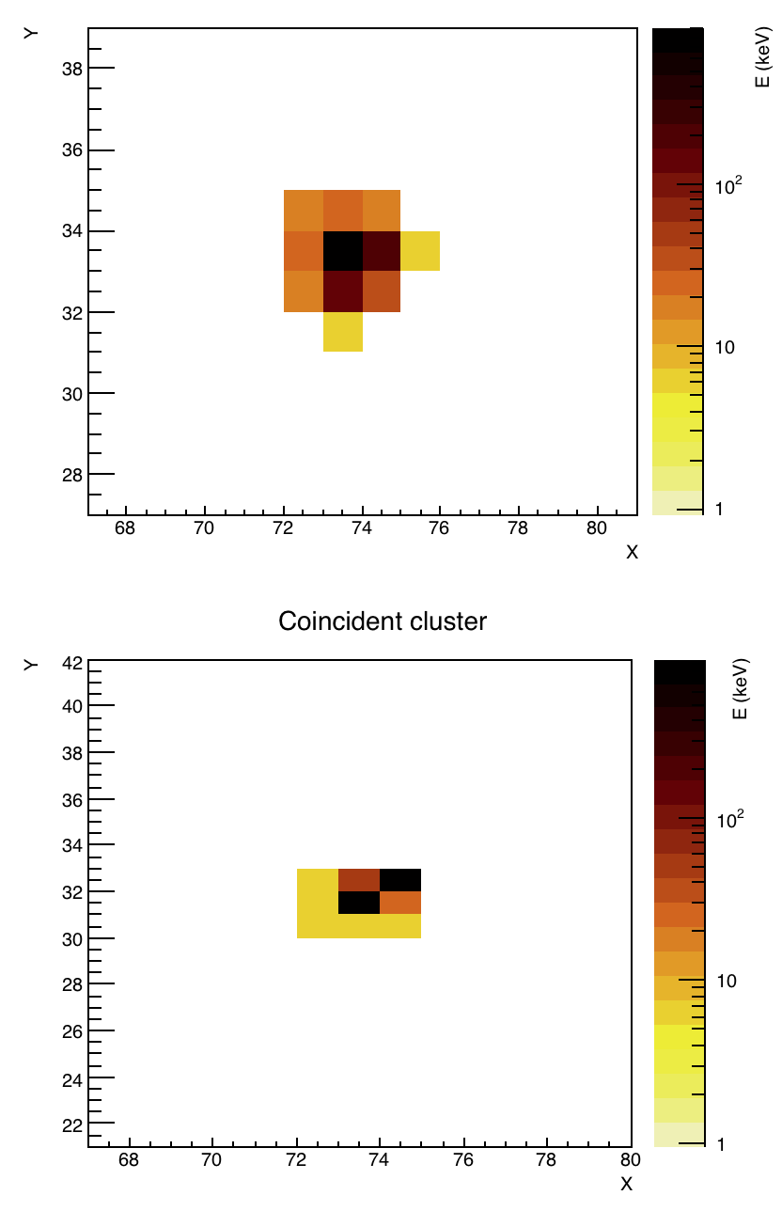
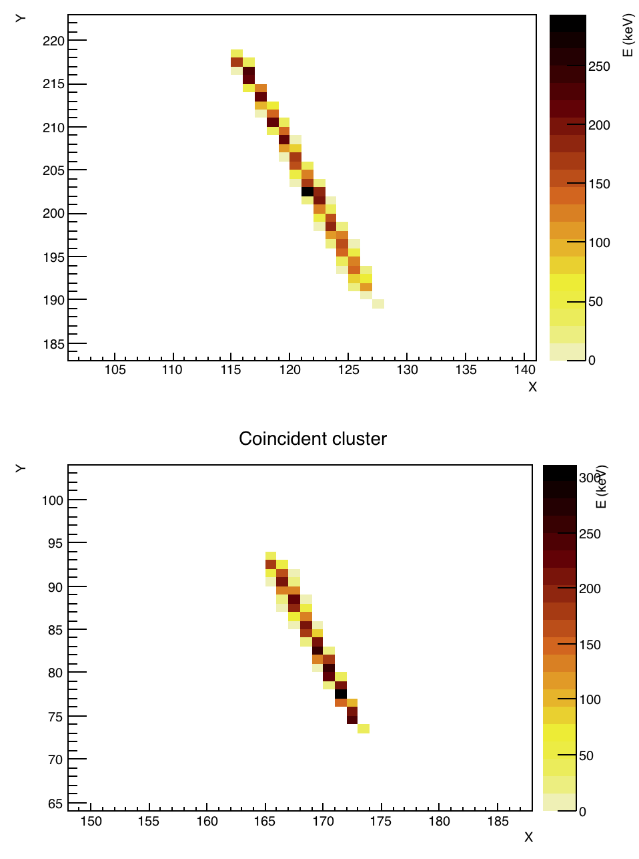
Coincidence determination
For each frame, tracks from the two different layers are considered coincident if they are of the same type and if they fulfill the following criterias:
Heavy blobs / dot / small blobs:
same center (± 2 pixels)
Heavy tracks / straight tracks:
same polar and azimuthal angles (±10º)
sensor 1
(300 um)
sensor 1
(300 um)
neutron
converters
neutron
converters
sensor 2
(500 um)
sensor 2
(500 um)

Slide 12
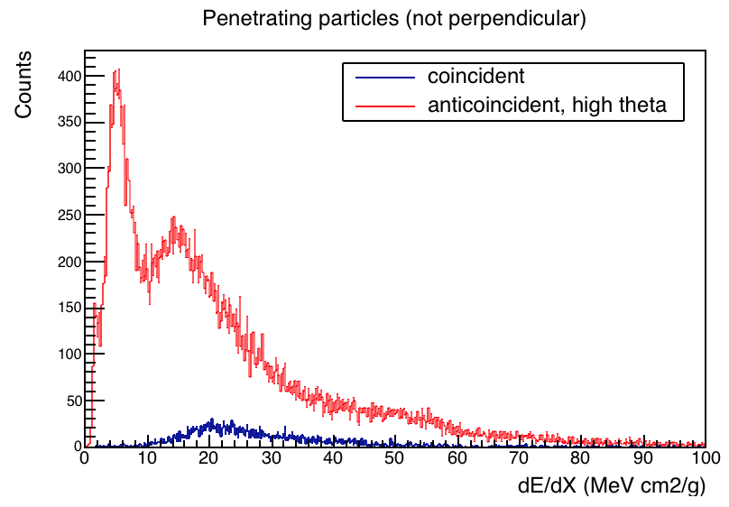
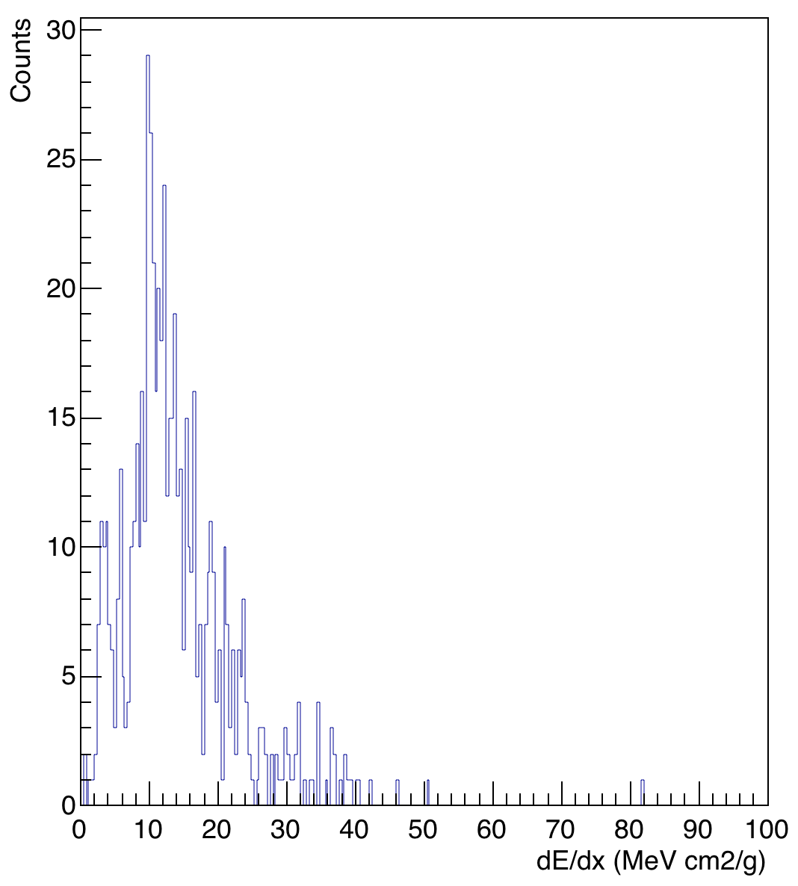
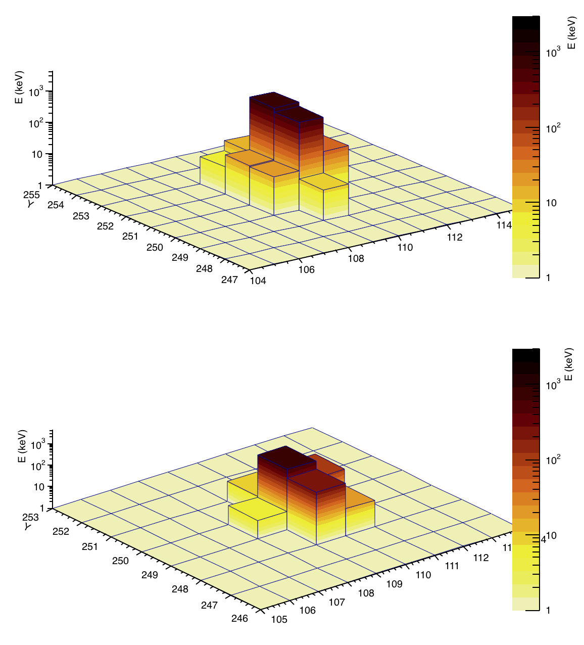
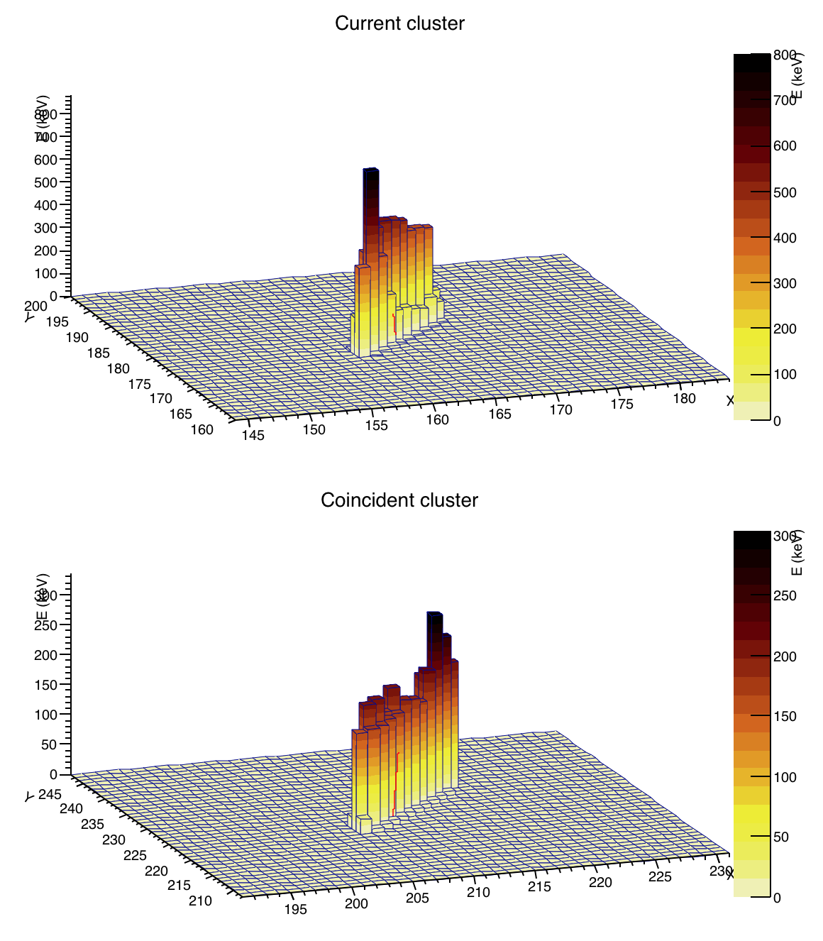
Example: measuring HET particles
Coincident heavy tracks + anticoincident heavy tracks with high incident angle
Coincident heavy blobs
sensor 1
(300 um)
sensor 1
(300 um)
neutron
converters
neutron
converters
sensor 2
(500 um)
sensor 2
(500 um)
TPX01 – 31/05/2016 – LHC fill 4965
Notes:
Energetic charged particles penetrating through sensor with high LET
Protons, muons, pions, below MIPs energy
Either going through the 2 sensors if perpendicular, or crossing one layer with a high angle of incidence

Slide 13
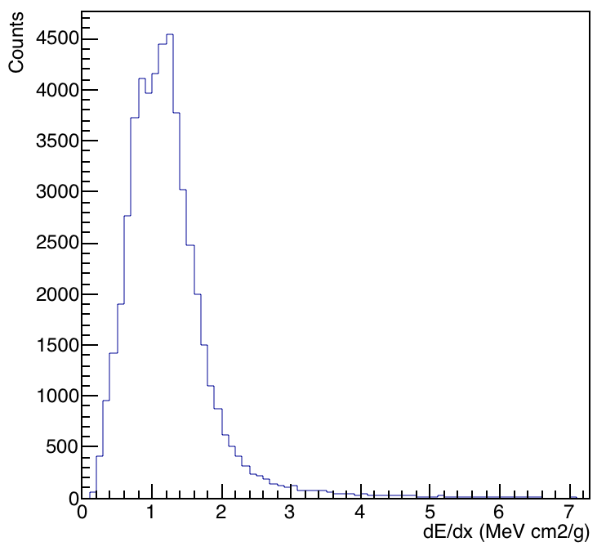
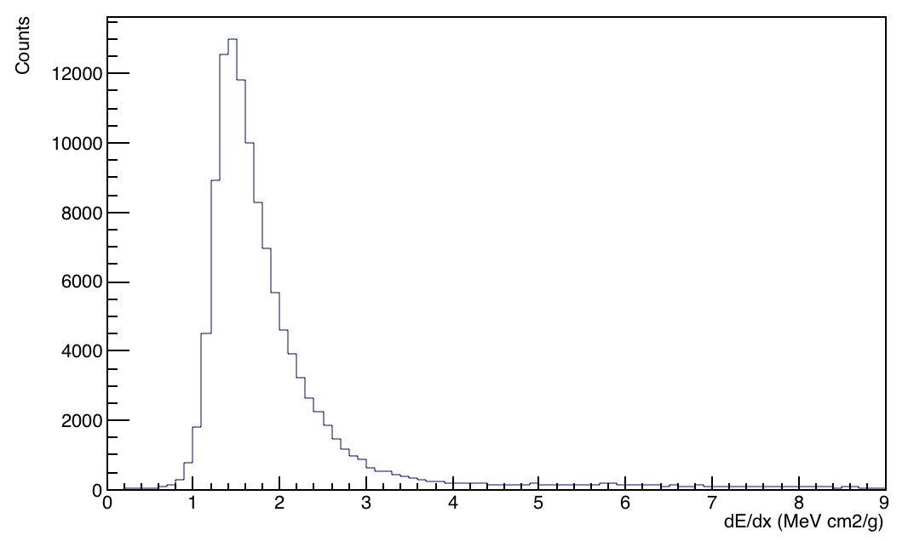
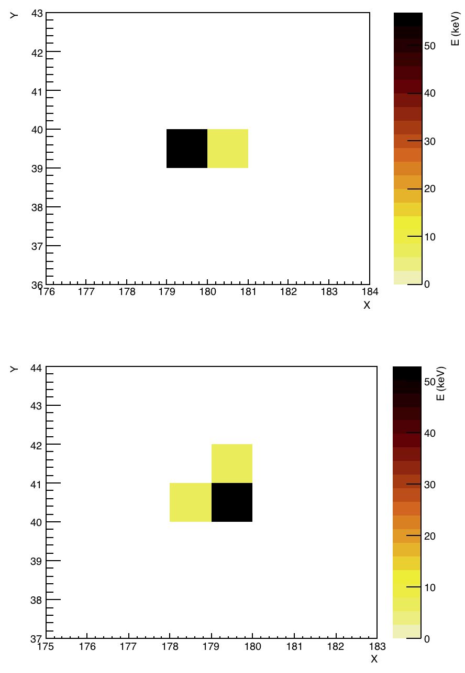
Example: measuring MIPs
coincident small blobs
coincident straight tracks
sensor 1
(300 um)
sensor 1
(300 um)
neutron
converters
neutron
converters
sensor 2
(500 um)
sensor 2
(500 um)
TPX01 – 31/05/2016 – fill 4965
MIP events also include (not shown here): anticoincident straight tracks, coincident dots, coincident dot + small blob
Notes:
Protons, muons, pions, in their MIPs regime
Smaller coincident clusters: dots, small blobs
Not all possibilities shown here: coincident dots, dots coincident with small blobs, anticoincident straight tracks (MIPs with high incident angle (parallel)
Events with delta rays not always fall in this category, depending on the track path
Corresponds nicely to MIP expected stopping power in Si

Slide 14
Use of Allpix² : motivations, implementation, test cases

Slide 15
Use of Allpix²: motivations
Test and improve particle categorization methods
Integrate Allpix2 in the simulation chain for radiation field benchmarking

Slide 16
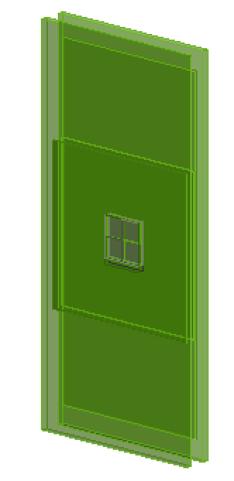
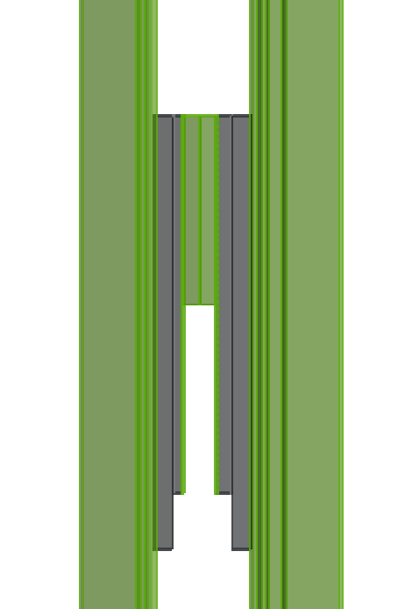
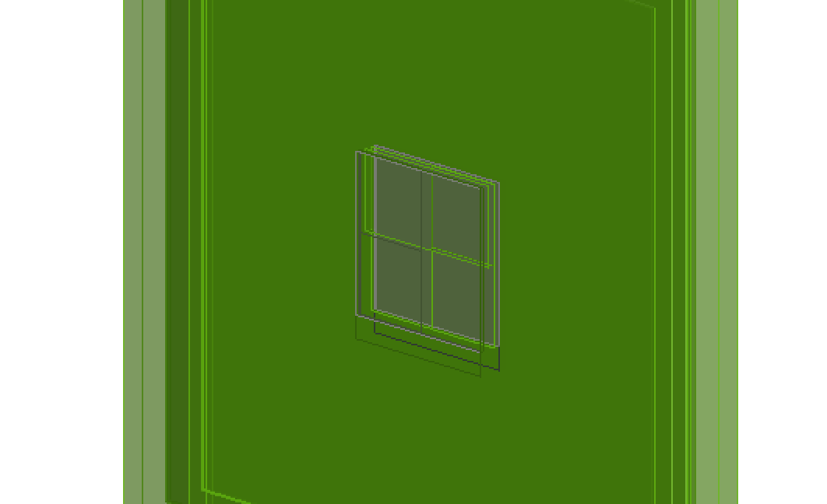
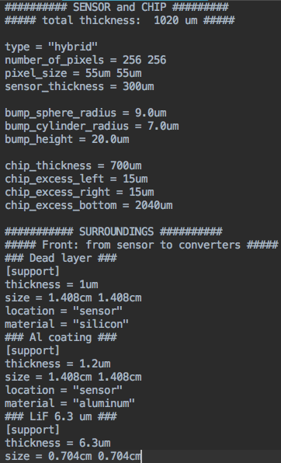
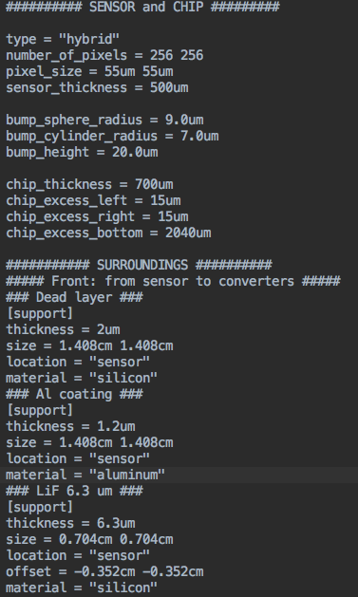
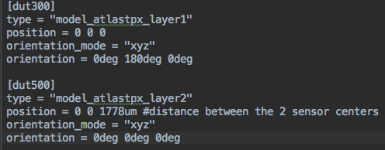
Model geometry
detector model files (inspired from Timepix model file)
detector configuration file
Notes:
Fixed geometry overlap
Neutron converters: need to implement those materials
Aluminum box: not completely surrounding

Slide 17
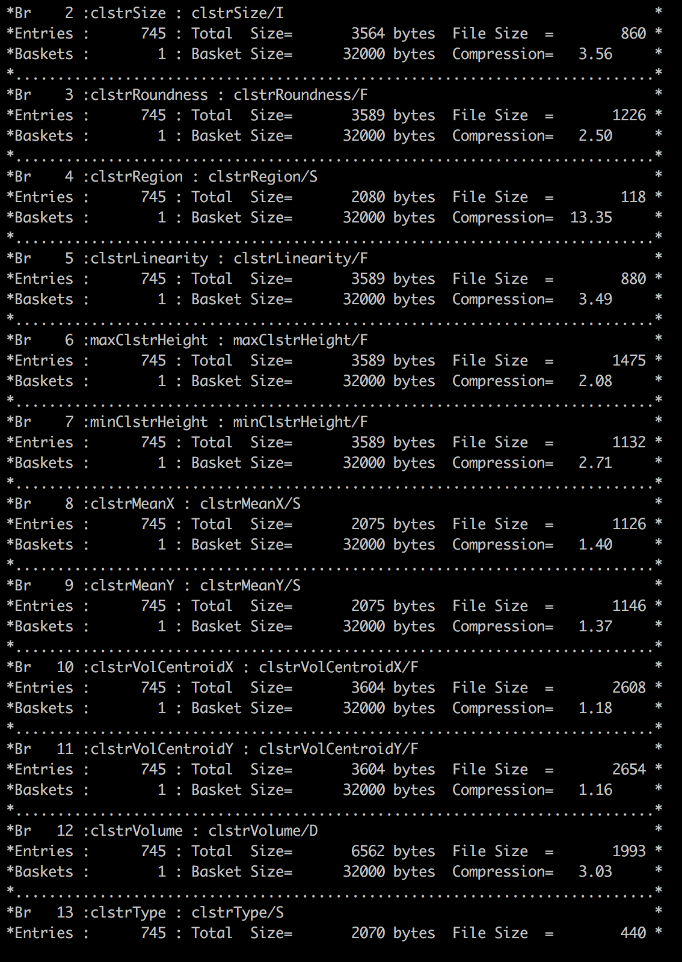
Data output
AtlasTPXwriter: root file
1 entry = 1 cluster
Cluster properties: layer, size, shape criterias, energy, etc…

Slide 18
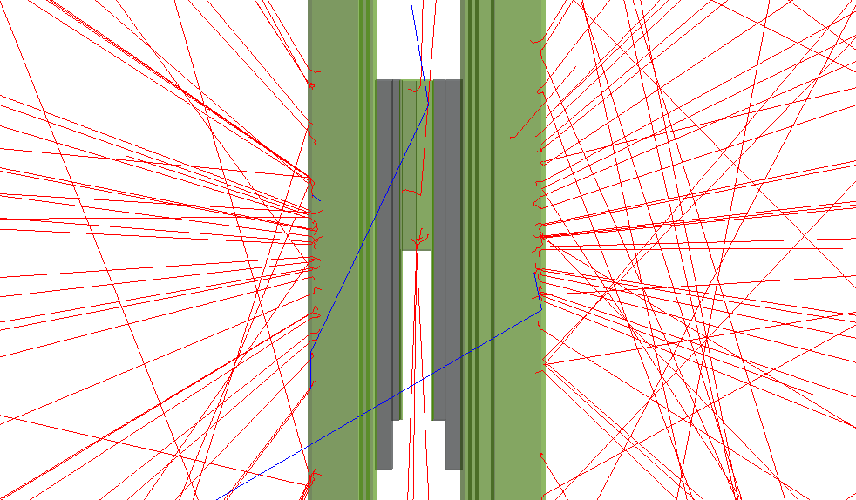
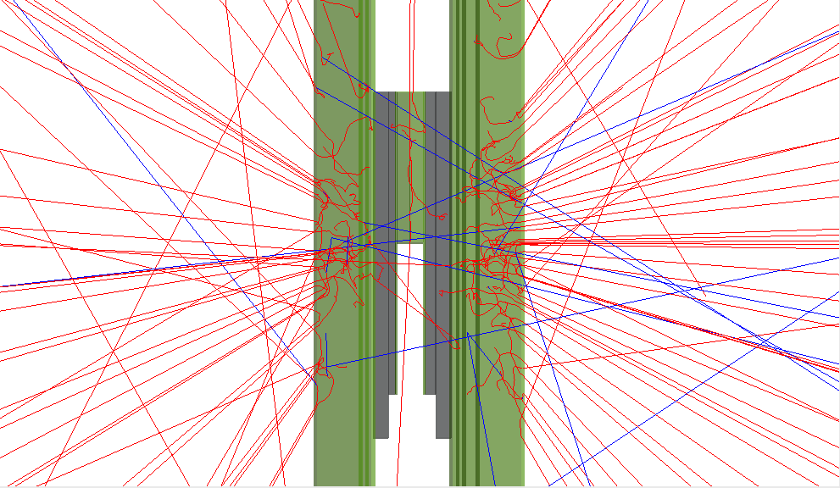
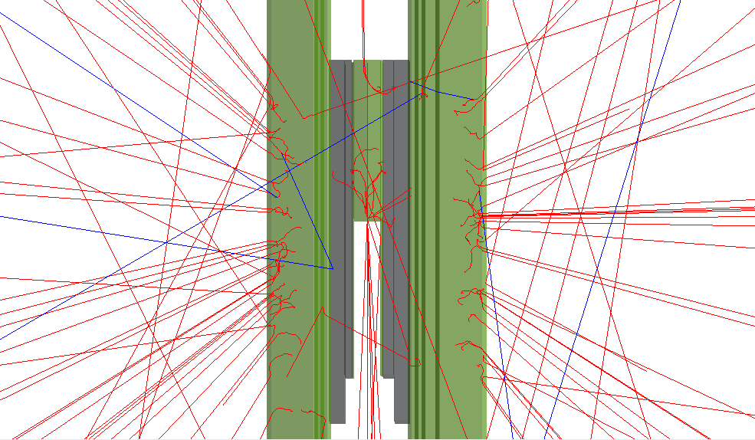
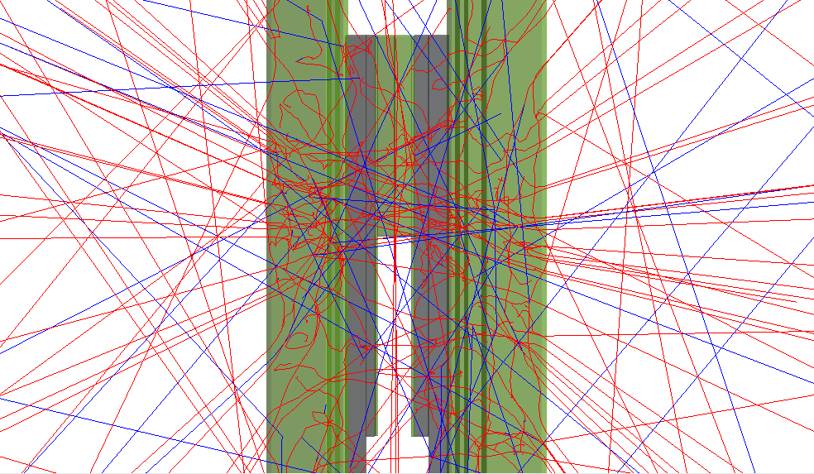
First test
Penetration of electrons in the detector: sphere source focused toward center
500 keV
2 MeV
1 MeV
5 MeV
Notes:
Estimation of incident electron detection efficiency
Look at cluster types for each energy

Slide 19
Thank you

