Slide 1

PPR Group Meeting https://indico.cern.ch/event/738531/
M.Capeans, M.Llorente, L. van den Boogaard
25/6/18

Slide 2
Outline
Overview of the TE Retreat 2018
PPR news
Merit exercise

Slide 3
TE Retreat 2018
3-4 May 2018, TE management, GL, DGLs, and invited depending on topic
  CERN and TE Priorities
  Projects, focus on HL-LHC
  Groups
  Departmental topics
    Resources: MTP and MPP
    Industrial support, FSU
    Host Lab

Slide 4
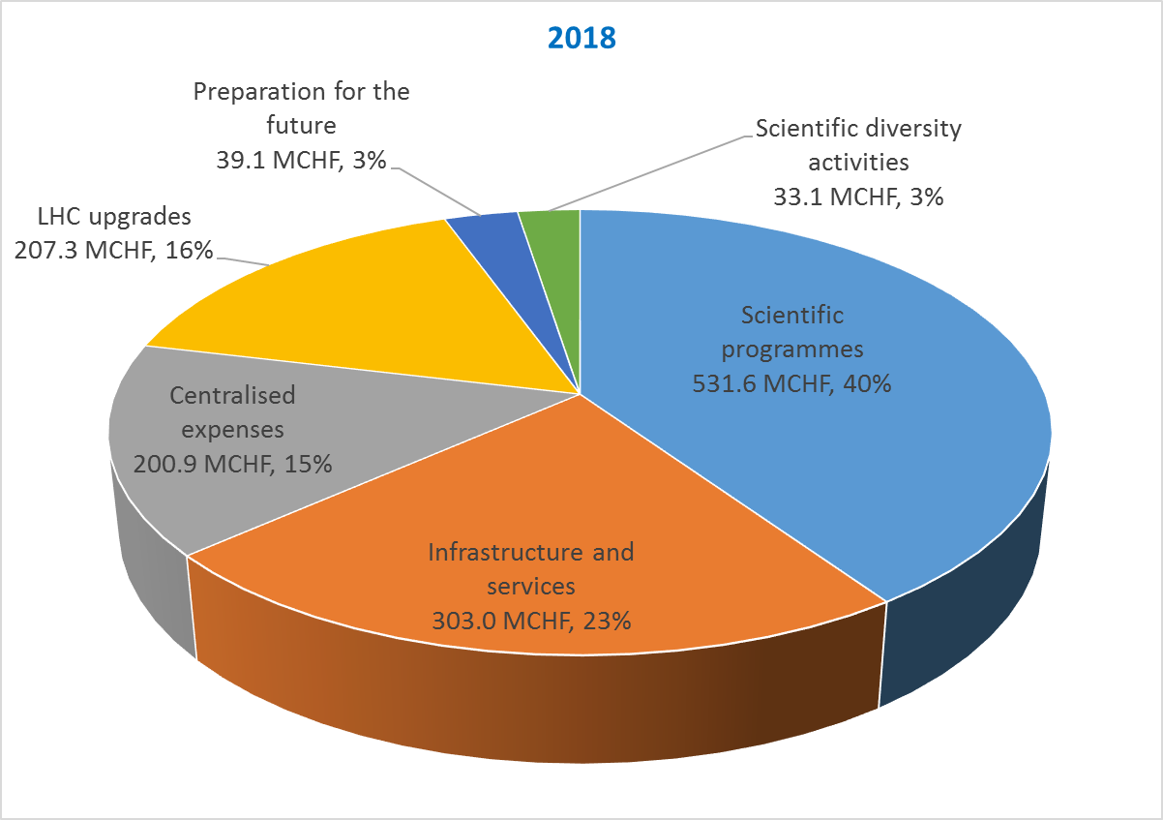
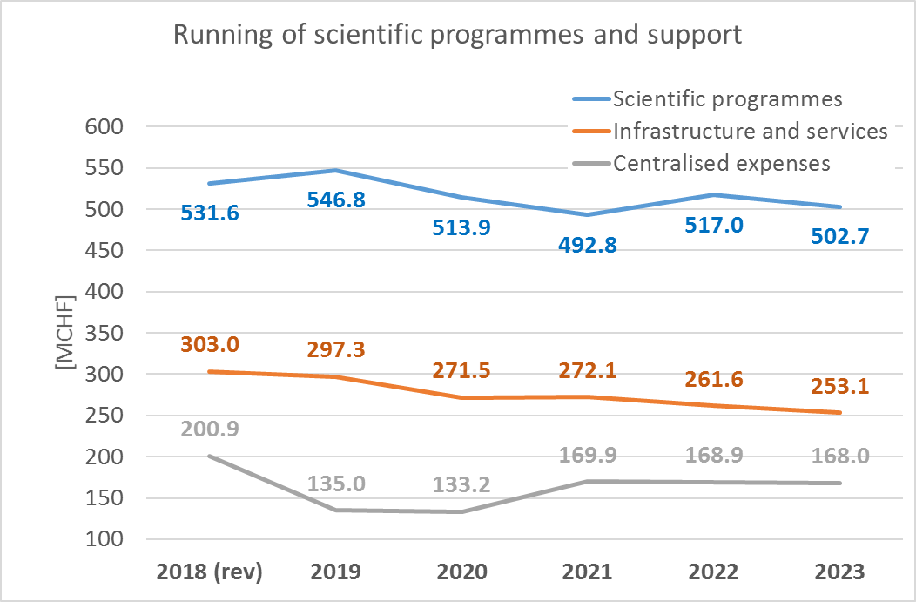
MTP
Scientific Programmes: LHC, non-LHC, other accelerators (consolidation)
Infrastructure & Services: Admin, Int. relationships, safety, buildings
Centralized Expenses: Personnel, Energy, Financial expenses
LHC upgrades: LIU, HLLHC, detectors
Future: LC, FCC, HEF, PBC, R&D
Diversity: Neutrino Platform, accelerators R&D

Slide 5
TE Challenges
Address the M&O Costs and impact on investment’s capabilities
Review the level of Services and Host Lab responsibilities
Integrate in the Strategy & Resources the outcomes of the:
  LIU / HL-LHC C&S Review
  Arbitrations on ACC-CONS, LS2 and DG Reserve
  MTP 2018-2028
Reinforce Resource traceability and commitment of the Organic Line towards Projects’ contributions
Build the Future with appropriate Personnel Strategy and R&D program

Slide 6
HL-LHC
Lots of preparation by all WPs for the HL-LHC C&S review of March
Identified areas for further internal review:
  Personnel & Spending profiles (Staff, M4P, IS, FSU, Material) update, including Support from other Groups
  Key Industrialisation/Collaborations still pending decisions
Proposed steps for 2018
  Finalise Procurement / Industrial / Collaboration scenarios
  Master Schedule update
  Personnel & Spending profiles (Staff, M4P, IS, FSU, Material) update, including Support from other Groups
    Missing Staff identified to keep under control the Technological and Industrial risks for some WPs
  Review interfaces Department - Project

Slide 7
Personnel
In April 2018, all TE recruitments have been put on hold to allow reevaluating the priorities of the MPP
Thorough exercise with all groups to re-evaluate staff needs and confirm/cancel/postpone posts in order to align the manpower plan with the TE strategy and priorities
LD2LD & Retirement replacement to be arbitrated at Department level
Prepared a reinforcement plan for key activities in the next 3 y (HL-LHC), and taking into account LS2 commitments (DISMAC, magnet exchange activities, <operation). The plan implies changes to budgets, FSU teams, etc

Slide 8
Industrial support, FSU
It concerns ~170 FTE (11 units)
Starting a review exercise of all units in TE
  Traceability, quality, divergences wrt to plan, charging codes, best practices...
  Approval of additional IS resources at DH Office level
    Provide Job profile, start/end date, expected deliverable and budget code
    Ensuring the availability of the financial resources
  For 2019 onwards, OSVC shall be specified
    List of Job profiles, start/end dates if less than 1 year, expected deliverables and budget code
    Performance indicators and invoicing traceability

Slide 9
Collaborations
Based on long-term mutual commitments
Competences are due…
  Impose the appropriate level of knowledge and performance
Avoid excessive dependence to Collaborations
  Re-organise the activities to decrease dependence, look for alternatives
Approval of Collaborations at DH Office level
  Following the defined procedure
  Ensuring the availability of the financial resources
Ensuring their Safety is our priority
  Liabilities and impact for CERN shall not be underestimated

Slide 10
Host Lab in TE
The CERN document “General Conditions Applicable to Experiments at CERN” sets out the rules and procedures in organizational, managerial and financial matters, which apply to the participation by Universities and Research Institutions in experiments at CERN; it therefore defines CERN obligations as Host Laboratory. The General Conditions apply to ‘Approved Experiments’ carried out on CERN site.
TE groups with major, recurrent Host Lab responsibilities in experiments are VSC, CRG, EPC. Groups with minor, recurrent Host Lab responsibilities are MPE, MSC and ABT.
  30 FTE are allocated to this activity TE-wide.
  About 4 MCHF in the centrally allocated TE operational budget cover the cost, which includes industrial support contracts used for M&O, On-Call services and the supply of cryogenic fluids to non-LHC activities.
TE specialized technical Services are often operated by TE staff, ~20 FTE total, and in some cases supported by FSU technicians. Services are generally free of charge for the client.

Slide 11
PPR Group

Slide 12
AGS
Maria Llorente | SL
Lucie Mainoli | ABT | LIU support
Caroline Cazenoves | CRG | Posters for the Department
Patricia Clerc | VSC | VIA programme
Sophie Gardette | EPC
Carnita Hervet | MSC
Macarena Gonzalez | MSC | Communication plan for the Department
Lauren Ormesher | MPE

Slide 13
PPR Hot News
Data privacy

